Slide 1




Building Economic Justice in Portland
City of Portland/Multnomah County Financial Empowerment Blueprint
Presentation to Portland City Council
November 13, 2019
Notes:
Seraphie introduces the group
Speaks briefly about the Mayor’s involvement and interest in this work.

Slide 2
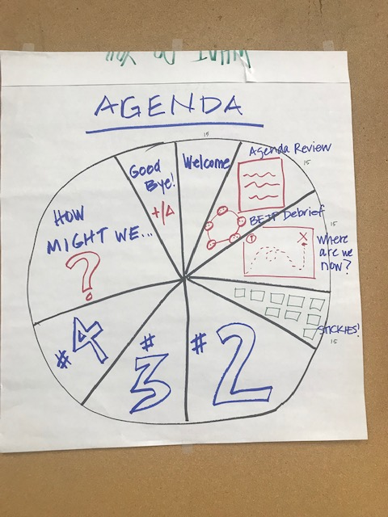
Agenda
Introductions
Cities for Financial Empowerment Model
Background & Process
Blueprint Recommendations
Next steps
Q&A
Notes:
Everyone introduces themselves
Talia walks through agenda

Slide 3
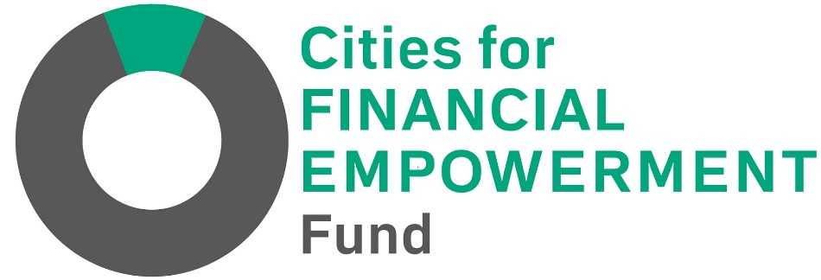
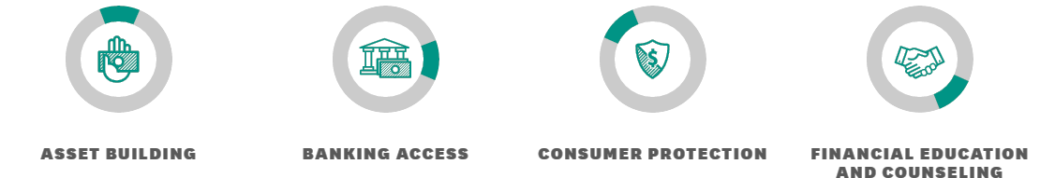
Helping government leaders embed systemic financial empowerment programs and policies into city services to improve individual and family financial stability
Notes:
Talia

Slide 4

2018 Blueprint Examples
Launching an Office of Financial Empowerment
Developing a financial consumer protection platform
Embedding financial empowerment efforts within affordable housing strategies
Exploring multiple City platforms (new immigrants, City employees, etc.) to include financial empowerment efforts
St. Paul, Minnesota
Notes:
Talia
Office of Financial Empowerment- Lansing, Boston, NYC
Developing a financial consumer protection platform
Setting up a community listening tour to understand the consumer financial empowerment issues facing residents
Cataloging current tools to manage consumer protection issues with the City.
Embedding financial empowerment efforts within affordable housing strategies
Focusing on prevention and diversion of from homelessness
Exploring multiple City platforms (new immigrants, City employees, affordable, etc.) to include financial empowerment efforts
Exploring financial counseling for new immigrants and City employees
Exploring integration opportunities with the City’s affordable housing strategy and leveraging the new created role of Housing Director to do so.

Slide 5
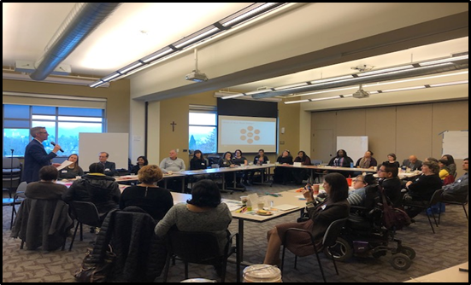
Background: CFE in Portland
Notes:
Applied April 2018, awarded $20k as a planning grant
$20k went as stipends for 9 design team nonprofits and participant for time, and food for meetings, MIL also chipped in for food
Started work summer 2018
Community meeting - to start recruiting to form a design team
Kick off meeting w Mayor 11/29- pic
6 design team meetings
One community forum
Came up with final blueprint you have
real cross agency collaboration
what the $20k went towards

Slide 6
Participants
Bradley Angle House
CASH Oregon
City of Portland
Credit Builders Alliance
Community Vision Inc.
Hacienda CDC
Innovative Changes
Metropolitan Family Service
Multnomah Idea Lab
Native American Youth and Family Center
Neighborhood Partnerships
Portland Community Reinvestments Initiatives, Inc.
Prosper Portland
SaveFirst/Catholic Charities
Self Enhancement Inc.
Notes:
Talia
Here is a list of all the partners who participated
Now, I will pass it off to Landra to talk more about our process

Slide 7
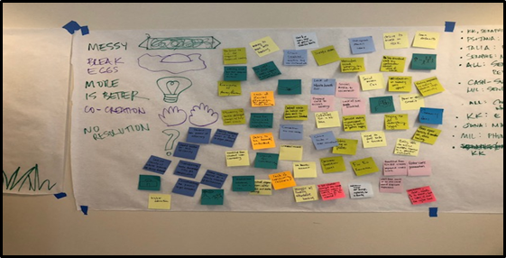
Human Centered Design Process
Notes:
Landra
When writing the City Start grant, the Multnomah Idea Lab led the design team through a Human Centered Design process in order to develop this Blueprint.
Human-centered design (HCD) is a process that starts with the end-users at the heart of the process by creating new solutions to suit their needs. HCD focuses on building a deep empathy for the client to create innovative, effective and sustainable solutions. Most importantly, it shifts the paradigm of how decision making usually happens.
For us this entailed many challenging conversations, sharing of our life experience, a ton of sticky notes (as you can see from the photo), and it did not always feel like a linear process.
Landra- share more about what this was like for you.

Slide 8
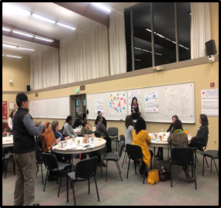
How might we create more opportunity for economic empowerment within systems in our community that contribute to the elimination of the racial wealth gap?
Notes:
Cecilia
At the heart of human centered design, is creating a design question that you seek to develop solutions for.
Keeping in mind that racial identity continues to be a major predictor of economic success, our design team wanted to prioritize addressing the racial wealth gap.
In Portland, African Americans and Native Americans are overrepresented in the houseless population, and communities of color continue to experience income disparities. The median income for White Portland households is roughly $57,000, compared to $27,000 for Black, Native American, and Hawaiian-Pacific Islander households; $36,312 for Hispanic/Latino households; and $53,377 for Asian households.
After much ideation, our team came up with the design question: How might we create more opportunity for economic empowerment within systems in our community that contribute to the elimination of the racial wealth gap?

Slide 9
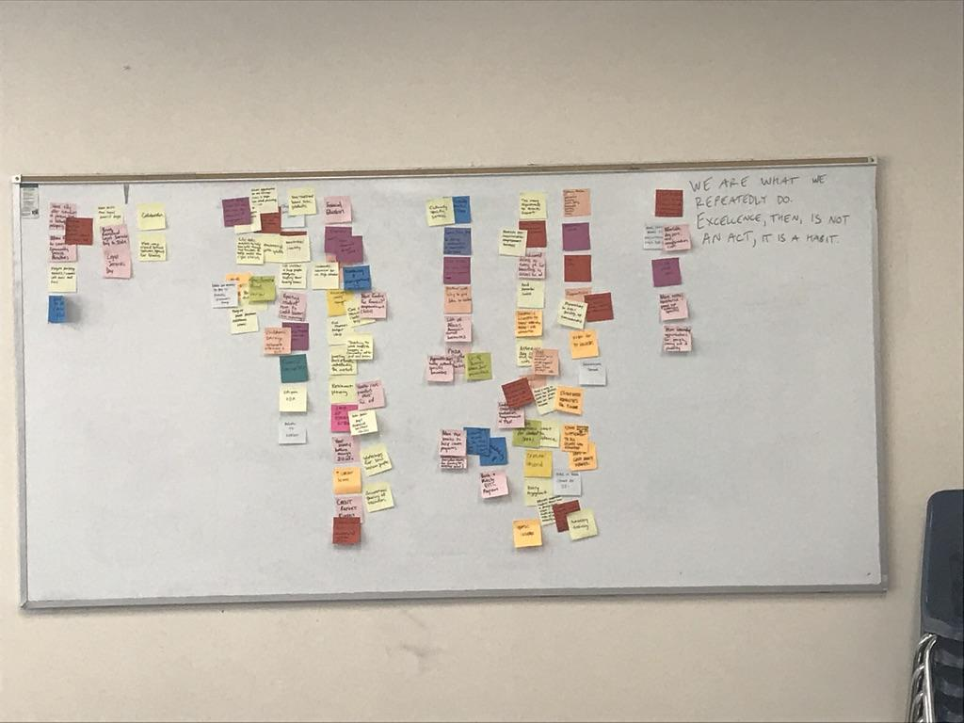
Our Recommendations
Systems Change
Fees, Fines, and Debt
Knowledge Sharing and Financial Inclusion
Barriers to Practitioner Organizations Efficiency, Creativity, and Innovation
Notes:
Cecilia
After creating our design question we went through a period of ideation. This involved brainstorming, hosting a community forum, filling out many sticky notes, sharing experiences, working together to prioritize strategies.
Ultimately, we developed 4 categories of recommendations that each have sub recommendations.
Many of these recommendation have work already in progress spearheaded by public and/or nonprofit leaders.
We will now walk you through these recommendations.

Slide 10
Systems Change
Continue a City Financial Empowerment Team to oversee implementation of the Blueprint
Educate big business on importance of, and tools to recruit and retain people of color in their organizations
Use a holistic and culturally specific and responsive approach to expungement services
Complete the “Color of Wealth in Multnomah County” Study
Communicate effectiveness of cash transfer strategies in financial empowerment and policy solutions
Notes:
Cecilia
Our first recommendations are around systems change.
The City of Portland and Multnomah County do not have a centralized authority that oversees financial empowerment policy and programs. Our financial empowerment team recommends that the financial empowerment work have a centralized home- one government body or department that will oversee the financial empowerment work happening across the city.
Next, one of the goals of Portland Means Progress (PMP), an initiative conceived of and overseen by the Mayor’s Council of Economic Advisors, is to address economic inequalities for communities of color. We see an opportunity for the Financial Empowerment Team to provide recommendations on how PMP can expand to advance financial empowerment goals, particularly in how the private sector can play a role in addressing economic inequalities.
Currently there are several efforts underway to handle record expungement, however, it is not clear how all of these efforts align and if these efforts have a clear racial justice lens. There are opportunities to examine more system wide efforts for expungements. An example is a San Francisco effort to automatically expunge prior marijuana convictions. There’s an opportunity for the Cannabis Policy Oversight Team to evaluate the effectiveness of the expungement services and their alignment with culturally specific and responsive approaches.
A study of the “Color of Wealth in Multnomah County” will provide insights to policy makers and community organizations who seek to address barriers to equitable attainment of wealth and assets related to race, and support the county’s, Prosper Portland’s, and Metro’s racial justice agenda. Efforts are underway to obtain the resources needed to conduct such a study which will replicate methods used in a survey produced through the Federal Reserve, Duke University, and the New School.
Lastly, the Design Team feels that any ongoing advocacy work should reflect the equal importance of getting cash into the hands of individuals, in addition to financial counseling. Once City/County Financial Empowerment Team established, we would like to spend time reviewing national studies and local examples of effective programs and develop a policy and program wish list for adding cash transfers as a strategy that complements existing financial empowerment programs.

Slide 11

Fines, Fees, and Debt
Expand Legal Services Day and use as a foundation to assess and develop solutions for a wide array of municipal fines and fees
Conduct an analysis of all fines and fees where they have jurisdictional authority and a budget analysis of income generated and cost to administer
End the practice of suspending driver's licenses for inability to pay, and reinstate those affected by the current policy
Notes:
Talia

Slide 12
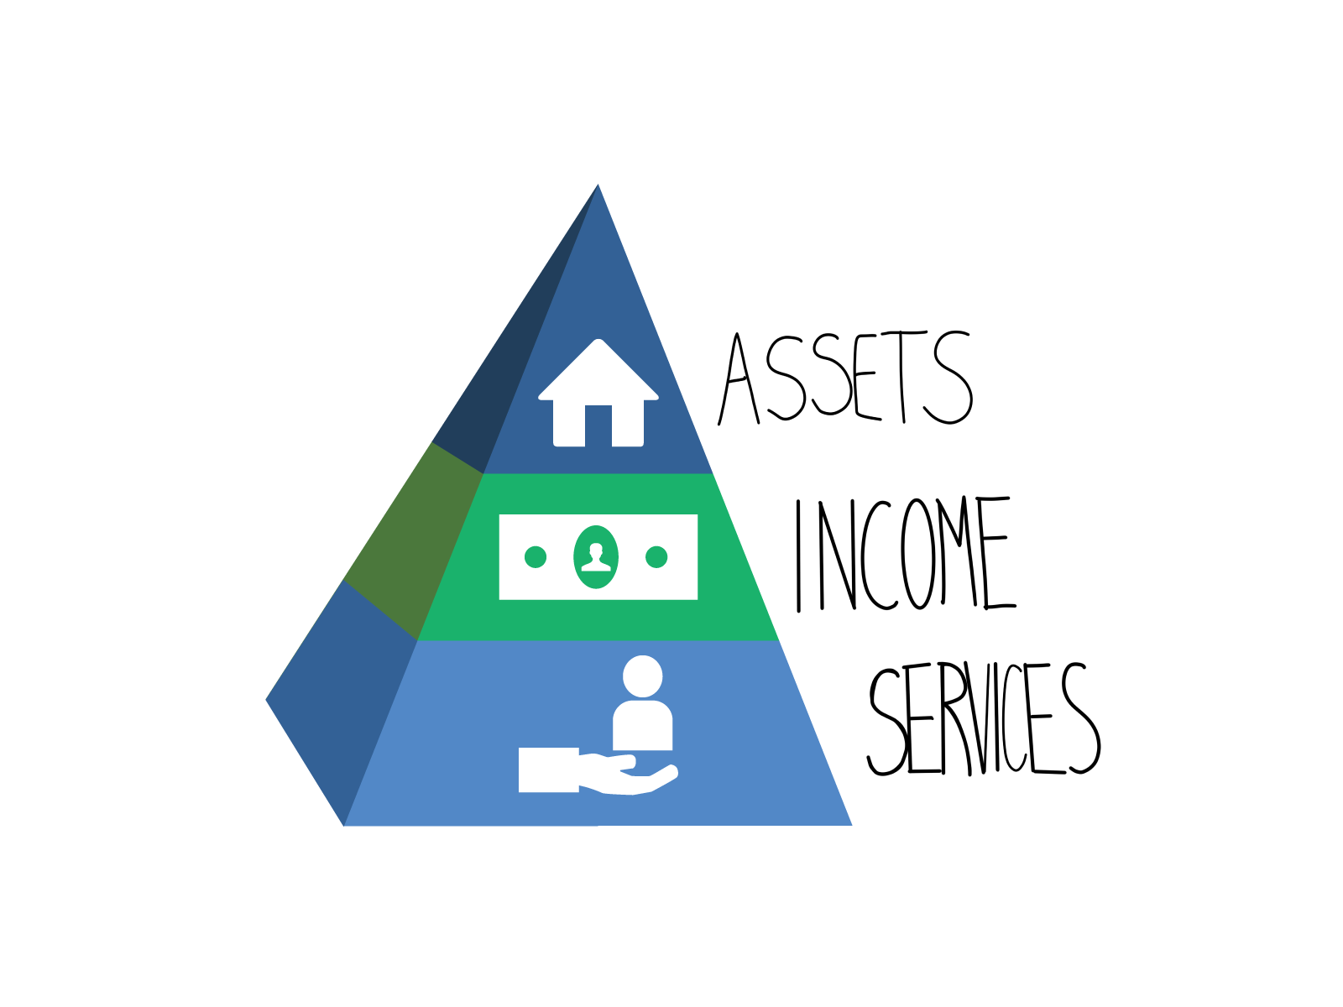
Knowledge Sharing & Financial Inclusion
Explore avenues to systematize youth financial education
Ensure quality financial education that is culturally specific
Increase accessibility of financial education, tools, and resources
Better integrate referrals to wealth building tools and resources
Notes:
Landra
[briefly share your experience as a financial educator]
A key driver of the racial wealth gap is the exclusion of people of color from mainstream financial institutions. We seek to not only increase access to financial institutions so that residents can access bank accounts, savings products, and safe and affordable credit, but in the long-term, to transform this system to more closely resemble the needs of residents of color and low-income residents, so that it proactively prioritizes wealth accumulation in these communities. Our design team identified key ways of fostering financial inclusion. I won’t go into detail on these recommendations, because there are many, but I wanted you to know that most of these recommendations build upon the strengths of existing efforts. They include:
Explore avenues to systematize youth financial education so that Oregon residents are learning key life skills before they have to learn the hard way.
Ensure quality financial education that is culturally specific through strategies such as creating a community of practice for financial educators, coaches, and mentors and hiring community curriculum designers and facilitators
Increase accessibility of financial education, tools, and resources- through centralized information and calendar, and perhaps a funding pool to employ culturally specific mentors to help clients navigate financial empowerment services
And, better integrate referrals to wealth building tools and resources

Slide 13
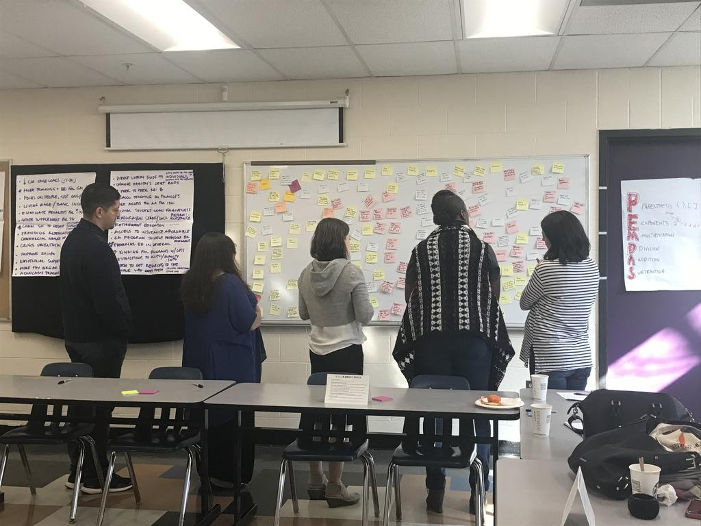
Barriers to Practitioner Organizational Efficiency, Creativity, and Innovation
Explore an ongoing Community of Practice model with multiple funders and practitioners
Centralize data on outcomes and outputs
Notes:
Talia

Slide 14

Need for Action!
Center racial justice in current system and future investments
Find a home base for centralization of financial empowerment efforts within the City
Support Design Team to plan implementation of recommendations
Intentionally engage with elimination/reduction of “fines and fees” exploration
Notes:
Talia

Slide 15
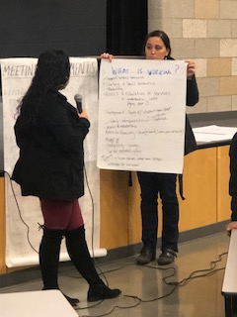
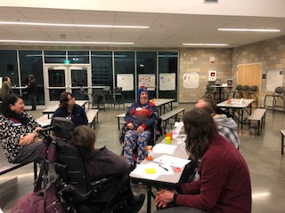
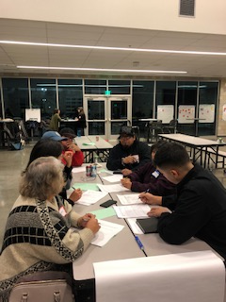
Questions?

