Slide 1

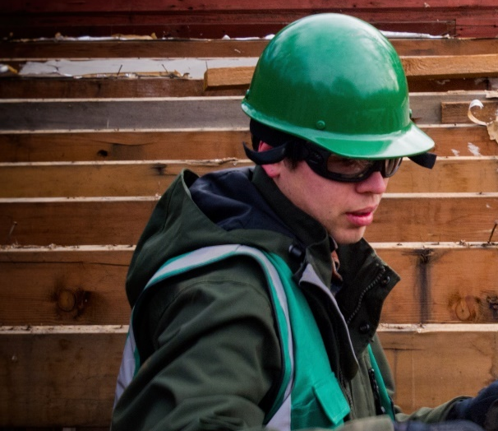
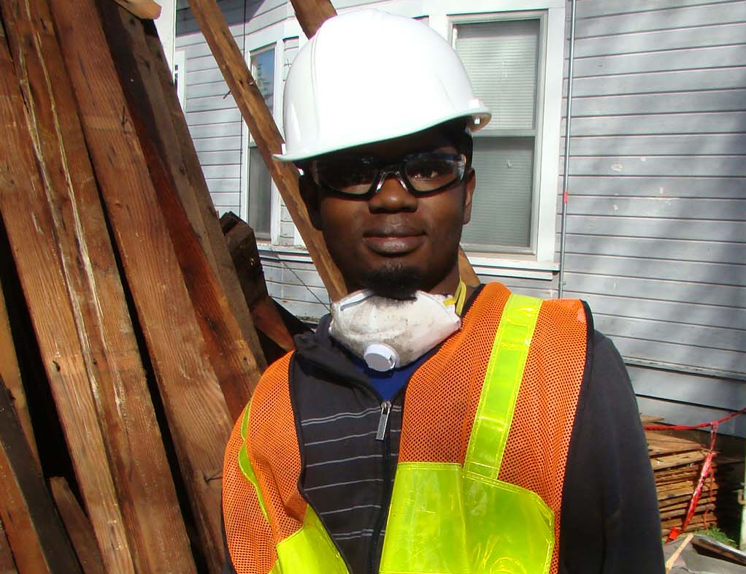


Amend Deconstruction of Buildings Law Code to Include Houses and Duplexes Built in 1940 or Earlier
Alisa Kane
Climate Action Manager
Shawn Wood
Construction Waste Specialist

Slide 2
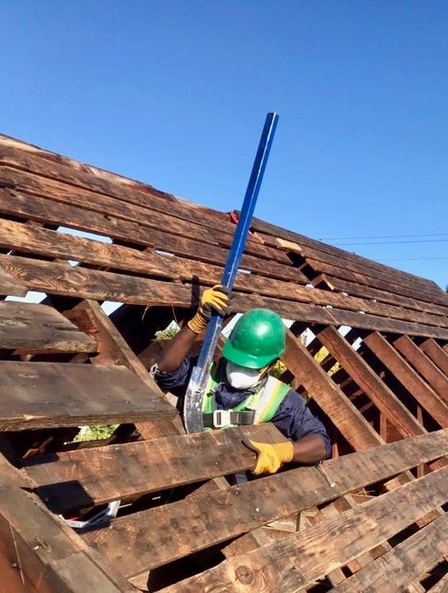
Background
First-in-the-nation deconstruction ordinance (requirement)
Portland’s leadership and local achievements are amplified
Material management matters
Notes:
Michele

Slide 3
Multi-Phased Approach
Incentives (deconstruction grants)
Requirements that could grow over time
Deconstruction Grants
Phase I:
Current
Ordinance
Phase II:
Proposed
Amendment
Phase III:
2015
2016
2017
2018
2019
2020

Slide 4
Current Ordinance
Purpose of the Deconstruction Ordinance
Deconstruction required for houses/duplexes:
  Built in 1916 or earlier; or
  Designated as historic
Goal of including houses/duplexes built before 1941 by 2019
Notes:
Purpose of the Deconstruction Ordinance (17.106.010):
Maximize the salvage of valuable building materials for reuse
Reduce carbon emissions associated with demolition
Reduce the amount of demolition waste disposed of in landfills
Minimize the adverse impacts associated with building removal

Slide 5
Proposed Amendment
Expand to houses and duplexes built in 1940 or earlier
Proposed effective date of January 20, 2020
Applies to two-thirds of demolition permits
Demolition permits declining since 2016
Notes:
Effective date based on feedback from BDS (after holidays and before AMANDA 7 go live).

Slide 6
Annual House Demo Permit Applications by Year
400
350
Downward trend in demos
300
250
200
# of Permits
150
100
-5
50
Existing
Existing
Proposed (116/Year)
Existing
Note: 2019 permits projected based on first 9 months of permit activity
0
Permit Year

Slide 7
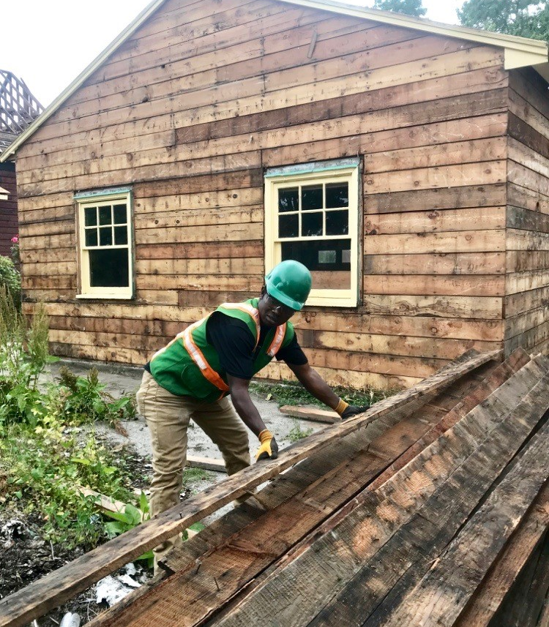
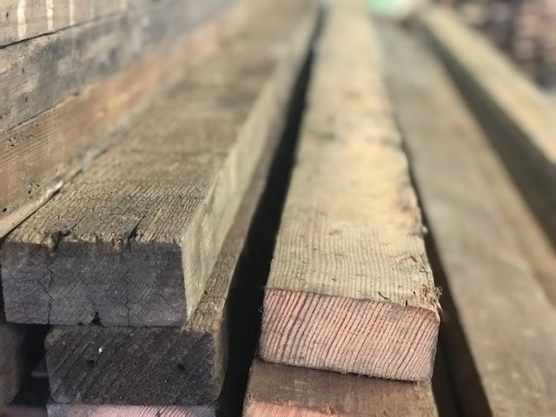
Benefits and Outcomes
Waste diversion
  Over 200 house deconstructions (1/3rd of all house demolitions)
  Over 2.4 million pounds of material recovered for reuse
Net carbon benefit
  Per house - 7.6 metric tons of CO2eq
  To date - Equivalent to removal of 350 cars from the road for a year
Notes:
All that salvaged material translates to carbon benefits.

Slide 8
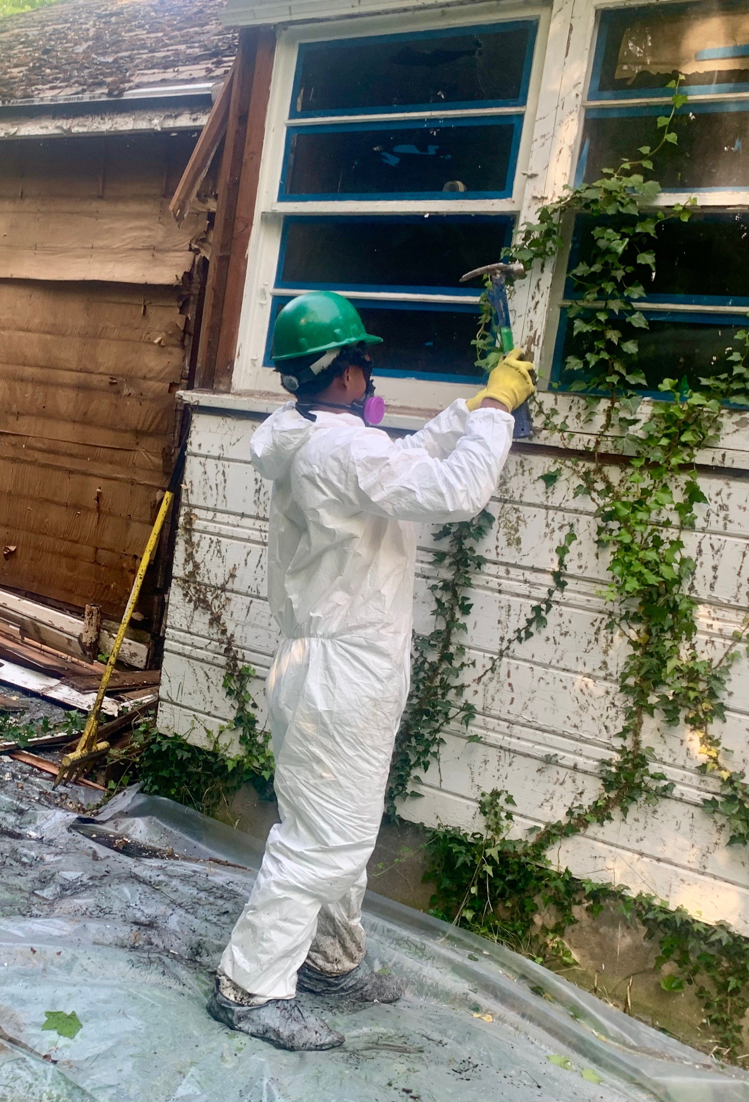
Benefits and Outcomes
Hazardous materials
  OHA best practice for addressing lead paint/asbestos
  All deconstruction contractors have current lead/asbestos certifications
  Increased opportunity for unabated hazmat discovery

Slide 9
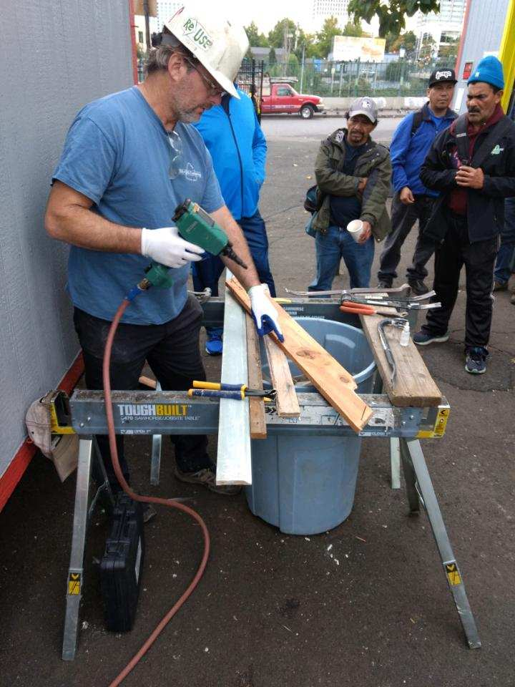
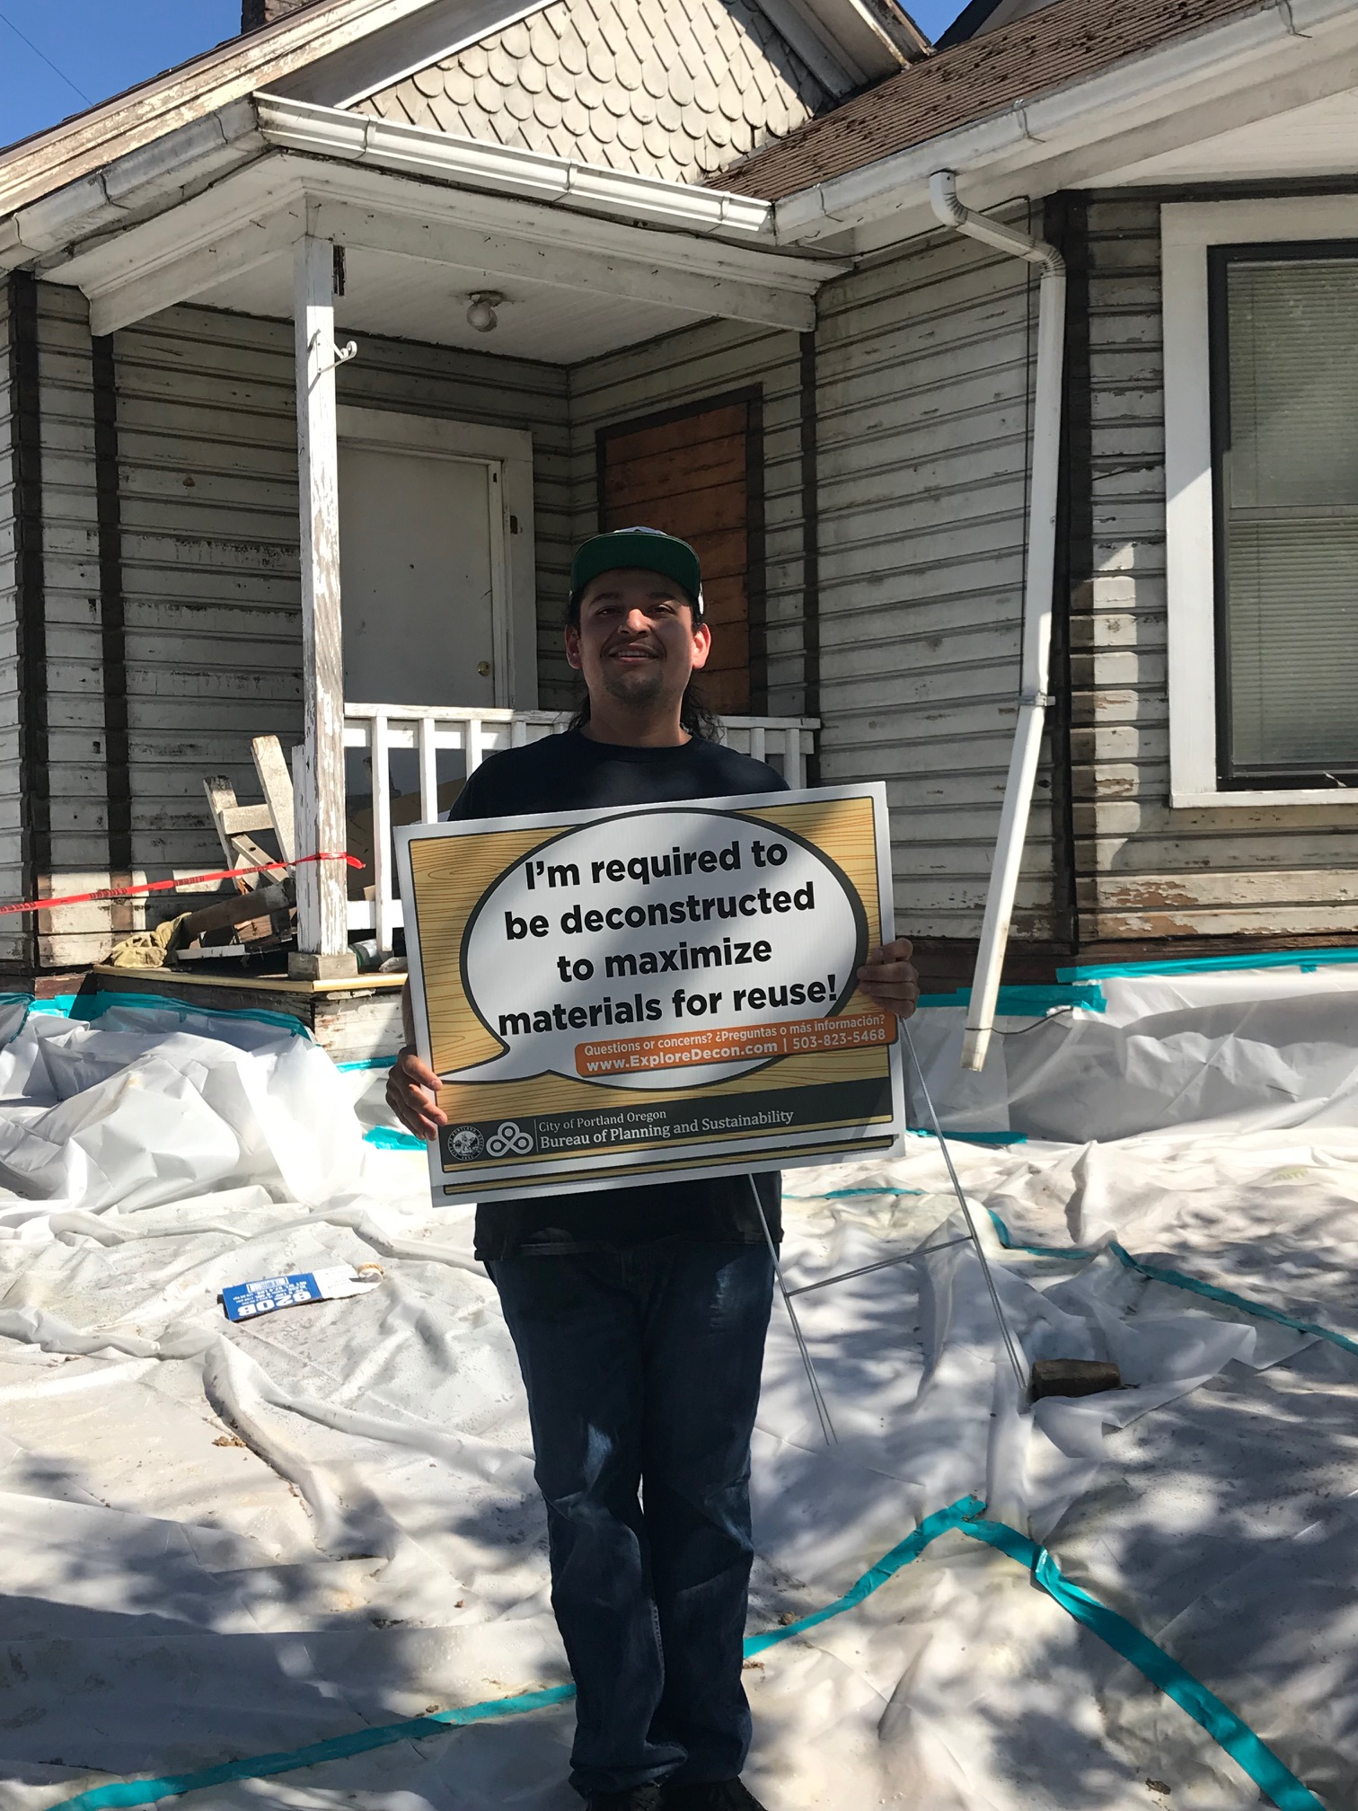
Benefits and Outcomes
Economic - Focus on women, people of color and other disadvantaged groups
  Grant priority 2015/2016
  Contractor and workforce training 2016/2017
  Oregon Tradeswomen 2019
  VOZ work center de-nailing 2019
  Earth Advantage/Metro COBID contractor training 2019
  Workforce (35% people of color and 16% female)
VOZ Worker Center
Newly Trained/Certified

Slide 10
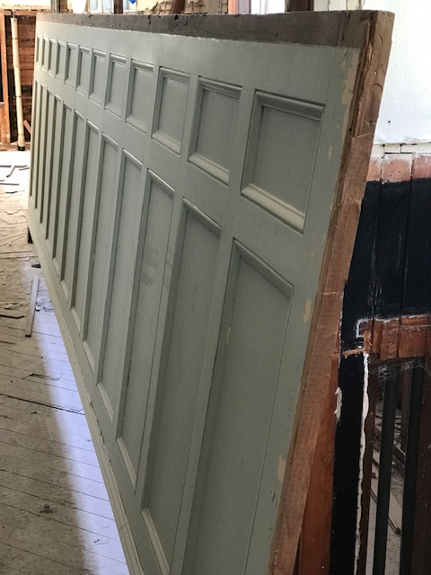
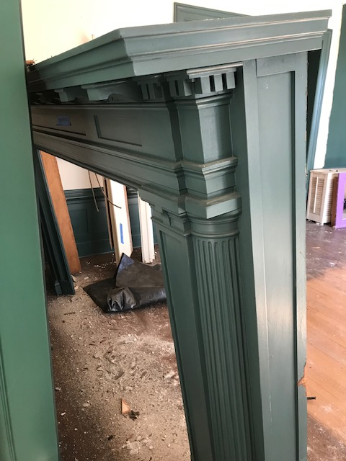
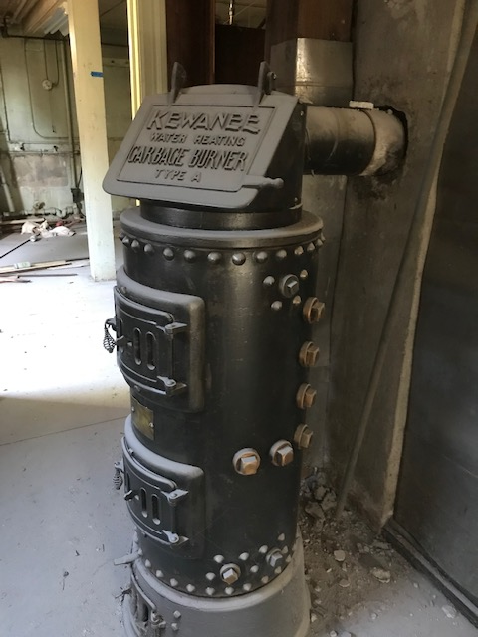
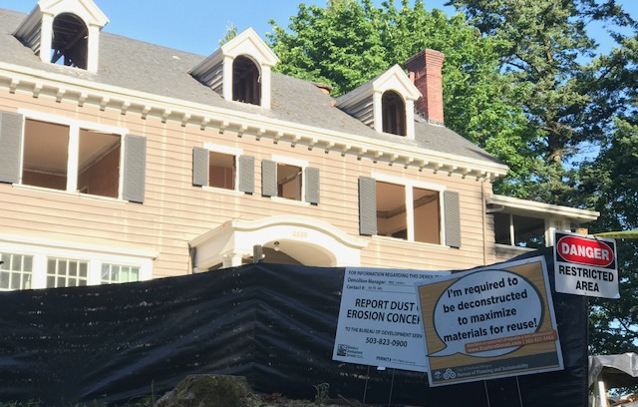
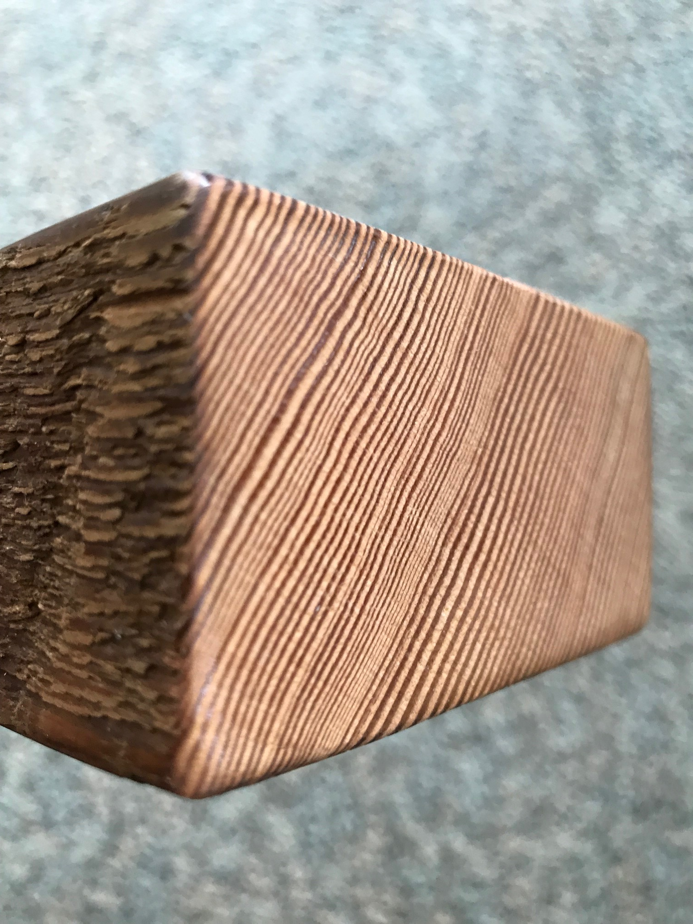
Benefits and Outcomes
Preservation
  Built history
  Craftsmanship
  Materials
  Old-growth lumber
Notes:
Kewanee Water Heating Garbage Burner

Slide 11
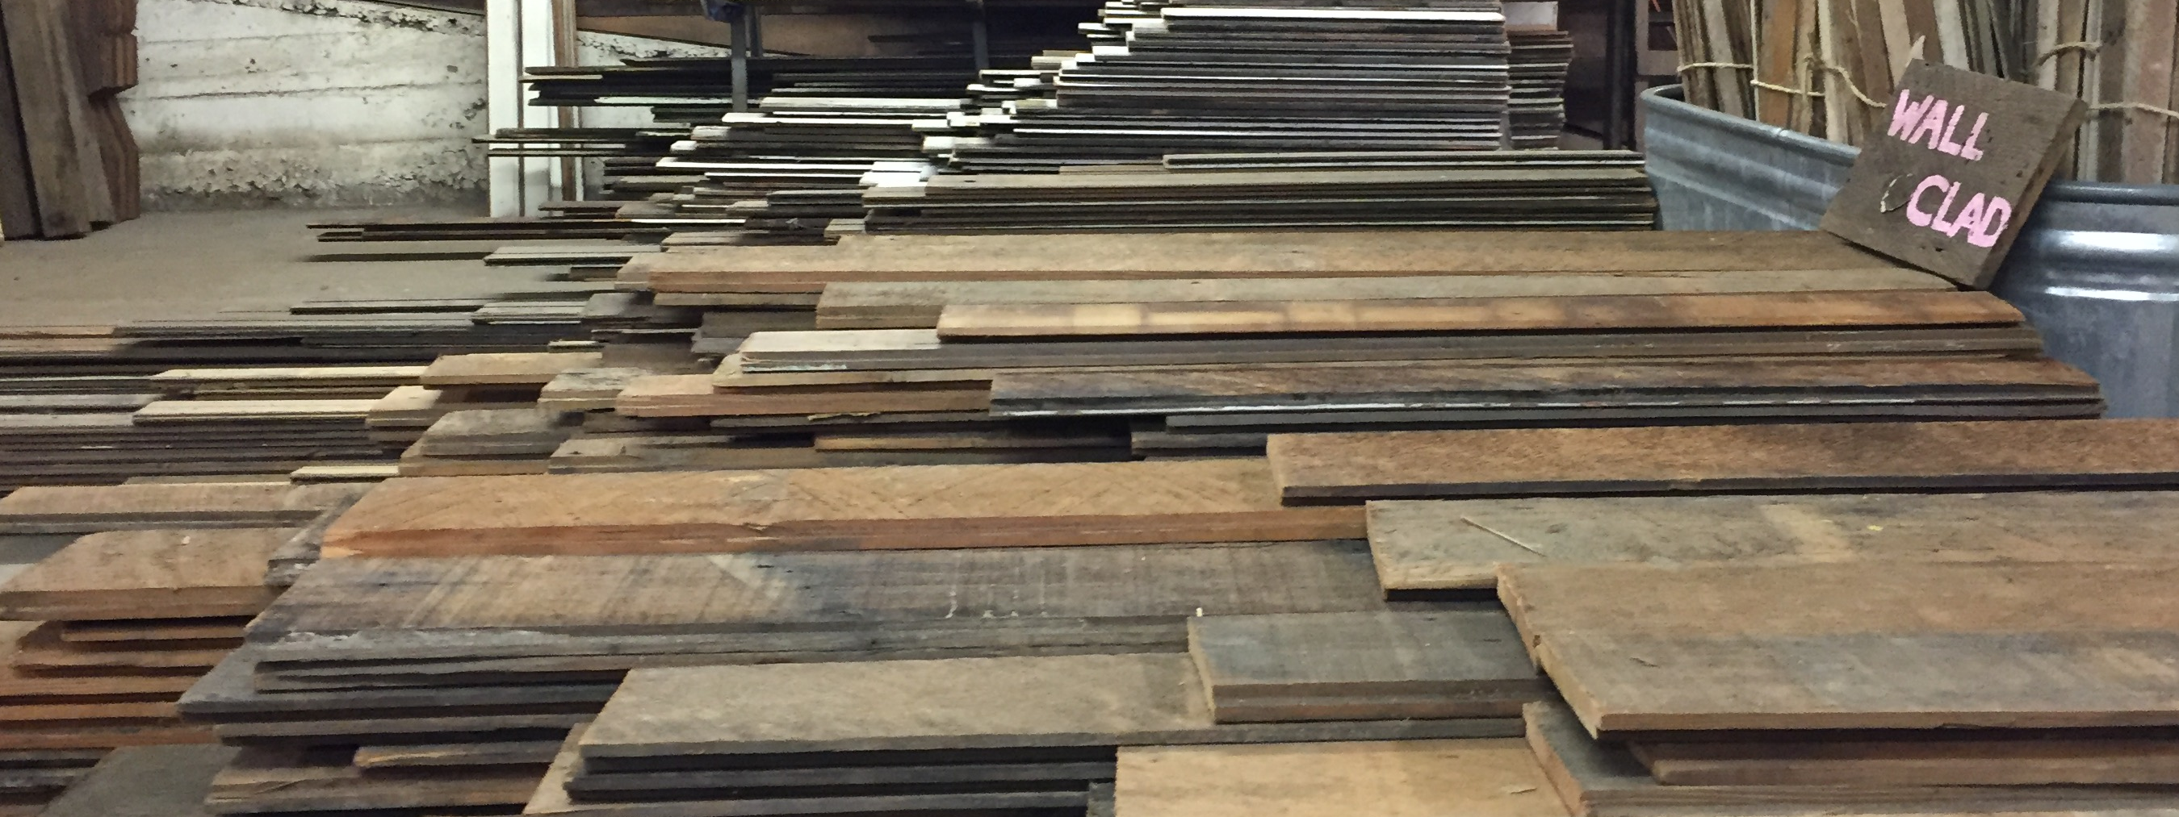
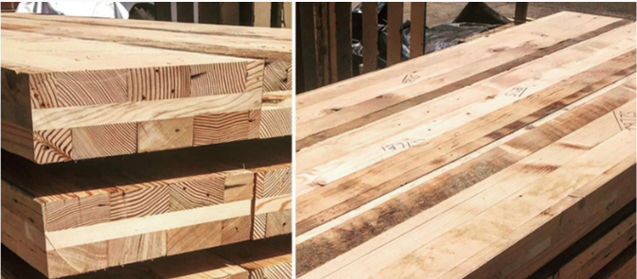
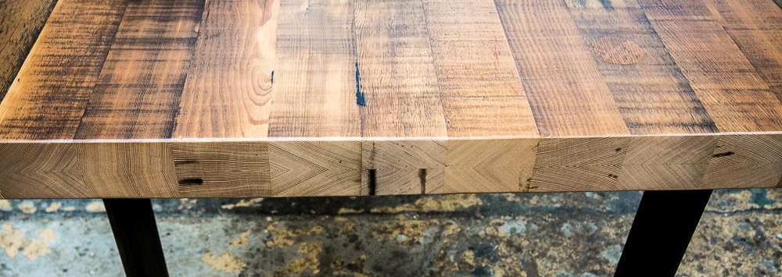
Industry Growth (3 years)
12 Certified Deconstruction Contractors (3 additional in training)
Two new salvage retail stores
Product development/research
  Furniture
  Siding
  Wall cladding
  Mass timber applications (CLT)
Grant awards/support
  Processing (portable saw mills)
  Boom trucks (loading/unloading)
  Training (focus on POC and women)
  Ongoing efforts
Retail
Research
Fabrication

Slide 12
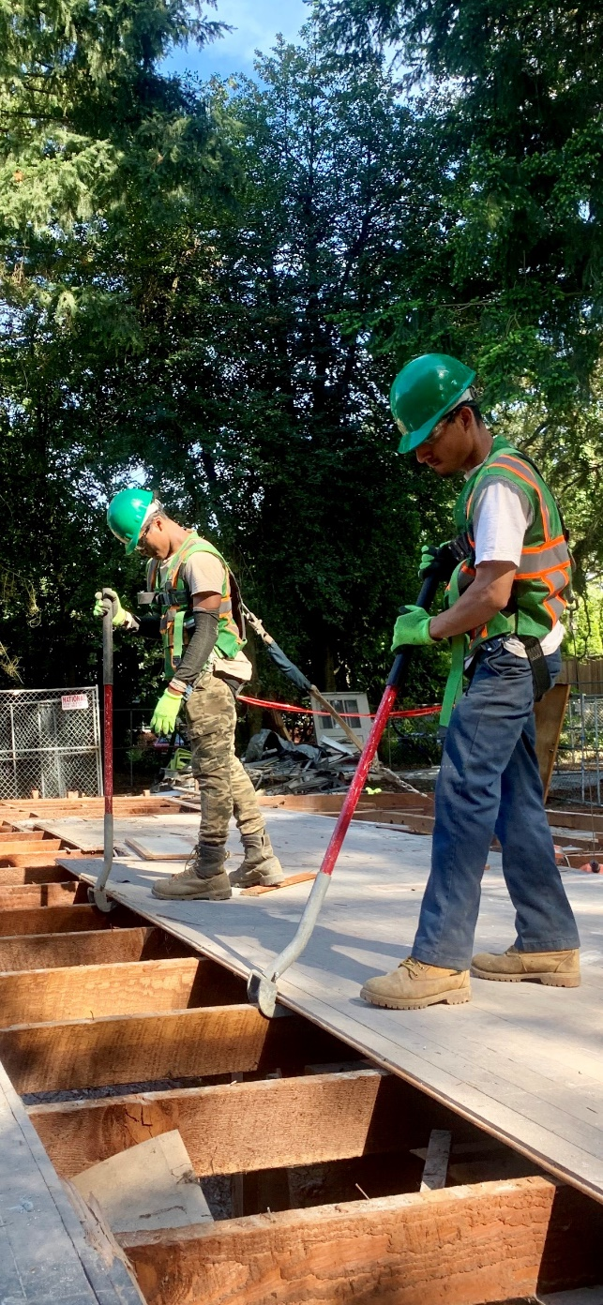
Cost of Deconstruction vs Mechanical Demo
Deconstruction
Deconstruction
Deconstruction
Cost
Mech Demo
Mech Demo
Mech Demo
Year 1
Year 2
Year 3

Slide 13

Cost Per Unit
12 units created for each decon
($250 additional per unit)
Exemption for affordable housing projects?
OR
1
2
3
4
5
6
Deconstruction
7
8
9
10
11
12
New Development - Replacement Units

Slide 14
Carrying Costs – Average Development Timeline
Application
Issued
Finaled
Issued/Approved
Demo permit review
(63 days)
Removal of structure
(59 days)
New Project/
LU Decision
Mechanical
Demo
45days
Decon 5 days less
35-day delay
Demo permit review
(59 days)
Removal of structure
(80 days)
New Project/
LU Decision
Deconstruction
23 days
3.4 Months
50
100
150
200
DAYS
Notes:
The notion that removing an old house as quickly as possible to deliver a new product to market is not supported by permit data and timelines. In fact, sites associated with deconstruction actually get started on the replacement structure 5 days sooner – meaning the carrying or holding costs for deconstruction are actually less.

Slide 15
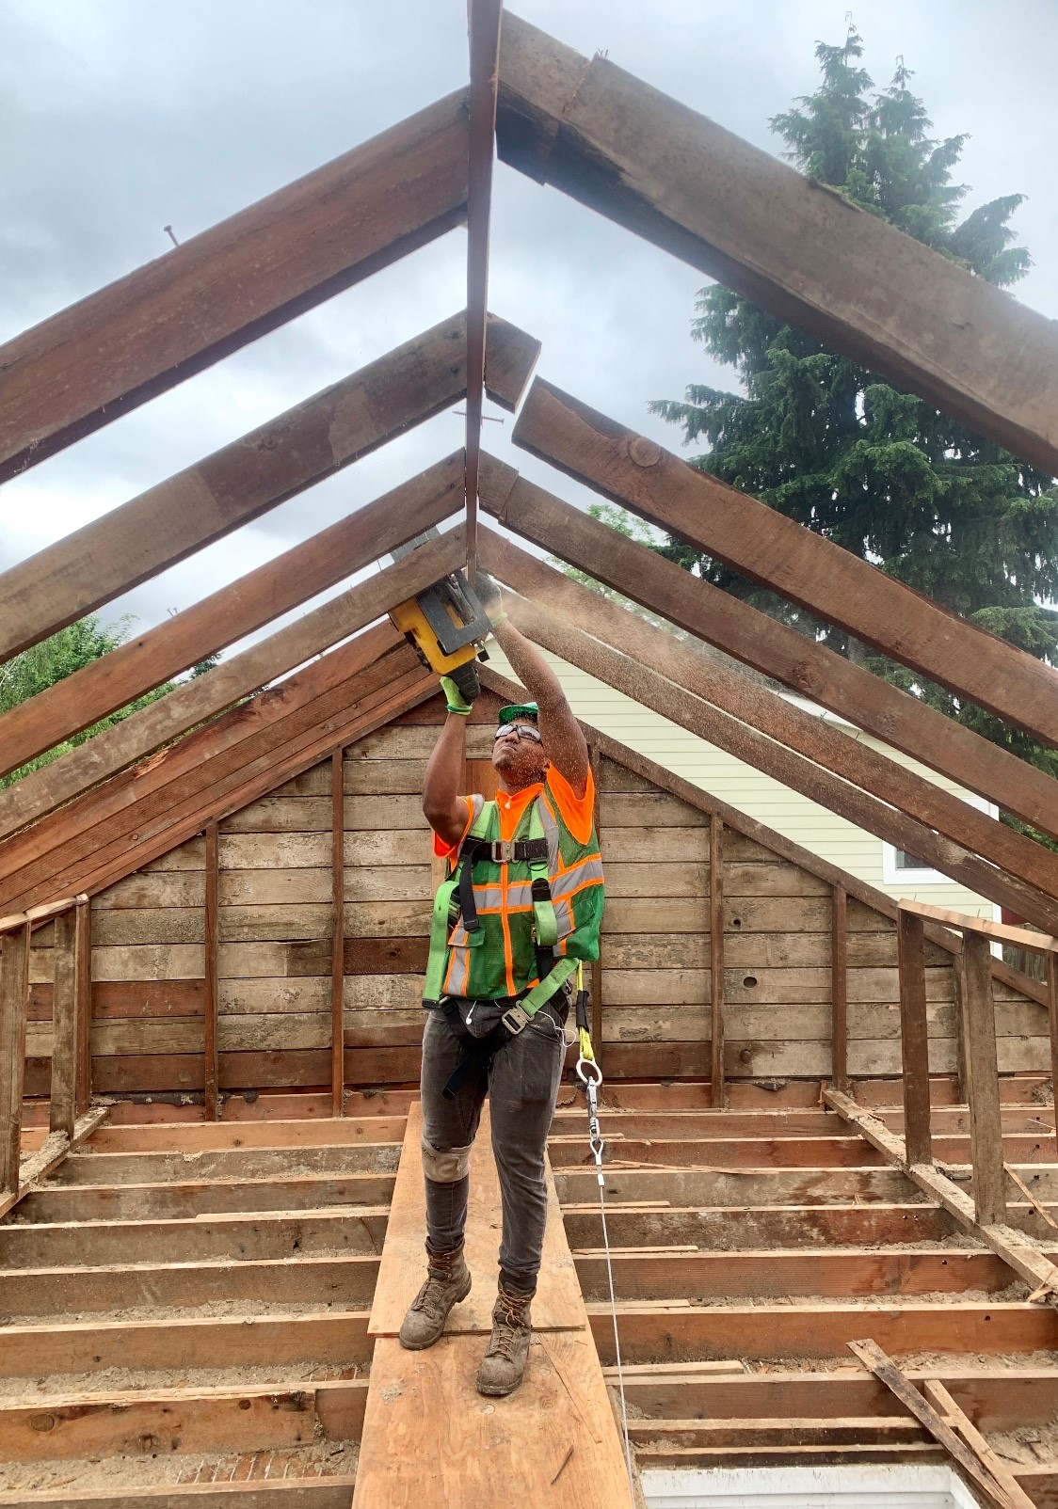
Timing
Why now?
  Deconstruction contractors and salvage retailers want more projects and material
  Decon and salvage infrastructure has matured and expanded
  Actively investing in future – equipment, staff, retail space
  Decline in demo permits presents a good time to expand (low risk)
Notes:
Why now?

Slide 16
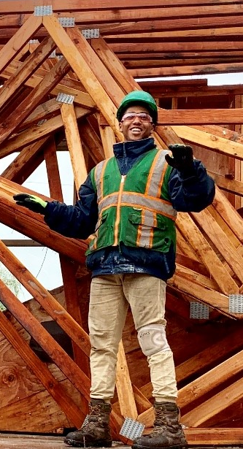
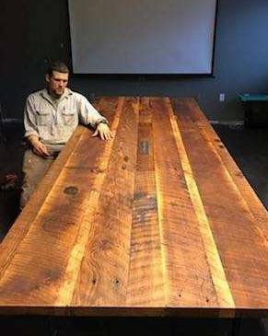

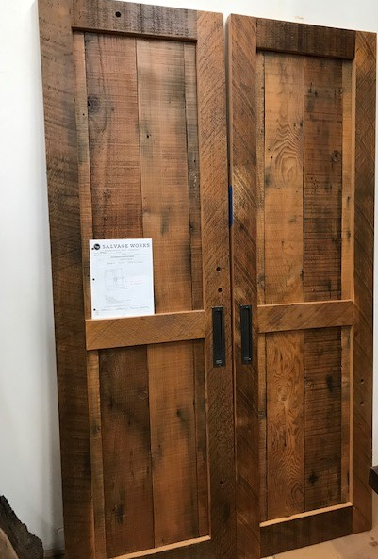
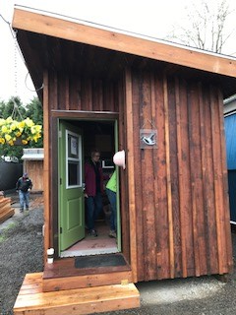
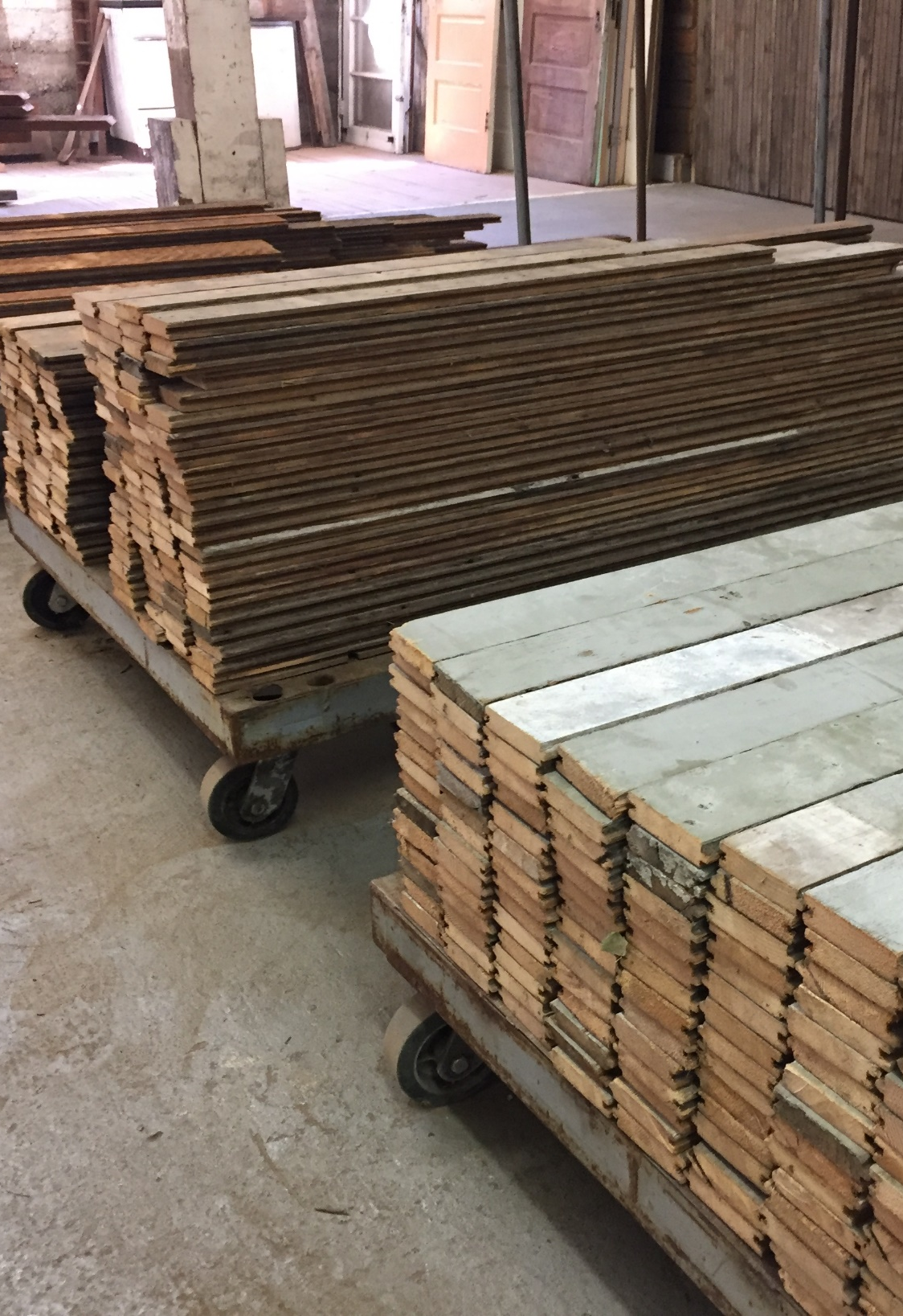
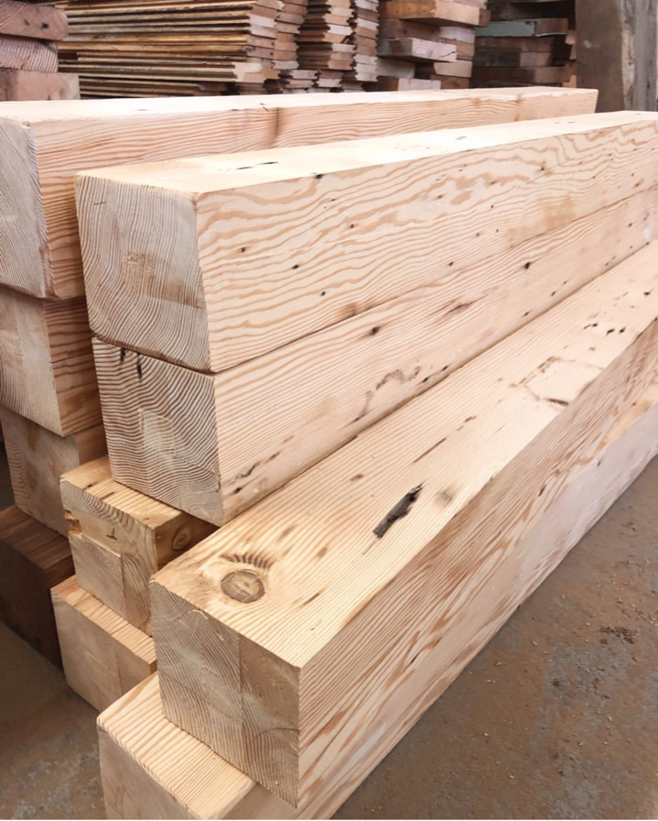
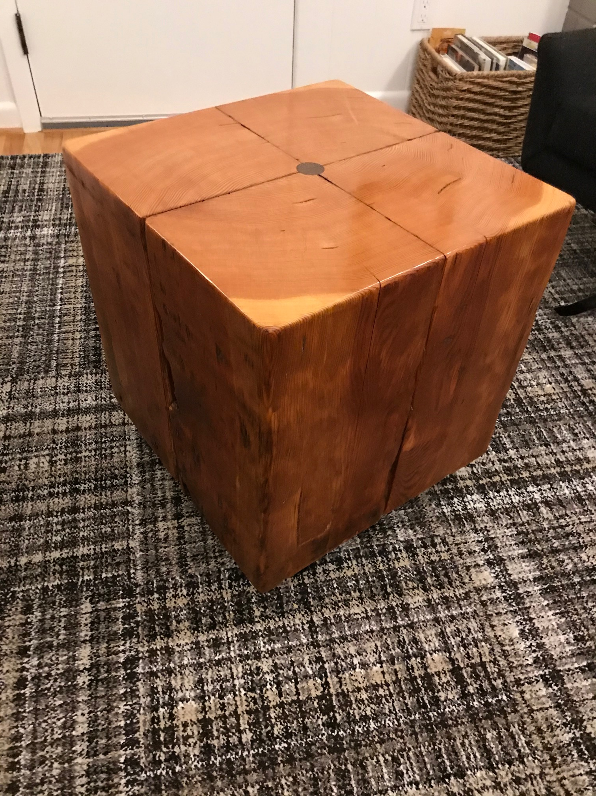
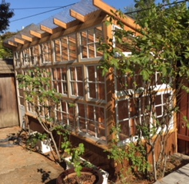

Slide 17
Extra Slides

Slide 18
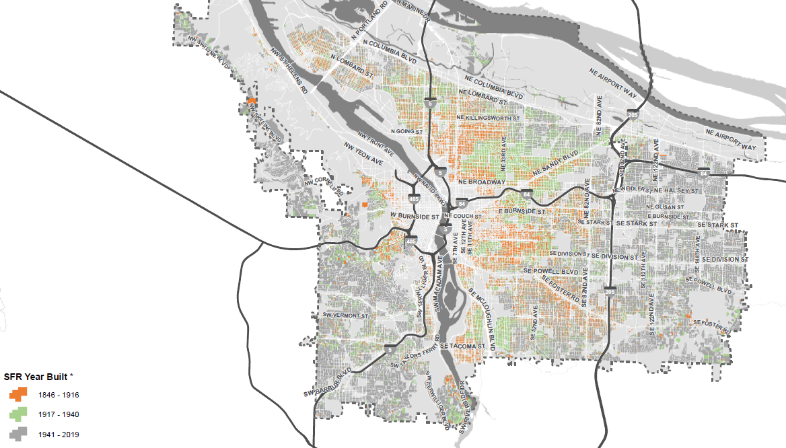
Geography

Slide 19
Deconstruction Program Timeline
Ordinance: Decon Code Language Approved
Council Direction: Advance
Deconstruction
Phase II: Decon Ordinance Effective
(<=1916)
Ordinance:
Proposed Amendment
(1940 or earlier)
Deconstruction
Advisory
Group (DAG)
Phase III: <=1940
Contractor
Training
Workforce Training
Phase I:
Decon Grants
Lead paint/
Asbestos Regs
Feb
Apr
Sep
Jul
Oct
Mar
Aug
Nov
Jan
2015
2016
2017
2018
2019
2020

