Slide 1
311 Program Resolution
Presentation to Portland City Council
November 13, 2019
Item 1041

Slide 2
TODAY’S resolution
FY2019-20 Budget Note: Funding for 311
Council is committed to establishing a 311 program in the City of Portland, but a decision point remains regarding the size and scale of this program. Council directs the Office of Management & Finance and the Office of Community & Civic Life to work with Council Offices on a resolution that confirms the details (including size, scope, additional FTE, funding requirements, and implementation timeline) of the 311 program. The resolution shall be before Council prior to October 1st, 2019, so that Council agreement on the scale and cost of the program is achieved prior FY 2020-21 budget development. Upon passage of a resolution, Council further directs CBO to increase the current appropriation level of the program to fund the one-time and ongoing costs of the 311 implementation as part of FY 2020-21 budget development.
RESOLUTION No.
WHEREAS, ………………….
WHEREAS, ………………….
WHEREAS, ………………….
WHEREAS, ………………….
NOW, THEREFORE, the Council directs:
A.
B.
C.
Council directs:
OMF to develop a 311 Program
Office of Community & Civic Life to transfer appropriated personnel and resources to OMF no later than July 1, 2020
CBO to increase the CAL target for the Office of the CAO for FY20-21 by $1,911,227* to support the program

Slide 3
ACKNOWLEDGEMENTS
Thank you to the countless City of Portland staff and leadership who contributed their ideas and expertise to this effort.
PROGRAM LEADERSHIP
Tom Rinehart, Chief Administrative Officer
Carmen Merlo, Deputy Chief Administrative Officer
Shoshanah Oppenheim, Office of the CAO
Suk Rhee, Director, Office of Community & Civic Life
Michael Montoya, Office of Community & Civic Life
Jeff Baer, Director, Bureau of Technology Services
Rick Nixon, Bureau of Technology Services
STAFF TEAM
Michelle Kunec-North
Joshua Gregor
John Dutt
CITY COUNCIL OFFICES
Kristin Dennis, Office of Mayor Wheeler
Nicole Grant, Office of Mayor Wheeler
Marshall Runkel, Office of Commissioner Eudaly
Winta Yohannes, Office of Commissioner Eudaly
Sonia Schmanski, Office of Commissioner Fish
Asena Lawrence, Office of Commisioner Fish
Claire Adamsick, Office of Commissioner Fritz
Tim Crail, Office of Commissioner Fritz
Kristin Johnson, Office of Commissioner Hardesty
BUREAU PARTNERS
Office of the Chief Administrative Officer
Office of Community & Civic Life
City Budget Office
Office of Community Technology
Bureau of Development Services
Bureau of Emergency Communications
Bureau of Emergency Management
Bureau of Environmental Services
Office of Equity and Human Rights
Bureau of Human Resources
Portland Parks & Recreation
Bureau of Planning and Sustainability
Portland Police Bureau
Bureau of Revenue and Financial Services
Bureau of Technology Services
Portland Bureau of Transportation
Portland Water Bureau

Slide 4
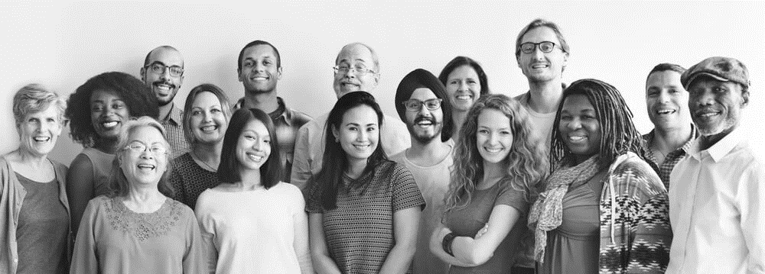
Portland’s 311 Vision
Portlanders can easily and effectively access City information and services, regardless of language, ability, or resources.

Slide 5
OPERATIONAL PRIORITIES
Establish a functional and successful 311 Program that simplifies and improves community access to government information and services.
Use a foundation of equity and universal design to expand access for all Portlanders.
Leverage existing investments, including institutional knowledge, technology and regional partnerships.
Pursue enhancements that will reduce non-emergency calls to 911 call-takers, in coordination with other efforts.

Slide 6
PROGRAM DETAILS

Slide 7
A 311 Program for Portland
Shift from 80% transferred to 80% resolved.
Provides multiple ways for Portlanders to easily and effectively access City information and services:
Complements other systems and programs:
211 (Statewide) Community & Health Services
911 (Regional) Emergency Response
ONLINE New One City, service-focused website
IN PERSON New Citywide Customer Service Center at the Portland Building, potential satellites
PHONE + Transition 823-4000 into 311 with resolution capabilities
City, County & Other Agencies Program specialists
Notes:
Portland’s 911 call center receives nearly 1 million calls per year—about 25% of these are considered ‘non-emergency’. A key goal of the 311 Program is to reduce unnecessary calls to 911.

Slide 8
?!
today
Program Specialist
Issue Intake
Community Member
Issue Resolved
City Council
Related City Programs

Slide 9
COMMUNITY Preferences
About half of residents have ever contacted the City.
They did so for many reasons.
17%
Seeking Information
1 in 3 residents think it is difficult to get information from the City.
No: 51%
Yes: 48%
17%
Parking, Traffic, Roads
11%
Public Safety
22% of residents have chosen not to contact the city with a question or concern because they “didn’t believe it would help.”
10%
Utilities
7%
Permits
9% of residents do not have internet access at home.
28%
All other reasons
Residents prefer to contact the City online or by phone.
35%
People of color and residents with lower income or education are more likely than average to access the internet on a mobile phone
32%
All other methods
In person, text, social media
33%
Preferred by:
Younger residents
Non-disabled persons
Higher-income residents
Need simple information
Preferred by:
Older residents
Disabled persons
Lower-income residents
Have a complicated matter
Virtual
Phone

Slide 10
311
311 Specialist
In-person, phone, online
Program Specialist
Issue Intake
311 vision
Community Member
Issue Resolved
Analytics & Reporting
City Council
Related City Programs

Slide 11
Governance
311 Leadership Team
OMF: Bureau of Technology Services
OMF: Office of the Chief Administrative Officer
Office of Community & Civic Life
311 Program
311 Advisory Committee
Forum for the ongoing involvement, input and oversight of partners and stakeholders

Slide 12
311 CUSTOMER SERVICE DELIVERY
FIND
City Council agendas
City plan or project information
City programs & staff contacts
Contract/bid opportunities
Construction updates
Emergency information
Employment opportunities
Facility hours & locations
Garbage/recycling/compost schedules
Land use notices
Leaf pickup schedules
Neighborhood / Coalition contacts
Online zoning & permit information
Parking rules
Park & facility amenities
Public events and meetings
Smart Trips/Trip Planning
Utility providers
Volunteer opportunities
REPORT
Abandoned auto
Abandoned bike
Code complaints
Construction without permit
Containers in right-of-way
Graffiti
Illegal campsites
Illegal parking
Liquor violations
Noise violations
Park maintenance issues
Private-for-hire complaints
Sidewalk obstruction/hazard
Sign, light, or signal issues
Vegetation concerns
Work zone concerns
APPLY / REGISTER
ADA or language access
Alarm permit
Block Party permit
Noise variance
Policy or project-related comment
Public records request
Recreation class or camp
Room, park, or facility reservations
Sidewalk/Driveway repair permit
Simple temporary street use permit
Street improvements
PAY
311 services

Slide 13
EXPANDING Service Delivery FY 2019-20 focus areas
Online self-service assistance
PP&R simple registrations and permits
ADA and language access
Portland Building customer service and visitor assistance
BOEC Partnership

Slide 14
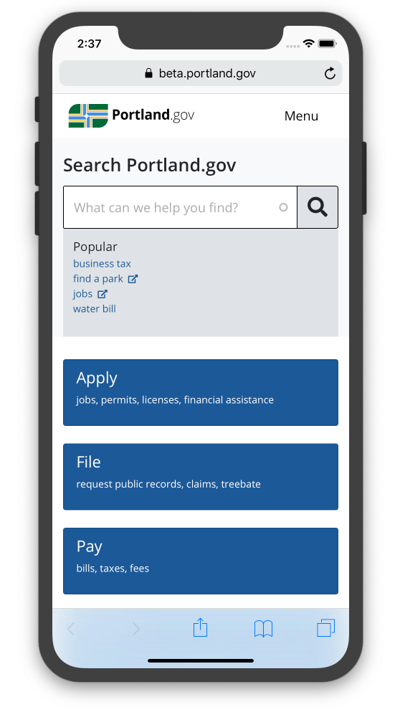
Supporting technology
Allows staff to:
Support community members in-person, by phone, text, chat, and email
Log contacts with community members and customers
Research questions in a knowledge base
Intake, route, and track reports or requests
Collect, manage, analyze and share well-designed data
Share information with bureaus Citywide
Website
Webform solution
Service Desk tool
Portland.gov
includes replacement of TrackIt

Slide 15
FY 2019-20
FY 2022-23
5.5 + 6 FTE
Program Manager
Customer Service Supervisor
Customer Service / I&R Reps (7)
Admin Specialist (0.5) -- --
Continuous Imp. Coordinator
Data Analyst
28 FTE
Program Manager
Customer Service Supervisor (+1)
Customer Service Reps (+13)
Admin. Specialist
Applications Analyst
Comm. & Outreach Coordinator
Continuous Imp. Coordinator
Data Analyst
311 I&R Program
311 Program
STAFFING
Leverage existing staff & knowledge:
Internal recruitments
Tiered CSR classification
Customer Service Resource Study

Slide 16
311 Foundation & In-Person Service
Establish the program and open a One City Customer Service Center at the Portland Building.
5.5 FTE + 6 FTE
New Channels
Expanded Channels
Integrate Information & Referral Program (6.0 FTE)
FY 2019-20
Portland.gov Service Directory (POWR)
Create a One City, service-focused website.
% of Total 311 Services
==========
I&R
Software Tools
New solution for online service forms, ability to log contacts with community members and intake, route, and track requests.
Onboard additional services
+ 2.0 FTE
Expanded Channels
% of Total 311 Services
==========
I&R
timeline
FY 2020-21
Expand Customer Service
Create a 311 Contact Center, increase capacity and enhance resolution capabilities. Communicate and market the program.
+ 7.5 FTE
New Channels
% of Total 311 Services
==========
311
FY 2021-22
Public Info Campaign
Full Citywide 311 Program
311 provides a first-stop for community questions and requests, whether someone contacts the City online, by phone, or in-person.
+ 7.0 FTE (28.0 FTE total)
Channels
FY 2022-23+
% of Total 311 Services
==========
311
Notes:
Talk about FTE that are operations vs. customer service.

Slide 17
Program costs & Benefits
Potential Benefits
Projected Expenditures
$3.15 million
(~$1.8 million over appropriated resources)
Projected Resources
$1.9 million CAL Target Adjustment
47% General Fund Discretionary
53% General Fund Overhead
Interagency with Portland Building tenants
Interagency with Multnomah County
Level and quality of customer service
Bureau capacity to respond to needs
Wait times
Transfers
Phone lines
Staff time processing requests Cost per contact

Slide 18
Next Steps
December 16th Portland Building Customer Service Desk opens
December 17th City Council work session
Spring 2020 FY 2020-21 Annual Budget

Slide 19
COUNCIL DISCUSSION
Notes:
START WITH WHAT “311” IS.

