Slide 1
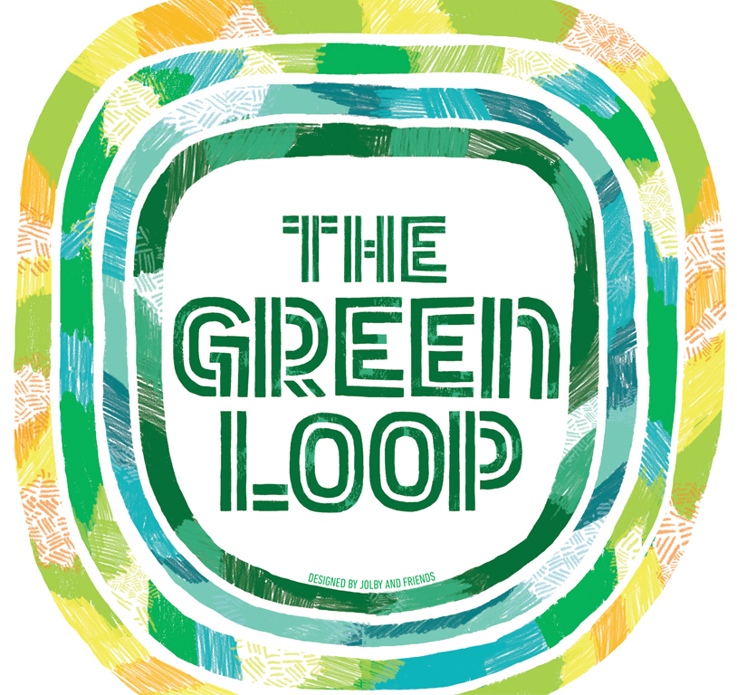
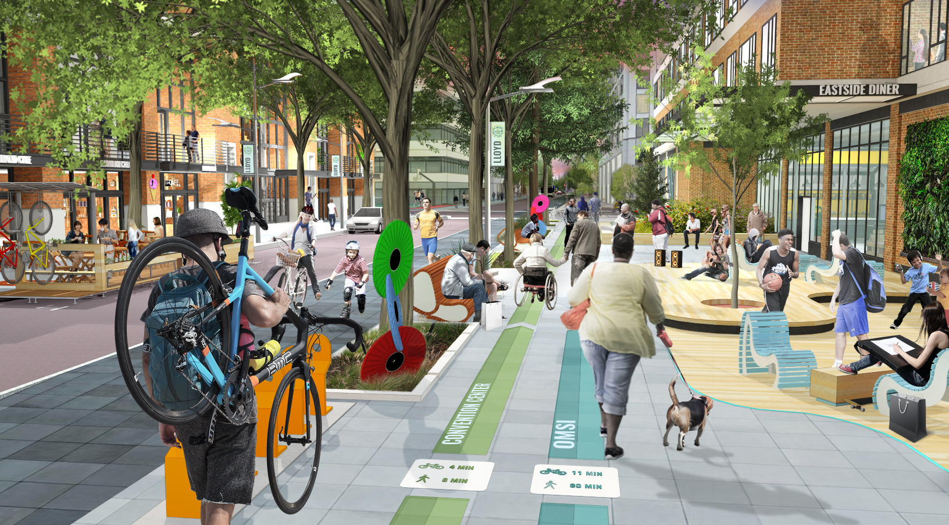
The Green Loop: A 21st Century Public Works Project

Slide 2
The Green Loop
Design Commission Briefing
August 2, 2018
Refresher: What is it // Where is it
What’s the Status post CC2035
Mind the Gap

Slide 3
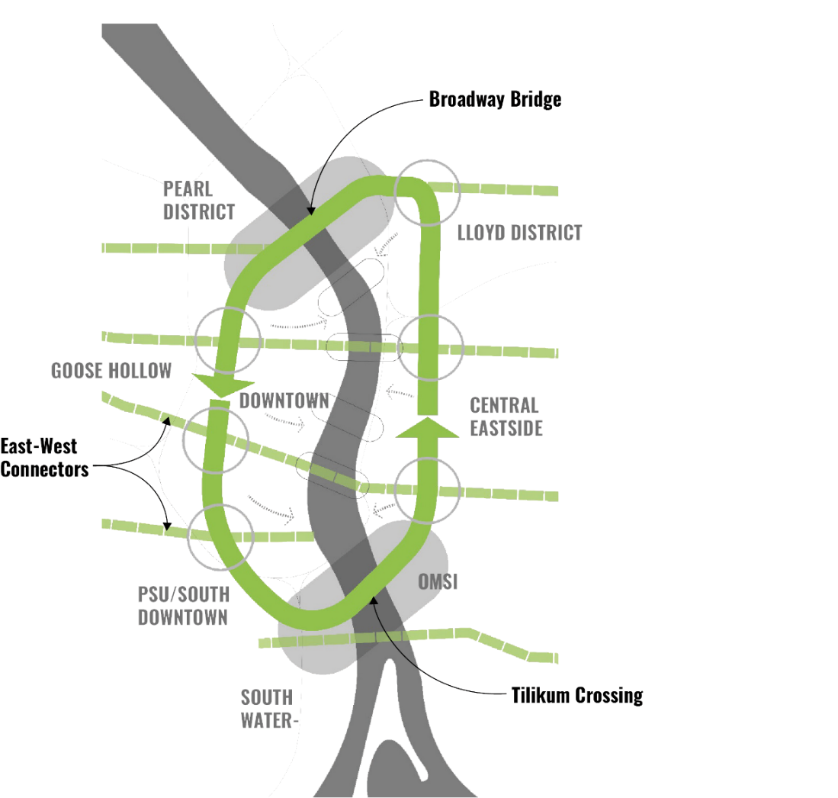
The Green Loop Concept is a
six mile linear park that invites residents, employees and visitors to experience Portland’s Central City in an entire new way.
Notes:
At its core, the Green Loop is a 6-mile walking and biking linear park. The concept connects the Broadway Bridge on the northern end to the Tilikum Crossing Bridge at the southern end. Both of these locations have tremendous redevelopment potential that can bring people closer to the Willamette River. A series of clear east-west connections link surrounding neighborhoods and districts to the loop and on through to the river. The Green Loop is an example of being more intentional with the Central City’s street network, prioritizing some routes for some functions and others for others, ala the Transit Mall.

Slide 5
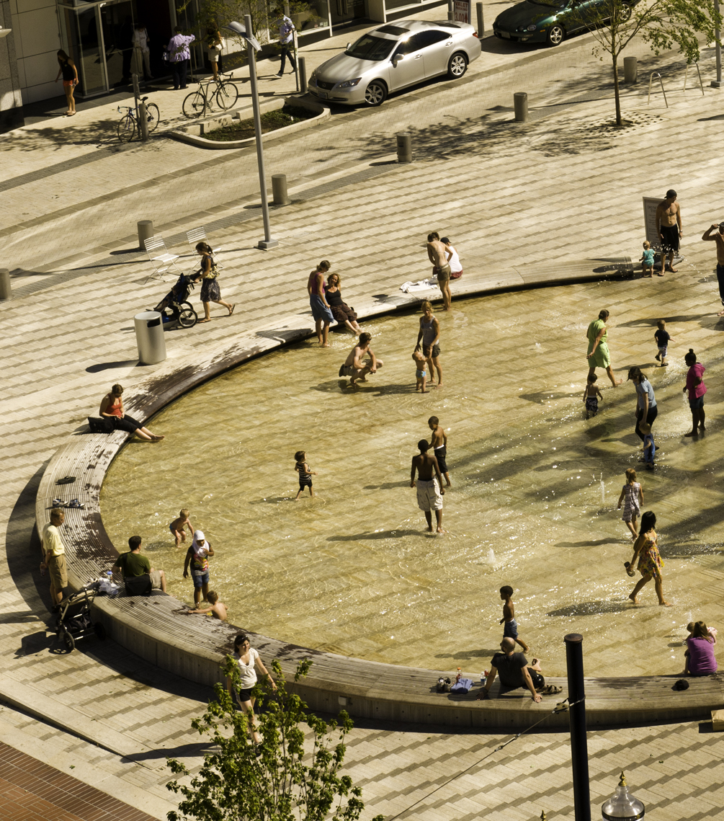
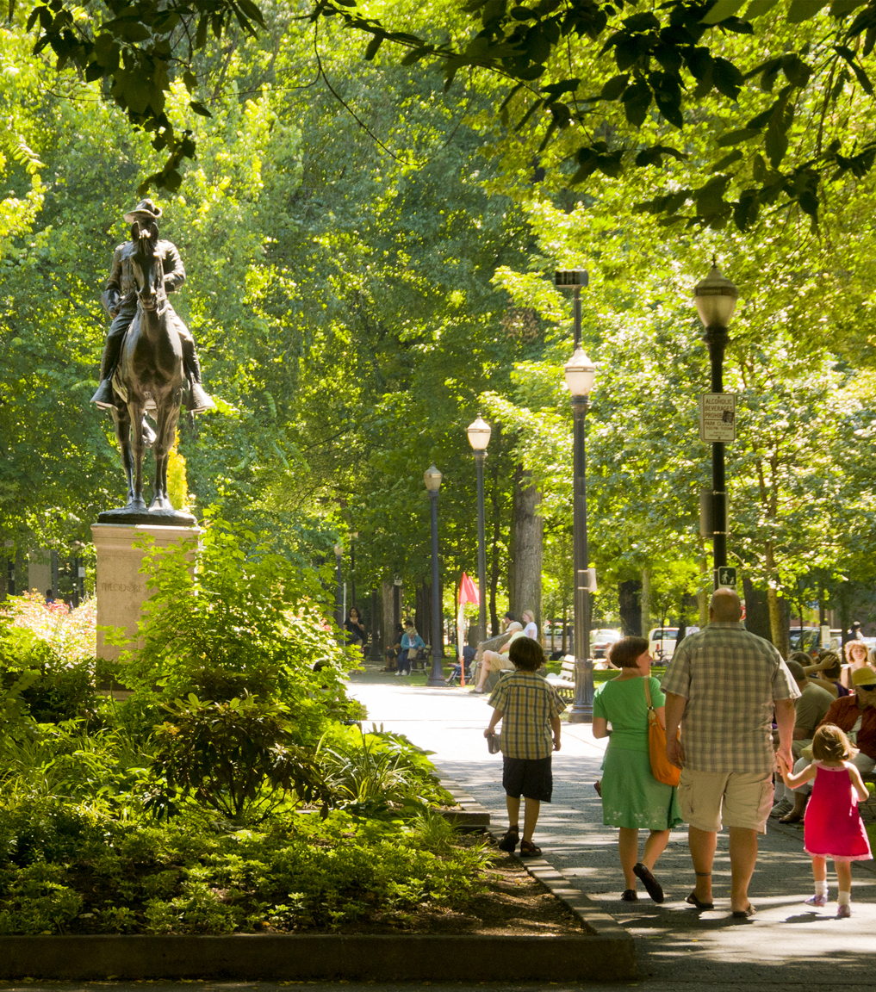
The Green Loop is about public space.
Notes:
Besides a way to move through the Central City, the Green Loop builds on the signature open space system that exists today, most notably on the west side, while creating opportunities for gathering and recreating on the east side where there aren’t currently any places of respite or activity.

Slide 6
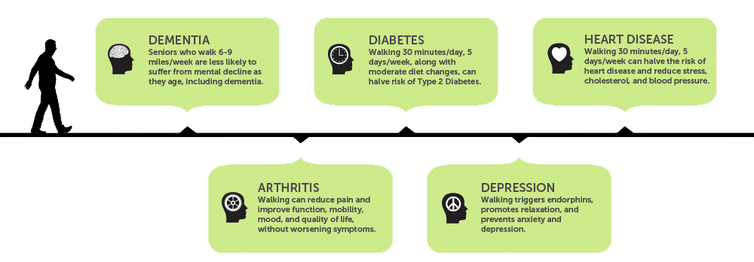
offering healthy options.
The Green Loop is about
Access to Parks
Active Transportation
Notes:
The Centers for Disease Control defines physical activity as “anything that gets your body moving.” Adults need regular physical activity, such as brisk walking, jogging or running, in addition to muscle-strengthening activities to help improve overall health and fitness and reduce the risk for many chronic diseases.
Currently, the east side of the Central City is park deficient, meaning that workers and residents have few public outdoor places for gathering, recreating, or exercising. The Green Loop is a linear park system, providing connections to existing open spaces and catalyzing new ones.
Today, 5% of Portlanders walk and 5% ride their bikes to work. The Portland Plan’s goal is to increase “active transportation” work-commute trips to 7.5% walking and 25% cycling by 2035. As the city’s largest employment center, the Central City needs to offer a safe and welcome system for commuters on foot and on bike. The Green Loop is a physically separated route that will provide cyclists and walkers with greater comfort and access to more places.

Slide 7
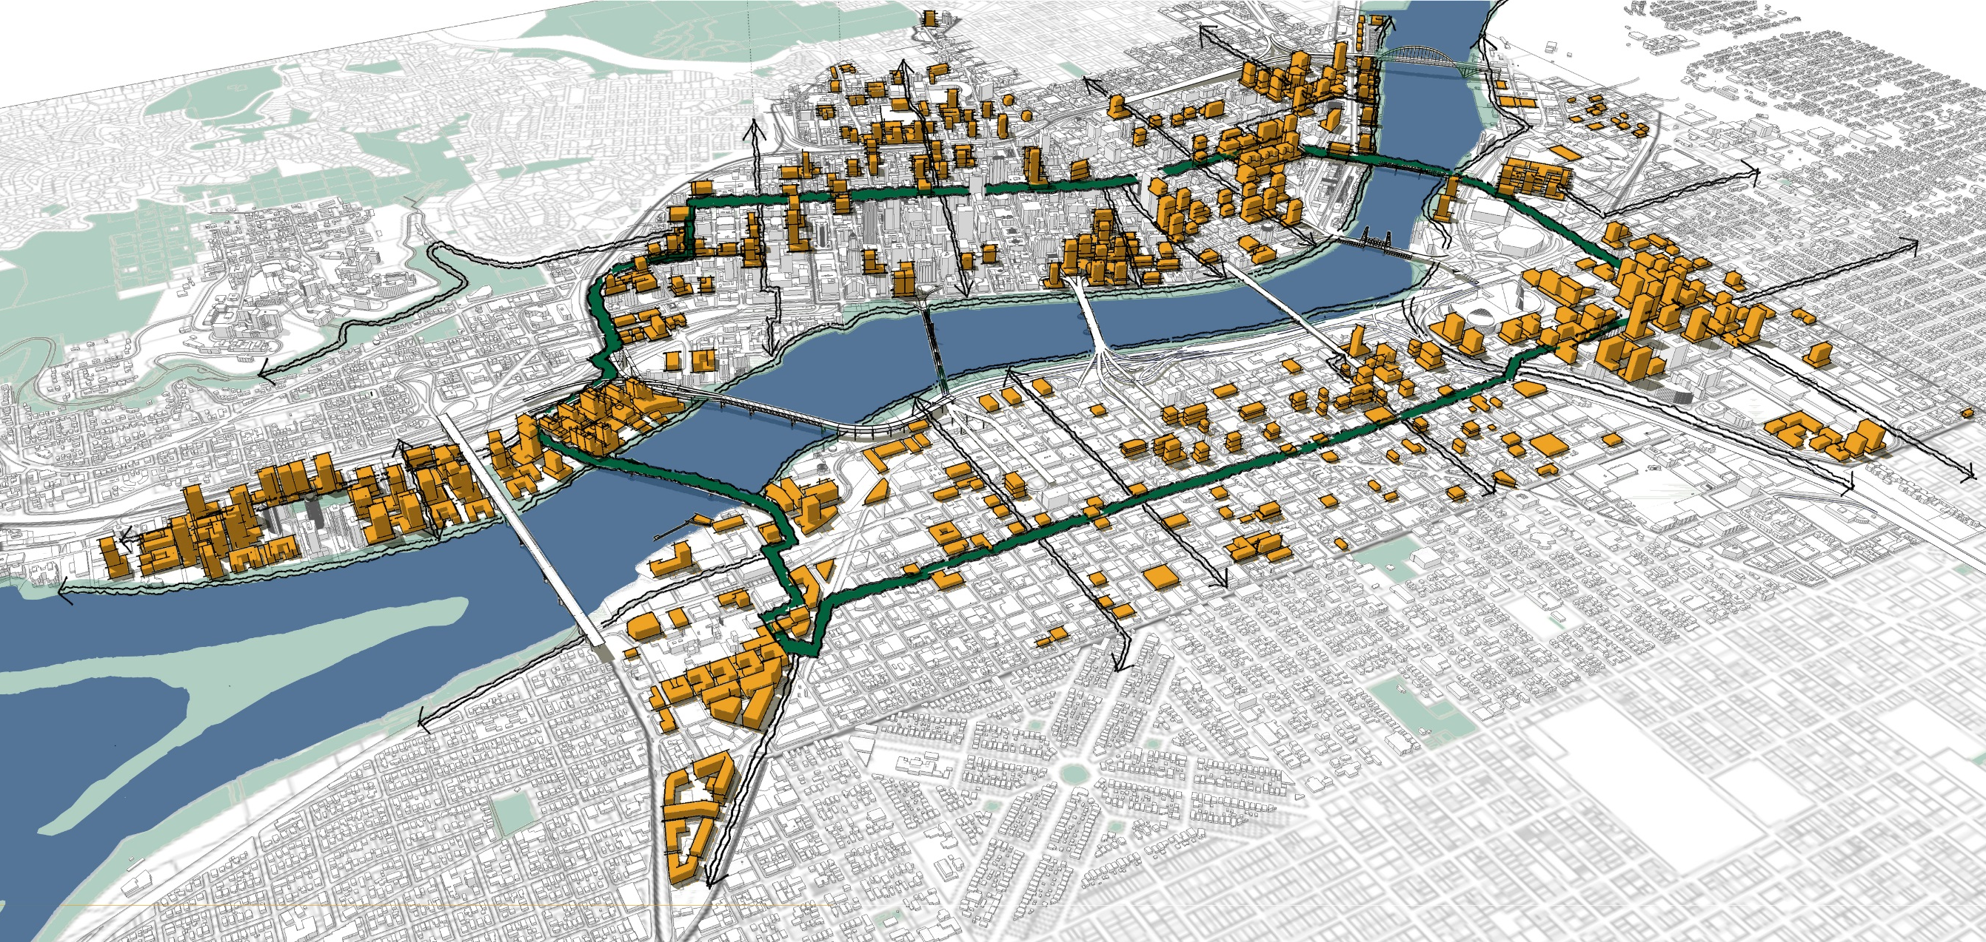
organizing growth.
The Green Loop is about
Notes:
The Green Loop builds on existing greenway paths and the Willamette River Loop between the Steel and Hawthorne Bridges. It adds a concentric ring roughly 10 blocks from the river, reaching the Central City’s places of highest activity and potential density with a series of safe east-west connections to surrounding areas.
The Central City has a lot of room to grow in the next 35 years. The diagram on the left shows a potential future build-out within the areas of high redevelopment capacity (circa 2012) in orange. As the Central City grows, it has the potential to shape new development around the Green Loop’s recreation and open space network.

Slide 8
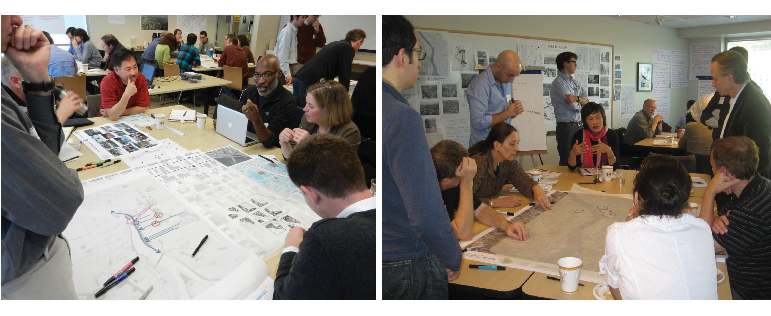
Community involvement.
The Green Loop is about
Notes:
The Centers for Disease Control defines physical activity as “anything that gets your body moving.” Adults need regular physical activity, such as brisk walking, jogging or running, in addition to muscle-strengthening activities to help improve overall health and fitness and reduce the risk for many chronic diseases.
Currently, the east side of the Central City is park deficient, meaning that workers and residents have few public outdoor places for gathering, recreating, or exercising. The Green Loop is a linear park system, providing connections to existing open spaces and catalyzing new ones.
Today, 5% of Portlanders walk and 5% ride their bikes to work. The Portland Plan’s goal is to increase “active transportation” work-commute trips to 7.5% walking and 25% cycling by 2035. As the city’s largest employment center, the Central City needs to offer a safe and welcome system for commuters on foot and on bike. The Green Loop is a physically separated route that will provide cyclists and walkers with greater comfort and access to more places.

Slide 9
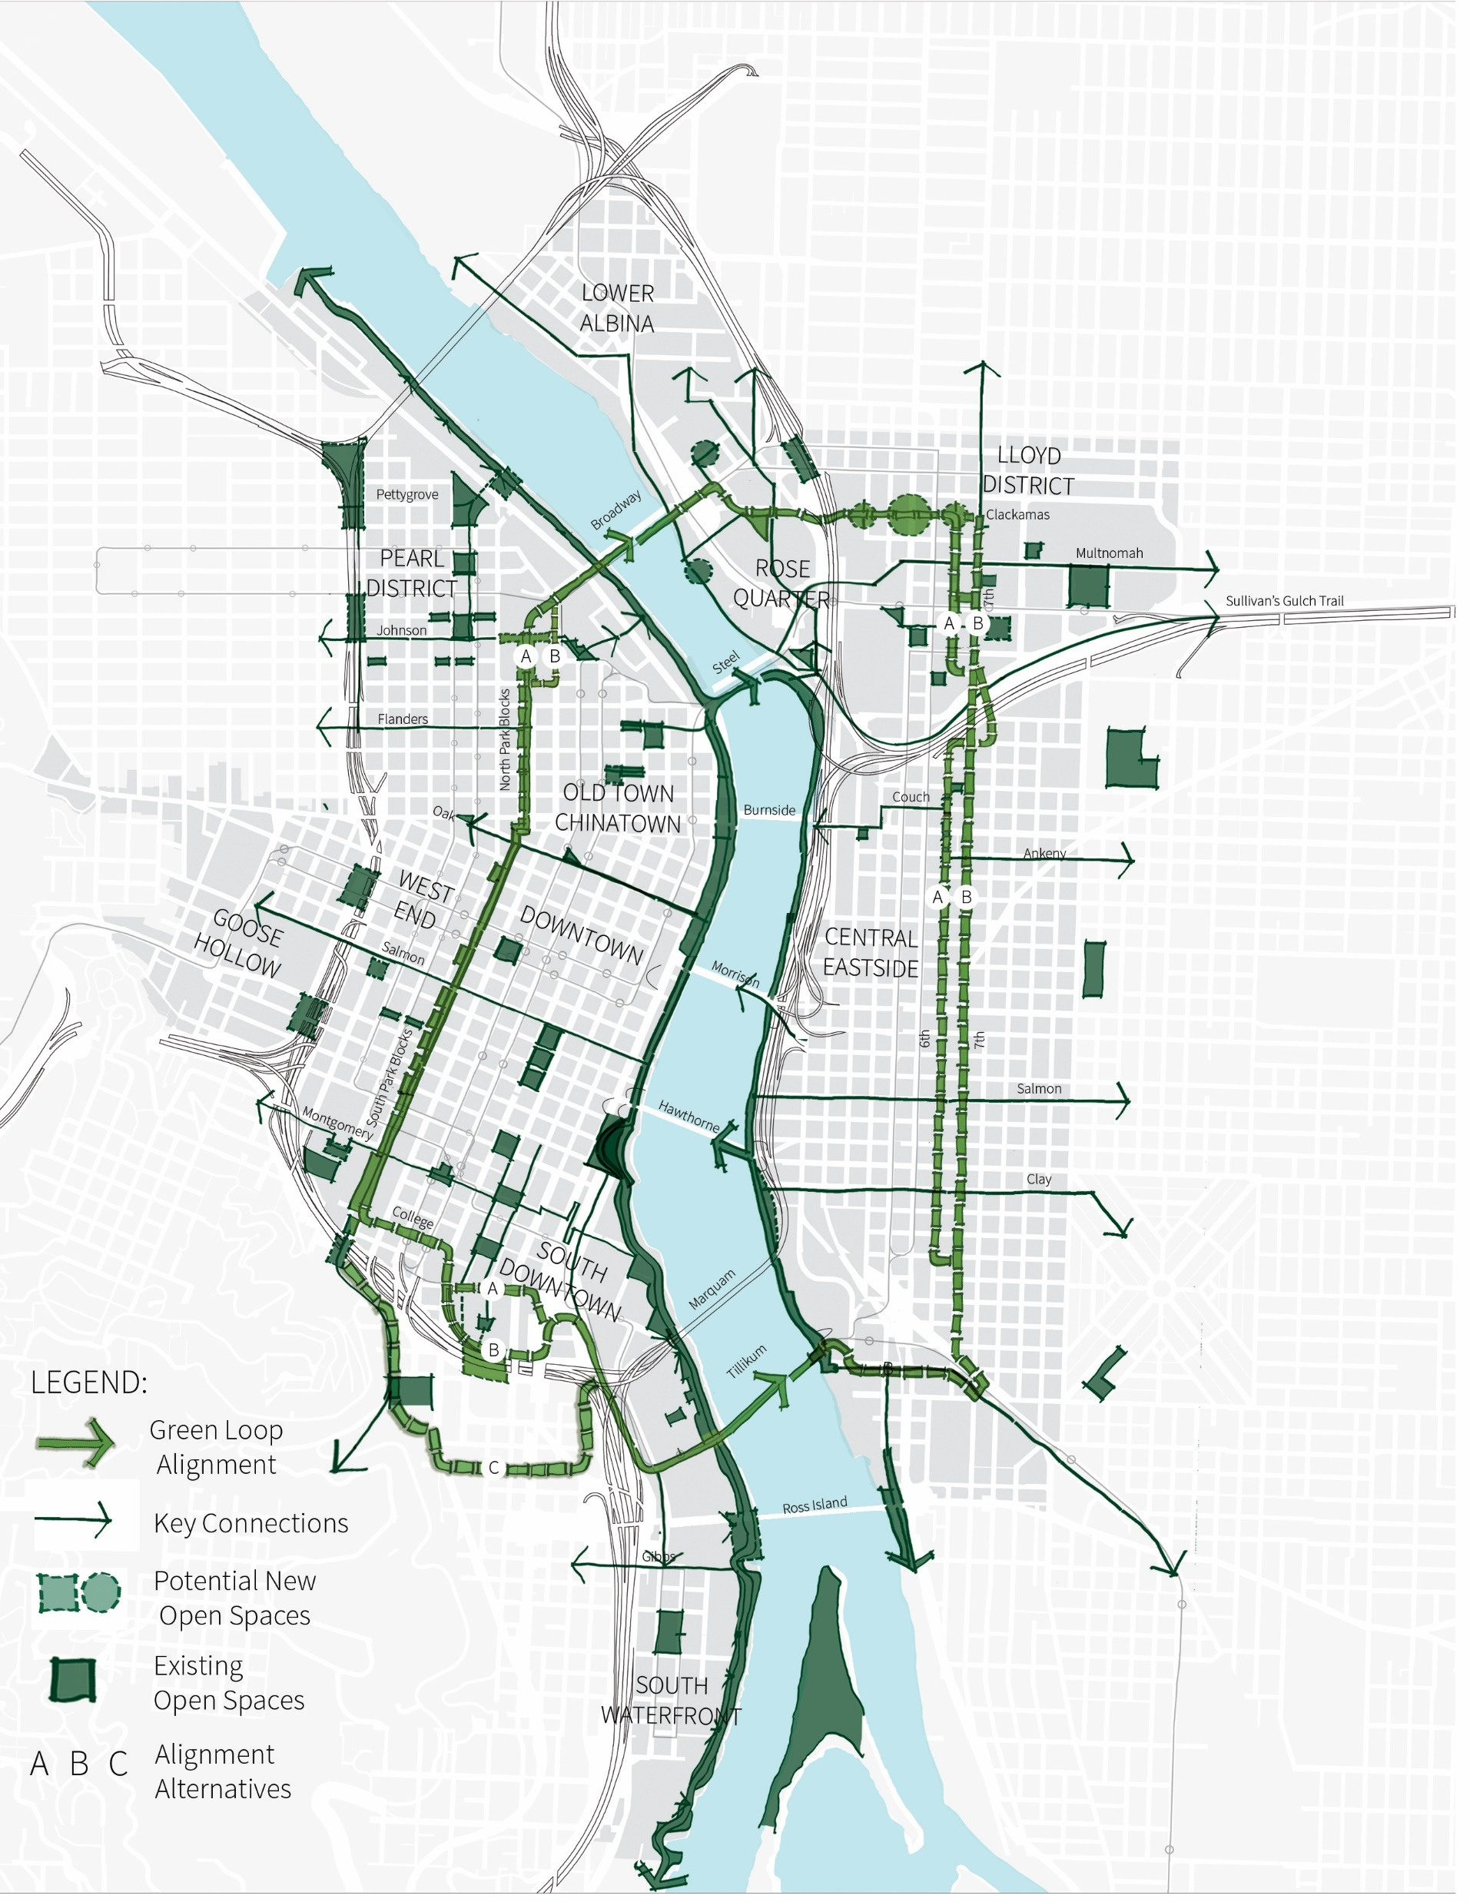
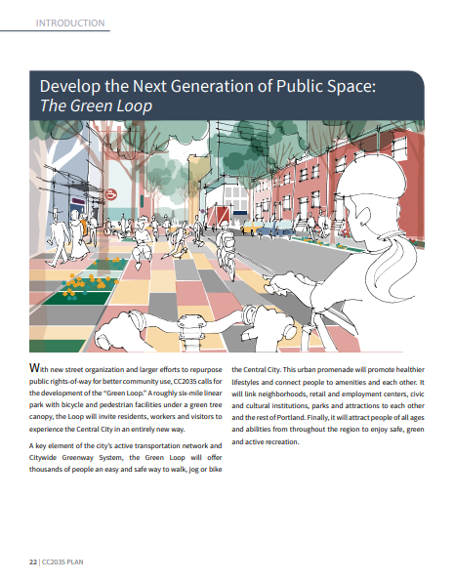
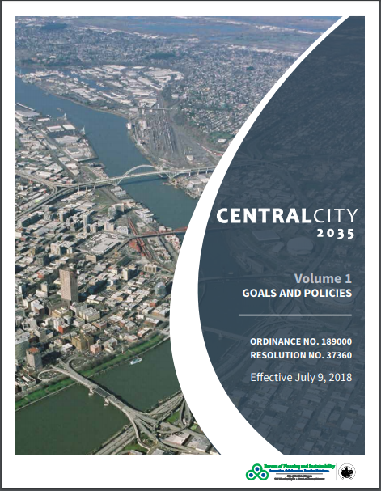
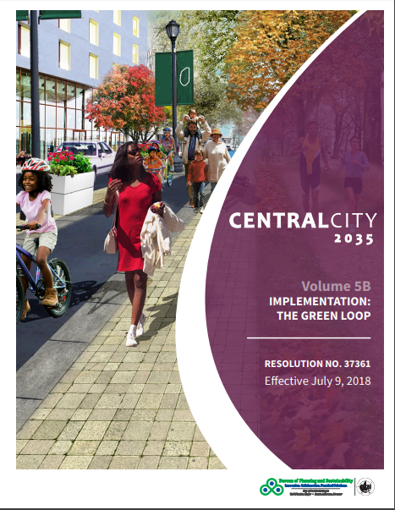
CC2035
The Green Loop
May 24, 2018:
City Council voted unanimously to endorse a resolution supporting the advancement of the Green Loop

Slide 10
CC2035
The Green Loop
Zoning Code change:
12’ setback along North and South Park Blocks
50% landscaped

Slide 11
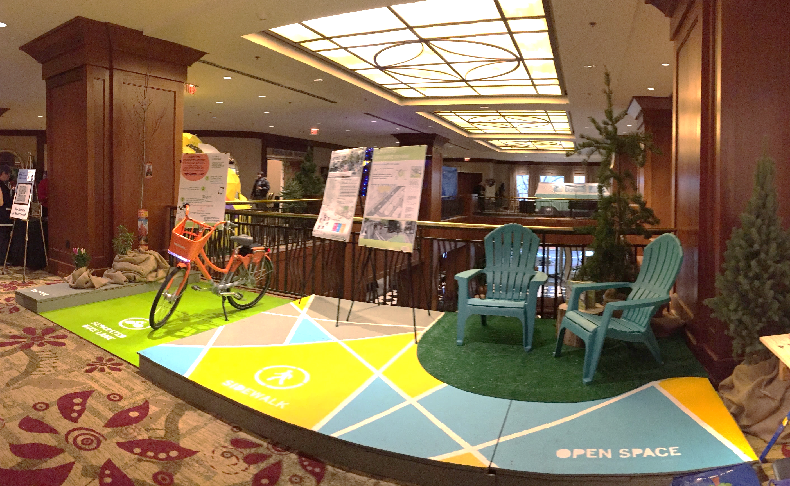
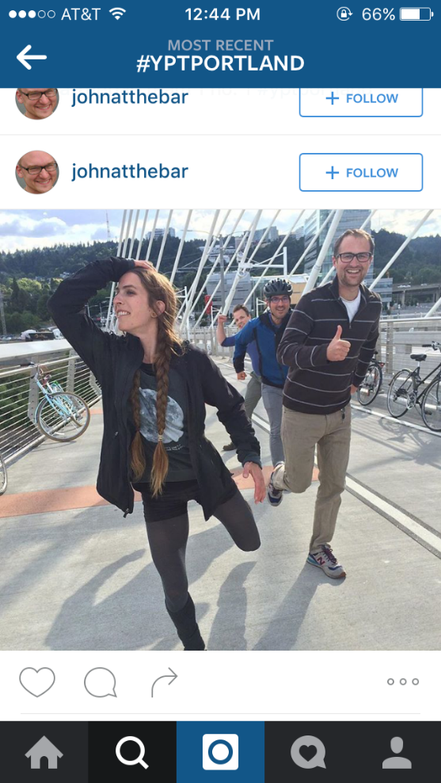
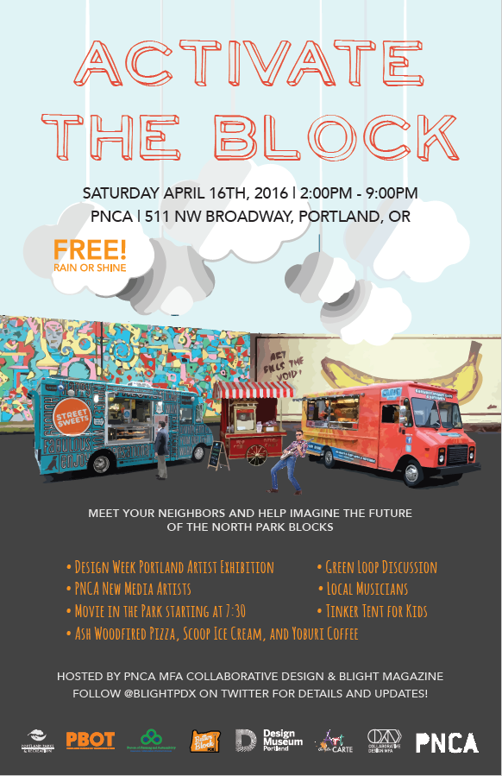
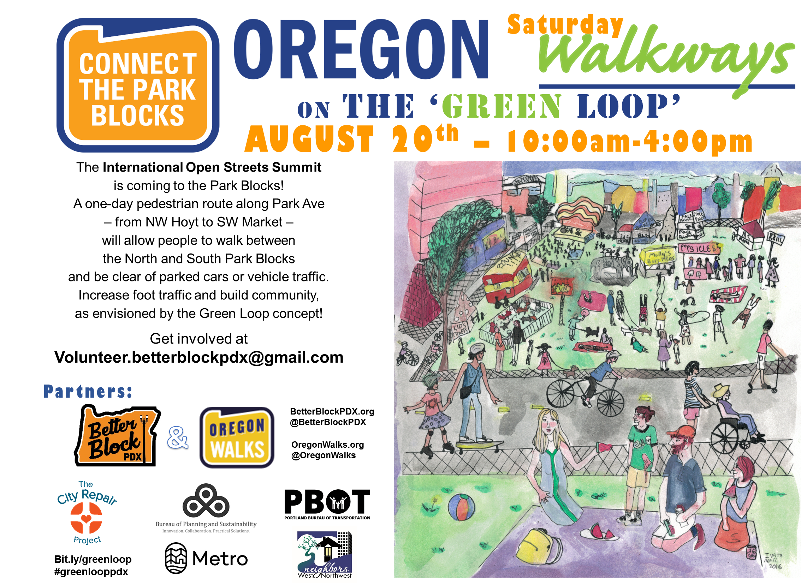
Community involvement.
The Green Loop is about

Slide 12
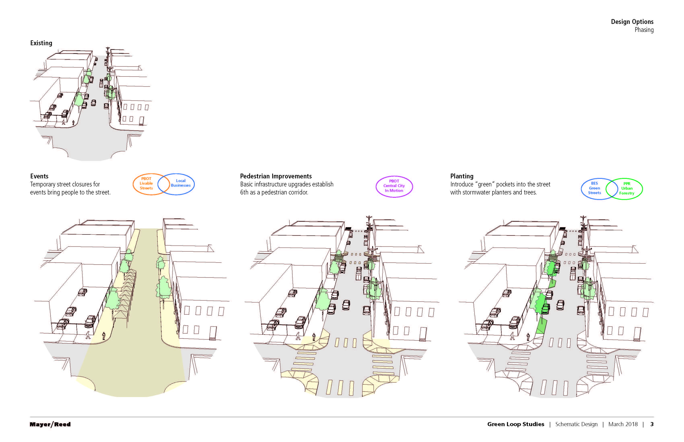

Slide 13
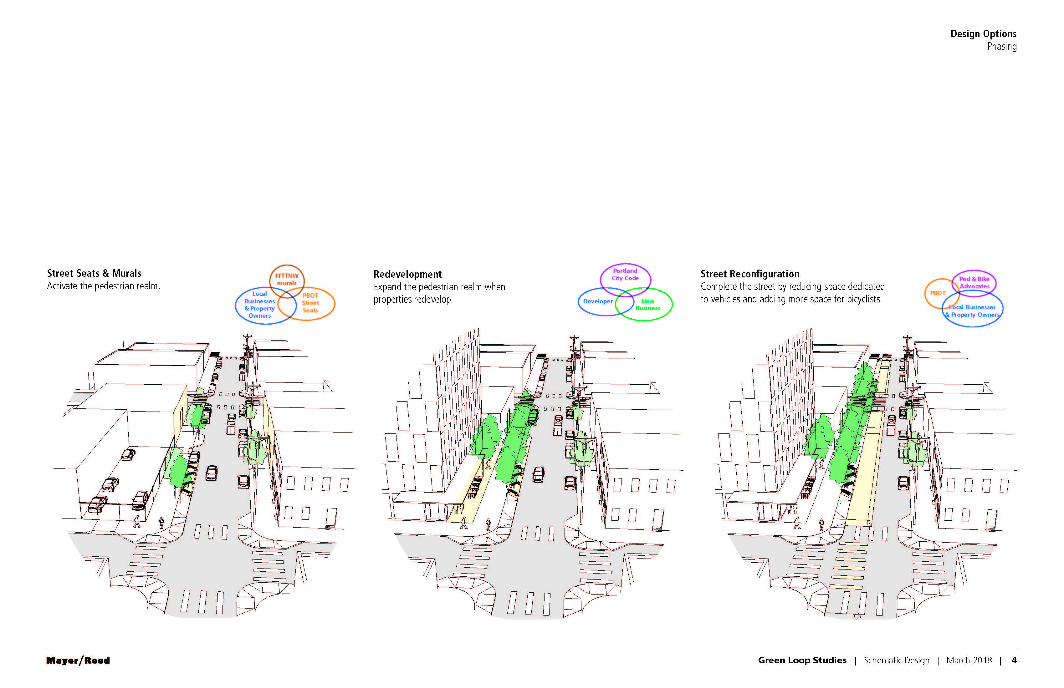

Slide 14
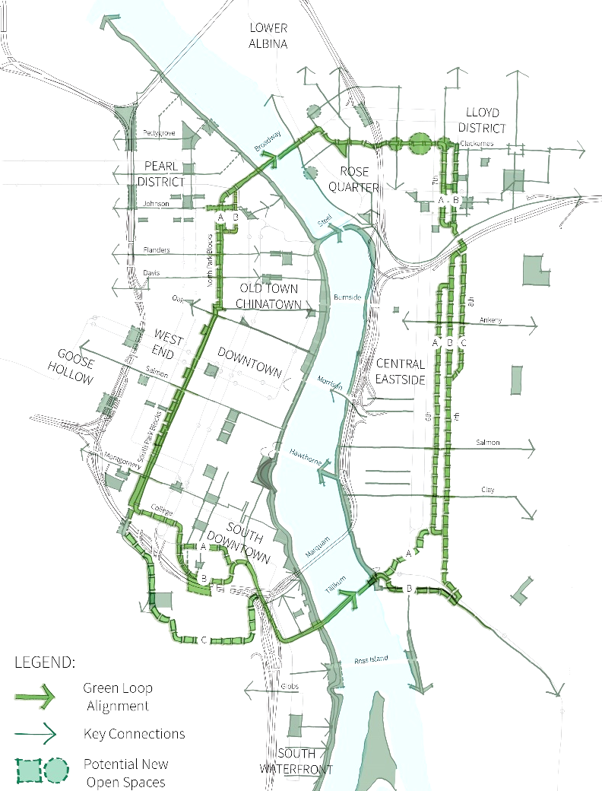
Capital Projects in Progress
The Green Loop
Trimet: Tilikum Crossing Bridge
PBOT: Sullivan’s Gulch Crossing
ODOT: I-5 Broadway/Weidler Interchange Project
PDC: Broadway Corridor Framework Plan (USPS site)
PBOT: Central City in Motion
Metro/TriMet: SW Corridor connections to Central City
TBD: “Hill Park” connection
Metro/TriMet: Division Transit Project
3
4
2
5
7
6
1
8

Slide 15
Analysis / Future Implementation in Progress
The Green Loop
Existing Conditions Analysis:
North Park Blocks
Central Eastside from Sandy to I-84
Lloyd District from future bridge to future bridge
South Downtown

Slide 16
Analysis / Future Implementation
The Green Loop
Related Project with Portland Parks:
South Park Blocks Master Plan

Slide 17
Analysis / Future Implementation
The Green Loop
Potential Implementation with PBOT
Central City in Motion:
North Park Blocks
Central Eastside (signals on 6th Avenue)
South Downtown (College St.)

Slide 18
Analysis / Future Implementation
The Green Loop
Potential first segment: Lloyd

Slide 19
Analysis / Future Implementation
The Green Loop
Existing Conditions Analysis:
North Park Blocks
Central Eastside from Sandy to I-84
Lloyd District from future bridge to future bridge
South Downtown
Related Project with Portland Parks:
South Park Blocks Master Plan
Potential Implementation with PBOT
Central City in Motion:
North Park Blocks
Central Eastside (signals on 6th Avenue)
South Downtown (College St.)
Potential first segment: Lloyd

Slide 20
Alignment in progress
The Green Loop
Lloyd:
NE Clackamas, TBD
NE 6th / NE 7th, TBD
(Potential first segment)
North Park Blocks:
NW 8th / NW Park,
TBD (PBOT CC in Motion)
Midtown Blocks and
South Park Blocks:
SW 9th, SW Park/SW 9th,
TBD (PBOT CC in Motion)
Central Eastside:
SE 6th
(PBOT CC in Motion)
South Downtown:
TBD
(Existing Conditions Analysis)

Slide 21
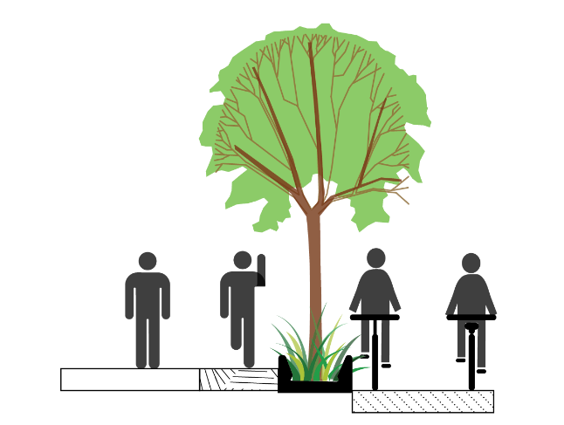
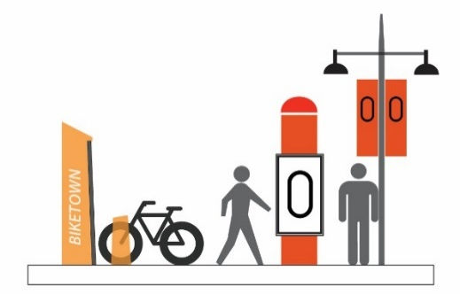
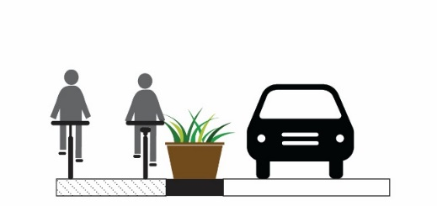
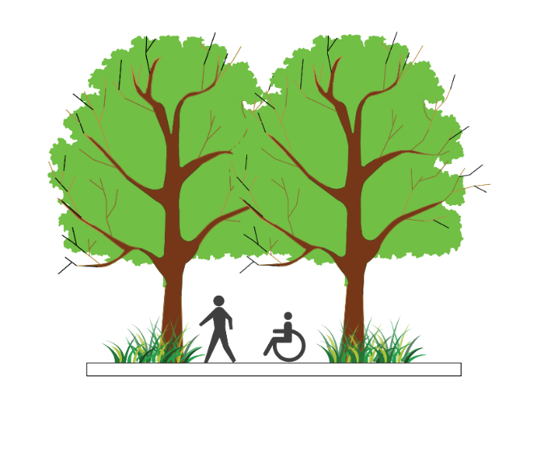
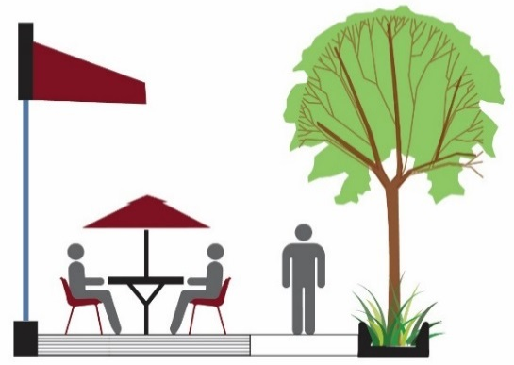
Design Principles
The Green Loop
Physical Separation
Walking, Jogging, Biking
Branding / Identity
Connected Canopy
Creative Furnishing Design
Building Orientation
Notes:
The Green Loop aims to follow four key design principles:
It will incorporate a multi-use path that is intended to accommodate but separate pedestrians and joggers from cyclists.
Though it will be located within many of Central City’s existing street network, the Green Loop will be physically separated from cars.
Where possible, the Green Loop will include a connected tree canopy as well as pedestrian and bicycle-related amenities such as seating, bike racks, lighting, wayfinding, and water fountains.

Slide 22
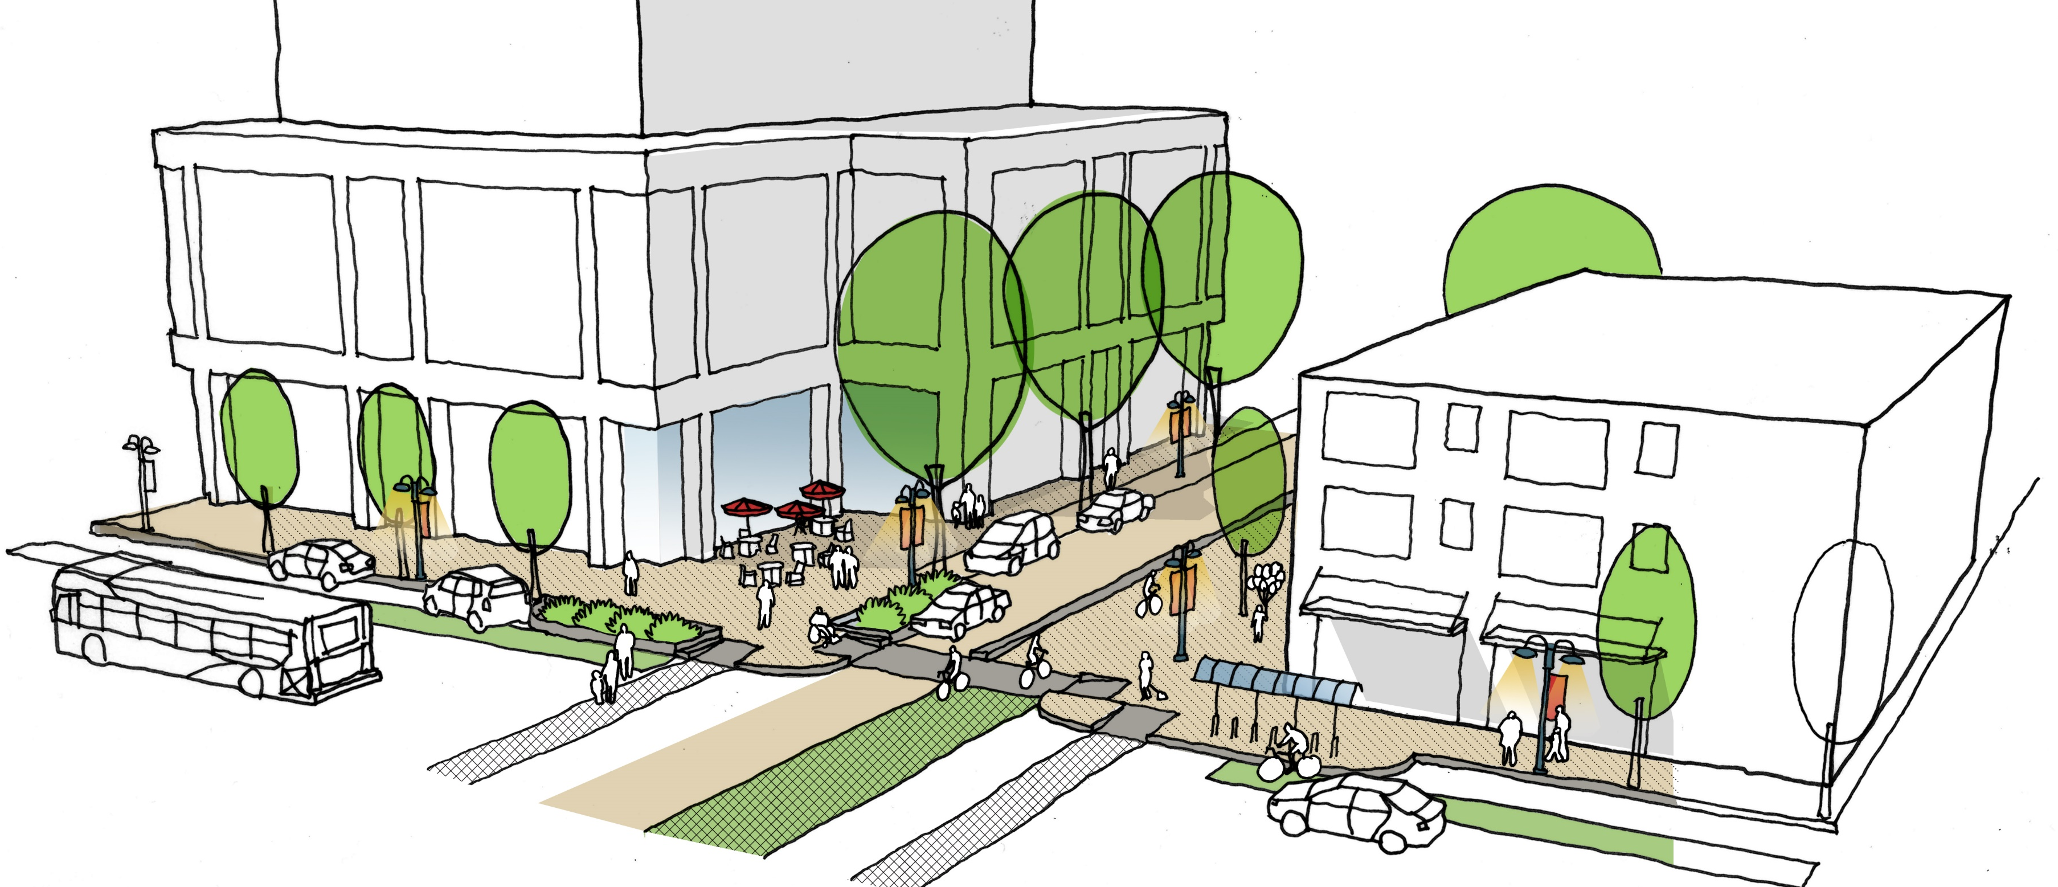
Design Principles
The Green Loop
Notes:
The Green Loop aims to follow four key design principles:
It will incorporate a multi-use path that is intended to accommodate but separate pedestrians and joggers from cyclists.
Though it will be located within many of Central City’s existing street network, the Green Loop will be physically separated from cars.
Where possible, the Green Loop will include a connected tree canopy as well as pedestrian and bicycle-related amenities such as seating, bike racks, lighting, wayfinding, and water fountains.

Slide 23
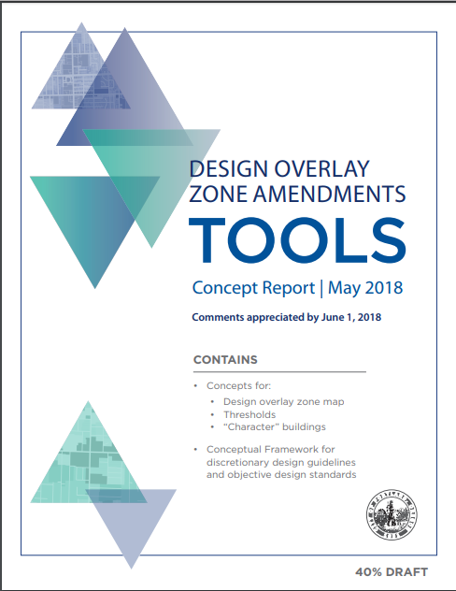
NEW
+
=

Slide 24
Related CC Fundamental Design Guidelines
The Green Loop
A 8 CONTRIBUTE TO A VIBRANT STREETSCAPE
Integrate building setbacks with adjacent sidewalks to increase the space for potential public use.
B 4 PROVIDE STOPPING AND VIEWING PLACES
Provide safe, comfortable places where people can stop, view, socialize, and rest. Ensure that these places do not conflict with other sidewalk uses.
B 5 MAKE PLAZAS, PARKS AND OPEN SPACE SUCCESSFUL
“dedicated public space”
Orient building elements such as main entries, lobbies, windows, and balconies to face public parks, plazas, and open spaces. Where provided, integrate water features and/or public art to enhance the public open space. Develop locally-oriented pocket parks that incorporate amenities for nearby patrons.
C 1 ENHANCE VIEW OPPORTUNITIES
Orient windows, entrances, balconies, and other building elements to surrounding points of interest and activity. Develop building facades that create visual connections to adjacent public spaces.
C 6 DEVELOP TRANSITIONS BETWEEN BUILDINGS AND PUBLIC SPACES
Develop transitions between private development and public open space. Use site design features such as movement zones, landscape elements, gathering places, and seating opportunities to develop transition areas where private development directly abuts a dedicated public open space

Slide 25
Related CC Fundamental Design Guidelines
The Green Loop
D 1 PARK BLOCKS
Orient building entrances, lobbies, balconies, terraces, windows, and active use areas to the Park Blocks.
In the South Park Blocks, strengthen the area’s emphasis on history, education, and the arts by integrating special building elements, such as water features or public art.
In the Midtown Park Blocks, strengthen the connection between the North and South Park Blocks by using a related system of right-of-way elements, materials, and patterns.
In the North Park Blocks, strengthen the area’s role as a binding element between New China / Japantown and the Pearl District

Slide 26
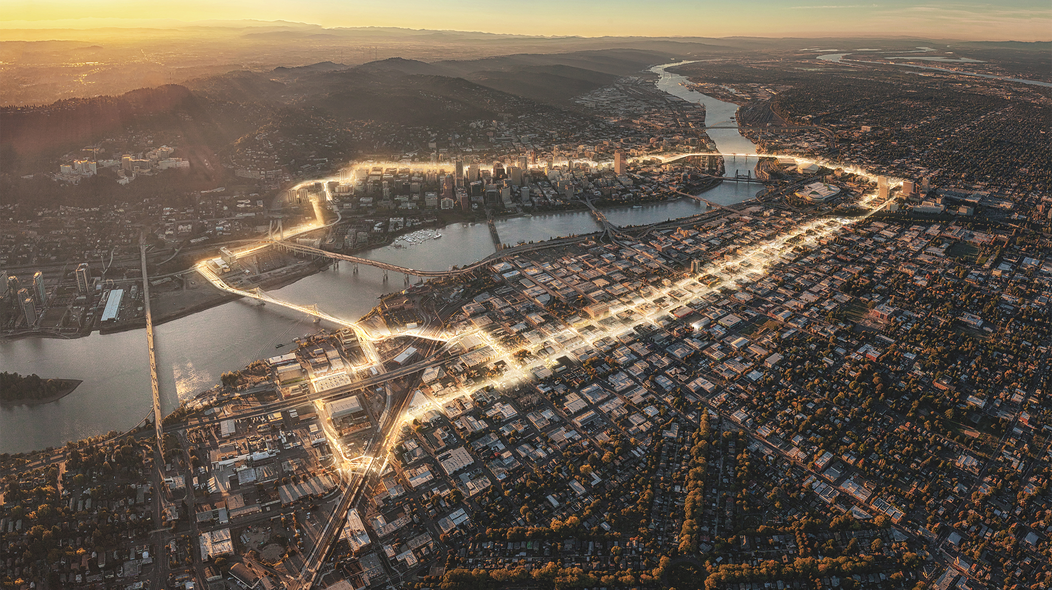
Credit: Untitled Studio

