Slide 1
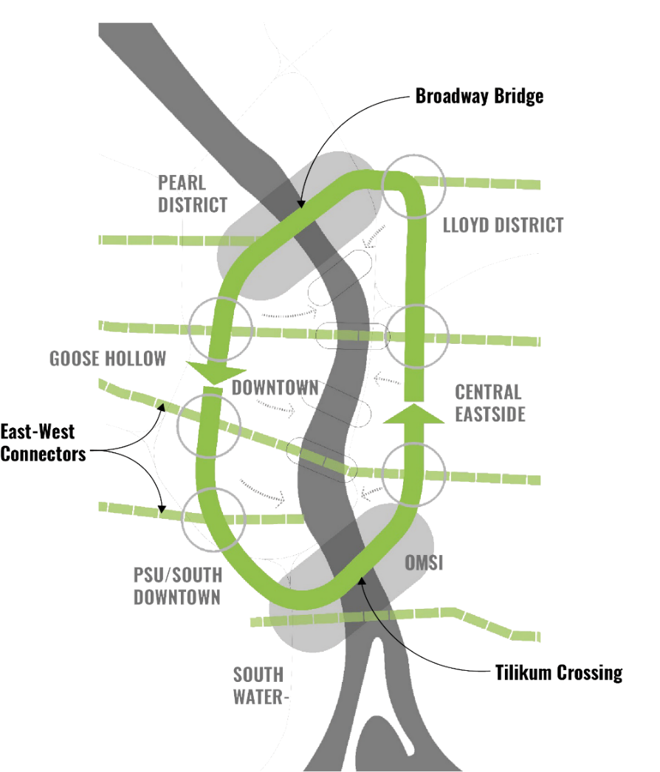
City of Portland
Design Commission
Briefing
Green Loop
October 17, 2019
Staff Presentation

Slide 2
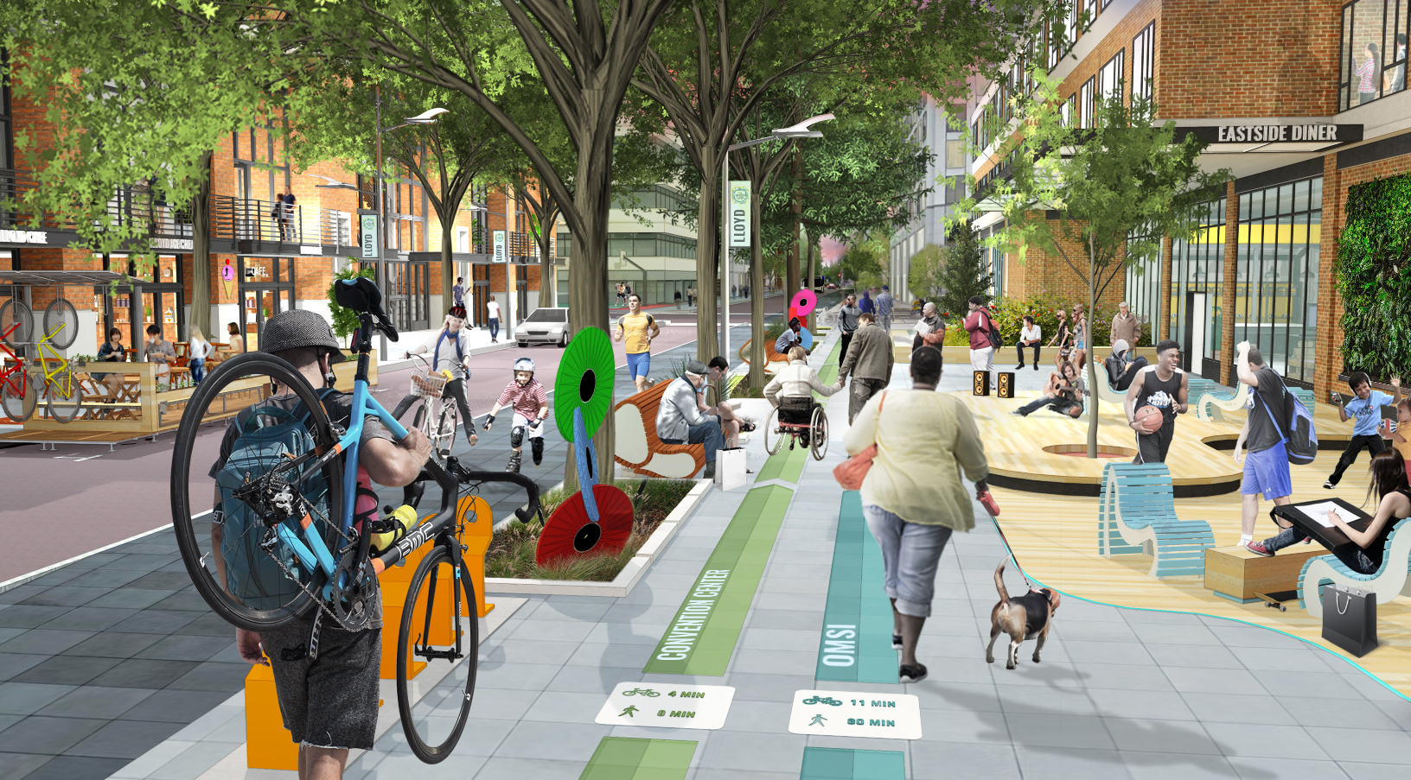
Image from Aug 2018 Briefing

Slide 3
Block 216 – SW 9th Ave

Slide 4
Block 216 – SW 9th Ave

