Slide 1

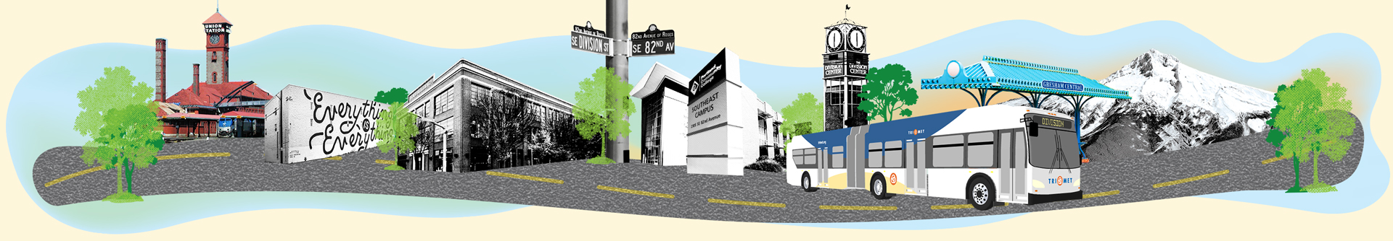
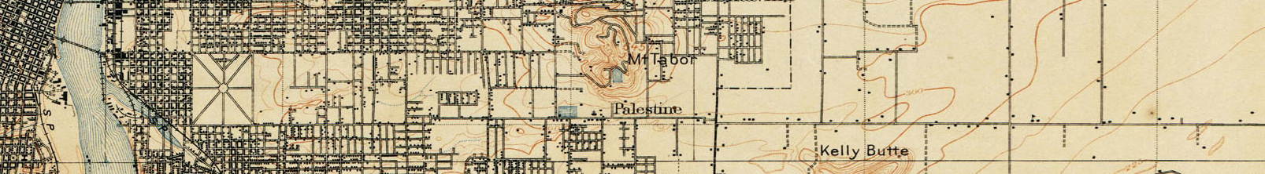
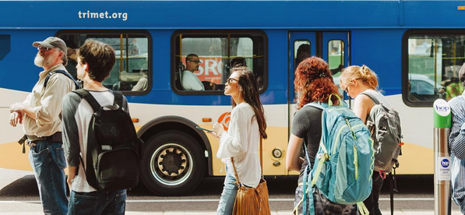

PORTLAND DESIGN COMMISSION
Caitlin Reff (PBOT) Jesse Stemmler (TriMet)
September 19, 2019
Notes:
CAITLIN

Slide 2

Today’s Agenda
Project Refresher
Stations Update
Shelter & Amenity Details
Station Design - 34th Westbound Example
Commission Q & A / Discussion
Notes:
Caitlin

Slide 3
Transit Standards in Public ROW
Created for Yellow Line + all prior transit - 2000
Green Line - 2007
Orange Line – 2017
Division Transit & SW Corridor
Notes:
Caitlin
DRC advisory role for the project
History of working with DRC to set standards
Regular updates – continue through construction (tell you what we are planning, updates along way, then report of what we did)
Updates to standards in Public ROW implemented after project completion

Slide 4
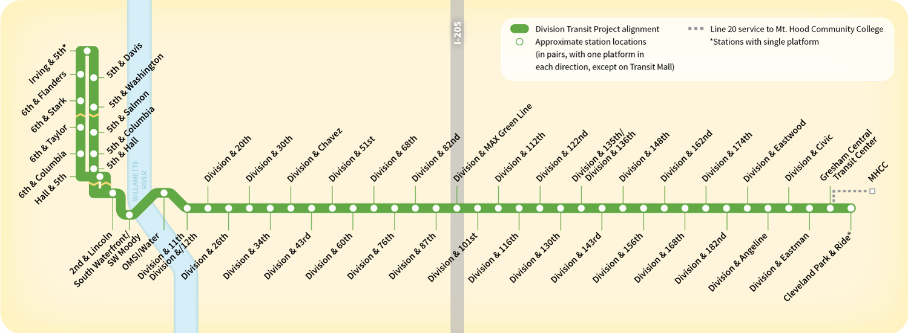
Division Transit - Corridor Map
Federal Small Starts Project (Local Funding Match)
New 42 stations total; 35 in Portland
More than 70% of transit users will have service near current stop
95% of existing riders will have service within 3 blocks of current stop
Notes:
Caitlin
REMINDER OF BENEFITS OF PROJECT
Improved Transportation, Well-being, Equity & Efficiency
Safety (protected bike lanes & enhanced crossings)
Traffic Signal Upgrades
Fiber communications – smart city transit priority
Concrete bus pads

Slide 5
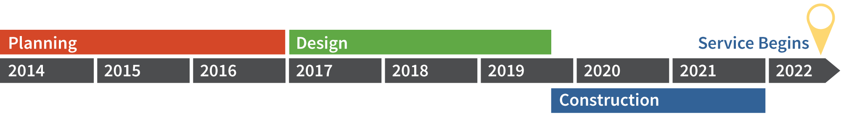
Project
Schedule
90% Design Complete (August, 2019)
100% Design Complete (Oct, 2019)
Contractor Aboard
We Are Here
Major Construction (Feb, 2020)
Start Early Construction(Nov, 2019)
Notes:
Caitlin

Slide 6
Project Updates
Anticipated Federal Funding in Fall 2019
Close coordination with ODMMSP
Early utility work starts November 2019
Major construction starts February 2020
Service Opening 2022
Notes:
CAITLIN

Slide 7
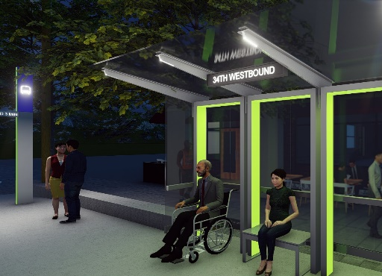
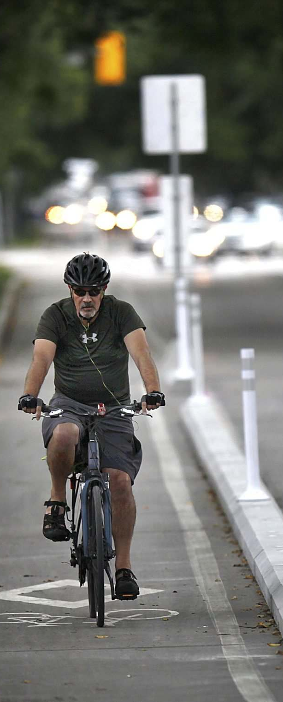
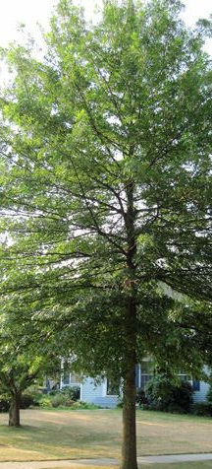
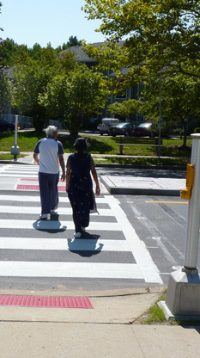
Division Transit - Setting The Table
Improved lighting, safety, accessibility & connectivity
Improved pedestrian environments
Street trees, stormwater & landscaping
Enhanced stations environments
Reinforcing (when possible) existing furnishing and frontage zones
Recognizing future development
Opportunities for future public art & place-making
Notes:
JESSE
Priority is improving transit service & improving safety – those in desperate need.
Model for the region.
Set table for Future
Limited by requirements/funding (art + hard-capped budget)
Recognizing opportunities & tee-up possibilities for future.
Engaging community & partners in possible placemaking (Metro Community place making grant)
Communications Development Community (82nd & coordination of street trees, seating elements, location for public art)
Equitable transit-oriented development - public/private partnership for larger community benefit

Slide 8
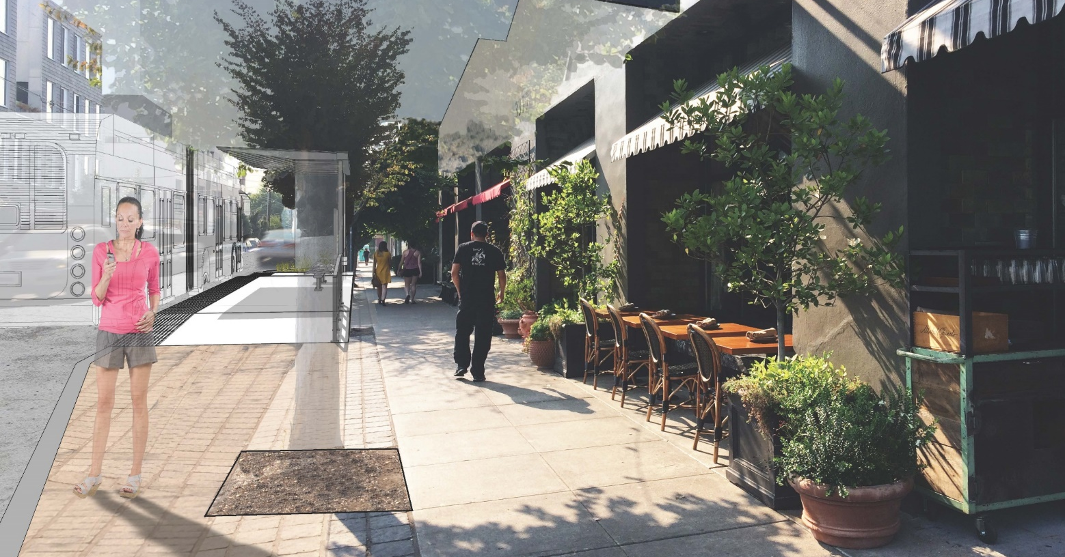
Station Design Update
Notes:
JESSE
Last Presentation – shared process & design ethic
Block-by-block analysis to understand context
Alignment with City’s Vision (Portland Comp Plan & Community Design Guidelines)
Emphasize
Contextual response
Clear design vocabuarly
Consistant and compatible with neighborhood
Reinforcing sense of
Respond to context
Quality and sense of purpose
Clear design vocabulary
Compatibility with neighborhoods
Reinforce sense of place
Connect with cultural & social qualities of community
Support economic vitality

Slide 9
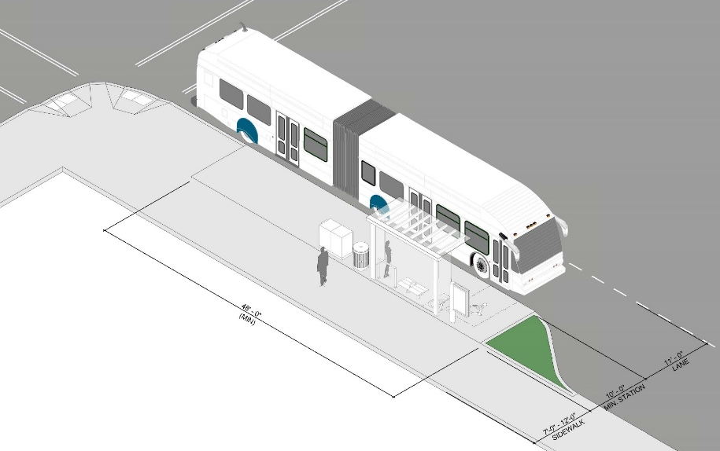
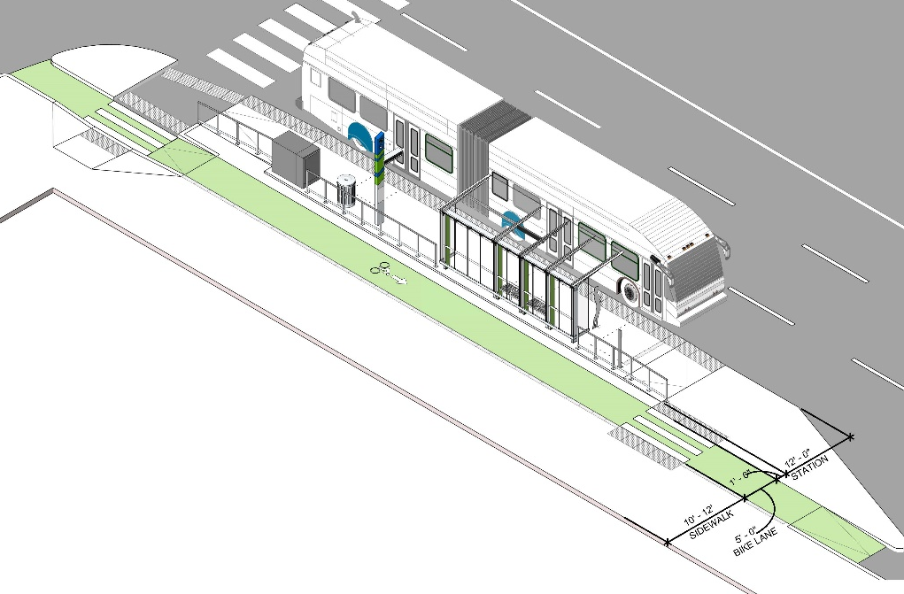
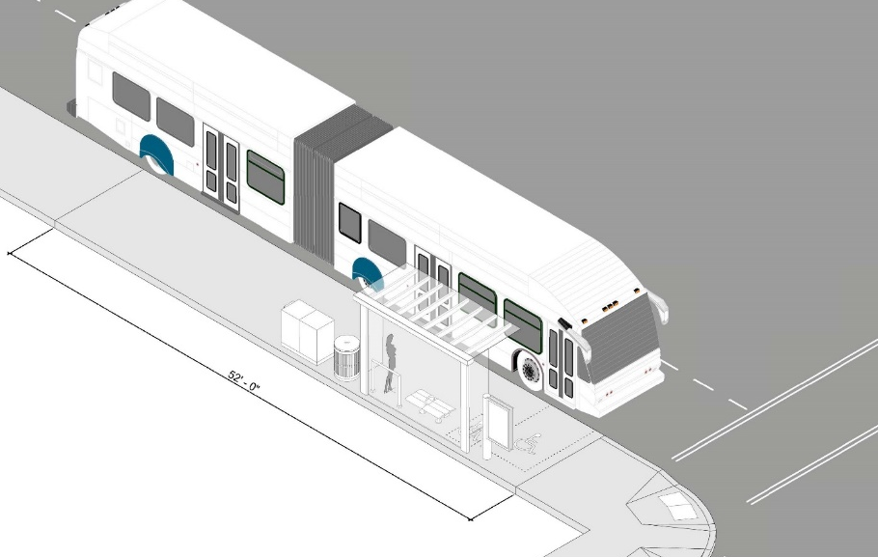
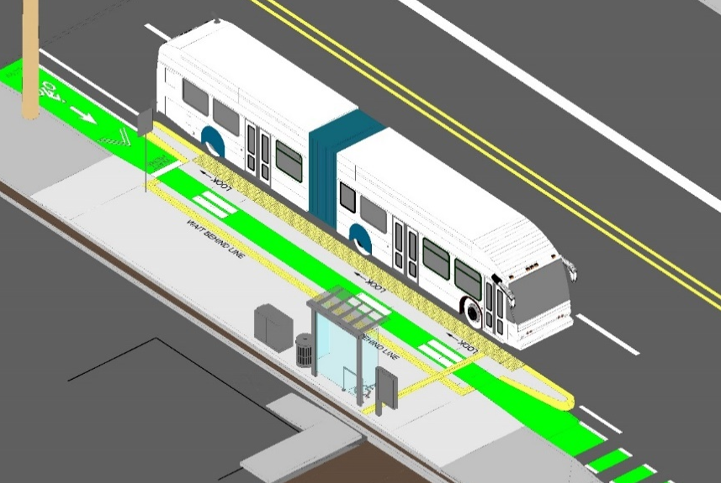
Station Designs – Four Contextual Solutions
Pedestrian By-Pass Station
Island Station
Pedestrian Pass Through Station
Shared Bike/Pedestrian Station
Notes:
JESSE
Different station types respond to context - staying within ROW
By-pass – bulbing out, bus stays in lane. Pedestrian walkway behind
Pass-Through- integrated into the existing sidewalk with shelter/amenities at back of walk
Shared Bike/Ped – integrated buffered bike lane infrastructure in coordination with COP’s ODMMSP
Island station - New station type considered early on in project. Considered a standard.
Brought back possibly two locations (82nd & 122nd) space within public ROW

Slide 10
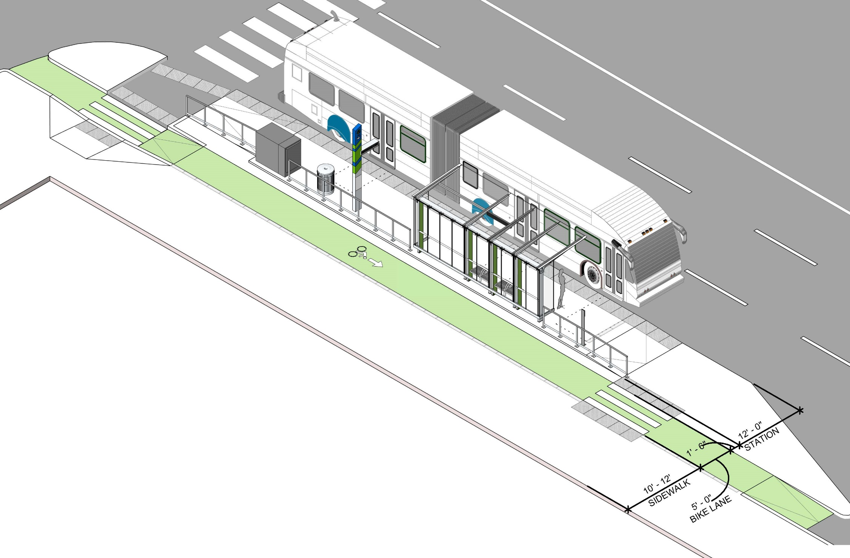
Island Station Design
Notes:
Island Station
Bike behind station platform shelter & amenities
Two controlled points of crossing – SW Moody, NE Weidler/103rd
8-10’ sidewalk behind

Slide 11
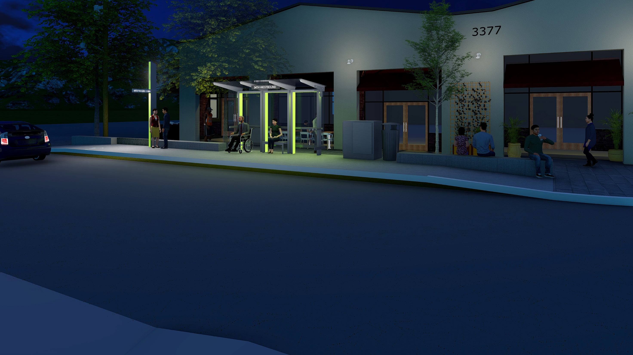
Station Amenities
Weather Protection/Shelter
Bus Marker (Lighting, Real Time Information)
Lighting
Seating, leaning rails, trash receptacles, bike racks, etc.
Notes:
Typical amenities
No changes but additional detail

Slide 12
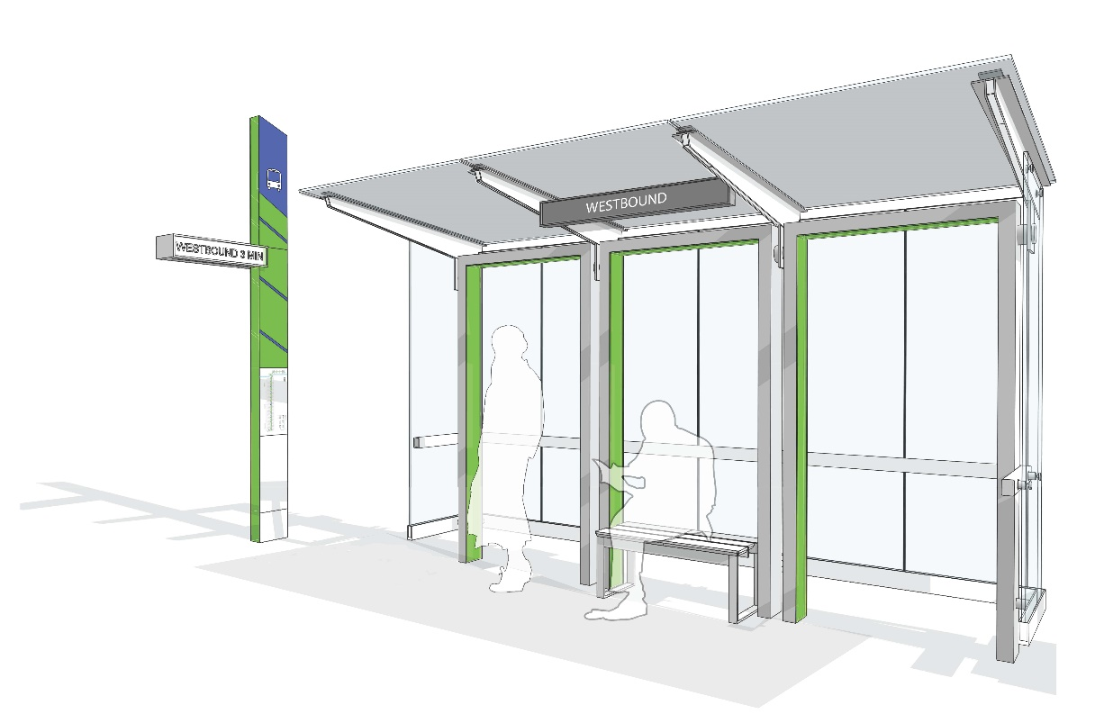
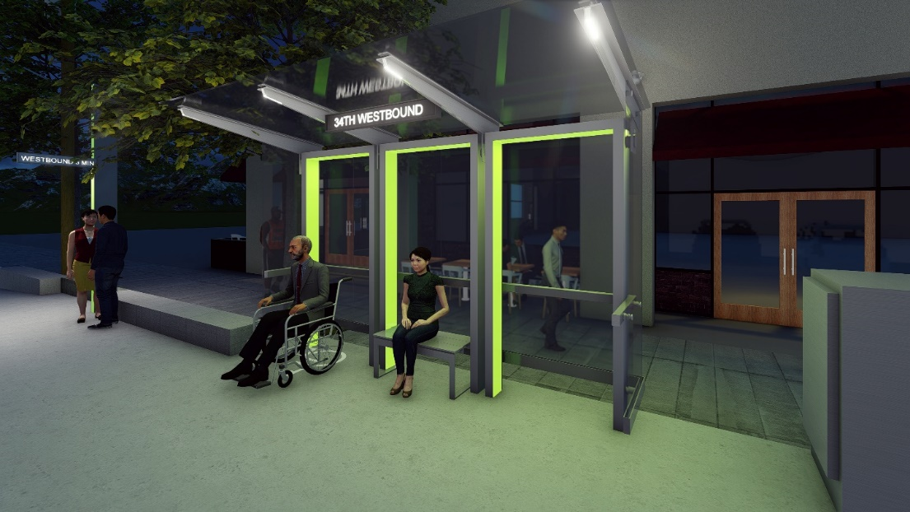
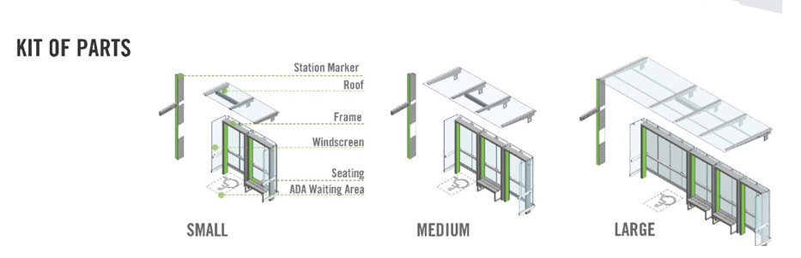
Shelter Design “Frames”
DESIGN REVIEW FEEDBACK:
Frames” – preferred shelter design
Shelter should provide sufficient shade
Scalable, modular & replicable
Sensitive to context
Easier to maintain, clean & repair
Safe sight lines
Maximizes circulation space
Easier to fabricate & install
Shared transit design vocabulary
Tinted canopy glass
Notes:
JESSE
Preferred Option by stakeholders – meets key design criteria with understanding design revisions needed.

Slide 13
Bus Marker Design
Notes:
Jesse
Provides an important branded element & identity across corridor
Lighting
Information for patrons to navigate line (real-time information, station id, system map signage)
12’ high, 6’ thick, 12” wide
Respond to context, placed where we need light and can be seen by operators, patrons, etc.

Slide 14
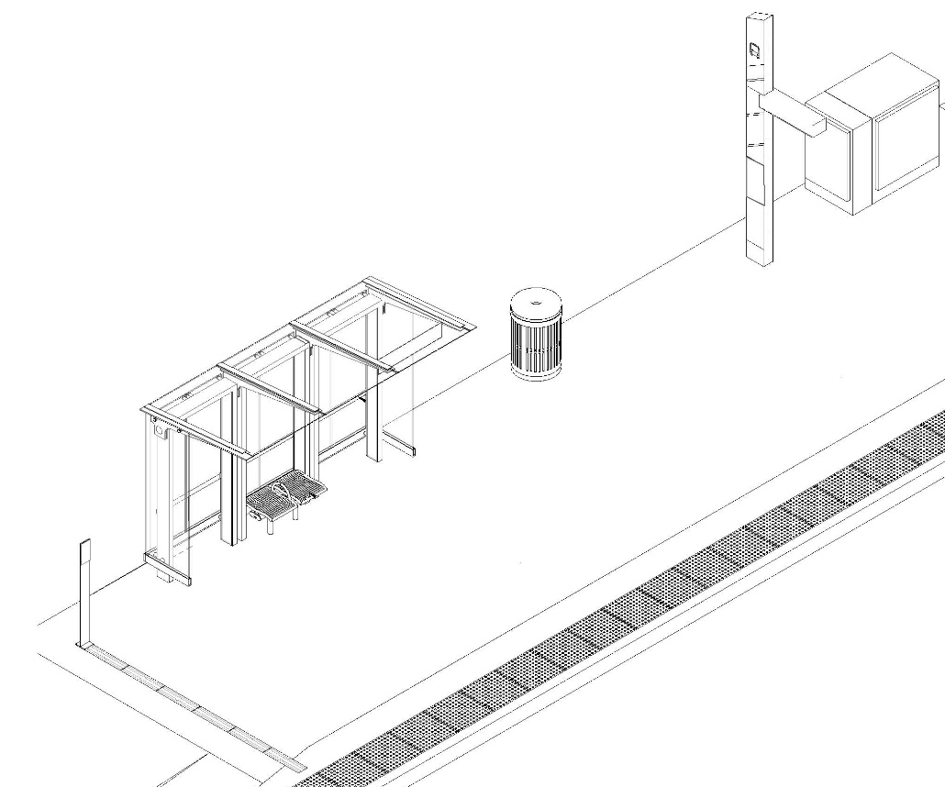
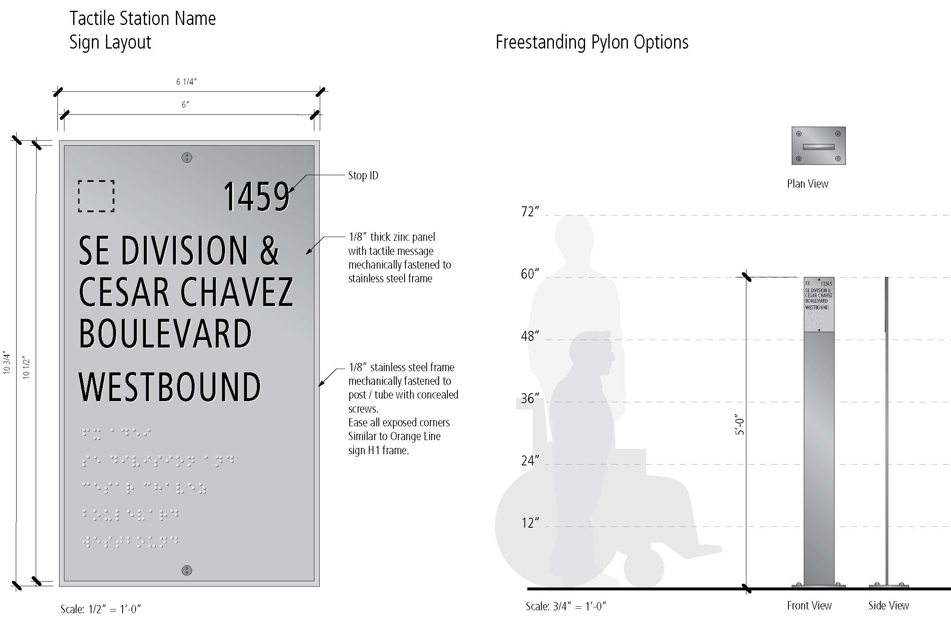
Freestanding Tactile Sign
Notes:
Jesse
Work extensively with BAC, PAC, CAT & OR Comm. Blind
Consistent way to navigate to front door of our bus
Directional, tactile paver. Cane-detectable
Paver band aligns bus door to important station ID information (braille, raised lettering)
ROW requires adjustments. Most locations shelters or markers align door and have attached readable tactile info. Some locations freestanding marker
60” tall, 6” WIDE, 3/8” Thick
26 OF THEM

Slide 15
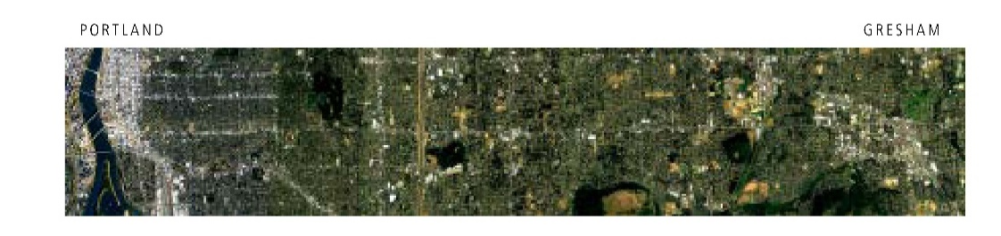


Shelter Windscreen Design
Corridor-Wide Pattern
Reduce graffiti & instances of vandalism
Ensure safe sightlines
Custom corridor-wide etch pattern (density weave)
Notes:
Jesse
Windscreen etchings important to deter graffiti, visual interest, solidify cohesiveness across corridor.
Cannot do art.
Can have artistic elements integrated.
Mayer Reed – assist with corridor wide etch pattern
Sample here – testing sightlines (60% transparency)

Slide 16
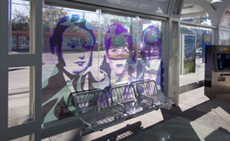
Shelter Windscreen Design (Place-Based)
4 Locations: 82nd, 92nd(Green Line), 122nd, Gresham Transit Center
Custom graphics by location
Graphic Interlayer
DESIGN IN DEVELOPMENT
Place-based shelter design (MAX Green Line/Division)
Notes:
JESSE
Cannot hire artist. Engage robust public-process around art
Community open houses, CAC, others organizations along corridor inform place-based designs at major stop locations
4 locations – 82nd, 92nd, 122nd, GCTC
Engage in conversation around whats important in communities and placed-based features
Concept design phase – works at different scales
92nd
I-205 also Connection to landscape
Where viewsheds open – Powell Butte, Rocky Butte, Mt Tabor
Connection to landscape and wildlife
Coexist,cohabitate – growing awareness and efforts to reconnect communities
Community excitement around this design that we’ll take to other 3 locations

Slide 17
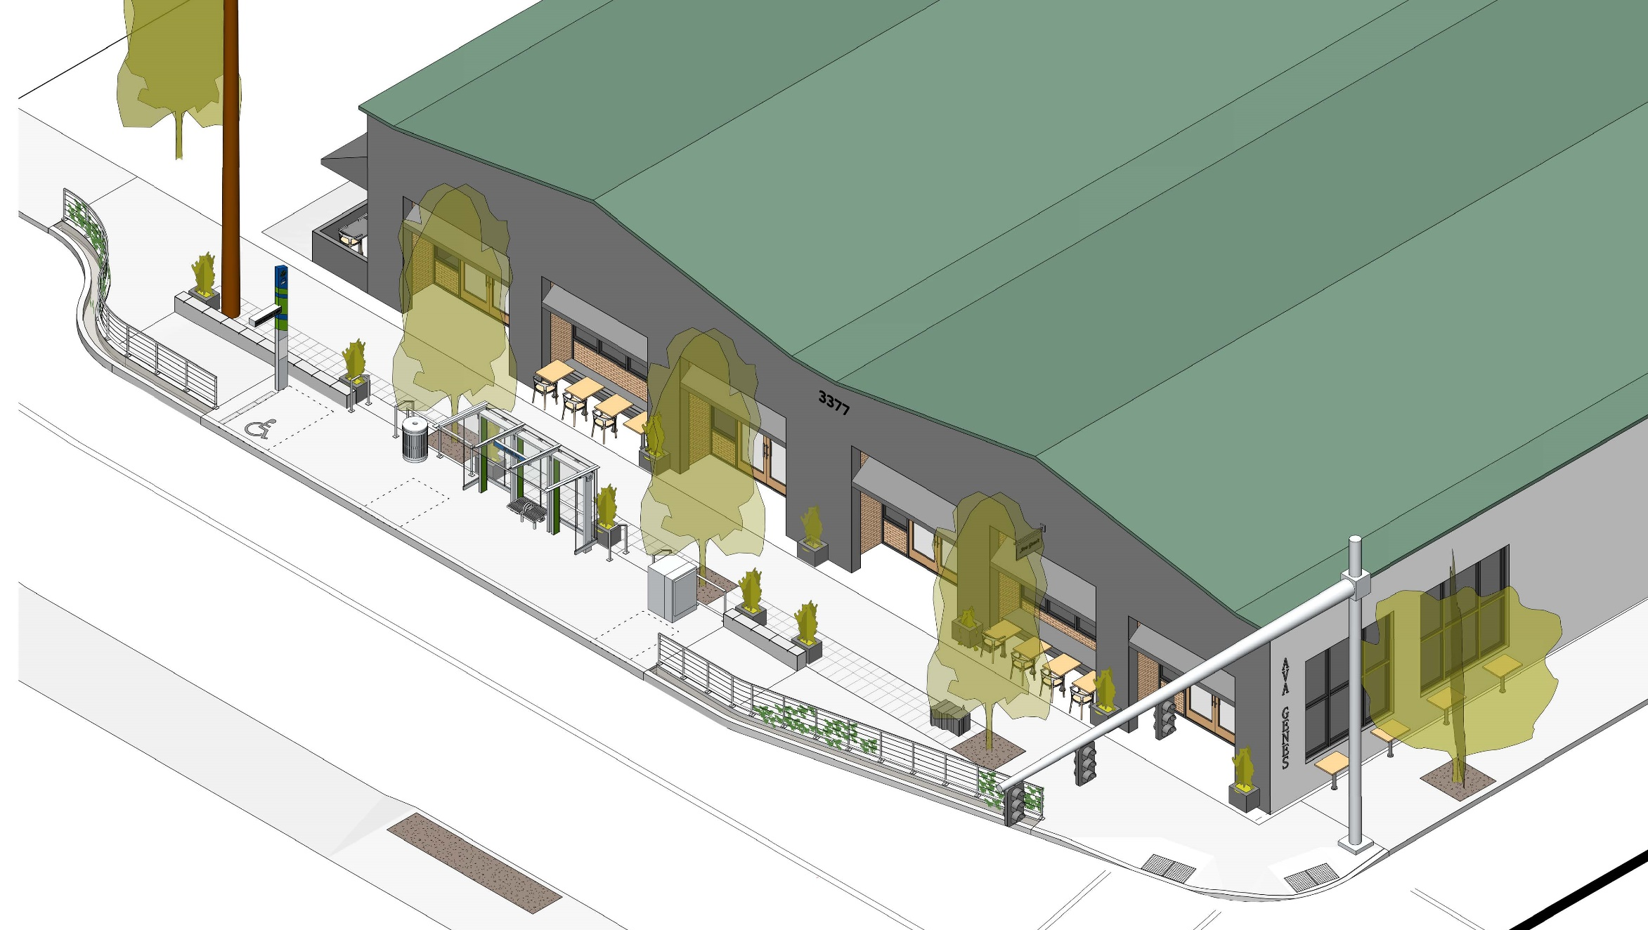
DESIGN REVIEW FEEDBACK:
Explore a more “porous” design for 34th WB station
Look at more contextual responses to station design, beyond just making stations “fit”
34th Westbound Station
Notes:
Jesse
Previously, presented 34th – stations start to look like
Design overlay area
Perceptive feedback – explore contextual solutions beyond making stations fit
Continue this work across corridor – responsive to surroundings
Site-specific
Alignment of amenities & sightlines, access
Place-based work – identifying future opps, using toolkit to reinforce place (street trees and furnishings at 82nd)
share how corridor-wide approach at same location previously shared
Retained existing sidewalk environment (shifting center line).
Reduce physical or perceived barriers - access
Carry vocabulary of materials and elements throughout (container plantings, recycling pavers in planting strip
Retaining street trees
Seating walls
Working with RACC, artists Re-siting existing public art (Crystal Shenk & Shelby Davis)
Exploring opportunities for additional plantings on railings double as trellis

Slide 18
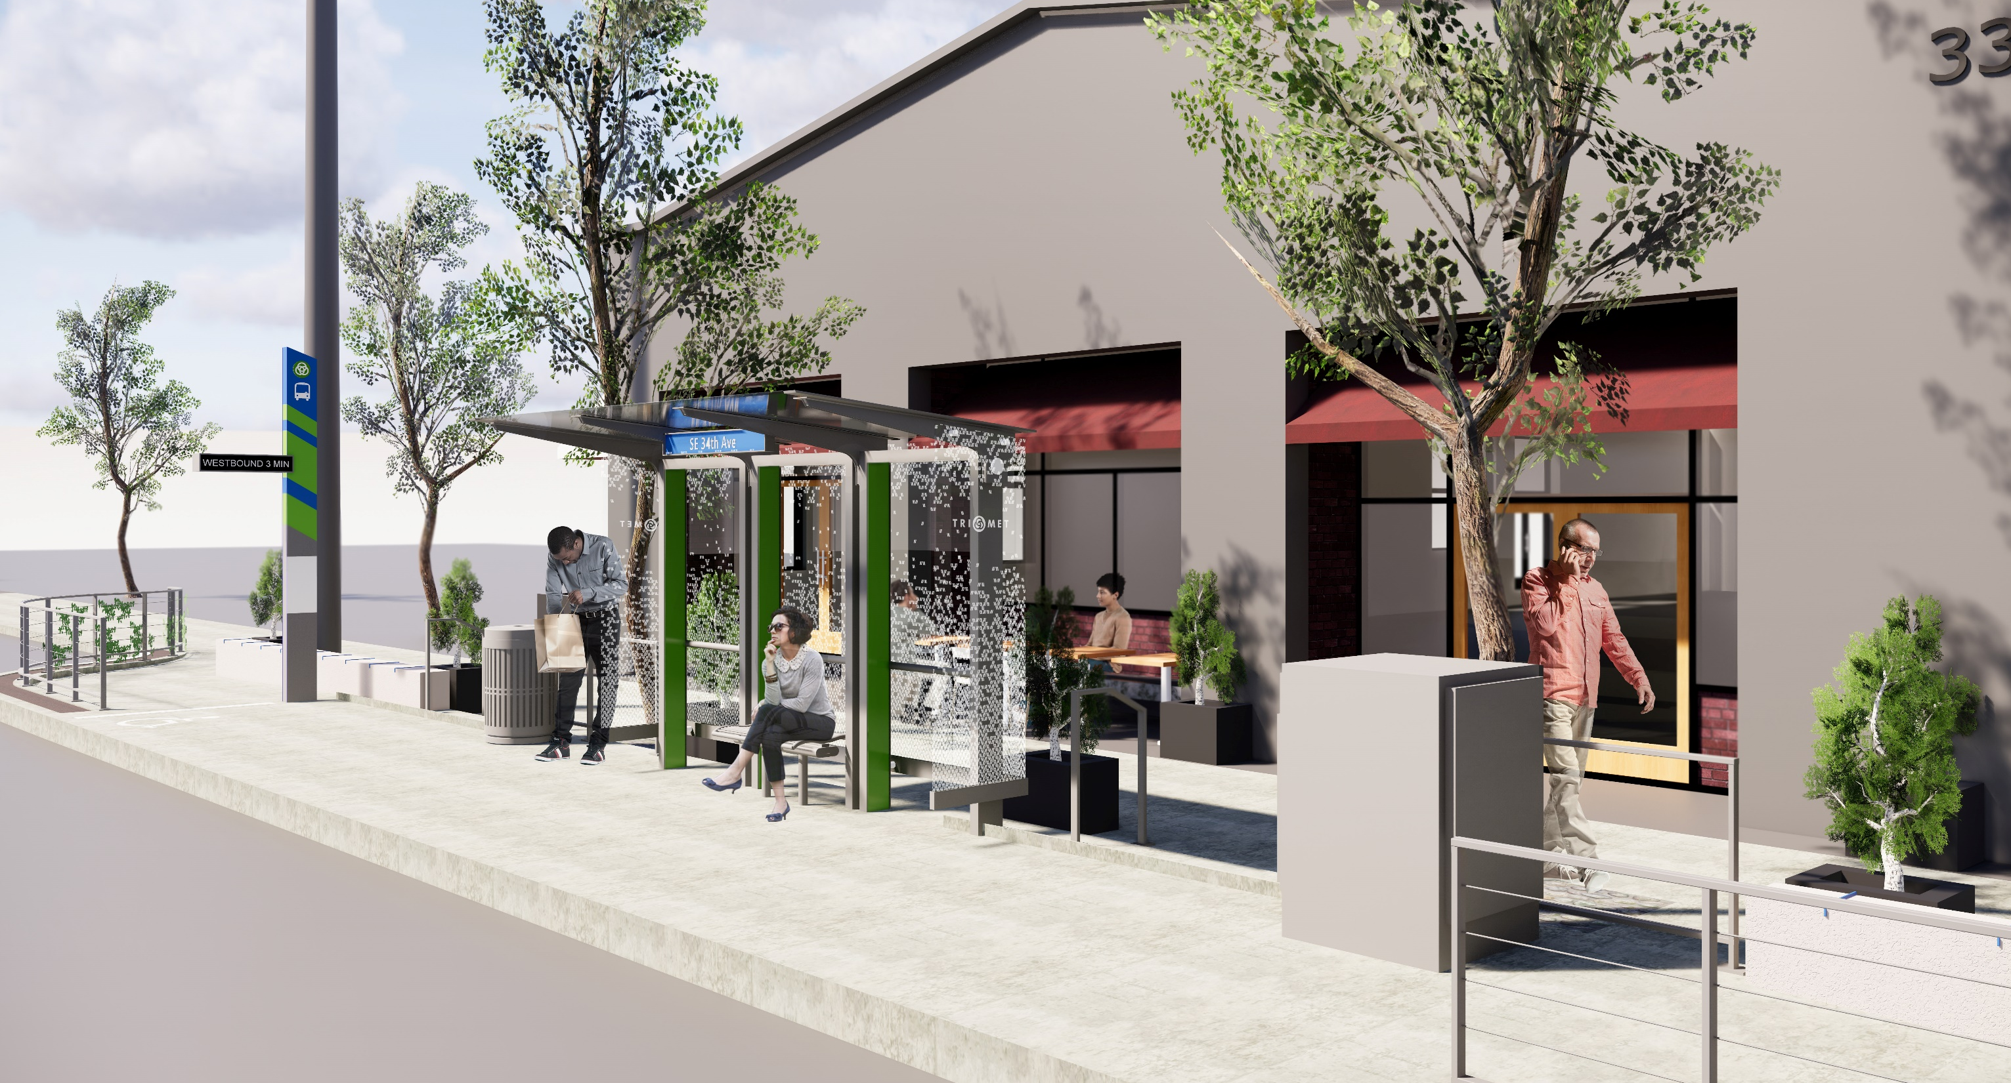
34th Westbound Station
Notes:
Windscreen pattern
Pedestrian perspective
Communications cabinet – another opportunity for public art

Slide 19
Feedback & Next Steps
Your feedback today
100% design & details
Shelter/Station Amenity Mock-up
Progress shelter & amenity details
Final Community Open House
Shelter/Amenity Shop Drawings
Construction updates to Design Review
Notes:
CAITLIN/JESSE

Slide 20
THANK YOU!

