Slide 1
North/Northeast Neighborhood Housing Strategy Oversight Committee
November 9, 2017

Slide 2
Habitat for Humanity
7513 N. Olin Street Condos
www.habitatportlandmetro.org
(503) 287-9529

Slide 3
Olin Condos Floor Plan
Three Bedroom [ $113,500 – $230,000]
2 Bath, 1,119 square feet
12 Units Available
[ First Floor ]
[ Second Floor ]
E

Slide 4
Olin Street Project Overview
10 homes to remain permanently affordable to buyers at or below 80% of Median Family Income
2 homes shall remain permanently affordable to homebuyers eaming between 80% and 100% of area median income.
ALL homebuyers must qualify under the N/NE Preference Policy
ALL families will be first time homebuyers

Slide 5
First Mortgage Amounts and Families Served
35-60% Median Family Income - $113,500
A minimum of 6 townhomes will be sold to 35-60% MFI families
61-80 Median Family Income - $190,000
A maximum of 4 townhomes will be sold to 61-80% MFI families
81-100% Median Family Income - $230,000
A maximum of 2 townhomes will be sold to 81-100% MFI families
E

Slide 6
Development Team
Developer and General Contractor
Habitat for Humanity
Architect
Ankrom Moisan
Permanent Affordability Partner
Proud Ground
Homeownership Counseling Partner
African American Alliance for Homeownership Collaborative
E

Slide 7
Standard Features
Interior
Luxury vinyl flooring available in two color options Tile backsplash in kitchen and bathroom
Custom cabinets and hardware (two color options) Houses will have carpeted bedrooms (two color options) Energy Recovery Ventilation system for circulation of fresh clean air
Humidistat moisture detecting fans in bathrooms
Energy Star Refrigerator Electric range/hood vent Energy Star Dishwasher Washer and dryer
Gas tankless water heater Cadet heaters in each room for independent temperature control
Exterior
Hardy Plank Siding - long lasting and more durable than vinyl
Low Maintenance sod and native-plant landscaping Bike Parking in Unit
ADA accessible units available Double pane windows
Energy star rated doors and windows

Slide 8
Finishes
We offer customized finish options to make new houses feel like home.
Countertop, Backsplash and Cabinetry Options
Three package options available for kitchen and bathroom countertop and backsplash
Option of Light or Dark Cabinets
Flooring Options
Families will have the a light and dark option for both carpet and the vinyl flooring
Bedrooms will be carpeted and families may choose between carpet or vinyl plank flooring for the remainder of the home

Slide 9
Green Features
Earth Advantage Certified Homes
WaterSense water fixtures
Energy Star certified appliances, exterior doors, and windows
Light fixtures with LED bulbs Double paned windows
Panasonic WhisperComfort ERVs and WhisperGreen fans in all Habitat homes.
Drought-tolerant native plant landscaping On-Site stormwater management
Between 2016 and 2017 Habitat sold a total of 20 Earth Advantage Platinum Certified homes, and was named the 2017 Low Income Green Home Builder of the Year
In addition, we work to use materials that are sustainably sourced, recyclable and environmentally friendly, and energy efficient whenever possible.
We also partner with NW Natural to provide gas service to the homes we build in areas where service is available, and in exchange they donate on-demand gas water heaters for each of our homes.

Slide 10
Powered by Volunteers
Built by the community
Habitat for Humanity will be the Developer and General Contractor
15,000 volunteer hours
2,000+ volunteers will contribute to the project Participation from corporate, youth, faith, and other community teams Future Habitat homeowners will work with neighbors and community members to contribute 300 hours of on site Sweat Equity

Slide 11
Additional Subsidies and Funding
In Kind Donations
Whirlpool appliances, Malarkey Roofing, NW Natural Water Heaters
Corporate Donations
SHOP and other public subsidies will be pursued.

Slide 12
Providing Job and Leadership Training for Portland
Portland YouthBuilders Tivnu
Women Build
Other apprenticeship programs

Slide 13
Minority Women Emerging Small Business (MWESB)
Equity and Diversity in HFH Subcontracting
43%
of the contracts awarded at our 21 home Helensview site went to MWESB.
per unit build went to MWESB
$23,383

Slide 14
Hiring for Diversity
Equity and Diversity in Hiring
of the 3⁵2 new⁹hire%s in 2016 were Section 3
21%
Staff Hires in 2017 were people of color

Slide 15
Impact on children, multigenerational families, and people with disabilities
Impact on Habitat Homeowners
92%
of kids who grow up in Habitat homes in Oregon graduate from high school, 17% higher than the statewide graduation rate.
70%
said their children's grades improved after moving into their Habitat home
90%
38
80%
say it was easy for their children to find a quiet place to study in their new home
People with disabilities served
Can't imagine moving

Slide 16
Schedule
Project Timeline
Site Aquisition
August 2017
Site Demolition and Clearing November 2017
Building Permits
February 2018
Home Buyers Identified June 2018
Construction Completed
June 2019
Sale of Units
November 2019

Slide 17
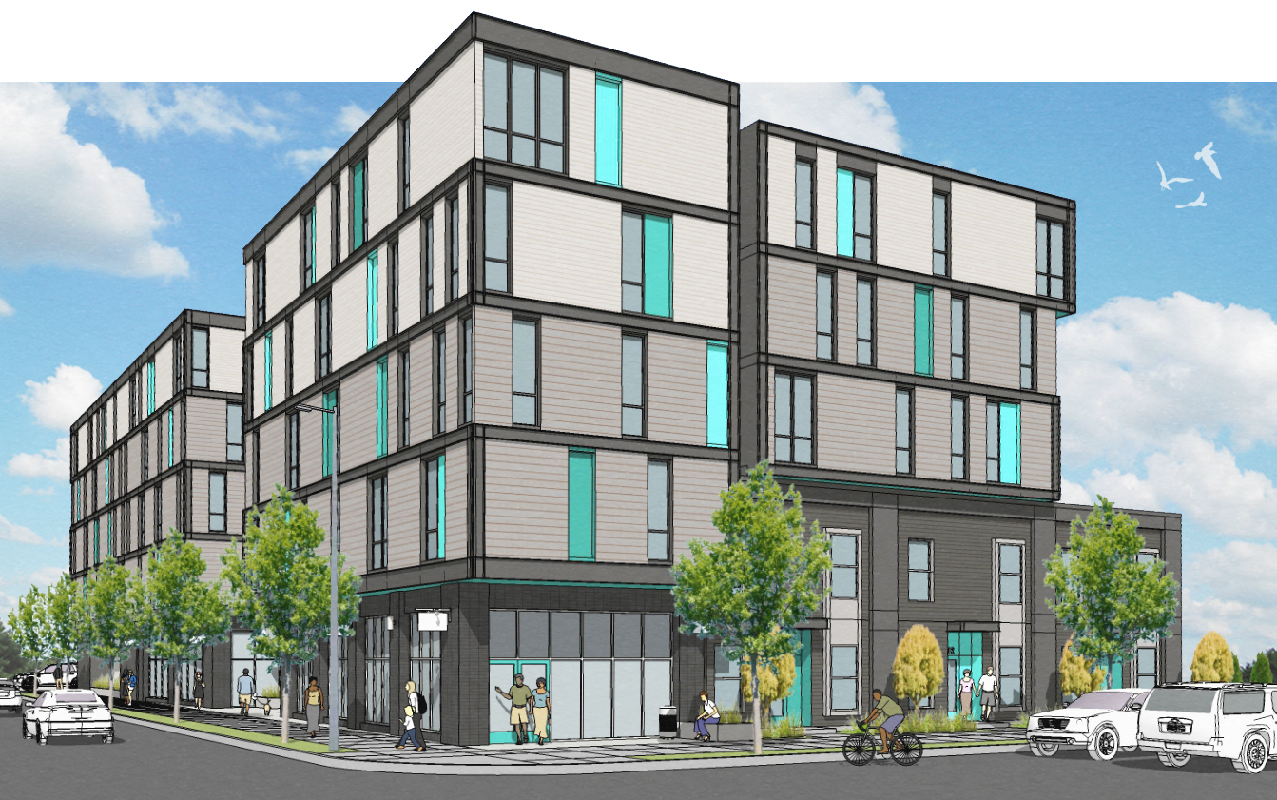
5020 Condos 5020 N. Interstate Proud Ground in partnership with Habitat for Humanity Portland/Metro East
Notes:
Diane presents Overview

Slide 18
Project Overview
Project Name | 5020 Condos
Residential Units | 50 (41 affordable units)
Parcel Size | 20,000 sq. ft.
Common Area | 1,400 sq. ft.
Building Size | 56,547 sq. ft.
Stories | 5
Parking Spaces | 20 (12 onsite/8 stalls)
Commercial Space | 1,000 sq. ft.
Enclosed Play Area | 1,400 sq. ft.
Based on conceptual proposal, subject to change.
Notes:
Diane

Slide 19
Affordability Levels
UNIT MIX
HOME TYPE | UNITS | AFFORDABILITY | PRICE Average
2 Bedroom | 11 units | 35-60% MFI | ~ $94,000
2 Bedroom | 11 units | 60-80% MFI | ~ $169,000
3 Bedroom | 2 units | 35-60% MFI | ~ $113,500
3 Bedroom | 1 unit | 60-80% MFI | ~ $195,500
3 Bedroom | 13 units | 80-100% MFI | ~ $269,500
3 Bedroom TH | 3 units | 80-100% MFI | ~ $275,500
1 Bedroom | 5 units | 100-120% MFI | ~ $215,500
1 Bedroom | 4 units | 120-140% MFI | ~ $235,500
Notes:
Diane – Bring market rate comparisons

Slide 20
Development Team
Proud Ground – Sponsor
Brings a 17-year history of providing working families, particularly families of color, with permanently affordable homeownership opportunities using the Community Land Trust model.
Habitat for Humanity – Lead Partner
One of the nation’s top performing Habitat affiliates and the only local organization consistently building and selling affordable homes to families earning 35-60% MFI, and working with these families to financially prepare them for successful homeownership.
JM Woolley & Associates – Owner’s Representative
A MWESB certified development services consulting firm with significant experience developing commercial and affordable housing projects and working on community economic development projects that seek to improve the livability and viability of urban neighborhoods like N/NE.
Notes:
Introduce team

Slide 21
Development Team
Carleton-Hart Architecture – Architect
A minority certified architectural firm that brings deep experience in affordable housing, community engagement and neighborhood building to the team, with approximately 70% of its work being with non-profits organizations that provide affordable housing to the community.
LMC Construction – General Contractor
A general contracting firm that has had the construction and renovation of affordable housing projects throughout Oregon and Washington as one of its primary focuses since its inception, with a proven track record in completing projects that achieve or exceed MWESB participation, construction workforce hiring, and other community benefit goals.
Housing Development Center – Development Consultant
Housing Development Center (HDC) is a nonprofit committed to strengthening opportunities for low-income families and individuals by developing, preserving and sustaining affordable housing and community facilities. Serving nonprofits, housing authorities and public entities in Oregon, Washington and throughout the United States, HDC helps organizations and communities build a lasting foundation for meeting critical human needs.
Notes:
Intro team

Slide 22
Collaborative Equity Focus
Proud Ground and Habitat for Humanity have been members of the AAAH Collaborative for over 3 years, together serving the needs of Preference Policy families and their communities
In total, 49% of Proud Ground homeowners are families of color
Over 69% of Proud Ground’s waitlist are households of color
The median income of Proud Ground homebuyers is 63% MFI
Habitat is the only homeownership organization consistently serving households as low as 35%-60% MFI
90% of households served in 2016 were families of color
AAAH collaborative has experience working with and placing Preference Policy families in homeownership
Actively involved in all N/NE Neighborhood Housing Strategy and implementation activities.
Notes:
Diane

Slide 23
Community Engagement
Targeted outreach meetings with community organizations including Urban League, NAACP, Black Parent’s Initiative, PAALF, SEI, POIC, KairosPDX, N/NE Neighborhood STEAM Coalition, local churches, PCRI, Hacienda CDC, and NAYA
Small focus groups series with prospective families to identify, prioritize, and inform their needs within the design and development process.
Large focus group with neighborhood stakeholders to identify concerns, issues and input they may have about the design and development of the exterior of the project.
Attend neighborhood association meetings to discuss the project.
An eco-charette session with the development team and families that have been identified as prospective buyers to identify sustainable features to include.
Naming process to engage local community stakeholders in naming the building.
Regular project presentations to the N/NE Housing Oversight Advisory Committee.
Notes:
Diane introduces Jeana

Slide 24
Community Benefits
The community’s needs is the driving force
of the project’s design and development
PROJECT ENGAGEMENT
Interactive community visioning and planning of design
Focus groups with clients and key stakeholders
Cross-cultural community outreach support
PROJECT DEVELOPMENT
Contractor’s Construction Diversity Plan focuses on MWESB bidding/hiring
Potential uses of commercial space to be open to community input
Committed to community engagement in all stages of development
LONG-TERM COMMUNITY BENEFITS
Permanent affordability guaranteed for next generations of N/NE residents
First-floor commercial space aimed at resident-supportive business or non-profit activates economic development and activity in the area
One-time subsidy investment, while also leveraging other private/public funds
Post-purchase counseling ensures continued track record of zero foreclosures
Notes:
Jeana

Slide 25
Project Schedule
NOFA
Negotiation
Mar. 2017 - PG submits NOFA response
Project Planning
Nov. 2017 - Oversight Cmte. presentation
Nov. 2017 - Reservation of Funds Awarded
Apr-Oct. 2017 - PG structures proposal to meet PHB's requests
Apr. 2017 - PG receives exclusive rights to negotiate with PHB
Nov-Mar. 2017 - Pre-Development Loan Negotiations
Mar. 2017 - Close Pre-Development Loan
Notes:
Jeana

Slide 26
Project Schedule
Pre-Development
Nov 2017 - June 2018 - Plan/Spec. Dev.
Financing
Feb. 2018 - Sept. 2018 - Design Review
Aug. 2018 - Nov. 2018 – Finalize Construction Documents
Nov. 2018 – Feb. 2019 - Bidding
Dec. 2017 - Apr. 2018 - OHCS LIFT Funds
Nov. 2017 – Mar. 2019 – Permanent Loan
Nov. 2018 – Mar. 2019– Permitting
Apr. 2017 – Mar. 2019 – Secure GAP funds
Nov. 2017 - Mar. 2019 - Construction Loan
Notes:
Jeana

Slide 27
Project Schedule
Development
Apr. 2019 - Construction begins
Marketing
Dec. 2020 - Sales complete
May 2020 - Certificate of Occupancy
Apr. 2020 - Construction substantially done
Oct. 2019 - May 2020 - Preference Policy HH’s identified, become mortgage ready
Notes:
Jeana

Slide 28
Project Design & Sustainability Features
Project Features
Attractive, family friendly, cost efficient design and materials
Designed to LEED GOLD standards to promote comfort, durability, and cost efficiency for families who live in the units
Sustainable features including energy efficient mini-split HVAC systems, energy efficient lighting fixtures and appliances, low-flow plumbing fixtures, low VOC and durable interior finishes and materials to promote healthy indoor air quality
All units include dishwasher, refrigerator, stove, microwave, and washer/dryer
Enclosed bike parking and raised box landscaping
On light rail, increasing public transportation access and use
1,400 sq. ft. protected outdoor play area for families with small children and access to additional public park space within two blocks walking distance.
Notes:
Jeana

Slide 29
5020 Condos Discussion Points & Questions
Notes:
Introduce Chelsea – Answer Questions

Slide 30
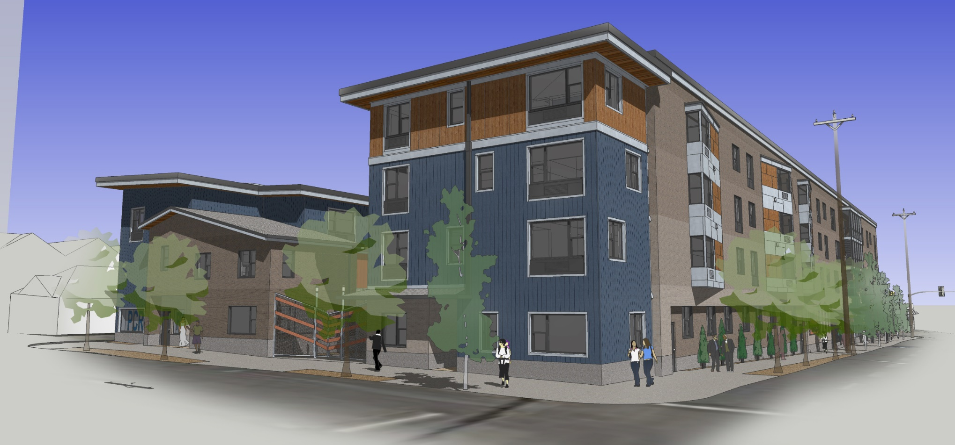
PCRI – King + Parks Apartments Development Team Update

Slide 31
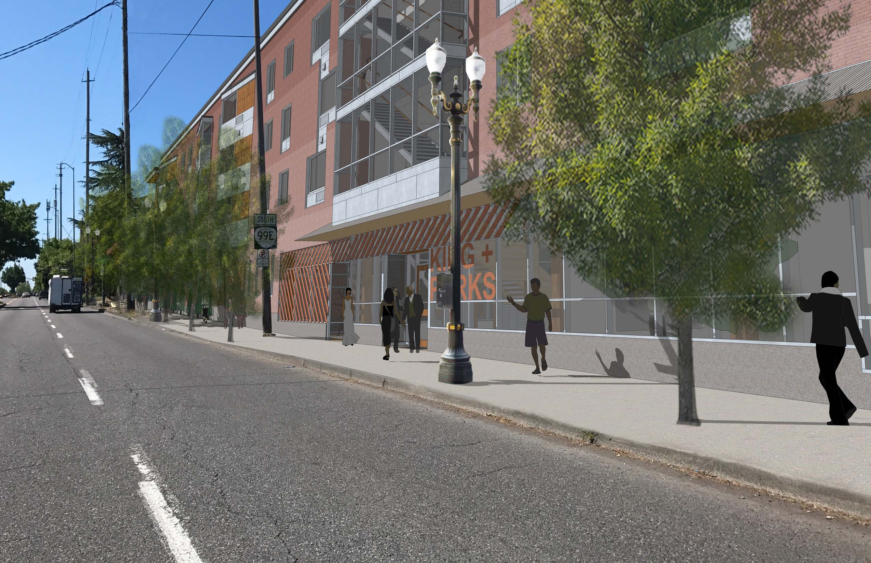
King + Parks Apartments Summary
Development Team
Architect: Merryman Barnes Architects (WBE)
Contractor: Colas Construction (MBE)

Slide 32
King + Parks: Development Timeline
1/2016: PHB NOFA Application Submitted
4/2016: Initial PHB NOFA Awards Announced
5/2016: PCRI Awarded Development of Site
PHB Requested PCRI apply for 9% LIHTC
9/2016: OHCS 9% LIHTC Application Submitted
11/2016: OHCS Award Announced (King + Parks not selected)
4/2017: OHCS Announces 9% LIHTC Award for King + Parks
5/2017: PCRI Submits for Public Works Permitting
6/2017: Additional Credits Awarded for reduced LIHTC pricing
Notes:
OHCS: King Parks is 1 of 3 Portland developments submitted, but is ranked #2 and not funded.

Slide 33
King + Parks: Projected Unit Mix
Unit Size | AMI % | Target Rent/Mo | Quantity | Total
1-bedroom | Project-based Section 8 | 30% of household income | 6 | 20
 | 30% | $412 | 2
 | 60% | $825 | 12
2-bedroom | Project-based Section 8 | 30% of household income | 8 | 38
 | 30% | $495 | 2
 | 60% | $990 | 27 + mgr
3-bedroom | Project-based Section 8 | 30% of household income | 6 | 12
 | 60% | $1,143 | 6

Slide 34
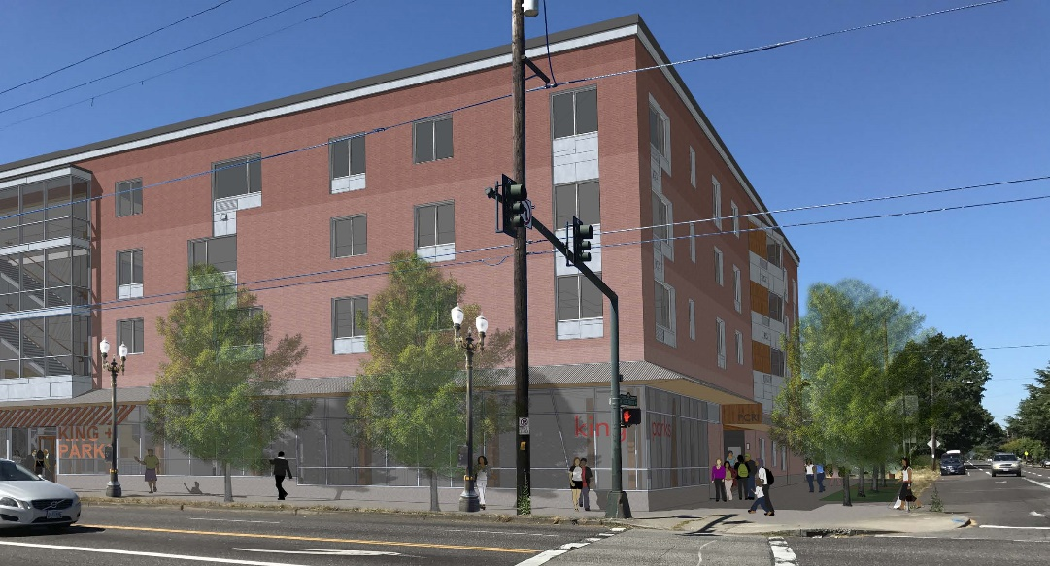
King + Parks Apartments Summary
Amenities:
Open courtyard with play area
Ground floor community room
Laundry on each floor
Less than one block from PCRI office, services

Slide 35
King + Parks: Development Status
Community Engagement:
Multiple neighborhood association meetings
Direct outreach to neighbors
Ongoing open communication & one-on-one meetings with interested stakeholders
Check Points:
Community Design Standards (no design review)
Public Works Permits – 60% submission by 12/17
Building Permits – est. submission 12/17
Finalize details of finance structure – 11/17

Slide 36
King + Parks: Development Status
Construction/Financing Timeline
Closing for Financing: March/April 2018
Construction Start: April 2018
Construction Period: 14 months
Completion: August 2019

Slide 37
ACCESSORY DWELLING UNIT PILOT LOAN PROGRAM

Slide 38
Program Overview
A loan program designed to assist low-income, long time homeowners in retaining their home, thereby reducing displacement, by creating a fully permitted accessory dwelling unit (ADU)

Slide 39
ADU Uses
Flexible uses
Family member
Live-in caregiver
Downsize, and rent the primary home
Non-regulated rents
Cannot be used as a short-term rental.

Slide 40
Loan Terms
$80,000 Maximum loan amount
15-year 0% Interest loan
180 equal monthly payments
Assumable by family member
Secured by a lien on title
Up to $15,000 additional for Home Repairs
Silent / No Payments
Forgiven after 15 years

Slide 41
Loan Qualifications
Current on Mortgage payments
Current on property taxes or in Tax Deferment Program
Have enough home equity to secure loan amount.
Debt to Income ratio up to 60%
No Reverse Mortgages

Slide 42
Eligible Applications
Current Homeowner
Household income under 120% AMI
Purchased home prior to August 2000
- OR -
Purchased a home that has been in the family prior to August 2000

Slide 43
Eligible Properties
Located in Interstate Corridor Urban Renewal Area
Single-family detached owner occupied unit
Home has a basement with a minimum of 500 sq. feet.
Primary unit in safe and habitable condition or able to be improved to program standards within available funding limits.

Slide 44
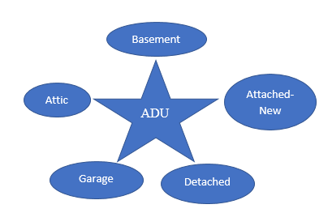
Why Only Basements
Lowest overall cost on average
Allows for program focus
Develops efficiency
Allows for expansion rather than contraction

Slide 45
Program Requirements
Complete landlord education
Register as a business with the City of Portland
Sign agreement for loan terms and program restrictions.

Slide 46
Supportive Services
Budget and Program Review
Property Inspection and Assessment
Metro HomeShare
Income Tax Education
Landlord Education
Community Partners

Slide 47
Outreach
PHB will send out a mass mailing to all home owners in the ICURA
PHB will send out a second targeted mailing to identified homes that could qualify
Communicate with community partners to share with their clients.

Slide 48
Questions?

Slide 49
North/Northeast Neighborhood Housing Strategy Oversight Committee
November 9, 2017

