Slide 1
Underground Wiring District Code Change
4/24/19 City Council Item #360
Notes:
Thank you Commissioner Eudaly, Mayor Wheeler and the rest of City Council. I have a short presentation for
you today followed by invited testimony from Design Commissioner Brian McCarty and BDS staff Tim Heron. They are joining me here this morning.

Slide 2
Outline
Background: Small Wireless Facilities
City Owned Street Light Poles
City Code Update – Underground Wiring District
Underground Wiring District Maps
Underground Wiring District Code Update Public Outreach
Street Light Pole Design Process
PBOT Proposed Amendment
Notes:
Note: Macro towers are usually taller than 80’, this example is around 80’ to be to scale with the 40’ cobra head

Slide 3
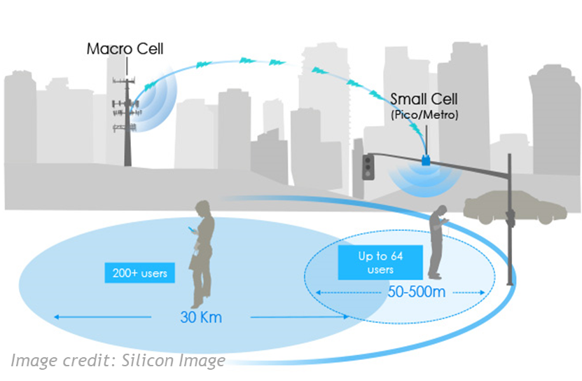
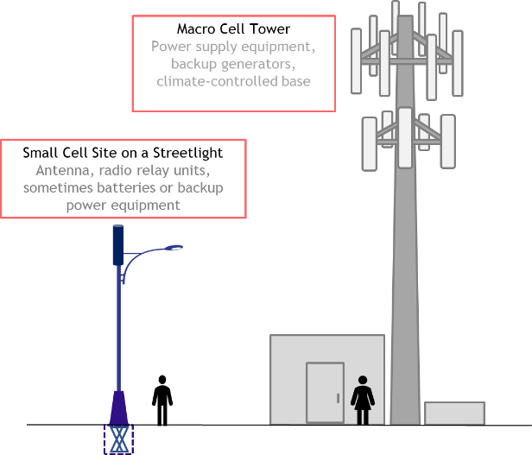
Background: Small Wireless Facilities
Small cells or distributed antenna systems (DAS) — short range, low‐powered cellular radio access
Small because these mobile phone base stations have:
Shorter range and handle fewer calls/sessions
Not because of physical size
Notes:
1. As you are aware, cellular and wireless providers are currently expanding their networks of small cells throughout urban areas to
improve coverage and increase cellular network capacity to meet the increasing demand on their current networks served by cell towers.
2. Small cells are short range, low‐powered cellular radio access. These mobile phone base stations have a shorter range and handle fewer calls/sessions.
3. It is anticipated that there could be 2,400 wireless small facilities throughout the City of Portland.
4. While the many of these attachments will be attached to utility poles, many will be attached to city owned streetlight poles in the right of way.

Slide 4
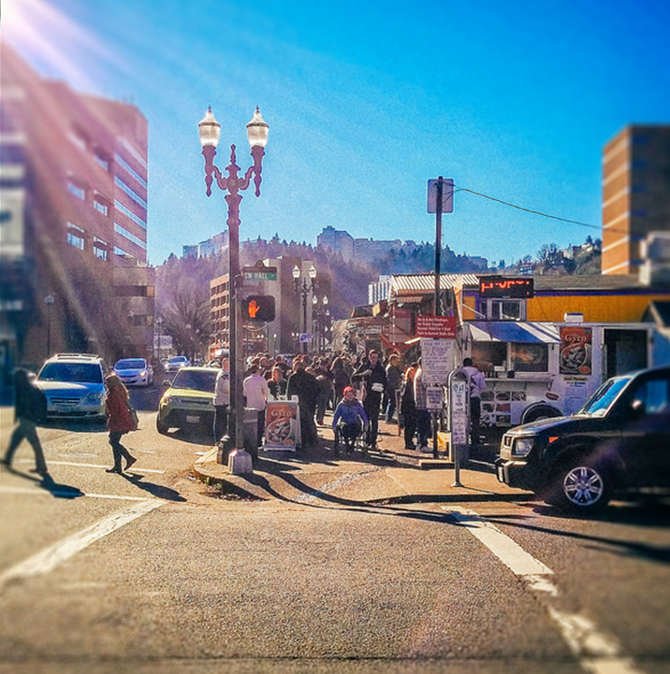
City Owned Street Light Poles
City code restricts attachments to poles in the right of way in Underground Wiring Districts.
Most of downtown Portland is located in an Underground Wiring District.
In downtown Portland, the only poles in the right of way are city owned poles.
In Spring 2018, PBOT staff briefed the Design Commission and Historic Landmarks Commission on potential small wireless facility impacts on Portland’s right of way.
The Commissions advised staff to create an inventory of street light poles in the right of way, supported no above ground cabinets, no monopoles and the requirement of shrouding.
Notes:
City owned vertical infrastructure in the ROW is suddenly in high demand.
City code restricts attachments to poles in the right of way in Underground Wiring Districts.
Most of downtown Portland is located in an Underground Wiring District.
In downtown Portland, the only poles in the right of way are city owned poles.
In Spring 2018, PBOT staff briefed the Design Commission and Historic Landmarks Commission on potential small wireless facility impacts on Portland’s right of way.
The Commissions advised staff to create an inventory of street light poles in the right of way, supported no above ground cabinets, no monopoles and the requirement of shrouding.
Design Commissioner Tad Savinar and Landmarks Commissioner Annie Mahoney joined staff from PBOT, BPS, BDS and OCT from June thru November 2018 to develop components of the Vertical Infrastructure Program.
The City of Portland has established directives on how we will govern this emerging technology:
Ensure digital inclusion across communities
Manage the public right-of-way (ROW) to support the well-being of residents
Secure fair and reasonable compensation for use of the ROW
Ensure VI deployments support the Digital Equity Action Plan (DEAP), as adopted by City Council
Ensure that the City protects the public health, safety, and welfare of its citizens

Slide 5
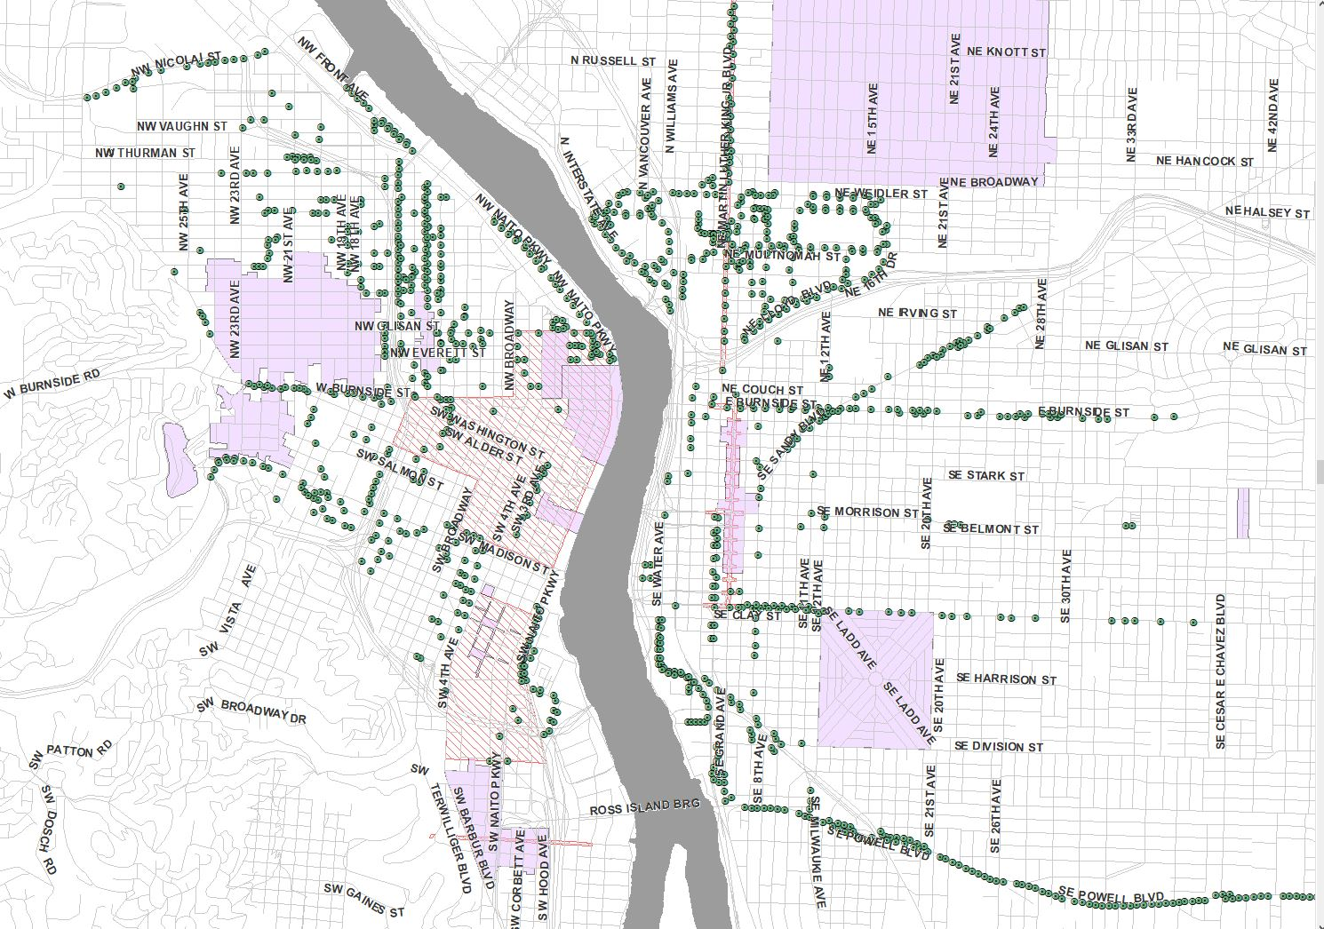
City Owned Street Light Poles
PBOT staff have completed an inventory of street light poles in the underground wiring district
All inventoried street lights are non decorative poles.
The initial City owned street light pole inventory to be released includes non-decorative street light poles.
There are areas without city owned pole locations in downtown Portland.
Notes:
The green dots on this slide are non decorative street light poles in the downtown core. Underground Wiring Districts and historic districts are represented in the shaded areas.
Additionally there are city owned street light poles concentrated on SE Powell, NE Airport Way and NE MLK Boulevard.
Signal light poles are expensive to replace because the entire intersection has to be replaced along with the signal cabinet and ADA requirements, at the same time.

Slide 6
City Code Update – Underground Wiring District
This code change update will allow for small cell attachments on city-owned poles in the ROW.
Proposed changes to City Code Chapter 17.60.110 Exceptions
Addition of the following language:
F. Appliances or appurtenances on, through or by means of which telecommunications data is wirelessly collected or transmitted, as defined by the City of Portland Wireless Master Plan and Transportation Administrative Rules. This exemption does not include attachments to transit and/or transit supporting infrastructure not owned and maintained by the City.
Notes:
This code change update will allow for small cell attachments on city-owned poles in the ROW.
Currently there are no attachments allowed on any poles in the ROW

Slide 7
Underground Wiring Districts
Notes:
Underground Wiring Districts
There are four major Underground Wiring Districts, located in downtown Portland, and portions of Grand Ave., Martin Luther King Junior Blvd and NE Airport Way.

Slide 8
Underground Wiring District Code Update Public Outreach
On March 22, 2019:
Sent notification to impacted neighborhood associations and coalitions, business associations, and other community stakeholders
Published public notice of hearing of 4/24 hearing in the Daily Journal of Commerce
Published proposed Code language on PBOT website
Notes:
City-owned design that can be provided to many manufacturers for fabrication. This is like the current twin ornamental pole procurement
Less desirable outcome: Sole source justification for the purchase of a specific pole from a specific manufacturer. This is like the current South Waterfront poles that must be purchased from Valmont

Slide 9
Street Light Pole Design Process
Spring 2019, staff returned to Design and Landmarks Commissions to discuss the potential need for more locations in downtown Portland.
PBOT will lead a design exercise to design a new street light pole standard to be used when replacing other city owned street light poles—including potentially replacing mid block ornamentals.
May 2019, PBOT will kickoff the RFI process with an estimated completion date of Summer 2020.
Historic Landmarks Commissioner Maya Foty and Design Commissioner Brian McCarter have volunteered for the Design Review Committee
Additional Committee members will be invited from the community.
Notes:
Staff anticipated that as the carriers’ networks were built out, there was a possibility that there were not enough locations to satisfy all requests.
We returned to the Design and Landmarks Commissions to discuss this anticipated issue in March 2019.
They recommended instead of using a faux ornamental, to collaborate with participating Commissioners to determine the best possible design for a new street light pole to be used across the City.

Slide 10
PBOT Proposed Amendment
PBOT would like to offer an amendment stating our intent to return and report back to City Council once a final design has been determined for the new street light pole.
Amendment to Council Item 360, April 24, 2019 – Streetlight Design Staff Report
City staff will bring a Report to Council for adoption on the new streetlight pole design to be used throughout the City by the end of summer 2020.
Notes:
I would now like to turn it over to Tim Heron from BDS and Design Commissioner Brian McCarter

Slide 11
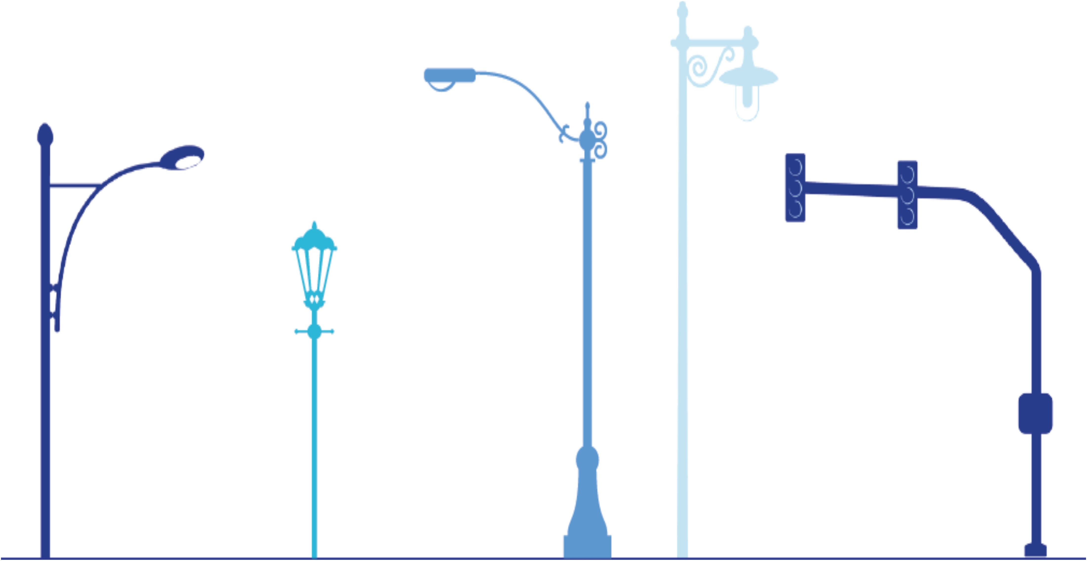
Contact Information.
Anne Hill, PBOT
Anne.hill@portlandoregon.gov
503-823-7239
The City of Portland complies with all non‐discrimination, Civil Rights laws including Civil Rights Title VI and ADA Title II. To help ensure equal access to City programs, services and activities, the City of Portland will reasonably modify policies/procedures and provide auxiliary aids/services to persons with disabilities. Call 503-823-5185, TTY 503-823-6868 or Oregon Relay Service: 711 with such requests, or visit http://bit.ly/13EWaCg

