Slide 1

City Council Briefing
Mary Hull Caballero
City Auditor
Portland Parks Golf (May 2019)
Fixing our Streets (May 2019)
Portland Building Follow-up (June 2019)
Portland Housing Bond (June 2019)

Slide 2
Portland Parks Golf
Portland Parks Golf:
Changes needed to ensure long-term sustainability
May 2019

Slide 3
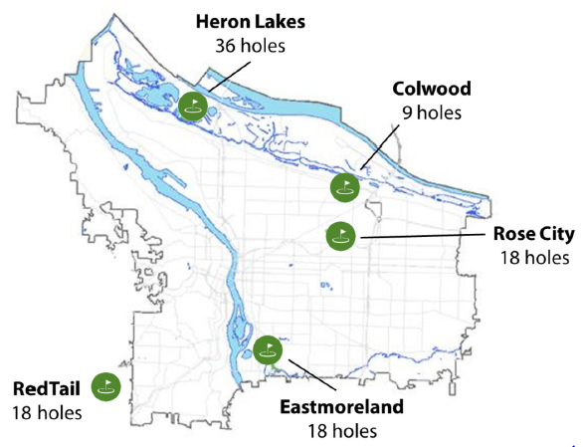
Portland Parks Golf

Slide 4
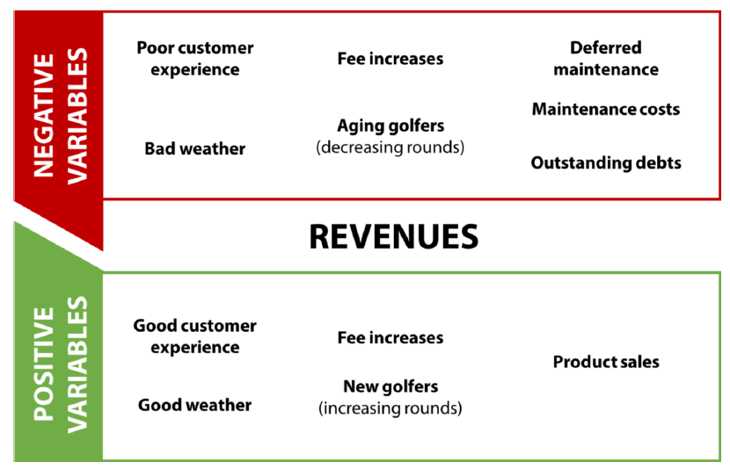

Slide 5
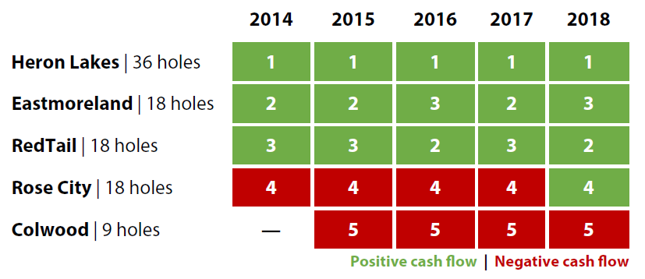
Some courses are doing better than others:

Slide 6
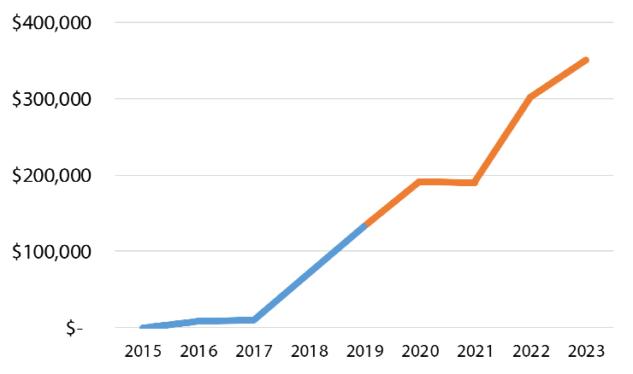
Colwood debt repayment will impact the golf fund for four more years:

Slide 7
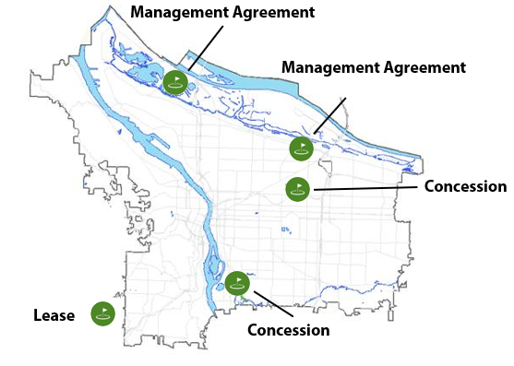
Portland Parks Golf

Slide 8
We recommend that Parks:
Develop alternative financial forecast scenarios and present them to City Council for direction on how to proceed; and
Negotiate contracts to reflect current program conditions, and increase monitoring to ensure contract provisions are followed.

Slide 9
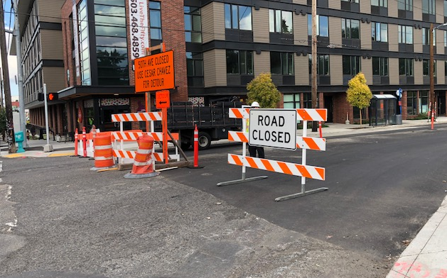
Fixing Our Streets

Slide 10
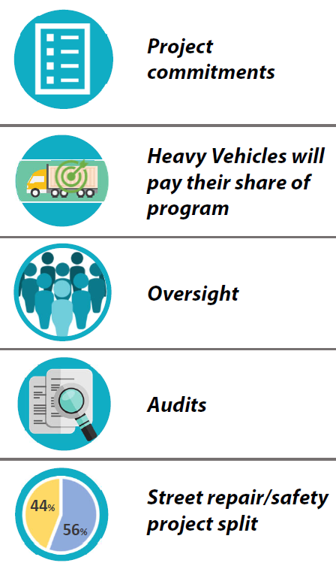

Slide 11

Fixing Our Streets

Slide 12
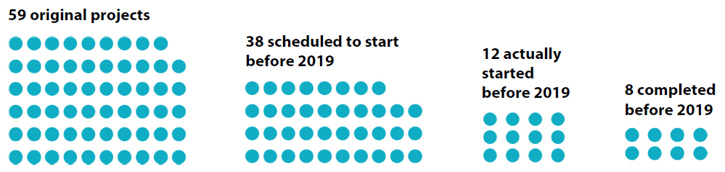
Fixing our Streets

Slide 13
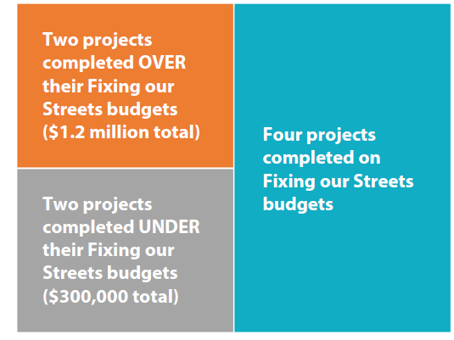
Fixing our Streets

Slide 14

Fixing our Streets

Slide 15
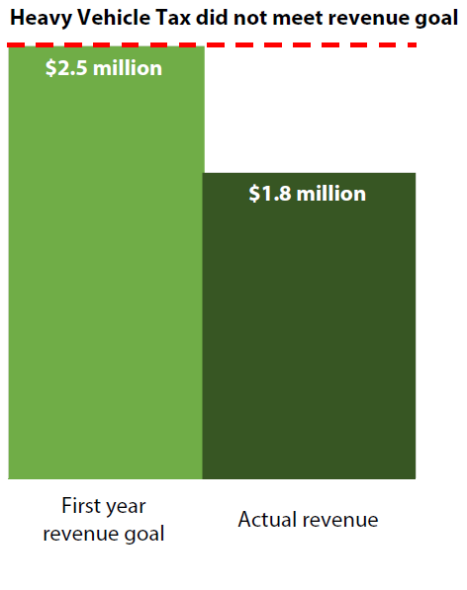

Slide 16

Fixing our Streets

Slide 17

Fixing our Streets

Slide 18
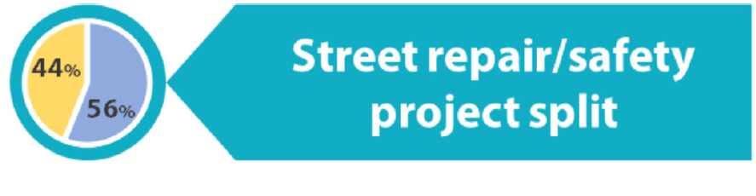
Fixing our Streets

Slide 19
Fixing our Streets
Provide the Fixing our Streets oversight committee with information needed to understand and carry out its responsibilities.

Slide 20
Fixing our Streets
Track and report on projects as they relate to public commitments.
Explore options to ensure that heavy vehicle owners pay their share.
Specify type of audit desired and share results publicly.
Make ballot commitments that are clear, realistic, measurable, achievable and time-bound.

Slide 21
Fixing our Streets
Clarify language regarding the split of funding for street repair and safety projects in program and oversight committee materials.
Informed by the clarification, the Bureau should track and account for spending to ensure that the split of funding for street repair and safety projects is maintained.

Slide 22
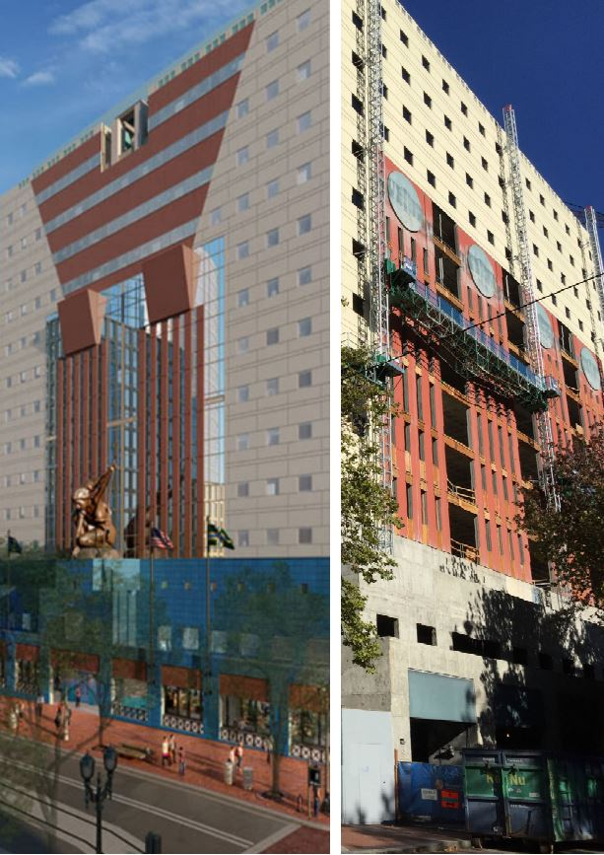
Portland Building Follow-Up
Greater public transparency needed about:
project costs,
trade-offs, and
missed equity requirement

Slide 23
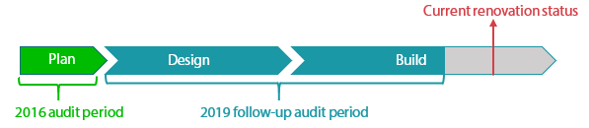
Portland Building Follow-Up

Slide 24
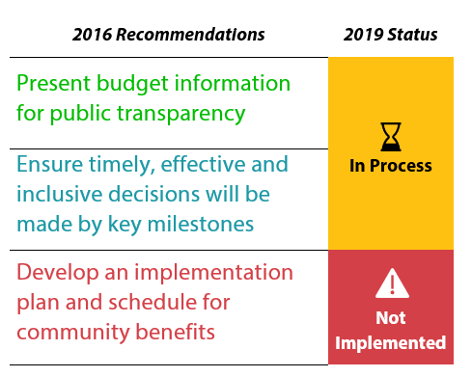
Portland Building Follow-Up

Slide 25
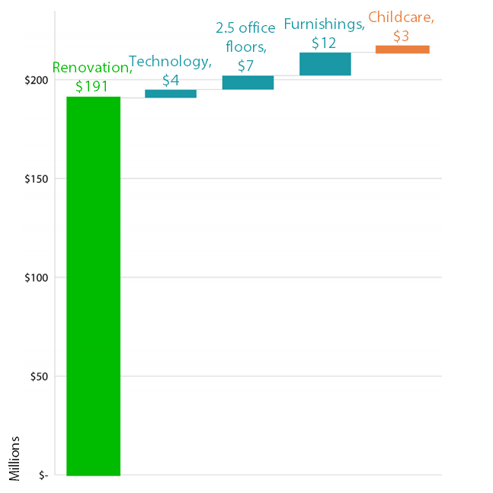
Portland Building: Project Costs
$214million
$195million

Slide 26
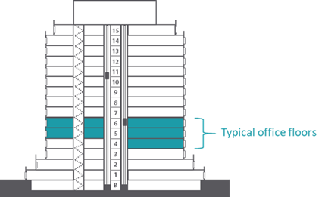
Portland Building: Project Costs
$7 million

Slide 27
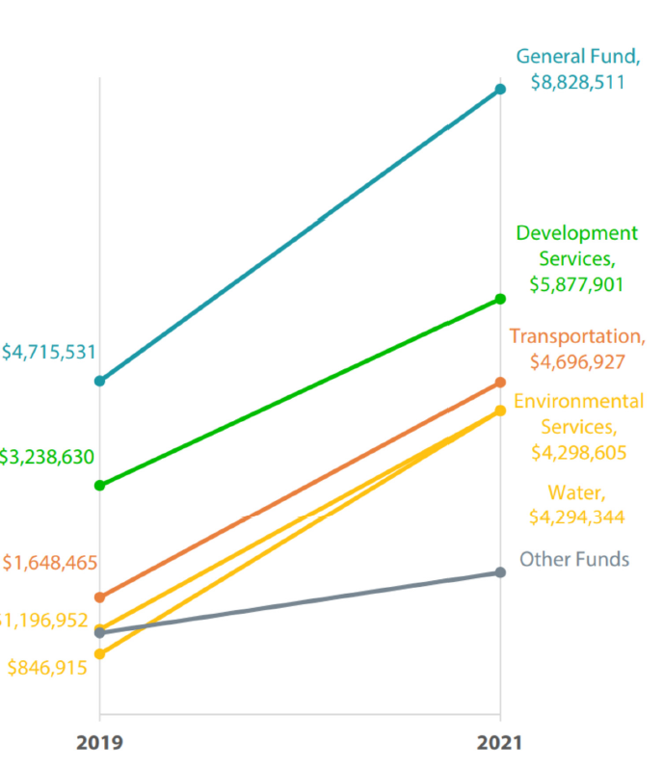
Portland Building: Project Costs

Slide 28
Portland Building: Project Costs
Recommendation
Present budget-to-actual reports to Council and Oversight Committee for the collective Portland Building costs.

Slide 29
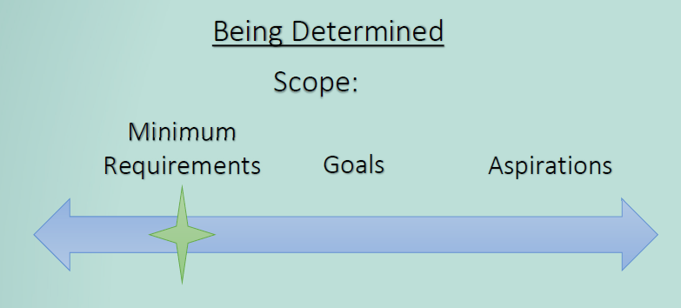
Portland Building: Trade-Offs
Source: Excerpt from project team’s July 2016 presentation to Council.

Slide 30



Portland Building: Trade-Offs
On track to meet
minimum requirements
Will fall short of other
aspirations

Slide 31




Portland Building: Trade-Offs
HISTORIC PRESERVATION
ACCESSIBILITY
SUSTAINABILITY

Slide 32
Portland Building: Trade-Offs
Recommendations
Incorporate ADA inspections and report on compliance status
Complete remaining state and local historic preservation requirements

Slide 33



Portland Building: Equity Grants
  Set aside $1 million for equity grants
  Disburse money in phases during project
  Report regularly to Council on results

Slide 34



Portland Building: Equity Grants
No reports to Council
No community grants
Unclear ratepayer accountability
Missed strategic opportunity

Slide 35
Portland Building: Equity Grants
Recommendations
Report to Council, and inform applicants of grantmaking status
Remove ratepayer funds if future grants not reasonably related to water/sewer services

Slide 36

Portland Housing Bond
Early implementation results mostly encouraging
June 2019

Slide 37
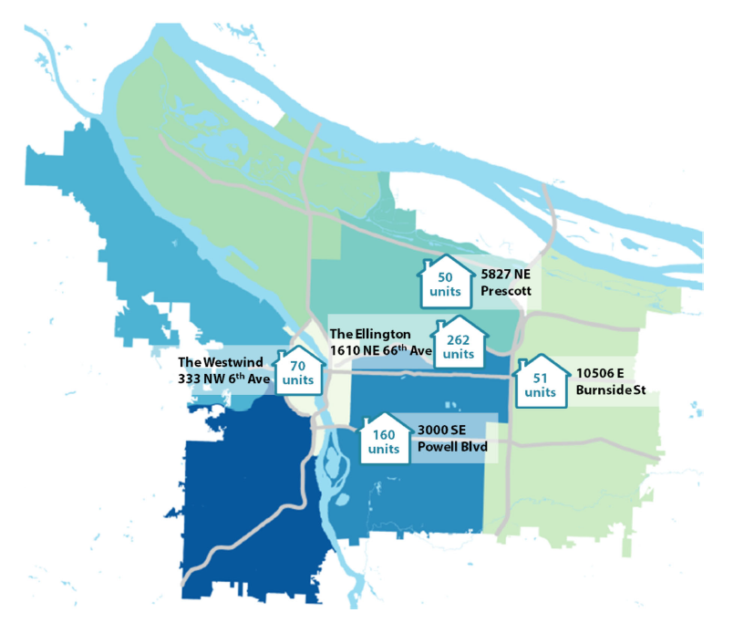

Portland Housing Bond
593
total
units

Slide 38

Portland Housing Bond
1,300 units
All units
low-income
650 units family-sized
600 units
very low-income
City’s goal:
300 of the very low-income units would be Supportive Housing units if non-bond funds are available

Slide 39

February
2017
September
2017
June
2018
July
2018
November
2018
The Ellington
1610 NE 66th Ave
262 units
3000 SE
Powell Blvd
160 units
estimated
10506 E
Burnside St
51 units
5827 NE
Prescott
50 units
estimated
The Westwind
333 NW 6th Ave
70 units
estimated
2016
2017
2018
November
2016
October
2017
November
2018
Bond passes
Policy Framework completed
Constitutional amendment
passes

Slide 40
Portland Housing Bond
“Shall Portland issue bonds, fund affordable housing for low income families, seniors, veterans, people with disabilities; require public oversight?”

Slide 41
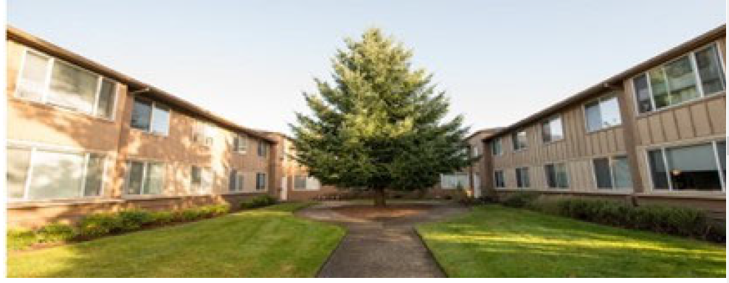
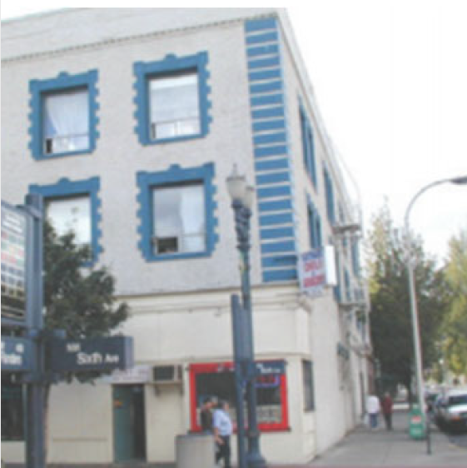
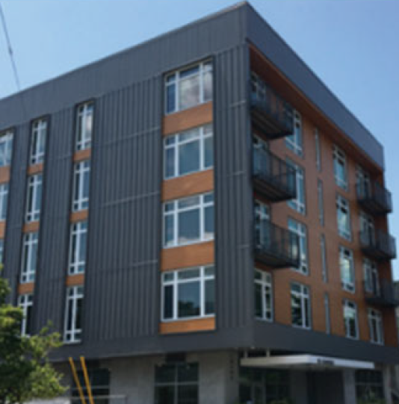
Portland Housing Bond

Slide 42

Portland Housing Bond

Slide 43
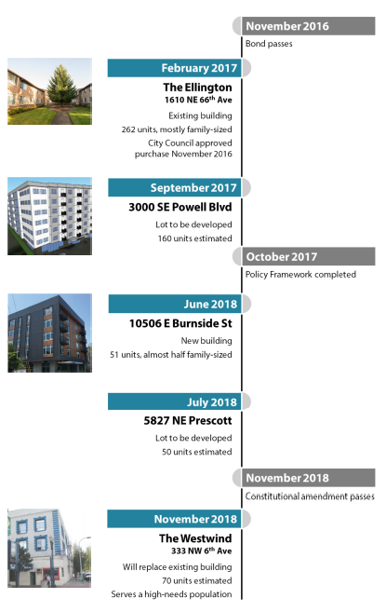
February
2017
September
2017
June
2018
July
2018
November
2018
The Ellington
1610 NE 66th Ave
262 units
3000 SE
Powell Blvd
160 units
estimated
10506 E
Burnside St
51 units
5827 NE
Prescott
50 units
estimated
The Westwind
333 NW 6th Ave
70 units
estimated
2016
2017
2018
November
2016
October
2017
November
2018
Bond passes
Policy Framework completed
Constitutional amendment
passes

Slide 44
Portland Housing Bond
Recommendations:
Add emphasis on voter commitments and report on service to those communities
Provide specific information about underlying rationale in documenting decision-making
Evaluate effectiveness of new approach to reaching target populations for bond projects

Slide 45
City Council Briefing
For copies of the reports, go to the
Audit Services Division webpage at:
www.portlandoregon.gov/auditservices

