Slide 1
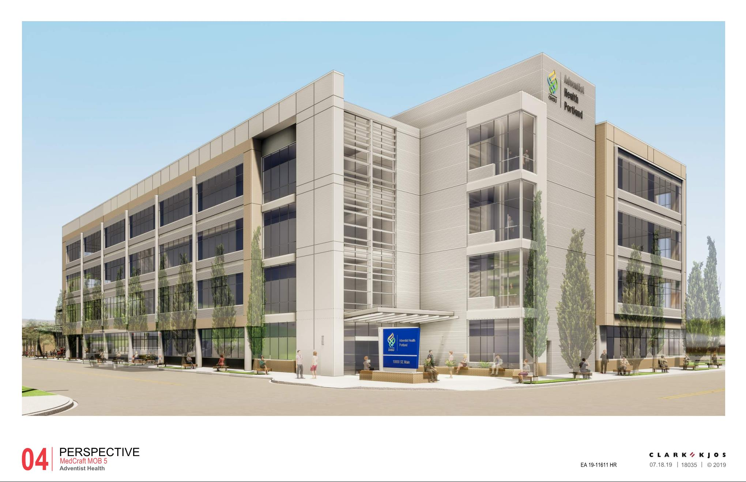

City of Portland
Design Commission
Design Advice Request
EA 19-110611 DA
1500 SE 96th Avenue
August 1, 2019
Staff Presentation

Slide 2
Staff Introduction
Applicant Presentation
Staff Discussion Topics
Public Comments
Commission Conversation

Slide 3
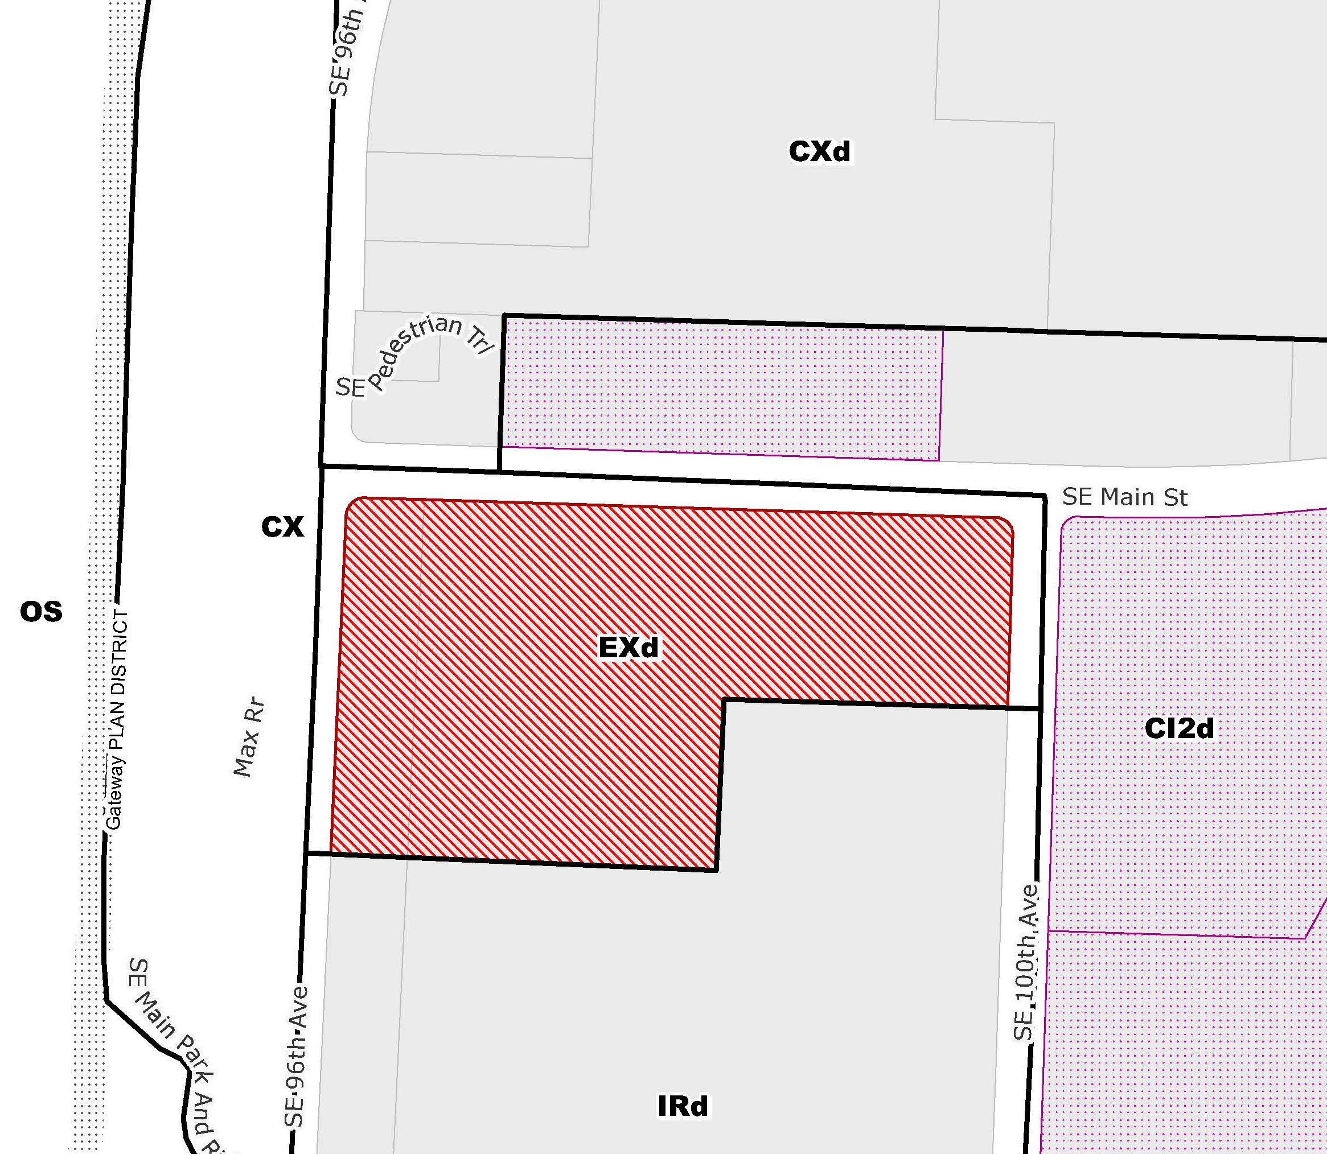
Location:
Gateway Plan District
Base Zone:
Exd, Central Employment with a Design Overlay
Approval Criteria:
Gateway Regional Center Design Guidelines
Site: 6.2 acres
Height:
65’ max base
120’ max with bonus
Floor Area Ratio:
Max: 8:1 base along north half; 4:1 along south portion for non-residential uses (6:1 for residential uses)
Min: .25:1 (65,885 square feet)
Zoning

Slide 4
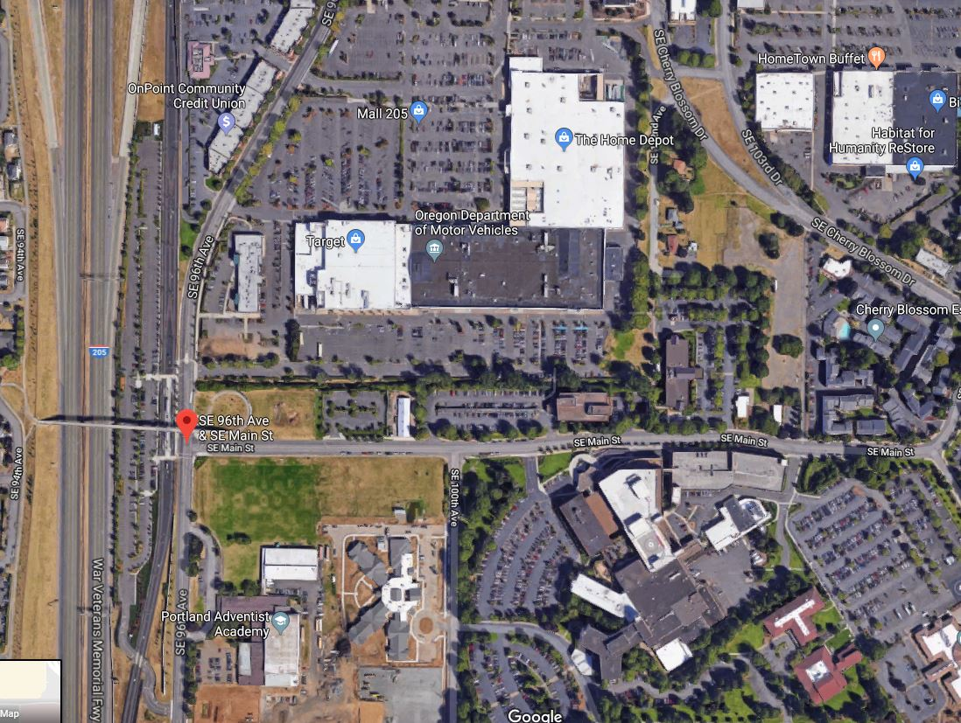
Mall 205
I- 205
Adventist Hospital

Slide 5
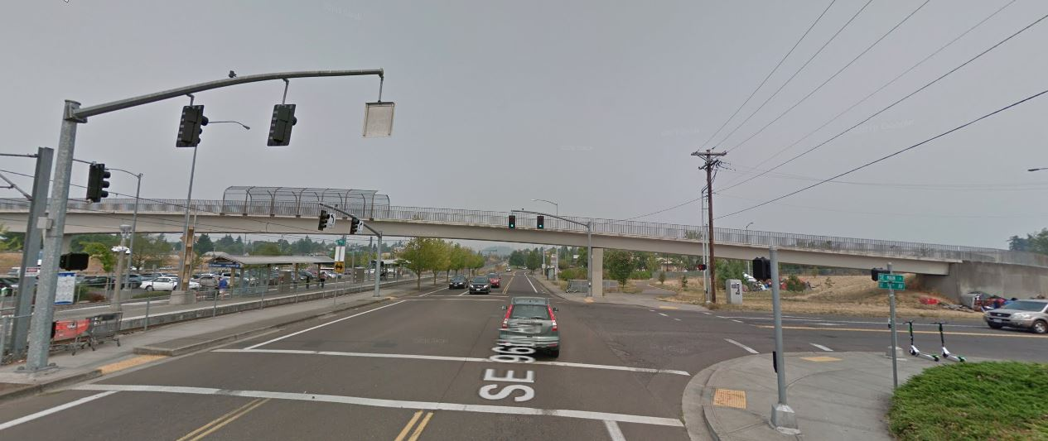
MAX Stop
Site

Slide 6
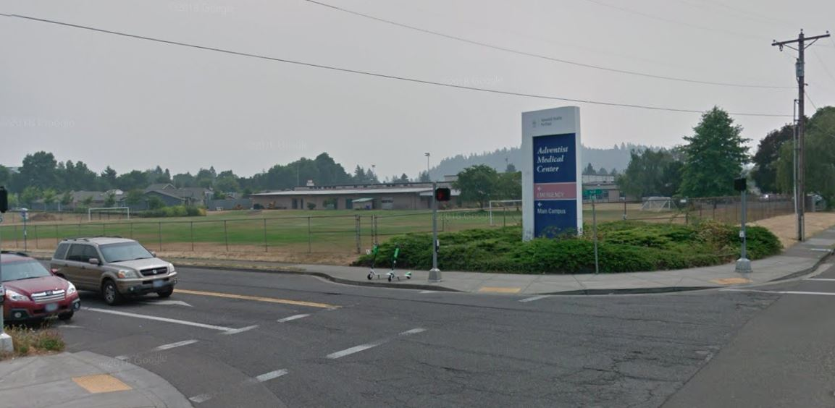
Site
SE 96th & SE Main

Slide 7
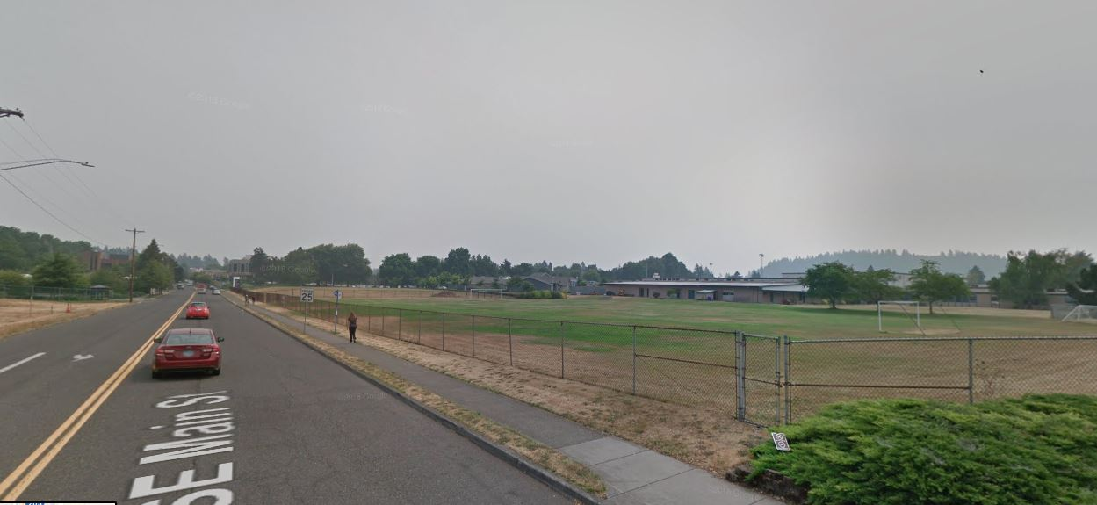
SE Main, facing east

Slide 8
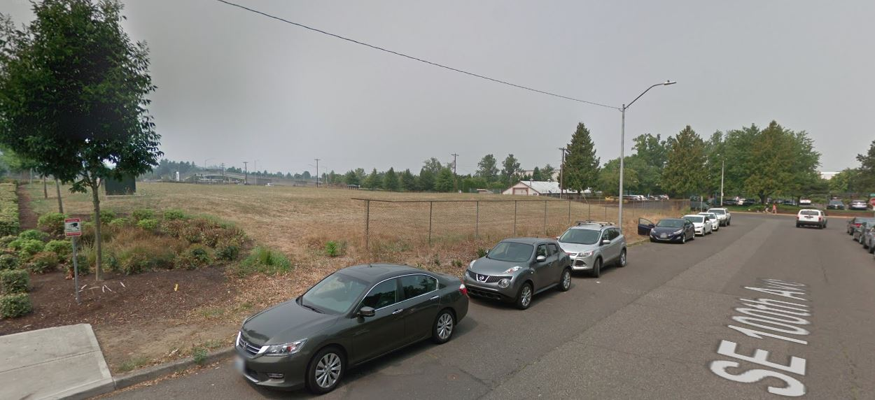
SE 100th
Looking south on NE 27th, toward NE Sandy, Zipper on the left

Slide 9
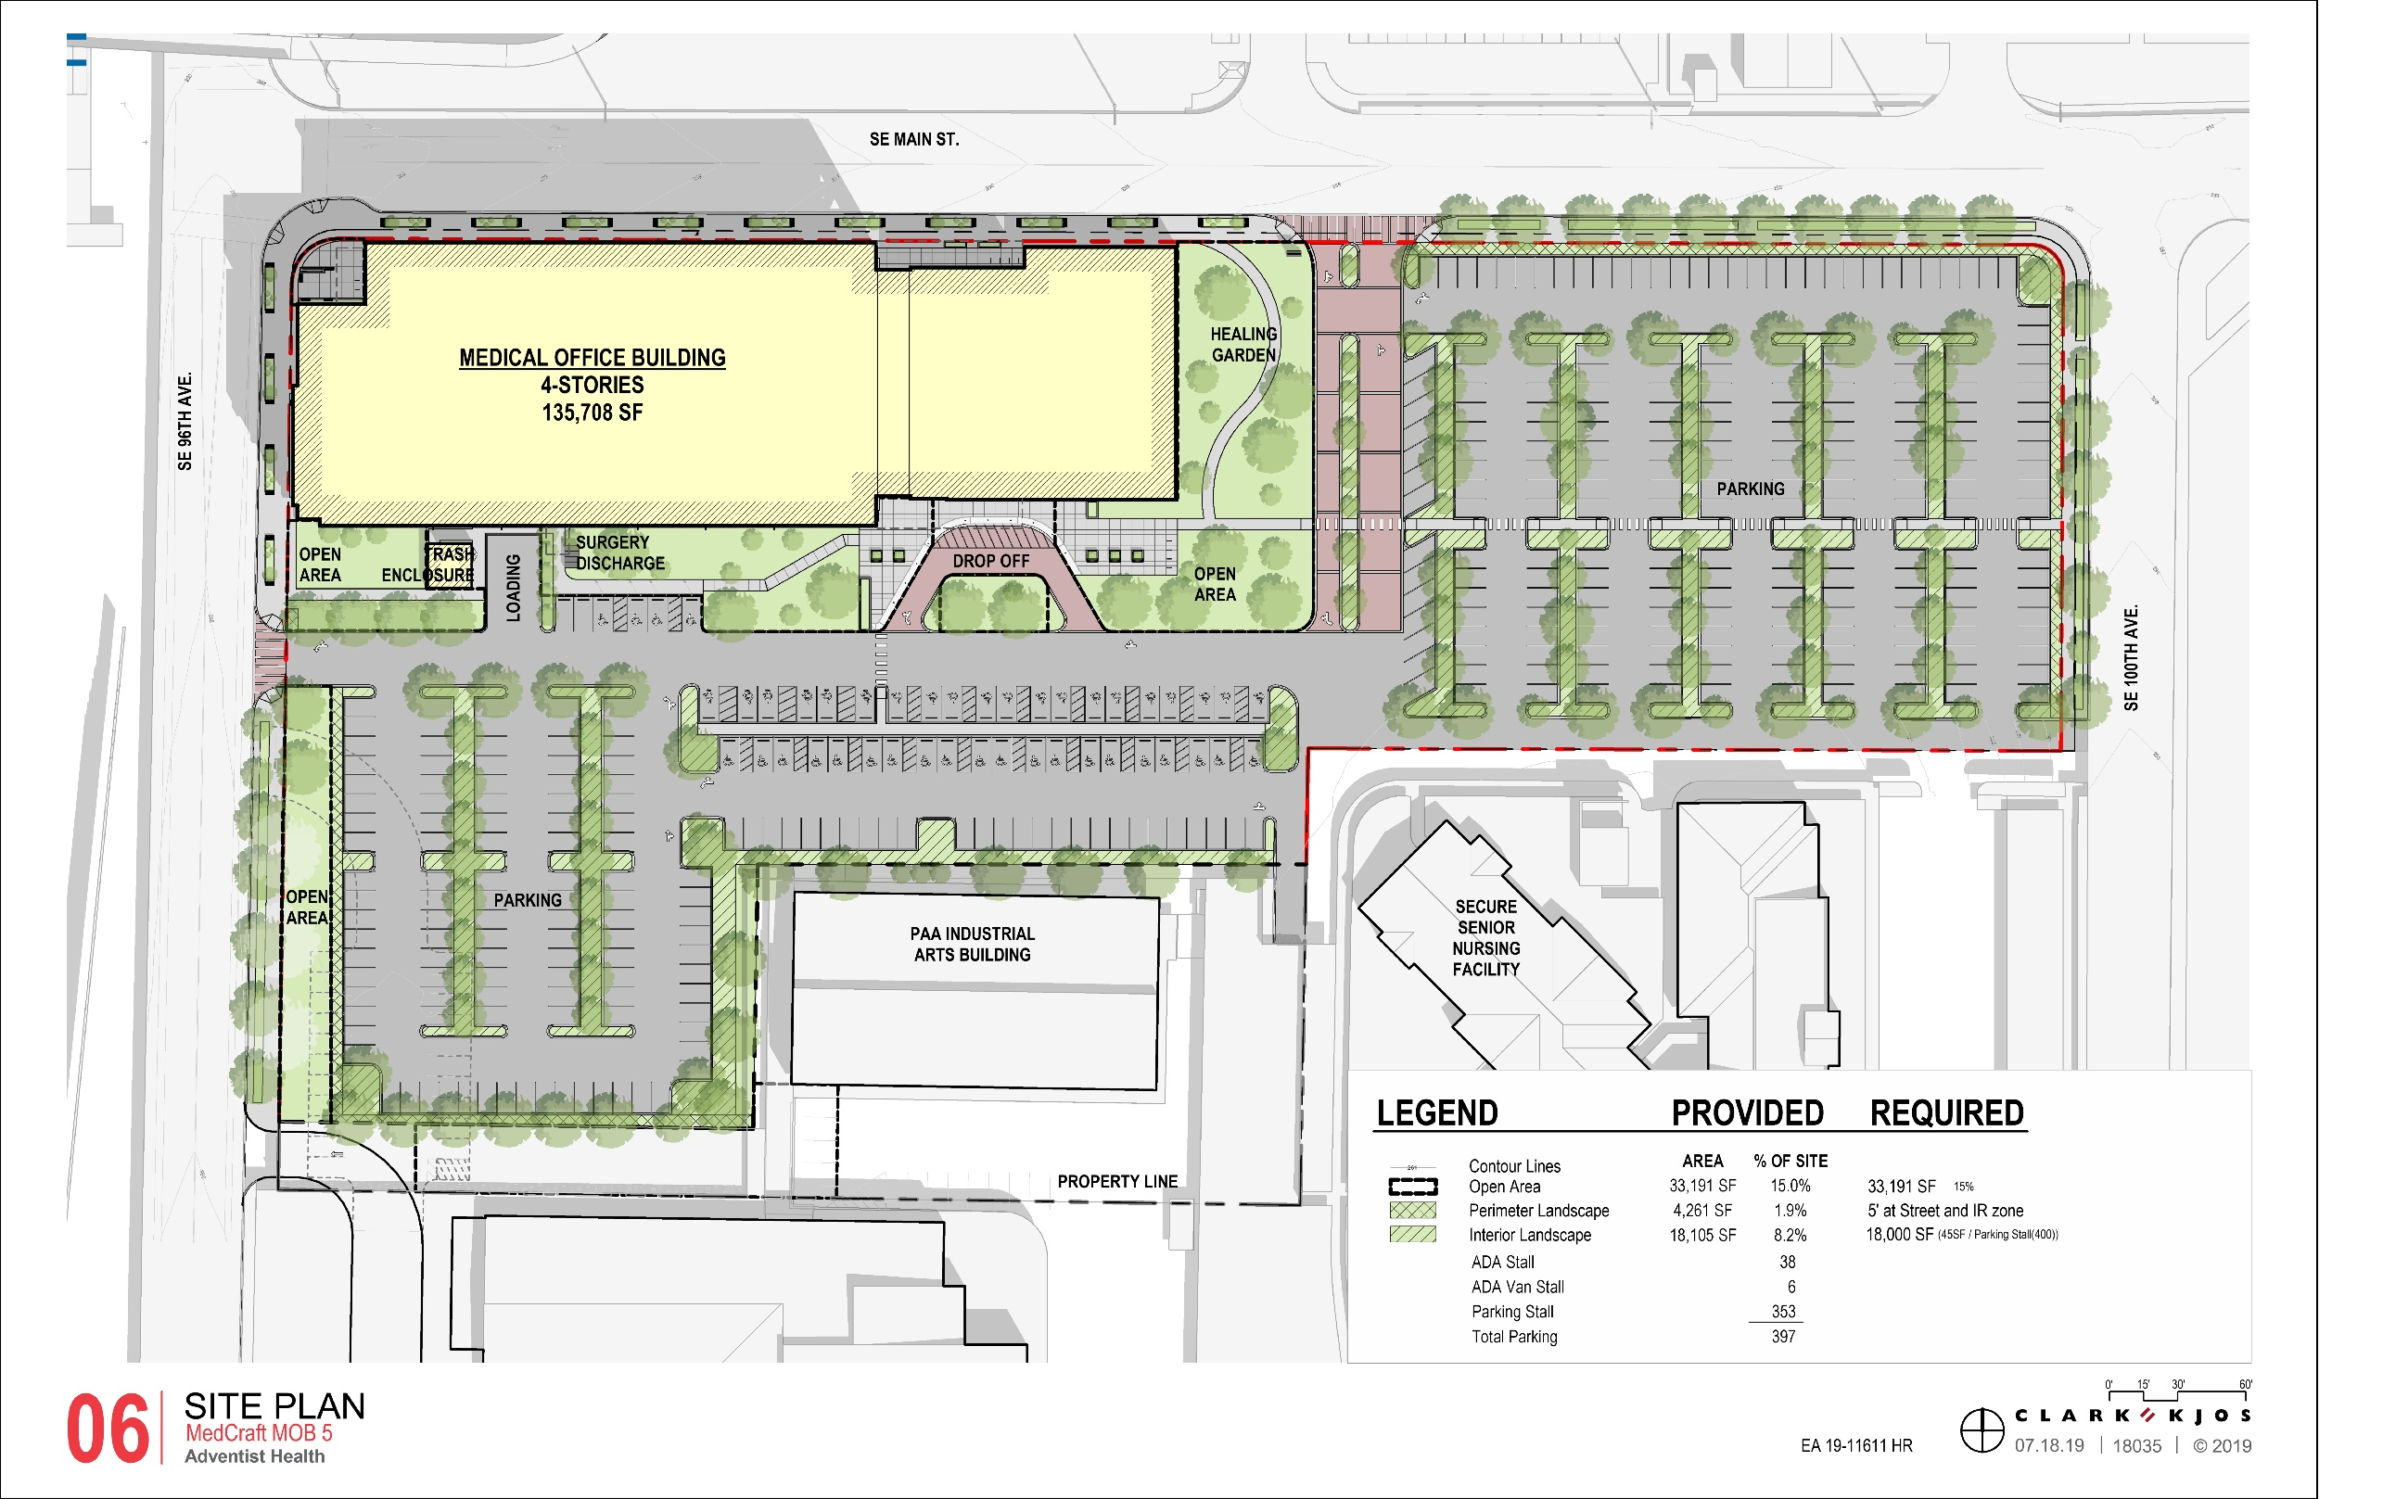
SE 100th
Looking south on NE 27th, toward NE Sandy, Zipper on the left

Slide 10
Staff Introduction
Applicant Presentation
Staff Discussion Topics
Public Comments
Commission Conversation

Slide 11
Staff Introduction
Applicant Presentation
Staff Discussion Topics
Public Comments
Commission Conversation

Slide 12
Context:
Open Area
Public Realm:
Parking/Vehicle Area
Architecture
Modifications:
Reduce Parking Aisle Width
Increase Maximum Building Setback
Vehicle Frontage Limitations
Reduce the Required Building Length on SE Main
Phase or Defer Open Area Requirement

Slide 13
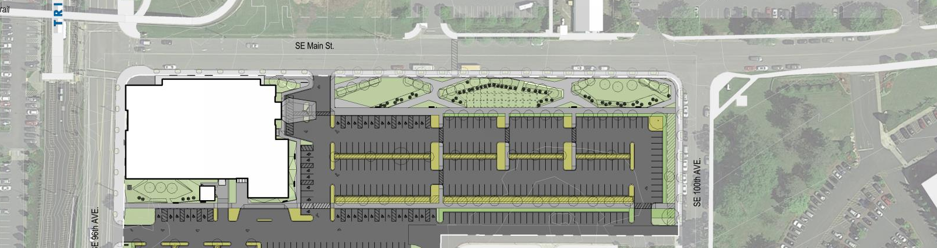
Context: Open Area
Previous Proposal
In Gateway Plan District, sites over 5 acres are required to provide .5 square foot of open area for each square foot of floor area proposed, up to a maximum requirement of 15 percent of the site area. Adjustments to this standard are prohibited.
Required Open Area: 15% of site area

Slide 14
Open areas are parks; plazas; or other similar areas such as children’s play, picnic areas, landscaping, benches, paved walkways or trails, gardens, sport fields, or other outdoor amenities. Open areas do not include areas used for parking or loading, or landscaping within parking areas. It must abut a public sidewalk or on-site pedestrian circulation.
Context: Open Area
Current Proposal

Slide 15
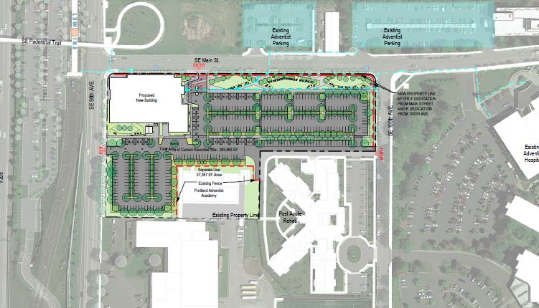
Public Realm
Parking + Vehicle Area
Minimum Required Parking Spaces – There is no minimum number of required parking spaces.
Maximum Allowed Parking Spaces for a Medical Office – 1 space per 204 square feet of net building area. (638 parking spaces)
Previously proposed: 374 parking spaces
Currently proposed: 400 parking spaces

Slide 16
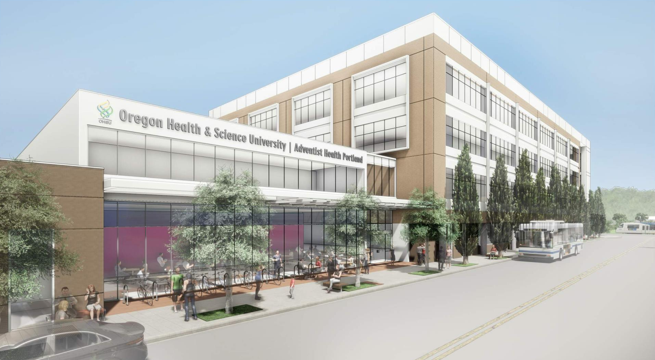
Public Realm + Quality & Permanence
Architecture
Massing, articulation, canopy coverage, entrances, corners, materials

Slide 17
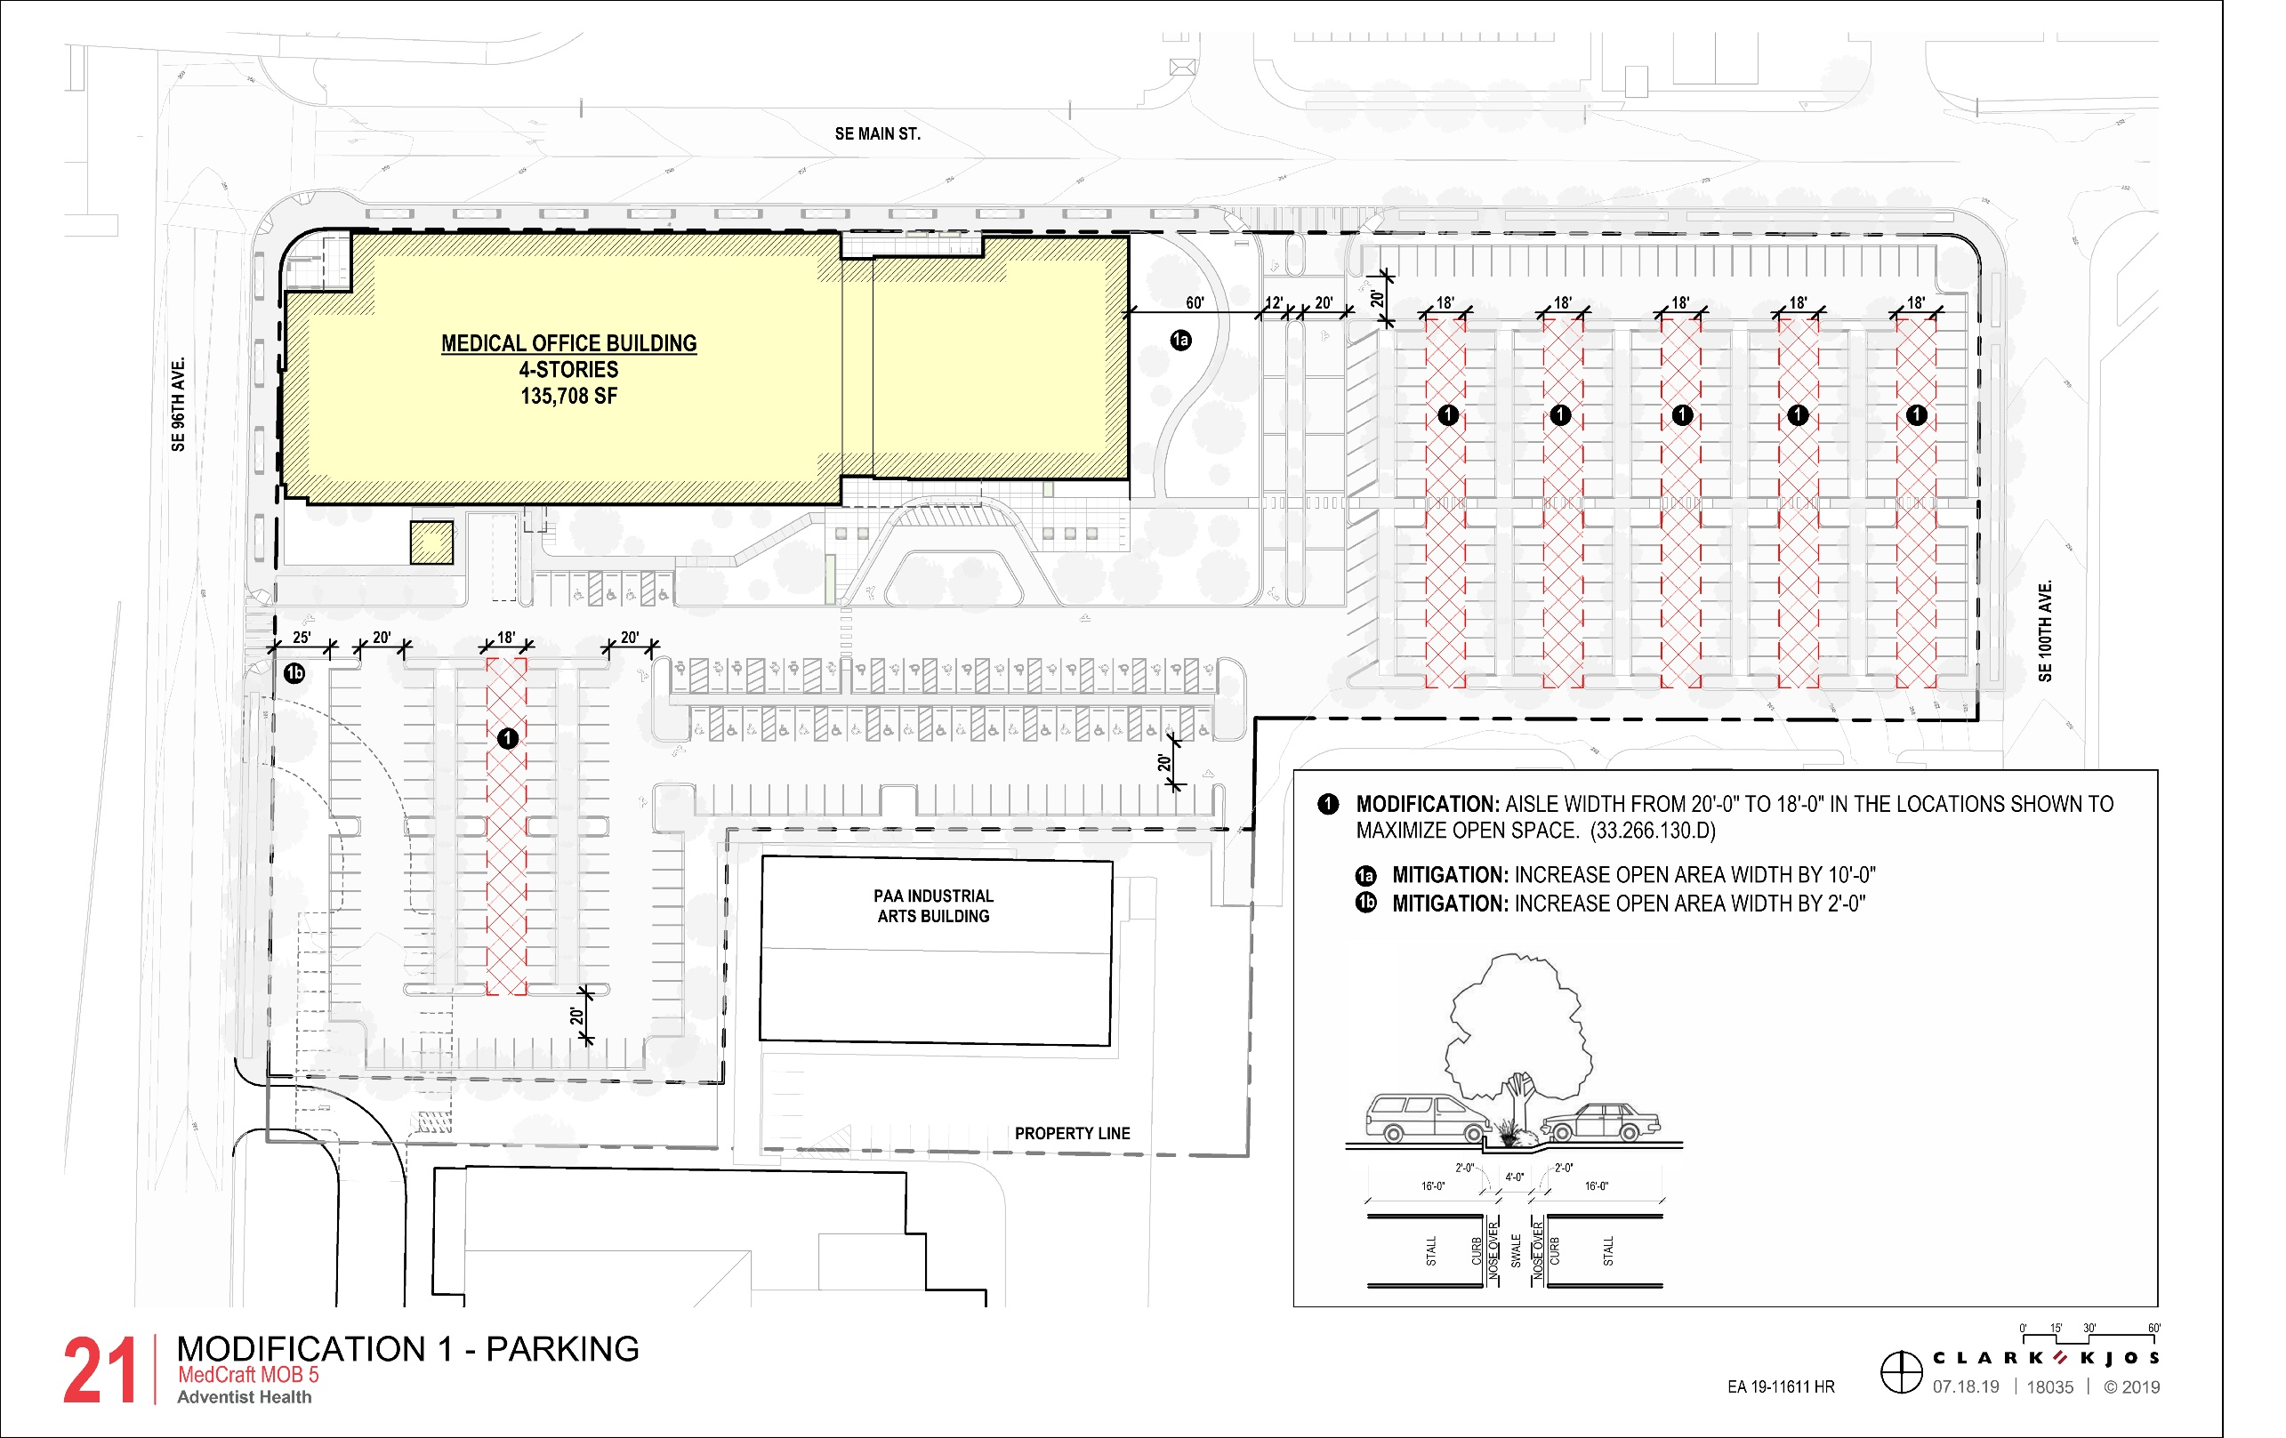
Modification 1
Reduce Parking Aisle Width
(Table 266-4)
Parking aisles that serve 2-way traffic are required to be 20’ deep. The Modification request is for 18’ deep aisles.
Purpose statement: Parking area layout standards are intended to promote safe circulation within the parking area, provide for stormwater runoff, and provide convenient entry and exit of vehicles.

Slide 18
Modification 2
Increased Maximum Building Setback
(33.140.215.C.1.c(2))
100 percent of the length of the ground level street-facing façade of the building must be within the maximum setback.
The maximum setback is 10 feet. Proposal includes a 25’ notch at the NW corner and a recess at the main lobby.

Slide 19
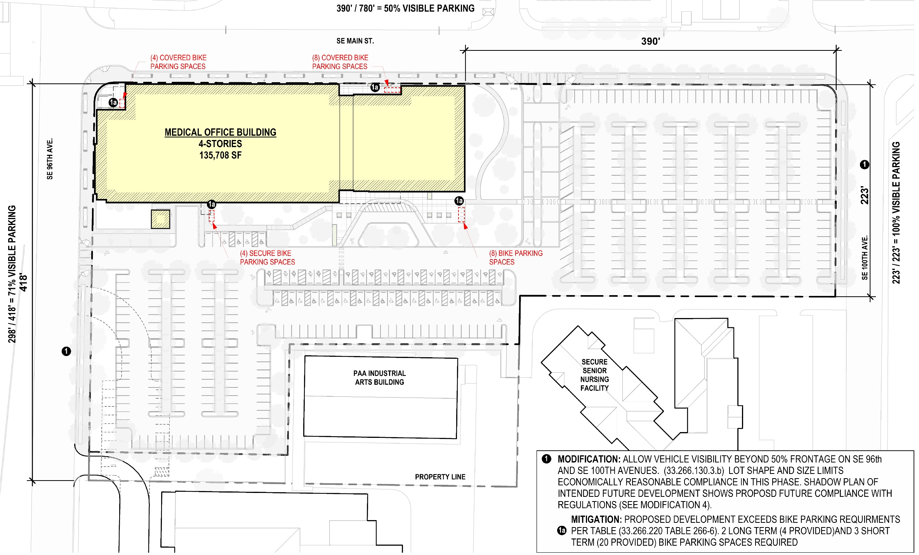
Modification 3
Vehicle Frontage Limitations
(33.266.130.C.3.b)
Where vehicle areas are adjacent to a transit street or a street in a Pedestrian District, no more than 50 percent of the frontage on the transit street or street in a Pedestrian District may be used for vehicle areas. The proposal is for 50 percent on SE Main, 100 percent on SE 100th and 71% on SE 96th.

Slide 20
Modification 4
Required Building Length on SE Main Street
(33.526.280.C)
Buildings on Enhanced Pedestrian Streets where development adds at least 40,000 square feet must extend to the street lot line along at least 75 percent of the lot line. The proposal extends to the street lot line for less than 50 percent.
390’
390’

Slide 21
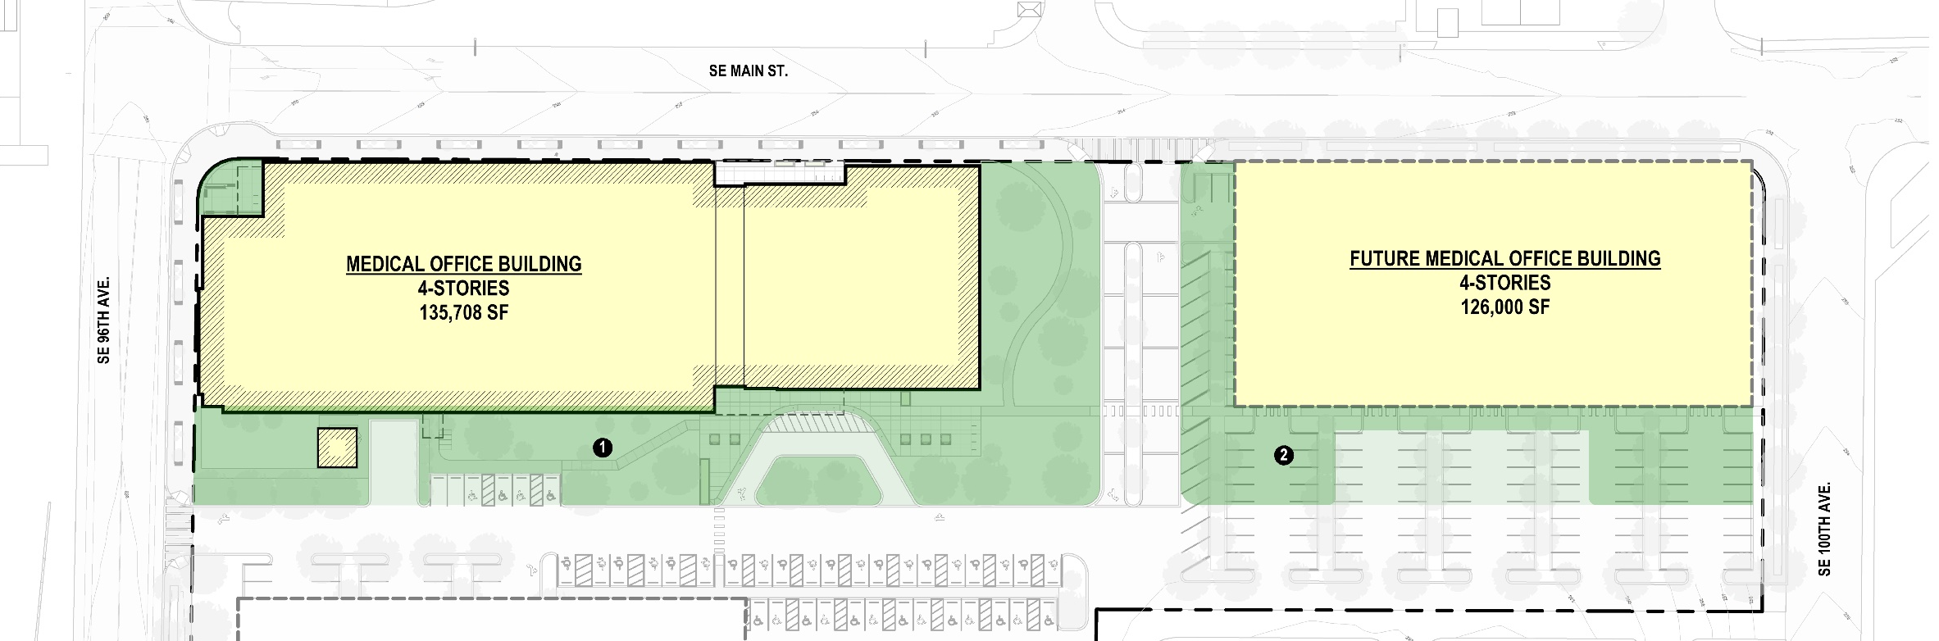
Modification 5
Phase or Defer Open Area Requirement
(33.526.240)
Open area is intended to be occupiable space for people. It does not include areas used for parking or loading, or landscaping within parking areas. It may be phased through the Gateway Master Plan process, or provided off-site through a fee in lieu program. Adjustments to the quantity of open area required are prohibited.

Slide 22
Staff Introduction
Applicant Presentation
Staff Discussion Topics
Public Comments
Commission Conversation

Slide 23
Staff Introduction
Applicant Presentation
Staff Discussion Topics
Public Comments
Commission Conversation

