Slide 1
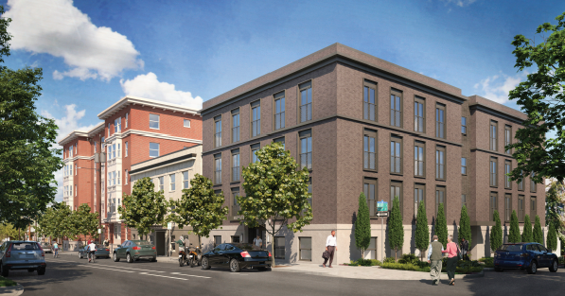
City of Portland
Historic Landmarks Commission
Appeal of Type III Approval
LU 18-187493 HRM
Block 126 Apartments,
1727 NW Hoyt
November 29, 2018
Staff Presentation
Notes:
Good afternoon, Mayor and Commissioners.
My name is Grace Jeffreys, and I am a city planner with the Bureau of Development Services.
Today, I’ll be providing some basic context for the proposal for Block 126 Apartments at 1727 NW Hoyt., and summarizing the Final Findings and Decision of approval by the Historic Landmarks Commission.

Slide 2
Context
Regulatory framework
Site and Context
Proposal
Land Use History of Site
Project History
Project - HRR
Additional Reviews
Historic Landmarks Decision
Appeals
Reasons for Appeal
Council Alternatives
Notes:
Context
Regulatory framework
Site and Context
Proposal
Land Use History of Site
Project History
Project - HRR
Additional Reviews
Historic Landmarks Decision
Appeals
Reasons for Appeal
Council Alternatives

Slide 3
Context
Notes:
First, the Context.

Slide 4
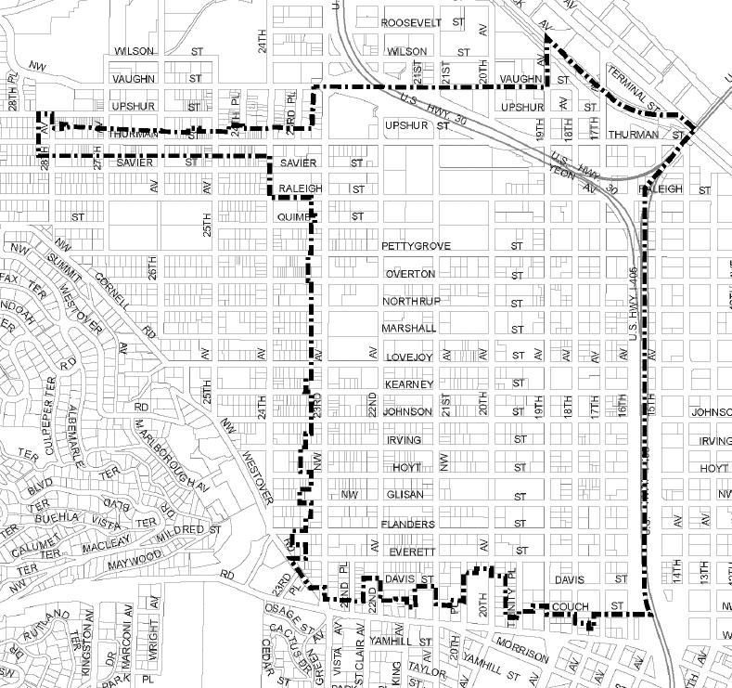
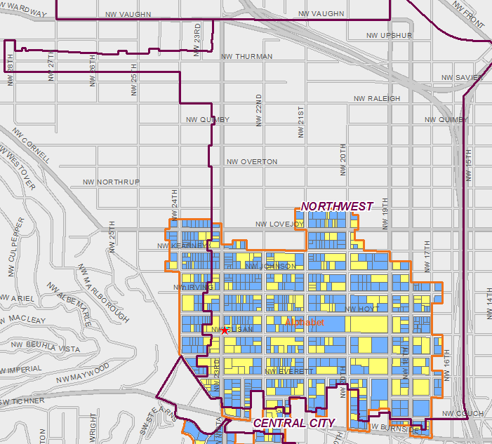
Context
Regulatory Framework
Location:
Northwest Plan District
Alphabet Historic District
Base Zone: RH
Overlay:
Historic Resource Protection Overlay
Floor Area Ratio:
Max: 4:1 base, 5:1 w/ IH Proposed: 3.6:1
Height:
Max: 75’
Prop: 58’
Approval Criteria:
CDG/HAD
MOD
AD
Northwest Plan District
Alphabet Historic District
Notes:
The subject site is located in NW Portland, in the Northwest Plan District and the Alphabet Historic District.

Slide 5
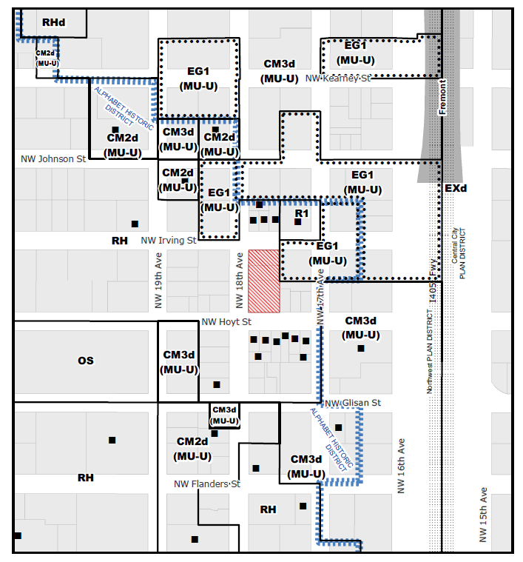
Context
Regulatory Framework
Location:
Northwest Plan District
Alphabet Historic District
Base Zone: RH
Overlay:
Historic Resource Protection Overlay
Floor Area Ratio:
Max: 4:1 base, 5:1 w/ IH Proposed: 3.6:1
Height:
Max: 75’
Prop: 58’
Approval Criteria:
CDG/HAD
MOD
AD
Zoning Map
Notes:
The site is zoned RH, which is short for High Density Residential.

Slide 6
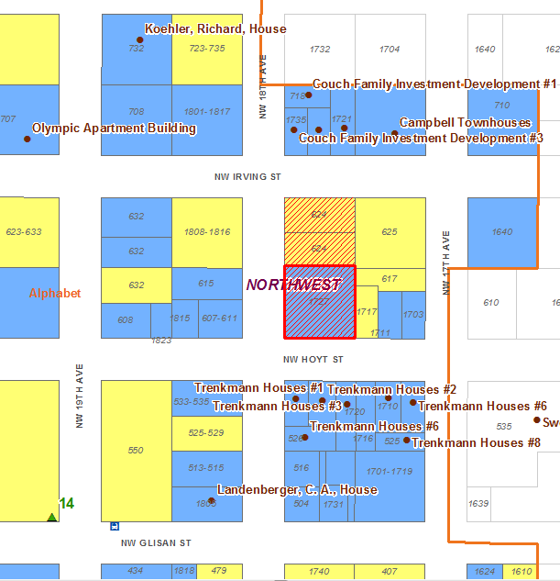
Context
Regulatory Framework
Location:
Northwest Plan District
Alphabet Historic District
Base Zone: RH
Overlay:
Historic Resource Protection Overlay
Floor Area Ratio:
Max: 4:1 base, 5:1 w/ IH Proposed: 3.6:1
Height:
Max: 75’
Prop: 58’
Approval Criteria:
CDG/HAD
MOD
AD
Part of Alphabet Historic District Map
Notes:
Because the site lies within the Alphabet Historic District, it has a Historic Resource Protection Overlay. Directly on the site lies the Buck-Prager Building, indicated in solid red, which is considered a Contributing Resource to the district. Historic Resources close by include:
To the north and south of the site, across NW Hoyt and NW Irving, are Individually listed landmark structures (indicated by brown dots)..
To the west of the site, across NW 18^{th ,} are Contributing Resources (indicated by blue shading).
Non-contributing development is indicated in yellow.

Slide 7
Floor Area Ratio:
Max: 4:1 base, 5:1 w/ IH
Proposed: 3.6:1
Height:
Max: 75’
Prop: 58’
Subject to IH reqmt’s
Context
Regulatory Framework
Location:
Northwest Plan District
Alphabet Historic District
Base Zone: RH
Overlay:
Historic Resource Protection Overlay
Floor Area Ratio:
Max: 4:1 base, 5:1 w/ IH Proposed: 3.6:1
Height:
Max: 75’
Prop: 58’
Approval Criteria:
CDG/HAD
MOD
AD
Zoning Map
Notes:
Zoning allowances include:
A base floor area ratio, or FAR, of a maximum 4:1. For proposals meeting Inclusionary Housing requirements, a FAR of up to 5:1 is allowed. The proposal is well under that, at 3.6:1.
The maximum allowed of height is 75’. The proposal is well under that, at 58’.
This proposal is also subject to Inclusionary Housing requirements under zoning code Chapter 33.245, Inclusionary Housing. This chapter requires:
New buildings with 20 or more dwelling units; and
Alterations to existing buildings that add 20 or more dwelling units.
to provide Affordable dwelling units at prescribes rates.
(PAUSE)
Those rates include:
(1) 8 percent of the total dwelling units must be affordable to those earning no more than 60 percent of the area median family income; or
(2) 15 percent of the total number of dwelling units must be affordable to those earning no more than 80 percent of the area median family income.

Slide 8
Context
Regulatory Framework
Location:
Northwest Plan District
Alphabet Historic District
Base Zone: RH
Overlay:
Historic Resource Protection Overlay
Floor Area Ratio:
Max: 4:1 base, 5:1 w/ IH Proposed: 3.6:1
Height:
Max: 75’
Prop: 58’
Approval Criteria:
CDG/HAD
MOD
AD
Zoning Map
Notes:
Adjacent to the site, the NE corner of the block is zoned EG1, which has different zoning allowances than the RH zone. A modification is requested to landscaping setback for the proposed loading space adjacent to this property. I will speak more about this Modification in a later slide.
Zoning allowances for this zone include:
FAR 3:1 and height of 45’,
Required Side setbacks, which vary from 5’ to 14’ depending on size of the building wall.
Required Landscape buffers at side lot lines of 5’ of L3 if wall is less than 15’ high, and 10’ of L3 if wall is over 16’ in height.
(PAUSE)

Slide 9
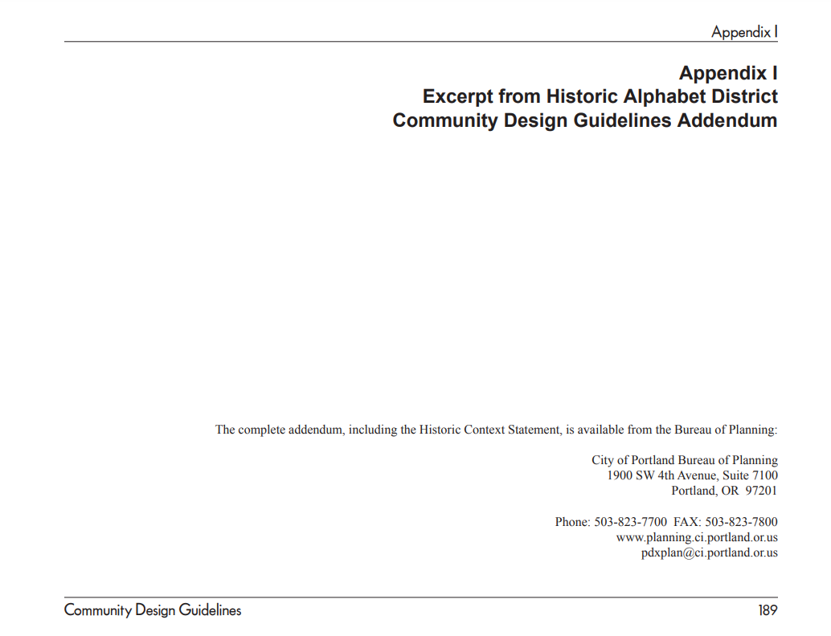
Context
Regulatory Framework
Location:
Northwest Plan District
Alphabet Historic District
Base Zone: RH
Overlay:
Historic Resource Protection Overlay
Floor Area Ratio:
Max: 4:1 base, 5:1 w/ IH Proposed: 3.6:1
Height:
Max: 75’
Prop: 58’
Approval Criteria:
CDG/HAD
MOD
AD
Approval Criteria
Historic Resource Review Community Design Guidelines (CDG)
Historic District Alphabet CDG Addendum (HAD), CDG Appendix I
Modifications 33.846.070 – Modifications Considered during Historic
Resource Review
Adjustments 33.805.040 – Adjustments, Approval Criteria
Notes:
This land use review consists of three parts, each with its own approval criteria:
For the Historic Resource Review, the approval criteria are the Community Design Guidelines and the Historic Alphabet District Community Design Guidelines Addendum, which is included in Appendix I of the CDG. These documents are separate from the zoning code, but are referred to in zoning code section 33.846.060.E.1.c
For the 2 requested Modifications, the approval criteria are found in zoning code section 33.846.070, Modifications Considered during Historic Resource Review,
For the requested Adjustment, the approval criteria are found in zoning code section 33.805.040.

Slide 10
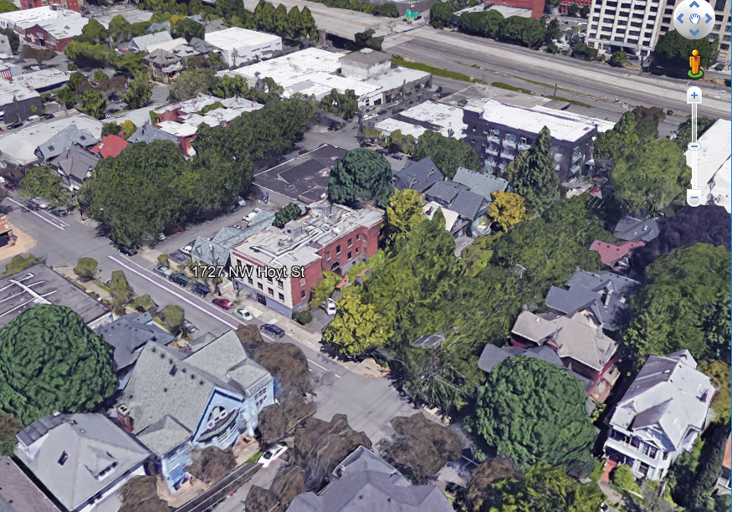
Context
Site & context
Site Area
Total Site: 20,000 SF
Existing
Buck-Prager
One-story structure to be demolished
2 surface parking areas
Street Frontages
NW 18th Avenue [200’]
NW Hoyt Street [100’]
NW Irving Street [100’]
Notes:
The Site Area is 20,000 SF, which is a city half-block. Existing development on the site includes:
the Buck-Prager building,
an existing one-story multi-dwelling structure to its north that will be demolished, and
surface parking areas at the north and south.
Street Frontages include:
200’ on NW 18th Avenue
100’ on NW Hoyt Street
100’ on NW Irving Street

Slide 11
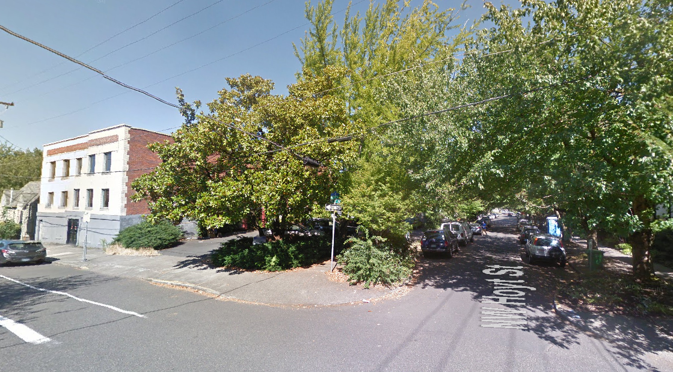
Context
Site & context
Notes:
This is a view of the SW end of the site from the corner of NW 18th & Hoyt. You can see the painted brick front of the Buck-Prager building facing NW 18th, and its exposed red brick side facing the existing surface parking lot to the south.

Slide 12
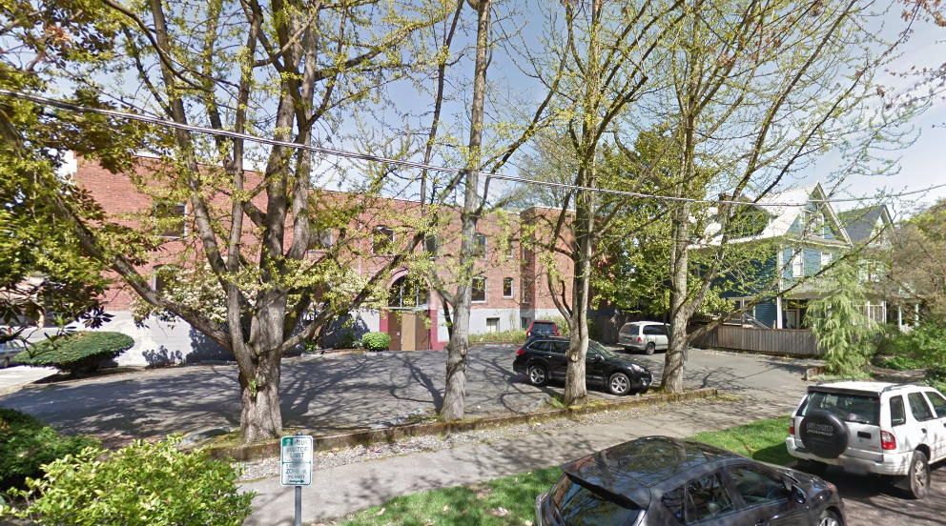
Context
Site & context
Notes:
This is a view from NW Hoyt showing the side elevation of the BP beyond the surface parking, and the adjacent residence to the east on NW Hoyt.

Slide 13
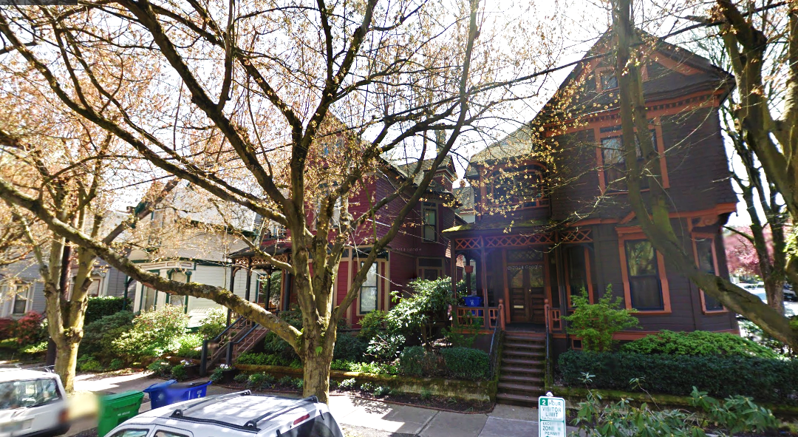
Context
Site & context
Notes:
This is a view of the individually listed Landmark Houses across NW Hoyt from the site, which are part of the Trenkmann Houses group

Slide 14
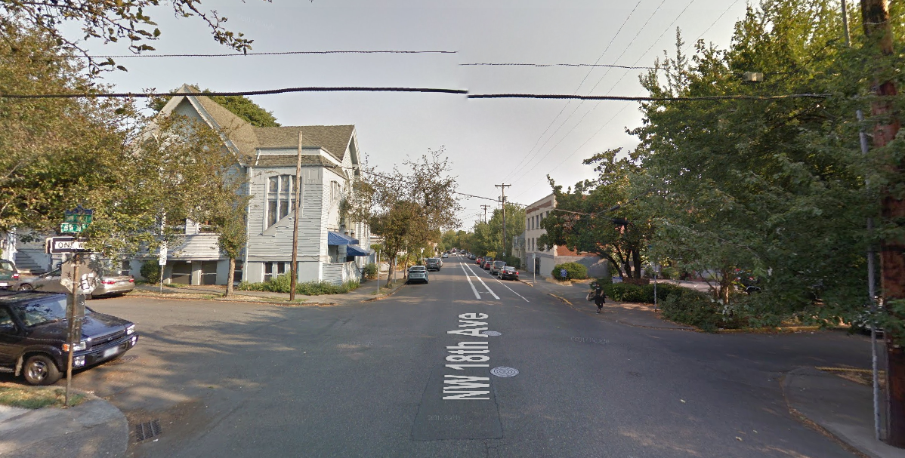
Context
Site & context
Notes:
This is a view north on NW 18th showing the First Norwegian–Danish Church across NW 18th from the site, which is considered a contributing resource in the district.

Slide 15
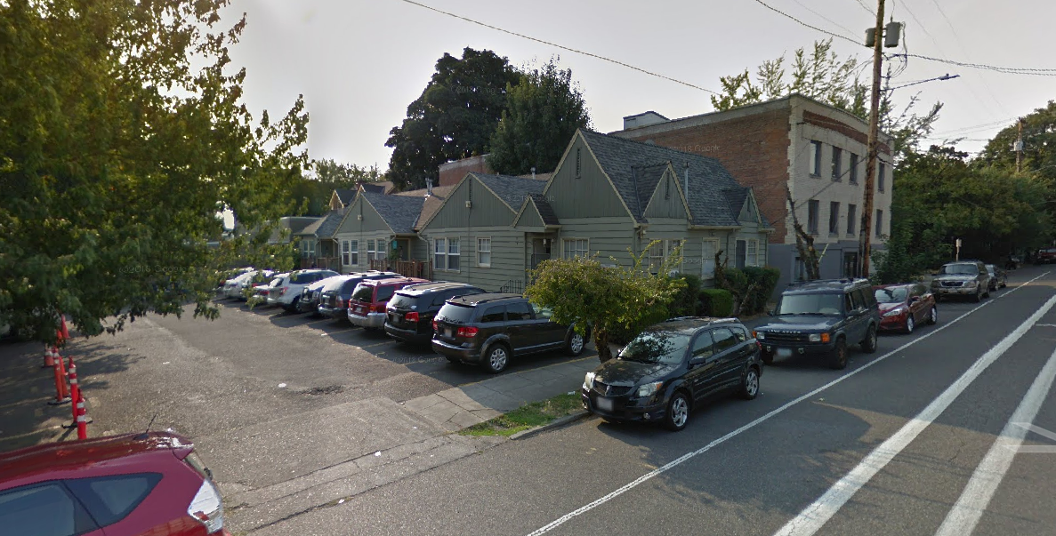
Context
Site & context
Notes:
This is a view of the NW end of the site, from the corner of NW 18th & Irving. You can see the existing one-story, wood-framed, multi-dwelling building which will be demolished to the north of the Buck-Prager building. This also shows the existing surface parking lot on the north end of the site.

Slide 16
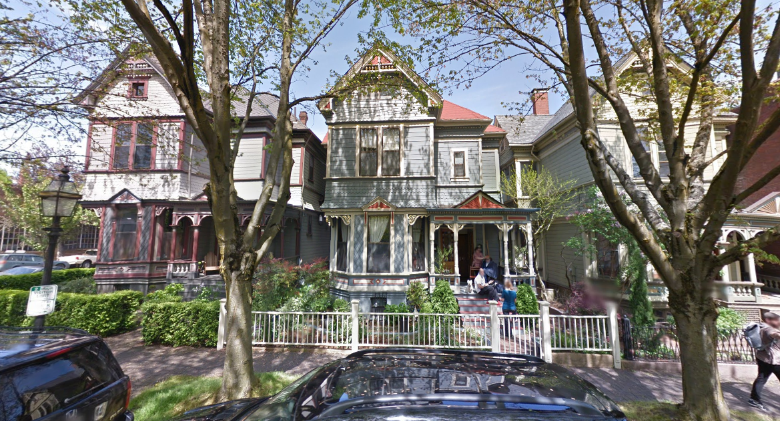
Context
Site & context
Notes:
This is a view of the individually listed Landmark Houses across NW Irving from site, which are part of the Couch Family Investment Development.

Slide 17
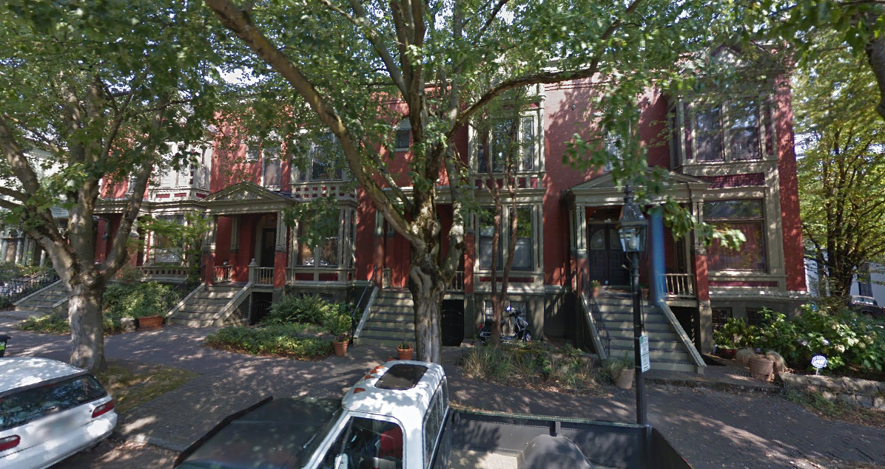
Context
Site & context
Notes:
This is a view of the individually listed Landmark Houses across and down NW Irving from site, the Campbell townhouses.

Slide 18
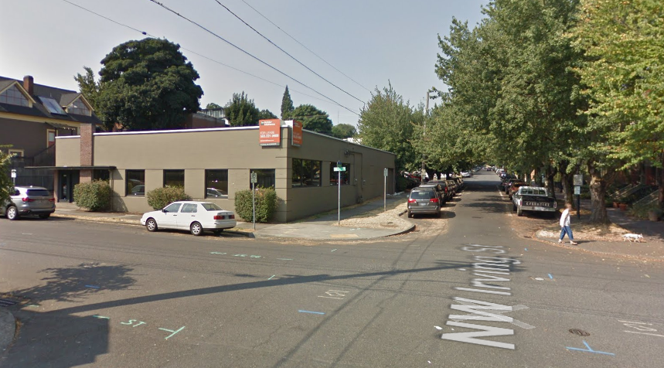
Context
Site & context
Notes:
This is a view west on Irving showing the existing one-story commercial structure to the east of the site, which, as noted earlier, is zoned EG1, General Employment 1.

Slide 19
Proposal
Notes:
Now I will give a brief overview of the proposal.

Slide 20
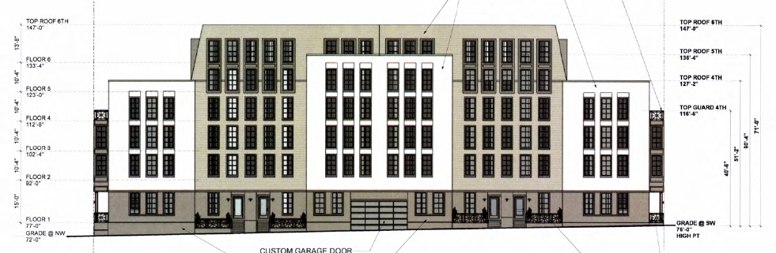
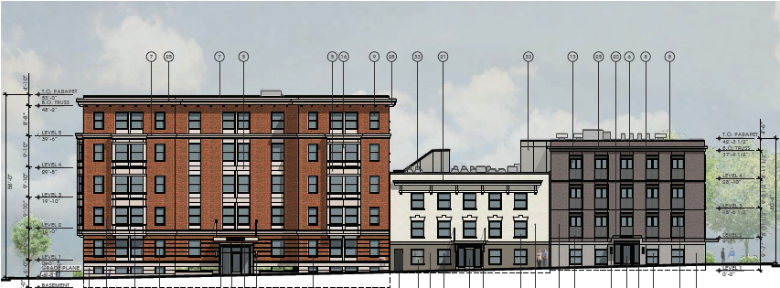
Proposal
Land Use History of Site
2014 Type IV Demolition Review – Denied by CC
Approved LU Proposal
Notes:
There was a previous Land Use decision by the City Council for this site.
In 2014, the City Council denied a Type IV Demolition Review for the demolition of the Buck-Prager Building, the existing contributing resource on this site.
The top drawing shows that proposal, with an overlay of this current proposal, shown with a red dotted line.
(PAUSE)

Slide 21
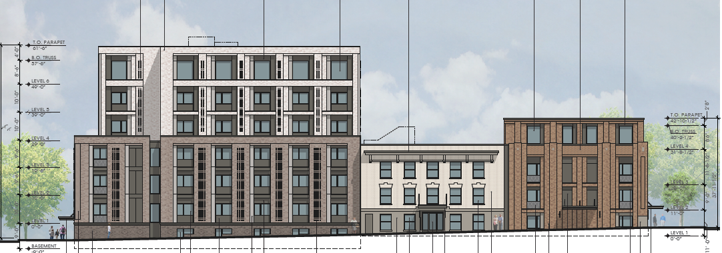
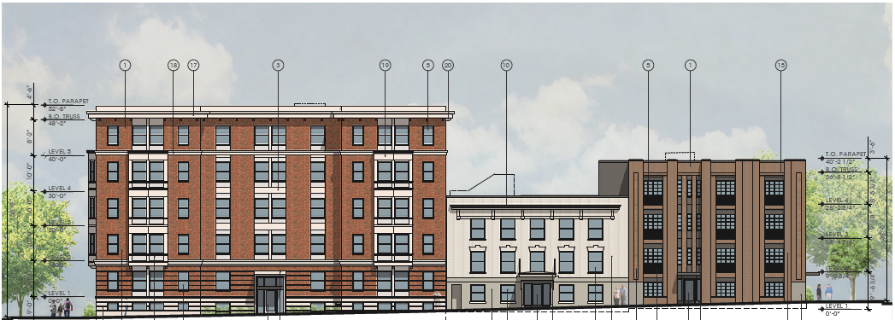
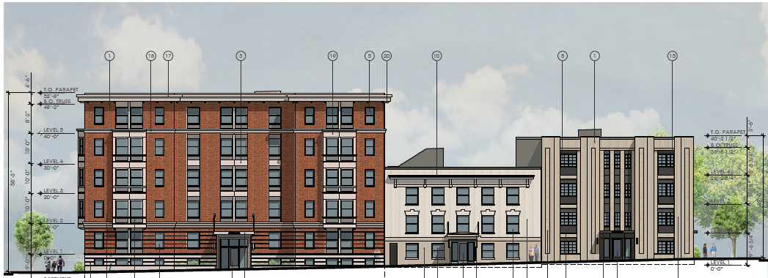
Proposal
Project History
DAR #1
DAR #2
DAR #3
APPROVED LU PROPOSAL
Notes:
For this current proposal, three voluntary Design Advice request meetings were held with the Landmarks Commission.
The applicant was very responsive to feedback, and undertook numerous changes to the proposal, including revisions to massing, height, and design refinements, to better respond to the Buck-Prager as well as the surrounding neighborhood and district character.

Slide 22
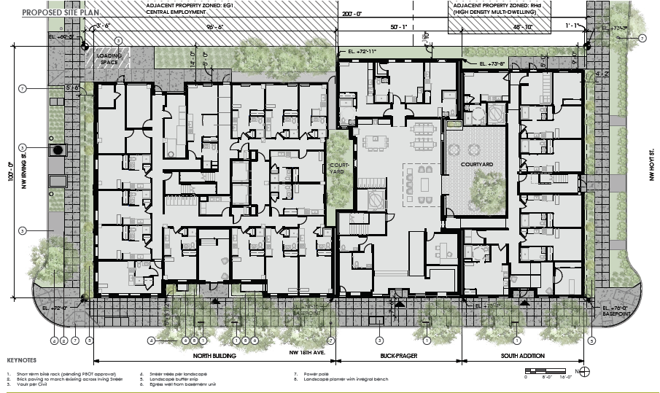
Proposal
Historic Resource Review
Overall
5+-story North Building
Buck-Prager renovation
4-story South Addition
Program
148 new dwelling units
One loading space
No parking
North Building
Buck-Prager
South Addition
Notes:
The proposed development includes three structures:
5+-story North Building
Buck-Prager renovation
4-story South Addition to the BP. This structure is considered an “Addition” because there are internal connections to the BP.
The Program consists of:
148 new dwelling units
One loading space
No parking

Slide 23
Proposal
Additional reviews
Modifications
1. Bike parking spacing
2. Loading setback/landscape
Adjustment
1. Number of loading spaces
Notes:
Additional reviews request include 2 Modifications and 1 Adjustment.
Modification #1 is to reduce the required spacing between long-term bike parking spaces from 2’-0” to 1’-6”, and to provide non-lockable bike racks in dwelling units (33.266.220.C.B); This is a commonly supported modification.

Slide 24
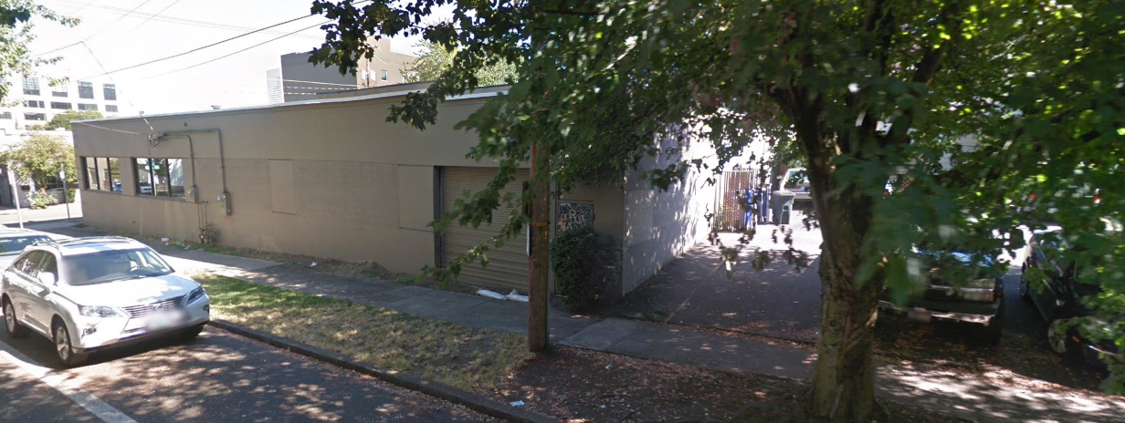
Proposal
Additional reviews
Modifications
1. Bike parking spacing
2. Loading setback/landscape
Adjustment
1. Number of loading spaces
Notes:
Modification #2 is to omit the required 5’ of L2 landscape screening buffer required between the loading space and the adjacent EG1 property off NW Irving.
It is important to note this is only for required landscape setback at the loading space, shown by the red arrow and dotted line.
The new buildings themselves meet the required side setback minimums, and landscape is provided the remaining length of the property line.
The top image shows the concrete side wall of the neighboring 1-story commercial building, adjacent to the proposed loading area.
The findings note that:
This moderation covers only a small part of the length of this side property line. The adjacent building is a solid concrete wall which provides screening.
Relative to this development, the standard is to provide high wall screening and landscape at the property line, to provide screening from adjacent properties.
However, placing a screening element at this location is redundant due to the screening provided by the adjacent concrete wall.
Eliminating this buffer where it will have little positive impact allows the applicant more flexibility elsewhere to include setbacks where they aren’t required by code, but are more consistent with the Historic District, such as the proposed frontage landscape setbacks on Irving and Hoyt.

Slide 25
Proposal
Additional reviews
Modifications
1. Bike parking spacing
2. Loading setback/landscape
Adjustment
1. Number of loading spaces
9’
loading
14’
setback
5’
ped path
Notes:
Here is a blown-up image of that area.
Note that there is both a required 5’ wide pedestrian path and a 9’ wide loading space are located in this area.
Note also that there is additional, non-required Landscaping provided close by, along the frontage at Irving.

Slide 26
Proposal
Additional reviews
Modifications
1. Bike parking spacing
2. Loading setback/landscape
Adjustment
1. Number of loading spaces
Notes:
The requested Adjustment is to reduce the required number of loading spaces from two (2) Standard B spaces to one (1) Standard B space (33.266.310.C).
For residential developments 100 units or less, the zoning code requires one Type B loading space. Because there are 100 units in the north building, shown in orange, a loading space is proposed to serve that population.
The adjustment was requested to not provide an on-site loading space for the 48 units in the BP and SA, shown in blue. Because this proposal is for senior housing studio apartments, PBOT found that:
These types of units have a much lower turnover rate, and being studios, not as much to move in or out.
PBOT’s view of on-site Type B spaces has been evolving, and their experience has been that most are not being used for loading, but as a trash and recycling area that has a curb cut to wheel out the dumpsters. The curb cut for a Type B space is 10-ft wide with 6-ft wide commercial wings. This results in 22-ft of curb space that is permanently lost for private use.
PBOT would rather have control over how the curb zone is managed,, and by allowing an on-street loading space, they can assign the hours, so it is available to residents and visitors during peak demand times.
This adjustment was supported by both BDS and PBOT.

Slide 27
Portland Historic Landmarks Commission voted 5 : 1 for approval
Proposal
PHLC Decision
North Building
Buck-Prager
South Addition
Notes:
The Portland Historic Landmarks Commission voted 5 to 1 to approve this land use review.

Slide 28
Appeal
Notes:
Now I will briefly go through the issues brought up in the two appeals.

Slide 29
Appeal
Reasons for Appeal
Guidelines
Procedures
Guidelines raised by Appellants
HAD 2 - Differentiate new from old
HAD 3 - Hierarchy of Compatibility
CDG Pl - Plan Area Character.
CDG P2 - Historic and Conservation Districts.
CDG D6 - Architectural Integrity.
CDG D7 - Blending into the Neighborhood.
Procedural Issues raised by Appellants
Application was declared complete when Guideline Pl had not been addressed.
The hierarchy of regulations was not followed.
An incomplete history of site was provided.
Public comments addressing approval criteria were not acknowledged or evaluated.
Harassment of one Historic Landmarks Commissioner adversely affected the proceedings.
Notes:
The HLC’s decision of approval with conditions was appealed by two parties.
Both appellants both cite:
6 guidelines as not being met, and
5 procedural issues.

Slide 30
Appeal
Reasons for Appeal
Guidelines
Procedures
Guidelines raised by Appellants
HAD 2 - Differentiate new from old
HAD 3 - Hierarchy of Compatibility
CDG Pl - Plan Area Character.
CDG P2 - Historic and Conservation Districts.
CDG D6 - Architectural Integrity.
CDG D7 - Blending into the Neighborhood.
Final Findings & Decision Summary:
The proposed development will retain and preserve the Buck-Prager, a contributing resource to the AHD, and the resulting multiple building frontage will add a fine-grained scale to the block which is a desired characteristic of historic development in the district.
Notes:
Guidelines HAD #2 and #3, CDG #P1, P2, D6 and P7 all speak to the proposal’s response to its surrounding context. In their Final Findings & Decision Summary, the Historic Landmarks Commission found that:
The proposed development will retain and preserve the Buck-Prager, a contributing resource to the AHD, and the resulting multiple building frontage will add a fine-grained scale to the block which is a desired characteristic of historic development in the district.
Note the Red arrow points to the BP.

Slide 31
Appeal
Reasons for Appeal
Guidelines
Procedures
Procedural Issues raised by Appellants
Application was declared complete when Guideline Pl had not been addressed.
The hierarchy of regulations was not followed.
An incomplete history of site was provided.
Public comments addressing approval criteria were not acknowledged or evaluated.
Harassment of one Historic Landmarks Commissioner adversely affected the proceedings.
Notes:
Now I will address the Procedural Issues raised by Appellants

Slide 32
Appeal
Council Alternatives
Alternatives Facing Council
Deny the appeal, and uphold the Historic Landmarks Commission’s decision to approve the requested Block 162 Apartments Historic Review (HR) with Modifications (M) and Adjustment (AD), case file # LU 18-187493 HRM AD.
Deny the appeal, and uphold the Historic Landmarks Commission’s decision to approve, with additional conditions of approval, the requested Block 162 Apartments Historic Review (HR) with Modifications (M) and Adjustment (AD), case file # LU 18-187493 HRM AD.
Grant the appeal, and overturn the Historic Landmarks Commission’s decision to approve the requested Block 162 Apartments Historic Review (HR) with Modifications (M) and Adjustment (AD), case file # LU 18-187493 HRM AD, thereby denying the proposal.
Notes:
The following alternatives face the Council:
Deny the appeal, and uphold the Historic Landmarks Commission’s decision to approve the land use review.
Deny the appeal, and uphold the Historic Landmarks Commission’s decision to approve, with additional conditions of approval, the land use review.
Grant the appeal, and overturn the Historic Landmarks Commission’s decision to approve the land use review, thereby denying the proposal.
This concludes the staff presentation.

Slide 33
Questions?
Notes:
This is the end of my presentation, Any questions for me?

Slide 34
References

Slide 35
Specific Development Standards to Note
Use (PZC 33.562.120.B, 33.120.100.B.2). Retail Sales and Services and Office Uses are not allowed in RH zones.
Height (PZC 33.562.210, 33.120.215). maximum allowed of 75’. Heights above this are allowed thru Bonus Options, however, none of bonus options listed apply to this location.
FAR (PZC 33.562.220, 33.120.205). maximum FAR of 4:1, and 5:1 with Inclusionary Housing. Because proposal is for two separate buildings, but FAR allowances are being spread over the entire site, an Allocation Covenant will be required at time of permit identifying FAR allocated from one part of site to the other.
Inclusionary Housing (PZC 33.245). Because this proposal includes new buildings with 20 or more dwelling units, Inclusionary Housing requirements apply.
Setbacks (PZC 33.120.220). minimum side and rear setbacks are determined by the area of the plane of the building wall, and range from 5’ to 14’.
Building Coverage (PZC 33.120.225). Maximum building coverage of 85% applies.
Minimum Landscaped Areas (PZC 33.120.235). Minimum landscaped requirement of 15%.
Required Outdoor Areas (PZC 33.120.240). At least 48 SF of outdoor area is required for each dwelling unit on site. This can be provided as individual, or shared areas.
Screening (PZC 33.120.250). Garbage, recycling, and mechanical equipment on the ground must be screened.
Pedestrian Standards (PZC 33.120.255). On-site pedestrian circulation system must be provided. Parking (PZC 33.562.280, 33.266). There are no minimum parking requirements.
Loading (PZC 33.266). One Standard A (35’x10’x13’) or two Standard B (18’x9’x10’) loading spaces are required.
Trees in Development Situations (11.50). Note in particular that Tree Preservation (11.50.040) and On-Site Tree Density (11.50.050) standards do apply to development on sites zoned RH.
Proposal

Slide 36
Procedural History
PRE-APPLICATION
Pre-Application Conference, December 12, 2017 (Required for Type III land use reviews)
Feedback: Concerns with massing, ground level activation and detail resolution.
DESIGN ADVICE REQUEST
1ST DAR, January 8, 2018,
Feedback: Concerns with massing, ground level activation and detail resolution.
2ND DAR, February 26, 2018
Feedback: Concerns with massing, ground level activation and detail resolution.
3RD DAR, April 23, 2018.
Feedback: Three “building” approach supported. Better response to BP needed. High level detail required.
HISTORIC RESOURCE REVIEW
1ST Historic Resource Review, August 27, 2018
Feedback: Entries, bay detailing, patio doors, landscape irrigation and street trees.
Record was requested to be held open by a member of the public to allow time for review of information (Exhibit H.23). The Commission agreed to hold the record open as follows:
New information was due in by 5pm on September 4, 2018.
Response to the new information was due in by 5pm on September 11,
A Final Applicant rebuttal was due in by 5pm on September 18, 2018.
2nd Historic Resource Review, September 24, 2018 (closed record)
Commission deliberated and voted to approve the proposal.
Vote was 5:1 in adopting Final Findings recommending approval.
APPEAL
2 Appeals received – October 22, 2018
Proposal
Notes:
An outline of the proposal’s procedural history is shown on screen. In short, there has been a required pre-application conference in December 2017, three voluntary Design Advice Request hearings in January, February and April , 2018, and two Design Review hearings during the fall of 2018, because the record was requested to be held open at the first hearing. The proposal was approved on September 24, 2018 by a vote of 5 to 1.
The appeals were both filed on October 22, 2018.

Slide 37
Context
Regulatory Framework
Base Zones
Notes:
Here is a zoning map with an overlay showing patterns of zoning:
- Employment is indicated in purple (located towards I-405 and to the north of site),
Commercial in red (generally grouped along more major streets such as Glisan to the south, 16th to the east, as well as 18 & 19th towards the north) .
Couch Park to the west of the site is zoned Open space, noted in green.
The site itself sits in a mainly residential zoned pocket, but employment zoning does abut the site on the northeastern corner of the block.

Slide 38
Modification 2
The Purpose: These standards ensure that the appearance of loading areas will be consistent with that of parking areas, which in turn promote vehicle areas that are safe and attractive for motorists and pedestrians.
The setback and landscaping standards for parking are intended to:
Improve and soften the appearance of parking areas;
Reduce the visual impact of parking areas from sidewalks, streets, and especially from adjacent residential zones;
Provide flexibility to reduce the visual impacts of small residential parking lots;
Direct traffic in parking areas;
Shade and cool parking areas;
Reduce the amount and rate of stormwater runoff from vehicle areas;
Reduce pollution and temperature of stormwater runoff from vehicle areas; and
Decrease airborne and waterborne pollution.
Proposal
Additional reviews
Modifications
1. Bike parking spacing
2. Loading setback/landscape
Adjustment
1. Number of loading spaces

