Slide 1
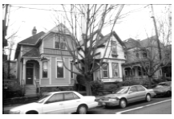
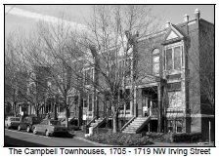
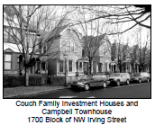
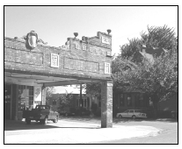
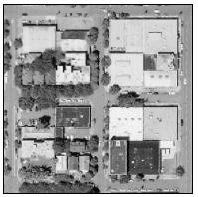
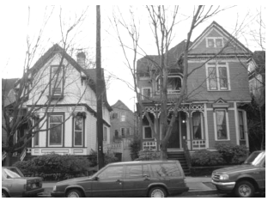
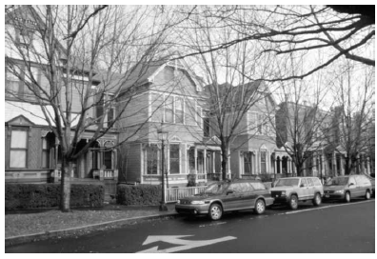
NWDA Appeal of
LU 18-187493 HRM AD
1727 NW Hoyt (Buck-Prager)
City Council Hearing – November 29, 2018
Pictures on this page (of surrounding historic properties)
are taken from City design review criteria documents.

Slide 2
Affordable Housing and Historic Preservation are not mutually exclusive

Slide 3
City Council is responsible for supporting Affordable Housing and protecting Historic Resources
We believe you can balance these goals and doing so will ensure the integrity, livability, and continued special character of Portland

Slide 4
The decision is not about affordable housing but incompatible design

Slide 5
Overview
We request that you deny the proposal.
Immediate Neighborhood a unique slice of Portland
Approval criteria are not met
  Historic Alphabet District Guidelines #2 and #3 and Community Design Guidelines P1, P2, D6 and D7
Procedural errors were made
  Five errors identified
Condition requested
  Limit development on this site to affordable housing for persons at 60% of median family income (MFI).

Slide 6
This is our neighborhood
The six blocks surrounding the site:
The first housing for investment/rental homes in Portland
Unique townhome architecture and complete block fronts of historical homes
Earliest Scandinavian Churches on the west coast
Catalyst for the Renovation of Northwest in 70’s
  with Bing Sheldon, William Jameson, Rick Michaelson and the City coming together to preserve the historic homes

Slide 8
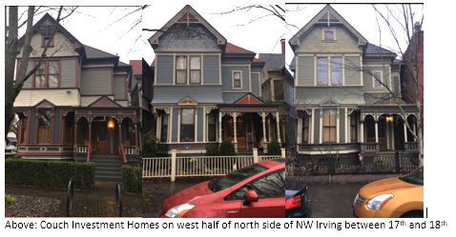
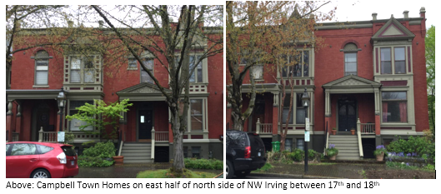
This is our Neighborhood: NW Irving

Slide 9
This is our Neighborhood: From NW 18th and Irving

Slide 10
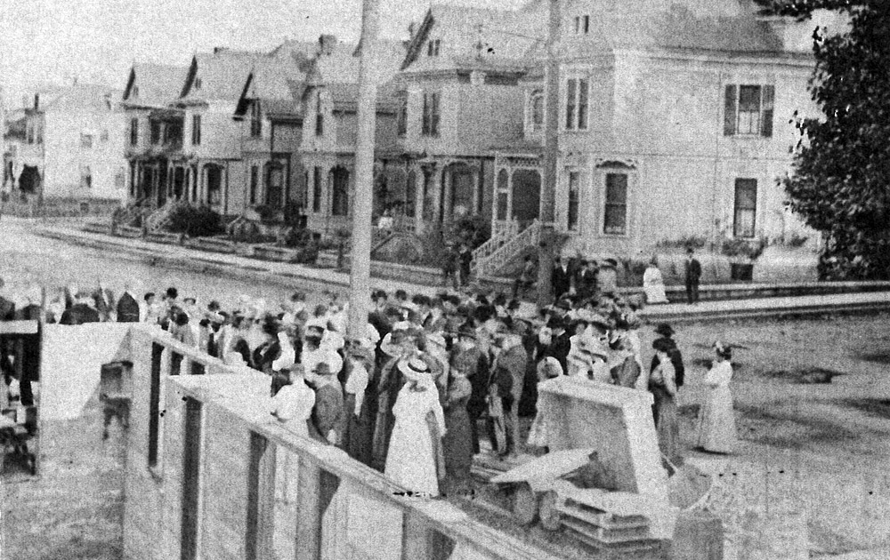
This is our Neighborhood: From NW Hoyt and 18th

Slide 11
This is our Neighborhood: NW Hoyt

Slide 12
This is our neighborhood:
A unique slice of Portland history
Predominantly small homes averaging 2.5 stories on fine grained lot pattern
Largest concentration of Individually Listed Historic Properties in Portland
This proposal would place overly large buildings on the site, driving a wedge into the center of the neighborhood and breaking up the continuity and cohesiveness

Slide 13
Overview
We request that you deny the proposal.
Immediate Neighborhood a unique slice of Portland
Approval criteria are not met
  Historic Alphabet District Guidelines #2 and #3 and Community Design Guidelines P1, P2, D6 and D7
Procedural errors were made
  Five errors identified
Condition requested
  Limit development on this site to affordable housing for persons at 60% of median family income (MFI).

Slide 14
Approval Criteria:
Historic Alphabet District Guideline #2:
Differentiate new from old. New additions, exterior alterations, or related new construction will retain historic materials that characterize a property to the extent practicable . . . The design of new construction will be compatible with the historic qualities of the district as identified in the Historic Context Statement.

Slide 15
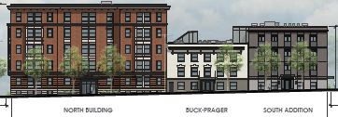
Approval Criteria not met
4-story South Addition and 6-story North Building do not complement scale or characterize the Buck-Prager and adjacent historic structures (all small structures described in historic context statement)
Incompatible feature examples:
Both new structures are large, blocky
buildings amid small detached,
highly articulated houses.
Set-backs: 13 inches on Hoyt;
42 inches on Irving
South Addition’s faux Juliet
balconies

Slide 16
Approval Criteria not met (Continued):
13 adjacent structures are individually listed on National Register and highlighted on pages 15-21 of NW Historic Context Statement; decision makes no mention of this important and most relevant context.
  “In 1884, the Couch family developed rowhouses on the block between I, J, 17th, and 18th Streets. These narrow frame houses [were] built in the Queen Anne style . . .In 1890, Herman Trenkmann, a contractor, constructed eight identical frame houses in the Queen Anne/Eastlake style at NW 17th and Hoyt. . . .In 1893, David Campbell built six brick rowhouses on the same block as the Couch family . . .properties.” [page 15] All of these surrounding properties were among the first houses built as rentals (also called "investment properties"), beginning a new trend. They were followed by construction of the fourplex on the southwest corner of NW 18th and Hoyt and the rowhouses on NW Glisan and 16th.
  “One of the first Scandinavian institutions to relocate [to Northwest] was the Immanuel Swedish Evangelical Lutheran Church. In 1906 it moved . . .to its present-day location at the corner of 19th and Irving Streets. The First Norwegian-Danish Methodist Episcopal Church followed . . . in 1910, it moved to its current site at 607-611 NW 18th Avenue. “ [page 21]

Slide 17
Approval Criteria
Historic Alphabet District Guideline #3: Hierarchy of Compatibility.
Exterior alterations and additions will be designed to be compatible primarily with the original resource, secondarily with adjacent properties, and finally, if located within a historic or conservation district, with the rest of the District. Where practical, compatibility will be pursued on all three levels. New development will seek to incorporate design themes characteristic of similar buildings in the Historic District.
This guideline mandates a clear hierarchy:
primary compatibility with the original resource,
secondary compatibility with adjacent properties,
finally … compatibility with the rest of the district.

Slide 18
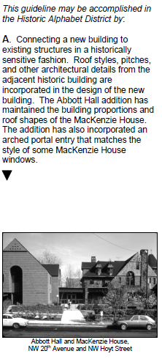
Approval Criteria not met
The findings erred in considering the North Building New Development:
Using Zoning Code definitions, the North Building is an exterior alteration to a site that is already developed, and therefore must meet the hierarchy
Findings for the North Building:
Ignore scale and proportion compatibility with the original resource, and
Ignore compatibility with adjacent properties.

Slide 19
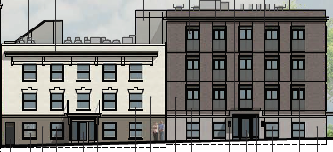
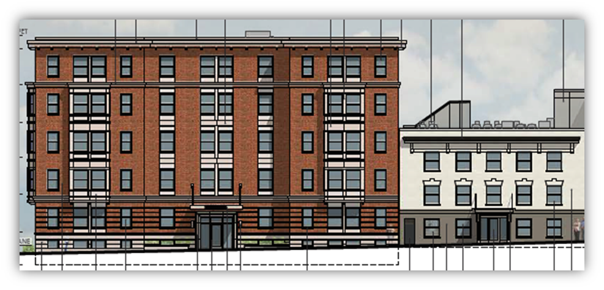
Approval Criteria not met
The South Addition is not designed in a historically sensitive fashion.
incompatible scale/proportion
addition not set back/subordinate
different fenestration (windows) –
major design feature.
not ‘fine-grained’ development
The North Building
Is not based on buildings primarily similar
to the historic resource on the site
Is not based on secondarily similar to
adjacent historic buildings
But is based on some of the most
dissimilar buildings in the district, set in
dissimilar contexts and not visible
from the project site.

Slide 20
Approval Criteria
Community Design Guideline P1 – Plan Area Character
Enhance the sense of place and identity by incorporating site and building design features that respond to the area’s desired characteristics and traditions.

Slide 21
Approval Criteria not met
The site is located within the Northwest Plan District; in the ‘Eastern Edge’ urban character area. The decision does not demonstrate compliance with the area’s desired characteristics and traditions:
  This particular area of the Northwest District’s Eastern Edge is distinguished by the unique cluster of houses built as rentals that are described as “middle-class Victorian houses, primarily in the Italianate and Queen Anne styles”, “Portland’s only nineteenth-century brick rowhouses”, and “occasional small wood-frame apartment buildings” (See discussion of architecture on page C-20 of the Northwest District Plan). “New development . . .[in] the Eastern Edge . . . [should] continue its established pattern of partial block massing…” (page C-21). “New buildings and additions that are taller than the two- to four-story building height that is predominant in the district should have upper stories stepped-back in order to contribute to a more consistent streetscape and to maintain neighborhood scale.” (page C-15 of the NW District Plan).
The lots in this area are small, with most residential lots less than 3,000 square feet in area. Even multidwelling buildings and rowhouses (such as the Campbell Townhouses and the fourplex at NW 18th and Hoyt) are typically designed to appear as individual residences on small lots.

Slide 22
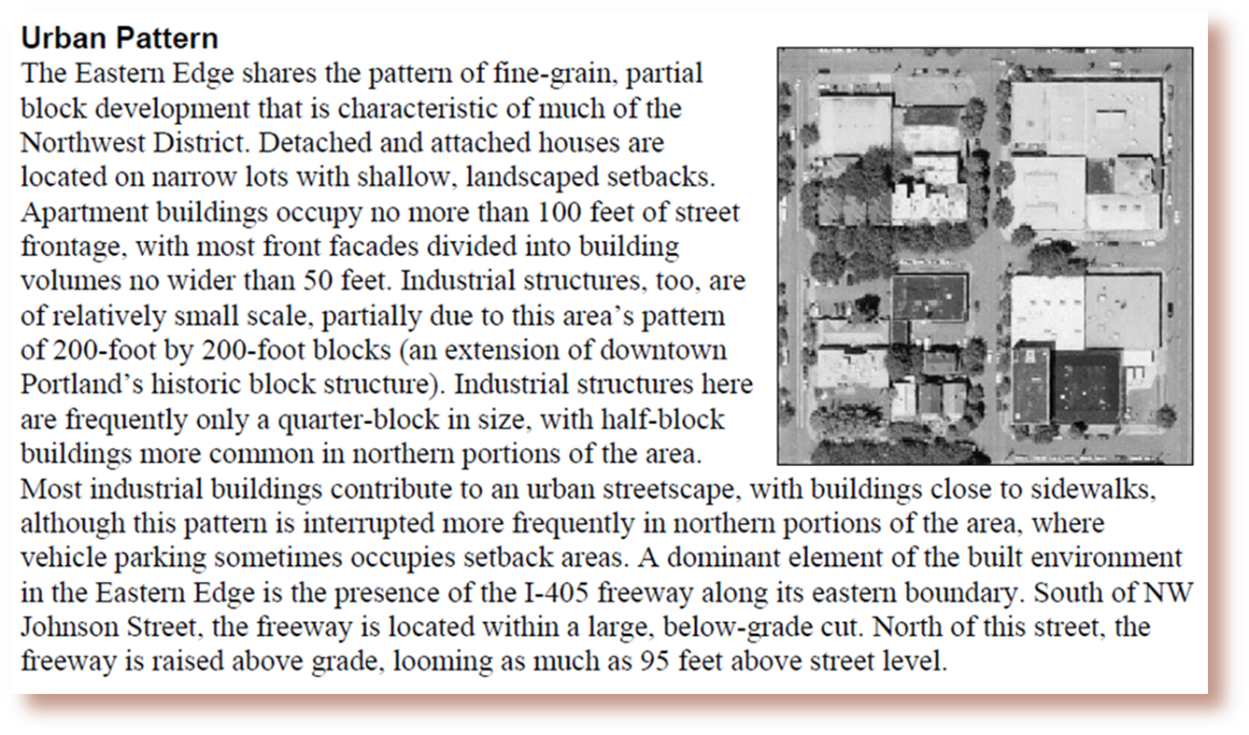
Project site is in the ‘Eastern Edge’ of the Northwest Plan District – it is included in example areal photo illustrating ‘fine grain, partial lot development’ (page C-20). Development with maximum lot coverage is inconsistent with the desired characteristics and traditions and a setting distinguished by a unique cluster of “middle class Victorian houses…” and “occasional small wood-frame apartment buildings”.
Eastern Edge urban design is “fine grain, partial lot development”
Adjacent and nearby contributing sites are being restored
Streetscape and pedestrian experience would suffer
At least 2 published historic walking tours feature this area

Slide 23
Approval Criteria:
Community Design Guidelines P2 – Historic and Conservation Districts.
Enhance the identity of historic and conservation districts by incorporating site and building design features that reinforce the area’s historic significance. Near historic and conservation districts, use such features to reinforce and complement the historic areas.

Slide 24
Approval Criteria not met
“New development in these areas should protect the integrity of individual historic resources and reinforce the historic character that defines the district.”(P2 background statement)
The Buck-Prager’s integrity is not protected when it is sandwiched between two significantly larger structures;
The character of the historic district is not reinforced when these incompatible new structures are placed in the middle of a nearly intact cluster of late 19th century middle class investment homes.

Slide 25
City Council’s Jan 2015 findings for this same site (LU 14-210073 DM)
Describe immediate context – “13 Landmarks within a one block radius of the proposed development” (see pages 26-27)
Note that the then proposed 4-6 story building “is not integrated with the existing urban fabric as it is not set back from the street, it does not feature intricate architectural detailing, and most significantly, it is much taller and more massive than the modest Landmark residential structures in the immediate vicinity.” (page 27)
With respect to the immediate context, City Council notes, “While the existing historic building is an appropriate scale for the adjacent properties, the proposed replacement building is severely out of scale and character, and would detract from the historic character of nearby Landmarks.” (page 30)
The Historic Landmarks Commission decision does not reference these very relevant City Council findings.

Slide 26
Approval Criteria:
Community Design Guideline
D6 – Architectural Integrity
Respect the original character of buildings when making modifications that affect the exterior. Make additions compatible in scale, color, details, material proportion, and character with the existing building

Slide 27
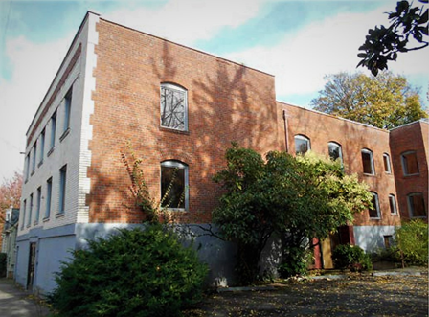
Approval Criteria not met
“Modifications should have the least impact on the character-defining features that are visible from the street.” (D6 background statement)
The Buck-Prager’s character-defining quoins (brick design) at both front building corners are
totally obscured.
The new structures overpower
the Buck-Prager and the many
adjacent historic structures.

Slide 28
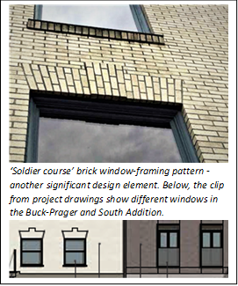
Approval Criteria not met
The South Addition is incompatible…
  In scale and proportion: it’s taller and almost twice as large as the petite Buck Prager
  In character: blocky, no cornice, no soldier course windows
  In details: for example, windows; quoins at building corner
A compatible addition would
  be smaller,
  be set back, and
  modestly mimic the historic building’s design features.

Slide 29
Approval Criteria
Community Design Guideline D7
Blending into the Neighborhood
Reduce the impact of new development on established neighborhoods by incorporating elements of nearby, quality buildings such as building details, massing, proportions and materials.

Slide 30
Approval Criteria not met
Large scale and lack of compatible set-backs of new development on side streets does not reduce the impact on the neighborhood.
The guideline calls for incorporating elements of nearby buildings. Intro specifies site details common in neighborhood and related to surrounding buildings in terms of scale, color, window proportions and façade articulation:
  Scale is larger and taller
  Windows are faux Juliet balcony style rather than brick soldier course and dissimilar to design of nearby buildings
  Façade has no compatible cornice, windows.

Slide 31
Approval Criteria not met
Examples for D7 demonstrate how the guideline is not met by proposed design:
Example A suggests incorporating elements and details found in nearby structures, showing how a new housing incorporates a nod to a visible nearby tower. | The design elements in the North Building are based on buildings many blocks away, in different settings and not visible from the project site.
Example B illustrates how large wall areas can be divided into distinct smaller planes that are more in keeping with scale of surrounding development. | The South Addition does not divide its wall planes along Hoyt to be compatible with Landmark structures; articulation of the North Building is minimal, providing texture but not mitigating the scale of the building or complementing adjacent architecture of Landmark buildings.
Example E notes that infill development should complement the scale and proportions of surrounding buildings. | The proposed scale is not close to complementary; the proportions bear no relationship to surrounding buildings, increasing incompatible impact.

Slide 32
Overview
We request that you deny the proposal.
Immediate Neighborhood a unique slice of Portland
Approval criteria are not met
  Historic Alphabet District Guidelines #2 and #3 and Community Design Guidelines P1, P2, D6 and D7
Procedural errors were made
  Five errors identified
Condition requested
  Limit development on this site to affordable housing for persons at 60% of median family income (MFI).

Slide 33
Procedural Errors
Application declared complete when it was not complete
Inappropriate application of City's Hierarchy of Regulations
Incomplete history of site.
Public comments addressing approval criteria were not evaluated or considered.
Harassment of Historic Landmarks Commissioner adversely affected the proceedings.

Slide 34
Overview
We request that you deny the proposal.
Immediate Neighborhood a unique slice of Portland
Approval criteria are not met
  Historic Alphabet District Guidelines #2 and #3 and Community Design Guidelines P1, P2, D6 and D7
Procedural errors were made
  Five errors identified
Condition requested
  Limit development on this site to affordable housing for persons at 60% of median family income (MFI)

Slide 35
PROPOSED CONDITION:
Development on this site is limited to affordable housing for households up to 60 percent of MFI.

Slide 36
Conclusion
Because:
Immediate Neighborhood a unique slice of Portland
Approval criteria are not met
Procedural errors were made
We request that you deny the proposal.

