Slide 1
Kilpatrick Development

Slide 2
Ordinances for N/NE Properties
Kilpatrick Phase I & II
N. Williams & N. Alberta
Shannon Callahan, Director
July 10, 2019

Slide 3
N/NE Neighborhood Housing Strategies
Strategy 1 – Preventing Displacement
Home repair grants and loans
Strategy 2 – Creating New Homeowners
Down Payment Assistance Loans (DPAL)
Home ownership unit development
Strategy 3 – Creating New Rental Homes
Strategy 4 – Land Banking

Slide 4
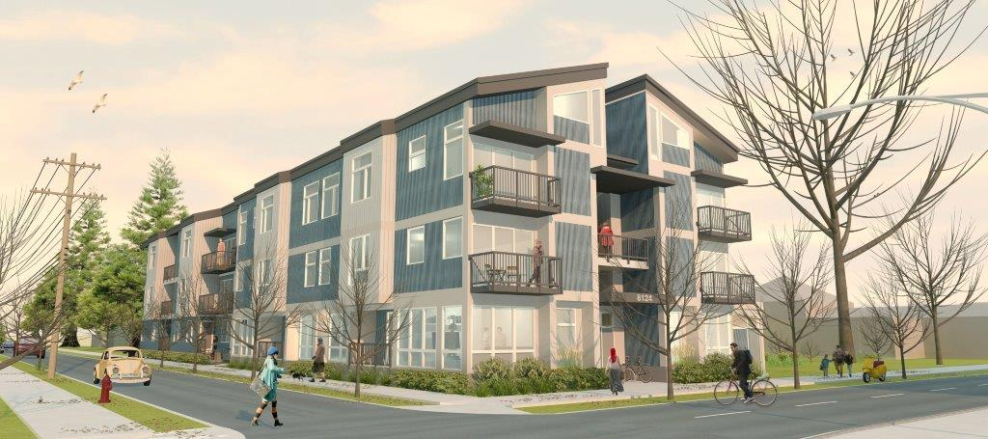
Strategy 2: Creating New Homeowners
Homeownership Unit Development –
Work with community partners to build affordable units for preference policy applicants within the district.

Slide 5
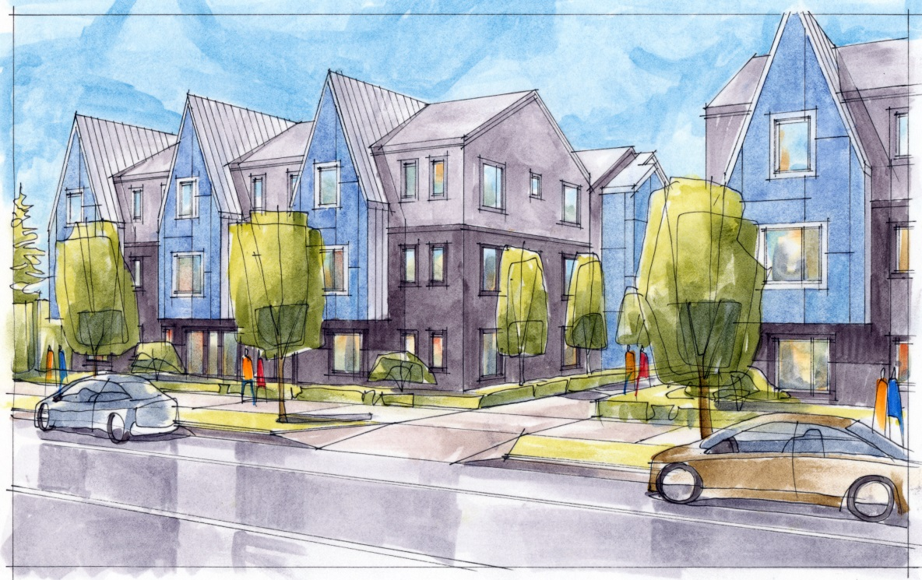
Kilpatrick Townhomes
30 new permanently affordable homes
Preference Policy households
First floor ADA visitable flats
2-story town homes above
Outdoor area

