Slide 1
Pricing for Equitable Mobility
July 2019
Notes:
Shoshana:
Thank you, Elizabeth. My name is Shoshana Cohen and I am the Mobility and Government Affairs Manager in PBOT's Office of the Director.
We will now switch gears and discuss the resolution around Pricing for Equitable Mobility.

Slide 2
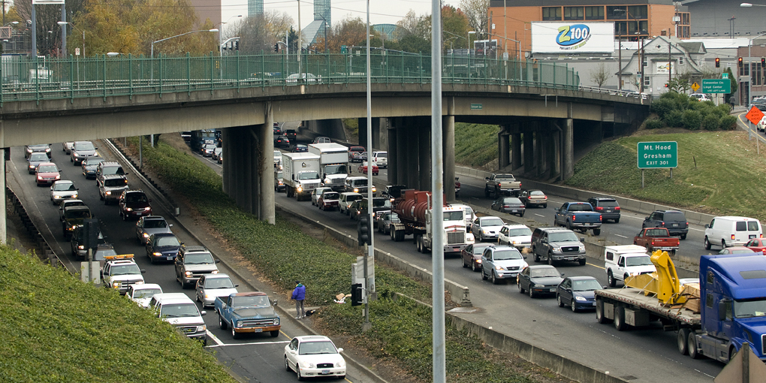
Why We’re Here
Central City 2035 paired Rose Quarter with requirement for congestion pricing
November 2017, City Council Resolution
Support ODOT I-5/I-205 Value Pricing
Research best practices for city-led congestion pricing
Report back to City Council
Notes:
First, why have we brought a Pricing for Equitable Mobility Resolution to council today?
This is the next stage of work that began in November 2017.
At that time, City Council asked PBOT and BPS to begin to consider congestion pricing, also known as pricing for mobility.
Specifically, we were asked to work with ODOT on their pricing project on I-5 and I-205 and advocate for pricing that supports demand management and a project that is designed to help to improve equity, climate, and safety outcomes.
This request to work with ODOT was driven by the fact that the city's Central City 2035 plan pairs the Rose Quarter improvement project with pricing along I-5. The reason that these things are paired is because managing demand on existing facilities is much more cost effective and better for our environment than continuing major expansions.
The second part of the resolution was to begin to more broadly explore how mobility pricing can be used as a congestion management tool to help us deliver on our transportation system plan goals.
And we were asked at that time to come and report back to Council.
So here we are.

Slide 3
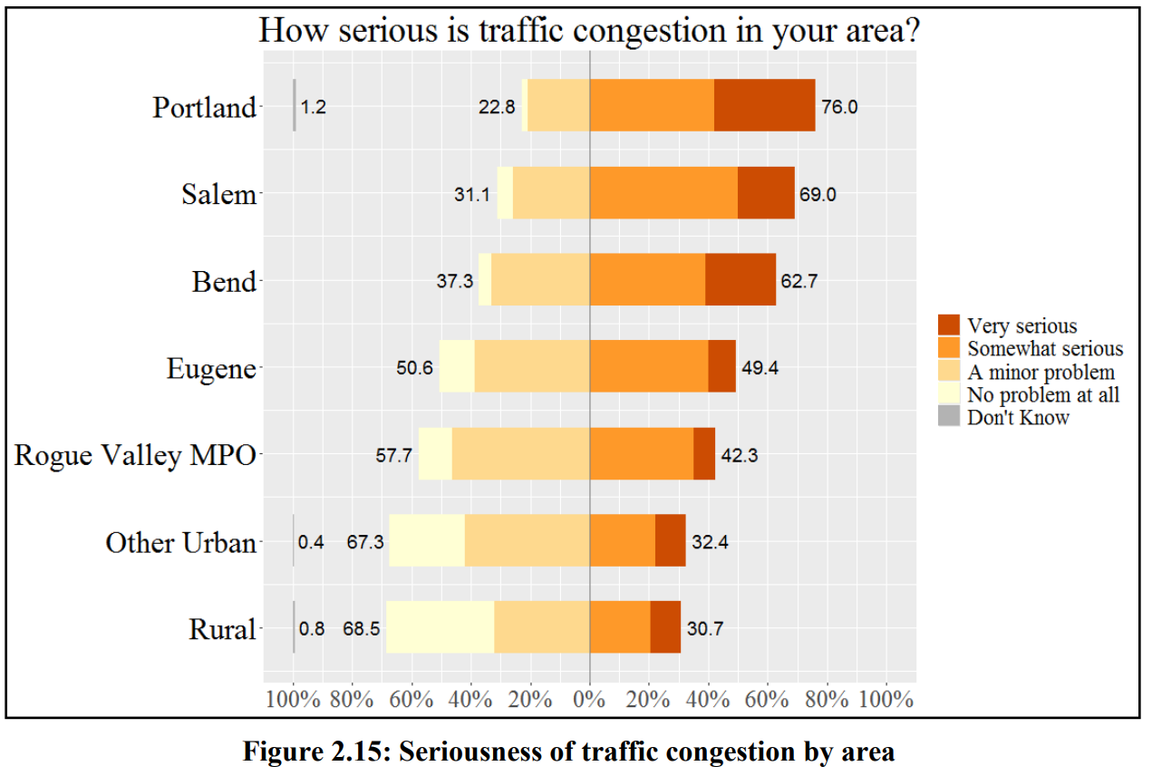
Source: Transportation Needs and Attitudes Survey, 2019
Notes:
Before we go over what we have learned since that time, we want to briefly revisit why we are even considering congestion pricing.
People don't like congestion.
This chart is from a 2019 ODOT Survey on Transportation Needs and Attitudes. When asked how serious is traffic congestion in your area, 76% of Portland survey respondents said that it was either very serious or somewhat serious.
Portlanders think congestion is a problem.

Slide 4
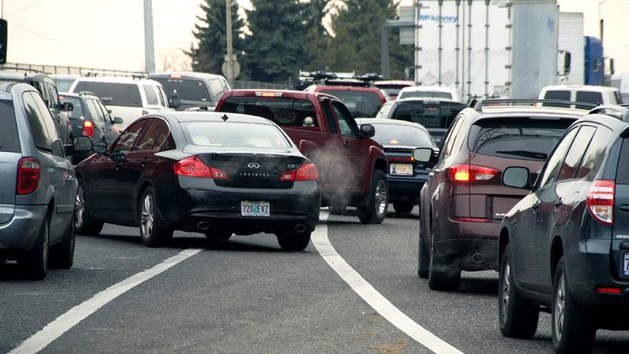
Why Price? Growth + Cars = Misery
500,000 new people in the region by 2040
Congestion is a growing problem for the city
Need to manage our roads to help people and goods get where they need to go
Notes:
And not only is congestion a problem right now, but it is a growing problem. The region is expected to grow by 500,000 people by 2040. As the population grows so will our congestion problem.
Put simply, more people and more cars = more misery for those stuck in congestion or those experiencing the negative impacts of congestion.
Extra notes
Between 2015 and 2017, hours of congestion increased 13.4% and daily vehicle hours of delay increased 20%, while population increased only 3.3% (ODOT, 2018)
We now have the 10th worst rush hour traffic in the nation (Inrix, 2018)

Slide 5
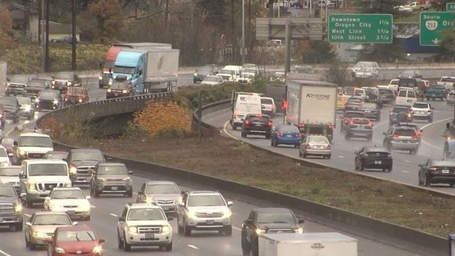
Why Price? Growth + Cars = Misery
Congestion is a
Hidden Tax:
Economy
Health
Climate
Notes:
Congestion brings with it very significant problems. And it amounts to a hidden tax or really multiple taxes.
Economic: there are economic costs to businesses and families for fuel, vehicle maintenance & lost time
Health: it brings health problems that are caused by long commutes and poor air quality
Climate: And, of course, there are Climate impacts.
Extra notes
Congestion costs the Portland economy $1.4 billion a year, which is about $1,625 a year per driver (Inrix)
Health: health problems that are caused by long commutes and poor air quality emissions & long commutes contribute to asthma, heart disease & other health problems
Climate: 40% of Oregon GHG emissions from motor vehicles

Slide 6
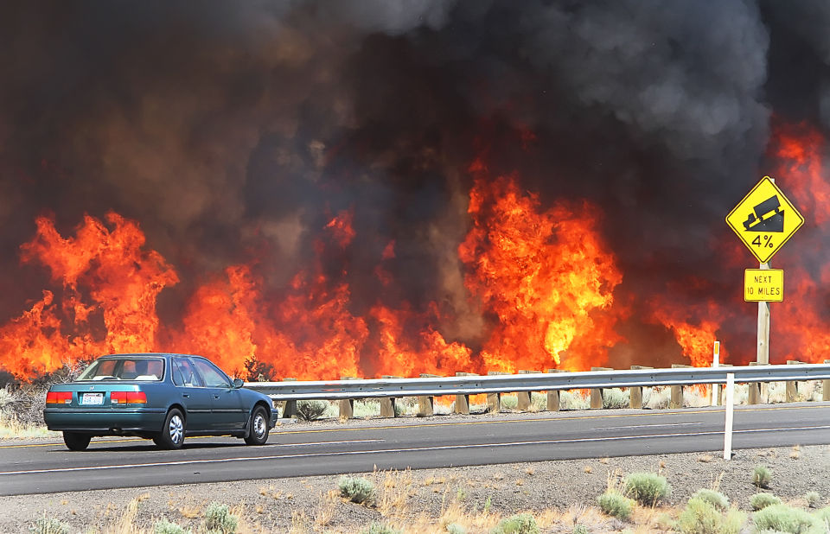
Why Price? We’re in a Climate Crisis
42% of GHG emissions in Multnomah County come from transportation*
Transportation emissions increased 8% since 1990*
We’re already experiencing the effects of the climate crisis:
More extreme weather
Increased forest fires
More frequent heat waves
* Source: Portland’s 2017 draft emissions inventory
Notes:
As mentioned earlier, about 42% of carbon emissions in Multnomah County come from the transportation sector.
And Transportation is trending in the wrong direction, greenhouse gas emissions have increased 8% since 1990.
All of the discussion today about climate, is because there is urgency to this work. In Oregon, we are already experiencing the effects of the climate crisis in the form of more extreme weather and forest fires.

Slide 7
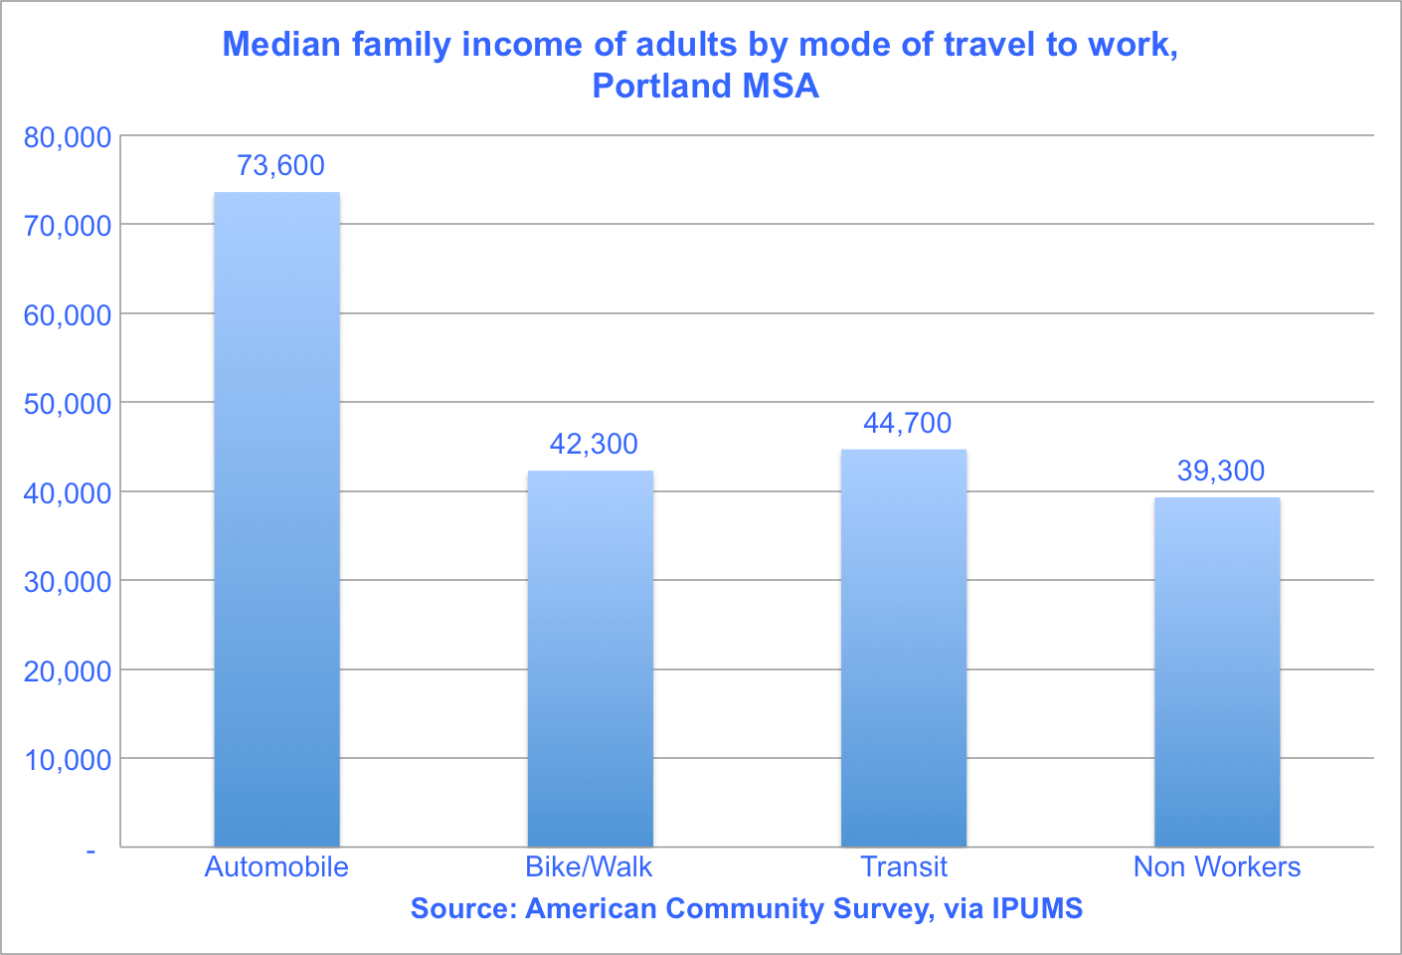
Why Price: Congestion is inequitable…and getting worse
Notes:
The status quo and the impacts of congestion are also inequitable.
The median family income of Portland area car commuters is about $73,000 while that of bike and walk commuters is about $42,000 and transit riders is $44,700.
And communities of color are more transit dependent. Non-white Portlanders make up only 22% of drive alone commuters, but 36% of transit commuters.
Extra data
It’s almost twice as fast to commute by car in Portland but…
Non-white Portlanders are more likely to commute by transit than white Portlanders
78% of drive-alone commuters are white, while only 64% of transit commuters are white (ACS 2012-2017)
More public transportation users speak a language other than English at home than those who drive to work
24% of public transportation commuters v. 17% of drive-alone commuters (ACS 2012-2017)

Slide 8
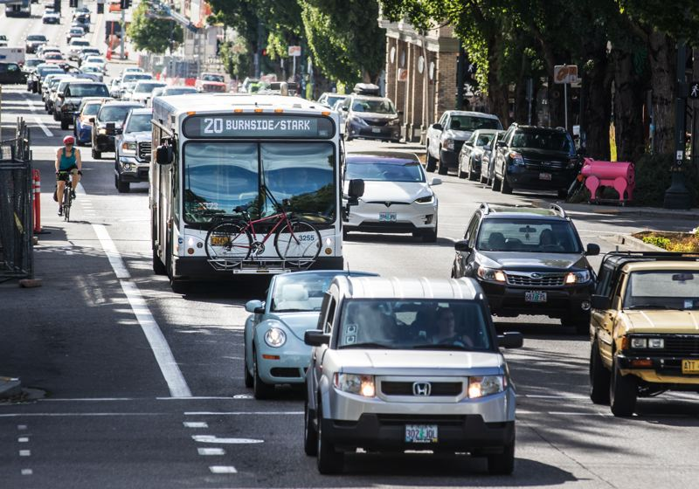
Why Price: Congestion is inequitable…and getting worse
Almost 31% of Black households do not have a vehicle. Just under 14% of white households do not have a vehicle.
Average commute times for Black commuters are 20% longer than white commuters.
Source: Policy Link National Equity Atlas
Notes:
As lower-income Portlanders have been displaced to the edges of the city, they have longer commutes.
Yet, as of 2015, almost 31% of black households in Portland did not have access to a vehicle, versus just under 14% of white households. And average commute times for Black commuters are 20% longer than white commuters.
As this picture demonstrates, currently most buses operate in the same lanes as car traffic. As you heard about earlier, we are working on more bus only lanes. But for now, those who are sitting on busses get caught in the same congestion that is caused by drivers.
For those that drive, it is expensive. Most transportation funding sources (like the fuels tax and the vehicle registration fee) are regressive. Transportation is often the second highest household expense. As transportation costs rise, lower income people have to spend proportionally more of their income on transportation.
Extra Data
Policy link 2015 – from ACS
Driving is expensive. Average annual Portland Household transportation cost is $11,751*, can contribute to a households overall Housing and Transportation burden.
Lower-income communities and communities of color are more transit dependent. In Portland (2015) 30.8% of Black households did not have a vehicle, compared to only 13.8% of White households**.
Transit dependent communities negatively impacted by congestion, but do not benefit from “free” roads.
Lower income communities and communities of color have longer commutes. Black Portlanders have average commute times of 29.7 minutes. White Portlanders have average commute times of 24.5 minutes**.
Corporate parking is subsidized and free for many employees.
Lower income communities and communities of color have historically not received as much transportation infrastructure investment or have received unwanted investments like highways that displaced communities.

Slide 9
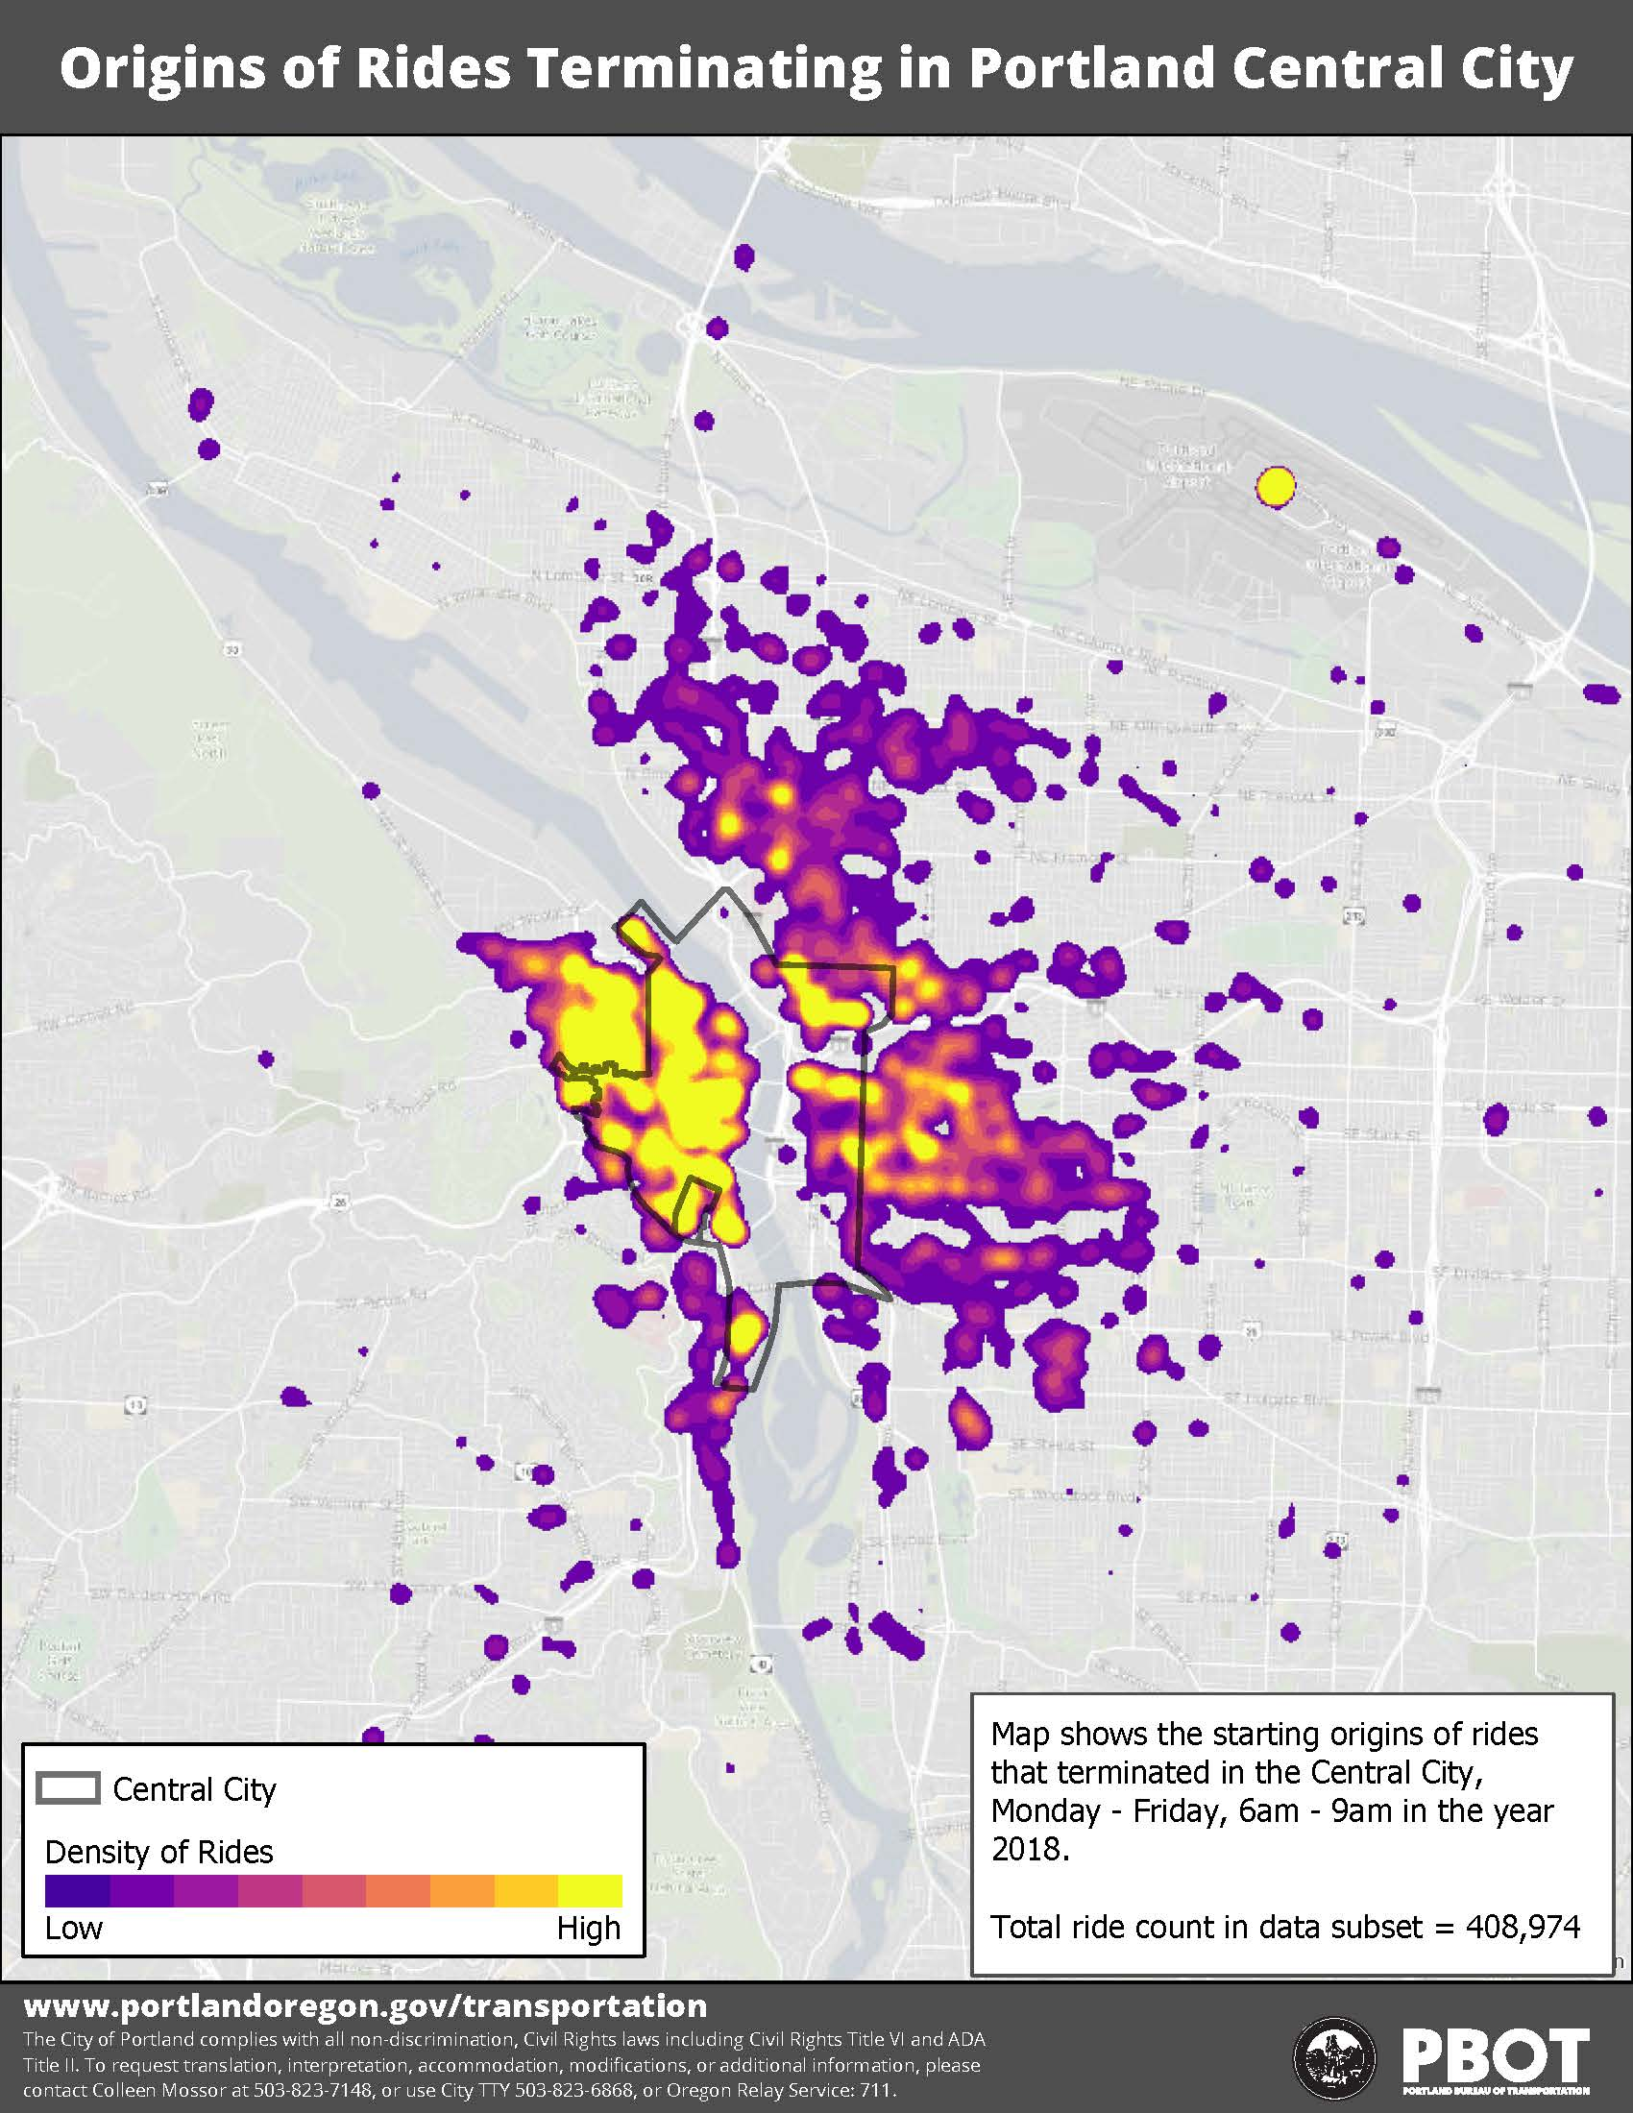
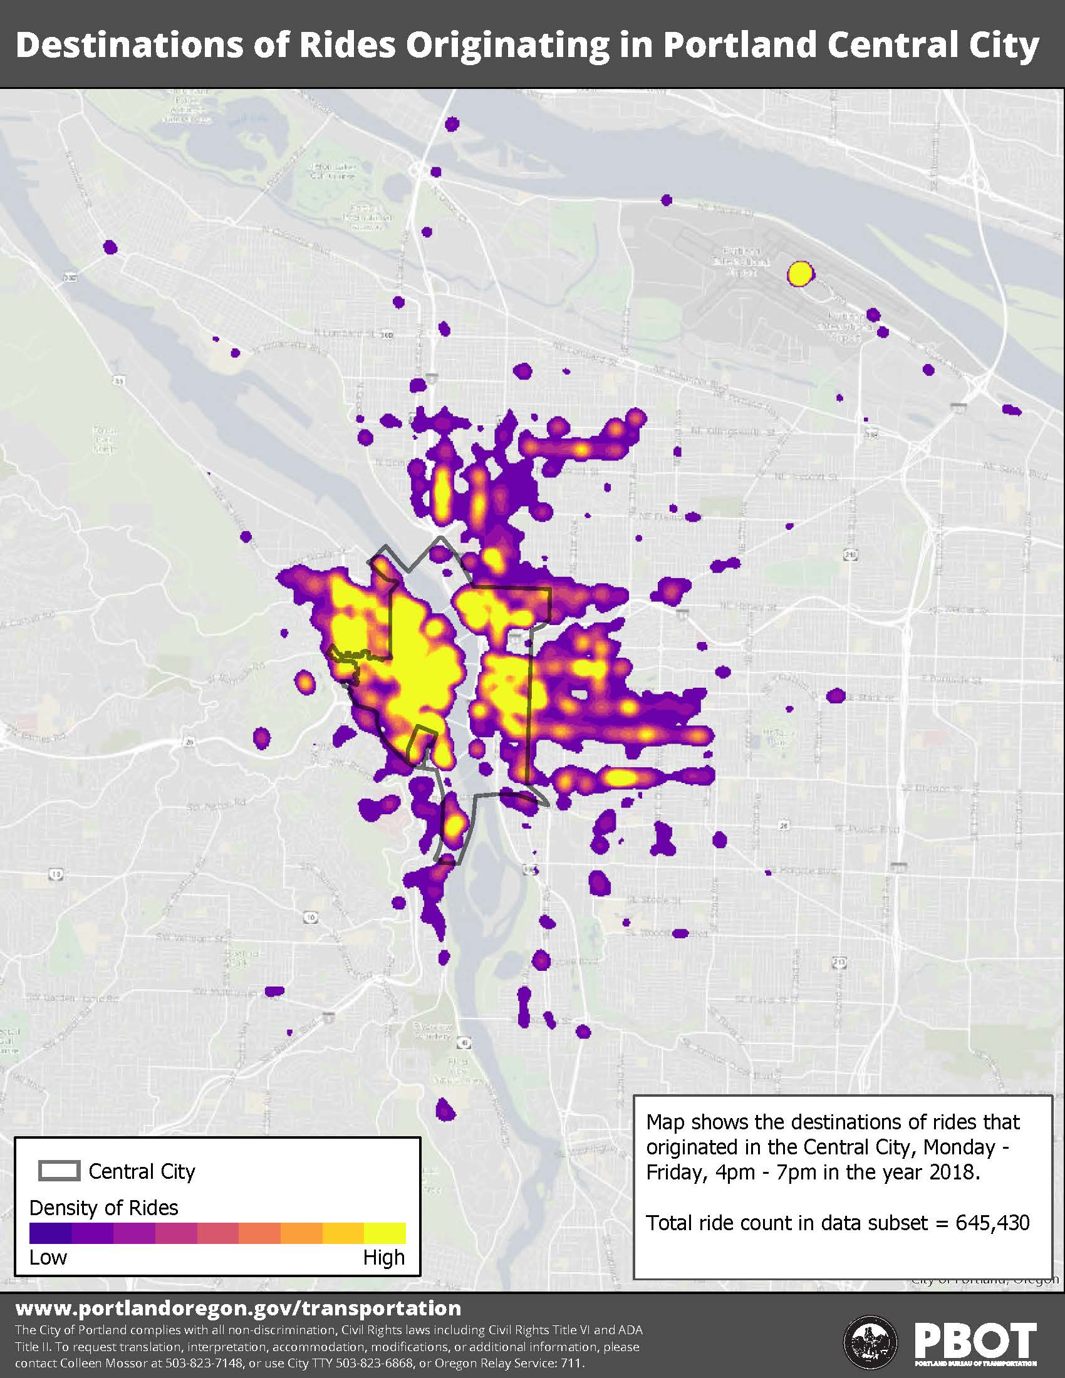
Private-for-hire rides during rush hour
Notes:
Transportation is also in the midst of big changes and things are getting worse.
These are maps of private-for-hire rides in rush hours. These include Lyft, Uber and taxi rides. On the left shows the origins of rides terminating in the central city. The yellow areas are the areas with the most rides. So we can see there are many short rides during peak hours which are happening in close in areas with a variety of transportation options.
On the right we see the same is true for rides that are leaving the central city during rush hour. Many are going just short distances in transportation rich areas.
Based on initial analysis, we know that these rides make up at least 5% of rides in the central city during peak hours. We are missing data so we know this is not the complete picture and it is likely significantly more.

Slide 10
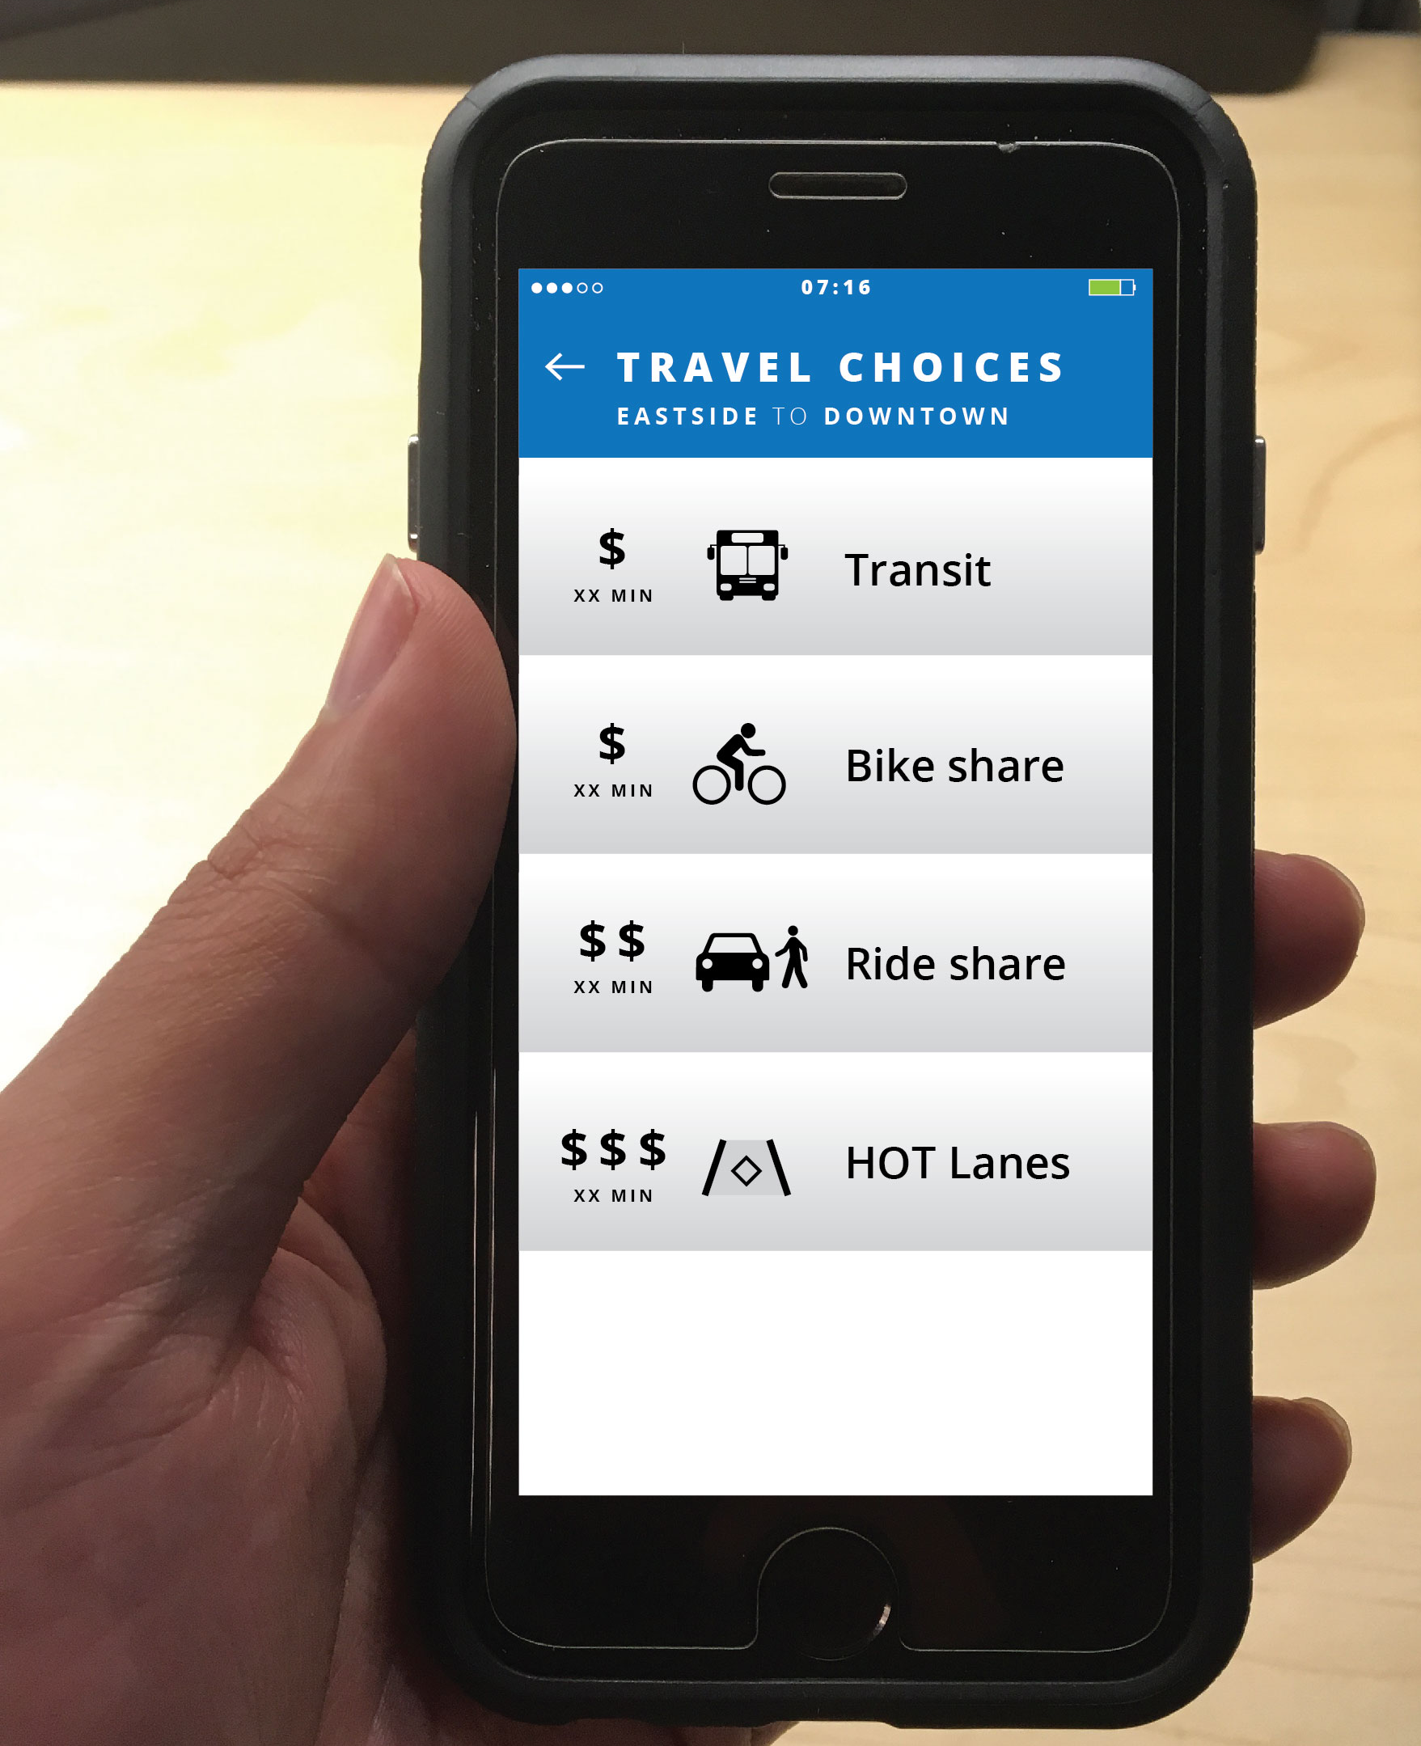
Why Price? What we’re doing isn’t enough
We’re doing a lot:
Providing alternatives to single occupancy vehicle trips – transit, carpools, biking, and walking
Considering transportation needs in our housing/land use planning
Investing almost $15 billion in our transportation system by 2040 through the Regional Transportation Plan
But still:
Vehicle hours of delay are still expected to go up by 120% by 2027 (from 2015)
Why?
Population growth… and behavior change is hard!
Notes:
It is clear that congestion causes many problem, but why do we think we need to consider pricing as one of the solutions? Because everything else that we are doing is not enough.
As a city we have many ambitious planned projects and strategies to relieve congestion and help people get where they need to go. We are constantly working to provide better facilities and options for people to take transit, to walk and to bike. We are not alone in this work. The Regional Transportation Plan lays out almost $15 billion worth of planned transportaiton system investments by 2040. Yet, modeling shows that even with all of these investments vehicle hours of delay are still expected to go up by 120% by 2027..
In other words, the status quo is not an option and we need to consider new tools like pricing if we want to more effectively relieve congestion and increase mobility for all of us.

Slide 11
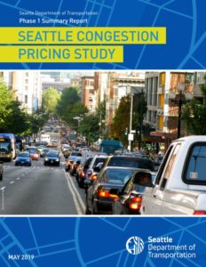
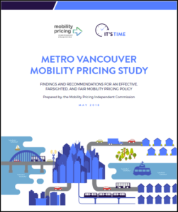
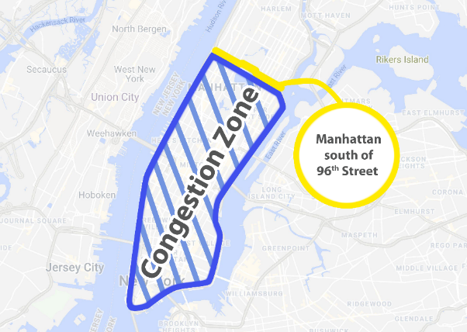
What have we done since November 2017?
Participated in ODOT’s Portland Metro Area Value Pricing Policy Advisory Committee
Engaged in peer learning with national & international cities through National Association of City Transportation Officials (NACTO), C40 Cities, Natural Resource Defense Council, American Cities Climate Challenge
Conducted research on best practices and reviewed existing literature
Organized a local workshop with national experts and key stakeholders
Focused on understanding equity questions and best practices for any pricing policy evaluation
Notes:
So what have we done since you first asked us to consider pricing?
The City of Portland participated in the ODOT Portland Metro Area Value Pricing Advisory Committee. We advocated for city of Portland values within this process. We are pleased that the first phase of the project finished with an application to the FHWA that reflected a commitment to continue analysis of equity impacts and solutions, transit needs, and diversion.
We have also engaged in peer learning, both directly with other cities and with a variety of national and international ssociations. We have learned from international cities like London and Stockholm, who have implemented congestion pricing. We have also learned from other North American cities who are grappling with congestion and like us considering how to use pricing to improve mobility, climate and equity.
We have focused in on questions of pricing and equity. We know that Pricing can work for demand management, the question is can it also be a tool to deliver more equitable transportation outcomes.
Noah will now provide some additional details about what we have learned since November 2017

Slide 12
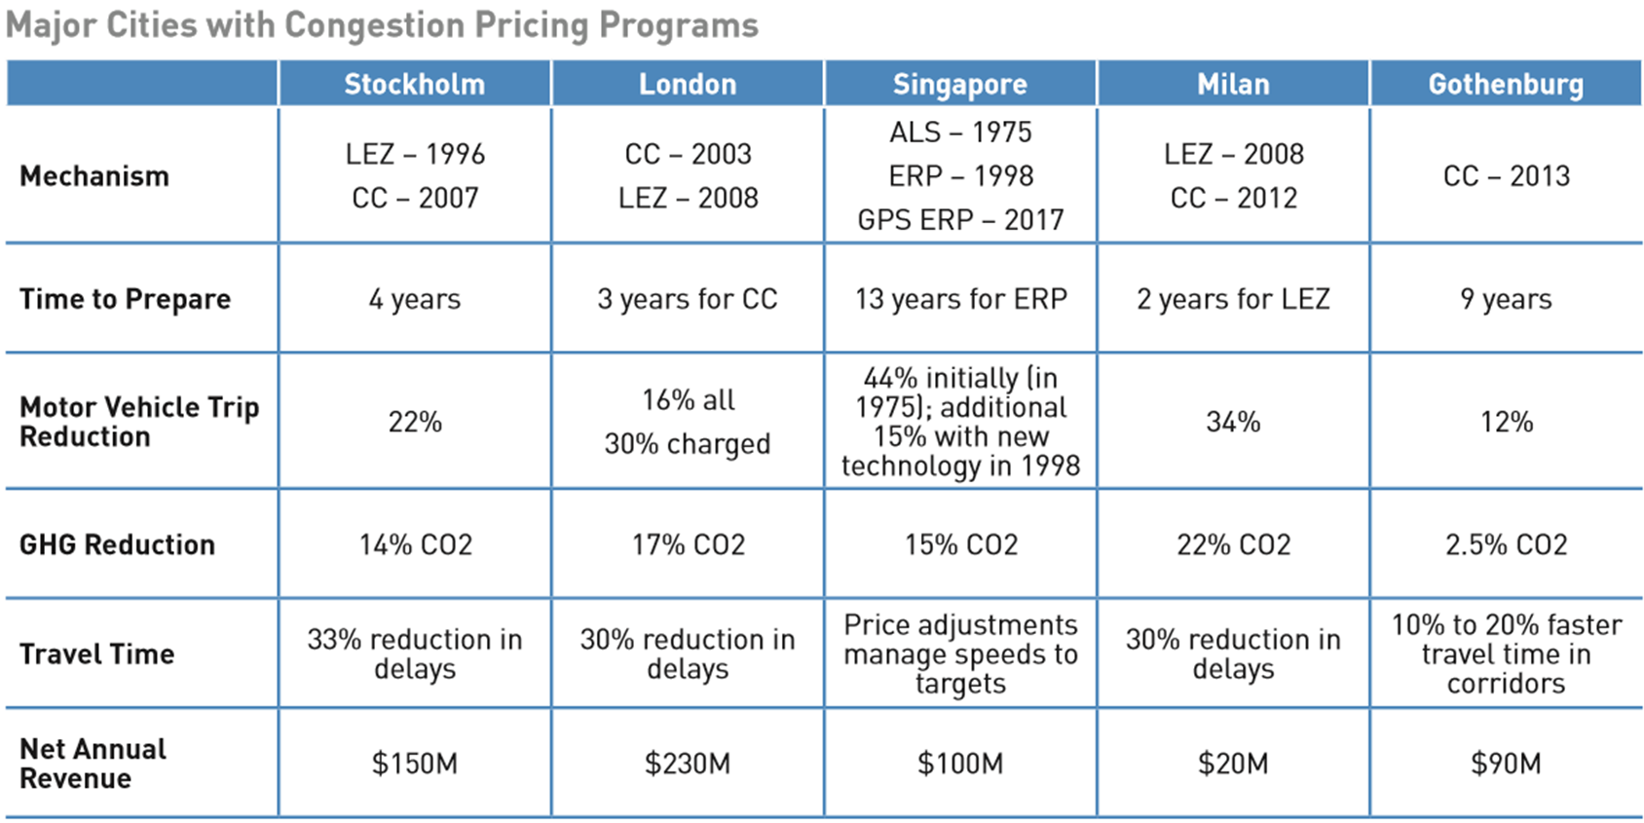
What have we learned?
Pricing works
Small changes matter
Transit is critical
Each place is unique
Trust is essential
LEZ: Low Emissions Zone; CC: Congestion Charge; ALS: Area Licensing Scheme; ERP: Electronic Road Pricing; GPS ERP: GPS-based Road Pricing

Slide 13
What We Learned: Small changes matter
In 2008, a 3% decline in vehicle miles led to a 30% decline in traffic congestion in Portland.
Source: Joe Cortright, City Observatory
Notes:
PBOT has big goals– 70% non-SOV trips by 2035.
But people still need to drive. It’s the non-essential trips that kill us.
In CCIM, we say that we want all NEW trips to be non-SOV

Slide 14
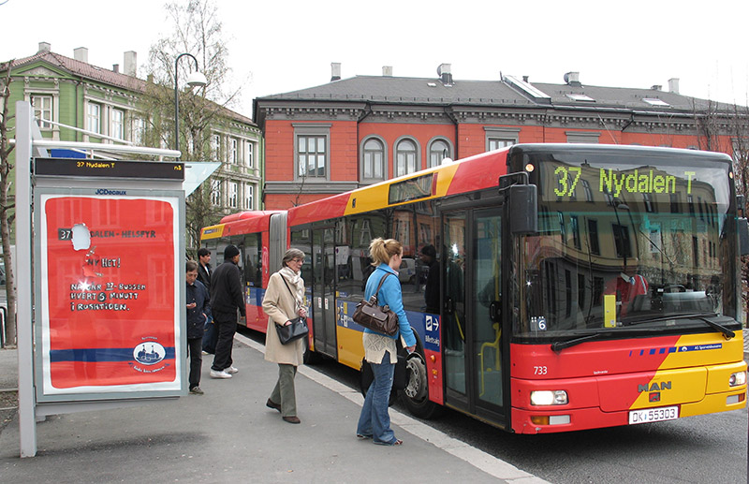
What We Learned: Transit is key

Slide 15
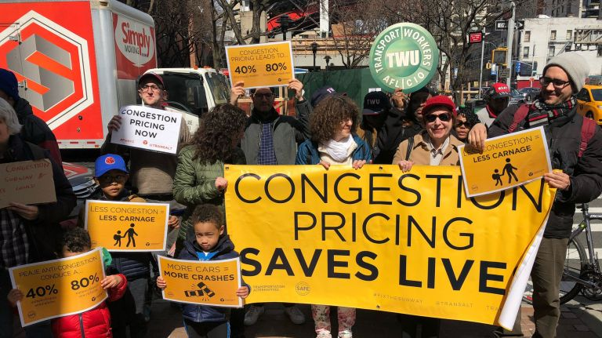
What We Learned: Each place is unique
Notes:
Madrid aimed to cut air pollution
Seattle GHG goals
London tax financial district to fund transit
Singapore looked to solve gridlock and air pollution

Slide 16
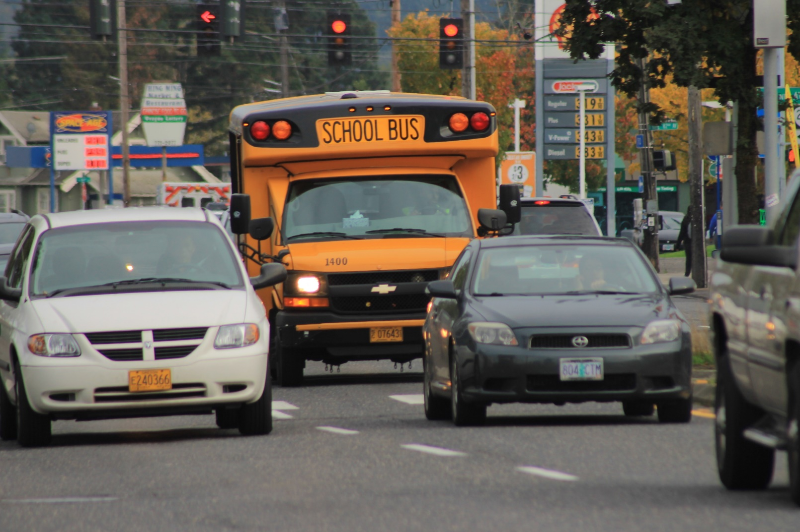
Challenges to pricing in Portland
Gentrification and displacement
65% of peak car commuters to central city are medium or low income
For many people cars are the immediate solution
Oregon constitutional restrictions on revenue

Slide 17
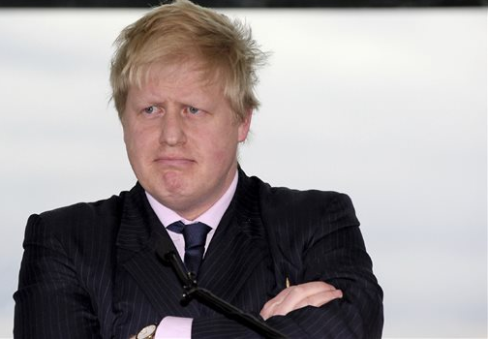
What We Learned: It’s hard
Notes:
New Madrid mayor just suspended low-emissions zone in Madrid, despite a 48% reduction in nitrogen dioxide
Opposition party in Oslo is current running against ring roads as their core issue
Transportation system is built for cars:
People have to transport kids, get to jobs, go to doctor’s appointments, run errands - cars are often most convenient
Hard to pay for something that is currently free
Not easy to believe that pricing will help relieve congestion
Counterintuitive that pricing could be good for equity
Costs of driving are already regressive, pricing could exacerbate
The inequities in the current system are not immediately transparent
After implementation, people see benefits & view pricing more favorably
Whatever the fractures are in your politics, congestion pricing will reveal them
Making collective change requires a high level of trust
But… recent polling by DHM showed 50/50 support for tolling in Portland area

Slide 18
Notes:
Make new investments
Prioritize use of our streets
Implement positive incentives and effective price signals
Link transportation and land-use

Slide 19
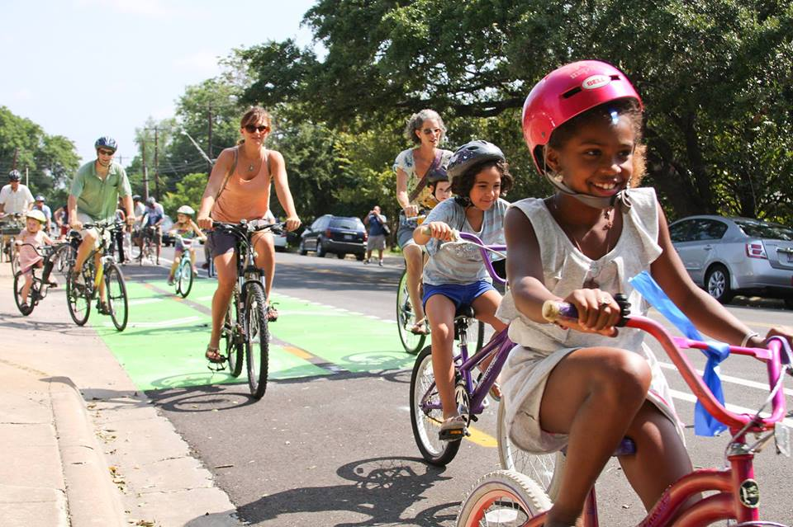
Moving to our Future: Transportation Justice
Will it reduce carbon emissions?
Will it help advance equity and address structural racism?
Notes:
Have to be inclusive as we make big change
Our work has to involve cultural shifts, especially if we’re asking people to make big changes

Slide 20
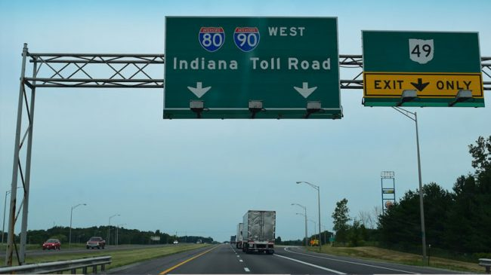
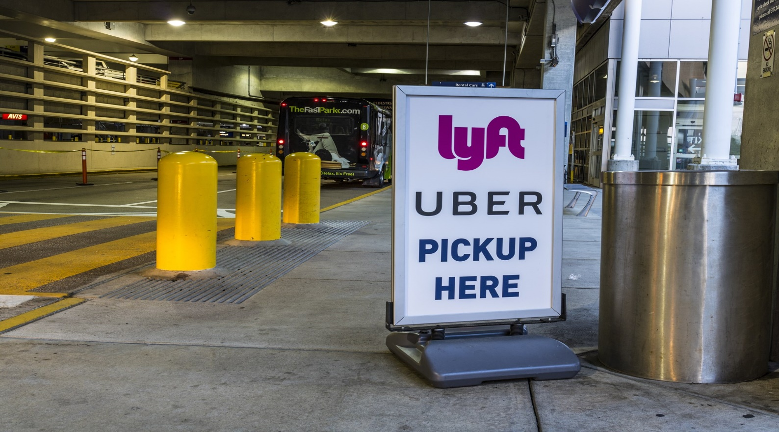
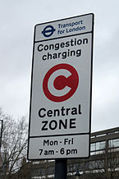
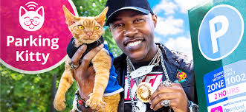
What is Congestion Pricing? Examples
Notes:
There are many types of pricing.
Some are on specific facilities.
Some manage congestion in places.
Some look at the entire system.
It matters a lot who owns and controls those facilities.

Slide 21
Proposal/Pricing for Equitable Mobility – Three types
Type I: Options for high congestion areas in Portland
Under City of Portland control
Type II: Value Pricing/I-5 and I-205 pilots
ODOT leads
Type III: Inter-jurisdictional systems
Metro leads policy analysis, implementation TBD
Notes:
Moving forward, we are proposing to consider three types of pricing policies. With each of the these types, the question is how could they be implemented in a way that increases equitable mobility.
The three types are based on who is in the position to deliver or implement new policies.
Type I are options for high congestion areas within Portland and under city of Portland control.
Type II is the ongoing work that ODOT is leading to consider how pricing can be used on I-5 and I-205.
Type III are inter-jurisdictional systems. Metro is leading this work and about to begin technical analysis of potential regional pricing policies.

Slide 22
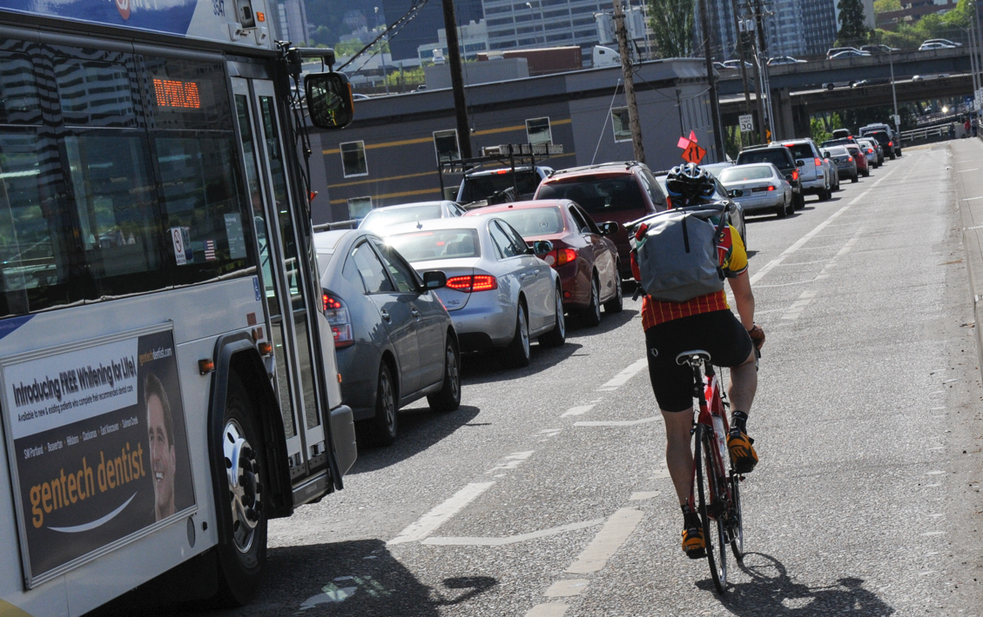
Type I: High Congestion Areas in Portland
Examples:
Dynamic parking
Private-for-hire fleet management
High Occupancy Vehicle prioritization
Notes:
There are a number of policies that we can consider within the City of Portland only.
For example, we could move to more demand-based, variable parking pricing.
We can consider private-for-hire fleet management pricing policies.
Or high occupancy vehicle prioritization and pricing policies

Slide 23
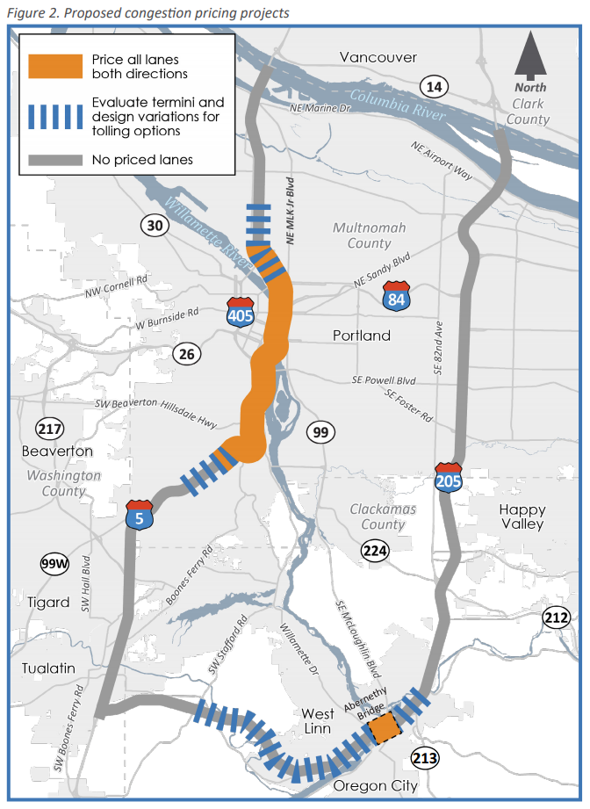
Type II: Value Pricing I-5 and I-205 pilots
2018 Value Pricing Policy Advisory Committee recommended moving forward with the next stage of technical analysis and engagement for pricing pilots on I-5 and I-205
Formal submission to FHWA reflects city priorities
Push for further engagement and implementation
Notes:
For the second body of work, we want to continue to stay engaged with the ODOT project and next stage of analysis.
This map shows the project that is currently under consideration. It includes full facility pricing on I-5 through much of Portland. Moving forward, we want to ensure that historically underserved communities share in the benefits of this project and are not further burdened.
We want to understand and mitigate any diversion to local streets and any potential safety issues.
And we will need to know more about the transit needs and other non-single occupancy vehicle options for people traveling in this corridor.
Ensure historically underserved communities share in the benefits and are not further burdened
Understand and mitigate diversion to local streets and potential safety issues
Evaluation of transit and other non-SOV transportation options

Slide 24
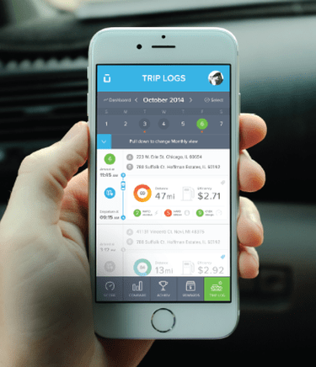
Type III: Inter-Jurisdictional Systems
Metro Study:
Analysis to understand technical feasibility and effects of different congestion pricing tools in our region
Examples:
Cordons
Road user charge
Tolling freeways
Tolling all high volume roadways
Parking pricing
Notes:
The third type of pricing is the inter-jurisdictional pricing system analysis that Metro is leading.
Part of the resolution before you today is a direction to us to enter into an IGA with Metro. They are leading an analysis to understand technical feasibility and effects of different congestion pricing tools in the region.
They will be considering tools like cordons, a road user charge where people are charged based on the miles they travel, and tolling a more comprehensive set of freeways.
These are all long range options that will take time to consider. New York is now moving forward with a cordon after at least 10 years of work considering it. We need Metro to begin this technical analysis so we can have a better idea of how these larger pricing moves may or may not help to manage demand and improve equitable mobility in the future.
Why start now? We have to do eventually. It takes a long time e.g. NYC

Slide 25
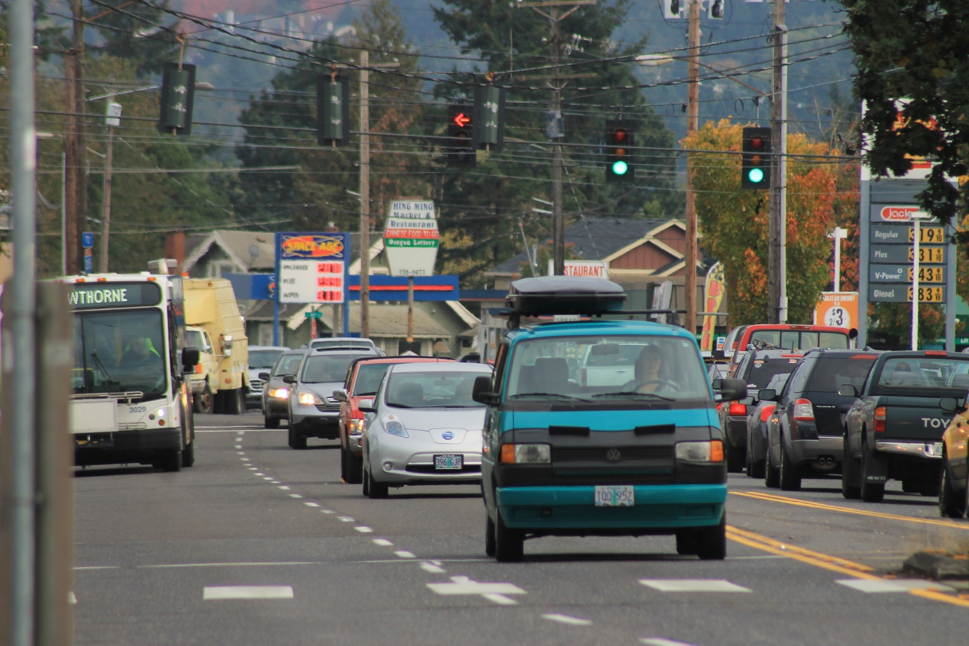
How do you actually price for equitable mobility?
How you spend the revenue
Links to transit service improvement and fare discounts
Better infrastructure for walking, biking, and transit - focus on underserved areas
Design for equity
Involve equity stakeholders in design choices
Choose geography and rates carefully
Discounts or exemptions on the fee for some drivers
Cash payment options
Prioritize emissions reductions for low-income communities
Notes:
How could we actually price to improve equitable mobility. Based on what we have learned over the last year, we know the answer is in how you spend any revenue and how you carefully design a particular pricing system.
Revenue is most often linked to transit service improvements and fare discounts.
Revenue can also be used for better infrastructure for walking, biking, and transit, especially with a focus on historically underserved areas.
We would need to target revenue in one way or another to help to improve transportation services for lower-income communities and communities of color.
In designing for equity, the first thing we need to do is to involve equity stakeholders in design choices.
We also need to choose particular geographies and rates carefully,
Likely provide discounts or exemptions on the fee for some drivers and provide cash payment options
And prioritize emissions reductions and other benefits for low-income communities.
For any particular pricing project, we need to ask who benefits and who is burdened by the proposal.
There is a lot of work to do to get this right.

Slide 26
Proposal: Convene Pricing for Equitable Mobility Task Force
• Bring together a range of stakeholders to study pricing
• Center equity voices
• Leverage Climate Challenge resources to partner with OPAL and other groups
• Report to Directors of PBOT and BPS
Learn about and advise on three main initiatives:
Notes:
Which is why the resolution before you today, directs us to Convene a Pricing for Equitable Mobility Task Force.
We want to bring together a range of stakeholder to continue to study pricing options with us.
And we want this Task Force to very clearly center equity voices.
We are excited to be leveraging Climate Challenge resources to partner with OPAL and other equity leaders.
And this Task Force will be set up to report directly to the Directors of PBOT and BPS.
They will learn with us more about the three areas we just described and advise us in the work moving forward in a way that works specifically in a Portland context.
Extra
Task Force to consider how to use new price signals as different forms of congestion pricing to help to relieve congestion and meet transportation system goals around mobility, equity, climate and safety

Slide 27
Proposal: Pricing for Equitable Mobility Task Force
Convene Task Force
Fall 2019
Near Term Recommendations
Summer 2020
Final Recommendations to Council
Spring 2021
Notes:
We are planning to convene the Task Force this fall and looking to them to provide a set of near term, initial recommendations by next Summer. They will then provide a final set of recommendations to Council in the spring of 2021.
That concludes our presentation. We have some invited testimony, and are also happy to take questions.

