Slide 1
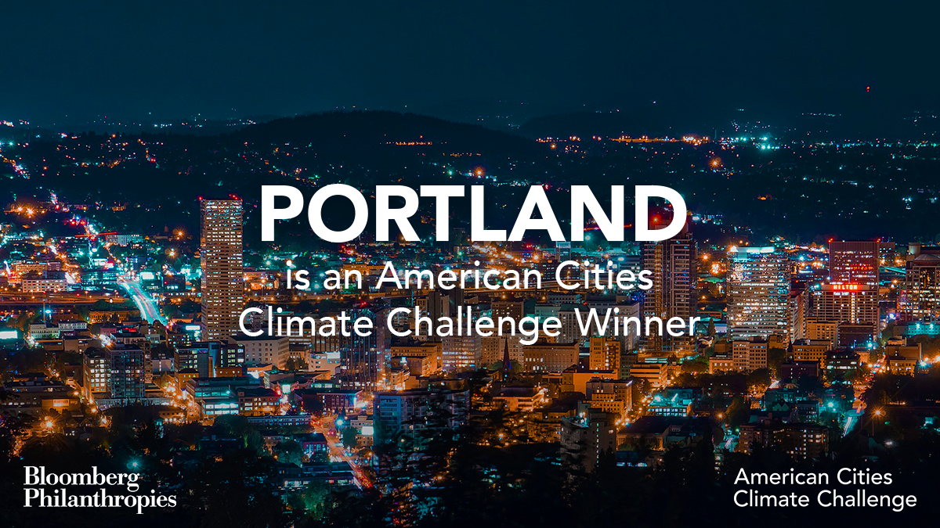
Notes:
Mayor Wheeler:
We will now hear a presentation about PBOT and BPS’ efforts through the American Cities Climate Challenge. Portland was selected to take part in the Bloomberg Philanthropies American Cities Climate Challenge in fall 2018. This is an unprecedented effort empowering 25 of the largest US cities to deliver America’s Pledge on climate.
As we all know, Portland is a climate action leader—which is a source of pride for our community. We’ve made great progress on reducing our carbon emissions, but the fact is we must do more. Through the Climate Challenge, we have another opportunity to show other cities around the US and the world how to lead on tackling the climate crisis. We’re accelerating our efforts over the next two years through the Climate Challenge, and also embarking on an update of our pioneering, award-winning Climate Action Plan. All of these actions support our work to reach a 100 percent renewable energy economy and community by 2050.
On July 17, I will testify in front of the Senate Democrats’ Special Committee on the Climate Crisis alongside Mayors from Atlanta, St. Paul, and Pittsburgh. I will relay much of the information we’re about to hear about how Portland is leading the way in this space and call on the federal government to make moves that help—rather than hinder—city innovation and progress around carbon reduction.
Commissioner Eudaly:
Climate change is an issue of economic and racial injustice as well as an environmental crisis. People of color and communities with low-income levels and wealth are disproportionately impacted by climate change. Communities who are already vulnerable due to economic injustices bear the brunt of climate disasters and do not have the resources to face them. In this presentation, we’ll also hear how PBOT and BPS’ efforts through the Climate Challenge will support our City commitment to advancing racial equity and transportation justice objectives.
The transportation sector contributes 42% of our local carbon emissions, and while we have made progress overall on reducing carbon emissions, we are going the wrong direction on transportation. As the Commissioner in charge of PBOT, I am excited to see the bold transportation actions we will hear about during this presentation. These actions are not only critical to combatting climate change, as you will hear about today, they are all grounded in equity and important steps for creating a more equitable transportation system.
There is a reason this is called the Climate Challenge. It pushes to go further and faster and I know we are up for the challenge.
PBOT Director Chris Warner will kick-off the presentation.

Slide 2

The American Cities Climate Challenge is a Bloomberg Philanthropies initiative that aims to accelerate and deepen U.S. cities’ efforts to create the greatest climate impact through 2020 and showcase the benefits – good jobs, cleaner air, and cost savings – that climate solutions bring.
Reduce building energy use
Increase
renewable
energy
Reduce vehicle travel
Electrify vehicles
Cities Reach Paris Climate Goals
Notes:
Chris Warner:
Thank you, Mayor Wheeler and Commissioner Eudaly, and thank you Council for the opportunity to present about the work our two Bureaus are undertaking through the American Cities Climate Challenge.
As was just mentioned, this is an unprecedented effort. In 2018, in the wake of the Federal Government’s decision to pull out of the Paris Climate Agreement, Bloomberg Philanthropies created the American Cities Climate Challenge to empower cities to lead the way.
Cities are the biggest contributor to climate change, accounting for more than 70% of global emissions. But cities are also key to solving the challenge of climate change and mitigating its effects. Cities are effective hubs of innovation and experimentation, and city governments are also uniquely positioned to take accelerated, impactful action on carbon reduction efforts.
The Climate Challenge, supported with $70 million in funding from Bloomberg Philanthropies, provides access to a capacity-building package of resources to augment and accelerate our near-term climate action efforts. By participating in the Challenge, we can go further, faster in our work to curb emissions.

Slide 3
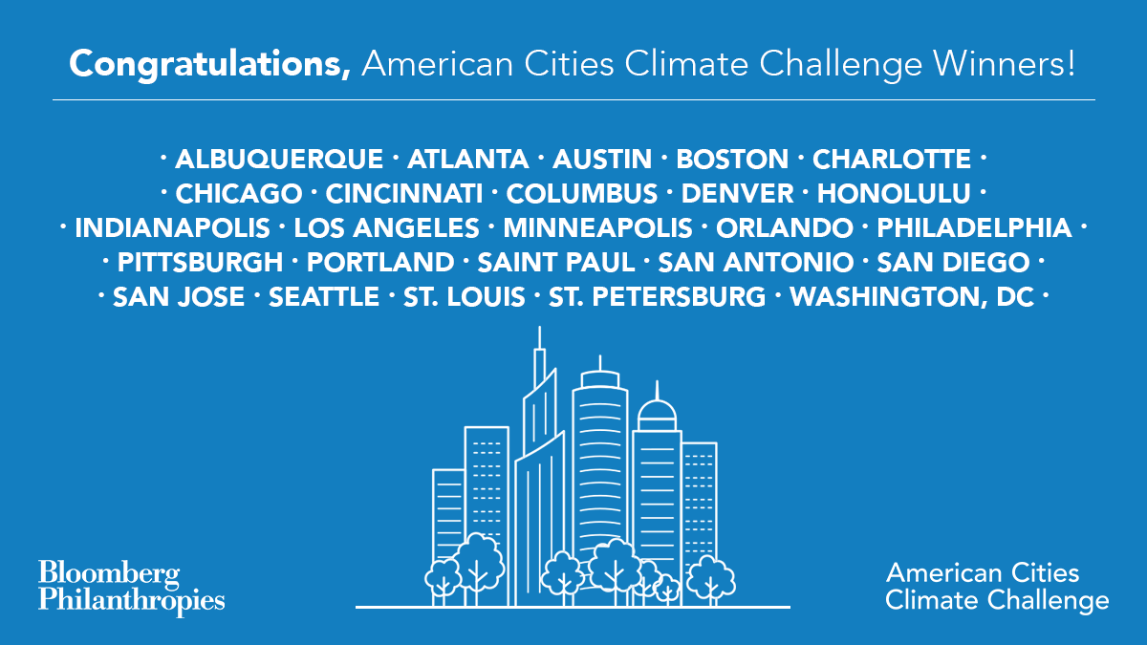
Notes:
Chris Warner:
The 100 largest U.S. cities were invited to apply to participate in the Challenge. Portland was one of 25 cities selected to take part in the two-year effort which runs through the end of 2020—the other participating cities are shown on the screen.

Slide 4
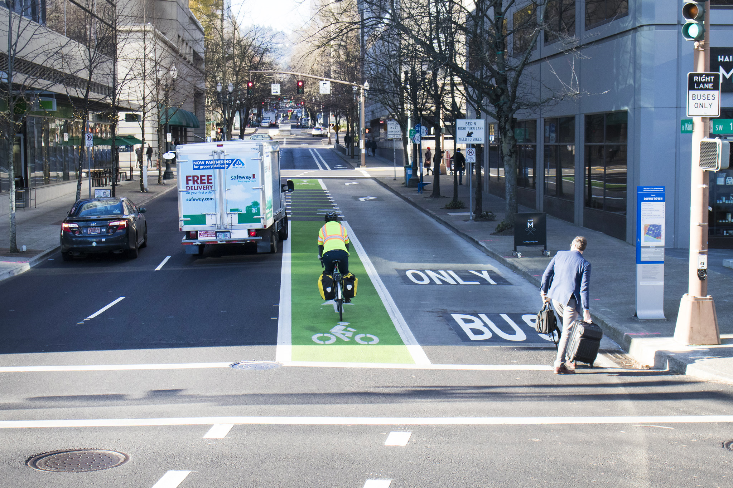
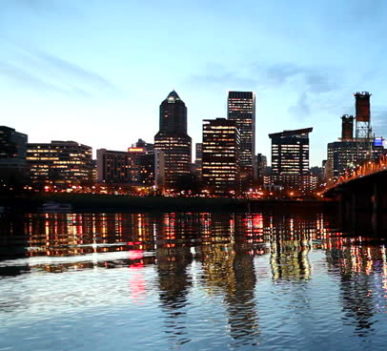
Building and transportation
Decarbonize
energy
Reduce emissions from transportation
Notes:
Andrea Durbin:
The Climate Challenge focuses on areas where cities can deliver the most impact: the transportation and buildings sectors. Most carbon emissions in the US come from powering our homes, businesses and vehicles.

Slide 5
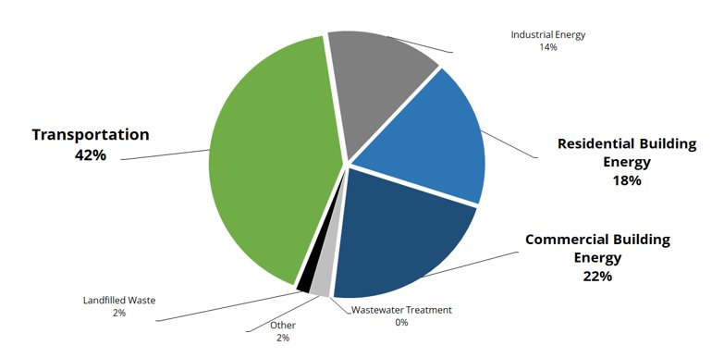
Multnomah County Carbon Emissions (2017)
Notes:
Andrea Durbin:
Portland is no different. Based on the latest figures, 42% of emissions in Multnomah County come from transportation, while building energy—broken up into residential and commercial—accounts for 40% of the pie.

Slide 6
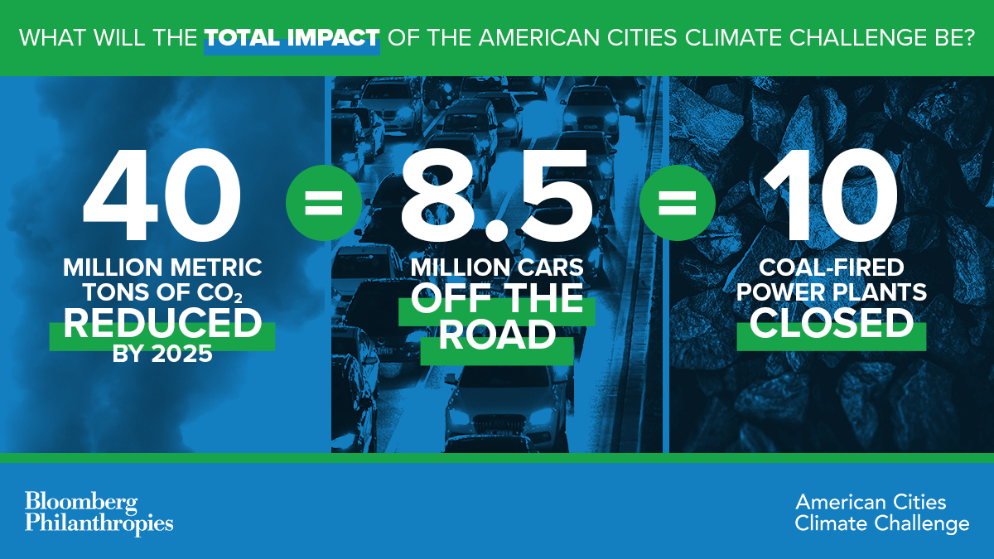
Notes:
Chris Warner:
The Climate Challenge focuses on impact and action. By providing cities resources to accelerate and augment our climate action efforts, the 25 cities combined have a goal of reducing 40 million metric tons of CO2 by 2025. This would be equivalent to taking 8.5 million cars off the road, or closing 10 coal-fired power plants.

Slide 7
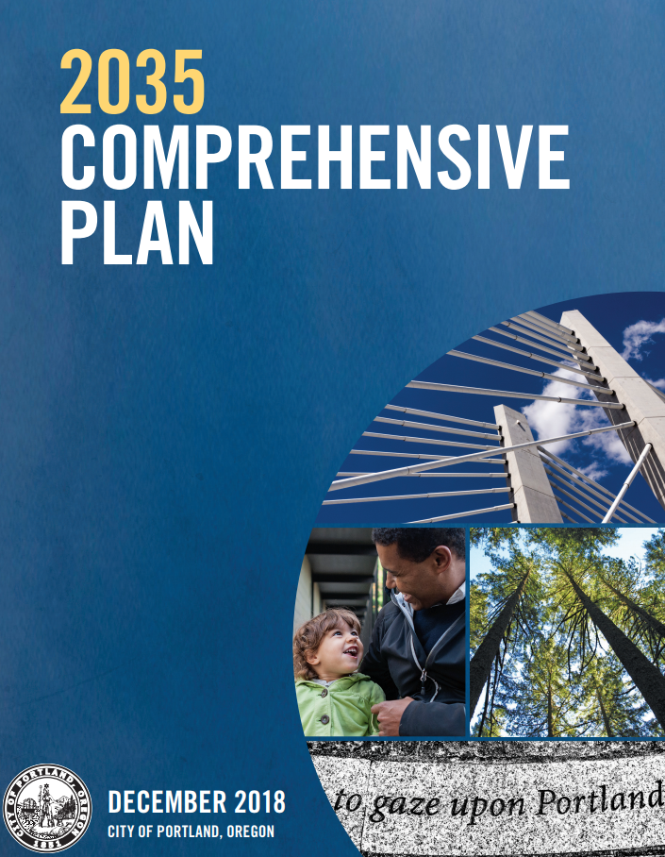
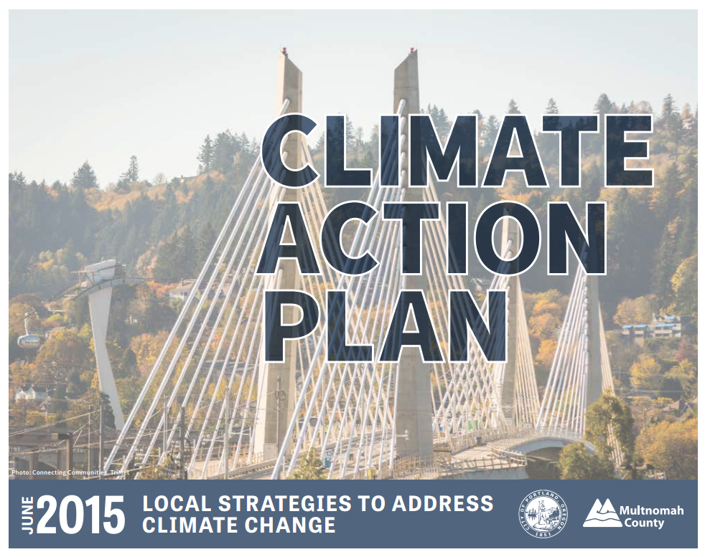
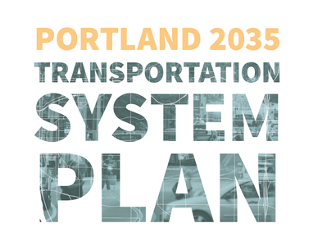
Advancing City goals around equity, climate action and transportation justice
Notes:
Andrea Durbin:
The Climate Challenge coincides with our Bureaus’ work to update Portland and Multnomah County’s Climate Action Plan in 2020. The initiatives and strategies we advance with Climate Challenge support will form the foundation for the building energy and transportation chapters of the updated plan.
The Climate Challenge efforts will also support the City's commitment to advancing racial equity and transportation justice objectives by:
First, providing resources that enable us to better partner with and build the capacity of community-based organizations to deliver innovative climate solutions in a climate justice-centered way.
Second, supporting technical analysis and modeling so we know who our investments impact, what barriers and choices Portlanders face when making transportation decisions, and how our climate action work improves equitable outcomes across our City.

Slide 8
Portland's carbon emissions are trending in the right direction...
Notes:
Andrea Durbin:
Before we dive into what we’ll be doing through the Climate Challenge program, let’s take a look at how we’re doing in terms of carbon emissions.
We’ve made progress over the last two decades, and we’re reducing emissions faster than the country as a whole.
That said, our emissions have fluctuated over the last two years, and we need to quicken the pace of action to cut carbon pollultion and to meet our goals.

Slide 9
…but we have a lot of work to do
2030 goal
2050 goal
Notes:
Andrea Durbin:
Our Climate Action Plan has ambitious goals.
By 2030, we’ve committed to reducing our emissions by 40% compared to 1990 levels, and by 2050, our current goal is to reduce carbon emissions by 80%, but we plan to recommend that this be updated to reflect the City's commitment on 100% Renewables and calls from scientists that say we need to reduce emissions by 100% below 1990 level by 2050
You can see here how far we have to go to close these gaps. Again, we need to accelerate and go bigger on our actions to reduce carbon

Slide 10
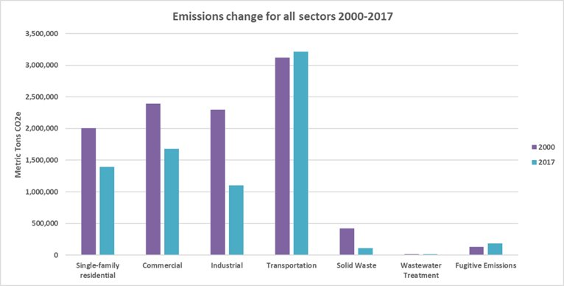
…and we’re heading in the wrong direction on transportation
Change in transportation emissions
Last year | Since 1990
+6.4% | +8%
Notes:
Chris Warner:
This chart shows the trend across different sectors for Multnomah County between 2000 and 2017.
As our population continues to grow and more and more people move through our region, our transportation emissions have actually increased as you can see by the bars in the middle of this graph. In the last year alone, transportation emissions increased by 6.4%, and since 1990, they've risen by a total of 8%.
To get back on the right track, we have to reduce the amount we each drive alone to move the dial on carbon emissions. And the vehicles that remain on the road need to be fueled by electricity or other low carbon fuels.

Slide 11














What do we get?
Access to Climate Challenge network of partners—with a tailored package of support for Portland:
Notes:
Chris Warner:
So what do we get by participating in the Climate Challenge?
All 25 cities get access to a network of partners to help build capacity, share information and resources, and engage in peer learning around how to accelerate carbon reduction efforts. Some of these partners are shown on this slide.
Portland also receives “deep dive,” tailored support to help advance our specific goals, including:
Technical planning and design consultation from Nelson\Nygaard, Rocky Mountain Institute and the Natural Resources Defense Council (NRDC).
Behavioral nudging strategy and campaign development support from ideas42 to enhance transportation demand management around PBOT capital projects
Funding from the Energy Foundation to engage local community-based organizations in our conversations around pricing for equitable mobility and community renewables
Data governance support from the Center for Government Excellence at Johns Hopkins University
A full-time Climate Advisor embedded at PBOT, funded by NRDC, to support project delivery, stakeholder engagement and coordination with the broader Climate Challenge network.

Slide 12
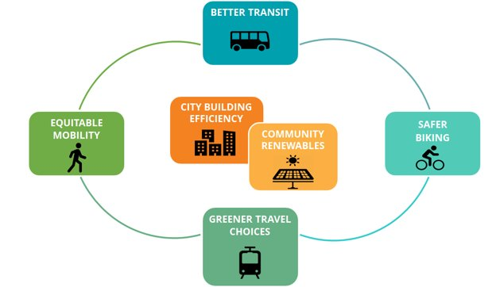


Portland’s Climate Challenge game plan:
Big moves and bright ideas
Notes:
Andrea Durbin:
What specifically are we advancing through the Climate Challenge? Our game plan encompasses several “big moves” and “bright ideas” that will move the needle on emissions in the building and transportation sectors.

Slide 13
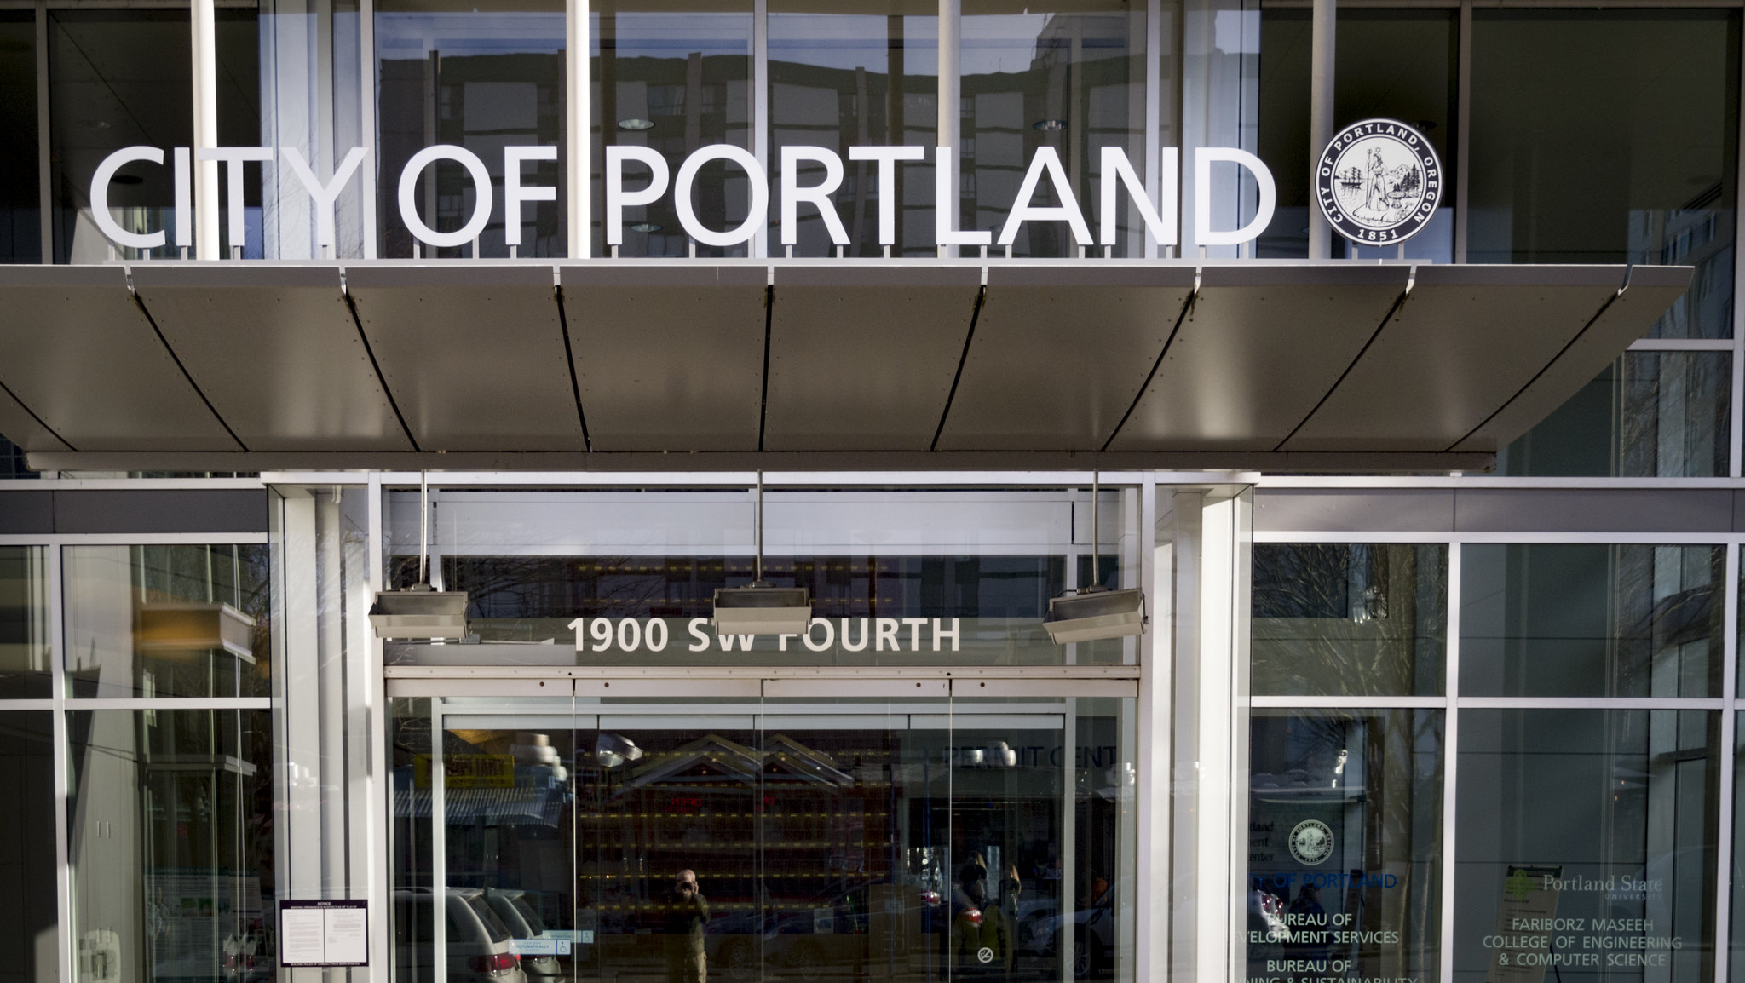
Energy efficiency upgrades in
City buildings
Establish Energy Action Plan for City Buildings, a roadmap to de-carbonize City buildings and energy supply.
Present Council with budget request for priority energy efficiency investments.
Implement energy management best practices and first-phase projects by December 2020.
Notes:
Andrea Durbin:
Energy efficiency is one of the most cost-effective actions we can take to reach our climate goals.
We have an opportunity to signficantly increase energy efficiency in buildings the City owns and manages, save the city money and use these cost savings to finance this program. With the help of the Climate Challenge, we're putting together an Energy Action Plan for City Buildings that will guide where we invest in energy efficiency at a much faster and deeper scale than we've attempted before.
In 2017, the City Council established a goal to be 100 percent renewable community- and economy-wide by 2050. Last fall, Mayor Wheeler signed C40’s Net Zero Carbon Buildings Declaration, which commits us to own and operate net zero carbon municipal assets by 2030.
Reducing energy use is a fundamental pillar of decarbonizing buildings and getting to 100% renewable. Without energy efficiency, we cannot meet our climate reduction goals.
The City has been investing in energy efficiency since the 1990s, through the Sustainable City Government program, which directs bureaus to invest in any energy efficiency measures that have a 10 year payback or less. These efforts have saved us over $80 million since 1991. PBOT's LED street lighting project is a great example of this.
However, investments in our building stock have lagged lately. We have a lot of energy efficiency savings potential and savings opportunities. Energy efficiency delivers multiple benefits and positive outcomes for the City aside from reducing carbon emissions: it saves us money, reduces maintenance costs, improves asset management, contributes to local jobs and opportunities for workforce development, and creates healthier buildings for people to work in. The Parks Bureau has created a great model of investing in energy efficiency for some of their buildings, which will save them millions in utility and maintenance costs over time. That work will inform our recommended plan.
We expect to come back to City Council with the Energy Action Plan and subsequent funding proposals to move this work forward that relies on the cost savings to fund these investments. So, more to come soon!

Slide 14
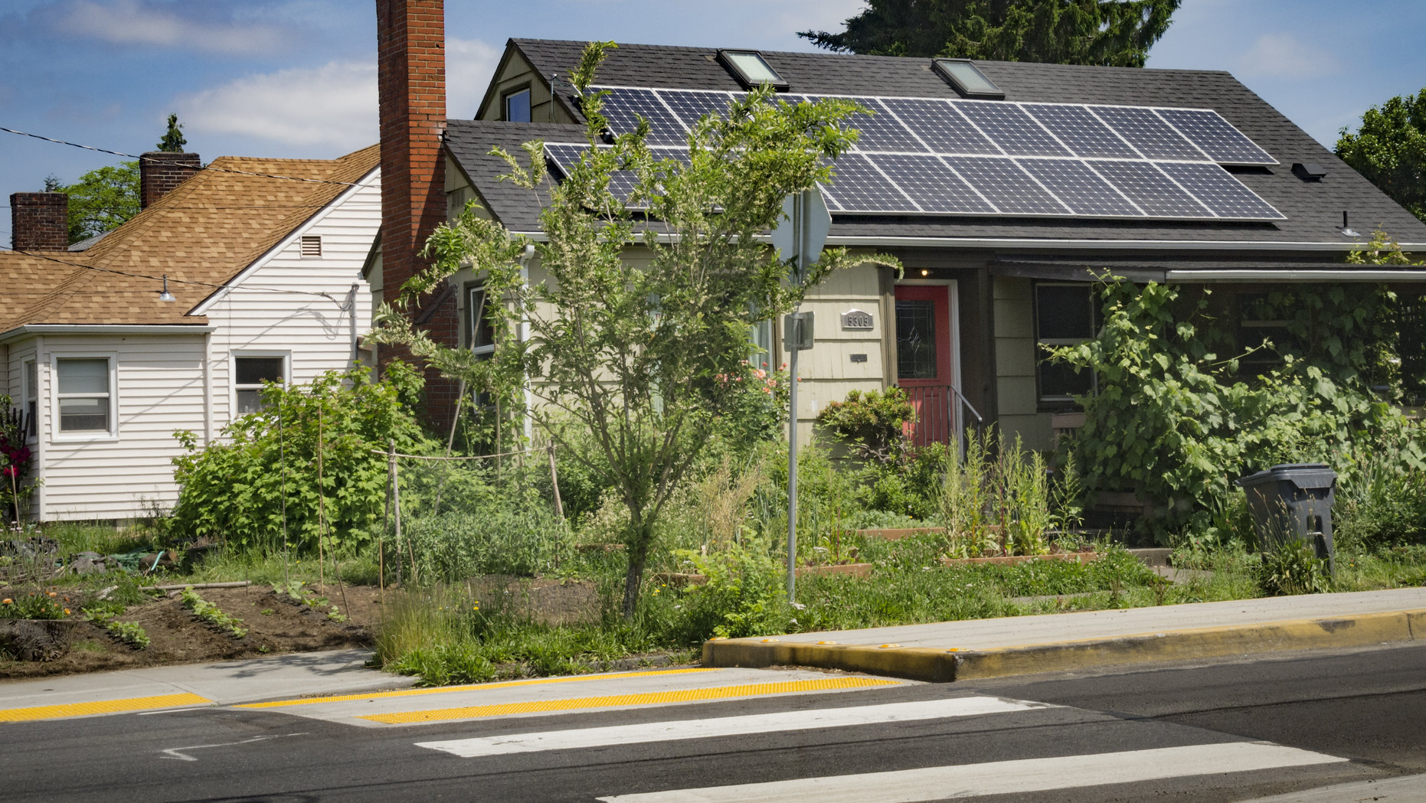
Community-based renewable energy
Support development of at least one community-solar project in Portland benefiting people of color and low-income communities
Inform Portland Clean Energy Fund investments
Notes:
Andrea Durbin:
The second area of focus for BPS in the Climate Challenge is community-based renewable energy, specifically community solar.
Community solar is a collective effort to site, fund and construct a commercial-scale solar energy system that benefits people who can't put solar on their own rooftops.
We know that our renewable energy programs of the past have benefited mostly white homeowners. Community solar offers a chance to expand access and benefits to people of color and low-income Portlanders, including reduced energy costs and creating jobs in this sector.
Our Climate Challenge goal is to support the development of at least one community solar project in Portland that benefits low income and communities of color by the end of 2020. We are working with several partners, including Verde, the Energy Foundation, and GRID Alternatives for this pilot.
The lessons from this project will also inform the work of the Portland Clean Energy Fund, which opens up the possibility of scaling community solar benefits across the city.

Slide 15
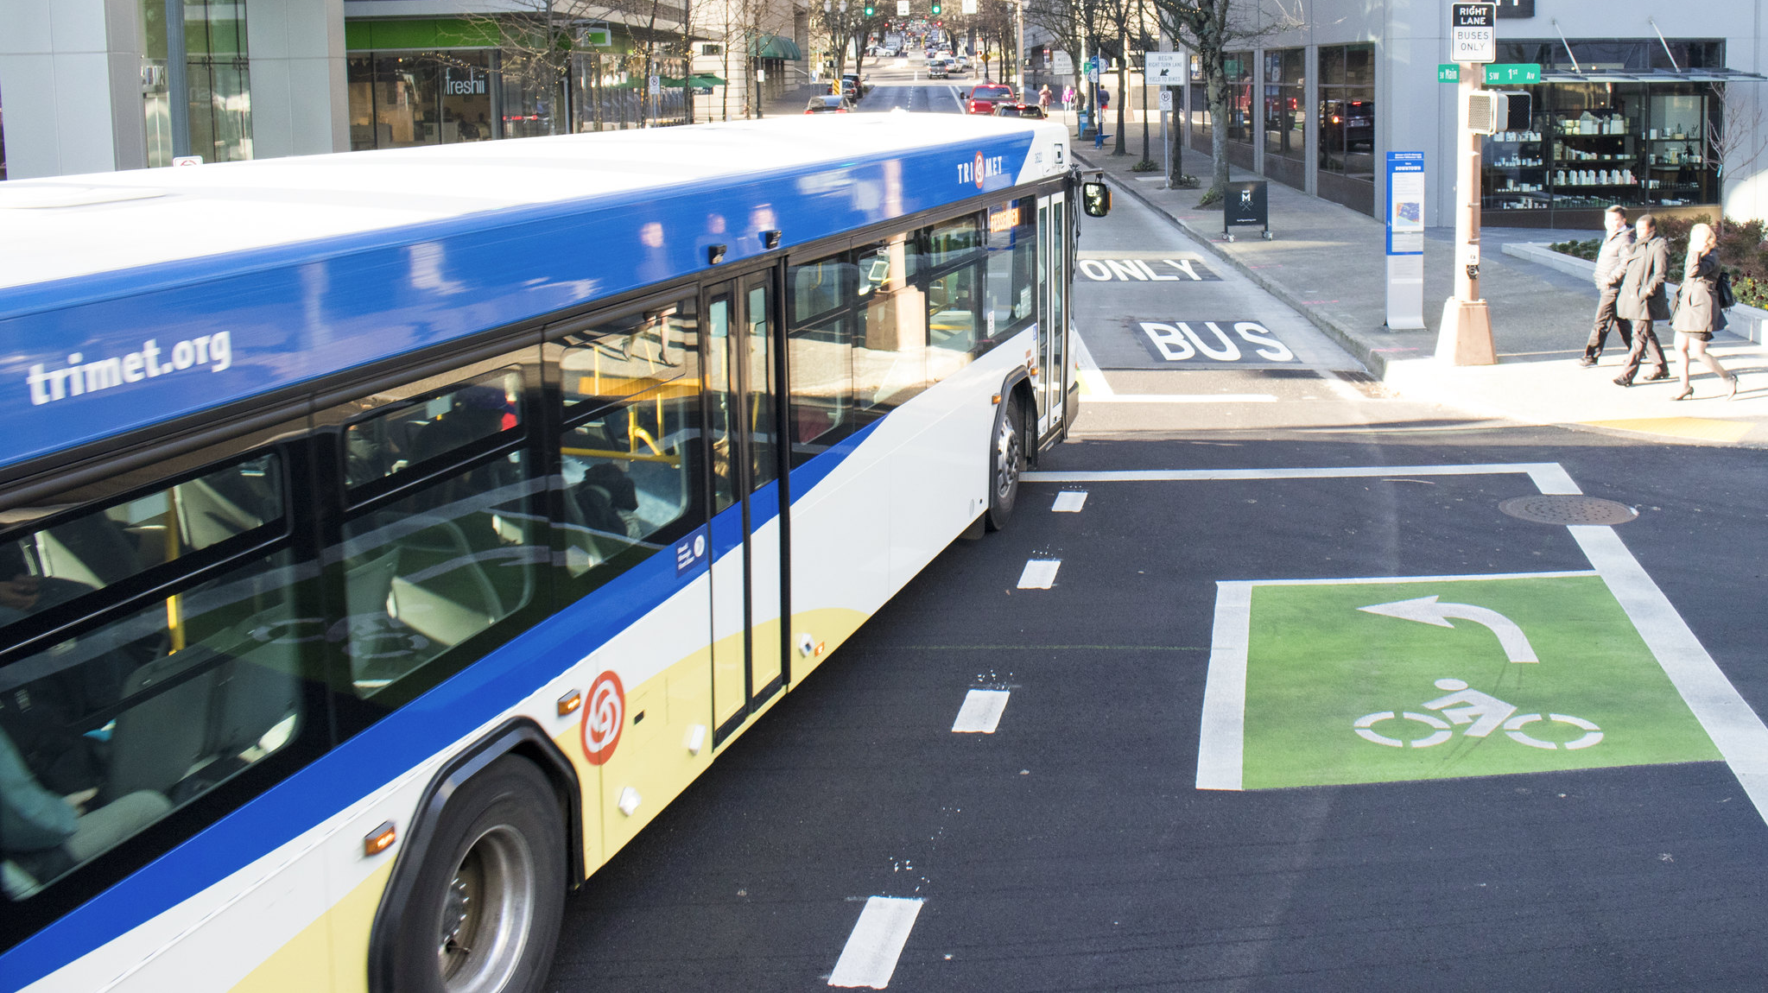
Transit improvements
Implement four Central City in Motion transit improvement projects by December 2020
Advance Rose Lane pilot project, expanding enhanced transit across the city
Notes:
Chris Warner:
As you know, Council adopted the Central City in Motion implementation plan in 2018. During the Climate Challenge period, we’ll be implementing four CCIM projects:
SW Madison dedicated bus lane (implemented May 2019)
NW Everett dedicated bus lane (coming July 2019)
Burnside Bridge, Phase 1 dedicated bus lane (coming fall 2019)
Burnside Phase 2, extending dedicated bus lanes up to 12th Ave (coming fall 2020)
Climate Challenge resources will help us improve and expand our communications around these projects, highlighting the climate action benefit and capitalizing on the improvements to encourage behavior change among Portland commuters.
We’ll also work with Climate Challenge partners—specifically Nelson\Nygaard—to learn from the CCIM experience and inform the development of an Enhanced Transit Priority Network pilot, which you’ve probably heard about as the “Red Lane” or “Rose Lane” project.

Slide 16
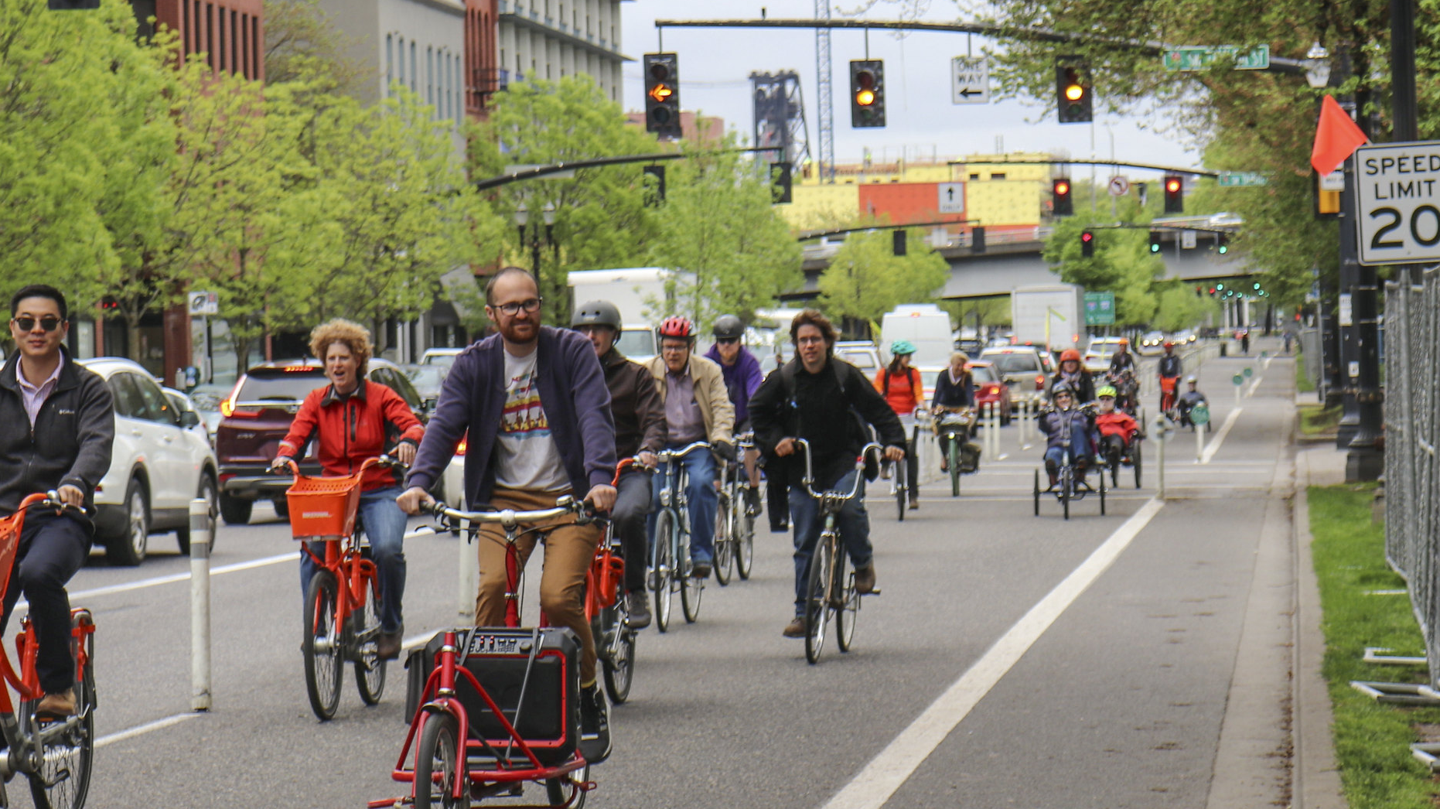
Bike network improvements
Implement three Central City in Motion bike network improvement projects, making cycling in the central city safer and more comfortable
Advance planning on permanent bike improvements on SW Naito and SW 4th Ave
Notes:
Chris Warner:
One the bike side, we’ll advance three CCIM bike projects during the Climate Challenge window (SW Madison and Burnside Phases 1 and 2), as well as advance planning around making Better Naito a permanent installation and adding dedicated bike lanes on SW 4th ave.

Slide 17
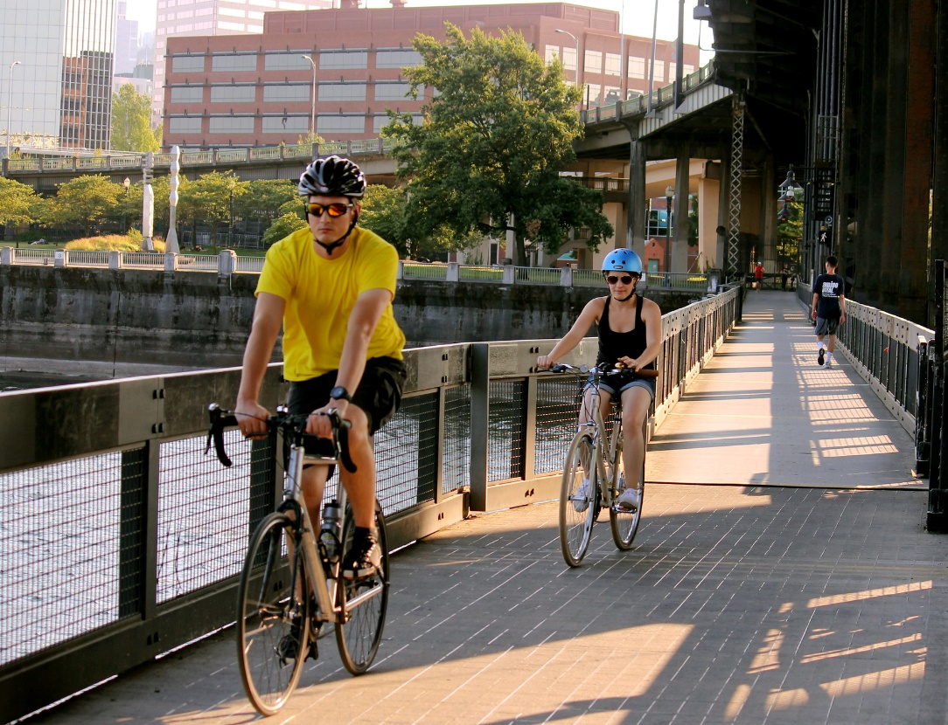
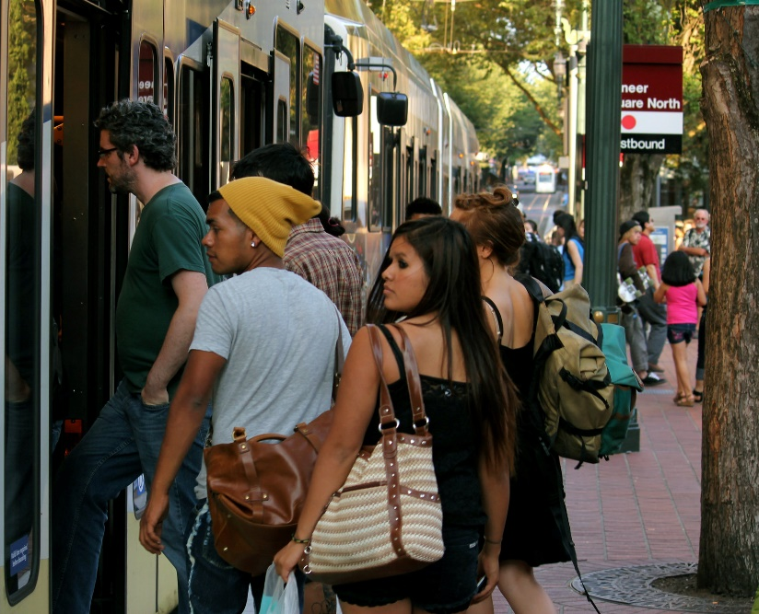
Commuter and resident incentives
Enhance Transportation Demand Management (TDM) programs, including:
  Expanding the Transportation Wallet
  Adopting a new TDM Action Plan
  Implementing and evaluating tailored TDM strategies around new infrastructure investments
Reduce single-occupancy vehicle trips by prioritizing curb space for multi-passenger trips
Notes:
Chris Warner:
Our Transportation Demand Management team within the PBOT Active Transportation and Safety division implements a number of top notch programs that encourage Portlanders to take transit, bike or walk. This includes SmartTrips, the Transportation Wallet and Sunday Parkways.
Through the Climate Challenge, we’ll get focused, deep-dive support from behavioral insights firm ideas42, who will help us develop new TDM tools and messages, test their effectiveness, and the boost the impact of our existing and future TDM efforts.
We’re also planning to pilot an HOV prioritization program that will incentivize multi-passenger trips in TNCs and taxis.

Slide 18
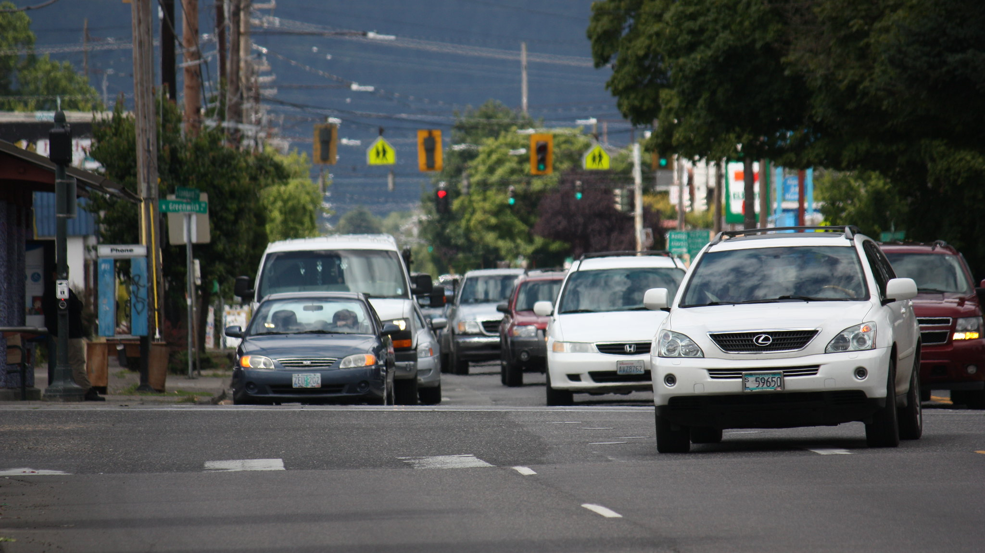
Pricing for equitable mobility
Establish "Pricing for Equitable Mobility" Task Force
Participate in ODOT’s Portland Area Value Pricing process
Engage with Metro’s regional modeling exercises
Notes:
Chris Warner:
Finally, Climate Challenge resources will enable us to engage local community partners in dialogue around pricing for equitable mobility. You’ll hear more about this in just a moment.

Slide 19

Notes:
Chris Warner:
But first, I’d like to invite our partners here today from NRDC to say a few words about the Climate Challenge and how they are supporting our work.
Elizabeth Stampe:
NRDC, and the American Cities Climate Challenge, are committed to supporting Portland in advancing this exciting work.
I manage the Climate Advisors across 6 cities, and am in frequent communication with Emma here and Portland staff.
Along with our partners at Delivery Associates, we support the City in keeping implementation moving forward, and connect PBOT and BPS to resources across the Climate Challenge partner network.
Now I will hand it over to Noah and Shoshana and I'm excited to hear more about the Pricing for Equitable Mobility initiative.

