Slide 1
Photographic traffic enforcement system & related services – Competitive solicitation

Slide 2
Overview
PBOT and PPB seek authorization to competitively solicit for photographic traffic enforcement system and related services
Competitive solicitation
New contract is needed
Update can provide newest technology
Compare pricing structures and costs
Supports expansion of system to support Vision Zero goals
Notes:
Current contract terminates Spring 2020 – so we need to do an RFP
There is a suite of four (4) photo enforcement options at intersections or along segments. Right now, we have two contracts – one for RLR and one for photo radar (vans). The photo radar contract was amended to include fixed speed. Plus we have a new option of adding speed to a red light running camera. This will allow us to consolidate the system under one contract. Many of the services and technology platforms are identical.
Seek a vendor to implement and provide for the design, installation, maintenance, and operation of a photo violation-monitoring system capable of detecting and recording speeding and red light violations, including the support services required for photographic traffic enforcement in conjunction with input from the city.
The suite of photo enforcement options include:
Signalized intersection red light running
Signalized red light running and speeding
HCN segment speeding (fixed speed)
Mobile speed van (photo radar)

Slide 3
Vision Zero Action Plan
Two actions call for expansion of Portland’s traffic safety cameras
1. Speed
Launch and expand fixed speed camera program
2. Dangerous Behaviors
Expand red-light running cameras
Notes:
Describing the problem. First, street design (e.g., 57% of our crashes happen on 8% of our streets – they [HCN] are primarily these are wide streets with four or more lanes of traffic, high speed and volumes; so design standards and funding for infrastructure improvements) plays a significant role. But so do human factors or behaviors: Alcohol or drug impairment, speeding, and dangerous behaviors like red light running and texting play a significant role in fatalities. (91% of DEADLY CRASHES INVOLVE SPEED, IMPAIRMENT, AND / OR OTHER DANGEROUS BEHAVIORS) What is Portland doing about this? PBOT is the champion safety to drive down fatalities on Portland’s streets by leading the City with the Vision Zero – a safety action plan that is City-wide – PBOT has many partners! So, what about Vision Zero addresses speed and dangerous behaviors and what does it have to do with photo enforcement? So --
We plan to expand red light running and speed cameras. Some RLR running intersection approaches that are located as a HCN intersection may be considered for dual enforcement (for RLR and speeding). But who has directed PBOT and partners to expand the photographic traffic enforcement system? Vision Zero Action Plan, of course!
=> Dangerous Driving Behavior (D1)
=> Speeding (S2)
WHY WE WANT TO DO IT -- As we reviewed earlier, there has been two decades photographic traffic enforcement system enforcing moving violations red light running and speeding. The Vision Zero Action Plan focuses on the High Crash Network and factors that contribute to crash severity. Action D1 addresses Dangerous Driving Behavior (D1) and calls for: “use data-driven process to reorganize and expand the red light safety camera program”; and Action Speeding (S2) that calls for: “pilot speed safety cameras on four high crash corridors in the first two years; expand program to additional high crash corridors following the pilot.”
ENGINEERING streets for safety
ENFORCEMENT of traffic laws
EDUCATING the community
EVALUATION and accountability
ENGAGEMENT for behavior and policy change

Slide 4
Photographic traffic enforcement system types
Mobile speed van (since 1996)
A uniformed police officer operates equipment out of a marked police vehicle; limited to four hours per day in any one location
Red-light running camera (since 2000)
Eleven (11) red-light cameras at ten (10) intersections
Fixed speed safety camera (since 2016)
Authority gained in 2015 as HB 2621, now Chapter 721, Oregon Laws Eight (8) enforced approaches on four (4) urban high crash corridors
Dual: Red-light running / Speed camera (new)
Authority gained in 2017 with HB 2409
Notes:
School zones, residential streets, work zones, or other streets with a high number of crashes or speeding complaints (Mobile speed van)
Significant crash history attributed to a disregard of traffic signal (Photo Red Light)
Urban high crash corridors among the High Crash Network (HCN) (Fixed speed safety camera)
HCN Intersection (Dual RL/speed)
A recent telephone survey showed us the public awareness of photo enforcement in Portland. Generally, two-thirds are familiar with photo radar. While a majority are aware of fixed speed, more Portlanders are far more familiar with the City programs that started during the late 90s: red-light cameras and mobile speed vans. The breakdown by option is as follows:
RLR awareness: 93%
Mobile speed van awareness: 84%
Fixed speed awareness: 63%
Overview of the photographic traffic enforcement system
For over two decades, the City of Portland (“City”) has been a leader in utilizing automated enforcement tools to bolster transportation safety. While each enforcement tool is unique, there are commonalities:
All photo radar imagery is reviewed, and citations are signed, by a police officer.
A rebuttable presumption exists that the vehicle’s registered owner was the driver when the citation was issued.
Advance signage indicates that a camera system may be in operation.
Jurisdictions must conduct an outcome evaluation once each biennium.
The following outlines the authority and some constraints of the respective automated speed enforcement radar systems.
Mobile Speed Van (ORS 810.439)
Ten municipalities authorized: Albany, Beaverton, Bend, Eugene, Gladstone, Medford, Milwaukie, Oregon City, Portland, and Tigard. (ORS 810.438)
The Oregon Department of Transportation may operate in work zones on state highways. (ORS 810.441)
In 1996, Portland Police Bureau (PPB) started its mobile speed van program.
City police deploy to school zones, residential streets, work zones, or other streets with a high number of crashes or speeding complaints. (ORS 810.438; City Ordinance 172517)
A uniformed police officer operates equipment out of a marked police vehicle.
Limited to four hours per day in any one location.
Fixed Speed Safety Camera (Chapter 721, Oregon Laws 2015)
In 2014, the City pursued fixed photo radar authority as a legislative priority.
In 2015, HB 2621 grants the City its authority.
The City collaborated with the Multnomah County Circuit Court to conduct a two-year fixed speed pilot of four corridors (eight cameras) through March 31, 2019 which is memorialized in a Memorandum of Understanding (MOU) that was authorized by Council on May 4, 2016.
In September 2016, City’s first cameras in southwest Portland captured speeding violations following a 30-day warning period.
In December 2016, the City adopted its Vision Zero Action Plan in which speed action item S.1 calls for expanding the fixed speed program following the pilot.
The City plans to amend its MOU as it expands the program beyond March 31, 2019 in fulfillment of Vision Zero.
Chapter 721, Oregon Laws (2015), sunsets on January 2, 2024.
Cameras must be placed on “urban high crash corridors”, as defined by state law.
Revenue beyond the costs will be dedicated to investing in traffic safety among the City’s High Crash Network corridors.
Intersection speed & RLR (“Speed on Green”, etc.) (ORS 810.437)
HB 2409 authorizes any city to use cameras at signalized intersections to enforce red light running or speeding without the presence of a police officer.
City’s red-light running program operationalized in 2000; City anticipates leveraging speed enforcement to complement the reorganization and expansion of the red-light running program (see also Vision Zero D2).
Citations are permitted for speeding 11 miles per hour or greater but prohibits the issuance of both a red light running citation and a Class C speeding citation. (ORS 810.437, ORS 810.436)
Camera placement is not limited by a finding of negative impact on safety or by type of street or area.
Unlike fixed or mobile speed, there is no requirement to provide an indication of or information about a driver’s speed in advance of the photo radar system.

Slide 5
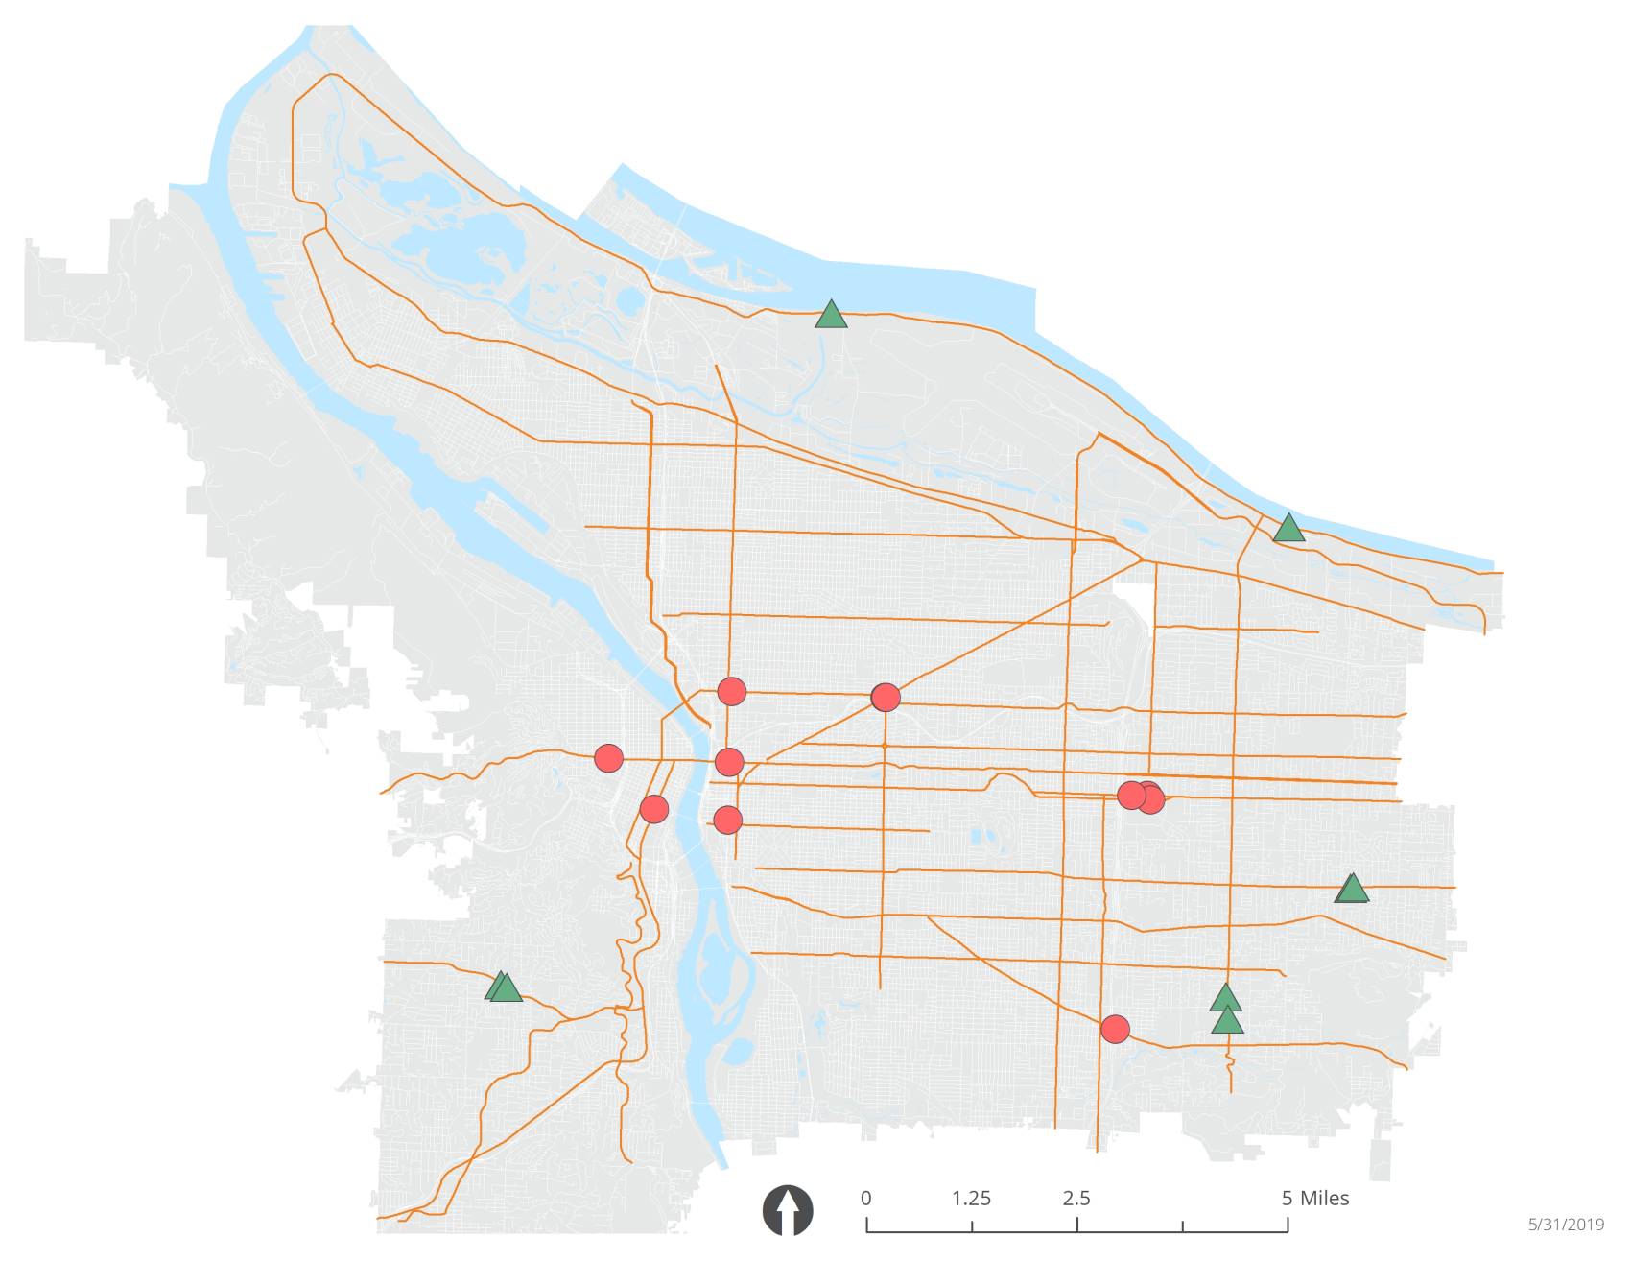
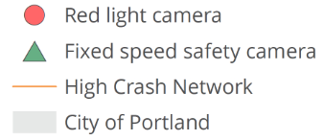
Existing Camera Distribution
Notes:
Recognizing disparate impacts and concerns
Geographic distribution
Avoid concentration in any one neighborhood
29 of 30 high crash intersections, however, are in East Portland
City staff capacity and court capacity allow for conservative expansion
Moving violation event using radar and technology (not contributing to racial profiling)
Warning period => Activation of camera always accompanied by an initial 30 day warning period. Speed reduction changes – interim warning period (Marine saw a 2-week warning period but this is not to say, however, that the interim warning period could be reduced to 7-days – recall that speed reader boards are in advance of the fixed speed cameras)
Traffic safety class is available (for a fee) for those who are eligible – attend it and the citation is dismissed (class is offered by PPB; not via the judicial framework like DUI)
Other/Future: Concerns center around issues related to the fine and ramifications of not paying. A citation may impact car insurance premiums. Unpaid citations may lead to suspension of a drivers license. Collection agencies go and collect. We will explore driver v. owner and/or ways to treat these more like parking tickets.
For example – some may choose to drive due to hate in public spaces like transit or walking. Example: Last year PBOT held focus groups where they asked Black community members to share their experiences walking in Portland, concerns that may have for themselves or for the Black Community in general, and any recommendations for how PBOT and/or the City of Portland might address these issues. Here is one of the responses: One participant shared that she pays a large amount of money for her son’s car insurance because it is safer for him to drive than to be exposed to harassment on public transit.
The “E” of enforcement cannot be discussed without facing another challenge of racial profiling on our streets. We have excellent traffic police in Portland, and work with them closely, but we have to acknowledge that inundating our streets with traffic police would almost certainly have disproportionate negative impacts on people of color. That’s why our Vision Zero Action Plan committed to not result in racial profiling and to limit use of enforcement. It’s also why we emphasize the use of street design, education, and automated enforcement as tools to support safe driving speeds.

Slide 6
System performance to date
Red light running: Reduction in injuries at intersections
4.64 injuries (before)
2.8 injuries (after)
Annual average injuries; all injury severities included to ensure sufficient data
Fixed-speed: Reduction in number of drivers speeding
57% decrease in number traveling over the posted speed
85% decrease in number traveling >10 mph over
Notes:
Reduction in injuries at signalized intersections with red light cameras 2.8 injuries on average post-camera installation compared to 4.64 injuries on average pre-camera installation (all injury severities are included to ensure sufficient data and based on five-year averages) Please note that there were 0 deaths at all camera locations before and after camera installation
In addition to speed limits and street design, we use speed safety cameras to support safe driving speeds. We began installing cameras in 2016, and now have a total of eight cameras on four of our highest crash streets. We don’t have enough crash data yet to evaluate their impact on safety, but we know they have reduced dramatically reduced driving speeds.
The effect of the cameras is especially strong on top-end speeders. On two streets, we have more than a 90 percent reduction in the number of people driving 10 miles per hour or more above the speed limit.
Fixed speed camera systems
Reduction in the number of drivers speeding
=> 57% decrease in the number of cars traveling over the posted speed limit; and
=> 85% decrease in numbers of drivers travelling more than 10 mph over the posted speed.
Speed studies – This is overall, comparing the change among the “before” speed study (before cameras were operationalized) and the most recent speed studies.
\\\\\\/////\\\\\\/////\\\\
Red Light Running => Source: Performance Measures, Vision Zero Annual Report (2017) located at: https://www.portlandoregon.gov/transportation/74093
An overview of the current locations. Intersection crashes can be especially devastating. Please note that this data includes all approaches and does not focus just on the enforced approach. Data includes all injury crashes involving ignoring a traffic signal (DIS-RAG, DIS-TCD and DIS-SIG). Annual average data at all camera locations with installation date (post-camera injuries|pre-camera injuries): --SW 4th & Jefferson, 2007: 1.1|3.6 --NE Broadway & Grand, 2003: 1.9|2.4 --W Burnside & 19th, 2002: 0.2|1.8 --SE Foster & 96th, 2009: 6.7|9.2 --NE Grand & Burnside, 2001: 2.2|7.4 --SE Grand & Madison, 2002: 2.1|2.6 --NE Sandy & Chavez, 2001: 1.1|2.2 --SE Stark & 99th, 2008: 3.4|3.6 --SE Stark & 102nd, 2008: 2.8|6.8 --SE Washington & 103rd, 2008: 6.0|6.8 Data: Oregon Department of Transportation

Slide 7
Public support
Using cameras to ticket drivers on High Crash Network streets
75%
Somewhat
Results shown for fixed speed (2018 telephone survey)
21%
Strongly
Notes:
Support: Portlanders overwhelmingly support fixed speed safety cameras on high-crash corridors.
Three quarters of residents surveyed in 2018 support the fixed speed safety cameras to ticket drivers who speed on streets with high crash rates. These results are similar to two separate on-line surveys conducted by PBOT and PPB in 2016 that demonstrated support of automated cameras to enforce speed and red-light running as well as monitoring speeds within school zones, construction zones and local roads in residential neighborhoods.
Residents in all regions are supportive of fixed speed cameras, but West Portland residents are most supportive.
When the 2018 survey participants were asked why they supported fixed speed safety cameras to enforce speed limits on streets with high crash rates, the most common responses were:
Reduces speeding
Increases awareness
Safety
Effective
Reduces crashes
Reduces reliance on police
Catches traffic violators
Those who expressed opposition to using fixed speed safety cameras to enforce speed limits, the following were some of the reasons:
Money-maker
Should be a police officer, not a camera
Inaccurate
Surveillance, privacy concerns
Awareness of photo enforcement
People are most aware of red-light cameras, followed by the mobile speed vans and fixed speed safety cameras. Comparing those who drive and those do not typically drive, 88% of drivers and 71% of non-drivers (i.e., use transit, walk, bike) are familiar with the mobile speed vans. In contrast, the difference is more subtle among these two groups when it comes to fixed speed safety cameras: 65% and 58%, respectively. The level of awareness associated with red light running and the mobile speed vans is unsurprising given their inception two decades earlier.
Do we use enforcement too little, too much?
Prior to asking survey participants about photo enforcement, they were asked a general question about traffic enforcement: “Do you think the City of Portland enforces traffic laws too little, about the right amount, or too much?” Most believe that the traffic laws are enforced about the right amount. Residents 55 and older are more likely to say that the City enforces traffic laws too little (45% compared with 35% of those under the age of 55). Few residents, however, think that speeding laws in the city are enforced too much—just 6%.
When asked whether the City uses fixed speed safety cameras to ticket speeding drivers too little, about the right amount, or too much, Portlanders were much more likely to respond that they did not know. At least one out of four residents do not know whether the City uses fixed speed safety cameras too little or too much. Residents may lack knowledge of how many fixed speed cameras are in use and where they are located. Residents may not have enough knowledge of where fixed speed safety cameras are located or how many exist to answer this question with confidence. While the data does not answer this question with specificity, it is worth noting that residents in West Portland and Inner Southeast are more likely to say they don’t know (35% and 32%), compared to residents in East Portland (19%).
What did people think about speeding and safety in the first place?
Well, many agree that speeding is indeed unsafe. Although there is strong agreement that enforcing speeding laws is effective in reducing speed, there is a sharp decline in the proportion of residents who strongly agree, as compared to the statement that speeding is unsafe. (Q9-13)
=> 89% surveyed agree that “speeding is unsafe and increases the risk of crashes, serious injury or even death.” What is noteworthy here, however, is that 66% STRONGLY AGREE with that statement and 22% somewhat agree. This is noteworthy when we look at the next two questions about ACTIONS we can take to reduce speed (and, logically, reduce crashes or the severity of crashes).
=> 76% surveyed agree that “enforcing speeding laws is effective in reducing speed”. Of those, only 39% STRONGLY AGREE and 37% somewhat agree. As you can see, the “strongly agree” is not as robust as the previous 66% (that speeding is unsafe).
=> 71% surveyed appreciated the idea that “reducing the speed of cars is an effective way to improve traffic safety”. Of those, however, there’s a 35% STRONGLY AGREE and 37% “somewhat agree”.
OTHER RELATED: Working on reducing posted speed limits, PBOT has experienced the same sentiment or pushback. That is, overall, there is tremendous support for better speed management on our streets. For every person who calls or emails us with concerns about slower speeds, we hear from five or 10 or 20 people pleading for us to do more to get driving speeds under control. But the resistance to slower speeds is real, and some examples of the concerns PBOT hears is:
“You are making people frustrated, leading to more dangerous driving behaviors.”
“Changing speed limits is pointless unless paired with more enforcement or street design changes.”
“I’ve lived here for 30 years—I’ve never noticed a safety problem on this street.”

Slide 8
Next steps
Release the Request for Proposals
July – August 2019
Review of proposals
September – October 2019
Contract negotiations
Nov 2019 – Jan 2020
Some camera replacement and new locations
Spring / Summer 2020
Notes:
Reduction in injuries at signalized intersections with red light cameras 2.8 injuries on average post-camera installation compared to 4.64 injuries on average pre-camera installation (all injury severities are included to ensure sufficient data and based on five-year averages) Please note that there were 0 deaths at all camera locations before and after camera installation
In addition to speed limits and street design, we use speed safety cameras to support safe driving speeds. We began installing cameras in 2016, and now have a total of eight cameras on four of our highest crash streets. We don’t have enough crash data yet to evaluate their impact on safety, but we know they have reduced dramatically reduced driving speeds.
The effect of the cameras is especially strong on top-end speeders. On two streets, we have more than a 90 percent reduction in the number of people driving 10 miles per hour or more above the speed limit.
Fixed speed camera systems
Reduction in the number of drivers speeding
=> 57% decrease in the number of cars traveling over the posted speed limit; and
=> 85% decrease in numbers of drivers travelling more than 10 mph over the posted speed.
Speed studies – This is overall, comparing the change among the “before” speed study (before cameras were operationalized) and the most recent speed studies.
\\\\\\/////\\\\\\/////\\\\
Red Light Running => Source: Performance Measures, Vision Zero Annual Report (2017) located at: https://www.portlandoregon.gov/transportation/74093
An overview of the current locations. Intersection crashes can be especially devastating. Please note that this data includes all approaches and does not focus just on the enforced approach. Data includes all injury crashes involving ignoring a traffic signal (DIS-RAG, DIS-TCD and DIS-SIG). Annual average data at all camera locations with installation date (post-camera injuries|pre-camera injuries): --SW 4th & Jefferson, 2007: 1.1|3.6 --NE Broadway & Grand, 2003: 1.9|2.4 --W Burnside & 19th, 2002: 0.2|1.8 --SE Foster & 96th, 2009: 6.7|9.2 --NE Grand & Burnside, 2001: 2.2|7.4 --SE Grand & Madison, 2002: 2.1|2.6 --NE Sandy & Chavez, 2001: 1.1|2.2 --SE Stark & 99th, 2008: 3.4|3.6 --SE Stark & 102nd, 2008: 2.8|6.8 --SE Washington & 103rd, 2008: 6.0|6.8 Data: Oregon Department of Transportation

Slide 9
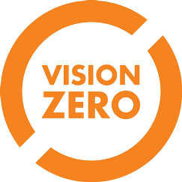
Thank you
Notes:
Thank you for your time!
Who wants to be the listed POC here?
We also have the PBOT Fixed Speed Safety Camera Program <fixedspeedsafetycamera@portlandoregon.gov>
What’s next?
Contract options
Update MOU among partners
Identify potential candidate locations

