Slide 1
Portland Enterprise Zone Program
10-Year Electronic Commerce Overlay Designation
July 1, 2019

Slide 2
Summary
Review Portland Enterprise Zone Program and Electronic Commerce Use (2008-2019)
Electronic Commerce Activity Impact
Enterprise Zone State Statute Overview
City Council Request

Slide 3
Adaptation and Evolution
Portland Enterprise Zone established, 10-year designation with Electronic Commerce Overlay
Aligning Enterprise Zone with Strategic Plan
New Enterprise Zone policy established for Portland and East Portland Enterprise Zones
Policy updates w/ Public Benefit Agreements
East Portland Enterprise Zone established
Identified as key
Financial Sustainability Plan resource
10-year Reauthorization completed &
Electronic Commerce Overlay request pending
10+ Public Benefit Agreements signed
2008
2012
2015
2017
2018
2019

Slide 4
Standard Enterprise Zone vs. Electronic Commerce
Standard Enterprise Zone Program Eligible businesses: Manufacturing, Assembly, Fabrication, Bulk Printing, Shipping, Storage, Recycling, Call Centers, and Headquarters Ineligible businesses: Electronic commerce, tourism, retail, entertainment, childcare, financial services, property management, housing or construction, retail, health care, professional services | Electronic Commerce Overlay Designation Additional eligible businesses: Engaging predominantly in transactions via the internet; Operations connected to the Electronic Commerce activity, which allows for otherwise ineligible activities such as administrative, technical, or other functions that are integral to the retail or commercial transactions

Slide 5
The Case for Including Electronic Commerce
Nearly 20% of projects in the Enterprise Zone (East Portland and Portland Enterprise Zones combined) qualified under the Electronic Commerce overlay
Prosper Portland has a tangible tool to influence business culture change in Electronic Commerce companies via the Public Benefit Agreement Menu
Electronic Commerce companies represent one or more of Prosper Portland’s four clusters; the software industry is the fastest growing industry in Portland
Without July 1 Council action, Electronic Commerce investments will not qualify under Portland Enterprise Zone

Slide 6
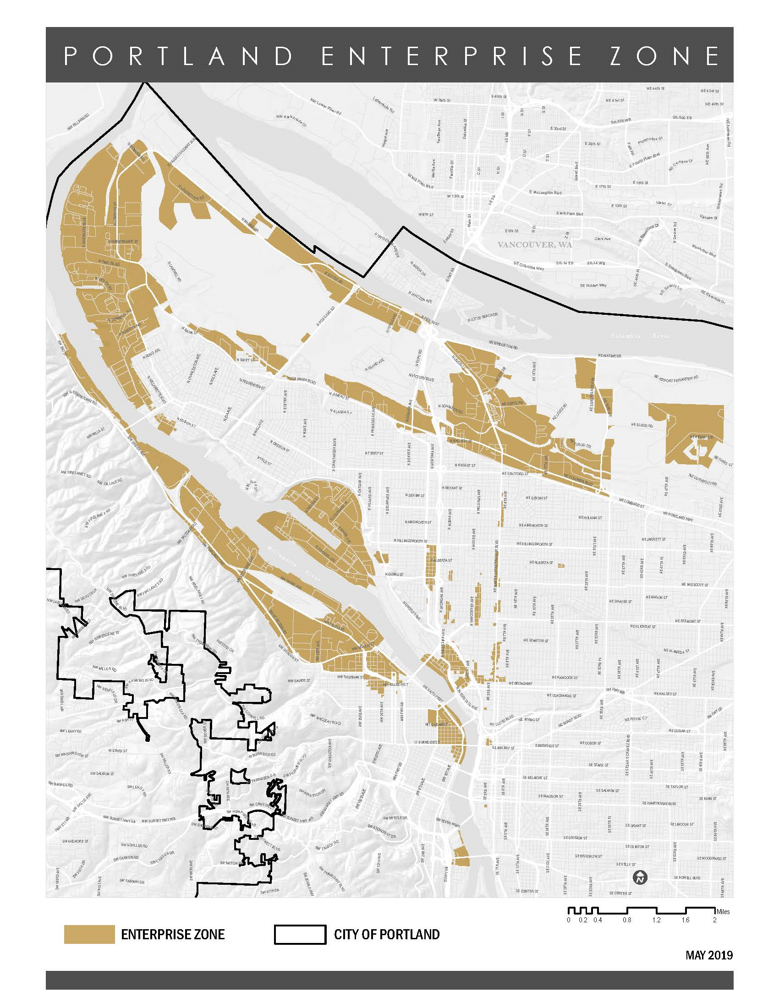
Portland Enterprise Zone (effective July 1, 2019)
City Council authorized the Portland Enterprise Zone on May 1, 2019 and it is in effect today (July 1)
Portland Enterprise Zone and Electronic Commerce overlay have identical maps
East Portland Enterprise Zone (not shown here) maintains its Electronic Commerce overlay until 2023 when the zone expires

Slide 7
Enterprise Zones Electronic Commerce Activity
90
53
17%
of active projects are Electronic Commerce businesses
Total projects
Active projects
10
YEARS

Slide 8
Active Electronic Commerce Companies in the Enterprise Zones
Ajinomoto Frozen Foods | Daimler Trucks NA | Mary's Fresh Harvest | Sun Edison
Ajinomoto Windsor | Dealer's Supply | McKenna's Metals | TEC - Headquarter
Archer Daniels Midland | FedEx Ground | New Seasons Market | TEC - Service Center
Ardon Health | FXI | Olympia Provisions | Treehouse Island
Bob's Metals | GXI | Portland Vital Signs | Triad Machinery
Bridge City Steel | House of Antique Hardware | Profile Laser | United Stationers Supply
Bridgetown Natural Foods | Instrument Marketing | RB Recycling | UPS Distribution HUB
Calbag Metals | Jaguar Land Rover | Rentrak | UPS Driver Training
Canpotex | KeHe Distributors | Simple Finance | UPS Integrated
Cascade Energy | King Cycle Group | Streimer Sheet Metal | Viewpoint Software
Cummins | LKQ Foster Auto Parts | Subaru | Vigor Industrial

Slide 9
Impact | Investments by Electronic Commerce Companies
$89,928,000
Total Capital and Procurement Investment, 2015-2018
$64 million
$26 million

Slide 10
Impact | Electronic Commerce jobs, wages & compensation
$43.16
Wages
362
$17.10
Benefits
$30.86
2017 NEW JOBS (from baseline)
$60.26
2017 AVERAGE
TOTAL COMPENSATION

Slide 11
Economic Development Value Proposition
4 year average forgone Property Tax Revenue: $64,000 City General Fund (Total= $ 257,195)
In return for forgone revenue, over 4 years:
$710
Cost Per Job
$129,000 Workforce Training & Business Development Fund
2.2% City Business Tax on applicable revenue
Estimated ‘payback’ of forgone revenue = 5 years after abatement expires

Slide 12
Oregon Electronic Commerce Statute Overview
15
70+
10-year overlay
Electronic Commerce overlays allowed by law, currently Portland and Medford have expired Enterprise Zones (as of June 30) that also released Electronic Commerce overlays to be picked up by a jurisdiction on July 1, 2019
Enterprise Zones across the state; nearly every medium/ large city in Oregon has an Enterprise Zone
Allows for projects that engage predominantly in Electronic Commerce transactions via the internet that otherwise would not qualify for the Enterprise Zone program

Slide 13
10-Year E-Commerce Designation
The Zone Sponsor (City of Portland) must:
Have completed a new designation for the Portland Enterprise Zone (completed on May 1, 2019)
Notify Business Oregon on Monday, July 1, 2019 of its intent to pass a resolution to designate an Electronic Commerce overlay (completed this morning)
Adopt a resolution on Monday, July 1, 2019 to potentially designate an Electronic Commerce overlay (first-come first-serve, starting 7/1)
Send resolution to Business Oregon no earlier than August 1, 2019

Slide 14
Portland City Council Request
Designate the newly re-authorized Portland Enterprise Zone
for Electronic Commerce (Resolution)

