Slide 1


FAIR ACCESS IN RENTING
May 29, 2019
Notes:
Good evening, Mayor and Commissioners. My name is Jamey Duhamel and I am the Director of Policy for Commissioner Eudaly. In April, we held two hearing on the Fair Access in Renting policy proposals that reform security deposit and screening criteria regulations. Since that first hearing, we have worked diligently with out colleagues, our city attorneys office, and our community partners to streamline the proposals and address concerns. We have submitted substitute proposals that we feel adequately address your inputs.
I am going to quickly walk through the policy proposals and describe the substantive changes we have made since it last came to council. As you all have hopefully noticed, the policy drafts have been re-worded and re-organized to make intentions clear as well as make it easier for people to understand. For tonight’s hearing we will be focusing on an overview of the policy and explaining the parts that shifted the regulations in any substantive way. For those in the audience who did not attend the first hearing, we strongly encourage you to watch it sometime if you have questions that aren’t answered here tonight.

Slide 2
Research Findings
Fair Housing Act sets the standard for addressing housing discrimination.
The industry relies on mythologies to assess risk.
Affordability
has disproportionate impacts.
Changes to screening practices can address discriminatory outcomes.
Screening barriers
have disproportionate impacts.
Notes:
To start, as a reminder, these are the 5 findings we used to help determine the solutions (read findings). During the first hearing, we spent considerable time on each of these findings and the research we used to determine them. We wont be doing that again tonight, but I wanted to remind everyone about why we are doing this work to begin with.

Slide 3
Solutions: Fair Access in Renting
Both policies
work together
Screening Criteria
Security Deposits
Notes:
There are two ordinances before you that address the findings we just discussed. These two policies seem distinct but in fact they work together and are fundamentally linked. We believe that one must go with the other in order to adequately address housing discrimination and not just ultimately make it worse. We will now do a brief walk through of those policies and talk about the changes made in the substitute draft that is before you today.

Slide 4
Security Deposit
Deposit Caps
  If asking for first month’s rent only, SD can be 1 month of rent (2x total move in).
  If asking for first and last months rent, SD can be .5 month rent (2.5x total move in).
  If they fail an individualized assessment or have low income ratio, SD can include an additional .5 month rent taken in 3 month installments (2.5x-3x total move in).
1x-2x
Total amount of
security deposits.
2x-3x
Total amount of
move-in costs.
Notes:
Let’s start with security deposits.
We have limited the total amount that can be asked for in security deposits to between 1x to 2x the rent depending on whether or not last months rent is also required and whether or not they meet screening conditions that allow a landlord to ask for additional security. When you include the standard first month’s rent, total move in costs will be limited to between 2x to 3x total. There were no changes made to this section.

Slide 5
Security Deposit
Condition Reports
  Landlord must provide a depreciation report of any items they may charge against the security deposit.
  Tenant has one week to complete a Condition Report after move in to establish baseline.
  Landlord may only dispute through third party validation.
  Landlord has one week after move out and tenant has right to be present.
Notes:
We are recommending a more thorough process for tenants and landlords to agree upon what damage already exist in the unit at move-in through a "Condition Report". This report is the baseline for any claims the landlord intends to make at the end of tenancy. In addition, a landlord must include pictures and proper evidence of labor charges when making claims for damage. There were no changes made to this section.

Slide 6
Security Deposit
Depreciation and Qualified Charges
  Limits charges to only items broken through intention or negligence.
  Limits charges to a depreciated value (tbd).
  Limits labor charges to local industry standards.
  Excludes repairs or replacements covered under warranty.
  REMOVED- Language preventing landlords from charging for “basic cleaning”.
Notes:
We are recommending a more complete definition of "wear and tear" that makes clear landlords cannot charge for items that weren't damaged intentionally or through misuse or neglect.
We are also recommending that the amount charged must follow a reasonable depreciation schedule. In effect, landlords should only be allowed to charge for the actual value of the item (what they could have sold it for in its used condition) at the time it was broken. We have not yet identified a specific depreciation schedule so that is an area that will be decided in administrative rules after passage of the policy and before implementation.
The substitute draft makes one change to the security deposit policy and it is the removal of the provision that defined basic cleaning as wear and tear and did not allow a landlord to charge for it. State law gives landlords explicit right to charge for cleaning and does not provide any ability for us to nuance that right on the local level.

Slide 7
Security Deposit
Accounts and Information
  Requires all SD be held in a separate account.
  Interest is optional but must be paid to tenant if accrued, minus optional 5% admin fee.
  Requires the tenant receive a completed rental history form and rental accounting (form created by the city) when notice of move out is given.
    AMENDMENT OFFERED: Change to also require when requested by tenant.
Notes:
We are recommending that landlords must put deposits in a separate account of their choice and can use the same separate account for all units. If they choose to use an interest bearing account, that interest is due the tenant upon move-out minus an optional 5% admin fee.
In addition, we are including new reporting requirements that are designed to assist tenants in providing evidence to their next landlord during the screening process. Before move-out, a landlord would need to provide a tenant with both a rental history form that follows specific conditions described in the screening criteria policy, and also a payment accounting of the last two years to enable them to demonstrate the history of payments they made to their current landlord. The amendment we submitted would apply here and give tenants the chance to request this info when they begin the housing search so they can use it with their applications.

Slide 8
Screening
Applications
  Creates a first-come, first-served system.
    Most equitable while also enforceable.
    Must give receipt and queue number.
    CLARIFIED- Landlord must “process”, not “serve” in order.
    AMENDED- Receipts are now by request and not by default.
    ADDED- Multiple applications can be processed at the same time.
  Disadvantages balanced through advertisement requirements/preference policies.
    AMENDED- Required information will be provided by City of Portland, and Landlord can choose how to deliver the information (web link, physical copy, etc).
    ADDED- Landlord can create a waitlist to minimize advertisements.
Notes:
Now on to screening criteria.
We are recommending a first-come, first served approach for all landlords. It was always the intent of the policy that what we termed “first-come, first served” was a provision that mandated a processing order, not an acceptance order. In other words, our policy never dictated that landlords must accept the first tenant that qualifies, we simply required that they make a determination of their application in order. That intention has been clarified in the policy.
In addition, we now require receipts be issued by applicant request and landlords now have 5 days to do so. We expect this will be more helpful to smaller landlords and landlords with more units may choose to simply issue a receipt to everyone instead of waiting for requests. It was also always the intention to allow landlords to process multiple applications at a time but the policy was silent on that so we made that more explicit.
Because moving to a first-come, first-served system is inherently inequitable to some degree, we are recommending accountability mechanisms such a 72 hour advertisement window before landlords accept applications for vacant units. This allows people who need to request time off from work, need translation assistance, have disabling conditions that require assistance, or need time to get their supplemental evidence gathered to have a shot at being front of the line. The advertisement requirements also included notification about units that are fully accessible by ADA building code standards and the preference policy allows individuals who need those units to be considered for them first if they apply within the first 8 hours of an open application period. It was always the intention to allow a landlord to keep a waitlist but the policy was silent so we added it explicitly. In fact, we feel this is an avenue for larger landlords who often have multiple openings to avoid having to constantly advertise and wait the 72 hours. They can simply advertise whenever they want and hold on to the applications as long as they issue a determination in order..
We have also amended several parts of the policy that refer to notice requirements and made them explicitly City of Portland created in order to minimize burden and maximize intent.

Slide 9
Screening
Applications
  Tenant notice of rights.
    AMENDED- Required information will be provided by City of Portland, and landlord can choose how to deliver the information (web link, physical copy, etc).
  Creates “Heads of Households” (limited screening for others).
    AMENDED- New definition of “Applicant”.
    AMENDED- Limited screening for “Non-Applicant Tenant” only excludes income and credit and is not limited for rental or criminal histories.
Notes:
Again, we have amended the requirement that landlords provide a notice of rights to all applicants by making it easy for them to link to a City of Portland document.
Finally, we have created a unique Heads of Household definition that we have redefined as “Applicant” for the sake of clarity. The applicant is the person responsible for paying the rent and is therefore the primary lease holder. We have created the opportunity for other adults to apply as “Non-Applicant Tenants” as additional members of the applicants household in order to make room for a variety of multi-generational households or adults with disabilities who may not be able to rent on their own. The Applicant would receive the full screening including income verification, while the Non-applicant tenant would be screened for everything except income or credit. The previous version of the policy provided a much more limited scope for screening non-applicant tenants that included look back periods for criminal and rental histories but ultimately it removed too much discretion from the landlords right to screen as allowed by state law.

Slide 10
Screening
General Screening
  Identification
    SSN/Citizenship status.
  Income
    2x to 2.5x income ratio.
      AMENDED- Income ratio now tied to HUD rent amounts.
    Guarantor or SD.
      AMENDED- Requirement only applies to applicants who do not meet the income standards.
    Can be combined (with others and types).
      AMENDED- Verifiable family/friend assistance is now optional.
Notes:
We are recommending a wide variety of possible forms of identification to allow people without government issued id to enter into housing. We have also added a provision that landlords cannot reject an application due to a lack of SSN.
In the previous hearing, we went into great detail about why the standard income ratio is creating economic segregation in this city. The previous version of the policy did not allow landlords to require higher than 2.0 income ratio across the board except if they require the tenant to pay for mandatory utilities.
We still feel very strongly that we must maintain a low income ratio in order to shorten the gap between current wages and current rents to get people into housing. After much thought and a lot of math, we have amended this part of the policy to tie income ratio directly to rent amounts, specifically whether or not the rent amount falls above or below the 80% MFI maximum rent allowed as defined by HUD for affordable housing providers. I will explain in greater detail on the next slide but let me explain the other changes first.
Because we changed the income ratio (which I will explain) we no longer felt there was need to offset risks by allowing a guarantor or extra security when applicants met the ratio standards. So we changed the option for the landlord to request additional security to apply only when the applicant falls below the income ratio standard.
Also, because there was no way to regulate for verifiable friend or family assistance, we have made it an option instead of a mandate.

Slide 11
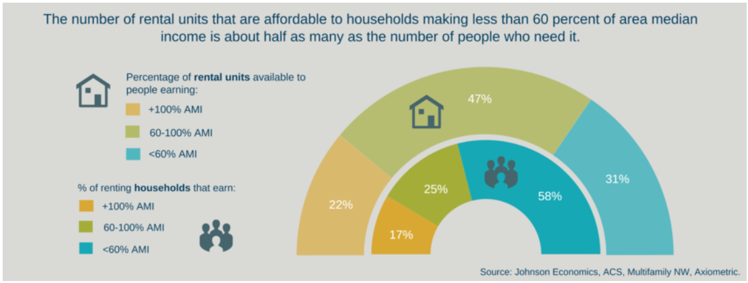
Screening
Affordability Mismatch
Notes:
In a healthy rental market, most private market housing rents fall between 80%-120% MFI, and then there are luxury rates at the top. They naturally fill the gap for the average renter. However, as we see here and as we demonstrated in the first hearing, in Portland we have a huge affordability mismatch between what is provided and what the average renter can afford.
According the housing bureaus state of housing report, the average median income for Portlanders as a whole is close to 80k a year while the average median income for renters is actually only around 36k a year.
At 3x income ratio, a single individual must earn $28 an hour to access a market rate 1-bedroom apartment. The median income of a single Portland renter is approximately $17.69.
So, we have changed the income ratio to say that if a landlord sets their rents below rates pegged to 80% MFI as published by HUD and the Housing bureau (it’s a specific policy that sets the rates for affordable housing rent amounts), then they can require a 2.5 income ratio. If they set their rents at rates pegged at 80% or higher, they can only require 2.0 income ratio. To some advocates, this feels regressive. But we believe that the math works out to show similar access to our previous policy while incentivizing workforce housing rent amounts.
This policy would make a market rate 1-bedroom apartment accessible to those earning roughly $17 and up. If landlords chose to more closely align their rents with 80% MFI rates, it would make housing accessible to people making $15 and up. It is reasonable for us to assume that the private market can and should provide housing to people who work full time making at or above minimum wage. People in these income brackets represent many essential workers including education, care giving, healthcare, restaurant, retail, customer service, and manufacturing, as well as thousands of City of Portland employees.

Slide 12
Screening
Barrier Screening. There are Two Choices:
Low Barrier fast track, prepackaged screening criteria (clear rental requirements, low risk tenancy, quick turnaround on property).
  AMENDED- Appeals process now applies to general screening and can be designed by the landlord.
  AMENDMENT OFFERED: Require consideration of evidence for criminal history barriers.
More restricted criteria, longer individualized assessment process.
  STREAMLINED
Option 1: Low Barrier Process
Option 2: Individualized Assessment Process
Notes:
Ok, lets talk screening for barriers.
Our proposed policy does not force landlords to rent to anyone, or remove a landlord's purview over who lives on their property. It is against state law to do so. Rather, this policy simply asks landlords to choose their own screening process and provides the following two options:
Option 1: Adopt the low-barrier set of criteria outlined in the code. This is a fast, simple way to screen as quickly and easily as the current system allows. This criteria is based on data that supports a more accurate and equitable assessment of what constitutes “risk” in an applicant’s history. In the previous version of this policy, we had created an appeals process that allowed Applicants to provide additional supplemental evidence or correct mistakes. To minimize administrative burden, we have now moved that appeals process to the general screening requirements (meaning it would apply to both of these tracks, and amended it to allow landlords to establish their own specific process as long as it gave 30 days for an applicant to provide additional info, gave them access to another unit if their appeal was successful, and did not require additional screening to access that new unit if it was within a 3 month window. This gives landlords the direct ability to control burden and costs. Commissioner Eudaly has also introduced an amendment that would re-insert language from the previous draft that requires landlords to consider any evidence specific to criminal histories if provided by an applicant.
Option 2: Adopt the individual assessment model. This allows landlords to choose whatever screening criteria they want (as allowed by state law), that is more restrictive than the Low-Barrier criteria but if they intend to deny an applicant, landlords must allow the applicant to provide evidence that they have mitigated or improved any of the housing barriers that they are being denied for. The landlord will still be empowered to make the final decision about if the applicant is right for their property - they just have to provide information to the prospective tenant about why they are being denied. This process is already outlined in HUD guidance and should be familiar to landlords. This section wasn’t substantively changed but was dramatically streamlined to be easier to read and follow.

Slide 13
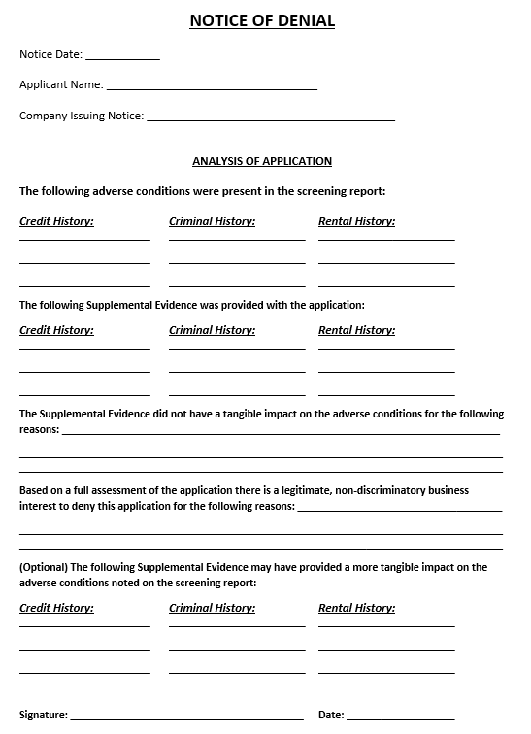
Screening
AMENDED- Removed language about “business interest” as required explanation for denial.
Notes:
To create a mechanism that gives applicants the information they need to understand and overcome their barriers, we created the Notice of Denial as a requirement of the individualized assessment model only.
Following HUD guidance, the previous version asked landlords to identify the “non-discriminatory business-interest reason” they concluded in denying the applicant after conducting an individualized assessment. However, after more analysis, we determined that there is no legal definition of “business interest reason” and leaving it in would create confusion and possible legal expense for housing providers. The notice still requires an explanation of the analysis the landlord made through the individualized assessment, but they no longer have to specifically name a “business interest reason”.

Slide 14
Screening
Fees
Must be paid back within two weeks if not screened or determination not communicated.
Must stay within 10%-25% of professional screening company if doing additional work.
Notes:
We are recommending a more nuanced approach to fees based on the feedback that the new policy may incentivize landlords to bring some of the assessment in-house. We have identified percentages that can be charged depending on the type of screening process the landlord adopts. We have also made explicit when fees must be returned. No changes were made to this section.

Slide 15
Screening
Exemptions
Preference policies and formal agreements.
  AMENDED- Now includes “coordinated access system”.
Shared homes.
Units not available to the general public.
Funding or loan screening requirements.
Notes:
We have included a few very important exemptions.
First, there are a number of ways in which resource providers and landlords have developed direct relationships and created agreements for placement preferences for vulnerable tenants. We do not want to interfere with those relationships as they serve the best interest of the tenant. We have amended this exemption to include coordinated access systems to make sure policies like the N/NE right to return strategy is covered.
Exemptions also include landlords or sub-lessors who share the residence, units that are rented privately, and any funding or loan requirements that mandate specific screening would supersede the parts of the policy in direct conflict with those requirements.

Slide 16
Thank You

