Slide 1
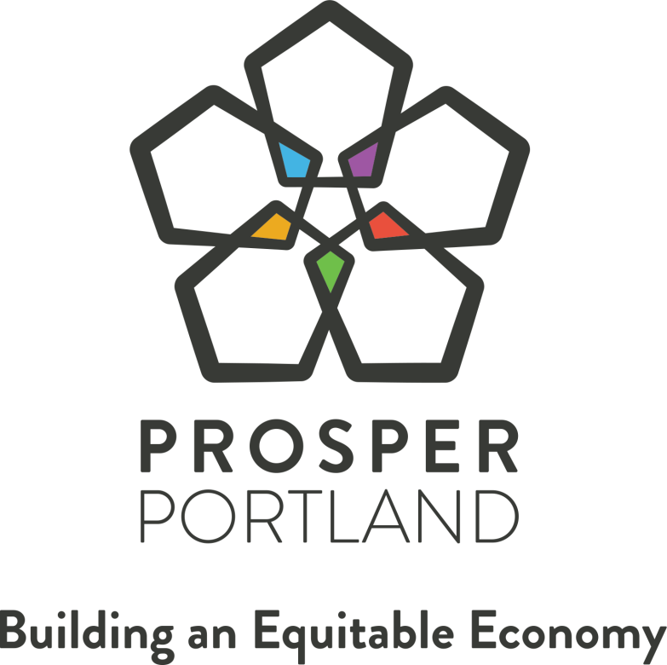
Notes:
TITLE SLIDE: Choose one of 3 colors and delete the others.
Go to Insert > Header & Footer and edit the footer text with your presentation title and meeting date, then click Apply to All.

Slide 2

PROPOSED ACTION & CONTEXT
Amend South Park Blocks Plan to include public buildings (Central Library & Arlene Schnitzer Concert Hall)
Subsequent IGAs with Multnomah County and Metro/City
Notes:
Portland City Council (the “Council”) adopted the South Park Blocks Urban Renewal Plan (as amended, the “Plan”) on July 24, 1985, by Ordinance No. 157635, which Plan had previously been approved and adopted by the Portland Development Commission on July 9, 1985 via Resolution No. 3362, to provide tax increment funding and urban renewal authority to eliminate blight and foster the development and redevelopment in order to protect the public health, safety, and welfare of the City of Portland;
The “primary goal” of the Plan is “to improve the condition and appearance of the Area, eliminate blight and blighting influences, to increase and improve housing, expand public facilities and upgrade the South Park Blocks;” the Plan’s general goals for public improvements to support housing, cultural and park areas is to “provide improvements necessary to promote downtown as the entertainment and cultural center of the metropolitan area, …[and to] establish the South Park Blocks as an art and cultural center in the City and region;” and the Plan’s general goal for historic preservation is to “Identify, preserve, protect and dramatize historical structures and locations within downtown, and to promote the conservation of designated City landmarks”;
Like the previous OCC scenario, ORS 457.085 (2)(j) requires that an urban renewal plan contains a project that includes a public building to also contain an explanation of how that public building will serve or benefit the urban renewal area;
Section 900(C) of the Plan, revised on April 11, 2012 via Amendment No. 11 pursuant to PDC Board Resolution No. 6933 provides that amendments that “identify a project that includes a public building” are to be considered “Council-Approved Amendments” that require approval by both the Prosper Portland Commission by resolution and by the City Council by resolution, but do not require any of the procedural or notice requirements found in ORS Chapter 457, including but not limited to the procedures set forth in ORS 457.085(4) and (5), and that “to the extent that a Council-approved amendment involves a public building, such amendment shall explain how the building serves or benefits the urban renewal area”;
the Plan reached its last date to issue bonded indebtedness on July 23, 2008, yet land area within the Plan can still be characterized as blighted and requires tax increment resources for investment beyond the current time constraints and availability of the existing Plan;
Projects
The Multnomah County Central Public Library (“Central Library”) and the Arlene Schnitzer Concert Hall are both located in the South Park Blocks URA and in need of capital improvements in order to continue to provide safe, attractive amenities to city residents and visitors.
With Council’s authorization, Prosper Portland will direct approximately $3M of tax increment resources to support these improvements. The agency will enter into intergovernmental agreements with these public entities to ensure adherence to investment guidelines including approved costs, construction and workforce polies, and timelines.

Slide 3
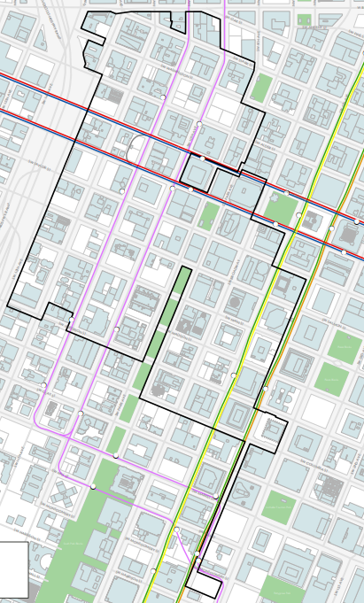
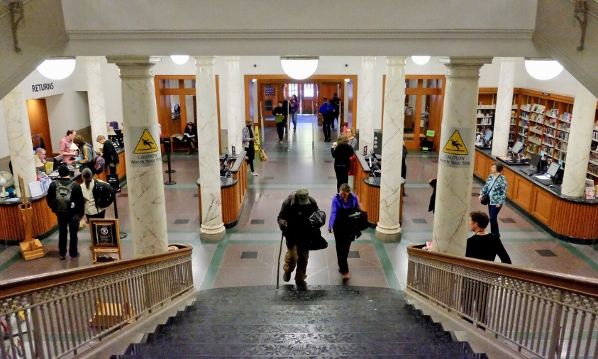
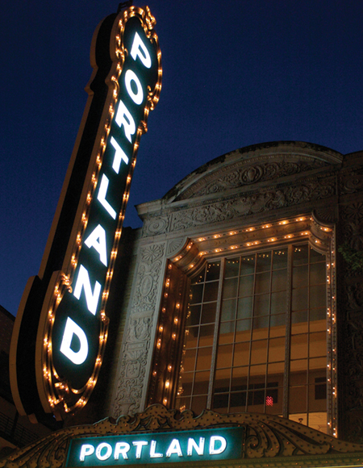
SOUTH PARK BLOCKS
SW Broadway
Multnomah County Central Library
Arlene Schnitzer Concert Hall
SW Columbia
Notes:
An opportunity to be a supportive fiscal partner and invest in two significant cultural assets in our downtown—the Central Library and Arlene Schnitzer Concert Hall—both which have been serving the community since the early 1900s.
Central Library
Opened its doors in 1913, and has since been providing a historic public space for all to gather, learn, create, and access the community’s collective knowledge and resources.
Receives approximately 665,000 visits per year for a variety of purposes including access to books and periodicals, job search assistance, and public gathering space.
The building was renovated in 1997 and Multnomah County staff has more recently identified a series of infrastructure improvements necessary to continue to provide quality services and experience for the community.
Improvements–
The library uses a lot of power—particularly for its heating and air, lighting, and office equipment used by both staff and daily patrons. And it only has one electrical transformer to service all of that demand, and that transformer is failing
Prosper Portland’s fiscal partnership will enable the library to replace the current transformer with two new ones and add a new heating ventilating air conditioning unit that will balance the load on the transformers and improve the building’s efficiency.
The library will also increase the safety of the emergency exit path leading from the US Bank Room which hosts daily public and library meetings as well as library programs—with sometimes over 100 people at a time
To do this, it will install a more accessible landing and path from the exit as well as address longstanding landscaping issues to remedy some visual barrier challenges and water consumption issues.
Central Library staff, is currently refining the scopes and collecting bids for the projects. It’s currently estimated to be about $1.5M.
The Arlene Schnitzer Concert Hall
A hallmark of Portland’s performing arts venues. It has served the Portland community since 1928.
It originally opened as the Portland Publix Theater and then operated as the Paramount Theater. In 1972, the Portland City Council voted to give exterior of the Arlene Schnitzer Concert Hall Landmark Status; the building was subsequently placed on the National Register of Historic Places in 1976.
The Schnitzer concert hall marquees require critical seismic, electrical, and cosmetic upgrades, including replacing rusting sheet metal; upgrading electrical wiring; updating structural elements to meet current seismic code; restoring the sign cabinet to its original appearance; and replacing the letter boards with electronic LED graphical displays. The estimated project cost for these improvements is $1,800,000 and work is expected to be completed by late 2020.
The City partners with Metro to program, operate and maintain the Portland 5 venues. Metro staff, which is currently working through the permitting process for marquee upgrades, has committed to meeting the terms of the South Park Block Urban Renewal Area funds including the using the money in a way that is consistent with tax increment fund requirements and spending timelines.

Slide 4
Proceeds from Bond Refunding
Ordinance 189428 – Authorized refunding of 2008 tax-exempt bonds
Bond reserve of $3.3 million released
Added $2 million available for projects within the district
Notes:
The City issued bonds on April 25, 2019 to refund the 2020-2024 maturities of the South Park Blocks Urban Renewal and Redevelopment Bonds, 2008 Series B (“2008B Bonds”) and to defease the 2019 maturity.
The refunding bonds were authorized by Ordinance 189428 passed by the City Council on March 20, 2019.
The refunding achieved Net Present Value Savings of almost $2 million.
The security for the 2008B Refunded Bonds included a debt service reserve of $3,341,047. The 2019 Refunding Bond eliminated the City’s debt service reserve requirement. Accordingly, $1,341,047 was contributed to the refunding, leaving $2 million of remaining reserves to be available for projects within the South Park Blocks URA.
The remaining $2 million 2008B reserve funds have been set aside for Prosper Portland to provide a grant to Multnomah County for capital improvements to the Multnomah County Central Library.
As requested by the City’s bond counsel, and to fulfill federal Internal Revenue Code requirements, Prosper Portland staff have committed to having a binding commitment (through an executed intergovernmental agreement (“IGA”)), to spend 5% of the reserve funds within 6 months and to spend at least 85% within three years.

Slide 5
SOUTH PARK BLOCKS BUDGET SUMMARY
Recent Accomplishments
  Small business assistance grants
Upcoming Activities
  Small business assistance grants
  Joyce Hotel – affordable ground floor commercial space (partnership with Portland Housing Bureau)
  Community investments
  Multnomah County Central Library
  Schnitzer Concert Hall

Slide 6
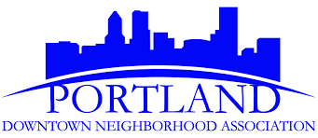
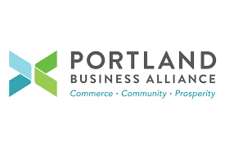
COMMUNITY FEEDBACK
Supportive of public investment in downtown’s cultural assets
Both projects will improve the appearance, safety and function of downtown buildings
Requested periodic updates as projects progress
Notes:
Prosper Portland staff met with the Downtown Portland Neighborhood Association Land Use and Transportation Committee and the Portland Business Alliance Central City Standing Committee to share the details of these two projects opportunities.
Both groups were very supportive of both projects and our agency’s investment in them – in particular as they improve the overall performance of the buildings including the aesthetics and safety.
Prosper staff will continue to keep them apprised as the projects progress.

Slide 7
QUESTIONS?

Slide 8
Notes:
TITLE SLIDE: Choose one of 3 colors and delete the others.
Go to Insert > Header & Footer and edit the footer text with your presentation title and meeting date, then click Apply to All.

Slide 9
PROPOSED ACTION & CONTEXT
Amend Oregon Convention Center Plan to include public building (100 Multnomah)
Notes:
Prosper Portland, the assumed business name of the Portland Development Commission is the designated urban renewal authority of the City of Portland under ORS Chapter 457. In this role, Prosper Portland delivers economic and urban development programs to build an equitable economy for Portland.
Prosper Portland is governed by a volunteer Board of Commissioners who are approved by City Council and report directly to Portland’s Mayor. The Board is authorized by the City Charter to administer the business activities of the agency.
The Oregon Convention Center (“OCC”) is one of 11 tax increment financing districts. It is guided by an Urban Renewal Plan, as amended (the “Plan”) was originally adopted by the Portland Development Commission (“PDC”) Board of Commissioners (the “Board”) on April 19, 1989 (Resolution 3774) and adopted by City Council by Ordinance No. 161925 on May 18th, 1989;
Prosper Portland is participating in the development of the OCC HQ Hotel Garage (“OCC Garage”) as authorized by Prosper Portland Board Resolution No. 7165 by entering into a Parking Structure Development Agreement with Mortenson Development to design and construct a parking garage on behalf of the agency that supports the development and operation of the adjacent Convention Center Hotel, a 600-room hotel to be owned and operated by Hyatt Corporation.
During the design and development process, the site was identified to have additional development capacity beyond the parking garage for which the agency invested $3,000,000 of additional costs to support a future phase office tower.
In furtherance of that investment and a mixed-use project, Prosper Portland is considering developing the 100 Multnomah office tower of approximately 100,000 square foot commercial office space, which may include public and/or private tenants and public/governmental meeting spaces.
Section 1002 of the Urban Renewal Plan (added on May 11, 2011 via Amendment 18 pursuant to Prosper Portland Board Resolution No. 6873), provides that amendments that identify a project that includes a public building are to be considered “Council-Approved Amendments” that require approval by both the Prosper Portland Commission by resolution and by the City Council by resolution, but do not require any of the procedural or notice requirements found in ORS Chapter 457.
ORS 457.085 (2)(j) requires that an urban renewal plan that contains a project that includes a public building to also contain an explanation of how that public building will serve or benefit the urban renewal area– the additional development of the OCC Garage to include commercial office space which may include public tenants and public/governmental meetings spaces will benefit the Plan area by leading to increased employment and economic development activity within the city and the Plan area.
The Prosper Portland Board of Commissioners approved the Twenty-first Amendment to the Oregon Convention Center Urban Renewal Plan, pending City Council approval. attached hereto as Exhibit A (the “ Twenty-first Amendment”);
Key Plan amendments related to this action:
Plan Amendment No. 9 (Section 601(k)) (via PDC Board Resolution No. 5519) on August 9, 2000 added “public building facilities supportive of the residential and business community development such as meeting, conference, educational, recreational, or cultural spaces” to the anticipated improvements to the Plan area;

Slide 10
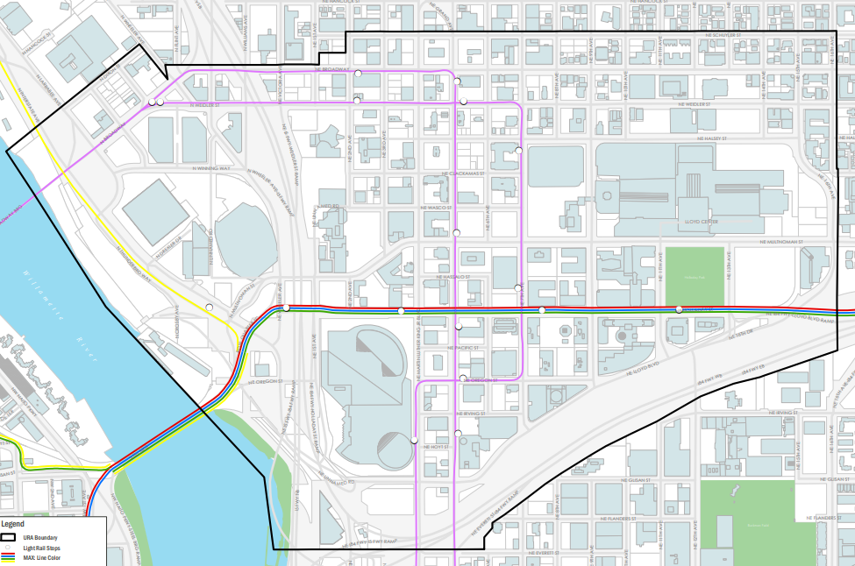
OREGON CONVENTION CENTER
NE Broadway
Interstate Ave.
100 Multnomah
I-84
Notes:
The OCC is 410 acres and bounded by the Willamette River to the west, NE Schuler St to the north, NE 16th Avenue to the east and I84 at the south.
Key purposes of the plan include “maximizing the regional job potential of the Oregon Convention Center” by “encouraging other support industries and businesses to locate in the Area or to upgrade existing facilities;” “foster the opportunity for office development in the area…; “create opportunities within the area for businesses to expand and service the convention trade,” by reinforcing the expansion of the Central City and the economic expansion of the eastside; and by encouraging lodging, entertainment, restaurant and retail development in the corridor between the OCC and the Lloyd Center.
100 Multnomah project will complete the build out of the block with the Convention Center Hotel. It will leverage Prosper Portland’s investment in the hotel garage by further activating the ground floor and creating additional space to grow employment in the area.

Slide 11
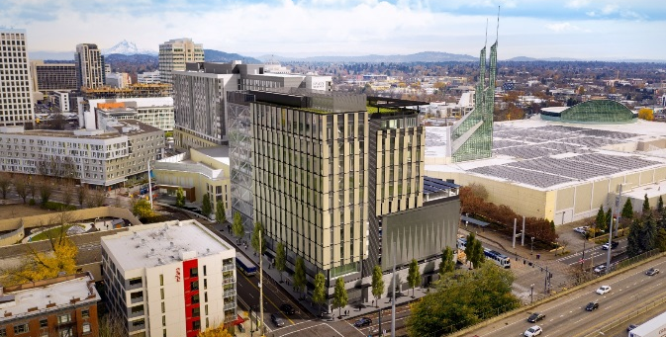
OREGON CONVENTION CENTER BUDGET SUMMARY
Recent Accomplishments
  Convention Center Hotel & parking garage
Upcoming Activities
  100 Multnomah office tower predevelopment
  Priority areas
  Rose Quarter/NE Broadway
  MLK/Grand
  Asset Management
  Inn at the Convention Center
Notes:
Support Convention Center Hotel construction

Slide 12
100 MULTNOMAH PROJECT SUMMARY
2014 | 2015 | 2016 | 2017 | 2018 | 2019 | 2020
Prosper Portland sold Block 47 for Convention Center Hotel construction
CCH garage permitted through Design Commission for future office expansion
CCH garage funded with infrastructure to support future office tower
Prosper Portland design and permitting of ~100,000 square foot office tower
Convention Center Hotel and garage construction started 2017, opening in February 2020
Office tower construction through 2021
City of Portland planning for downtown building space needs
Refinement of City’s space needs assessment
Notes:
Support Convention Center Hotel construction
City process led by OMF
Provide downtown office space needed for forecasted 5-year growth of 220 City employees
Optimize Portland Building usage
Avoid fluctuations in market rates for future leased space
Savings through reduction of move costs over time through flexibility between bureau spaces

Slide 13



COMMUNITY FEEDBACK
New building should maximize density and employment opportunities in Lloyd
Priority to build out the site with a preference on private tenancy
Supportive of reduced parking program to leverage area’s transit investments
Activate to bring more pedestrian traffic to the west end
LEED Gold aligns with neighborhood’s focus on sustainability
Notes:
Prosper Portland staff has an active presence in Lloyd including relationship management with the business and growing residential communities and serving on organizational boards.
Keeps them informed of public investment activities via regular board engagement and through the budget outreach process
Feedback guides investment and program opportunities ranging from grants and development opportunities
Area’s stakeholders have been involved since the initial design and development of the parking garage as part of bringing the Convention Center Hotel to the area. This effort builds on the plan to construct the tower.
Organizations provided guidance including:
Prosper staff worked with Go Lloyd on a parking strategy that will reduce the number of stalls to be delivered with the building and leverage the existing parking and transit infrastructure investments.
Use this an opportunity to push the architectural bounds of Lloyd’s design guidelines
Preference for Prosper to seek a private tenant to grow jobs in the area, but are supportive of a public tenant use
Building should help reflect principles of being an Ecodistrict.
With that, we have received positive feedback on this plan.

Slide 14
FRANKLIN GOTHIC DEMI
Franklin Gothic Medium
Bullets
Bullets
Bullets

Slide 15
INDEBTEDNESS & DEFEASANCE
TIF District | Maximum Indebtedness | Indebtedness Remaining as of March 31, 2019 | Projected Indebtedness to Be Issued | Projected Indebtedness Not Issued | Last Date to Issue Long Term Debt | Est. Yr. of Bond Defeasance | Acres
Downtown Waterfront | $165.0 | $0.0 | $0.0 | $0.0 | 2008 | 2024 | 233.1
South Park Blocks | $143.6 | $31.6 | $0.0 | $31.6 | 2008 | 2024 | 156.3
Airport Way | $72.6 | $0.0 | $0.0 | $0.0 | 2011 | 2020 | 885.1
Convention Center | $167.5 | $0.0 | $0.0 | $0.0 | 2013 | 2025 | 410.0
Lents Town Center | $245.0 | $71.2 | $71.2 | $0.0 | 2020 | 2026 | 2,846.3
River District | $489.5 | $52.1 | $52.1 | $0.0 | 2021 | 2022 | 314.8
Gateway | $164.2 | $108.2 | $44.0 | $64.2 | 2022 | 2029 | 658.5
Central Eastside | $126.0 | $15.3 | $15.3 | $0.0 | 2023 | 2023 | 708.5
North Macadam | $288.6 | $122.4 | $122.4 | $0.0 | 2025 | 2029 | 447.0
Interstate Corridor | $335.0 | $96.8 | $96.8 | $0.0 | N/A | 2023 | 3,990.0
Neighborhood Prosperity Initiative (6) | $7.5 | $4.7 | $4.7 | $0.0 | N/A | 2022 | 803.7

Slide 16
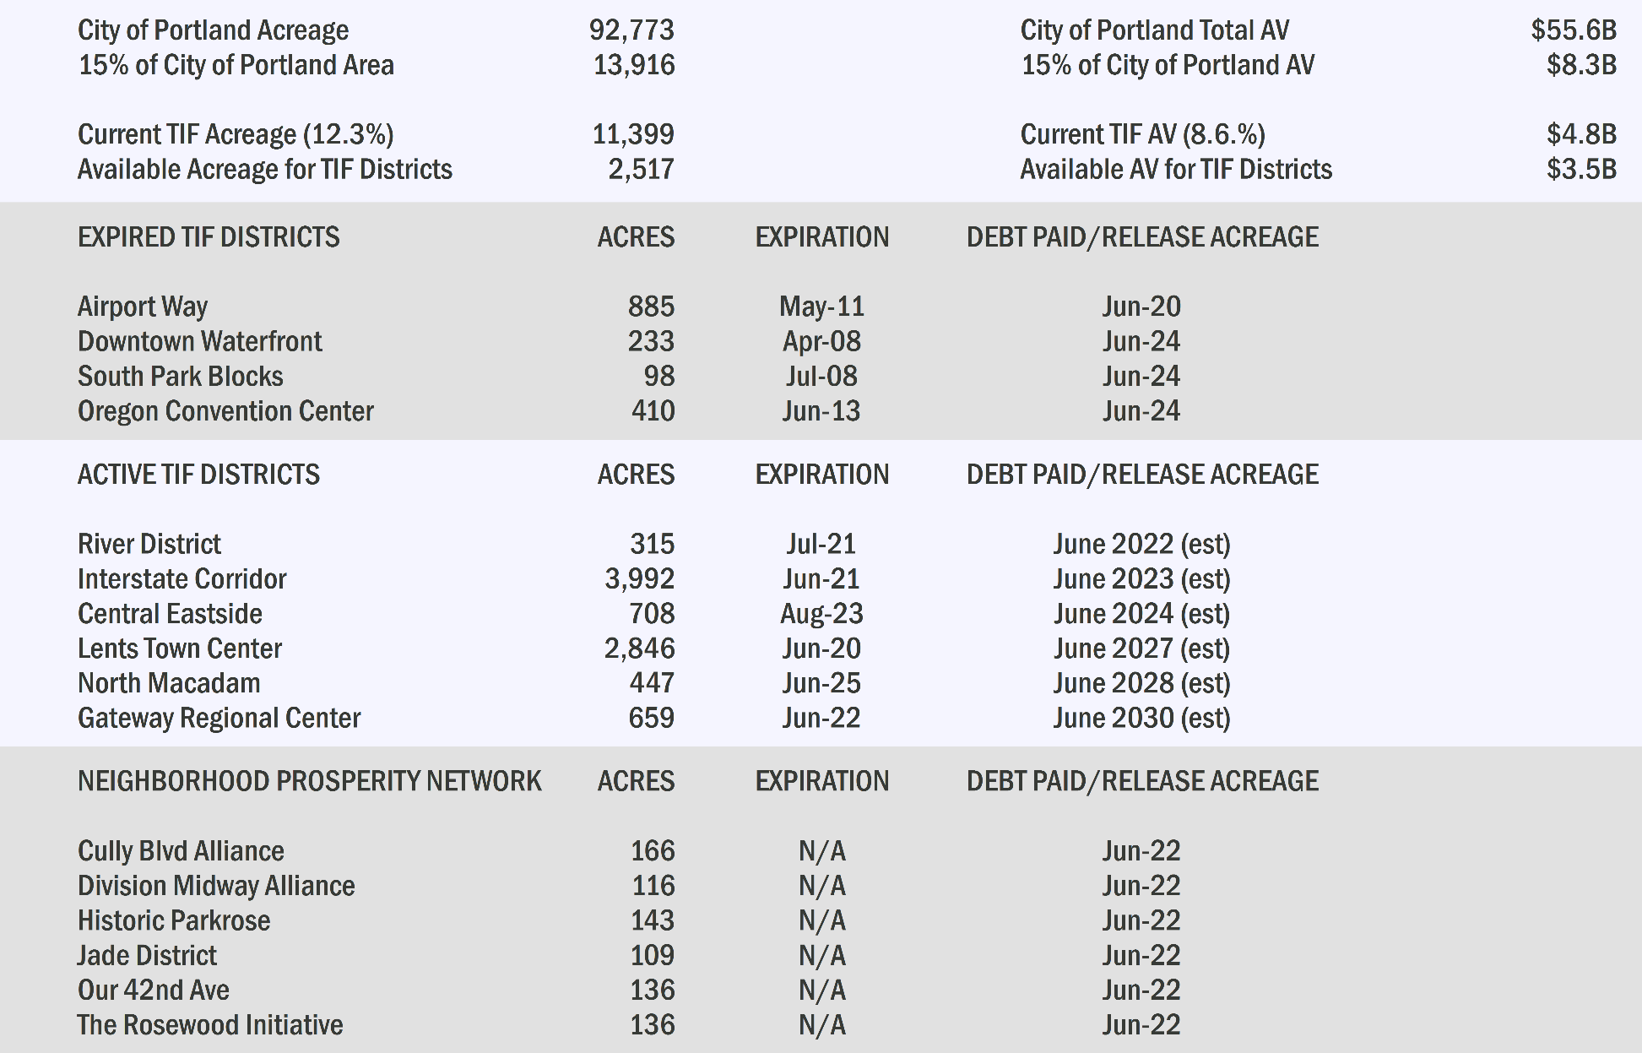
ACREAGE & ASSESSED VALUE

