Slide 1
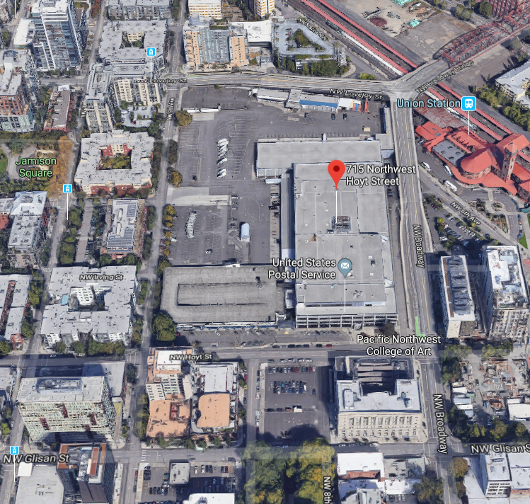
City of Portland
Design Commission
2nd Design Advice Request
EA 19-147114 DA
Broadway Corridor Master Plan
July 18, 2016
Staff Presentation

Slide 2
Staff Introduction
Applicant Presentation
Staff Discussion Topics
Public Comments
Commission Discussion

Slide 4
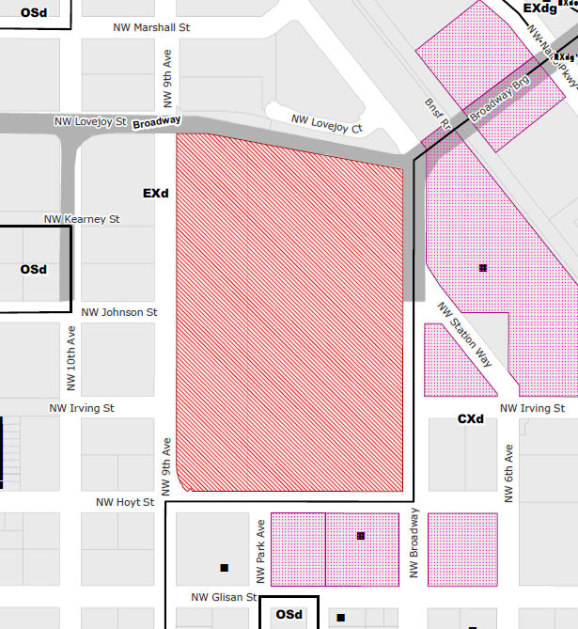
Location:
Central City Plan District
Pearl Subdistrict
Base Zone:
EXd, Central Employment, Design Overlay
Approval Criteria:
33.510.255.H (Central City Master Plan Approval Criteria)
Height:
400’ max. (on N ½)
250’ max. (on S ½)
Floor Area Ratio:
2:1 min.
7:1 max. base, 3:1 bonus with inclusionary bonuses, unlimited FAR transfers
Site Challenges:
Elevation change
Bridge frontages
Green Loop accommodation
Zoning

Slide 5
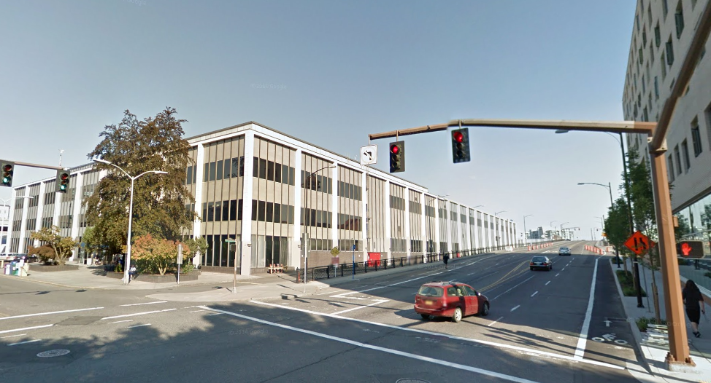
Looking southwest on NW Hoyt
Notes:
I am going to click through several images around the site. You’ve seen these before but as a reminder, the larger image is the view looking away from the site and the view in the upper right corner is looking toward the site from relatively the same location. This is the historic Post Office building with a lovely trash and loading area at the north end.

Slide 6
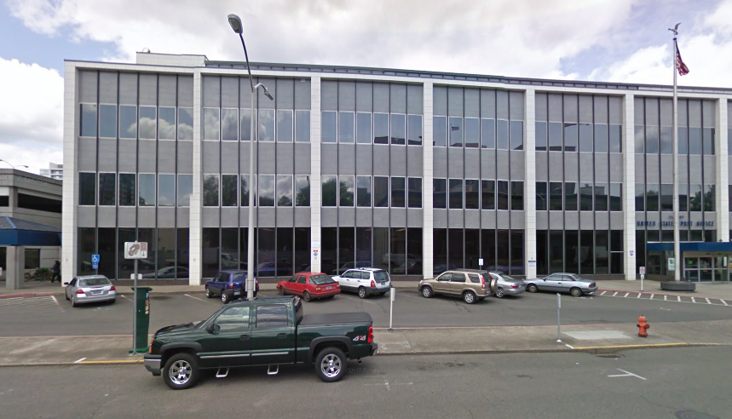
Looking south along NW 8th alignment
Notes:
This surface parking lot is intended to be redeveloped as an additional North Park Block.

Slide 7
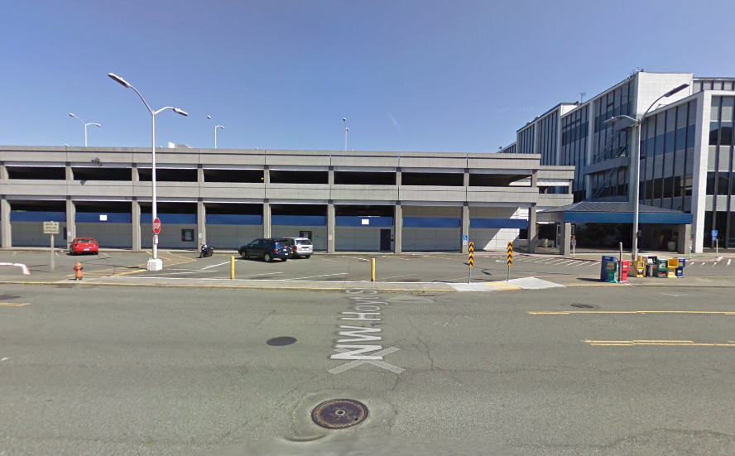
Looking southwest @ Park & Hoyt

Slide 8
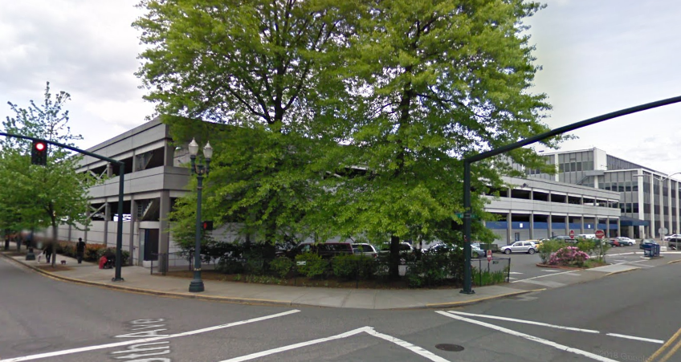
Looking south along NW 9th
Notes:
In the upper right you can see the parking garage that is intended to stay until Phase 3.

Slide 9
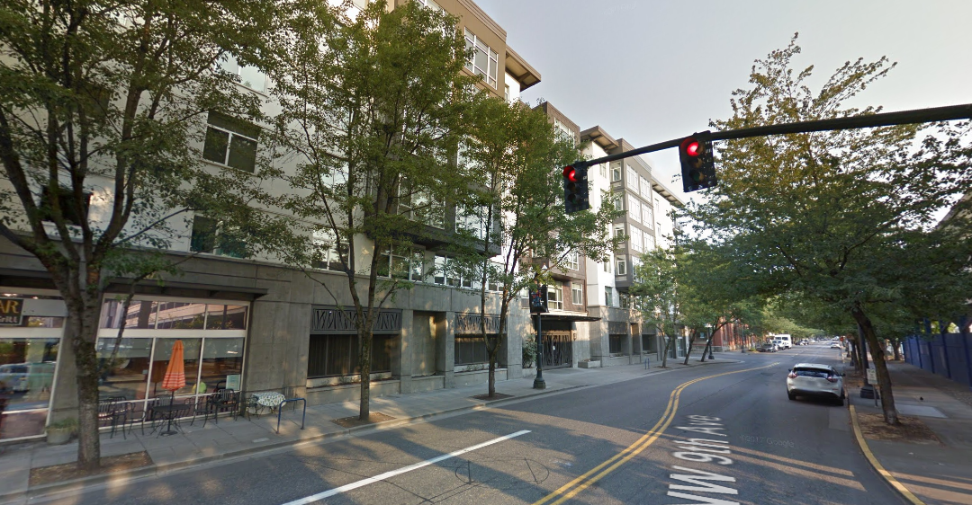
Looking north along NW 9th

Slide 10
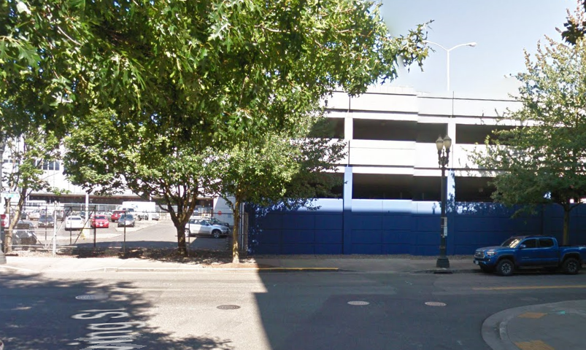
Looking northwest @ 9th & Irving

Slide 11
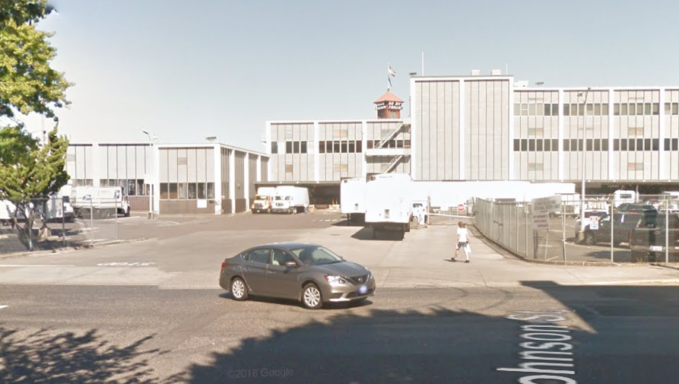
Looking northwest @ 9th & Johnson

Slide 12
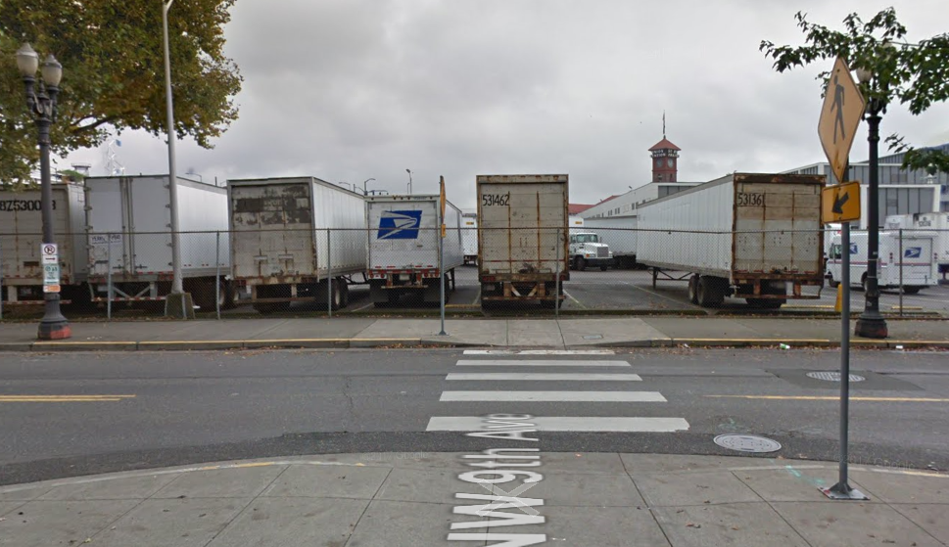
Looking north @ 9th & Kearney

Slide 13
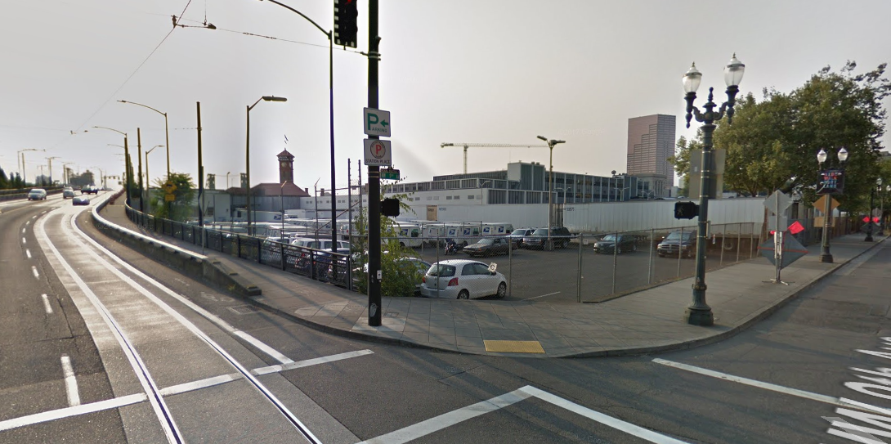
Looking northwest @ 9th & Lovejoy

Slide 14
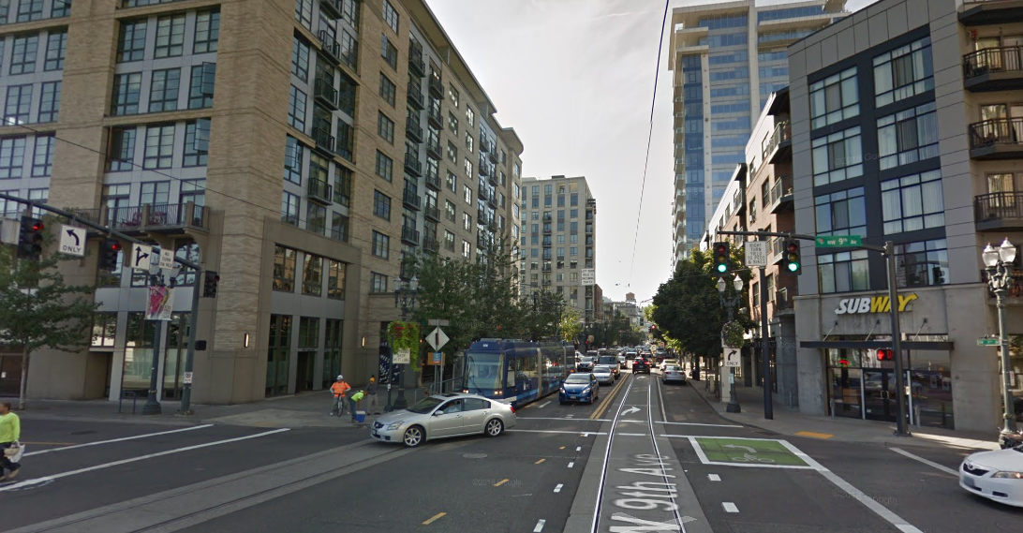
Looking east on Lovejoy

Slide 15
Looking southwest @ Broadway & Lovejoy

Slide 16
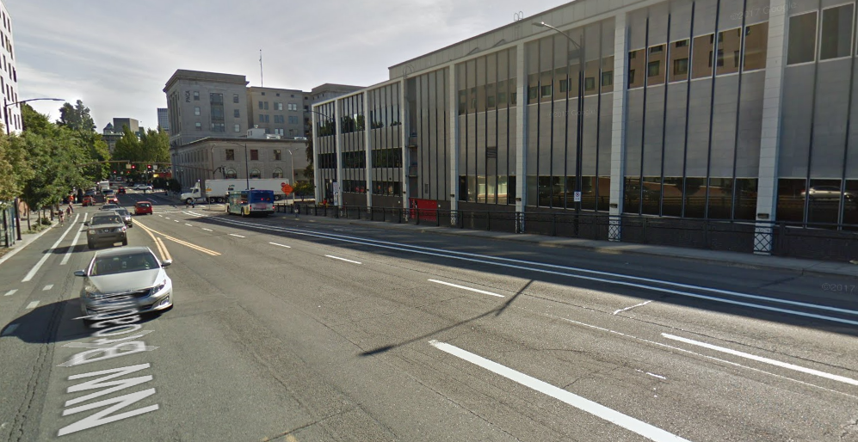
Looking east @ Broadway & Irving

Slide 17
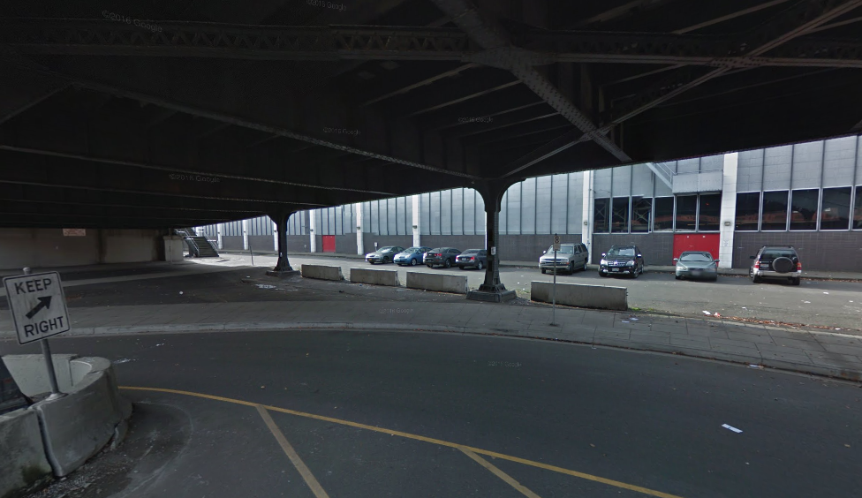
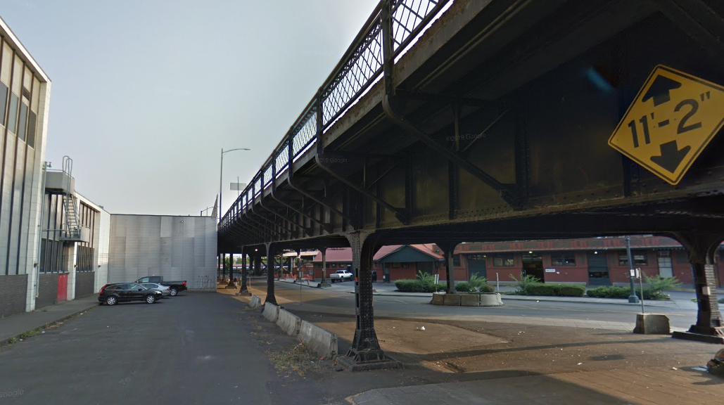
Looking northeast @ Johnson under Broadway
Notes:
This shows the area just to the right where Johnson is proposed to be re-routed at an angle under the Broadway Bridge ramp in order to gain more clearance.

Slide 18
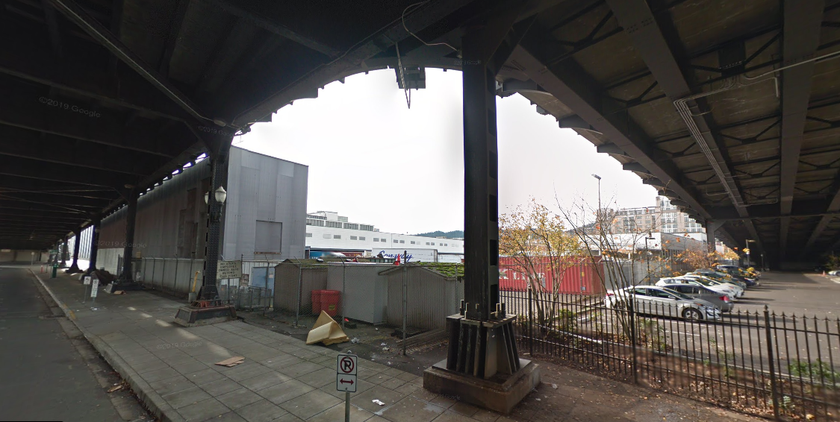
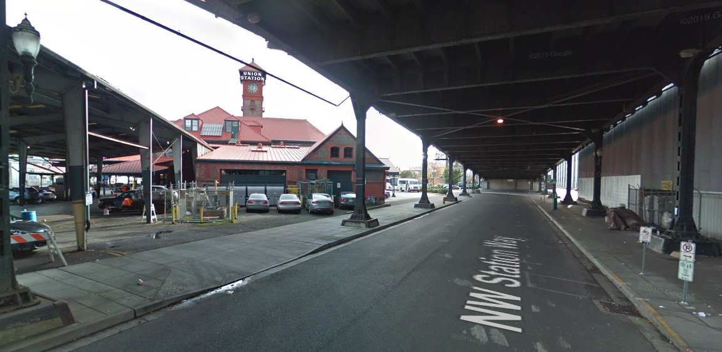
Looking south under Broadway
Notes:
This is the view of Station Way underneath the Broadway bridge ramp, near the Y. to the left is the back-of-house areas of Union Station. The upper view is looking west. You can see the private parking lot under the Lovejoy ramp

Slide 19
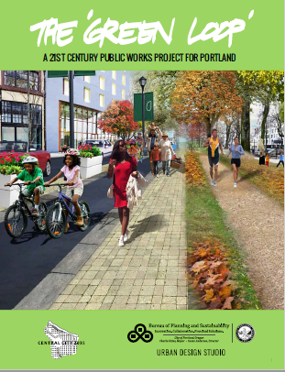
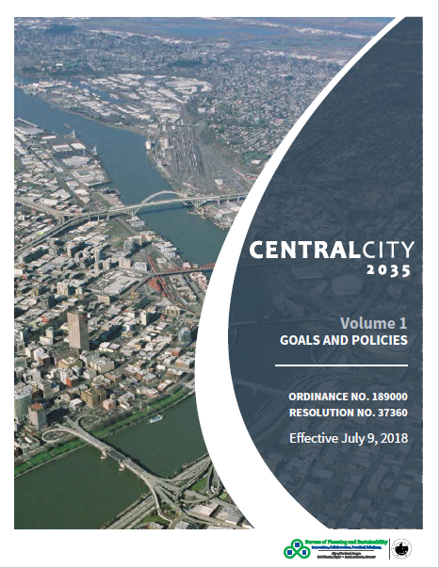
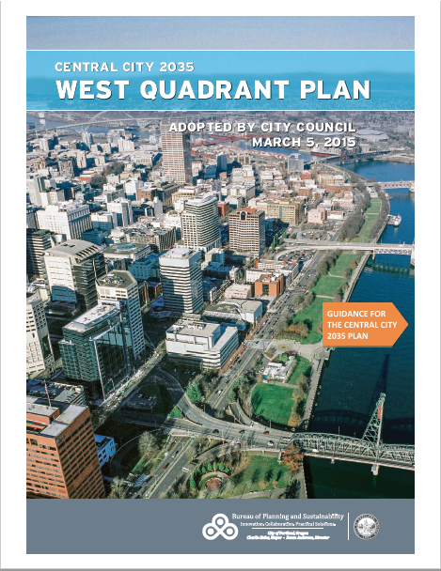
Long Range Planning Efforts

Slide 20
Staff Introduction
Applicant Presentation
Staff Discussion Topics
Public Comments
Commission Discussion

Slide 21
Staff Introduction
Applicant Presentation
Staff Discussion Topics
Public Comments
Commission Discussion

Slide 22
Response to Context
Open Space Framework
Open Space Calculation
Green Loop
3. Development Framework
Phasing
Parking
Massing
General considerations
Specific considerations
Development Standards
1. Massing envelopes
2. Active Use
3. Active Façades
4. Pedestrian Realm
North of Johnson
Underside of Green Loop
Vehicle Access
5. Infrastructure
Street Layout
Adequate Capacity
Timely Delivery of Infrastructure
Notes:
So these are the discussion topics as laid out in the staff memo. We may not talk about each of these sections, but this is the general framework of the rest of the presentation.

Slide 23
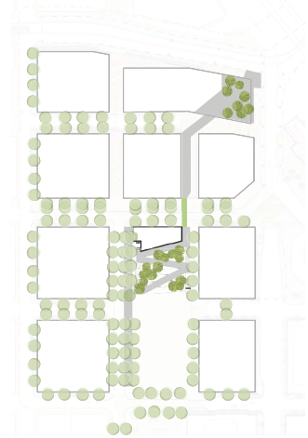
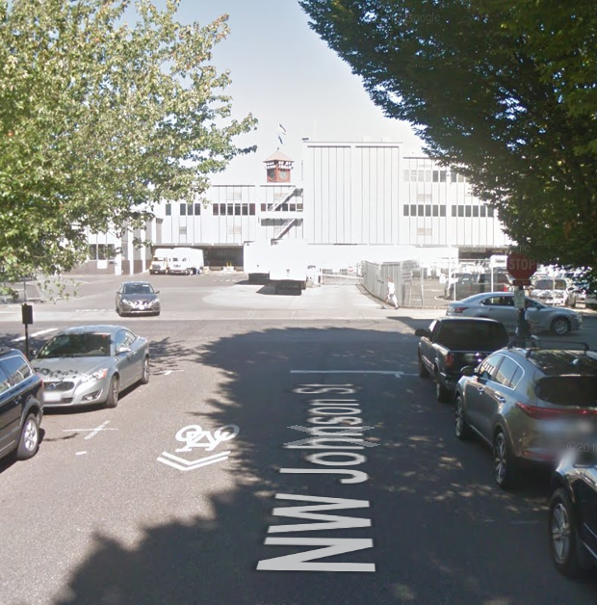
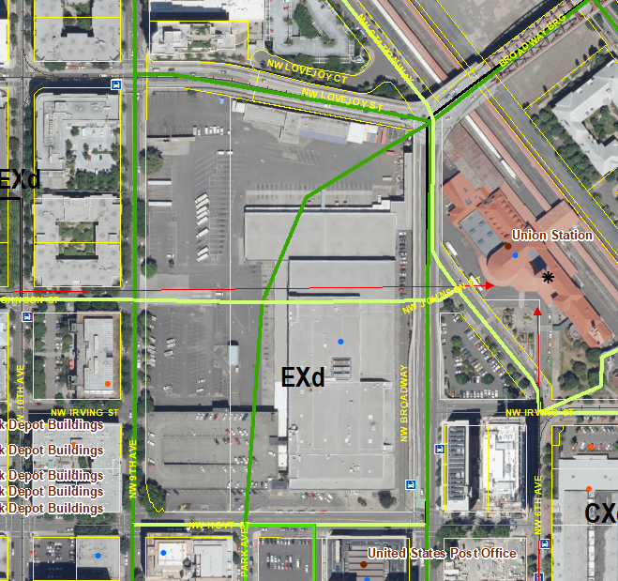
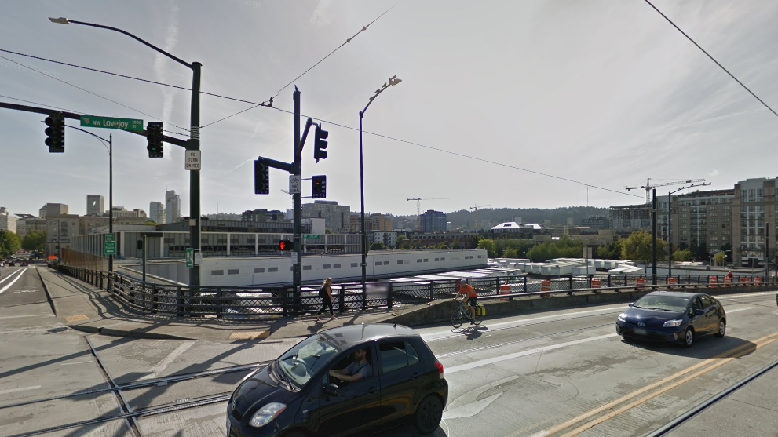
Context:
Response to Built Context
Notes:
This slide quickly shows the designated view down Johnson toward Union Station and the views down Johnson and at the Broadway Bridge Y. If you remember from the photos in the earlier slides, and perhaps the first DAR, the site has unique constraints/opportunities with regard to bridge ramps at the north and east and Union Station at the terminus of Johnson. This site, particularly with an elevated plaza at the Broadway Bridge Y has the opportunity to really mark itself as a gateway into the Pearl District and the broader Downtown. Keeping those elements in mind as we move through the rest of these topics can help frame some of the discussion.

Slide 24
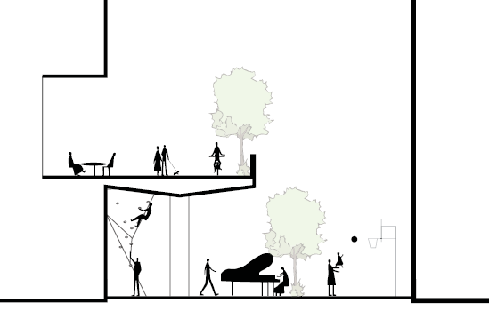
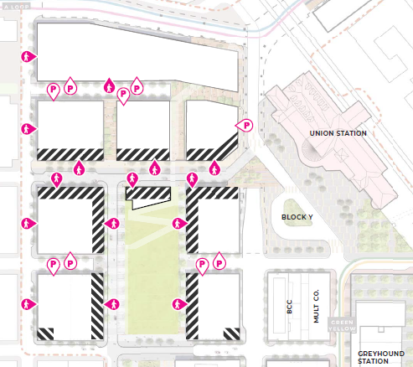
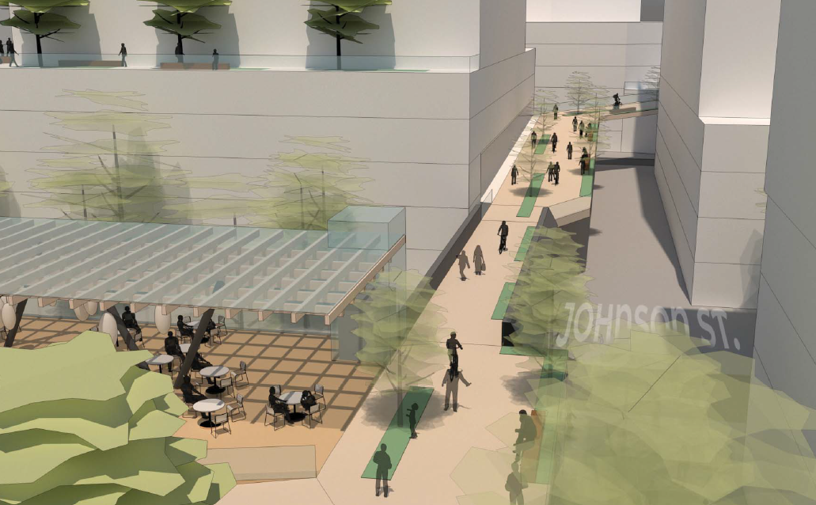
2. Open Space Framework
Green Loop
Notes:
As is noted in the staff memo, the Open Space calculations have been resolved. The biggest issue at the first DAR was the Green Loop and how it seemed to be driving the proposal; however, the intent and experience of the Green Loop wasn’t clearly understood by staff or the commission, due to a lack of information. What staff has come to understand is that the Green Loop is intended to have a wholly different experience than the commuter paths along Lovejoy and Broadway and this is an opportunity to create a truly unique experience in the city. With that understanding, staff is more accepting of the proposed alignment but still has concerns about what happens along the Green Loop, particularly underneath the bridge elements, as well as at the Broadway Bridge Y. Staff believes that the Master Plan must ultimately have some assurances through development standards that areas adjacent to the underside of the Green Loop (the areas captured within that circle) will be safe and pleasant at all hours.

Slide 25
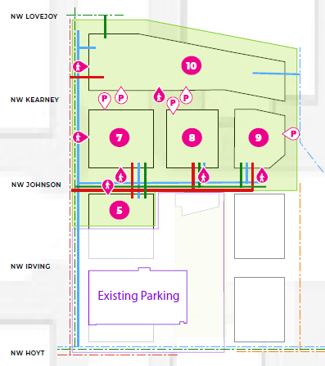
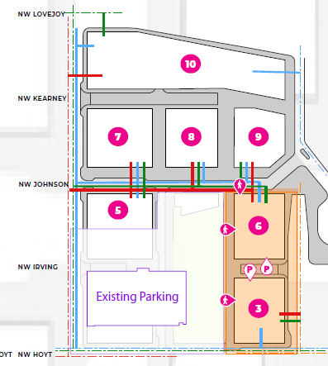
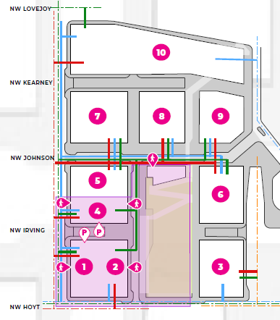
3. Development Framework
Phasing
Phase 1
Phase 2
Phase 3
Notes:
As noted in the staff memo, staff has concerns about the proposed phasing, particularly as it relates to delivery of the Green Loop. Notably, the phasing of the Green Loop elements are not specifically identified in the packet. As such, staff suggested that the northern portion of the Park with the Green Loop “offramp” (circled in red) should be developed in Phase 1 so that the Green Loop would not be developed as a dead end with no offramp. Staff also highlighted that this would ensure that a major portion of the public benefit would come early in the redevelopment rather than later. Staff also noted that the phasing is proposed in this way to maintain the existing parking garage but suggested that the Master Plan should require that the garage be demolished when a certain number of parking spaces have been constructed. This slide also covers Section 5 Infrastructure of the staff memo which noted in particular that the phasing and responsibility of the Green Loop’s delivery must be identified and made binding in the Master Plan approval.

Slide 26
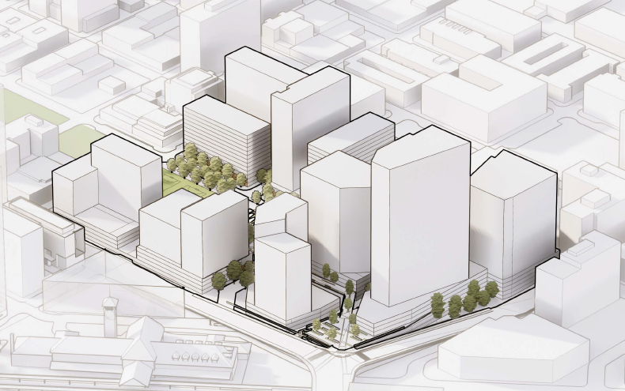
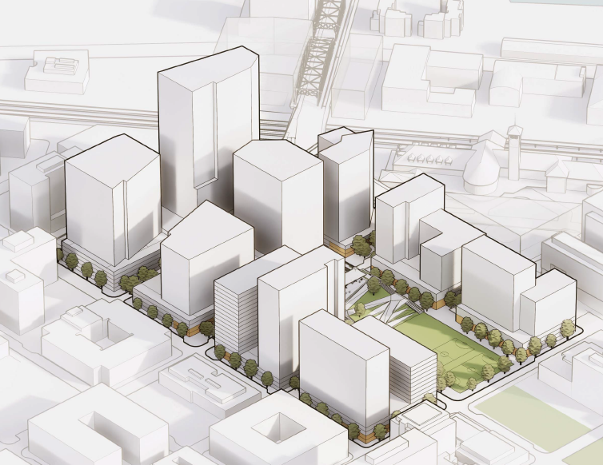
3. Development Framework
Parking
Notes:
No specific uses are shown in the Scheme A massing diagrams; however, ground floor active use areas appear to be highlighted. The applicant has indicated that the buildings will each have parking podiums as no below-grade parking is proposed. While ground floor active use requirements may protect some areas such as NW Hoyt, NW Johnson, and the perimeter of the Park as was discussed in the previous DAR and generally shown in yellow here, not all ground levels are protected from parking at the perimeter, nor are upper levels (shown in white). Staff is particularly concerned about upper floor areas adjacent to public areas such as the park, rights-of-way, public access easement areas, the terminus of NW Park Avenue, as well as along the bridge ramps.

Slide 27
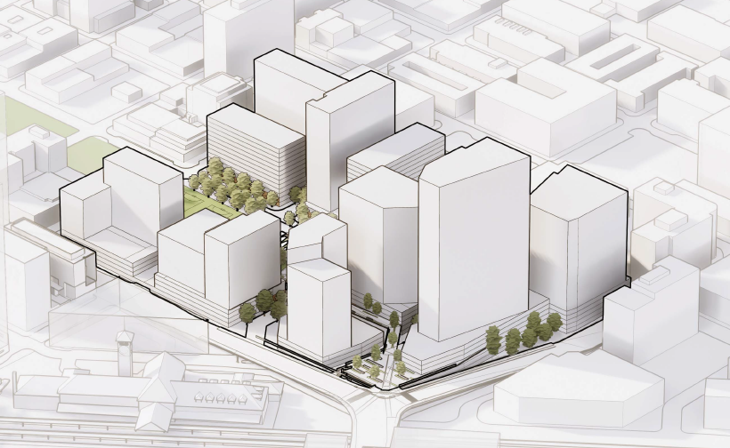
3. Development Framework
Massing
Notes:
Staff has expressed to the applicant that the massing diagrams are a bit confusing and intends to keep working with the applicant to identify how to make the massing diagrams that will be included in the Master Plan more easily understandable for staff, the Commission, and the general public (including developers). The massing diagram on page 30 represents the maximum limits of what each lot can accommodate with regard to height and footprint though it is unlikely any building will fill out those volumes and this is not representative of what will be built. The Scheme A diagrams are closer to what will actually be built but are only representative. That said, some of the elements shown in the Scheme A diagrams introduce interesting concepts that may want to captured in the approved Master Plan such as podiums rising above the elevated plaza and the recessed portion of the tower on Parcel 9 which allows more expansive views and solar access along the elevated Green Loop. Parcel 9 is on the left side of the oval.

Slide 28
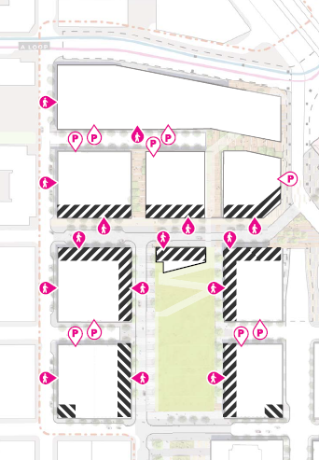
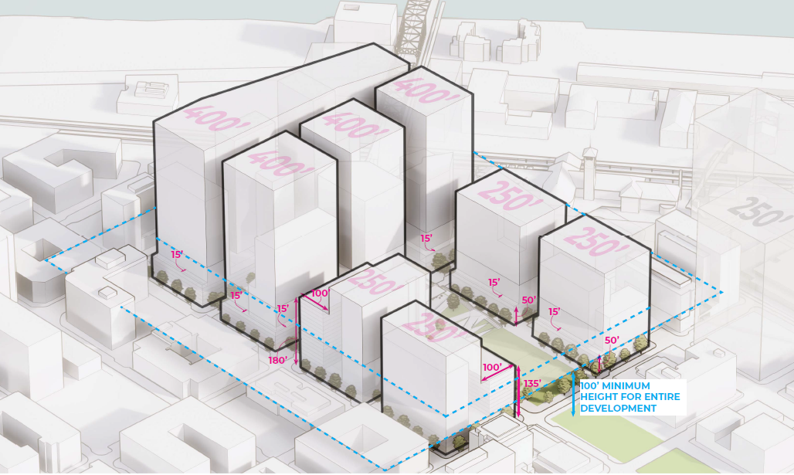
3. Development Framework
Development Standards
Notes:
This diagram shows the maximum heights allowed on the site and also indicates that there will be a minimum height for the entire development; the park pavilion will be the one exception. Staff notes that a 100’ minimum height will require that all buildings are developed as high-rise construction which may limit some developers from developing here; however it will ensure that the city’s investment in this area will provide greater returns. Requiring taller heights will also help to reinforce the bridgehead/gateway character of this site. Also noted in the memo and mentioned earlier, staff has concerns about the need for activation requirements at upper levels and beneath the Green Loop. The map in the upper right shows where the applicant is proposing to located active uses (striped), parking entrances, and main entrances. This map shows little activation north of Johnson and again is only representative of the ground level. Staff also notes that the entire length of Hoyt, at the bottom, is required to meet the Ground Floor Active Use standard.

Slide 29
4. Pedestrian Realm
North of Johnson
Underside of Green Loop
Vehicle Access
Notes:
This slide pertains to Section 4 of the memo. We have already discussed staff’s concerns with the area north of Johnson and the underside of the Green Loop. I would just like to highlight that safety is of particular concern if this area is developed as an office campus with no night-time activity. Activation of this area should be required through the Master Plan rather than dependent on Design Review staff to advocate for during the Design Review process for each future building. This slide also shows the proposed vehicle access areas which not have been consolidated from the previous DAR. Consolidation of parking and loading access and other back-of-house uses is a requirement of the Master Plan.

Slide 30
Staff Introduction
Applicant Presentation
Staff Discussion Topics
Public Comments
Commission Discussion

Slide 31
Staff Introduction
Applicant Presentation
Staff Discussion Topics
Public Comments
Commission Discussion

