Slide 1
5020 N Interstate Ave. Active Use Requirement

Slide 2
Background
The Overlook Neighborhood Association supports this project.
Portland needs more affordable housing.
It will be an excellent addition at the intersection of Interstate and Alberta.
But…
This hearing is not about affordable housing.
This hearing is about whether Portland will enforce its new Centers Main Street Overlay Zone requirements to create vibrant, active town centers.
Will residents of this building and of the neighborhood enjoy the full active use promised by the code?
Your role today is to render a legal decision.
Notes:
Affordable housing
Some testimony cites this. It is not applicable.
Telling that neither applicant nor staff cited affordable housing as a justification.
Put aside our personal feelings about the subjective value of the project – every project is valuable to someone – and focus on the code requirements that create a framework of development predictability and standards that enhance the community.
Make a legal decision.

Slide 3
Centers Main Street Overlay Zone (m-overlay)

Slide 4
Zoning map near 5020 N Interstate Ave
Notes:
Two commercial uses previously on site. Demolished to make way for this project.

Slide 5
Former Interstate Lanes development
Notes:
Centers Main Street Overlay meant to address projects like this.
Ground floor is all residential. No active use.

Slide 6
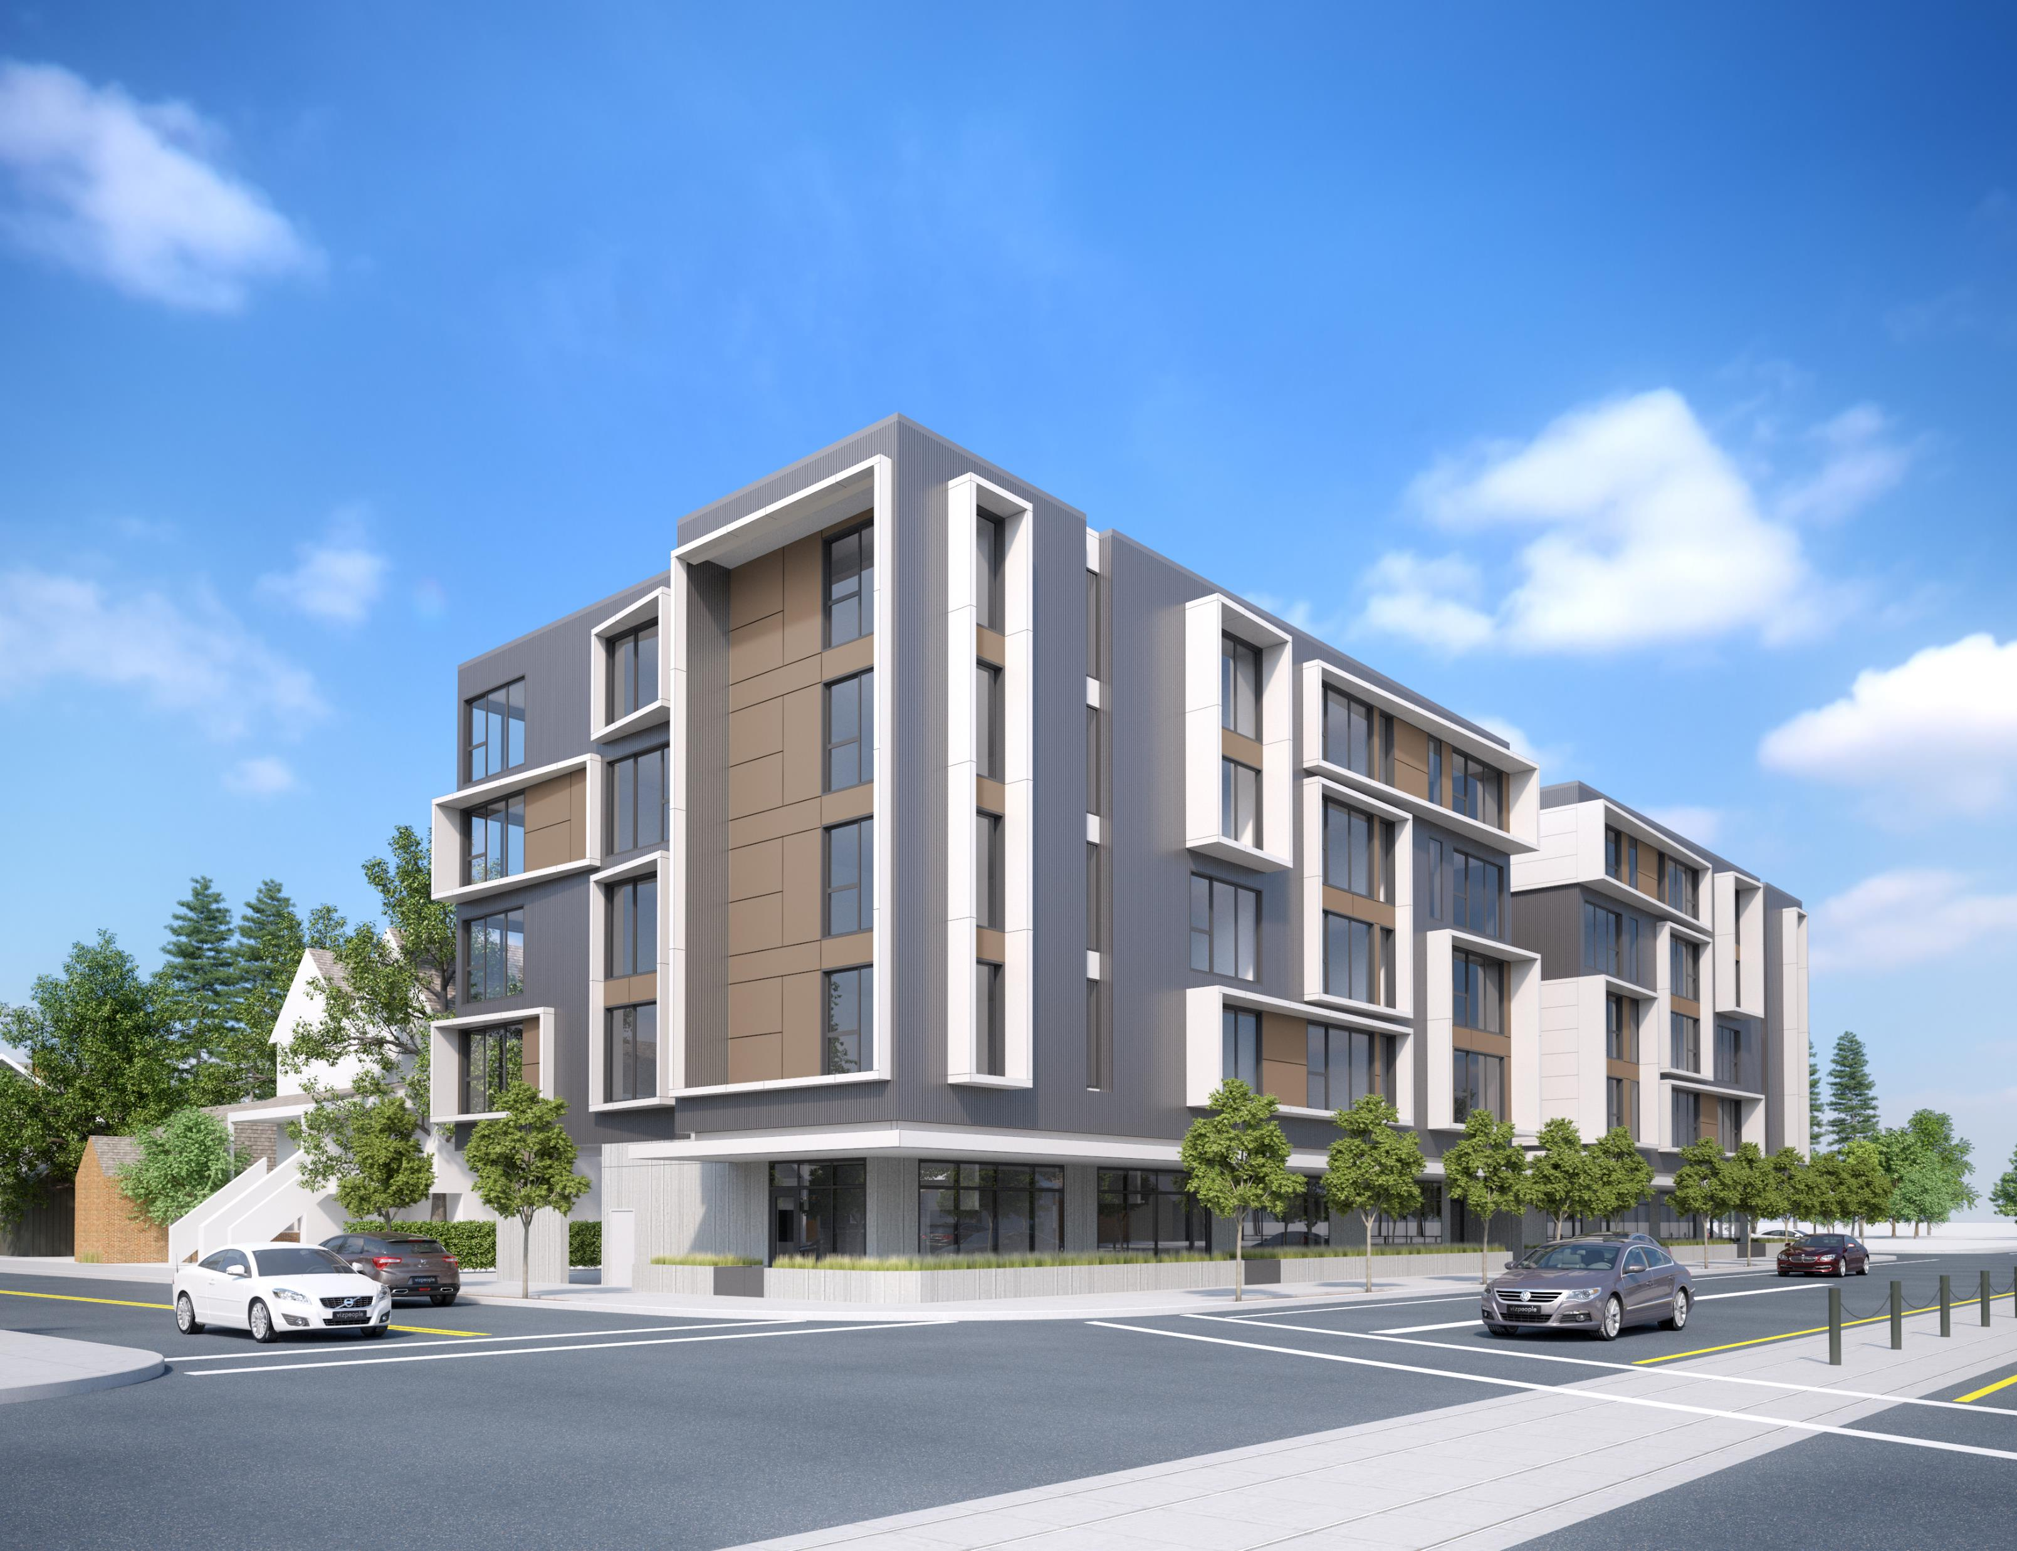
Aniva: 5009 N Interstate
Notes:
This project is across the street from the applicant site and still under construction.
It replaced a cute little coffee shop. Now it’s all residential on the ground.

Slide 7
Purpose of Centers Main Street overlay zone
33.415.010 Purpose
The Centers Main Street overlay zone encourages a mix of commercial, residential and employment uses on the key main streets within town centers and neighborhood centers identified in the Comprehensive Plan. The regulations are intended to encourage a continuous area of shops and services, create a safe and pleasant pedestrian environment, minimize conflicts between vehicles and pedestrians, support hubs of community activity, and foster a dense, urban environment with development intensities that are supportive of transit.

Slide 8
Active uses in the m-overlay
33.415.200 Required Ground Floor Active Use
Within 100 feet of a transit street, at least 25 percent of the ground level floor area must be in one of the following active uses. Only uses allowed in the base zone may be chosen:
Retail Sales and Service;
Office;
Industrial Service;
Manufacturing and Production;
Community Service;
Daycare;
Religious Institutions;
Schools;
Colleges. If a College use is provided to meet this regulation, the floor area must be in one or more of the following functions: lobby; library; food service; theatre; meeting area; or
Medical Centers. If a Medical Center use is provided to meet this regulation, the floor area must be in one or more of the following functions: lobby; waiting room; food service; outpatient clinic
Notes:
Council in fact did envision a mix of active uses and residential and other private uses on the ground floor.
25 percent was a compromise between those who wanted more active use required and those who wanted much less.

Slide 9
Applicant seeks to reduce the requirement
Application stage | Active use s.f. | Active use ratio
Original presentation | 0 | 0 percent
Application* | 1,606 | 14.8 percent
Revised application | 1,953 | 18.3 percent
Land use decision | 2,125 | 20.0 percent
m-overlay required | 2,665 | 25.0 percent
* Applicant originally did not calculate ground floor area correctly. This was addressed by staff in the decision.
Notes:
This has been a moving target.

Slide 10
Adjustment approval criteria
Six applicable adjustment criteria spelled out in 33.805.040.
All must be met to grant an adjustment.
Failure to meet one requires denial of the adjustment.
This project fails to meet three.
Notes:
In order to grant an adjustment:

Slide 11
Adjustment approval criteria
Adjustment Criterion A: Granting the adjustment will equally or better meet the purpose of the regulation to be modified.
Applicant proposes six ways in which the proposal satisfies this criterion.*
Staff does not incorporate most of them in the land use decision.
The adjustment approval focuses on the role of residential units and developing a continuous area of active use.
* Application for Adjustment to Ground Floor Active Use Standard dated April 2, 2019

Slide 12
Ground-floor residential units
Applicant claims:
“The ground floor residential units directly contribute to the dense, urban nature of the site while also orienting to the transit nature of the adjacent streets.”
Staff states in support of residential units:
“While the front porches proposed at the ground-level residential uses could conceivably foster miniature ‘hubs of community activity’, the proposed bike storage room will not.”
Notes:
Two striking things about this argument:
That something could “conceivably” foster a desired activity is far too low a threshold. The adjustment criteria doesn’t ask that the changes “conceivably meet or exceed the requirement.” It need to be more than imaginable. It needs to actually do it.
The argument being made by applicant and echoed by staff is audacious. They claim that including residential helps meet a requirement included specifically to limit residential overload. I want to be very clear here. The argument is “We are better accomplishing the goals of the m-overlay by doing the very thing that m-overlay exists to prevent.”

Slide 13
Ground-floor residential units (cont.)
Staff writes elsewhere in the decision:
“The two ground-floor residential units facing N Interstate Ave have large, raised porch areas between the sidewalk and the unit entries. These provide usable outdoor space for residents of the two ground-floor dwelling units here. Landscape planters feature a mixture of shrubs, grasses, and ground cover that will help to provide additional buffering and emphasize the transition between the sidewalk and porch.”
AND
“The required landscape planters in the ground running the length of the low fences that separate the sidewalk from the patio spaces will help to provide additional buffering between the sidewalk and patios and will help to emphasize the transition between these private patios and the public sidewalk.”
Notes:
Residential is not an active space. It is a private space that is buffered from the public by elevated porches and landscape planters.
Nor are planters and porches something unusual, something added with the intent to meet the m-overlay requirement.
These are just good design elements that many projects use, including those with no active use at all.

Slide 14
Aniva: 5009 N Interstate

Slide 15
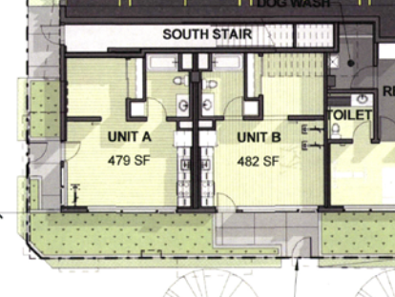
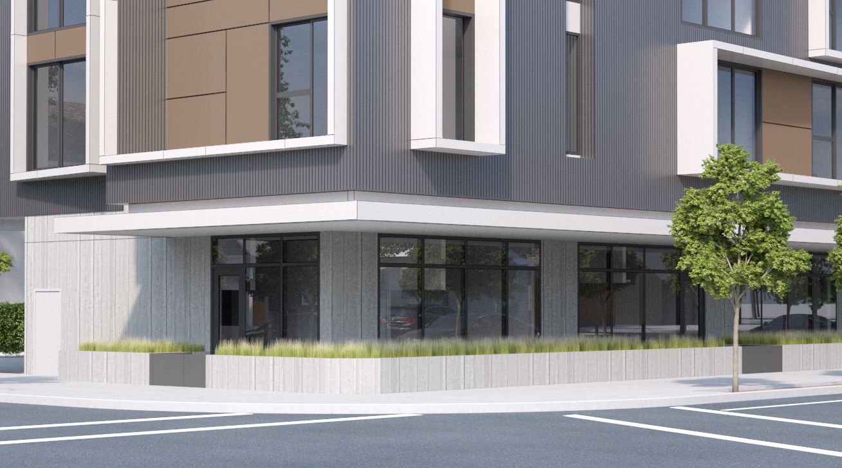
Aniva: 5009 N Interstate

Slide 16
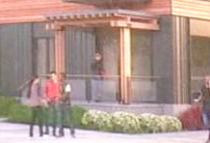
North Williams Center: 2100 N Williams 61 affordable housing units

Slide 17
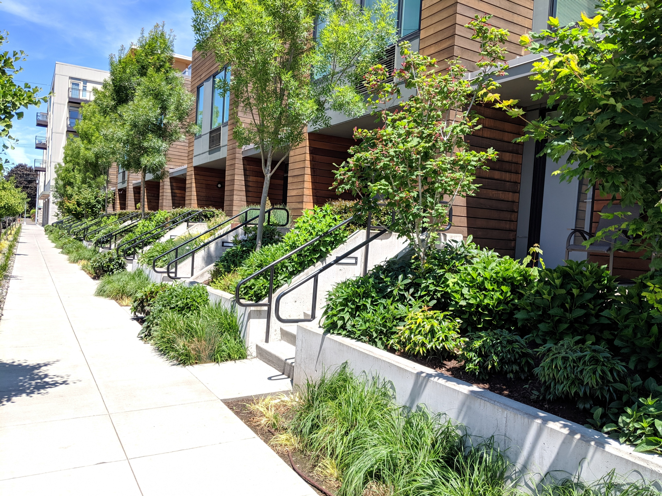
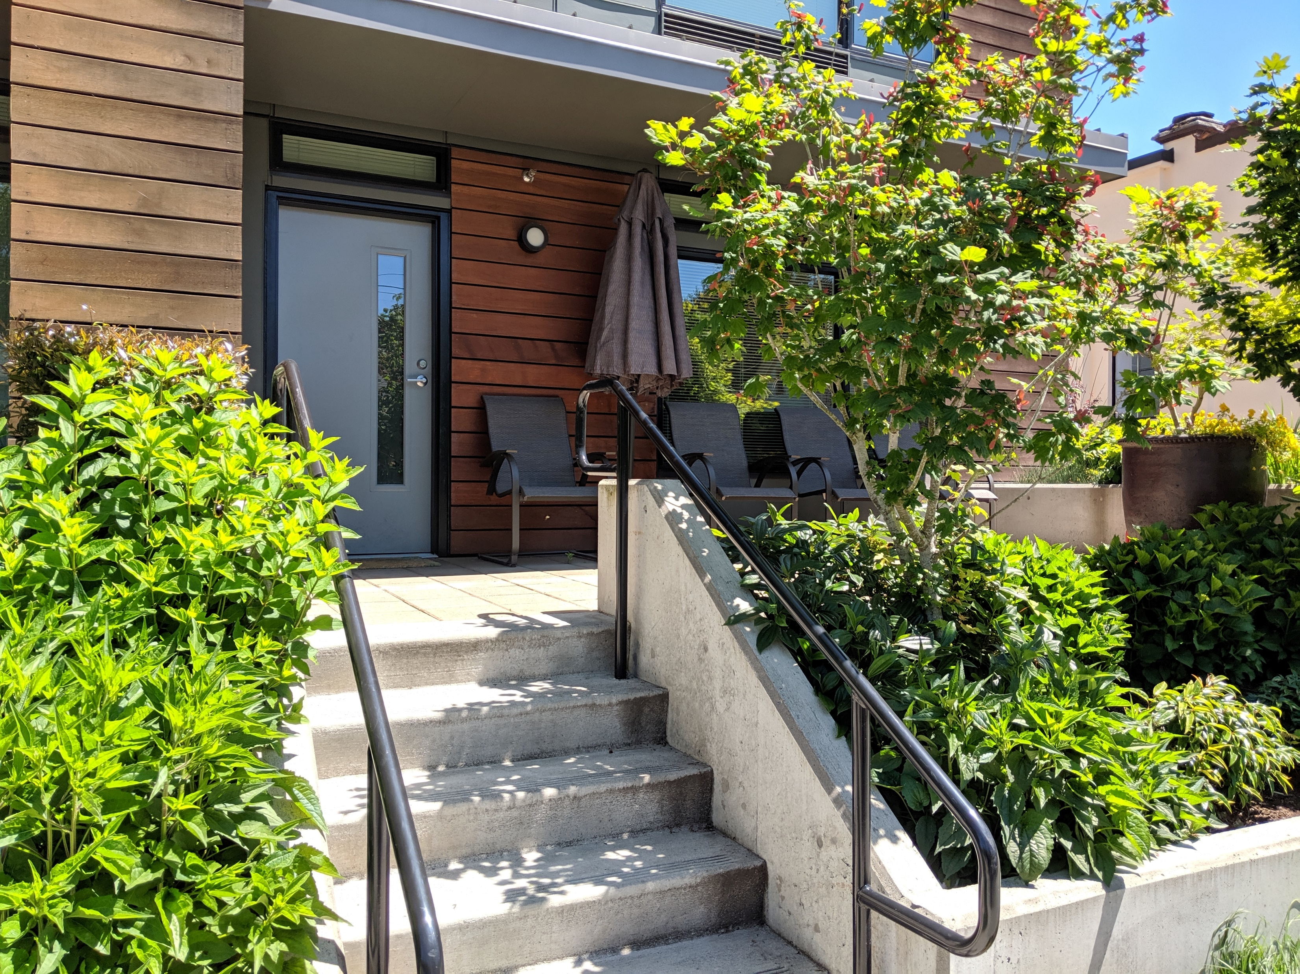
4239 N Vancouver Ave.
Notes:
This is just good design.

Slide 18
Active uses in the m-overlay
33.415.200 Required Ground Floor Active Use
Within 100 feet of a transit street, at least 25 percent of the ground level floor area must be in one of the following active uses. Only uses allowed in the base zone may be chosen:
Retail Sales and Service;
Office;
Industrial Service;
Manufacturing and Production;
Community Service;
Daycare;
Religious Institutions;
Schools;
Colleges. If a College use is provided to meet this regulation, the floor area must be in one or more of the following functions: lobby; library; food service; theatre; meeting area; or
Medical Centers. If a Medical Center use is provided to meet this regulation, the floor area must be in one or more of the following functions: lobby; waiting room; food service; outpatient clinic
Notes:
What do all of these have in common?
They are uses that invite the public in. They encourage the public to visit without having to know someone there first.

Slide 19
Criterion A was not met.
The project does not equally or better meet the purpose of the m-overlay.
Notes:
The adjustment rests on the notion that residential uses contribute to the goal, when they in fact interrupt the continuous area of active use.
It also rests on the notion that planters and patios are public spaces, when even staff concedes they are not.

Slide 20
North Interstate Plan District
Adjustment Criterion B: The proposal will be consistent with the classifications of the adjacent streets and the desired character of the area.
Adopted North Interstate Corridor Plan (2008) urban design concepts:
The plan envisions buildings in the corridor that will “feature active ground floor uses such as retail shops and stores, capitalizing on the visibility offered by the light rail; others may incorporate offices building lobbies or institutional uses.”

Slide 21
Criterion B was not met.
The proposed adjustment is not consistent with the classifications of adjacent streets and the desired character of the area.

Slide 22
Mitigation
Adjustment Criterion E: Any impacts resulting from the adjustment are mitigated to the extent practical.
Staff suggests that converting the bike storage to commercial mitigates the adjustment:
“The result will be that both corners of the building facing N Interstate Ave will be anchored by the Ground Floor Active Uses desired by the ‘m’ overlay zone and will help, at a bare minimum, to meet the purpose of the standard.”
Notes:
Helping meet the standard – but not actually meeting the minimum – does not mitigate the impacts.
Mitigaation is taking additional steps to offset the impact. No such steps are suggested.
Neither applicant nor staff presents a practical mitigation strategy.

Slide 23
Criterion E was not met.
The impacts resulting from the adjustment are not mitigated to the extent practical.

Slide 24
Questions
Notes:
The adjustment criteria were not met and the adjustment therefore should not be granted.

Slide 25
Response:
The active use requirement can be met
Notes:
Reiterate that this is a legal decision, not about whether we like affordable housing.
Even the residents of an affordable housing building deserve to live in a vibrant, active community as envisioned by the Main Street Overlay zone.

Slide 26
Active uses in the m-overlay
33.415.200 Required Ground Floor Active Use
Within 100 feet of a transit street, at least 25 percent of the ground level floor area must be in one of the following active uses. Only uses allowed in the base zone may be chosen:
Retail Sales and Service;
Office;
Industrial Service;
Manufacturing and Production;
Community Service;
Daycare;
Religious Institutions;
Schools;
Colleges. If a College use is provided to meet this regulation, the floor area must be in one or more of the following functions: lobby; library; food service; theatre; meeting area; or
Medical Centers. If a Medical Center use is provided to meet this regulation, the floor area must be in one or more of the following functions: lobby; waiting room; food service; outpatient clinic
Notes:
It doesn’t have to be retail.
This will be family housing for people making below median family income. Community services or daycare for the kids who live there seem excellent amenities.

Slide 27
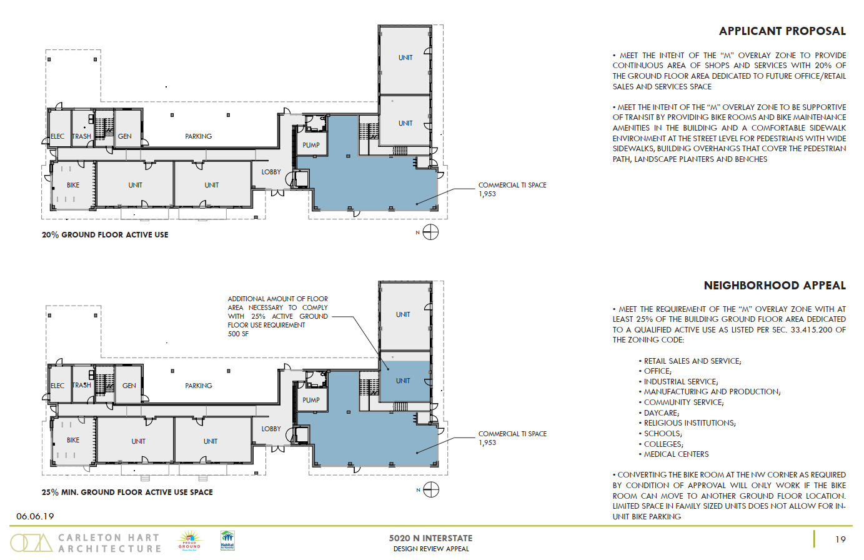
Notes:
Applicant suggests that our request is not feasible.
The percentages here are wrong.
This doesn’t come close.

Slide 28
Ground floor options (c. 700 sf more active use required)
1,953 sf
Notes:
Need to get to about 2,665 square feet.
Ground floor is about 10,672 square feet.
Precise number difficult because applicant did not include structured parking as required.

Slide 29
Relocate bike locker 2,124 sf = 19.9%
Bikes
524 sf
c. 1,600 sf
Notes:
This is staff’s proposal incorporating Condition D.
It’s a start, but inadequate for all the reasons I’ve articulated.
Less than half of Interstate frontage is active use.
Not continuous.

Slide 30
Convert 2A unit to active use 2,969 sf = 27.8%
Bikes
524 sf
845 sf
c. 1,600 sf
Notes:
A strong solution.
Removing one unit of 64 meets and slightly exceeds the active use requirement.
Makes northwest corner space larger and more functional to potential commercial uses.
Majority of Interstate frontage is active use.
So let’s look at another option.

Slide 31
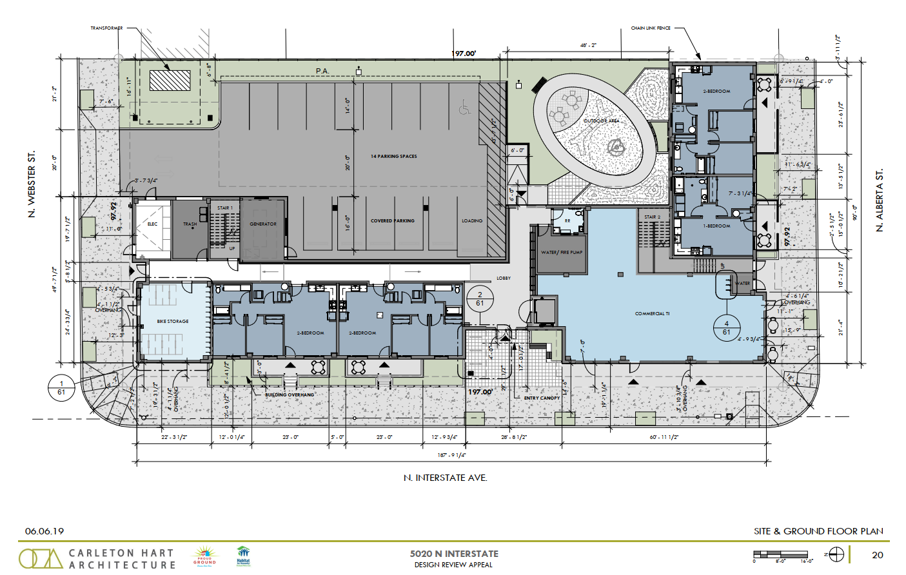
Notes:
Here’s a more-detailed floor plan.
This area here is the structured parking.
Here’s the thing not mentioned: No parking is required for this project.
As much as we like to see parking with residential projects, we like even more seeing projects meet the code.

Slide 32
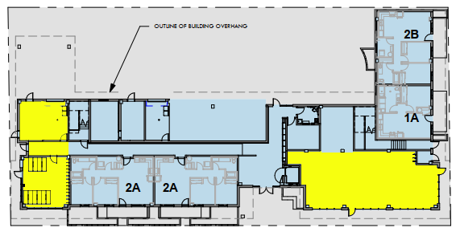
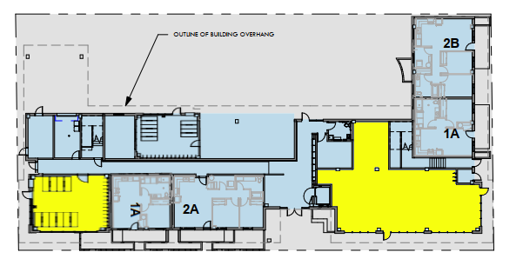
Solution: Eliminate a few parking spaces
Move electric and trash rooms; retain bike locker near commercial.
c. 2,699 sf = 25.3%
Move bike locker to parking area and reduce one unit to a large one-bedroom.
c. 2,665 sf = 25.0%
Notes:
These are rough presentations. Some adjustments would be necessary.
Reducing by one bedroom leaves a slightly oversized unit (about 657 sf)
All it takes is some imagination and a desire to meet the code.

Slide 33
Appealed conditions
Notes:
With regard to Applicant’s appeal:
Condition D: Obviously we oppose rolling backward even further from the 19.5% active use that staff required and not activating the northwest corner.
Condition E: We support staff’s analysis that including planters along the N Alberta Street will enhance the pedestrian environment as envisioned by the m-overlay.
Condition F: More lights are always nice, but we are neutral on this.
Condition G: We support staff’s analysis that additional awnings will improve the pedestrian environment on an active block.
Condition H: The residential units east of the property should have the wooden fence that will provide better screening and aesthetics than chain link.

Slide 34
Questions
Notes:
With regard to Applicant’s appeal:
Condition D: Obviously we oppose rolling backward even further from the 19.5% active use that staff required and not activating the northwest corner.
Condition E: We support staff’s analysis that including planters along the N Alberta Street will enhance the pedestrian environment as envisioned by the m-overlay.
Condition F: More lights are always nice, but we are neutral on this.
Condition G: We support staff’s analysis that additional awnings will improve the pedestrian environment on an active block.
Condition H: The residential units east of the property should have the wooden fence that will provide better screening and aesthetics than chain link.

Slide 35
Conclusion
Notes:
With a number, temptation to view meeting halfway as “compromise.”
The compromise was 25 percent. Neighborhoods would have liked more.
But we couldn’t ask for what we wanted. We’d have asked for 80-90 percent active use.
The compromise is meeting the bare minimum 25 percent.
Council concluded that 25 percent was the right minimum.
Code does not require a developer to go above and beyond.
It also does not easily allow one to come up short, though, without a good reason.
This project has not offered that good reason.
Everyone deserves predictability in development.
One of the first projects to fall under the Centers Main Street Overlay Zone.
Your decision will set precedent for the entire city going forward.
Every developer will want an adjustment to maximize profitable residential units, the very thing that council sought to prevent with the m-overlay zone.
The Overlook Neighborhood and other neighborhoods with the m-overlay ask that you send a clear message that Portland needs and wants vibrant, active town centers.

