Slide 1

City of Portland
Design Commission
Type II Land Use Appeal
LU 18-277183 DZM AD
5020 N Interstate
June 20, 2019
Staff Presentation

Slide 2
Staff Presentation
Appellant 1 (OKNA)
Appellant 2 / Applicant (Carleton Hart)
Public Testimony
Appellant 1 Response
Appellant 2 / Applicant Response
Appellant 1 Rebuttal
Appellant 2 / Applicant Rebuttal
Commission Deliberation
Presentation Order

Slide 3
Context
Location
Zoning
Approval Criteria
Context
Program Overview
Staff Decision
Approval with Conditions

Slide 4
Context

Slide 5
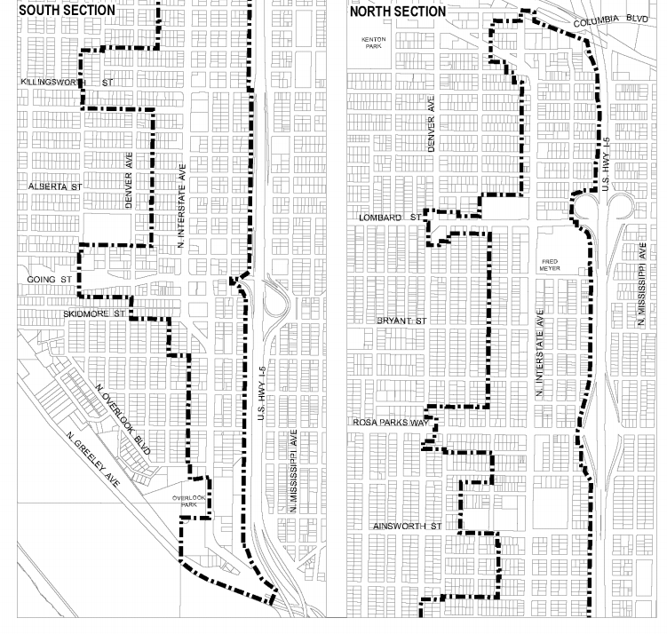
Location
North Interstate Plan District

Slide 6
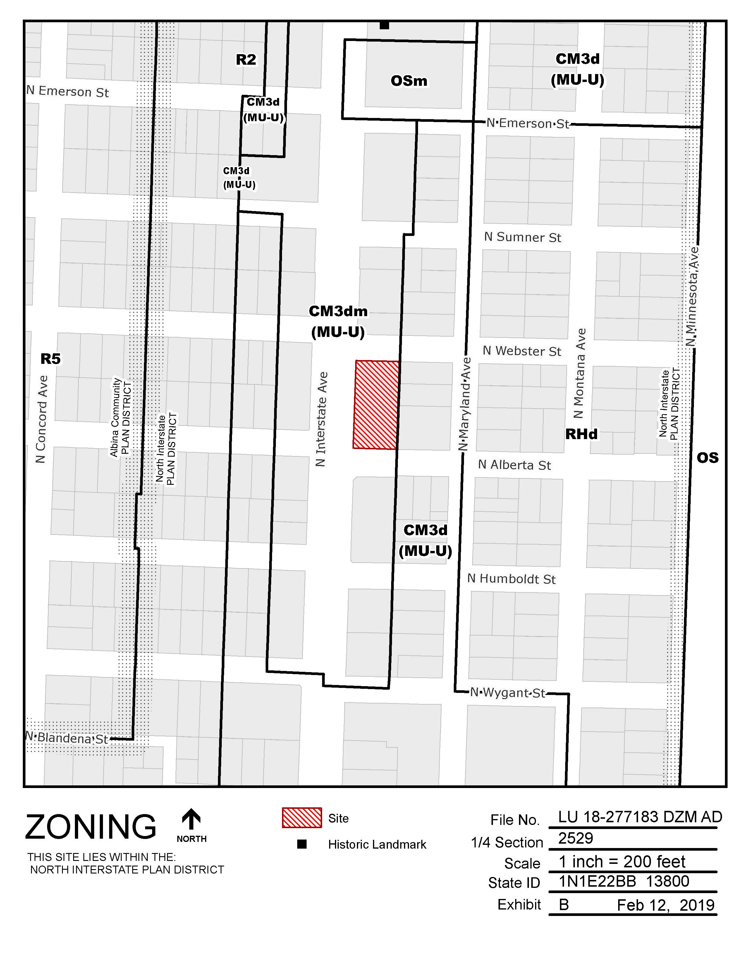
Zoning
Base Zone:
CM3 – Commercial / Mixed Use 3
Overlays:
Design (d)
Centers Main Street (m)
Floor Area Ratio:
3:1 base, 5:1 with bonus
Height:
65’ max base; 75’ max with bonus

Slide 7
Approval Criteria
Community Design Guidelines
PZC 33.825.040 (Modifications)
PZC 33.805.040
(Adjustment)

Slide 8
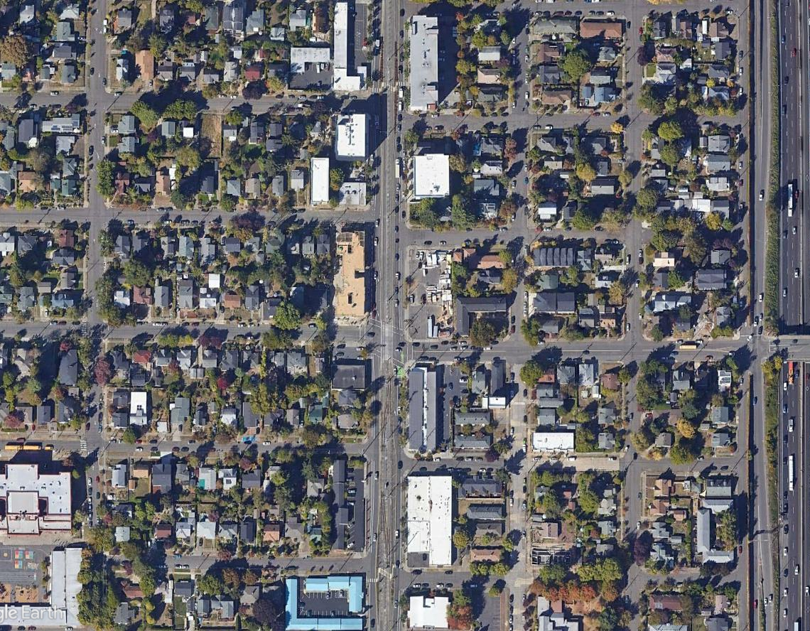
Context
NW corner of N Interstate Ave and Alberta St
MAX stations: 4 blocks to north at N Killingsworth St and 5 blocks to south at N Prescott St
N Sumner St
NW 21st Ave
N Webster St
N Alberta St
N Concordia Ave
N Interstate Ave
N Maryland Ave
N Humboldt St

Slide 9
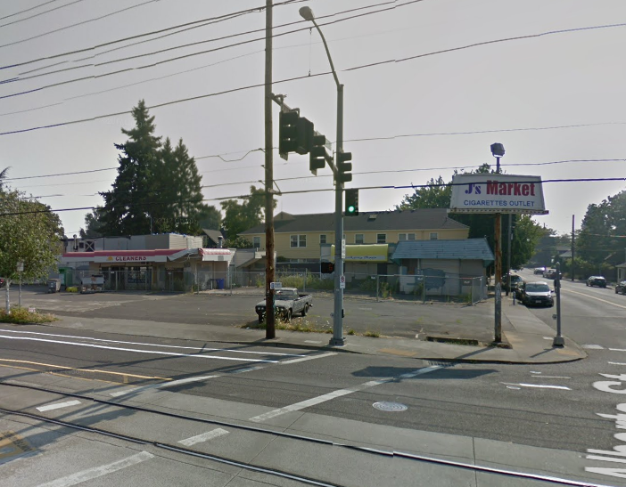
Context
Subject site as it looked in August 2017

Slide 10
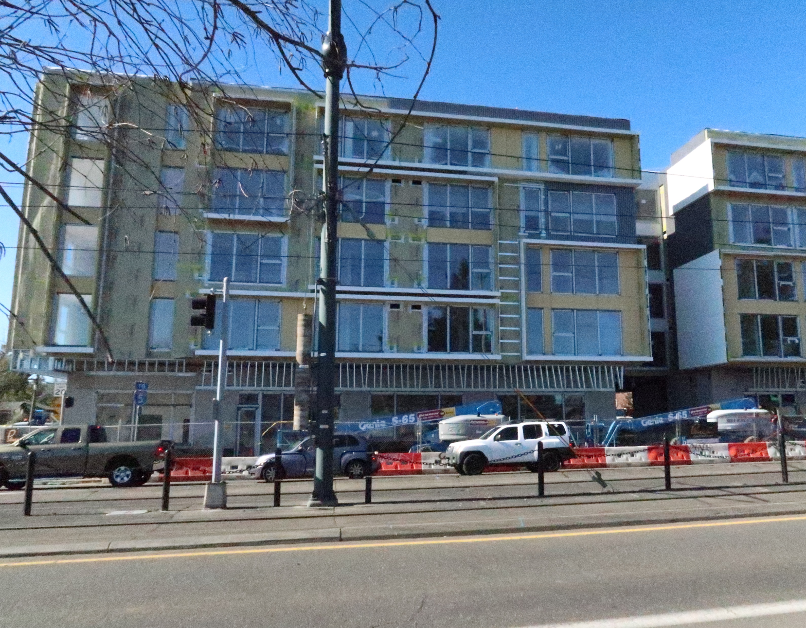
Context
New mixed-use development across N Interstate

Slide 11
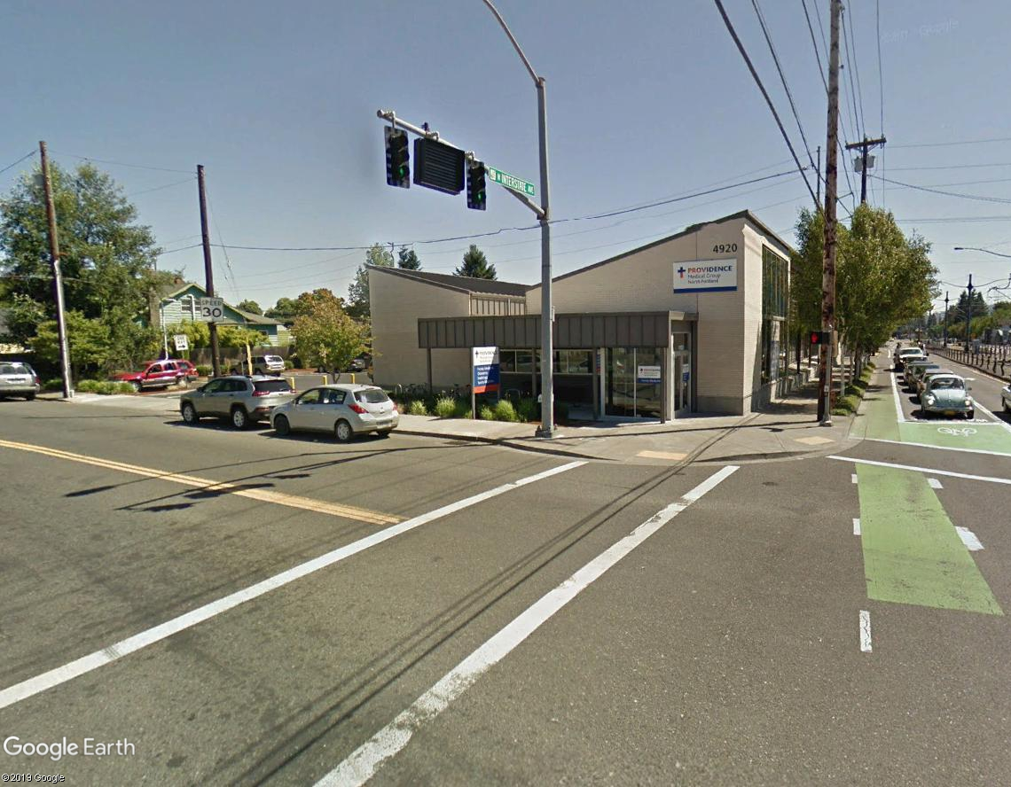
Context
Medical office across N Alberta St

Slide 12
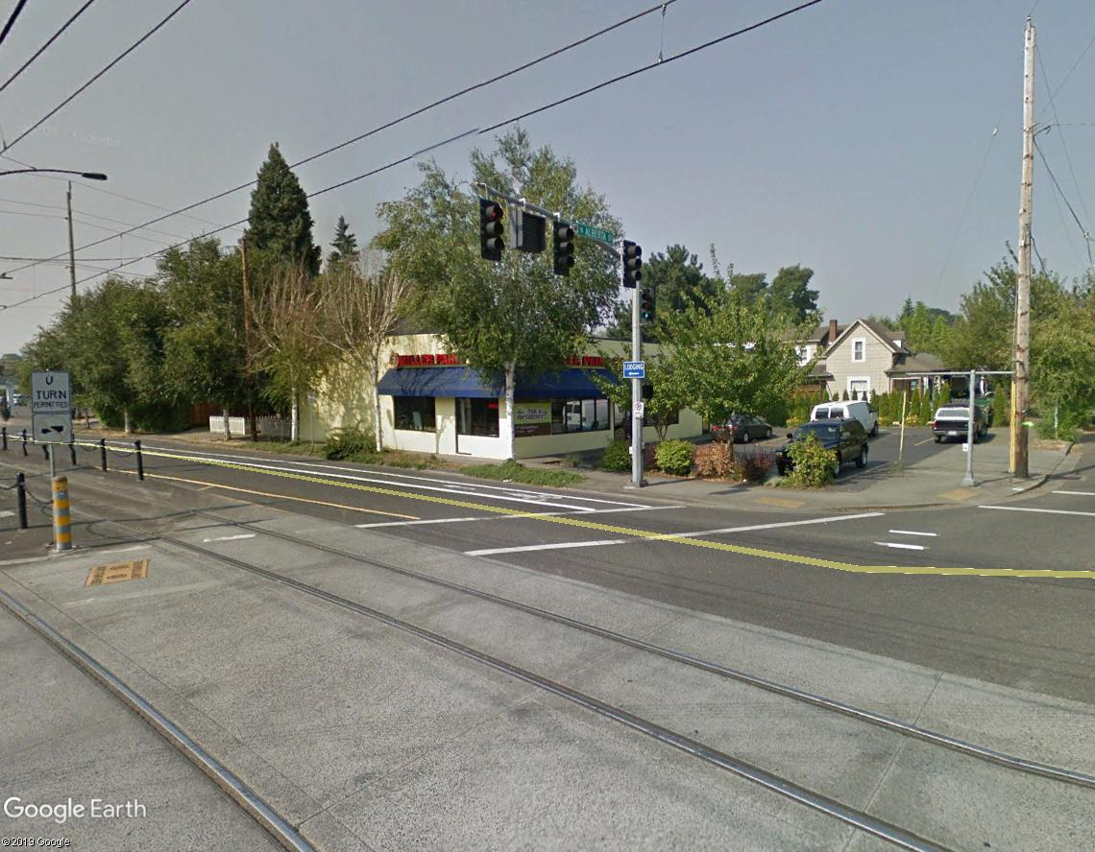
Context
Retail building at SW corner of N Interstate & Alberta

Slide 13
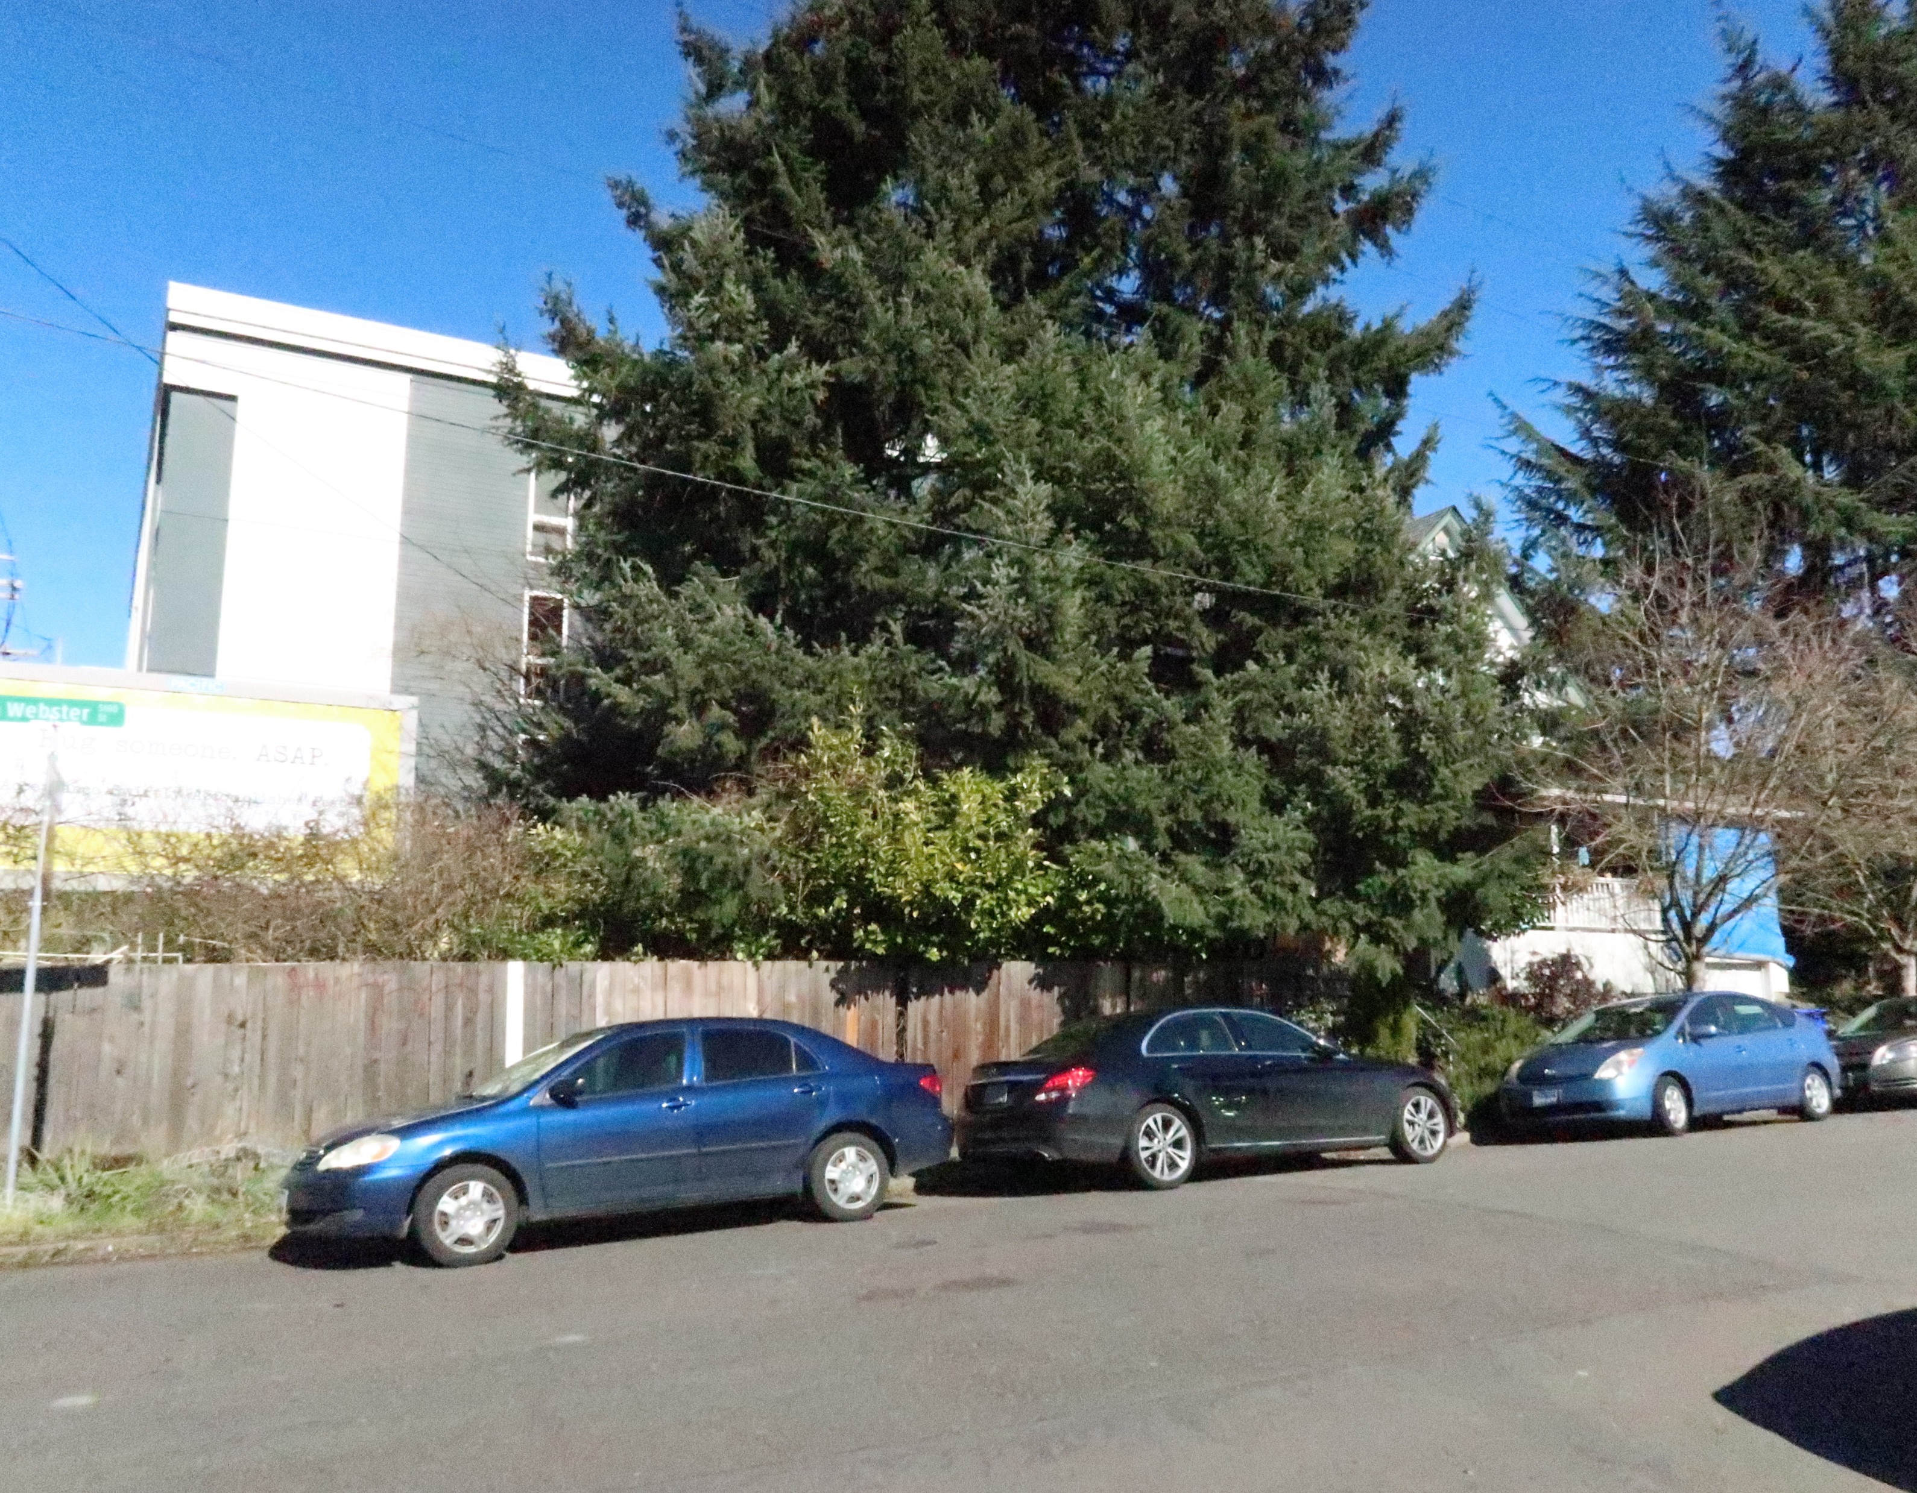
Context
Across N Webster from subject site

Slide 14
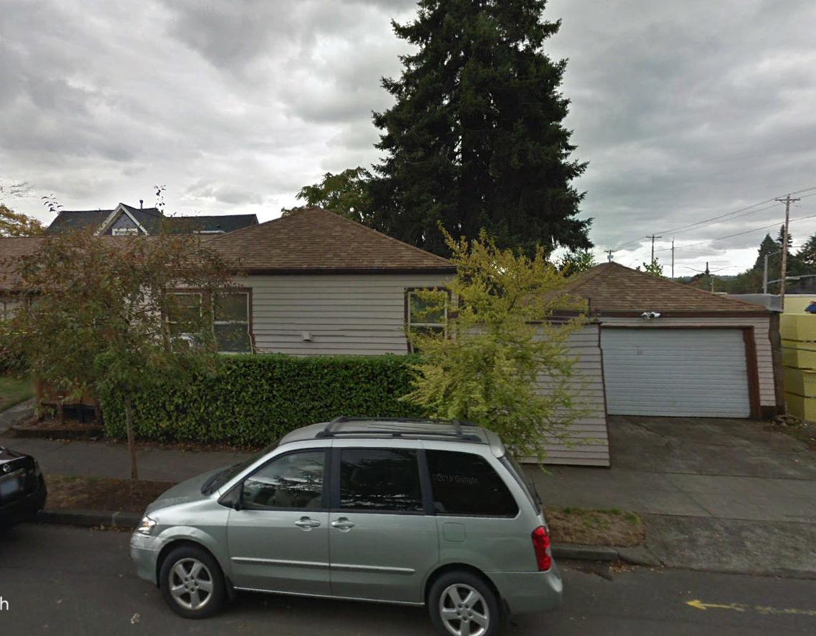
Context
East of subject site along N Webster

Slide 15
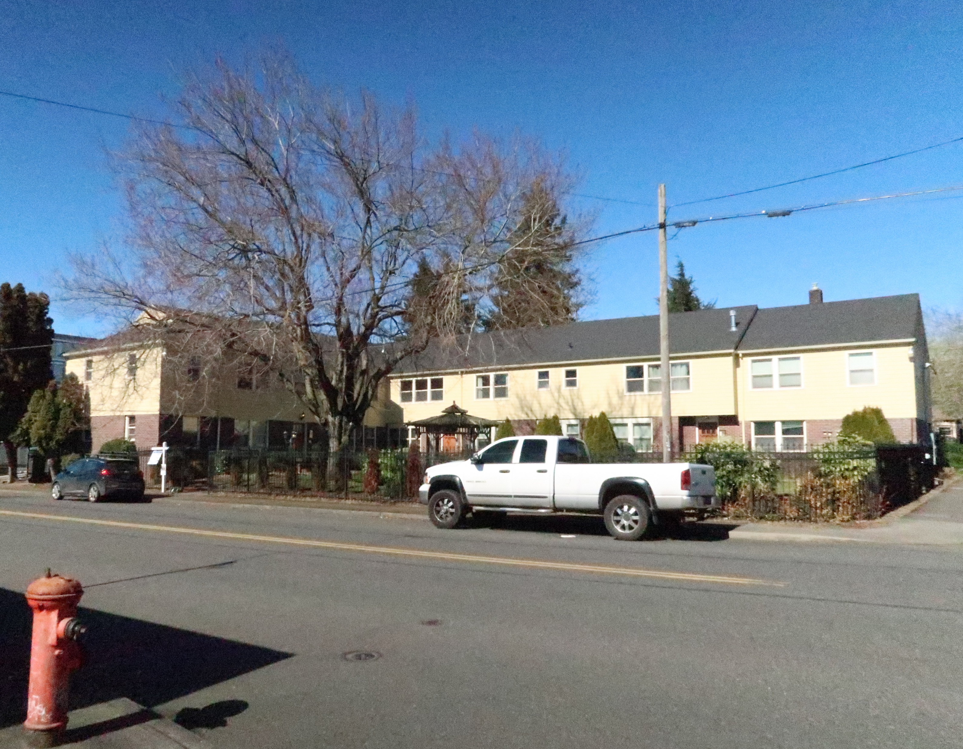
Context
East of subject site along N Alberta

Slide 16
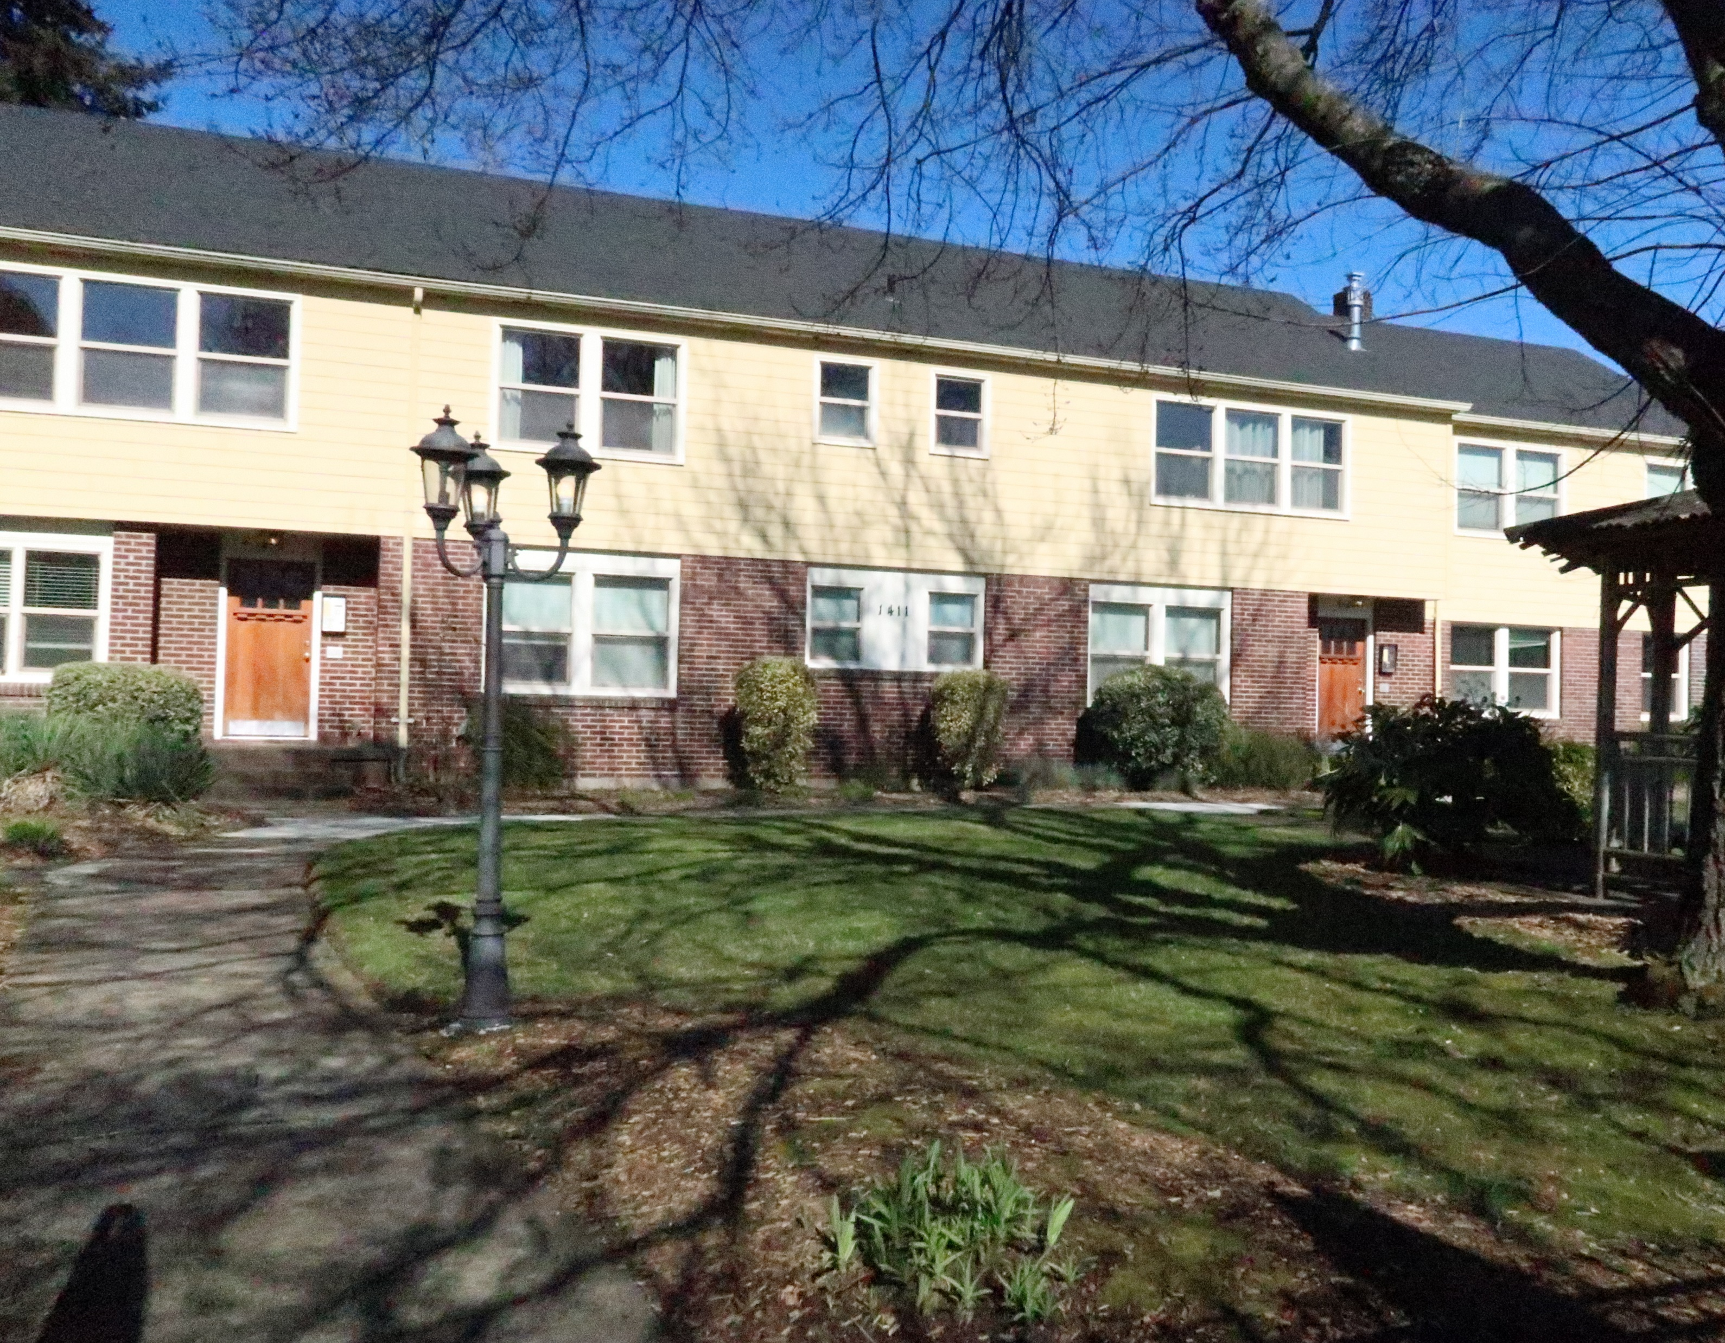
Context
East of subject site along N Alberta

Slide 17
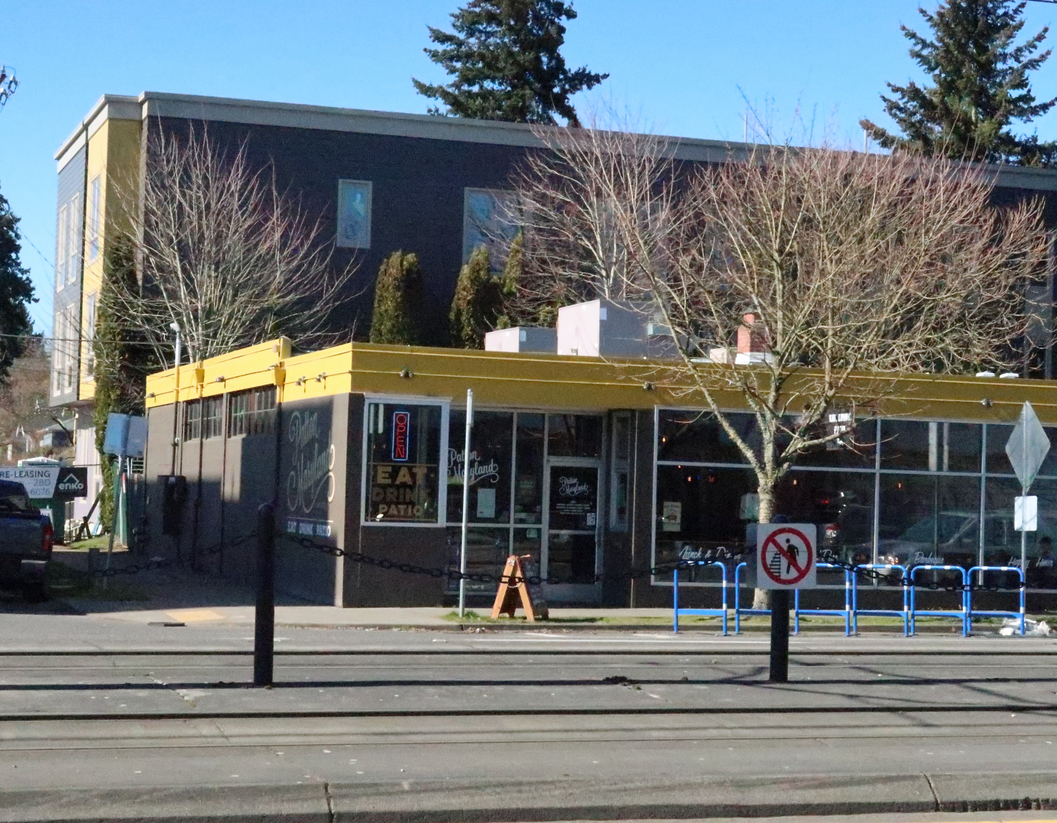
Context
Single-story retail space at N Interstate & Webster

Slide 18
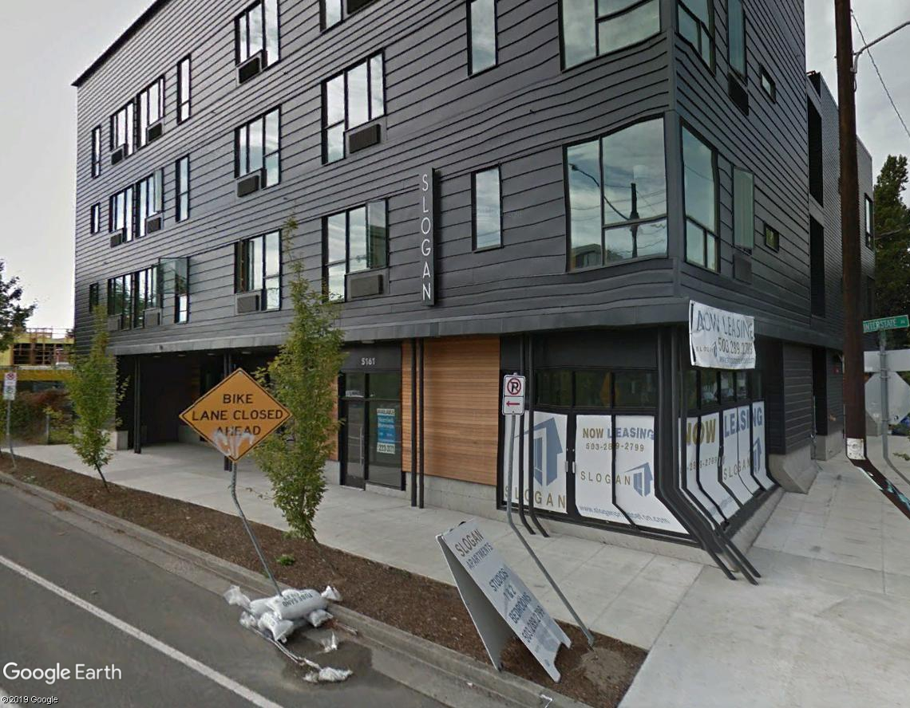
Context
Mixed-use development at N Interstate & Sumner

Slide 19
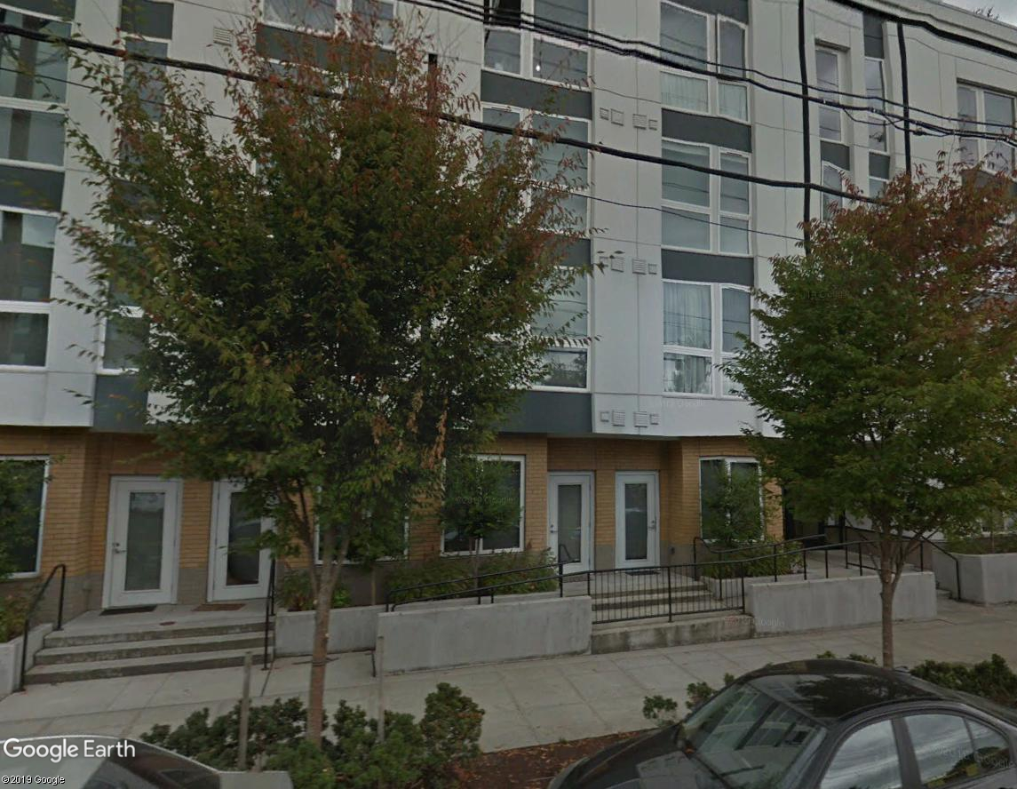
Context
Residential development along N Interstate

Slide 20
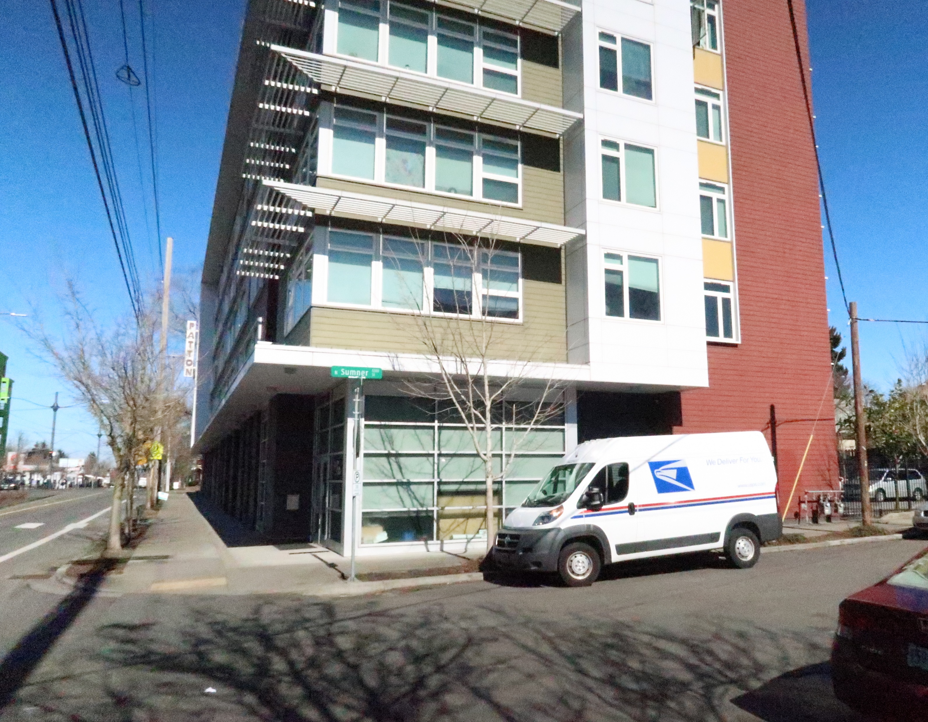
Context
Mixed-use development at N Interstate & Sumner

Slide 21
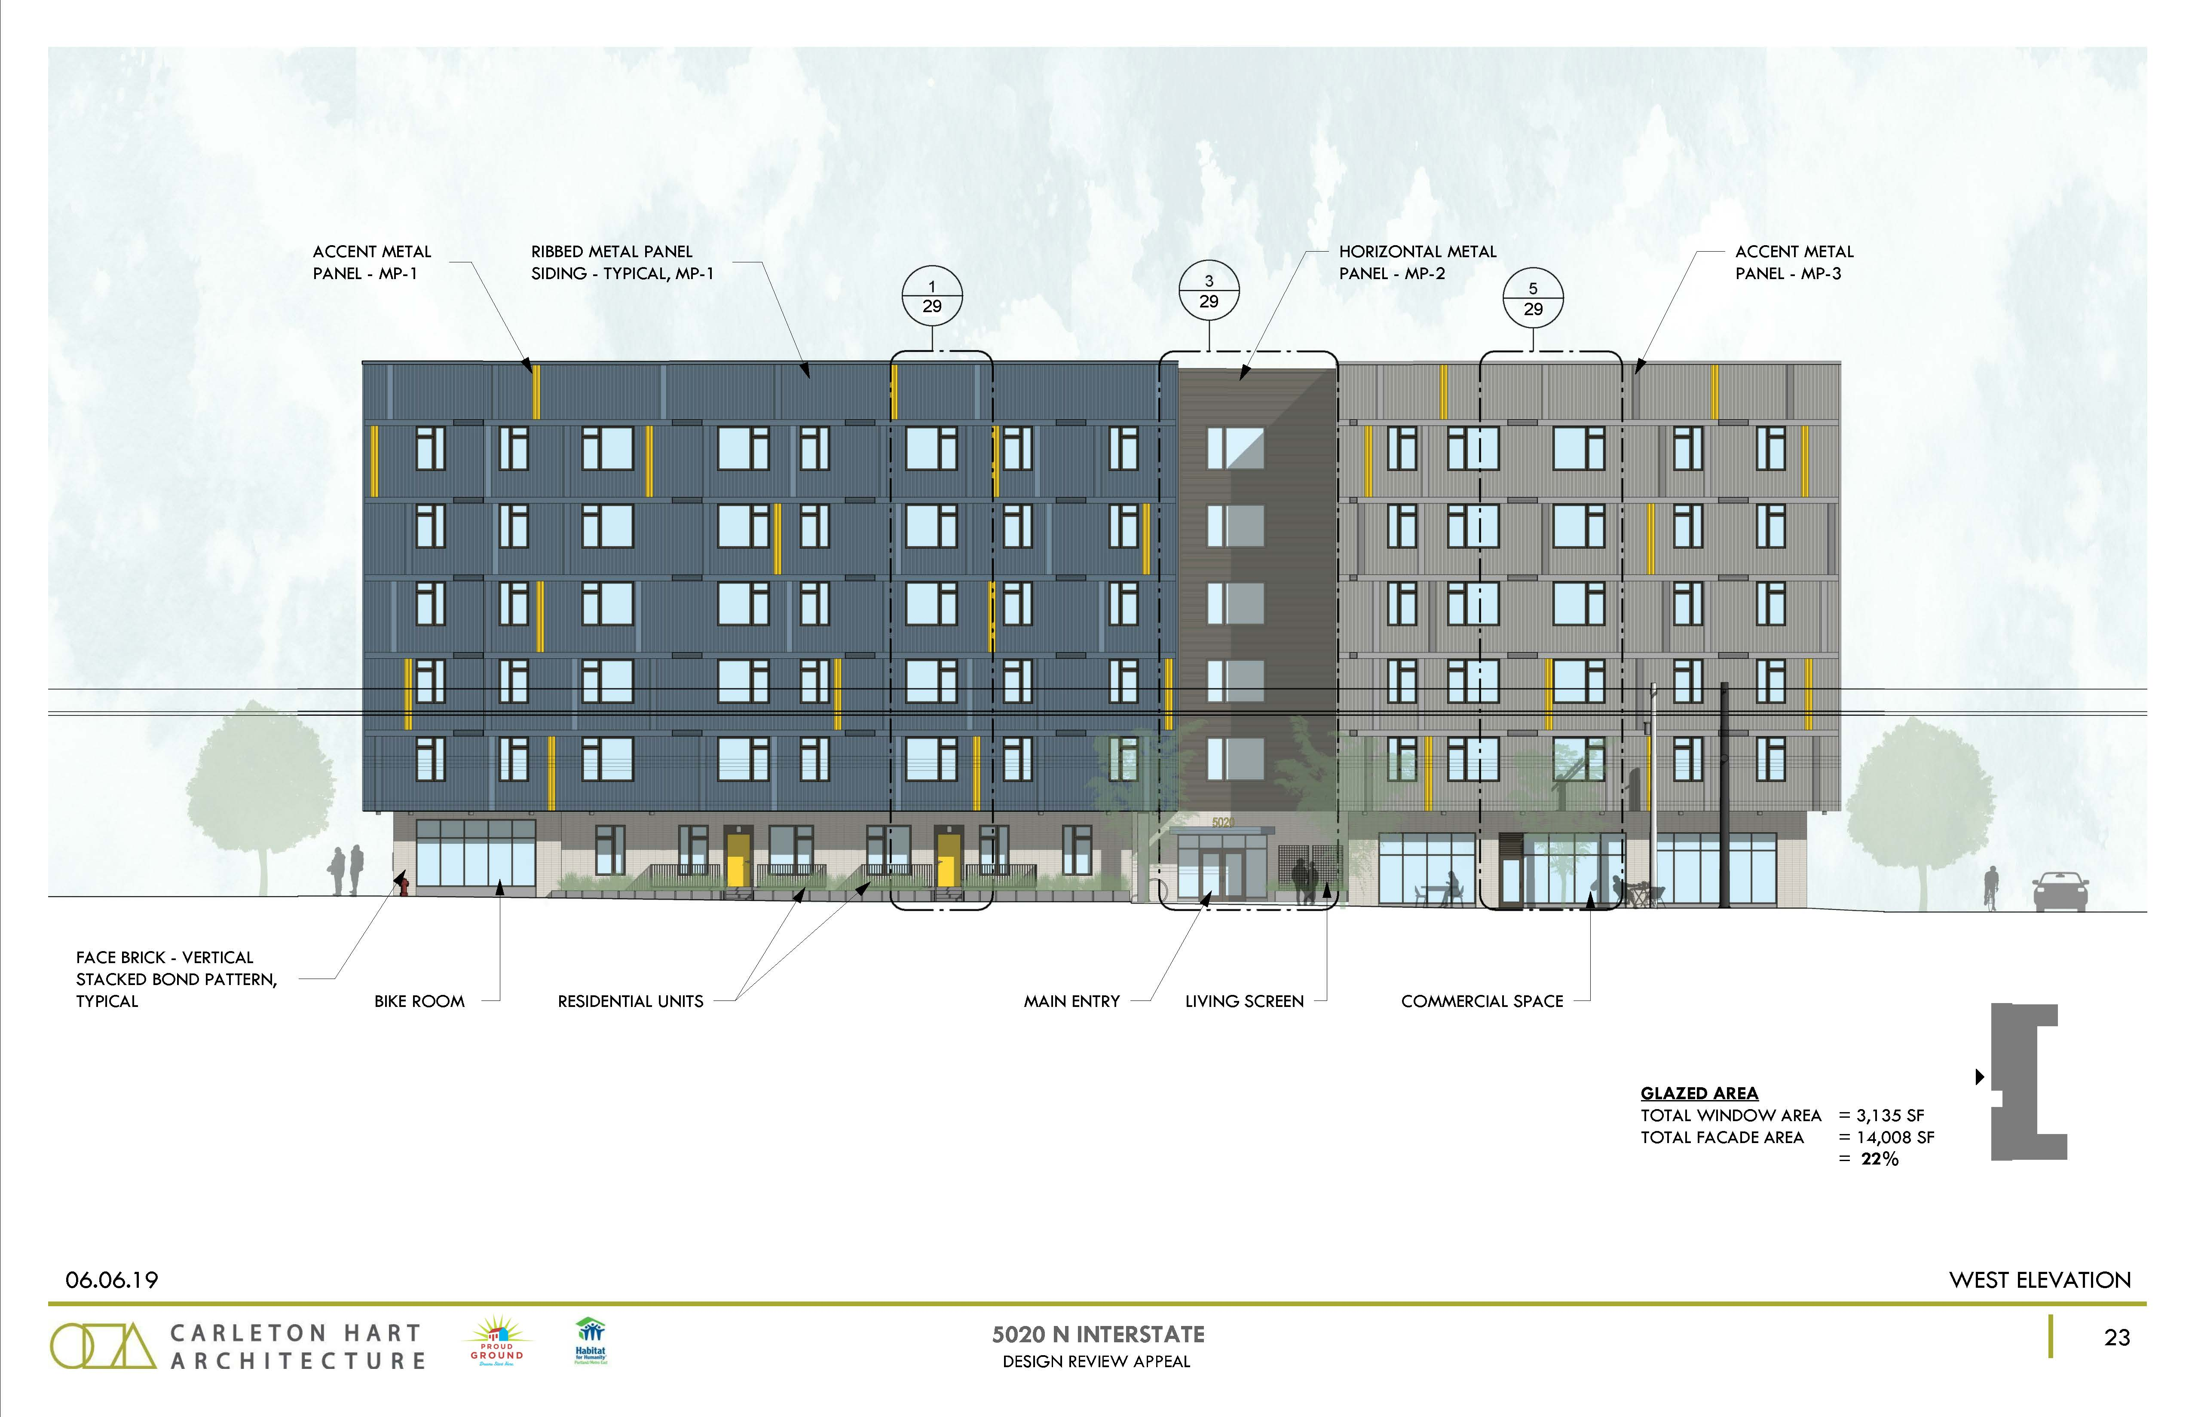
Program Overview
64 dwelling units
Ground floor commercial (approx. 1950 SF)
14 parking spaces

Slide 22
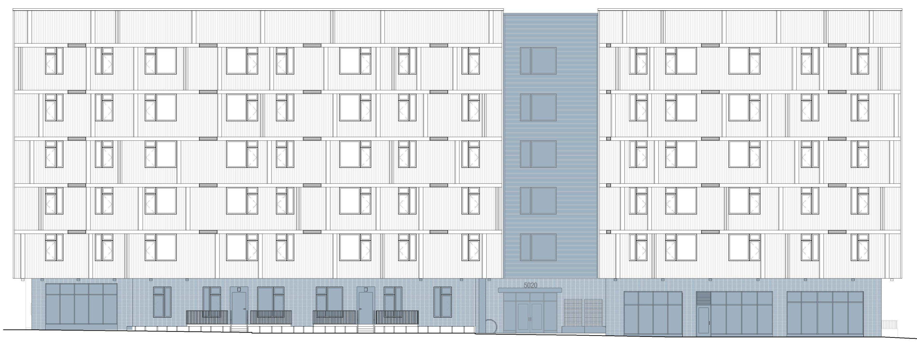
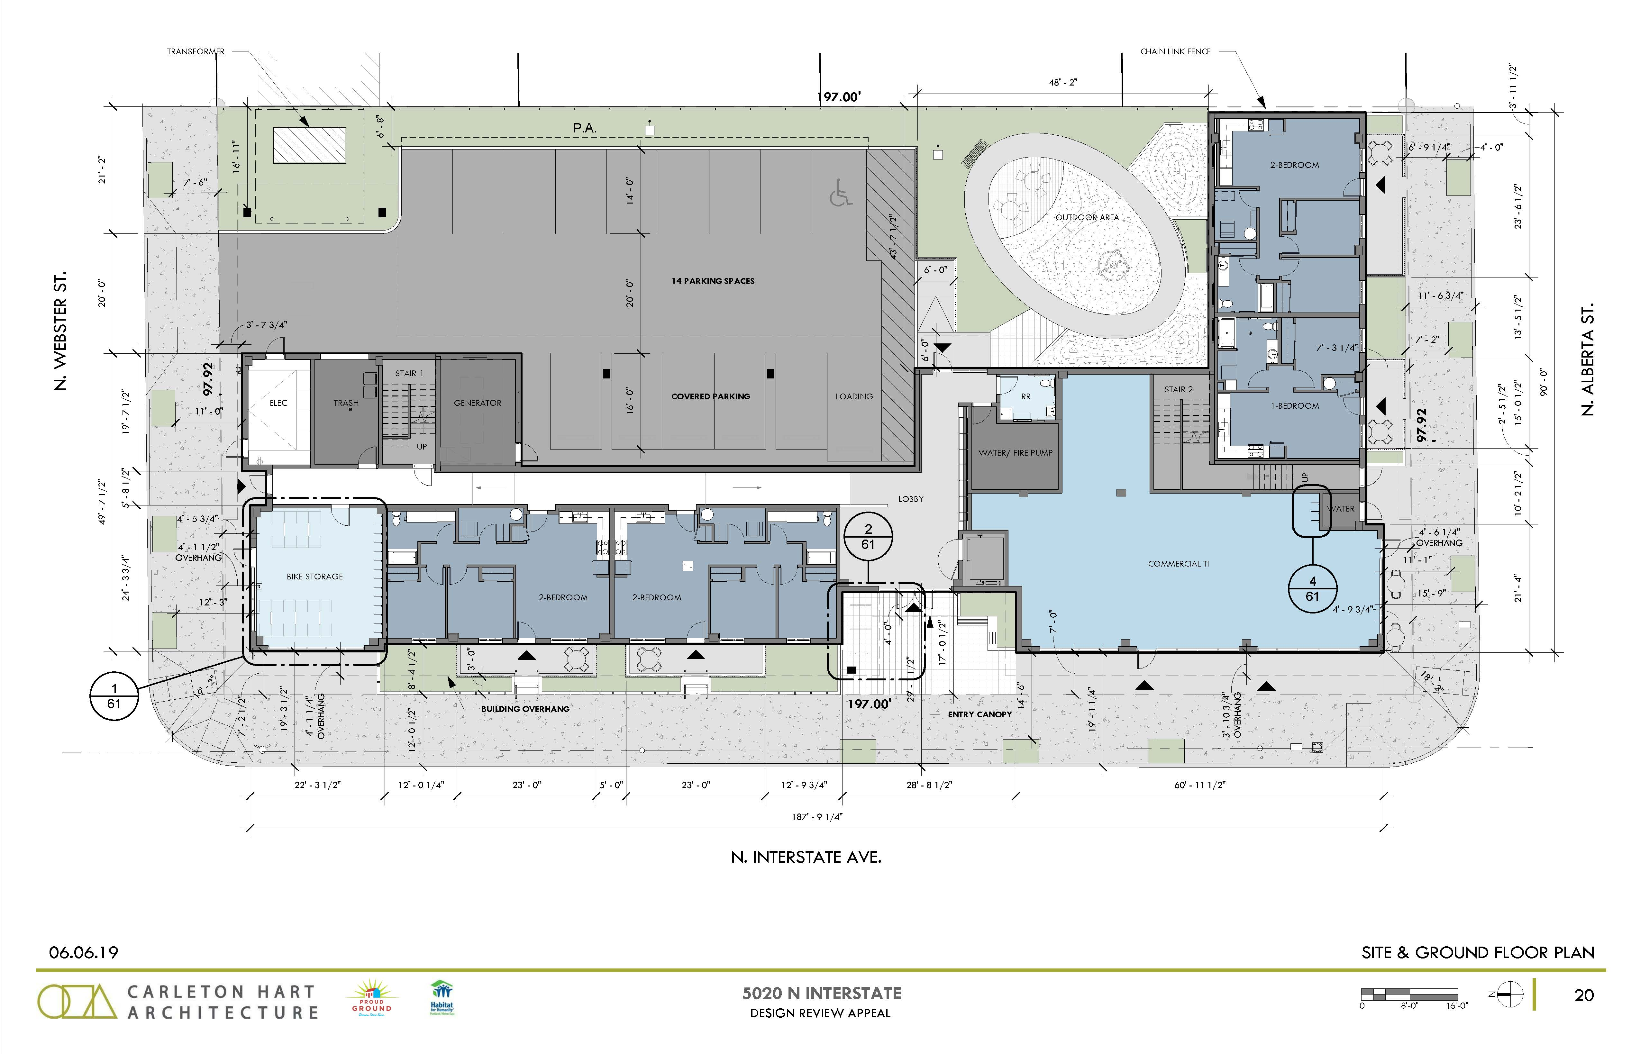
Modifications
1. Façade articulation
2. Screening, Mechanical equipment
3. Parking area setbacks and landscaping, Perimeter landscaping
4. Bicycle racks

Slide 23
Adjustments
1. Required Ground Floor Active Use (33.415.200)
Adjustment 1
The Standard: Within 100 feet of a transit street, at least 25% of the ground level floor area must be in one of the following active uses. Only uses allowed in the base zone may be chosen. A. Retail Sales and Service; B. Office; C. Industrial Service; D. Manufacturing and Production; E. Community Service; F. Daycare; G. Religious Institutions; H. Schools; I. Colleges (lobby, library, food service, theatre, meeting area); or J. Medical Centers (lobby, waiting room, food service, outpatient clinic).

Slide 24
Staff Decision

Slide 25
Approval with Conditions
1. Approval
2. Condition D
3. Condition E
4. Condition F
5. Condition G
6. Condition H
Approval
Guidelines met: E1 – The Pedestrian Network, E2 – Stopping Places, D1 – Outdoor Areas, D3 – Landscape Features, D8 – Interest, Quality, and Composition
Modification 1 – 33.130.222.C – Façade Articulation (reduce from 25% to 24%)
Modification 4 – 33.266.220.C.3.b – Standards for all bicycle parking, Bicycle racks (reduce width of long-term bike parking spaces from 2’-0” to 1’-6”)

Slide 26
Approval with Conditions
1. Approval
2. Condition D
3. Condition E
4. Condition F
5. Condition G
6. Condition H
Condition D
The proposed bike storage room at the northwest corner of the building shall be converted into a ground floor commercial use space (or other active use as listed in the “m” overlay zone, section 33.415.200); that bike parking that is currently proposed in this room shall be located either in individual units or in the original location shown in Exhibit A.18, or in a similar location to the south of the lobby along the east elevation of the building; and that a storefront entry door shall be placed on the N Interstate Ave frontage of the northwest corner commercial space.

Slide 27
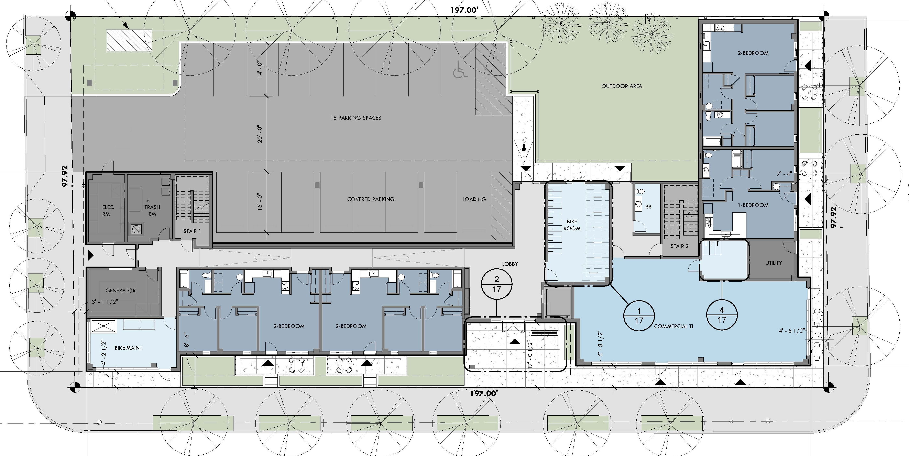
Approval with Conditions
1. Approval
2. Condition D
3. Condition E
4. Condition F
5. Condition G
6. Condition H
Condition D

Slide 28
Approval with Conditions
1. Approval
2. Condition D
3. Condition E
4. Condition F
5. Condition G
6. Condition H
Condition D
Better meets Guidelines P1 – Plan Area Character, D7 – Blending into the Neighborhood, E3 – The Sidewalk Level of Buildings, and E4 – Corners that Build Active Intersections and would also better meet Guideline D8 – Interest, Quality, and Composition.
Better meets Adjustment Approval Criterion A – Granting the adjustment will equally or better meet the purpose of the regulation to be modified; and Criterion B - … if in an OS, C, E, I, or CI2 zone, the proposal will be consistent with the classification of the adjacent streets and the desired character of the area.

Slide 29
Approval with Conditions
1. Approval
2. Condition D
3. Condition E
4. Condition F
5. Condition G
6. Condition H
Condition D
Also allows the proposal to meet the Ground Floor Windows development standard in 33.130.230.B.2.a.(2),General standard and B.3, Qualifying window features.
These standards require 25% window coverage on the N Webster St elevation and limit windows in to bicycle parking areas to “up to 25% of the ground floor windows coverage requirement.”

Slide 30
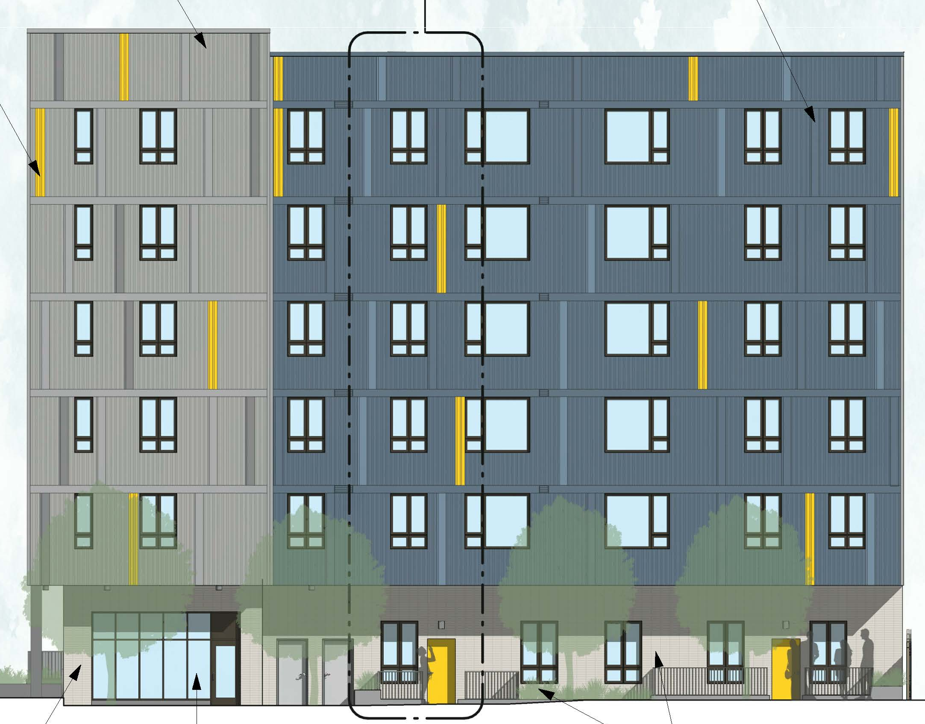
Approval with Conditions
1. Approval
2. Condition D
3. Condition E
4. Condition F
5. Condition G
6. Condition H
Condition E
Additional in-ground landscape planters, running for the length of the low fences, excepting space for entries, and at least 18 inches in width, shall be placed at the residential patios along N Alberta St. At least 6 inches of this space should be located on the sidewalk side of the fences and planted with ground covers, grasses, or flowering plants, and at least 12 inches should be on the patio side of the fences and planted with evergreen shrubs that will grow as tall as the fence itself.

Slide 31
Approval with Conditions
1. Approval
2. Condition D
3. Condition E
4. Condition F
5. Condition G
6. Condition H
Condition E
Better meets E3 – The Sidewalk Level of Buildings, D1 – Outdoor Areas, D2 – Main Entrances, and D3 – Landscape Features.
Furthermore, providing greater separation through additional landscaping could also better meet Guidelines P1 – Plan Area Character, D5 – Crime Prevention, D7 – Blending into the Neighborhood, and D8 – Interest, Quality, and Composition.

Slide 32
Approval with Conditions
1. Approval
2. Condition D
3. Condition E
4. Condition F
5. Condition G
6. Condition H
Condition F
Doors with full lights and transom windows above shall be provided at the four ground-level residential unit entries. Sidelights shall also be provided at the two ground-level residential unit entries facing N Interstate Ave.
Better meets Guidelines E3 – The Sidewalk Level of Buildings, D2 – Main Entrances, and D5 – Crime Prevention.
Though not directly addressed in the Findings, providing additional glazing would also help the proposal to better blend into the neighborhood (Guideline D7) and provide additional interest along the street (Guideline D8).

Slide 33
Approval with Conditions
1. Approval
2. Condition D
3. Condition E
4. Condition F
5. Condition G
6. Condition H
Condition G
A canopy or awning system shall be provided at a minimum 4’-0” depth for the length of each storefront window bay on the west elevation of the commercial spaces at the southwest and northwest corners of the building. These canopies or awnings shall all be approved through either a follow-up design review, or they shall all meet the exemption from Design Review in zoning code section 33.420.045.S.

Slide 34
Approval with Conditions
1. Approval
2. Condition D
3. Condition E
4. Condition F
5. Condition G
6. Condition H
Condition G
Better meets Guideline E5 – Light, Wind, and Rain.
Additionally, though not required by any condition of approval, providing canopies could allow for the walls along N Interstate to be pushed out closer to the property line, resulting in more square footage for the Required Active Ground Floor Uses that the Adjustment, reducing the impact of the Adjustment request

Slide 35
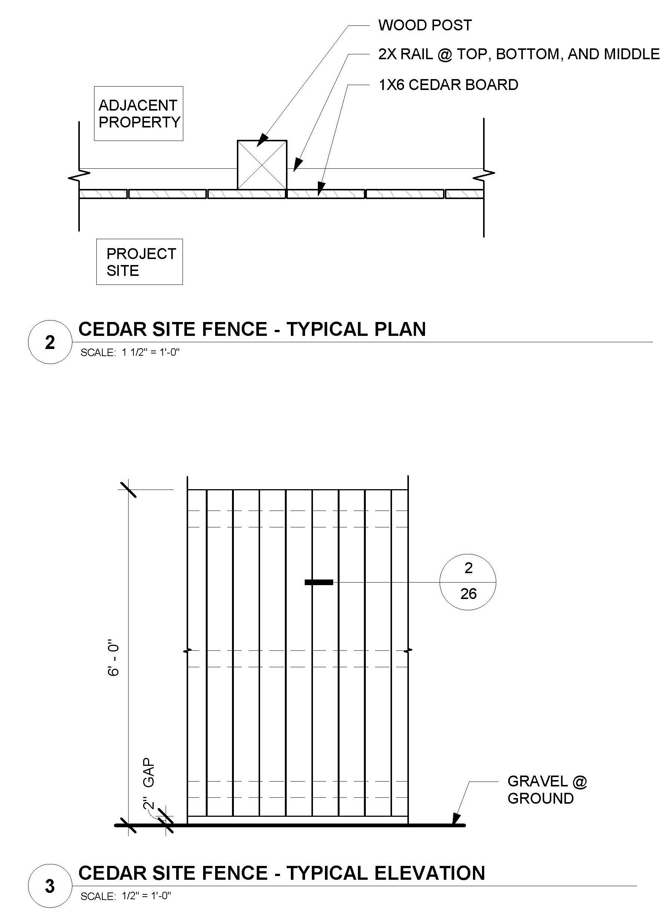
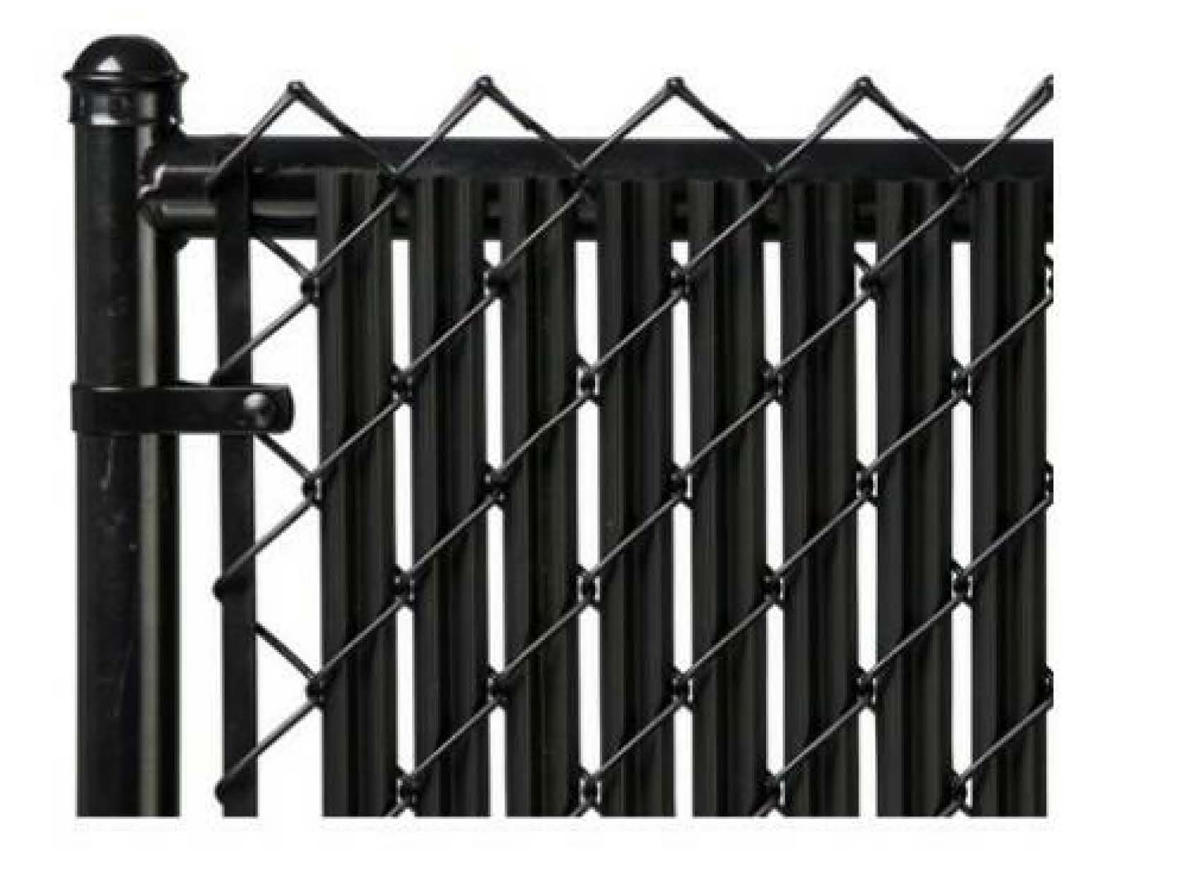
Approval with Conditions
1. Approval
2. Condition D
3. Condition E
4. Condition F
5. Condition G
6. Condition H
Condition H
The proposed chain link fence shall be replaced with the originally-proposed, sight-obscuring wood fence (as shown in Exhibit C.48).
Better meets Guideline D4 – Parking Areas and Garages.
Better meets Modification approval criteria for Modifications 2 (screening mechanical equipment) & 3 (perimeter landscaping).

Slide 36
Next steps
Design Commission Options
Approve one or both of the appeals, overturning the staff decision of approval with conditions.
  Approval of the OKNA appeal would require the proposal to meet the Required Ground Floor Active Use standard in 33.415.200.
  Approval of the Carleton Hart appeal would result in elimination of conditions of approval from the staff decision.
Deny one or both of the appeals and uphold the staff decision of approval with conditions;
Deny the proposal;
Add, delete, or revise one or more conditions of approval from the original staff decision; or
Request the applicant to return with further revisions.

Slide 37
Questions

