Slide 1

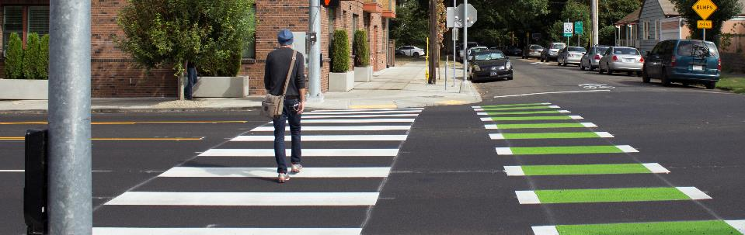

PORTLAND CITY COUNCIL
JUNE 5, 2019

Slide 2
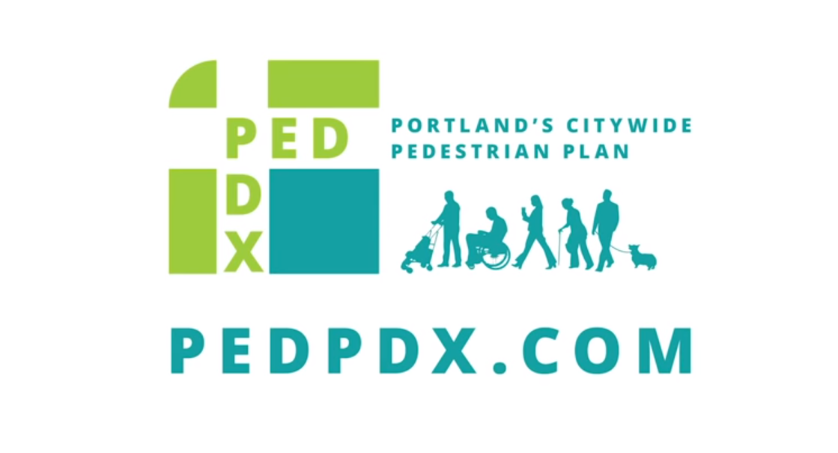
https://www.youtube.com/watch?v=J0zGfT1QI00&feature=youtu.be

Slide 3
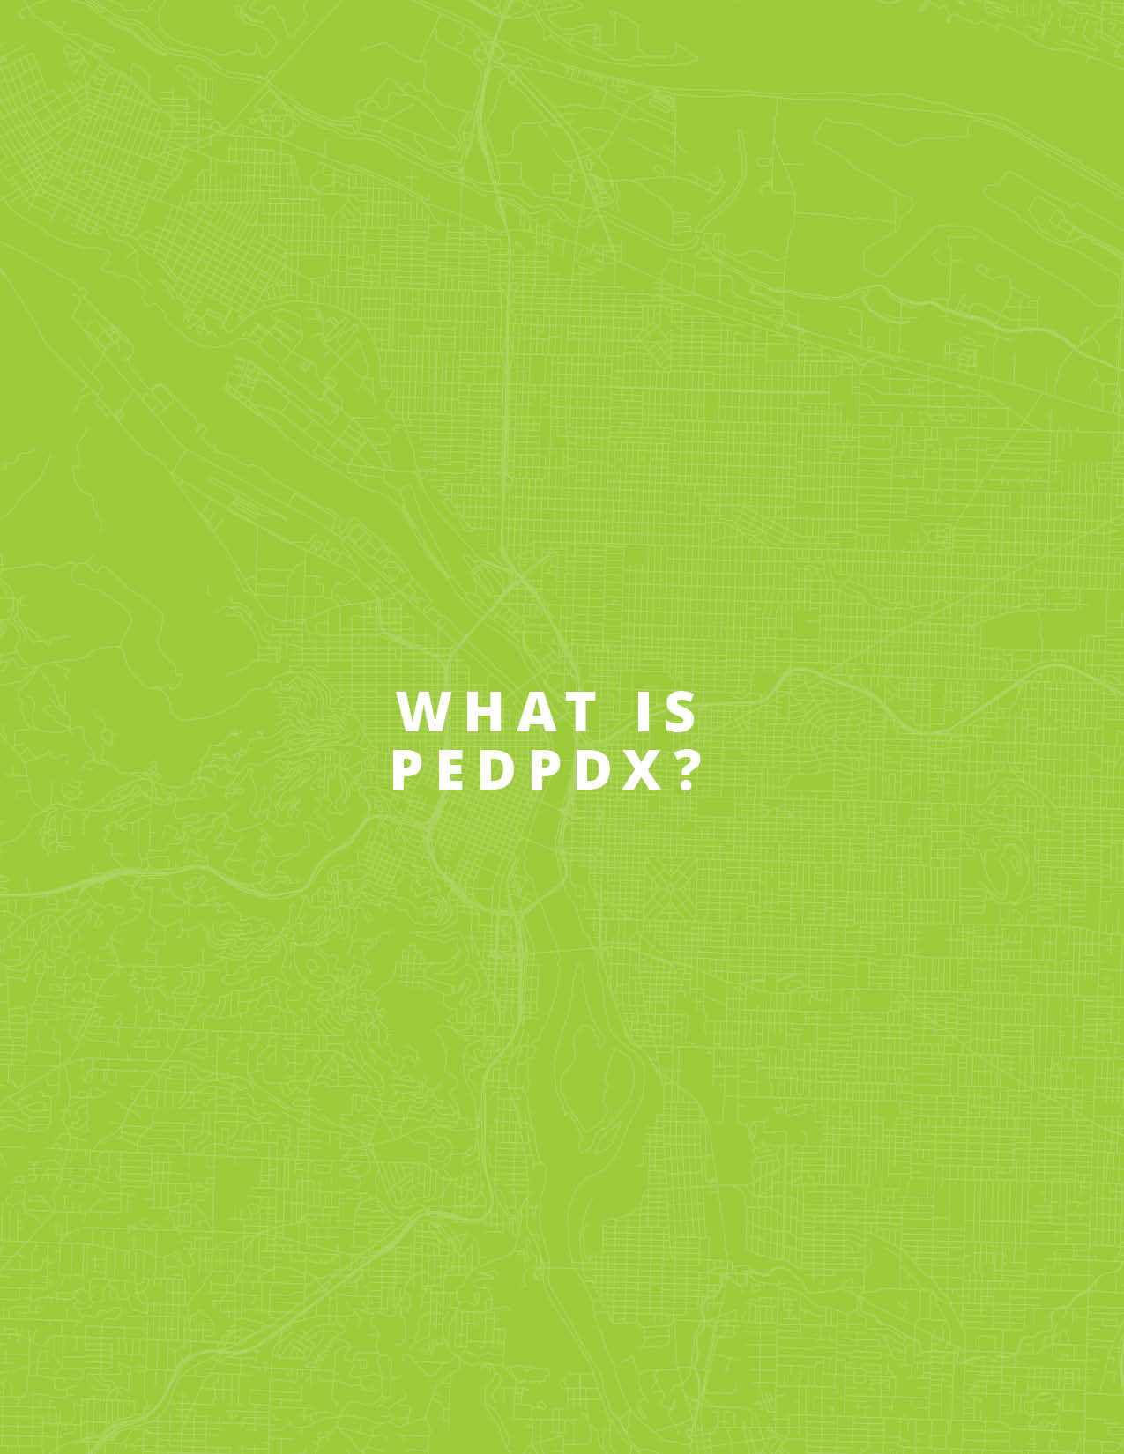
Notes:
Thank you Director Warner, and thank you Mayor and Commissioners for having me today.
My name is Michelle Marx, I am the Pedestrian Coordinator at the Bureau of Transportation. I am also the project lead on PedPDX.
I have to say that I am very excited to be here to share with you today what I think is a truly exciting plan for our city.
As we saw in the video this plan is directly informed by what Portlanders told us is most important. I want to acknowledge the many community members who participated in this effort are here today.
I’ll spend just a few minutes walking you through the key content of PedPDX.

Slide 4
Notes:
As Commissioner Eudaly noted in her opening remarks, through PedPDX, the City of Portland affirms walking ….

Slide 5
Notes:
PedPDX includes three key elements:
It establishes new pedestrian classifications, which in aggregate are referred to as the “Pedestrian Priority Network”
Those pedestrian classifications reflect the intensity of pedestrian activity, and are directly tied to the City’s Comprehensive Plan vision.

Slide 8
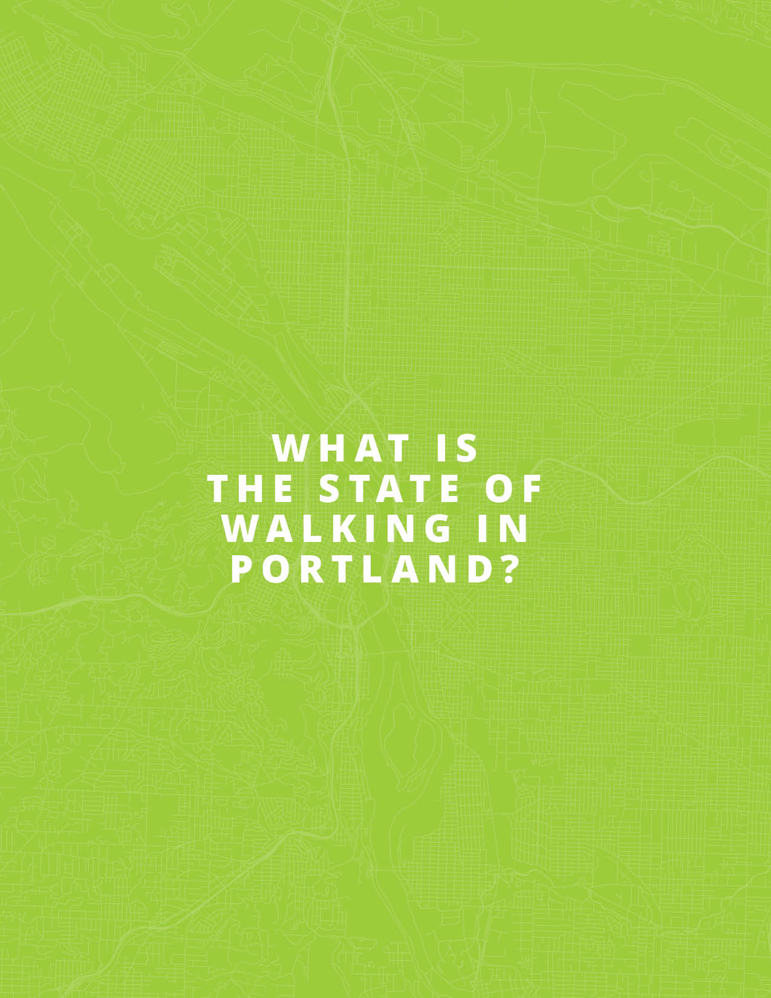
Notes:
(looking at safety data and the state of the network)

Slide 9
Notes:
We know that pedestrians suffer a disproportionate number of traffic deaths compared to other modes of transportation.
While pedestrian trips account for approximately 9% of all trips taken in Portland, 31% of all traffic fatalities involve people walking.

Slide 10
Portlanders that have to walk (including those who are transit-reliant) are most exposed to systemic safety issues
Notes:
What’s more we know that traffic safety is an equity issue.

Slide 11
Portlanders that have to walk (including those who are transit-reliant) are most exposed to systemic safety issues
People walking in East Portland die in traffic crashes at twice the rate of people walking elsewhere in Portland, on a per-person basis.
Source: Oregon Department of Transportation Crash Data System, 2005-2014; 2010 Decennial Census

Slide 12
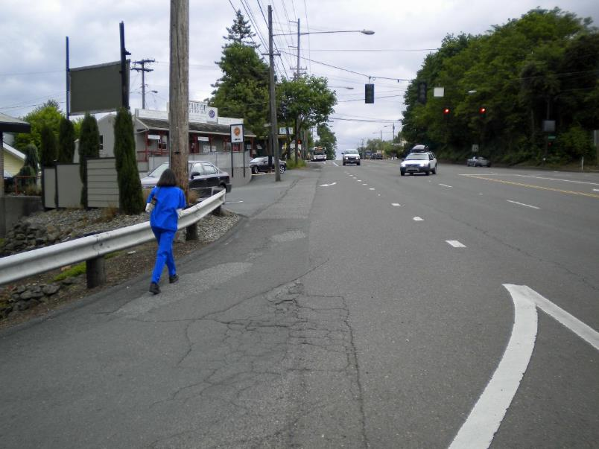
Notes:
Beyond safety, we know we also have significant infrastrure issues.

Slide 13
Notes:
New inventory
Geographic patterns – Southwest Portland and East Portland, areas of the city annexed in the later half of the last century.

Slide 14
Notes:
To quantify…

Slide 15
Approximately 350 miles of missing sidewalk on arterials/collectors
Notes:
In total, there are approximately 350 miles of missing sidewalk on our busy arterial and collector streets.
This does not include sidewalks that may be missing on local residential streets.
This is likely much more than we will have resources to address. For context, PedPDX found that in the 20 years since the 1998 Pedestrian Master Plan was adopted, we have constructed, repaired, or rebuilt approximately 250 miles of sidewalk in Portland. The remaining 350 miles of missing sidewalk is well beyond the 20 year planning horizon of PedPDX.
Given the enormity of this need, we know we will have to prioritize.

Slide 16
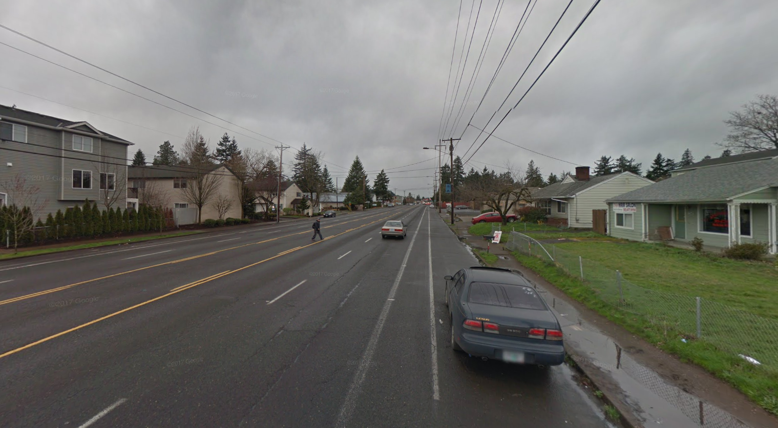
Notes:
In addition to sidewalks, PedPDX places great emphasis on crossings as a critical piece of the pedestrian network.

Slide 17
Approximately 3,500 marked crossing gaps on arterial/collector network
Notes:
we need about 3,500 additional marked crosswalks on our busy arterial and collector streets to meet our new crossing spacing guidelines.
This is more than we can likely provide in the next 20 years. For context, PedPDX found that in the 20 years since the 1998 Pedestrian Master Plan was adopted, we installed or re-installed approximately 2,500 crosswalks.
Similar to our sidewalk needs, given the enormity of need for new marked crosswalks, we must prioritize.

Slide 18
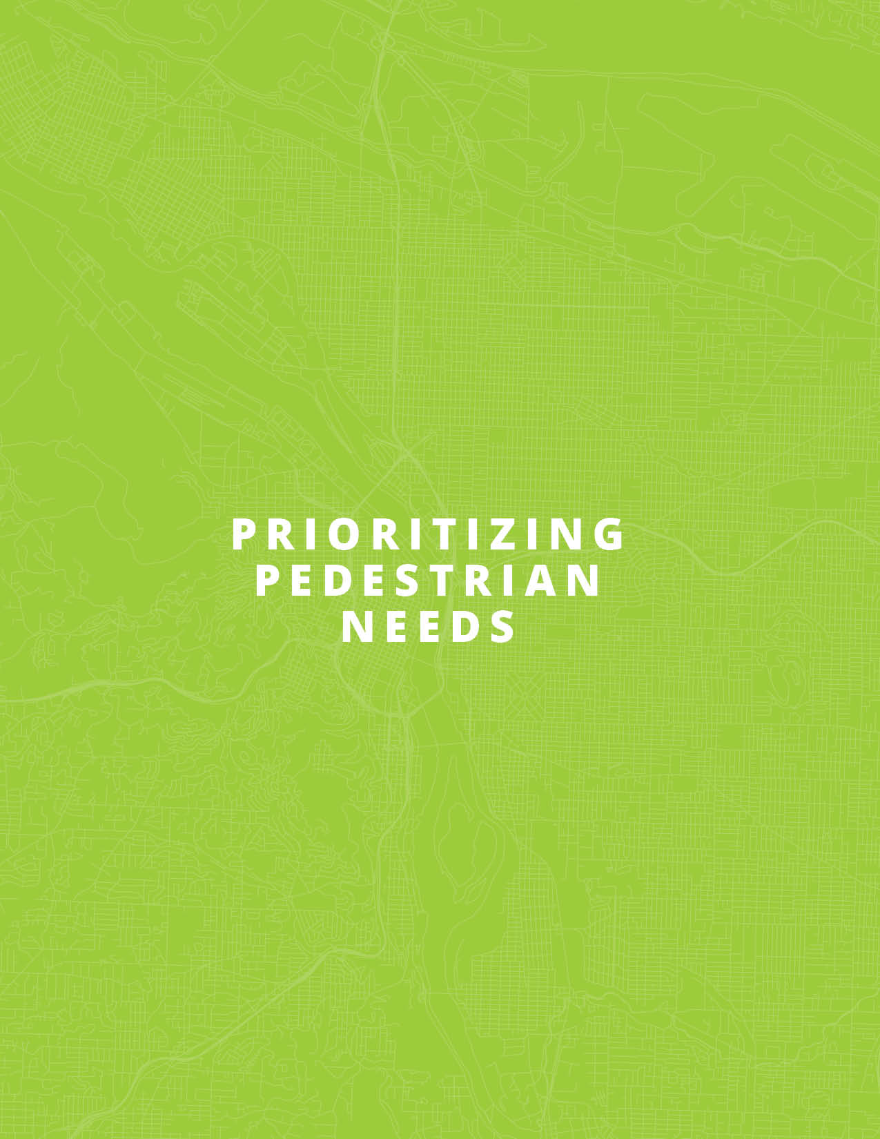
Notes:
Given the enormity of sidewalk and crossing needs across the city, we are obligated to ensure that we are directing resources to locations with the greatest need first

Slide 19
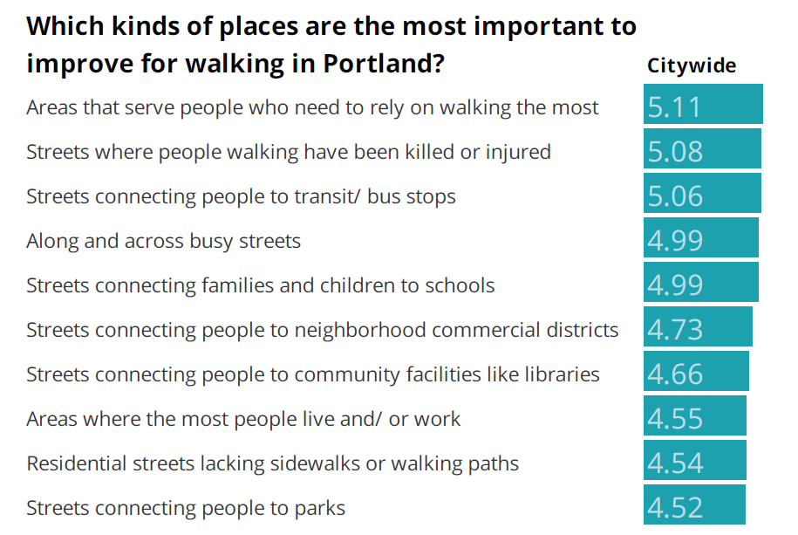
EQUITY
SAFETY
DEMAND
SAFETY
DEMAND
DEMAND
Notes:
As shown in the video, we conducted broad citywide outreach to hear directly from Portlanders where the most important places are to improve for walking.
We heard from over 5,400 in multiple languages, and the responses feel into these three buckets. We constructed the PedPDX prioritization accordingly.

Slide 20
Equity
Safety
Demand
Notes:
We analyzed the entire network against our criteria of equity, safety, and demand

Slide 21
Equity + Safety + Demand
Notes:
We then combine that analysis to identify locations where we have high equity needs, high safety issues, and a high number of people walking.

Slide 22
Sidewalk investment priorities

Slide 23
Crossing investment priorities
Notes:
This process is dynamic. We will run our equity, safety, demand evaluation regularly and compare against known sidewalk and crossing gaps on an ongoing basis.
This keeps the plan relevant over time and responsive to changing conditions.

Slide 24

Notes:
The toolbox is directly informed by
The Walking Priorities Survey
The PedPDX Safety Analysis
Work sessions with technical staff
And focus groups with impacted community members

Slide 25
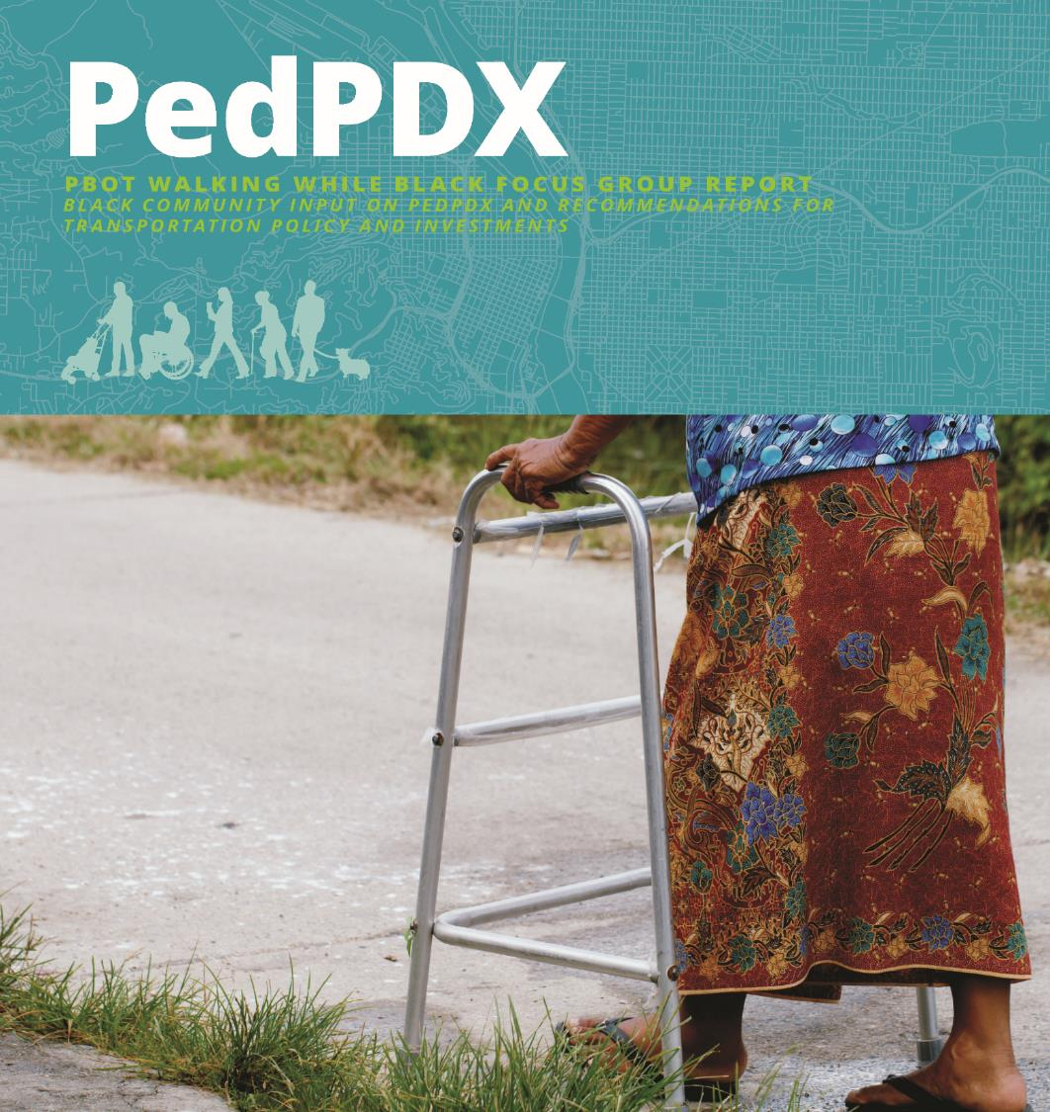
Notes:
In recognition of low response rates to our Walking Priorities Survey from members of the African and African-American community, PBOT
staff worked with community partners including
the Portland African American Leadership Forum (PAALF)
The Black Parent Initiative (BPI)
and Immigrant and Refugee Community Organization (IRCO) Africa House
to host two “Walking While Black” focus groups to better understand their priorities and concerns.
Nearly 50 community members participated in these sessions.

Slide 26
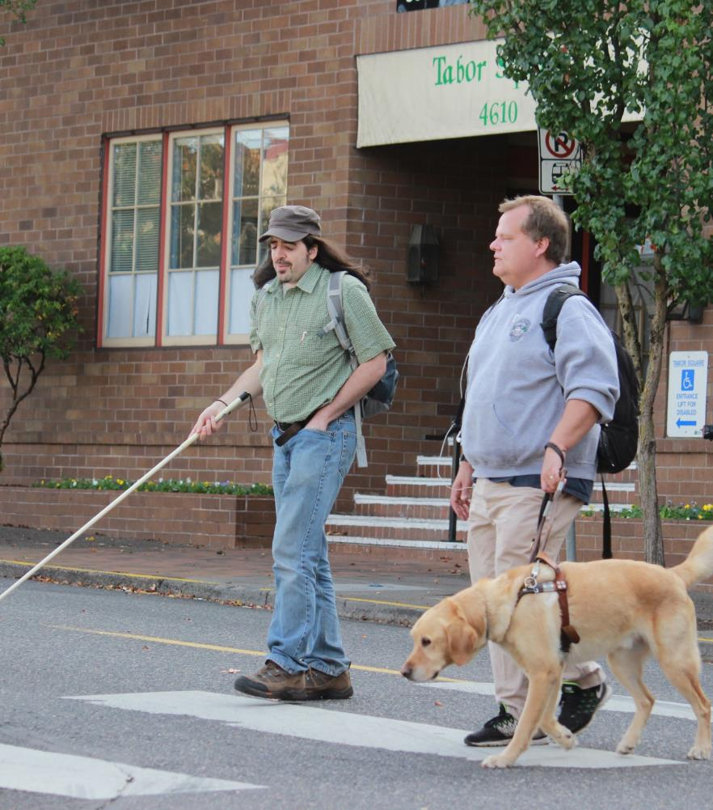
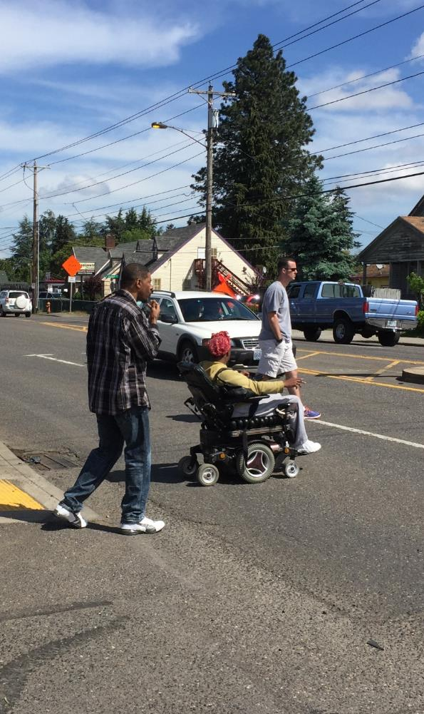
Notes:
We also held Toolbox workshops with members of the disability community in an effort to identify solutions to make walking safer and more pedestrian-friendly for everyone. The ideas generated during this workshop directly influenced the implementing strategies and actions in the PedPDX Toolbox.

Slide 32
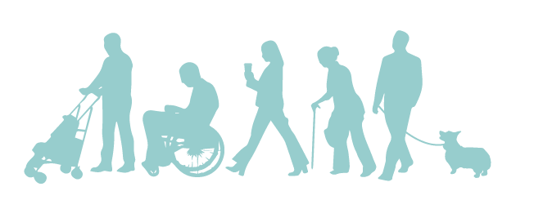
Thank you!
Michelle Marx | Pedestrian Coordinator
Portland Bureau of Transportation
Michelle.Marx@portlandoregon.gov

