Slide 1
Office of management & finance
Build Portland City Council Annual Update
June 5, 2019

Slide 2
Build Portland: FY 17-18
City Council Work Session:
  Build Portland vision, investment needs, framework
Resolution 37222:
  Build Portland Advisory Committee formed to develop criteria and prioritize projects; create a funding plan
  Team directed to provide annual Build Portland update
Resolution 37349:
  Seven Phase I projects authorized
  $50M total Program cost
Ordinance 18885:
  General-Fund debt authorized for financing project costs
August
2017
October
2017
March
2018
April
2018

Slide 3
Build Portland: FY 18-19
Program Initiation:
  Phase I Projects start
  Multi-bureau Program Administration established
Quarterly Updates:
  Phase I projects advance
  Advisory Committee update
Quarterly Updates:
  Phase I projects advance
  Advisory Committee update
Annual Update:
  City Council Annual Update
  Phase I projects advance
  Advisory Committee update
  Program Administration funding approved
July
2018
October 2018
January2019
May
2019

Slide 4
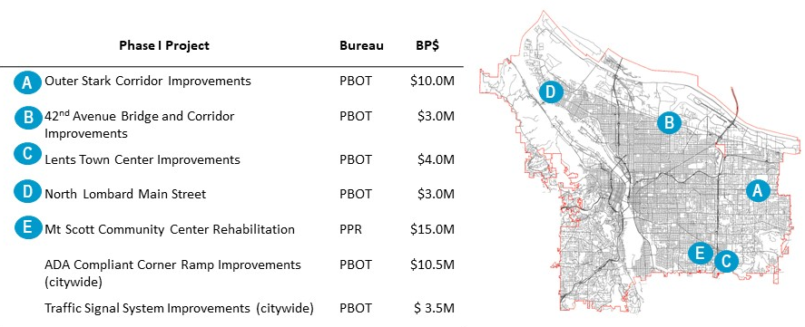
Phase I Projects
ALL PROJECTS ON TRACK TO MEET 2020 MILESTONES

Slide 5

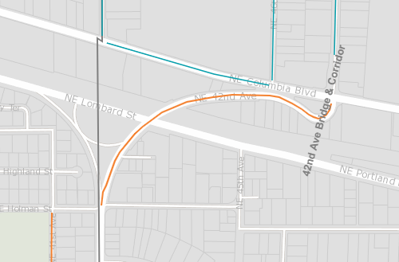
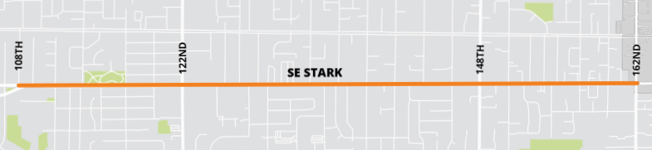
Phase I Projects: PBOT
OUTER STARK CORRIDOR IMPROVEMENTS |  | 42ND AVENUE BRIDGE & CORRIDOR IMPROVEMENTS
Stark Street: SE 108th – SE 162nd Avenues |  | NE 42nd Avenue: NE Holman Street – NE Columbia Boulevard
Paving (139th – 162nd) and signal upgrades, as well as enhanced pedestrian crossings and corridor safety improvements. |  | Bridge structure replacement, including paving and improvements to sidewalks, pedestrian crossings and bikeways.
Construction Start: Late 2020 |  | Construction Start: Early 2021
1
2
3
4
5
6

Slide 6
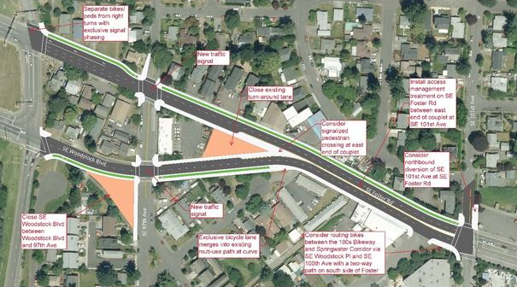
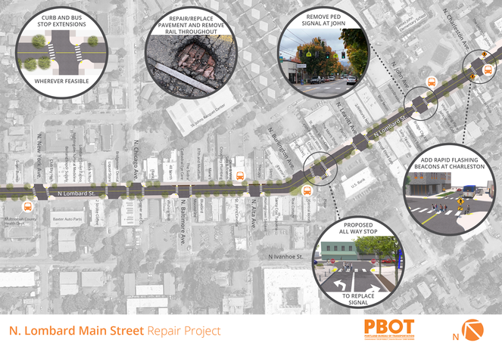
Phase I Projects: PBOT
LENTS TOWN CENTER IMPROVEMENTS |  | NORTH LOMBARD MAIN STREET
Foster Road / Woodstock Boulevard couplet, SE 96th – SE 101st Avenues |  | Lombard Street, N Saint Louis – N Richmond Avenues
Paving and improvements to sidewalks, pedestrian crossings and bikeway improvements. |  | Pavement reconstruction, as well as crossing treatments, transit pad improvements, and curb extensions
Construction Start: June 2020 |  | Construction Start: Late 2020
1
2
3
4
5
6

Slide 7
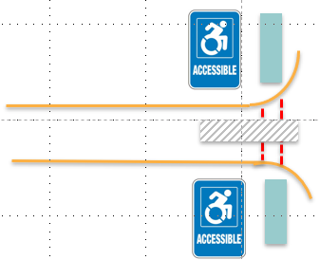
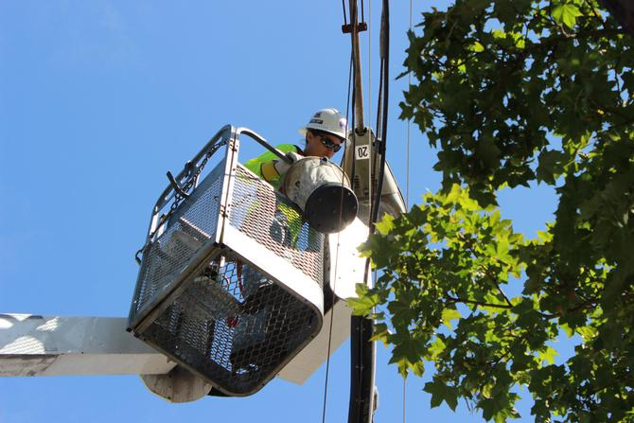
Phase I Projects: PBOT
ADA COMPLIANT CORNER RAMP IMPROVEMENTS |  | TRAFFIC SIGNAL SYSTEM IMPROVEMENTS
Priority Ramps / ADA Sidewalks |  | Signal Reconstruction / Rapid Flashing Beacon Program
$1.5M of ADA-compliant corner ramp improvements Citywide each year for seven years with work prioritized by risk and equity. |  | $480k of traffic signal improvements Citywide prioritized by safety, equity, and asset condition.
Construction Start: On-going |  | Construction Start: On-going
1
2
3
4
5
6

Slide 8
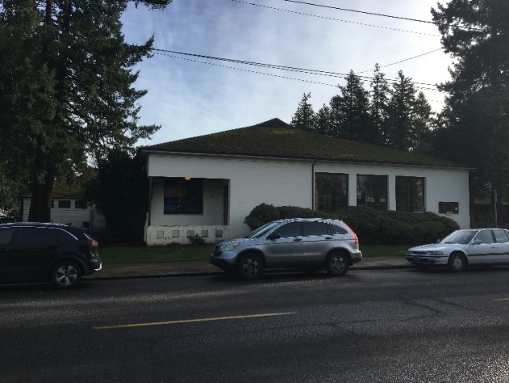
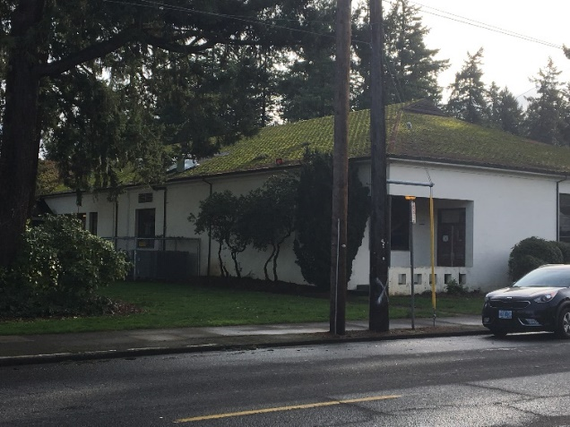
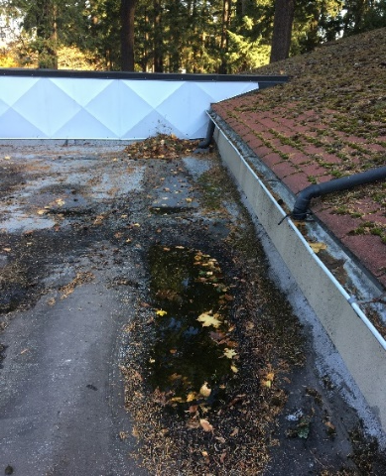
Phase I Projects: PPR
MT SCOTT COMMUNITY CENTER REHABILITATION
5530 SE 72nd Avenue
.Whole building seismic retrofit to code, roof replacement, HVAC system renovation, fire safety system upgrade, hazardous materials abatement, ADA improvements and energy efficiencies.
Construction Start: Summer 2022
1
2
3
4
5
6

Slide 9
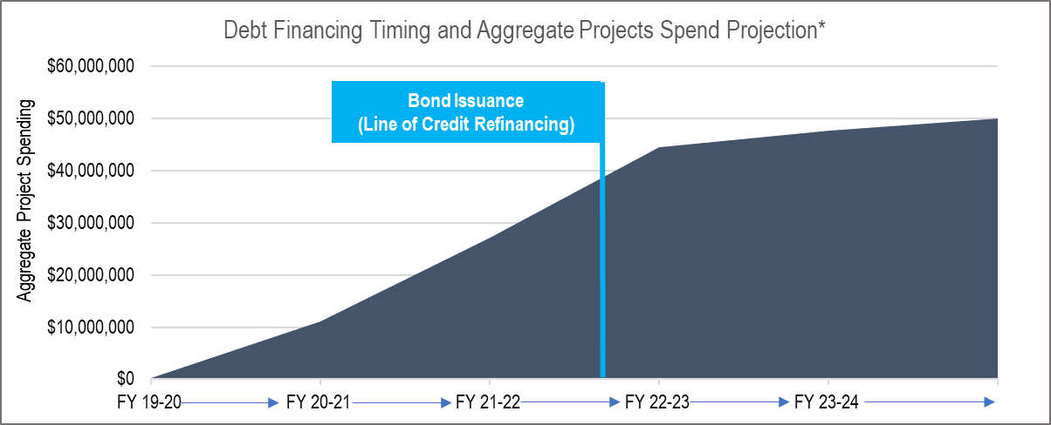
Phase I Funding Approach
Limited Tax Revenue Bonds (General Fund-secured) up to $52M authorized by Ordinance 188885
Line of credit to be issued FY2019-20
Bond issuance to occur in late FY2021-22

Slide 10
Program Organization by Bureau
Program Administration
CAO
Financial Forecasting
CBO
Financial Planning
BRFS
Project Implementation
Infrastructure Bureaus

Slide 11
Program Administration
Communication and Outreach
Citywide Program Coordination
Future Phases
Long Term Funding Plan

Slide 12
Build Portland: FY 19-20
Project Advancement
  Phase I projects continue to advance
  First location specific Phase I projects initiate construction (Spring 2020)
  Issue Phase I project funding line of credit
Program Administration
  Communication and Outreach Approach
  Citywide Program Administration
Advisory Committee Quarterly Updates
  Summer 2019, Fall 2019, Winter 2020, Spring 2020
Annual City Council Update
  Spring 2020

Slide 13
Questions?

