Slide 1
GARBAGE, RECYCLING, & COMPOSTING
RESIDENTIAL RATES
City Council
May 29, 2019

Slide 2
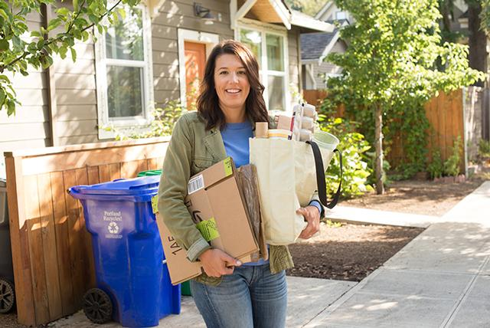
Recycling Markets

Slide 3


Slide 4
Key Rate Factors
Upward Pressure
  Yard debris/food scraps tip fees
  Portland Clean Energy Fund 1% surcharge
  Driver wages
Downward Pressure
  Lower vehicle depreciation
  Hauler efficiencies

Slide 5
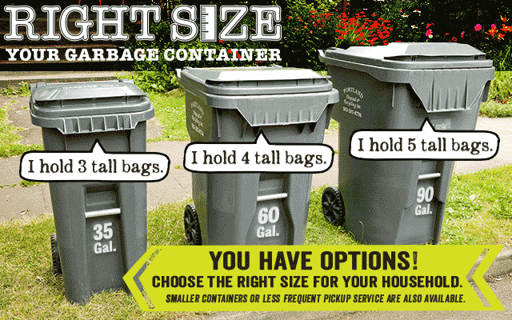
Ratemaking Policy

Slide 6
Proposed Monthly Rates
Primary Service Levels | Proposed Rate FY19-20 | Rate Change | % Households Served*
35-Gallon - Every 4 Weeks | $25.00 | + $0.75 | 6%
20-Gallon | $27.90 | + $0.75 | 8%
35-Gallon | $32.55 | + $0.75 | 51%
60-Gallon | $37.85 | + $0.20 | 26%
90-Gallon | $43.15 | - $1.00 | 5%

Slide 7
Questions?

Slide 8
Standardize Increments
Increment between Service Levels | Proposed | Current | Difference
Every 4 weeks to 20 gallons | $ 2.90 | $ 2.90 | $ 0
20 gallons to 35 gallons | $ 4.65 | $ 4.65 | $ 0
35 gallons to 60 gallons | $ 5.30 | $ 5.85 | $ (0.55)
60 gallons to 90 gallons | $ 5.30 | $ 6.50 | $ (1.20)

Slide 9
Disincentive Premiums
Service Level | Proposed Disincentive | Current Disincentive | Difference
60-Gallon | $ 1.96 | $ 2.53 | $ (0.57)
90-Gallon | $ 3.63 | $ 5.55 | $ (1.92)

Slide 10
Incentives and Disincentives
Primary Service Levels | Proposed (Incentive)/ Disincentive | Current (Incentive)/ Disincentive | Difference | % Households Served*
35-Gallon - Every 4 Weeks | $ (2.89) | $ (3.28) | $ 0.39 | 6%
20-Gallon | $ (2.93) | $ (3.23) | $ 0.30 | 8%
35-Gallon | $ 0.00 | $ (0.27) | $ 0.27 | 51%
60-Gallon | $ 1.96 | $ 2.53 | $ (0.57) | 26%
90-Gallon | $ 3.63 | $ 5.55 | $ (1.92) | 5%

Slide 11

Portland Clean Energy Fund

Slide 12
Proposed Monthly Rates
Primary Service Levels | Proposed Rate FY19-20 | Current Rate FY18-19 | Difference | % Households Served*
35-Gallon - Every 4 Weeks | $25.00 | $24.25 | $0.75 | 6%
20-Gallon | $27.90 | $27.15 | $0.75 | 8%
35-Gallon | $32.55 | $31.80 | $0.75 | 51%
60-Gallon | $37.85 | $37.65 | $0.20 | 26%
90-Gallon | $43.15 | $44.15 | ($1.00) | 5%

