Slide 1
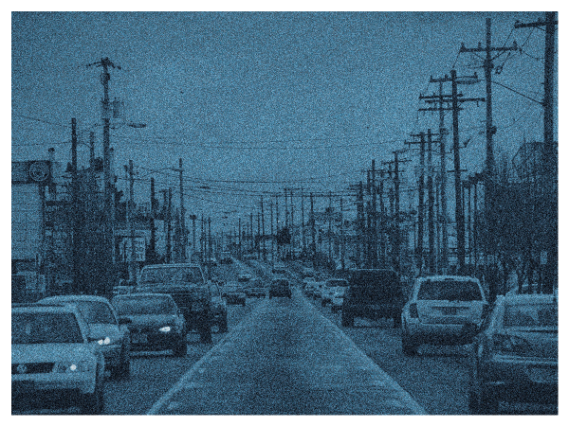
82nd Avenue Study:
Understanding Barriers to Development
Portland City Council
May 23, 2019

Slide 2
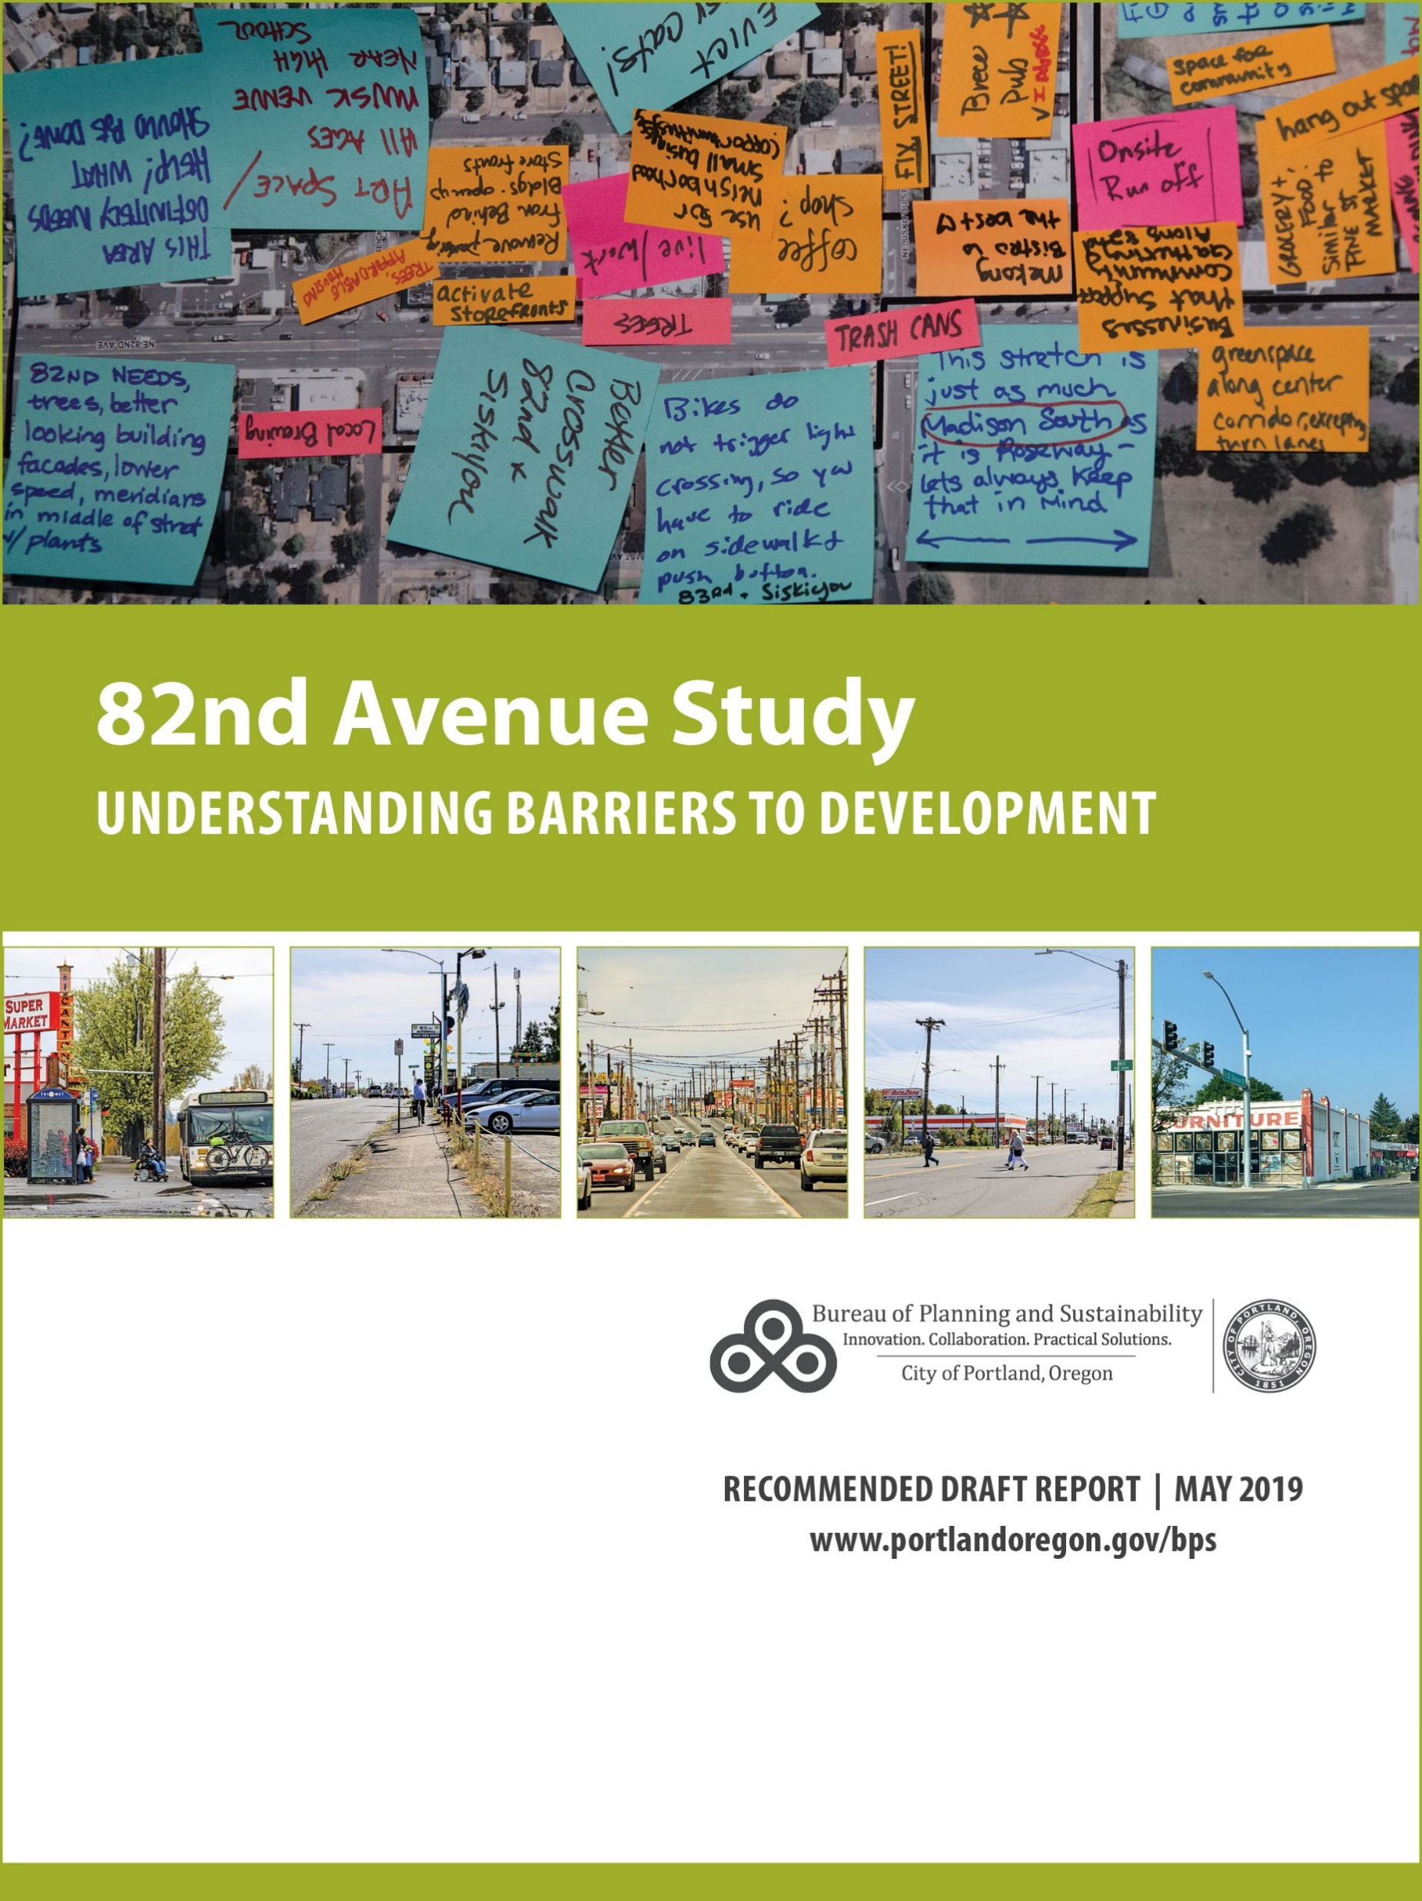
Recommended Council Action:
Adopt the 82nd Avenue Study map changes
Accept the 82nd Avenue Study: Understanding Barriers to Development as legislative history
(Ordinance)

Slide 3
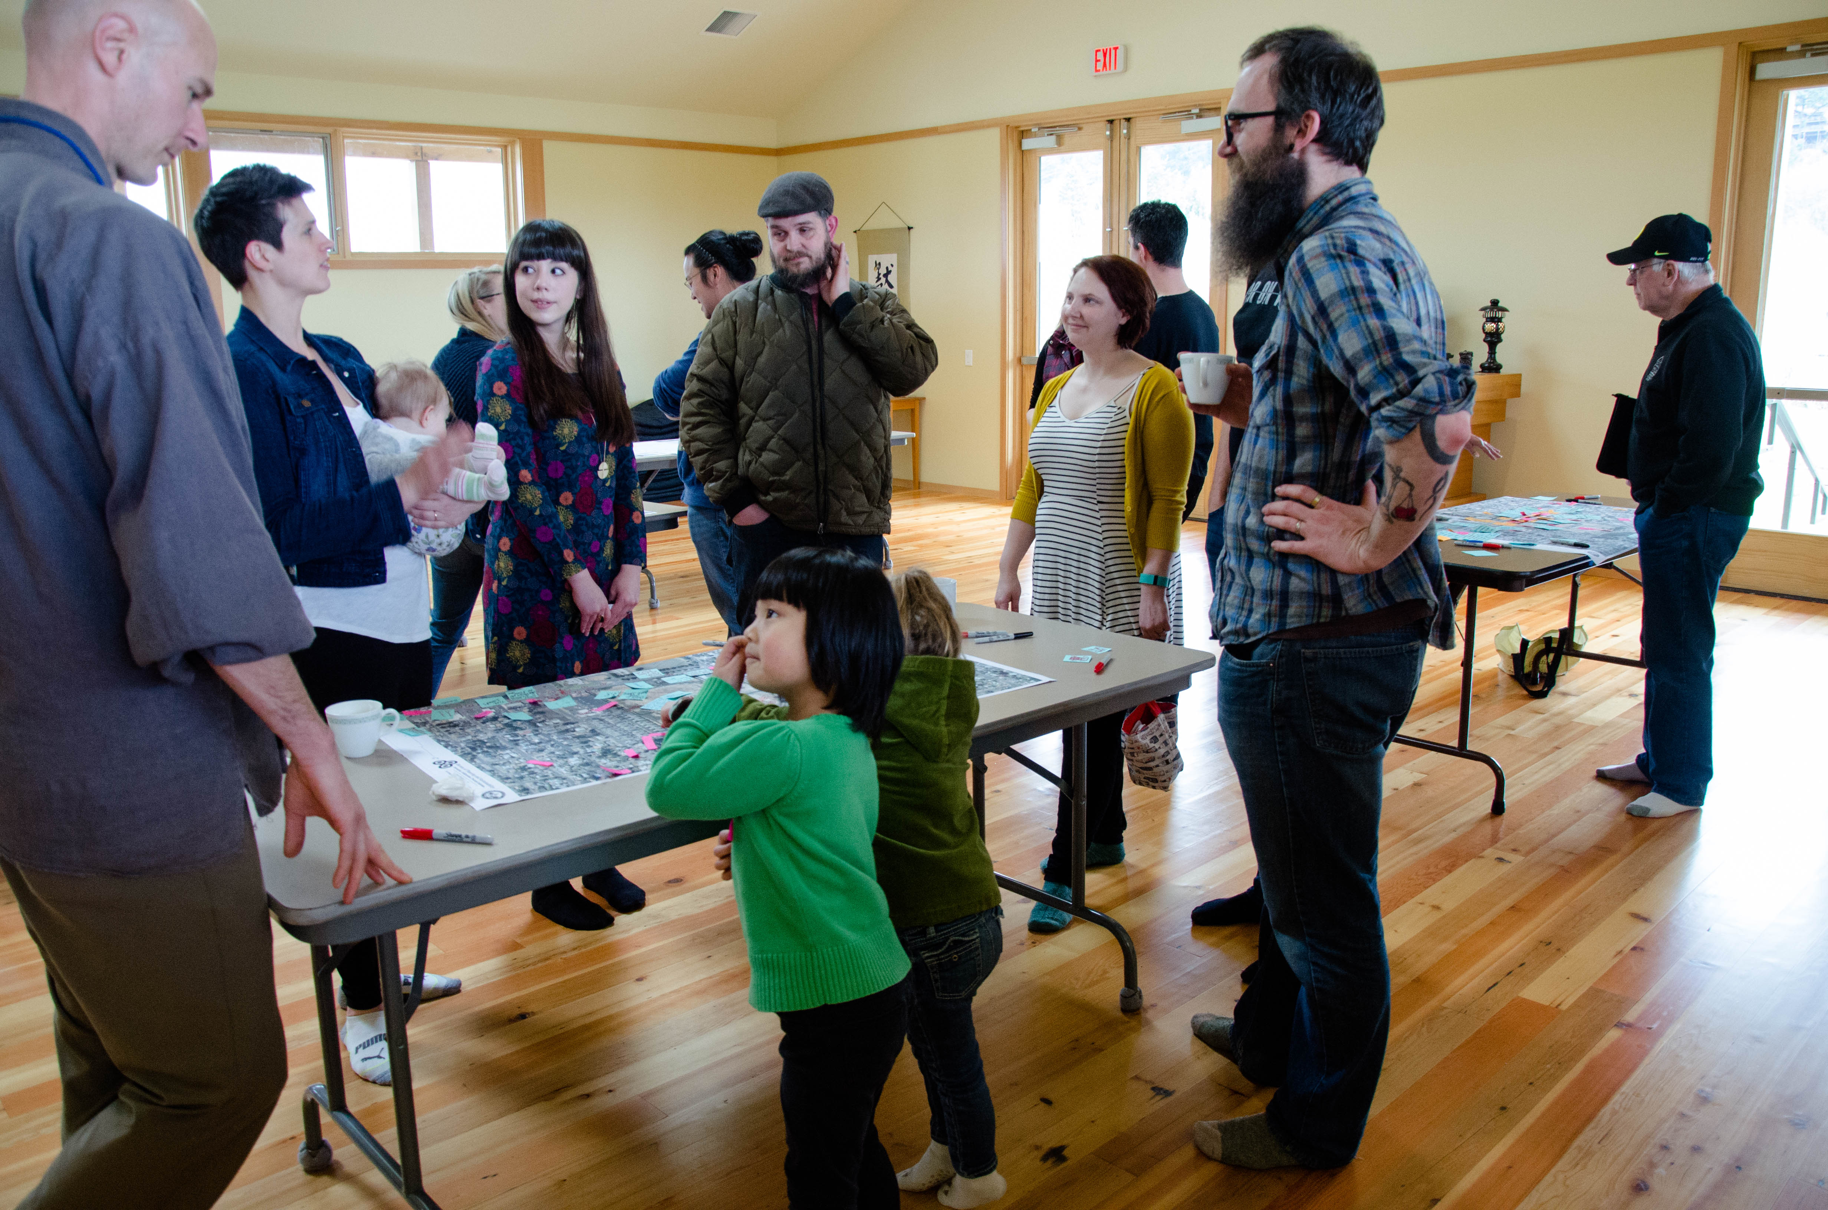
Milestones
2016-17:
Coordination with ODOT’s Community Advisory Committee
Property and business owner canvassing and broker interviews
Draft illustrations and initial prototypes
Evaluation of employment land
2018:
Shared study drafts with public and incorporated feedback
2019:
Map change proposal
PSC hearing/recommendation
Council hearing

Slide 4
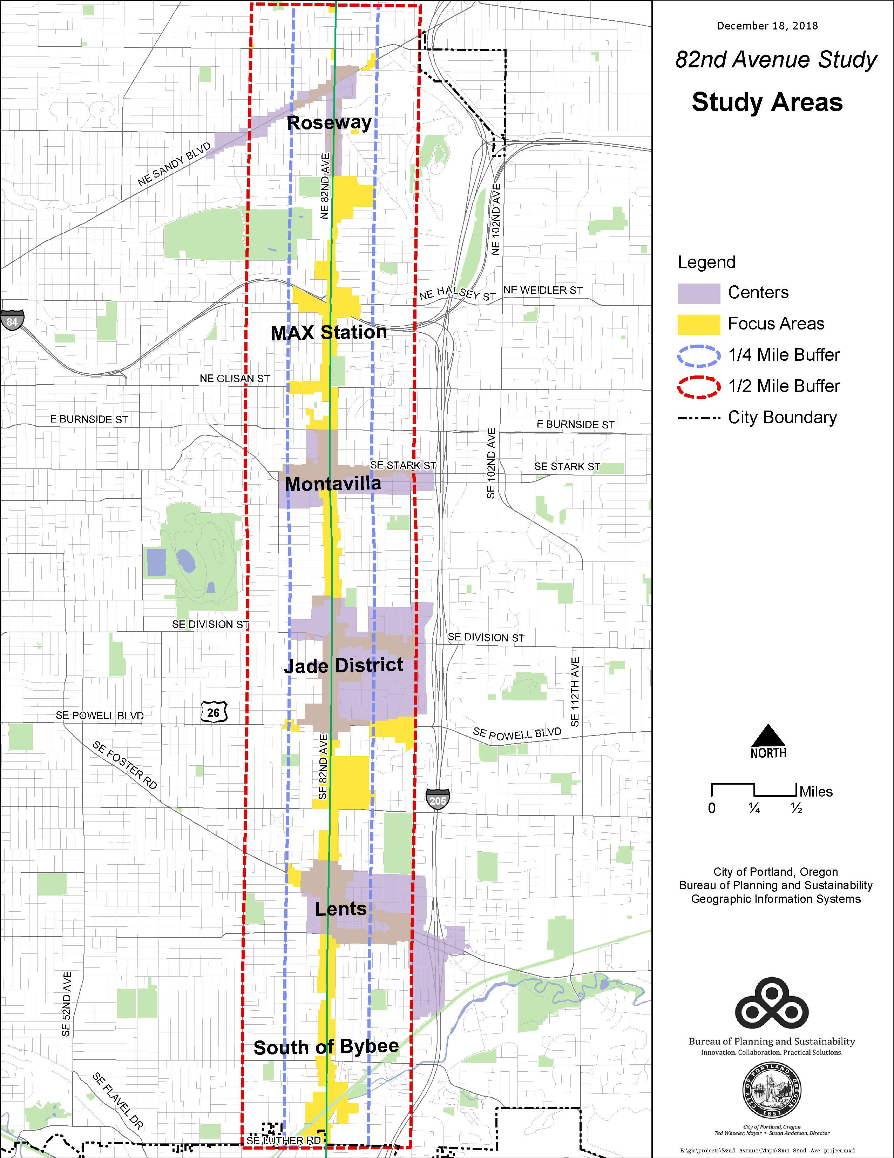
Study Areas
Notes:
The 2035 Comprehensive Plan designates 82nd Avenue as a “Civic Corridor.” One of the goals of this study was to update our understanding of 82nd Avenue as a “Civic Corridor” with the intent to improve 82nd Ave so this major corridor may become a vibrant urban place with key transportation connections.
Aims to better understand the barriers to development in this major eastside corridor from NE Killingsworth to the southern City Limits.
Considered six designated Centers and Focus Areas.

Slide 5
Goals of this Study
Update our understanding of 82nd Ave as a Civic Corridor
Identify strategic locations for public action or investment for businesses and property development on 82nd Ave
Address barriers to development while managing equity and social issues

Slide 6
Findings of this Study
Lack of available capital, funding and/or development experience
Market conditions
Development standards
Safety, connections, roadway, and public realm improvements
Homeless population increasing and services are limited
Notes:
Through the public engagement process, the project team heard about economic, physical and social issues that are affecting potential development, including, but in no particular order:

Slide 7
Near-Term Actions
BPS:
Refine employment zoning
Eliminate or modify split-zone sites
Conduct an economic, equity impact analysis specific to commercial displacement
PBOT:
82nd Avenue Plan

Slide 8
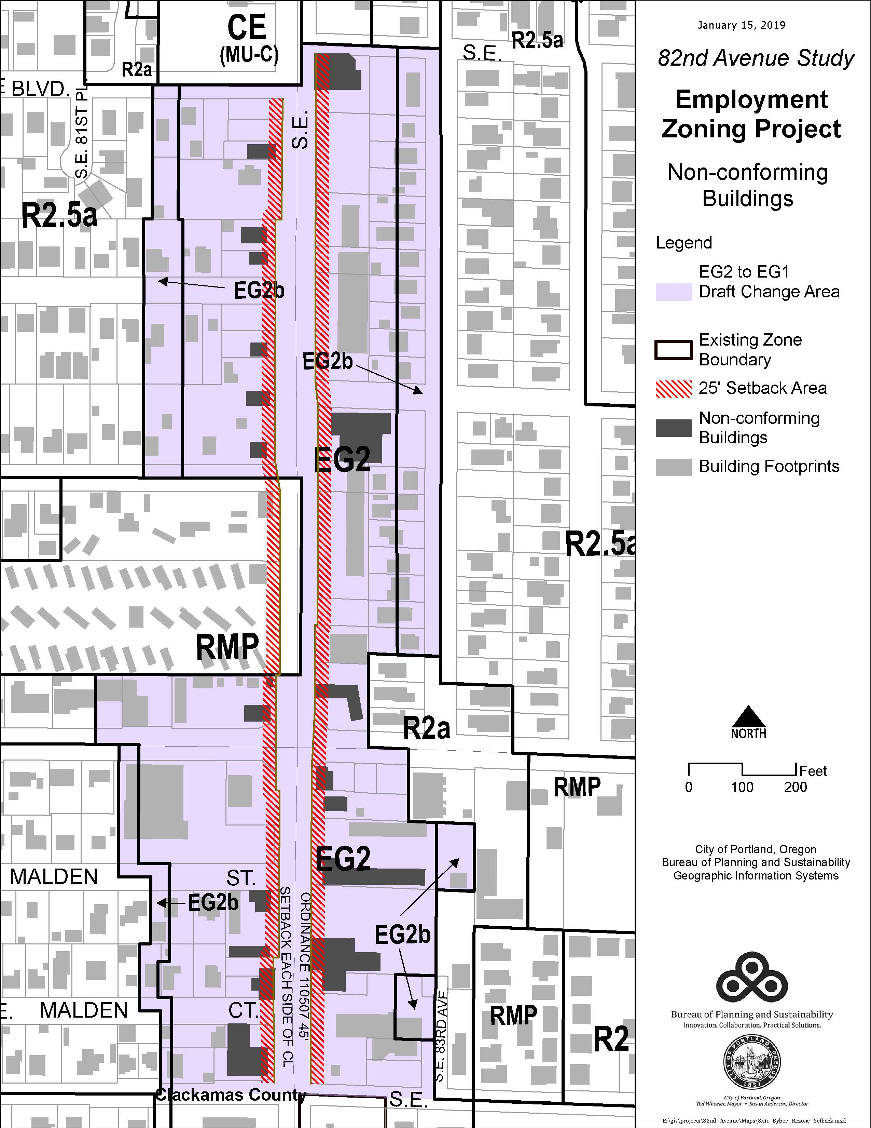
Employment Zoning Recommendation
Zone properties along SE 82nd Avenue from General Employment 2 (EG2) to General Employment 1 (EG1) from SE Bybee to SE Lambert
Notes:
The overall intent is to address barriers to development and for more efficient urban development of employment land along the corridor.

Slide 9
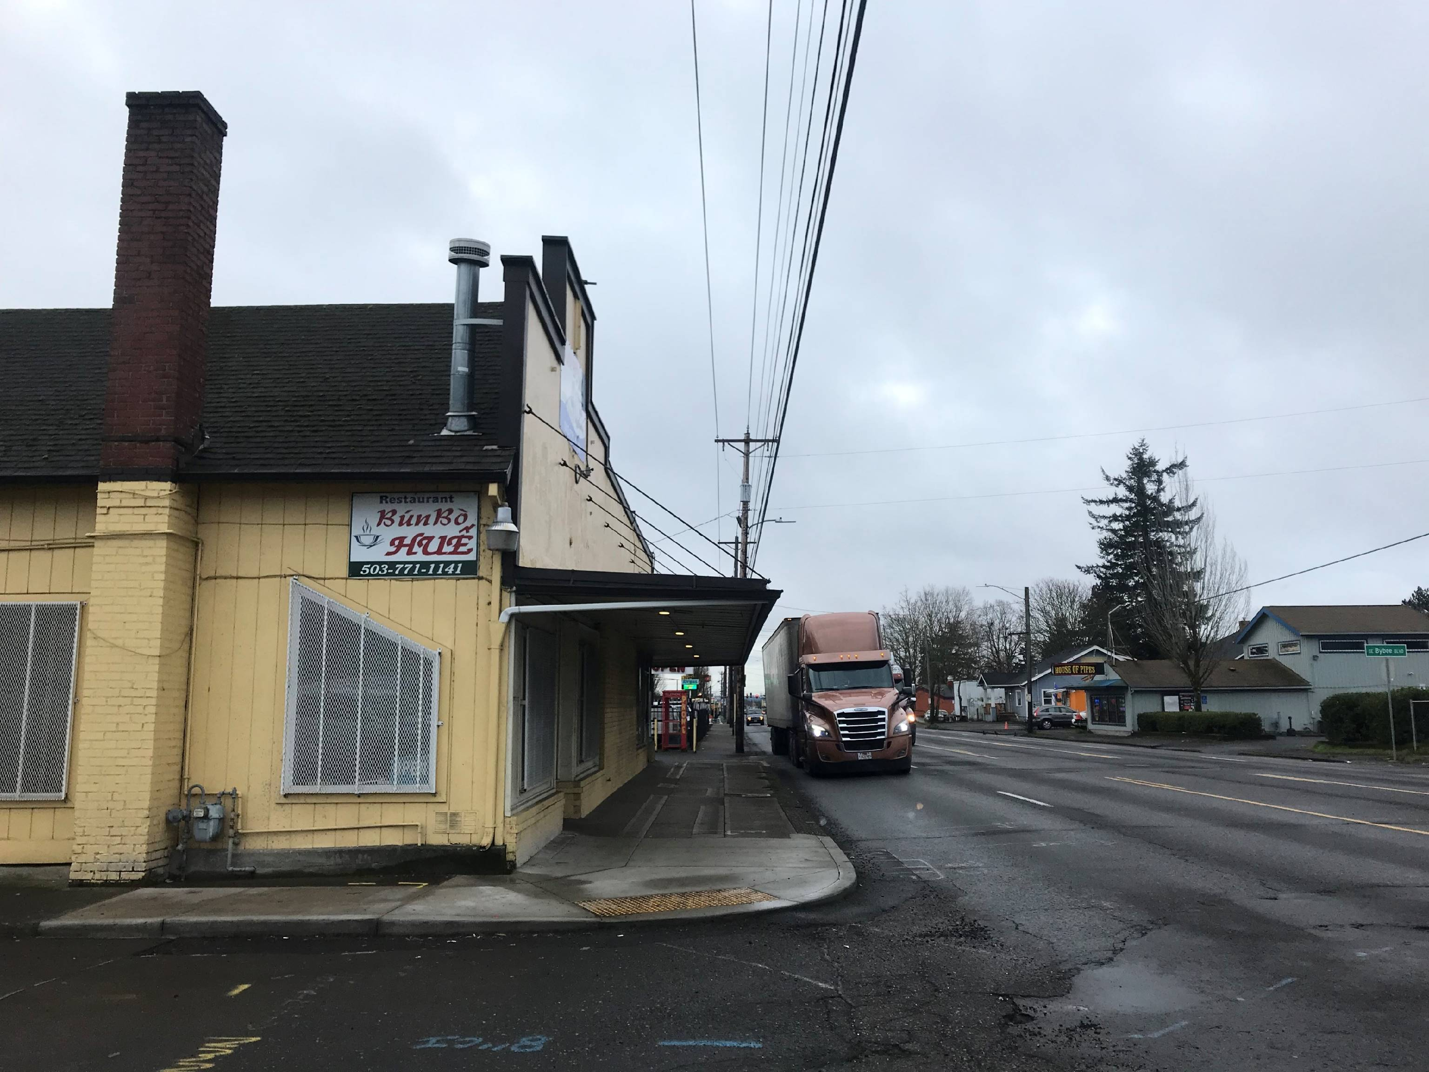
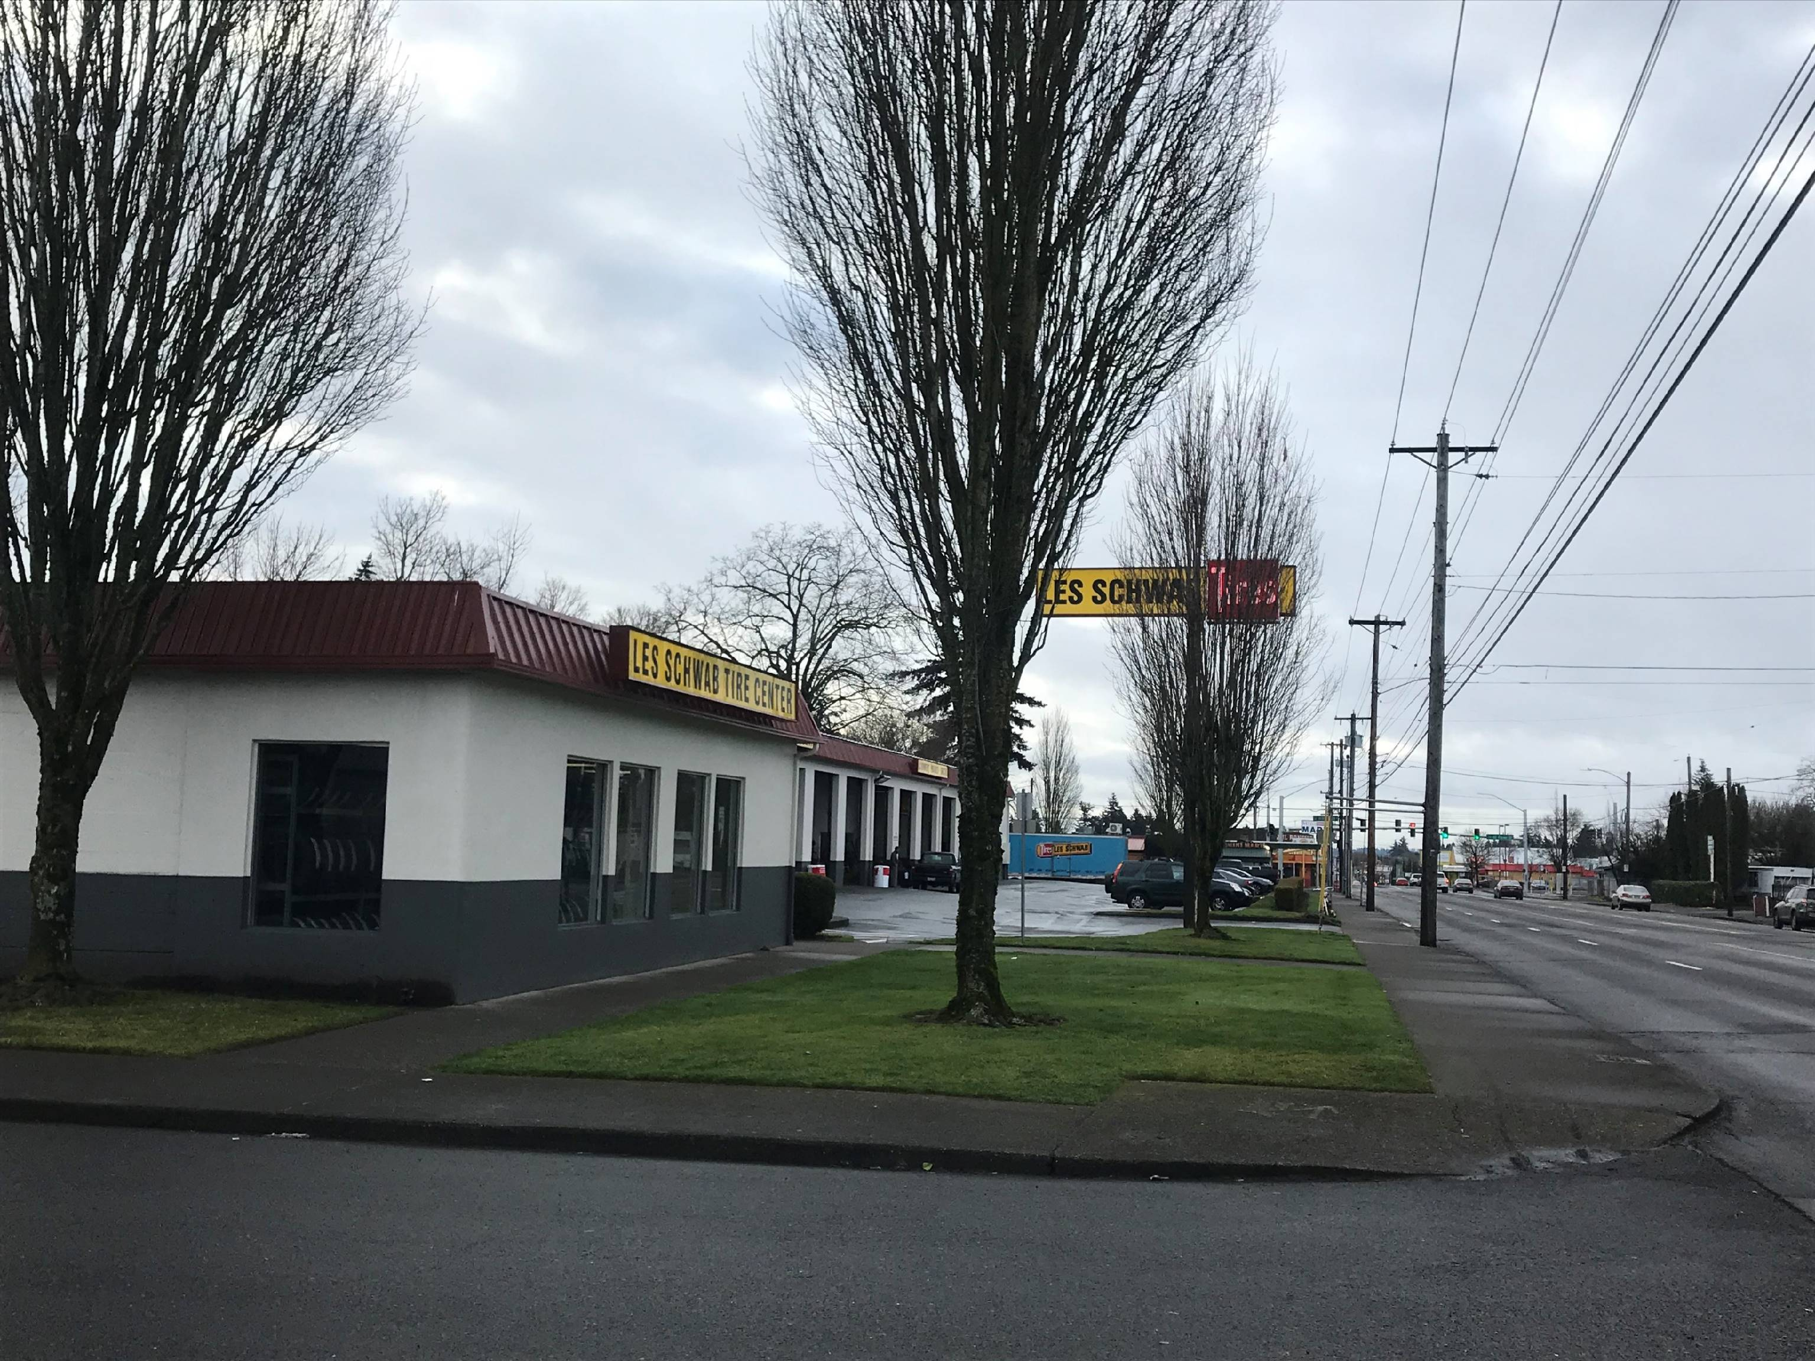
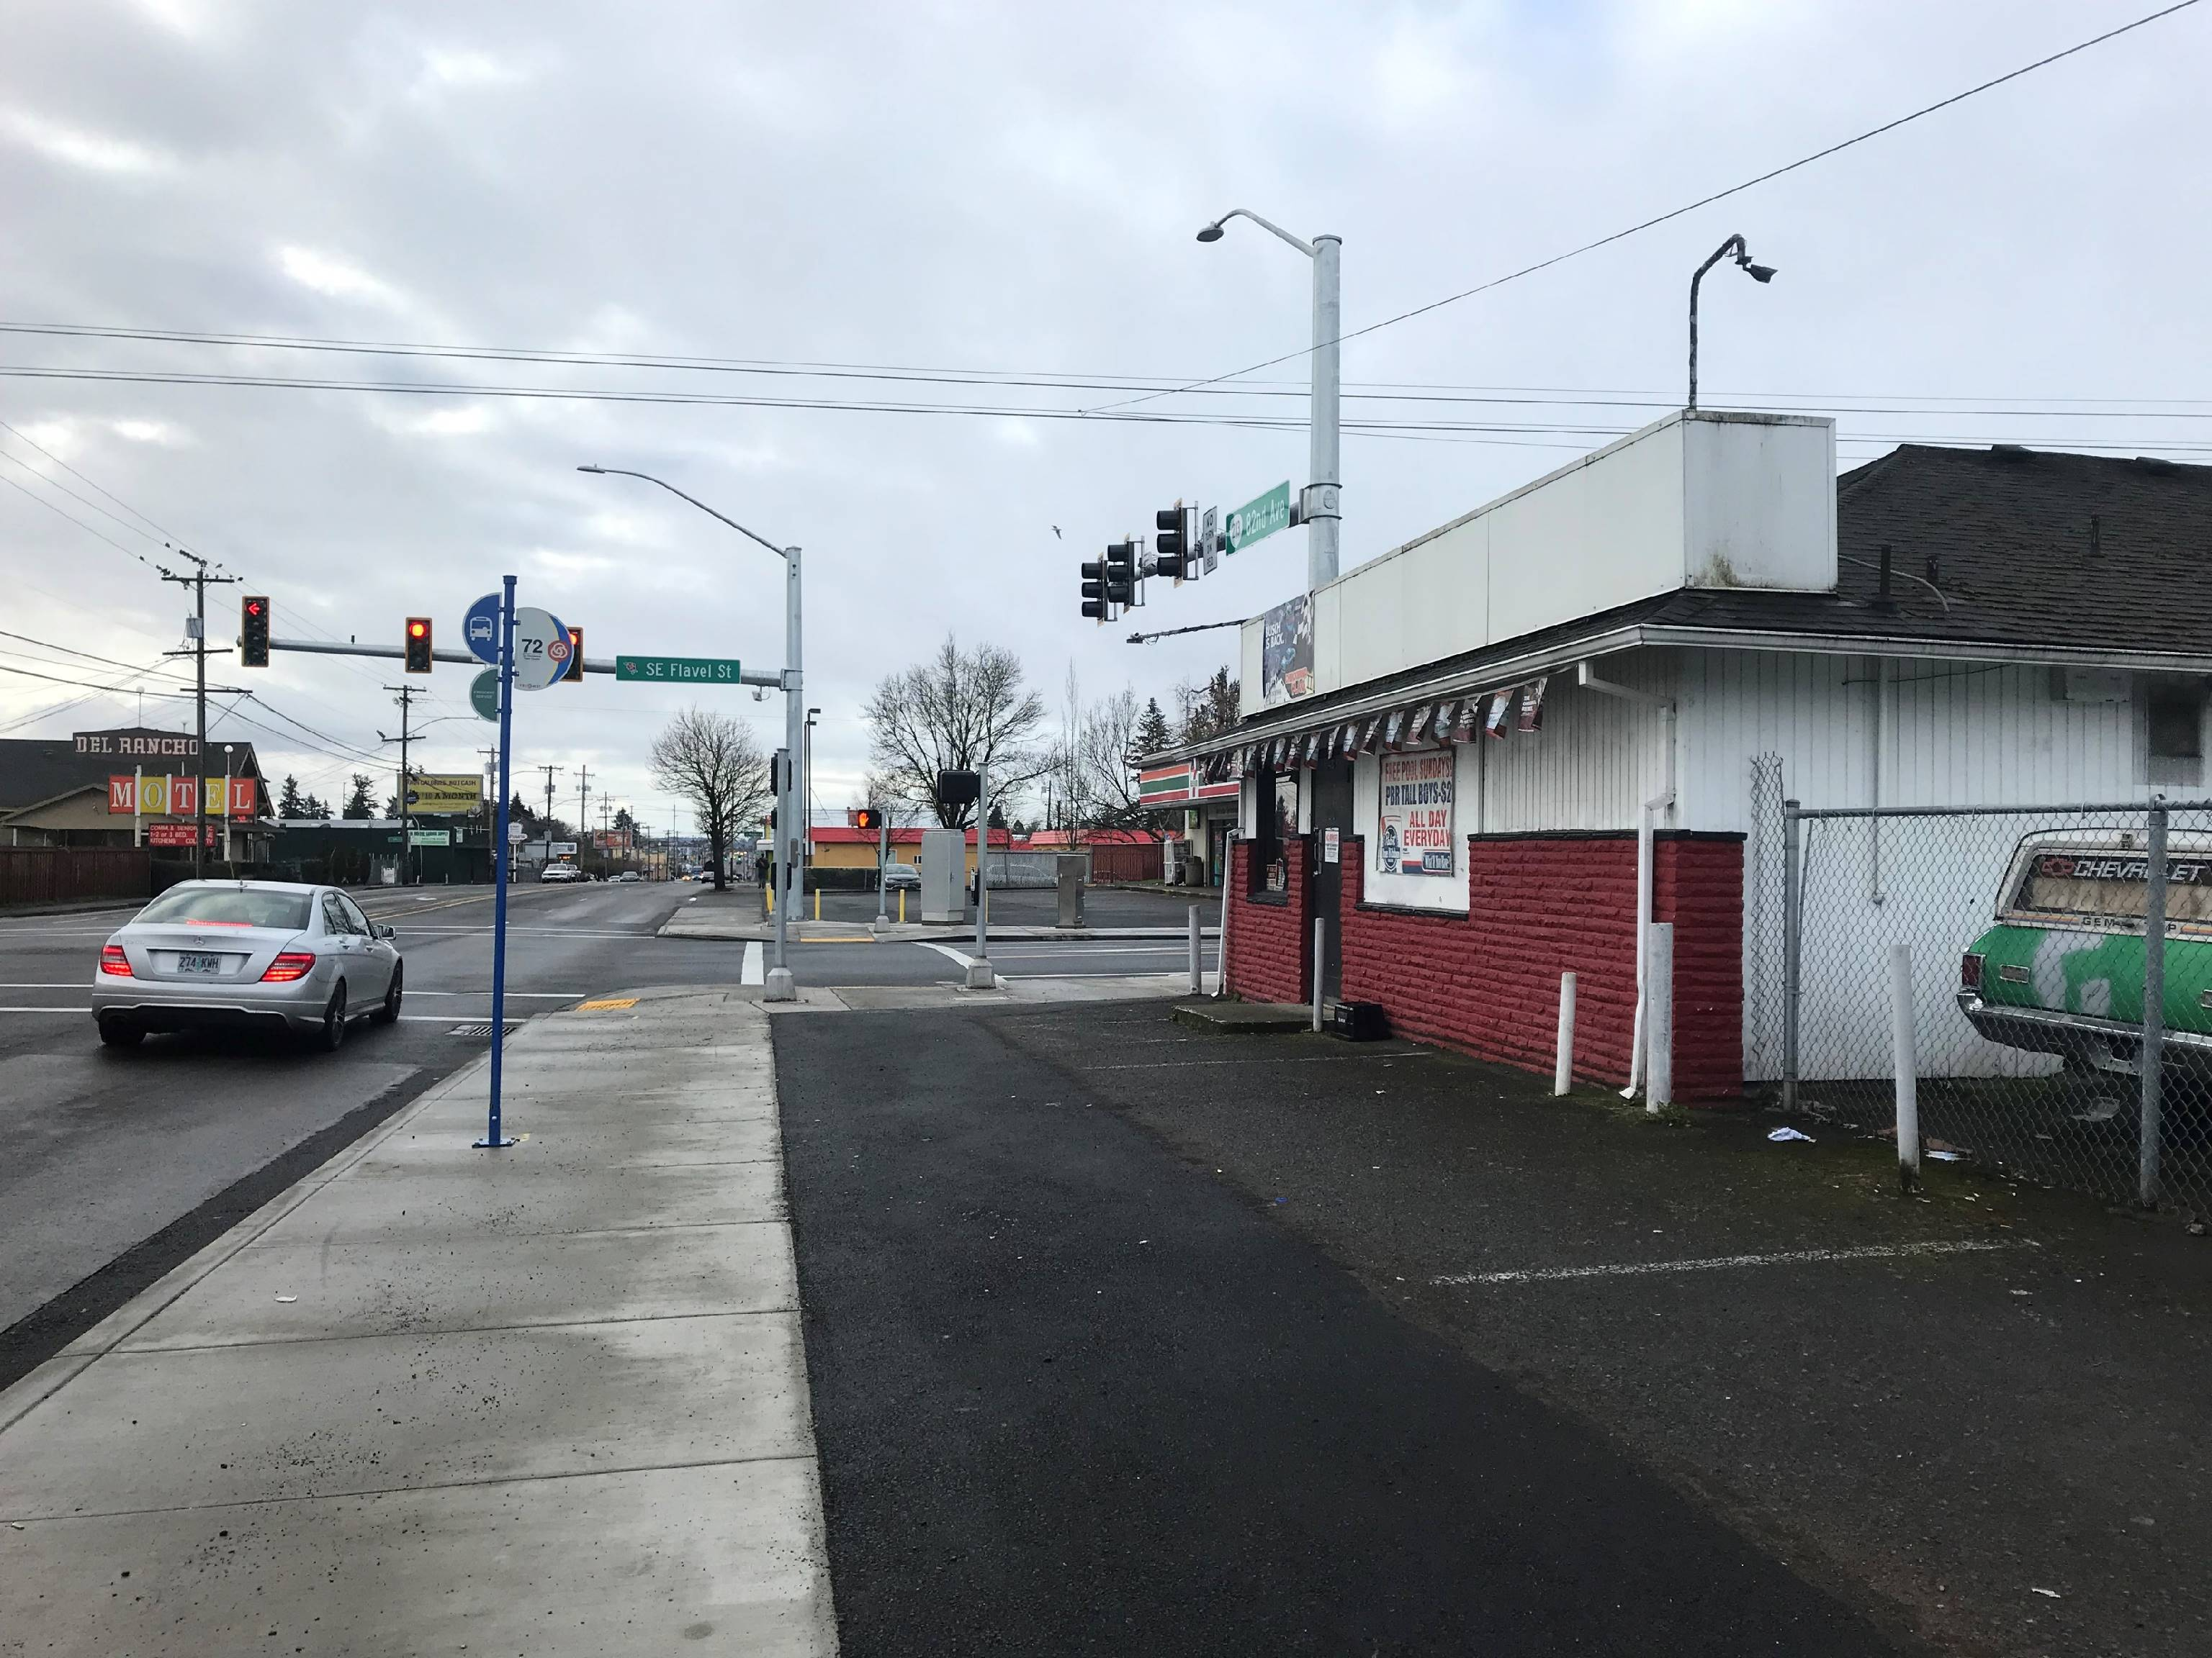
Employment Zoning Recommendation
Notes:
Why does this matter? The EG1 zone has a front setback of 10 feet, unlike the EG2 zone with a 25-foot front setback.
What is a setback? A “setback” is the distance from the curb to the front of the building.
There are 18 buildings within the 25-foot front setback, as required by the EG2 zone that are closer to the street than the zone allows. This zone change to EG1 will either bring the buildings into conformance or closer to conformance with the required 10-foot front setback.
Also, the EG1 zone is a more appropriate zone because several small-sized properties are less than 5,000 square feet. This creates a “mismatch” (or a nonconforming building) with the existing zone and its larger setback regulations.
What is a nonconforming building? This is typically one that complied with zoning and development regulations at the time it was built but – because of subsequent changes to the zoning and/or development regulations – no longer fully complies with those regulations.
The EG1 zone prohibits new exterior displays, exterior storage and exterior work activities, which minimizes public health risks related to offsite impacts (e.g., noise, vibration, odor, glare) to the adjacent residentially zoned areas.

Slide 10
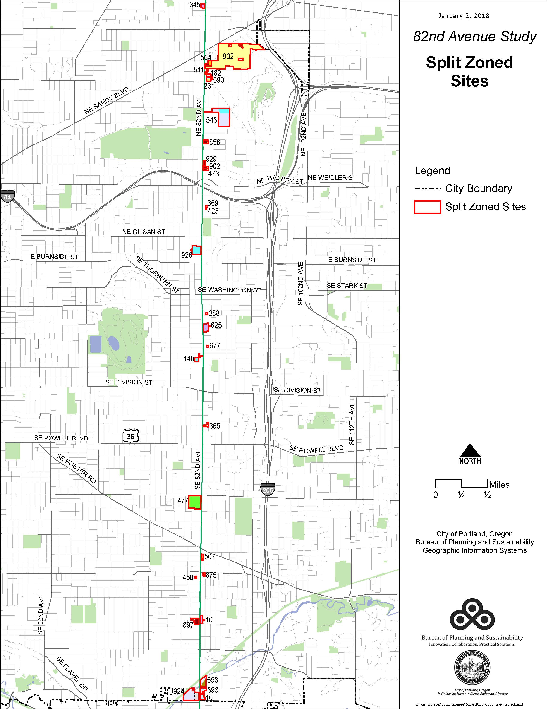
Eliminate or Modify Split-Zoned Sites
Remove barriers to redevelopment of the property
Eliminates or modifies 16 split-zoned situations
Notes:
Explain split zone site (e.g., commercial/residential zoned sites)
Some sites will remain split-zoned due to specific land use history, lack of infrastructure and/or natural resource conditions that warrant a split-zoned site.

Slide 11
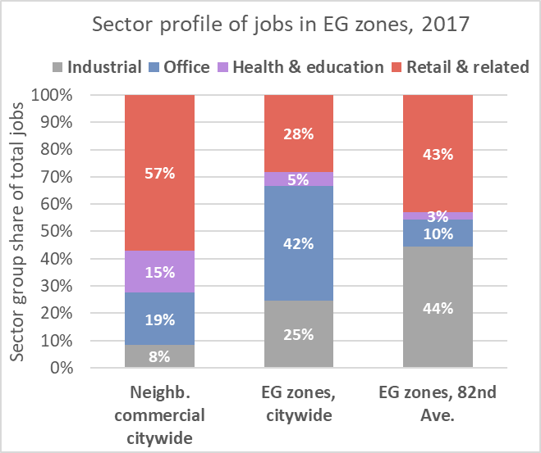
Economic Analysis
Notes:
We conducted an economic analysis on job growth and development trends in the EG zones, comparing city wide to 82nd Ave.
The economic analysis found:
The EG zones on 82 Ave have a higher mix of retail and industrial than the rest of the city. 43% Retail related 44% industrial. City wide EG zones 28% retail, 25% industrial
Development has occurred on 34% of the EG-zoned acreage citywide, 2007-2017
Policy support:
East Portland job growth
Address racial income disparities
Adequate industrial/employment land supply

Slide 12
Equity Impact Analysis
Demographics in study area
36% people of color, compared to 29% citywide
60% owner households, compared to 53% citywide
49% low income households, compared to 44% citywide
Business impact of rezone area
17 (42%) have been in location for over 15 years
15 businesses have been in location less than five years
Commercial/employment property ownership
50% of the parcels have been in the same ownership for 30-plus years

Slide 13
Council Testimony Requests
Property owner request to remove the Buffer “b” overlay on 50% of the eastern portion of the property at 8123 SE Henderson St to allow a non-residential driveway to a proposed auto-mechanic shop. BPS staff supports.
Property owner request for a map change from General Employment 2 (EG2) to Residential 2,500 (R2.5a) for the property at 8111-8115 SE Malden Ct for a recently constructed duplex. The “b” overlay on this site would then need to shift to the EG2-zoned property to the east at 8121 SE Malden Ct. BPS staff supports.
Property owner request for a map change from Residential 2,000 (R2a) to General Employment 1 (EG1b) for 7447-7449 SE 83rd Ave, 7433-7435 SE 83rd Ave and 7415-7417 SE 83rd Ave. BPS staff supports.
Notes:
Written testimony to elevate going into the Council session next week.

Slide 14
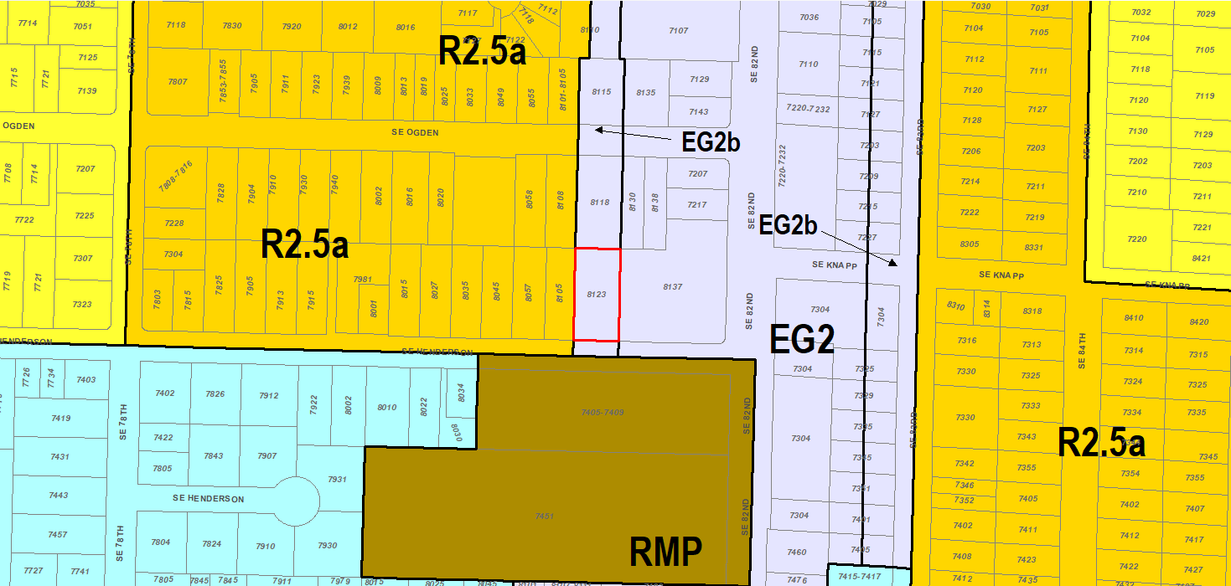
Council Testimony Request #1: 8123 SE Henderson St

Slide 15
Council Testimony Request #2:
8111-8115 SE Malden Ct, 8121 SE Malden Ct

Slide 16
Council Testimony Request #3:
NW corner of SE 83rd Ave and SE Flavel

Slide 17
Recommended Council Action:
Adopt the 82nd Avenue Study map changes
Accept the 82nd Avenue Study: Understanding Barriers to Development as legislative history
(Ordinance)

Slide 18
Portland Bureau of Transportation (PBOT) Near-Term Actions

Slide 19
Thank you

Slide 20
Motion
In prep for Second Reading on May 29th, direct staff to:
Per Council testimony, revise the Comprehensive Plan Map as depicted in Exhibit C and the Official Zoning Map as depicted in Exhibit D
Revise the 82nd Avenue Study (BPS) to address errata in the Executive Summary

