Slide 1
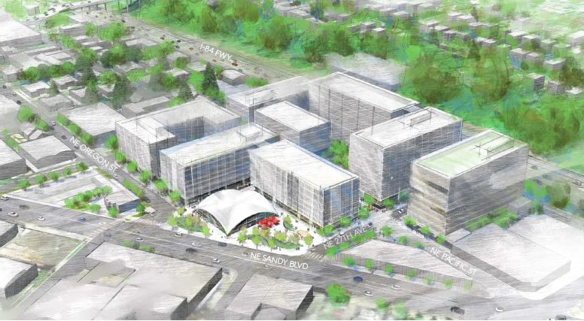
City of Portland
Design Commission
Design Advice Request
EA 18-281575 DA
2505 NE Pacific Street
May 23, 2019
Staff Presentation

Slide 2
Staff Introduction
Applicant Presentation
Staff Discussion Topics
Public Comments
Commission Discussion

Slide 3
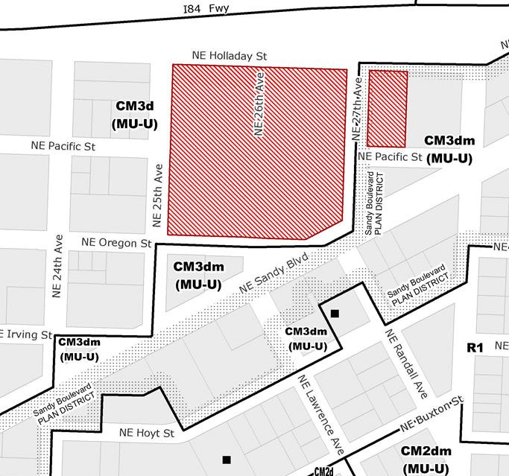
Location:
Sandy Boulevard Plan District
Base Zone:
CM3d – Commercial Mixed-Use 3
Approval Criteria:
Community Design Guidelines
Height:
120’ max height earned through Planned Development
87’ proposed
Floor Area Ratio:
5:1 earned through Planned Development
2.64:1 proposed
Site Challenges:
Woonerf Phasing
R-O-W improvements
Zoning

Slide 4
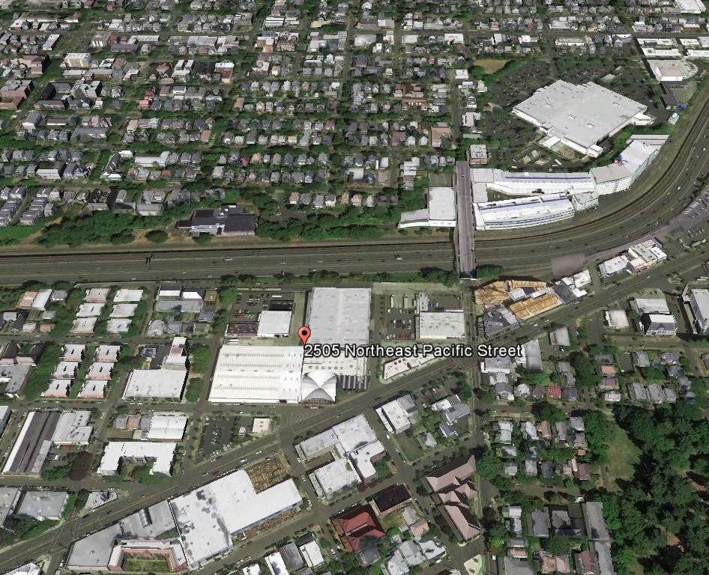
I-84
NE 28th Avenue
Site
Sandy Boulevard

Slide 5
View of Pavilion from Sandy Boulevard

Slide 6
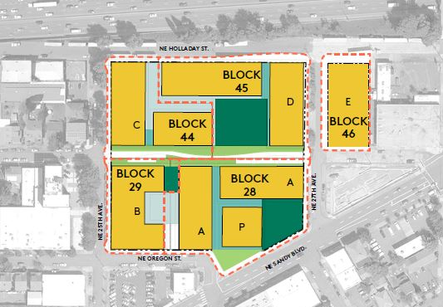
NE Pacific Woonerf
Sandy Blvd. Plaza
Renovation of Pavilion
Building A – 8 stories; 80 beds Inclusionary Housing; 190-210 below grade parking spaces
Phase One Scope

Slide 7
Staff Introduction
Applicant Presentation
Staff Discussion Topics
Public Comments
Commission Discussion

Slide 8
Staff Introduction
Applicant Presentation
Staff Discussion Topics
Public Comments
Commission Discussion

Slide 9
Context
Building Massing / Architectural Expression
Public Realm
Ground Floor Plans – Residential & Mews
Plaza Design
Woonerf Design
5. Loading Space Locations
Quality & Permanence
6. Materials & Details
Modifications & Adjustments

Slide 10
Context:
Building Massing/Architectural Expression
150’-200’ long buildings
Degree of differentiation needed

Slide 11
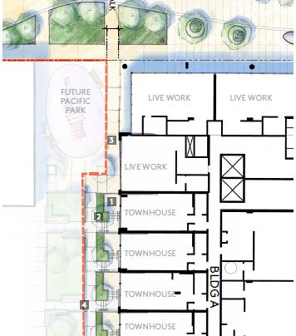
Public Realm:
Ground Floor - Residential
Entry sequence, floor plan, window sill height, ceiling height

Slide 12
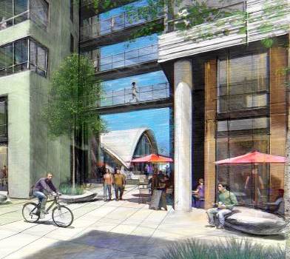
Public Realm:
Ground Floor - Mews
Path width
Height of bridge connector
Adjacent ground floor uses

Slide 13
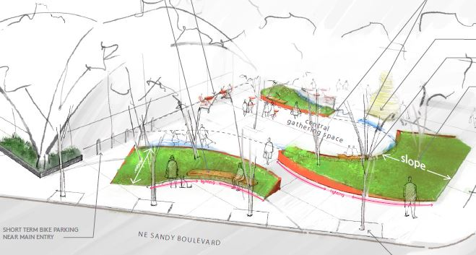
Public Realm:
Plaza Design
Dimensions of outdoor rooms
Height of grassy slopes
Adjacent ground floor uses

Slide 14
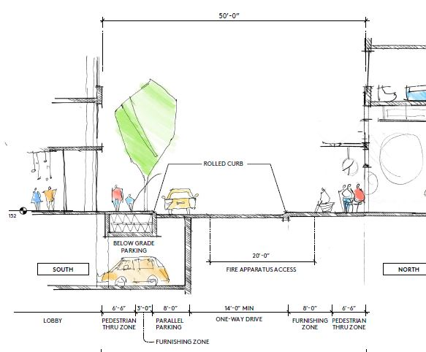
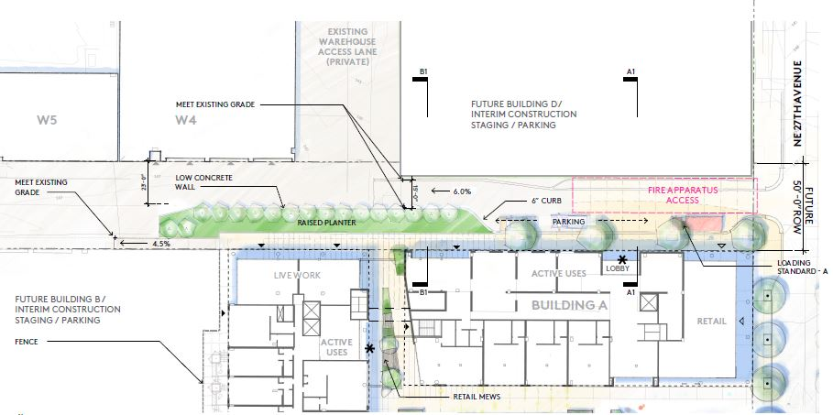
Public Realm:
Woonerf Design
Design & Phasing
Movement & Functionality
Adjacent ground floor uses

Slide 15
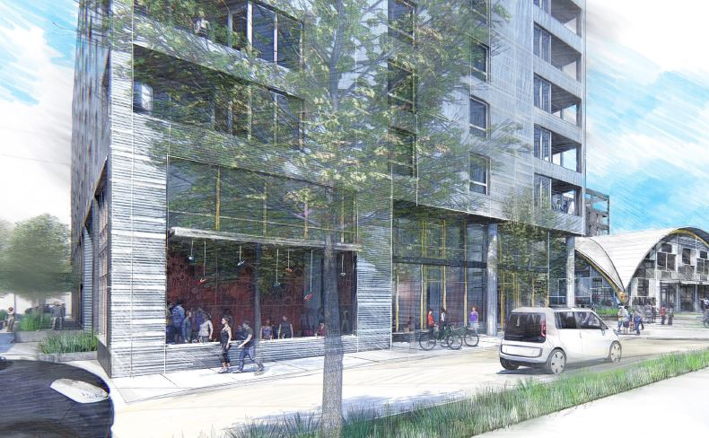
Public Realm:
Loading Space Locations
PBOT does not support loading in woonerf.
Location of Type B space may block windows and visibility.

Slide 16
Quality & Permanence:
Materials & Details
Metal cladding
Integration of vents
Canopies

Slide 17
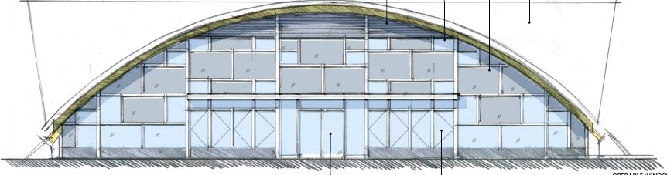
Modifications & Adjustments:
Transit Street Main Entrance
The existing pavilion entrance is more than 25’ from the transit street.

Slide 18
Modifications & Adjustments:
On-Site Loading
Request to Adjust the on-site loading spaces from 2 standard B spaces to 1 standard B.
Loading space in the woonerf is not ‘on site’.

Slide 19
Modifications & Adjustments:
Loading Space Landscaping
Request to Modify the 5’ required landscaping around the loading space. Proposal would include no landscaping.

Slide 20
Modifications & Adjustments:
Bike Rack Spacing
Reduce spacing between wall-mounted long-term bike racks.

Slide 21
Staff Introduction
Applicant Presentation
Staff Discussion Topics
Public Comments
Commission Discussion

Slide 22
Staff Introduction
Applicant Presentation
Staff Discussion Topics
Public Comments
Commission Discussion

