Slide 1
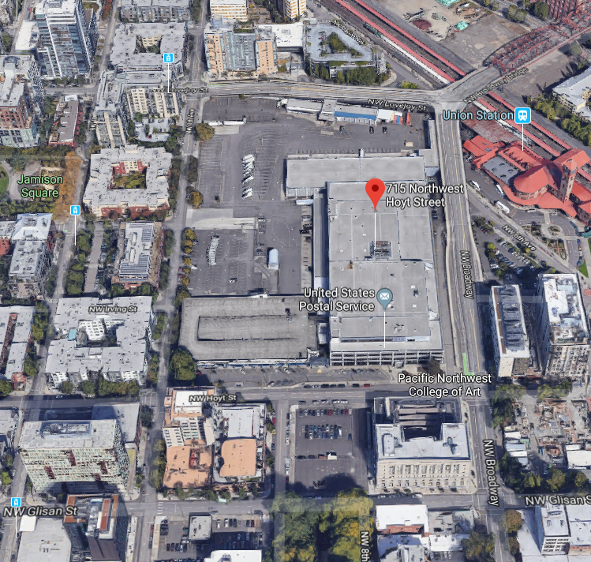
City of Portland
Design Commission
Design Advice Request
EA 19-147114 DA
Broadway Corridor Master Plan
June 6, 2019
Staff Presentation

Slide 2
Staff Introduction
Applicant Presentation
Staff Discussion Topics
Public Comments
Commission Discussion

Slide 4
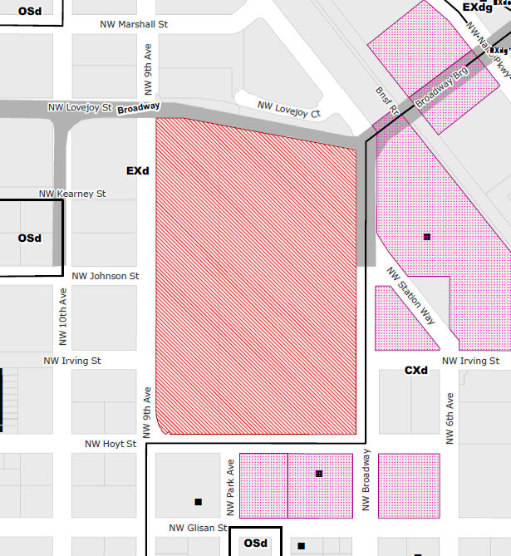
Location:
Central City Plan District
Pearl Subdistrict
Base Zone:
EXd, Central Employment, Design Overlay
Approval Criteria:
33.510.255.H (Central City Master Plan Approval Criteria)
Height:
400’ max. (on N ½)
250’ max. (on S ½)
Floor Area Ratio:
2:1 min.
7:1 max. base, 3:1 bonus with inclusionary bonuses, unlimited FAR transfers
Site Challenges:
Elevation change
Bridge frontages
Green Loop accommodation
Zoning

Slide 5
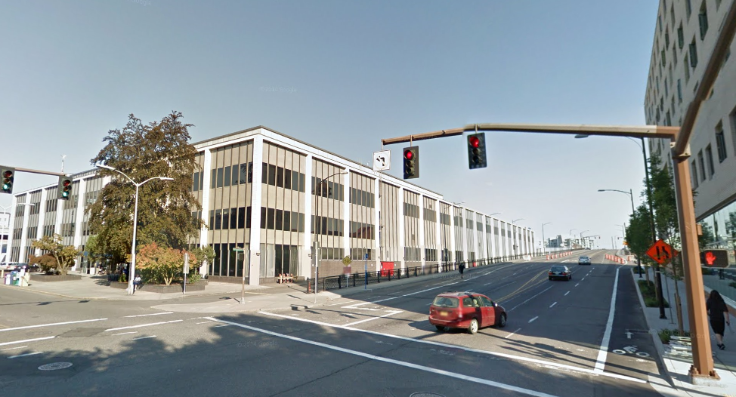
Looking southwest on NW Hoyt

Slide 6
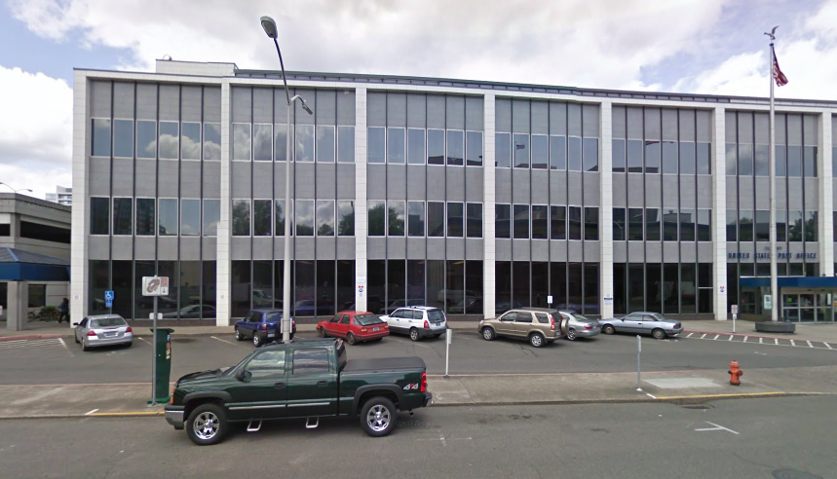
Looking south along NW 8th alignment

Slide 7
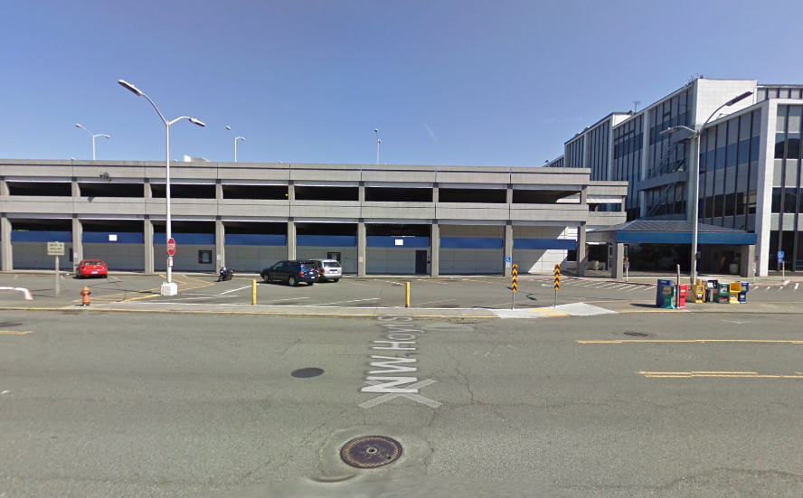
Looking southwest @ Park & Hoyt

Slide 8
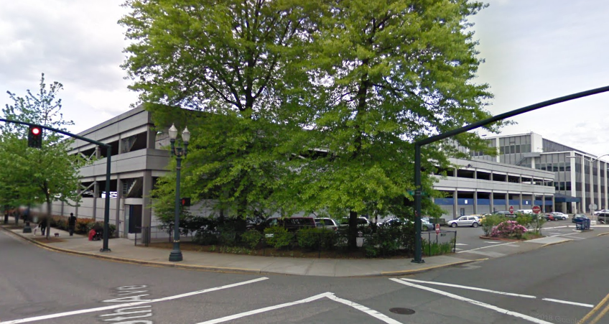
Looking south along NW 9th

Slide 9
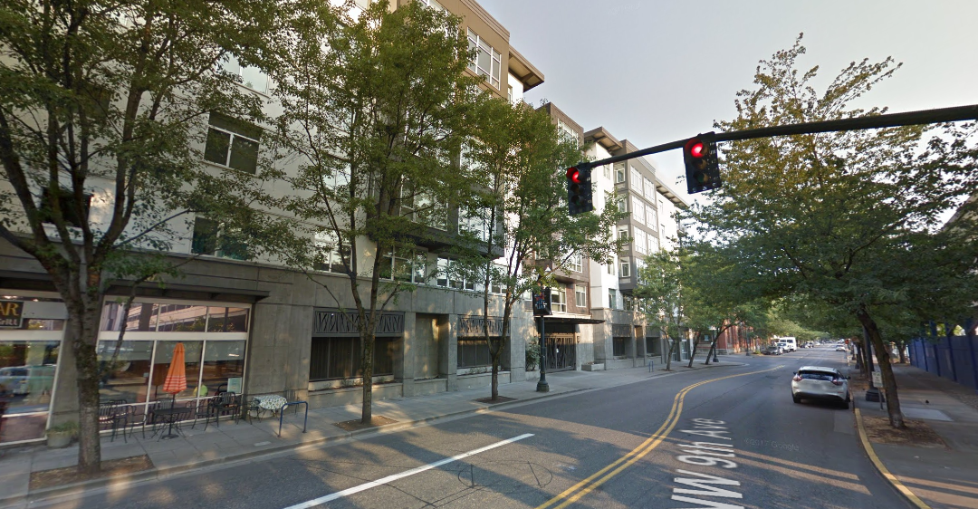
Looking north along NW 9th

Slide 10
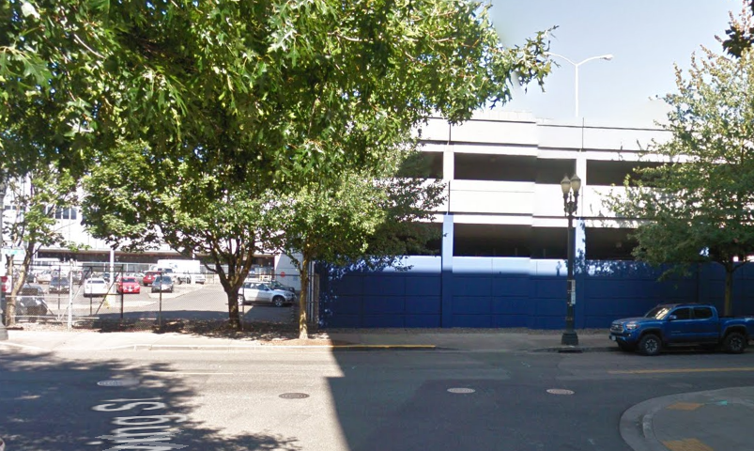
Looking northwest @ 9th & Irving

Slide 11
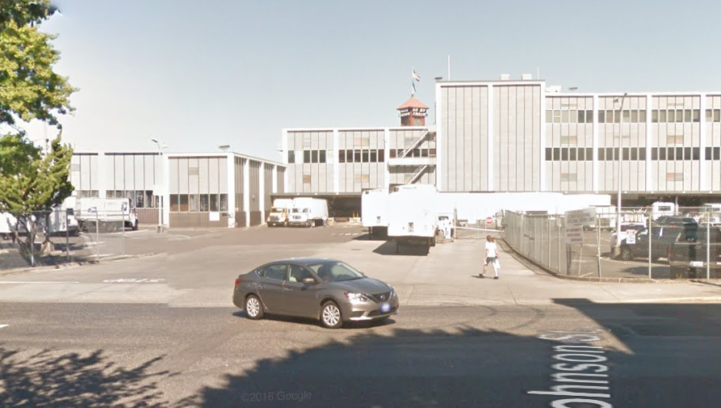
Looking northwest @ 9th & Johnson

Slide 12
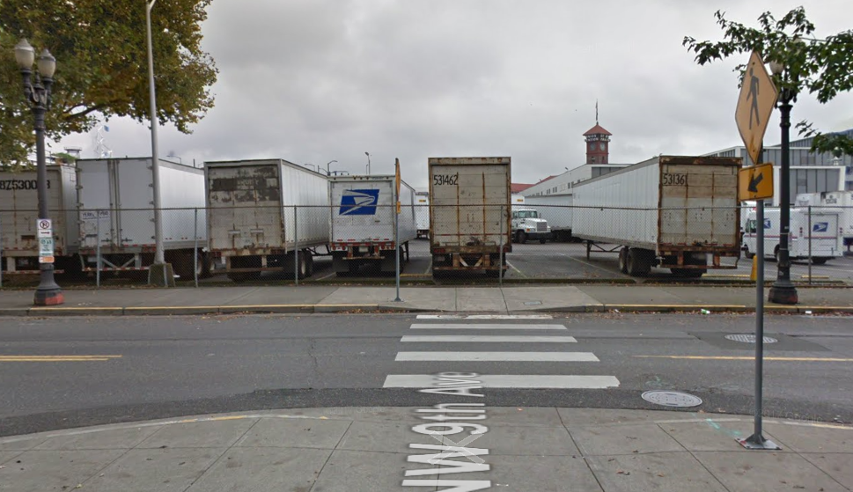
Looking north @ 9th & Kearney

Slide 13
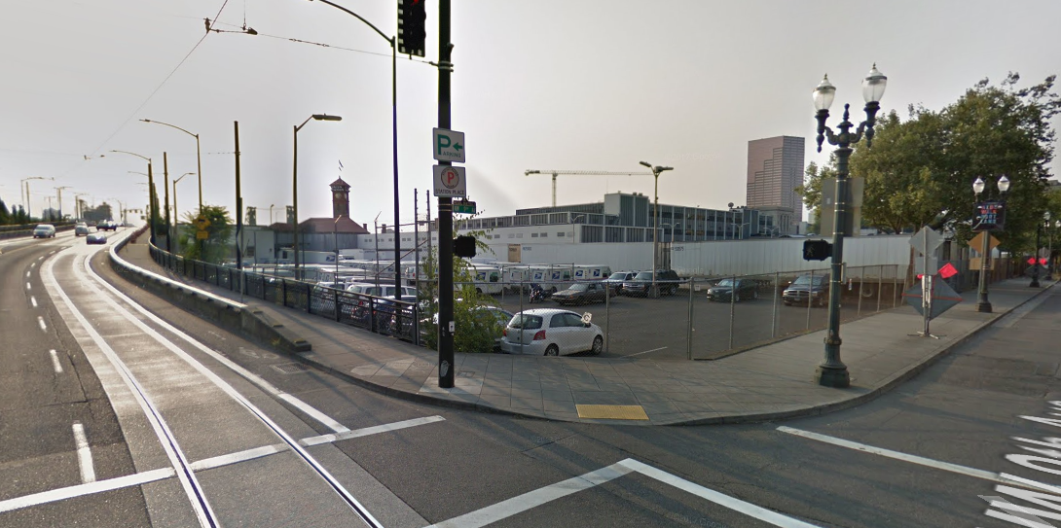
Looking northwest @ 9th & Lovejoy

Slide 14
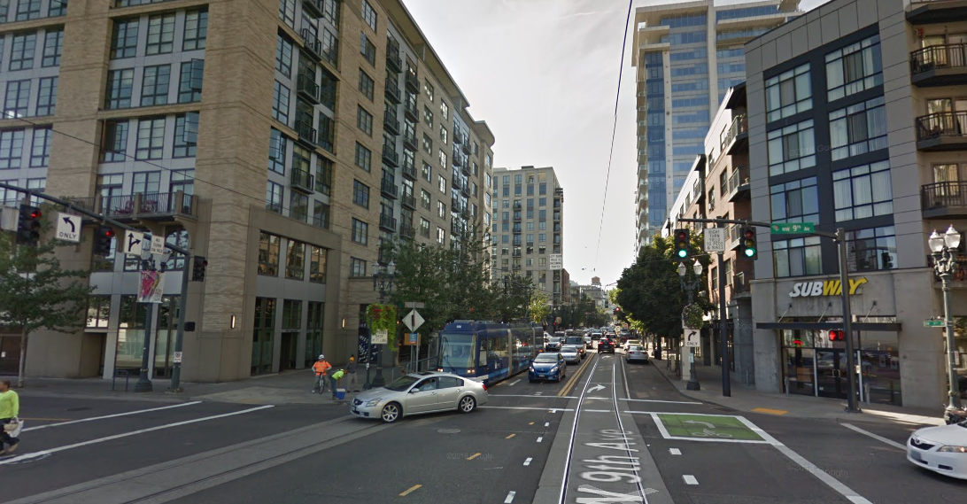
Looking east on Lovejoy

Slide 15
Looking southwest @ Broadway & Lovejoy

Slide 16
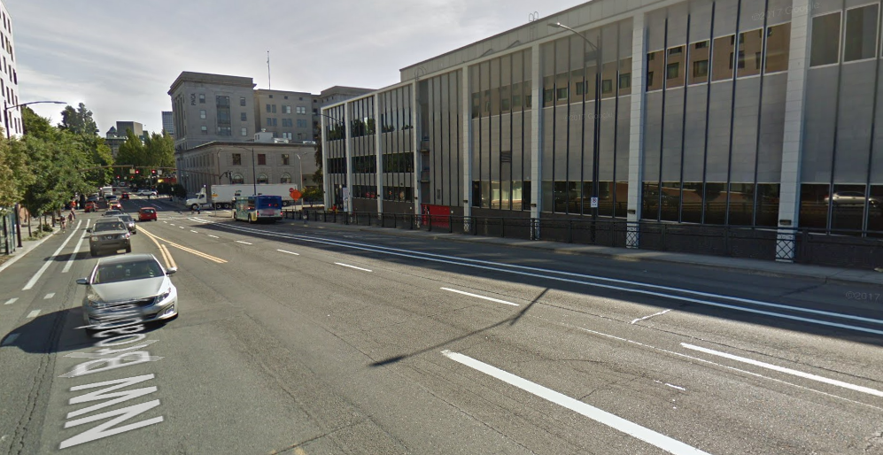
Looking east @ Broadway & Irving

Slide 17
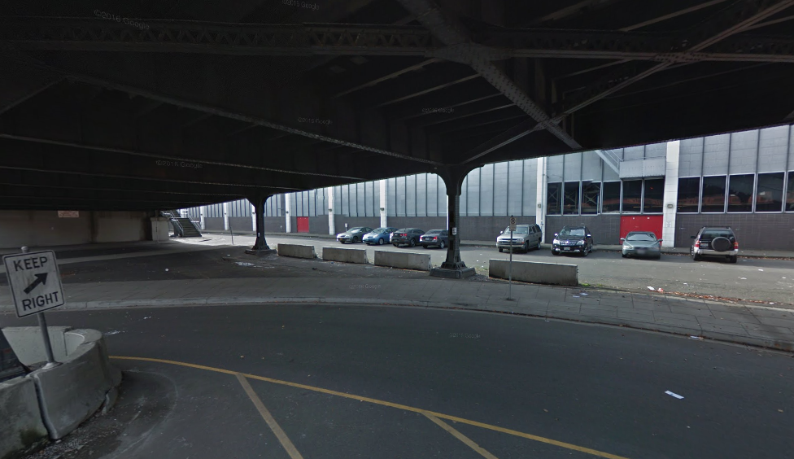
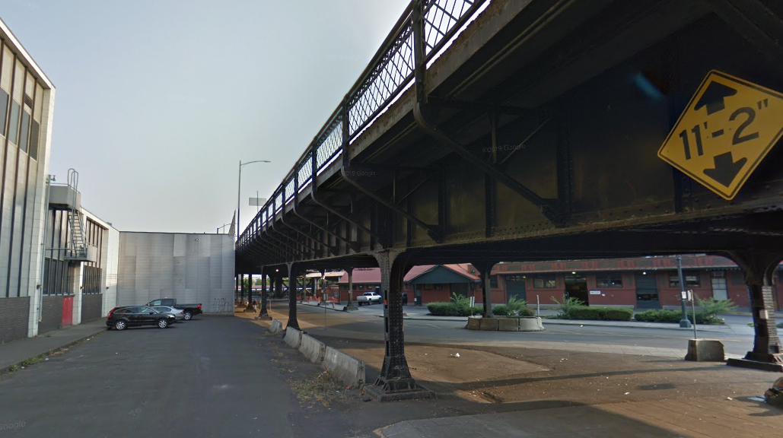
Looking northeast @ Johnson under Broadway

Slide 18
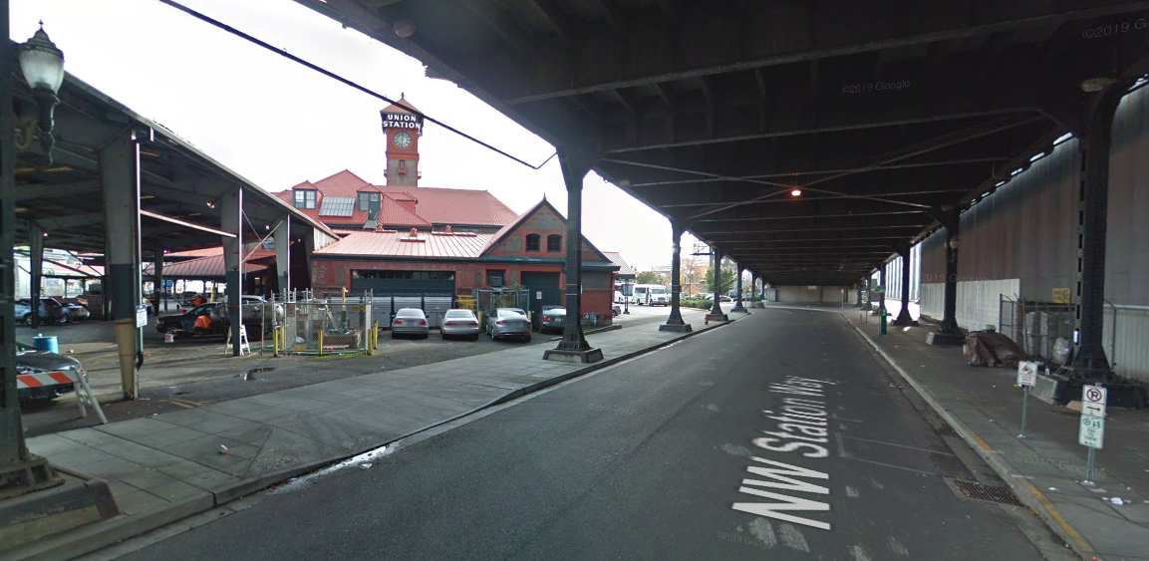
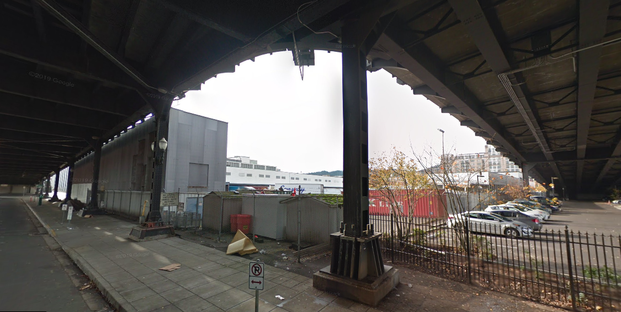
Looking south under Broadway

Slide 19
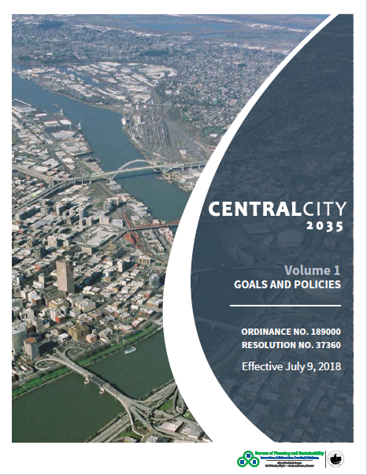
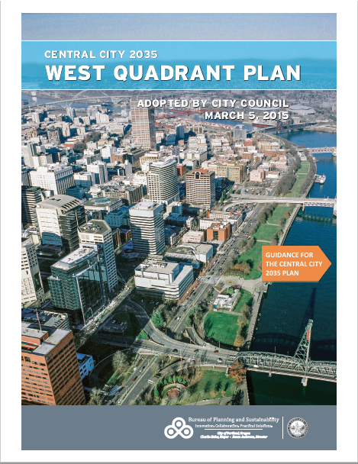
Long Range Planning Efforts

Slide 20
Staff Introduction
Applicant Presentation
Staff Discussion Topics
Public Comments
Commission Discussion

Slide 21
Staff Introduction
Applicant Presentation
Staff Discussion Topics
Public Comments
Commission Discussion

Slide 22
Context:
Response to Built Context
Public Realm
1. Site Organization
Open Space
Ground Floor Active Uses
Vehicular Access
2. Circulation System
Vehicles
Bicycles
Pedestrians

Slide 23
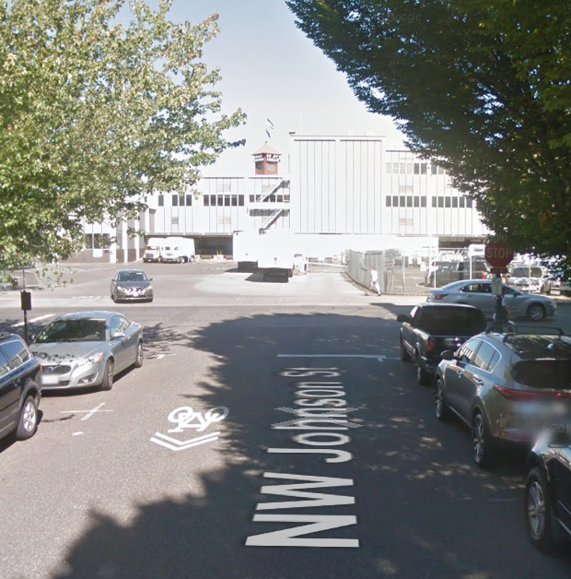
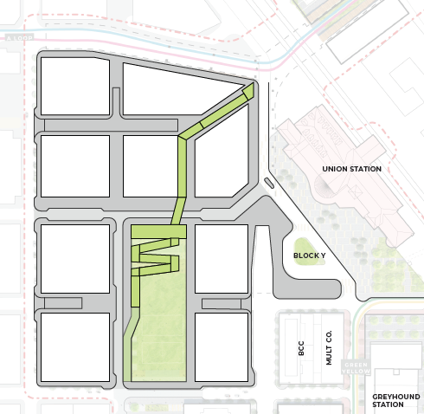
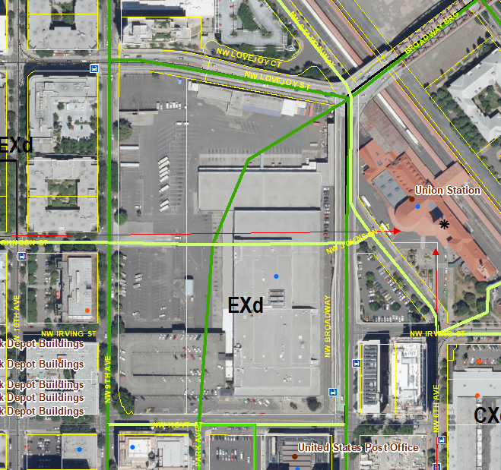
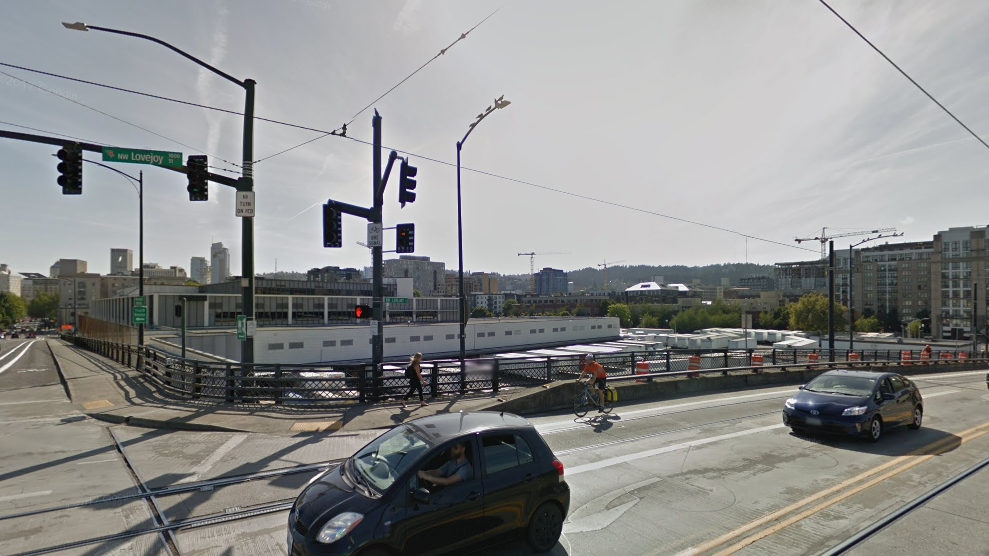
Context:
Response to Built Context

Slide 24
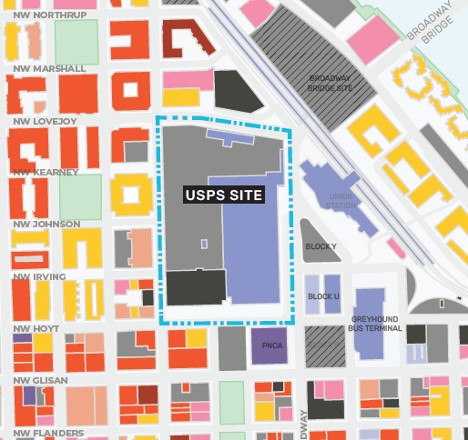
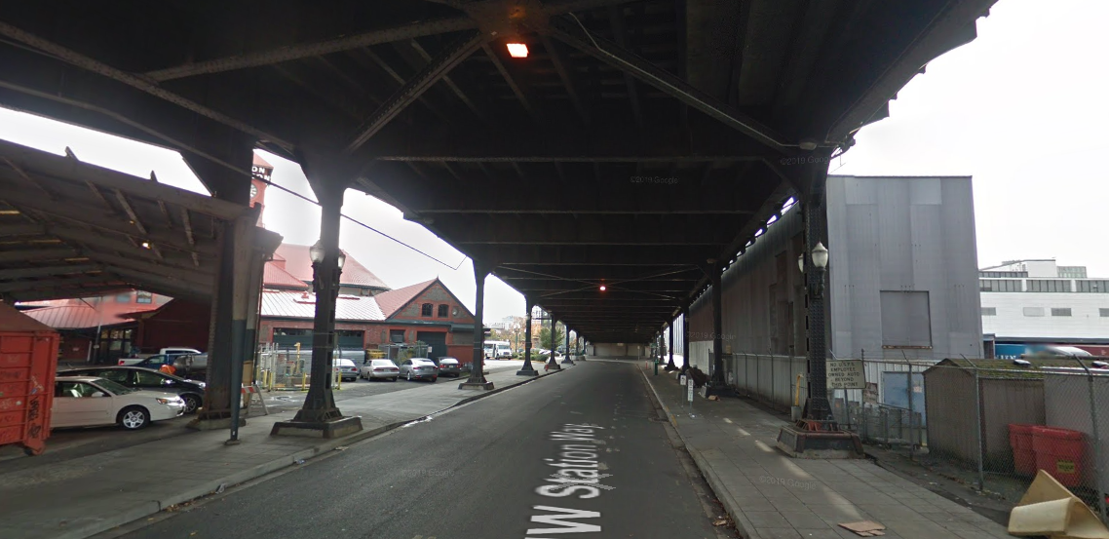
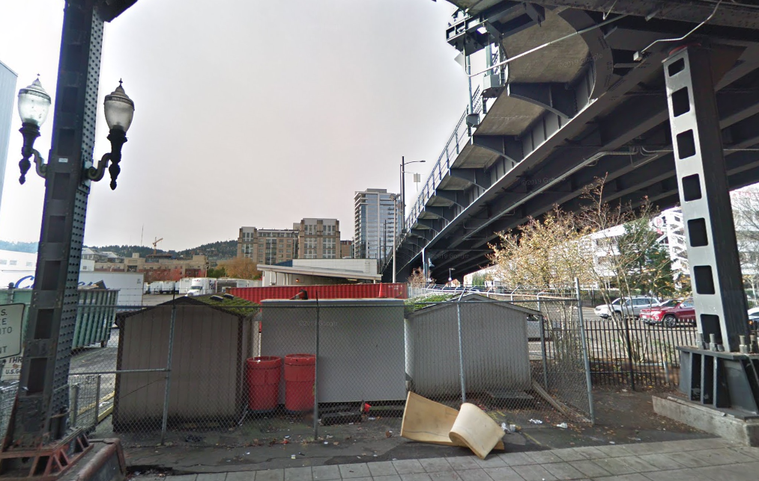
Context:
Response to Built Context

Slide 25
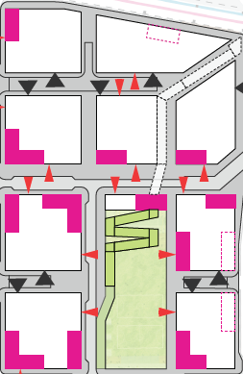
Context:
Response to Built Context

Slide 26
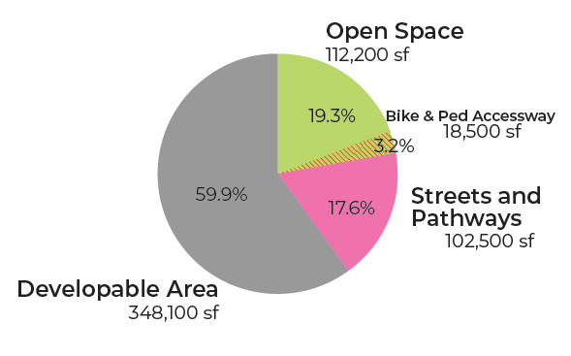
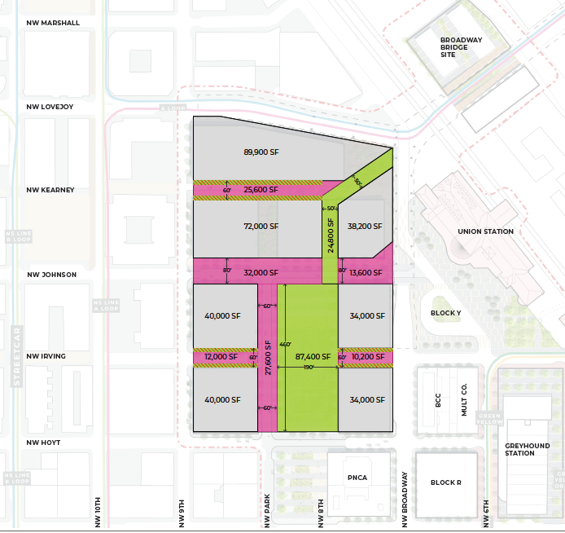
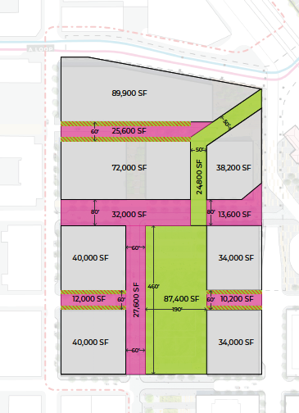
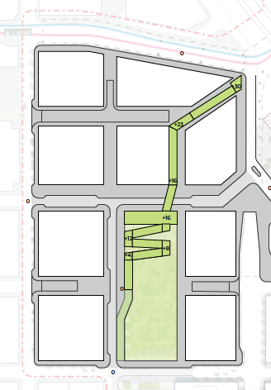
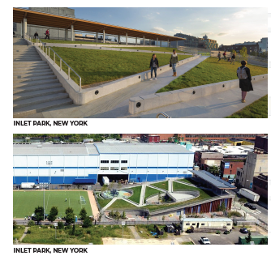
Public Realm
1. Site Organization
Open Space

Slide 27
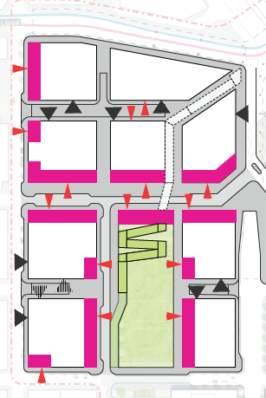
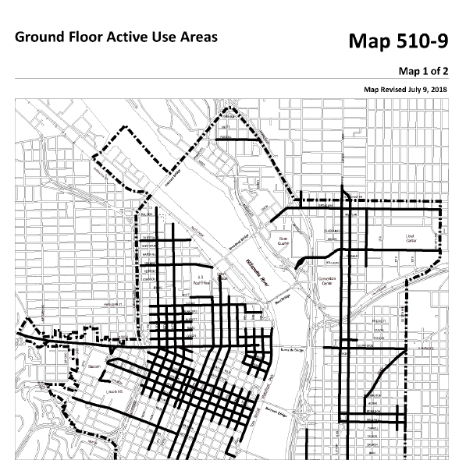
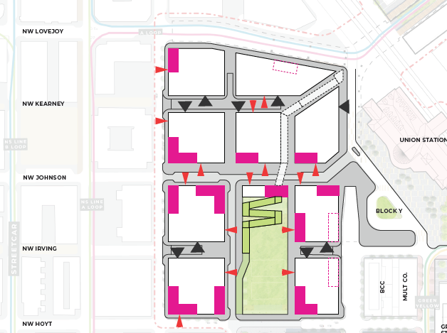
Public Realm
1. Site Organization
Ground Floor Active Uses

Slide 28
Public Realm
1. Site Organization
Ground Floor Active Uses

Slide 29
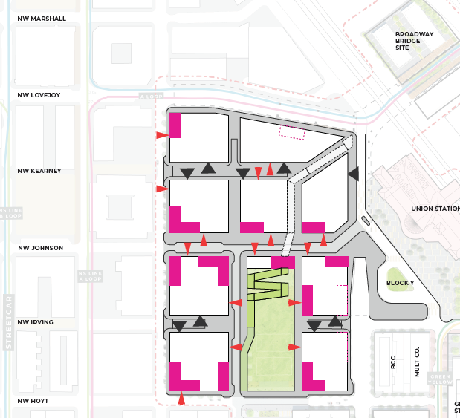
Public Realm
1. Site Organization
Vehicular Access

Slide 30
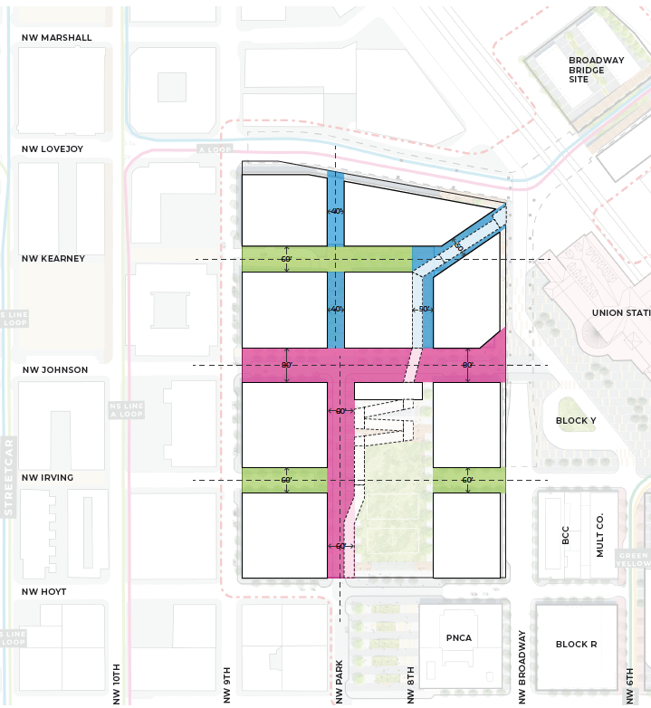
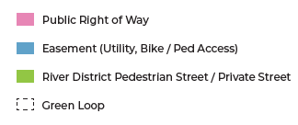
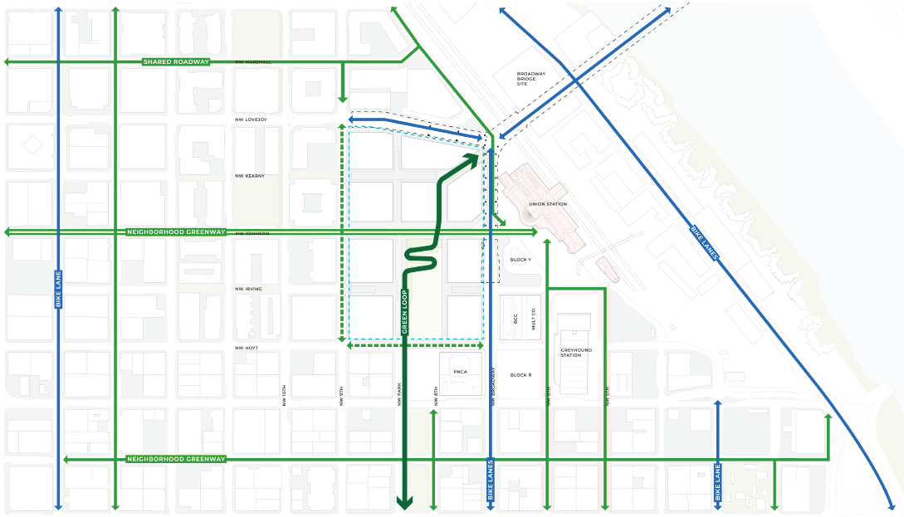
Public Realm
2. Circulation System
Vehicles
Bicycles
Pedestrians

Slide 31
Staff Introduction
Applicant Presentation
Staff Discussion Topics
Public Comments
Commission Discussion

Slide 32
Staff Introduction
Applicant Presentation
Staff Discussion Topics
Public Comments
Commission Discussion

