Slide 1
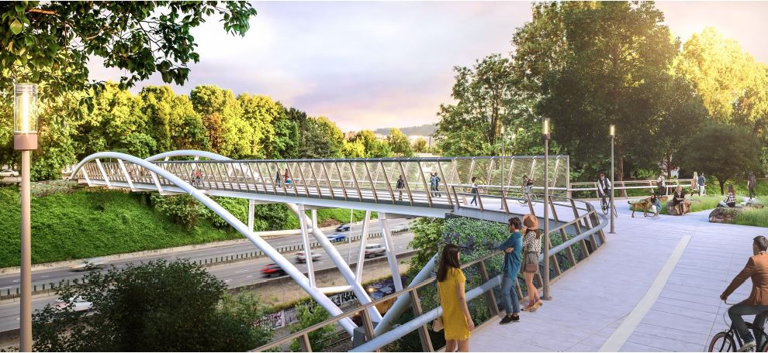
City of Portland
Design Commission
Design Advice Request
EA 19-151675 DA
NE 7th Across I-84
May 23, 2019
Staff Presentation

Slide 2
Staff Introduction
Applicant Presentation
Staff Discussion Topics
Public Comments
Commission Discussion

Slide 3
Location:
Central City Plan District
Lloyd Subdistrict to Central Eastside Subdistrict
Base Zone:
All public right-of-way.
No base zone.
Approval Criteria:
Central City Fundamental Design Guidelines
Lloyd District Design Guidelines
Height:
N/A
Floor Area Ratio:
N/A
Site Challenges:
Right-of-Way: PBOT; ODOT; Union Pacific
Slope
Construction Access
Connection to Sullivan’s Gulch Trail
Zoning

Slide 4
Looking southwest from Lloyd bridgehead

Slide 5
View from I-84, looking west

Slide 7
Staff Introduction
Applicant Presentation
Staff Discussion Topics
Public Comments
Commission Discussion

Slide 8
Staff Introduction
Applicant Presentation
Staff Discussion Topics
Public Comments
Commission Discussion

Slide 9
Context:
Green Loop branding
Neighborhood Connector: Central Eastside to Lloyd District
Response to Sullivan’s Gulch & Scenic Viewpoints
Public Realm
Connection to district bicycle/pedestrian facilities
Organization and separation of users
Quality & Permanence:
Structure: color and lighting
Touch zone materials: railings, mesh, hardscape, benches

Slide 10
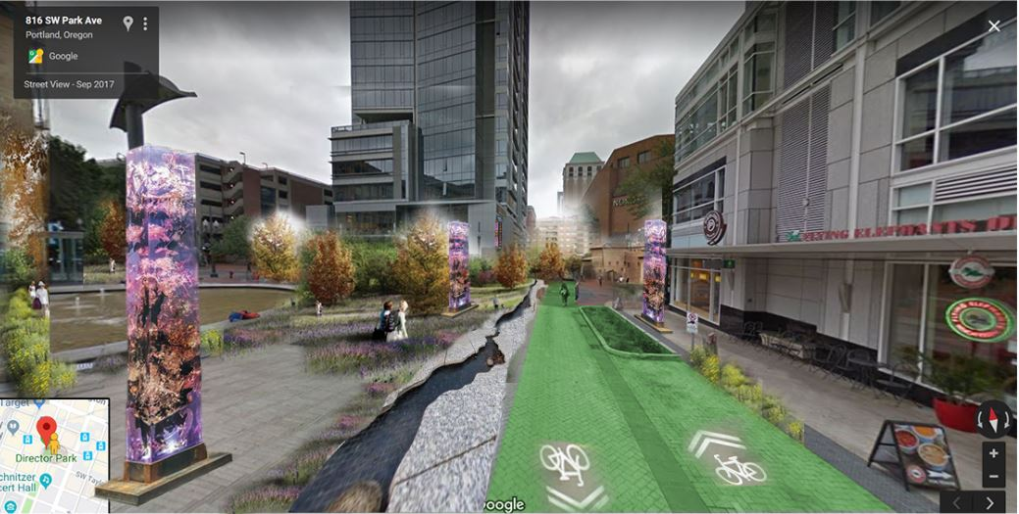
Context:
Green Loop Branding
Standard Green Loop Improvements: lighting, benches, art, wayfinding, landscaping
Credit: Sarah Bermudez

Slide 11
Context:
Neighborhood Connector
Response to Lloyd District and Central Eastside context

Slide 12
Context:
Sullivan’s Gulch & Scenic Viewpoints
Connection with proposed trail and mapped scenic viewpoints

Slide 13
Public Realm:
Connection with district bike/ped facilities
Explore how bicyclists and
pedestrians come to/move
from this bridge to connect
with the rest of the city

Slide 14
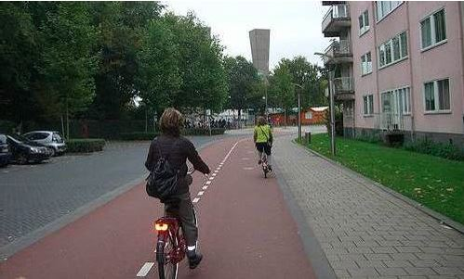
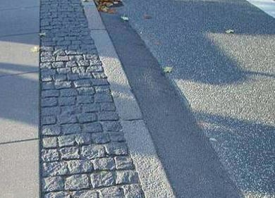
Public Realm:
Organization/Separation of Bridge Users
Bridge may facilitate emergency vehicles while using human-scale separations of bicyclists and pedestrians. Examples: vertical elements (benches, trees, mountable rolled curbs) and horizontal elements (hardscape patterns/material, color)

Slide 15
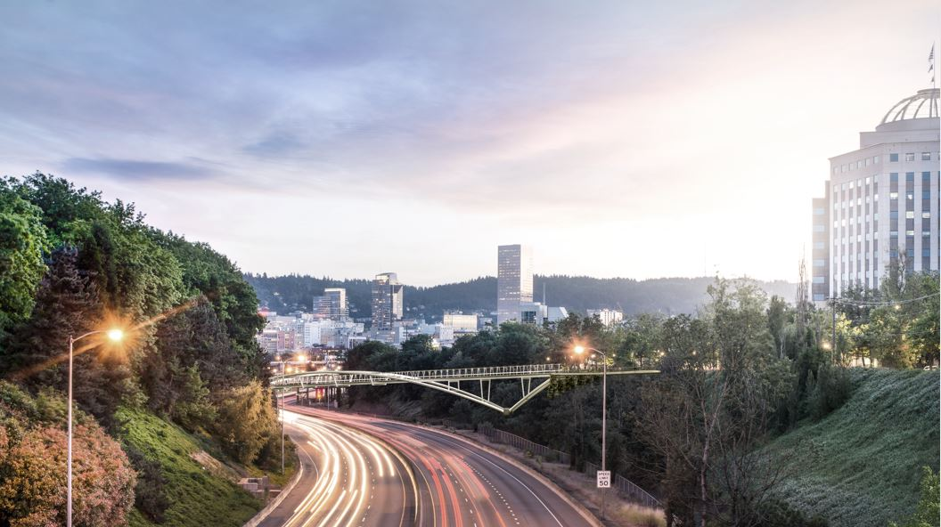
Quality & Permanence:
Structure & Lighting
June 2018 – Commission indicated support for a light colored bridge.
Light the structure from below, or the deck to emphasize the connection?

Slide 16
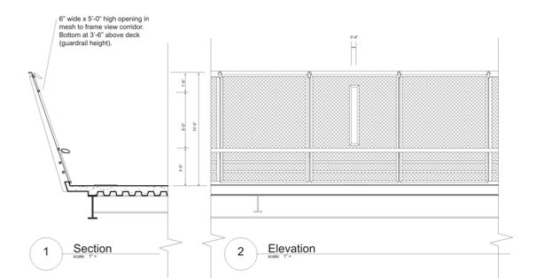
Quality & Permanence:
Touch Zone Materials
Opportunity to introduce placemaking and human scale.
Railings, Mesh, Hardscape, Benches, Lighting

Slide 17
Staff Introduction
Applicant Presentation
Staff Discussion Topics
Public Comments
Commission Discussion

Slide 18
Staff Introduction
Applicant Presentation
Staff Discussion Topics
Public Comments
Commission Discussion

