Slide 1

Amend Contract With Brown & Caldwell for Alder Pump Station Upgrade
BES Project No: E10359
Contract No: 30003063
Paul Suto, P.E., Engineering Manager
Aaron Lawler, P.E., Engineer
May 2, 2018

Slide 2
Ordinance
Amend Contract with Brown and Caldwell, Inc. for professional
engineering services for the Alder Pump Station Upgrades, BES Project No. E10359, in the amount of $85,000
(ordinance; amend Contract No: 30003063)
- This amendment is for additional design services during construction

Slide 3
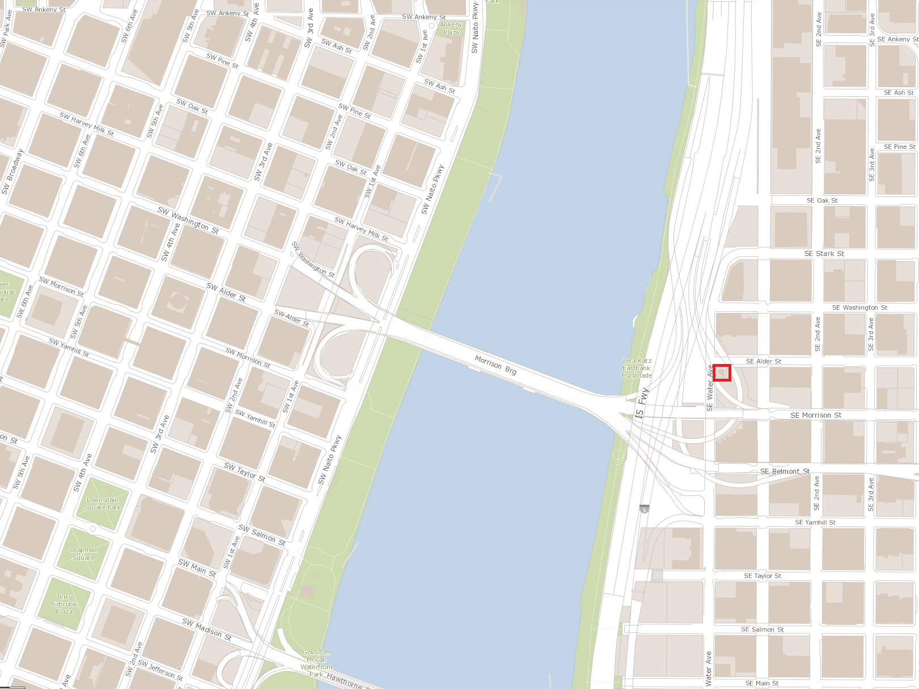
Location Map
Alder Pump Station Project Location

Slide 4
Project Objectives
Upgrade the pump station to accommodate future projected flows:
  Sanitary Pumps: 2,100-gpm firm capacity
  Storm Pumps: 900-gpm firm capacity
Integrate pump station operation with the Eastside CSO System
Simplify Pump Station Operation and Configuration
Improve O&M access to the PS
Improve Seismic Resiliency

Slide 5
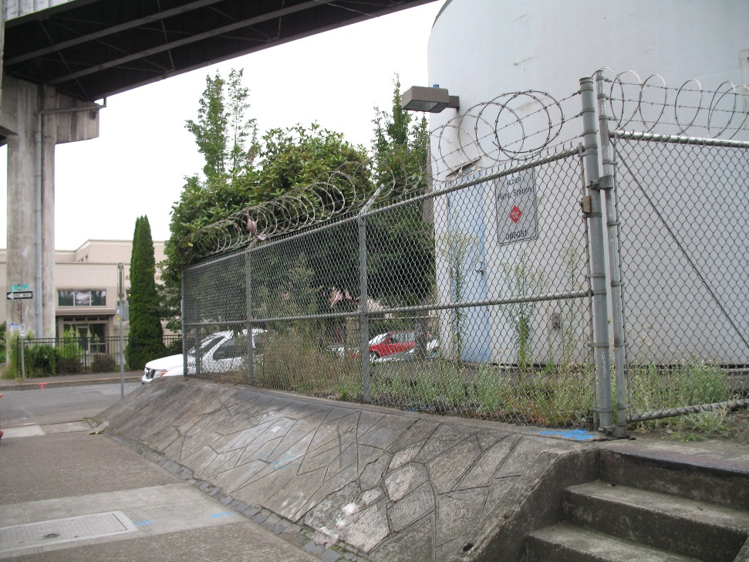
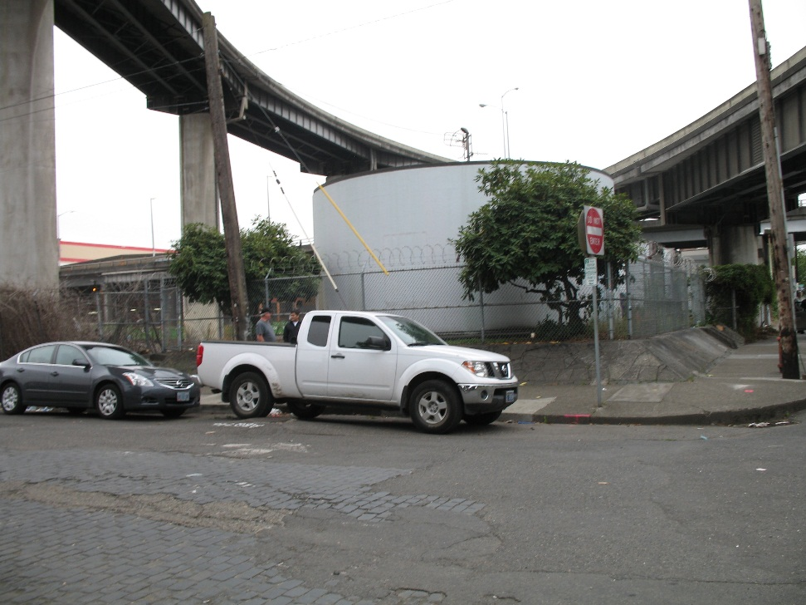
Original Alder Pump Station

Slide 6
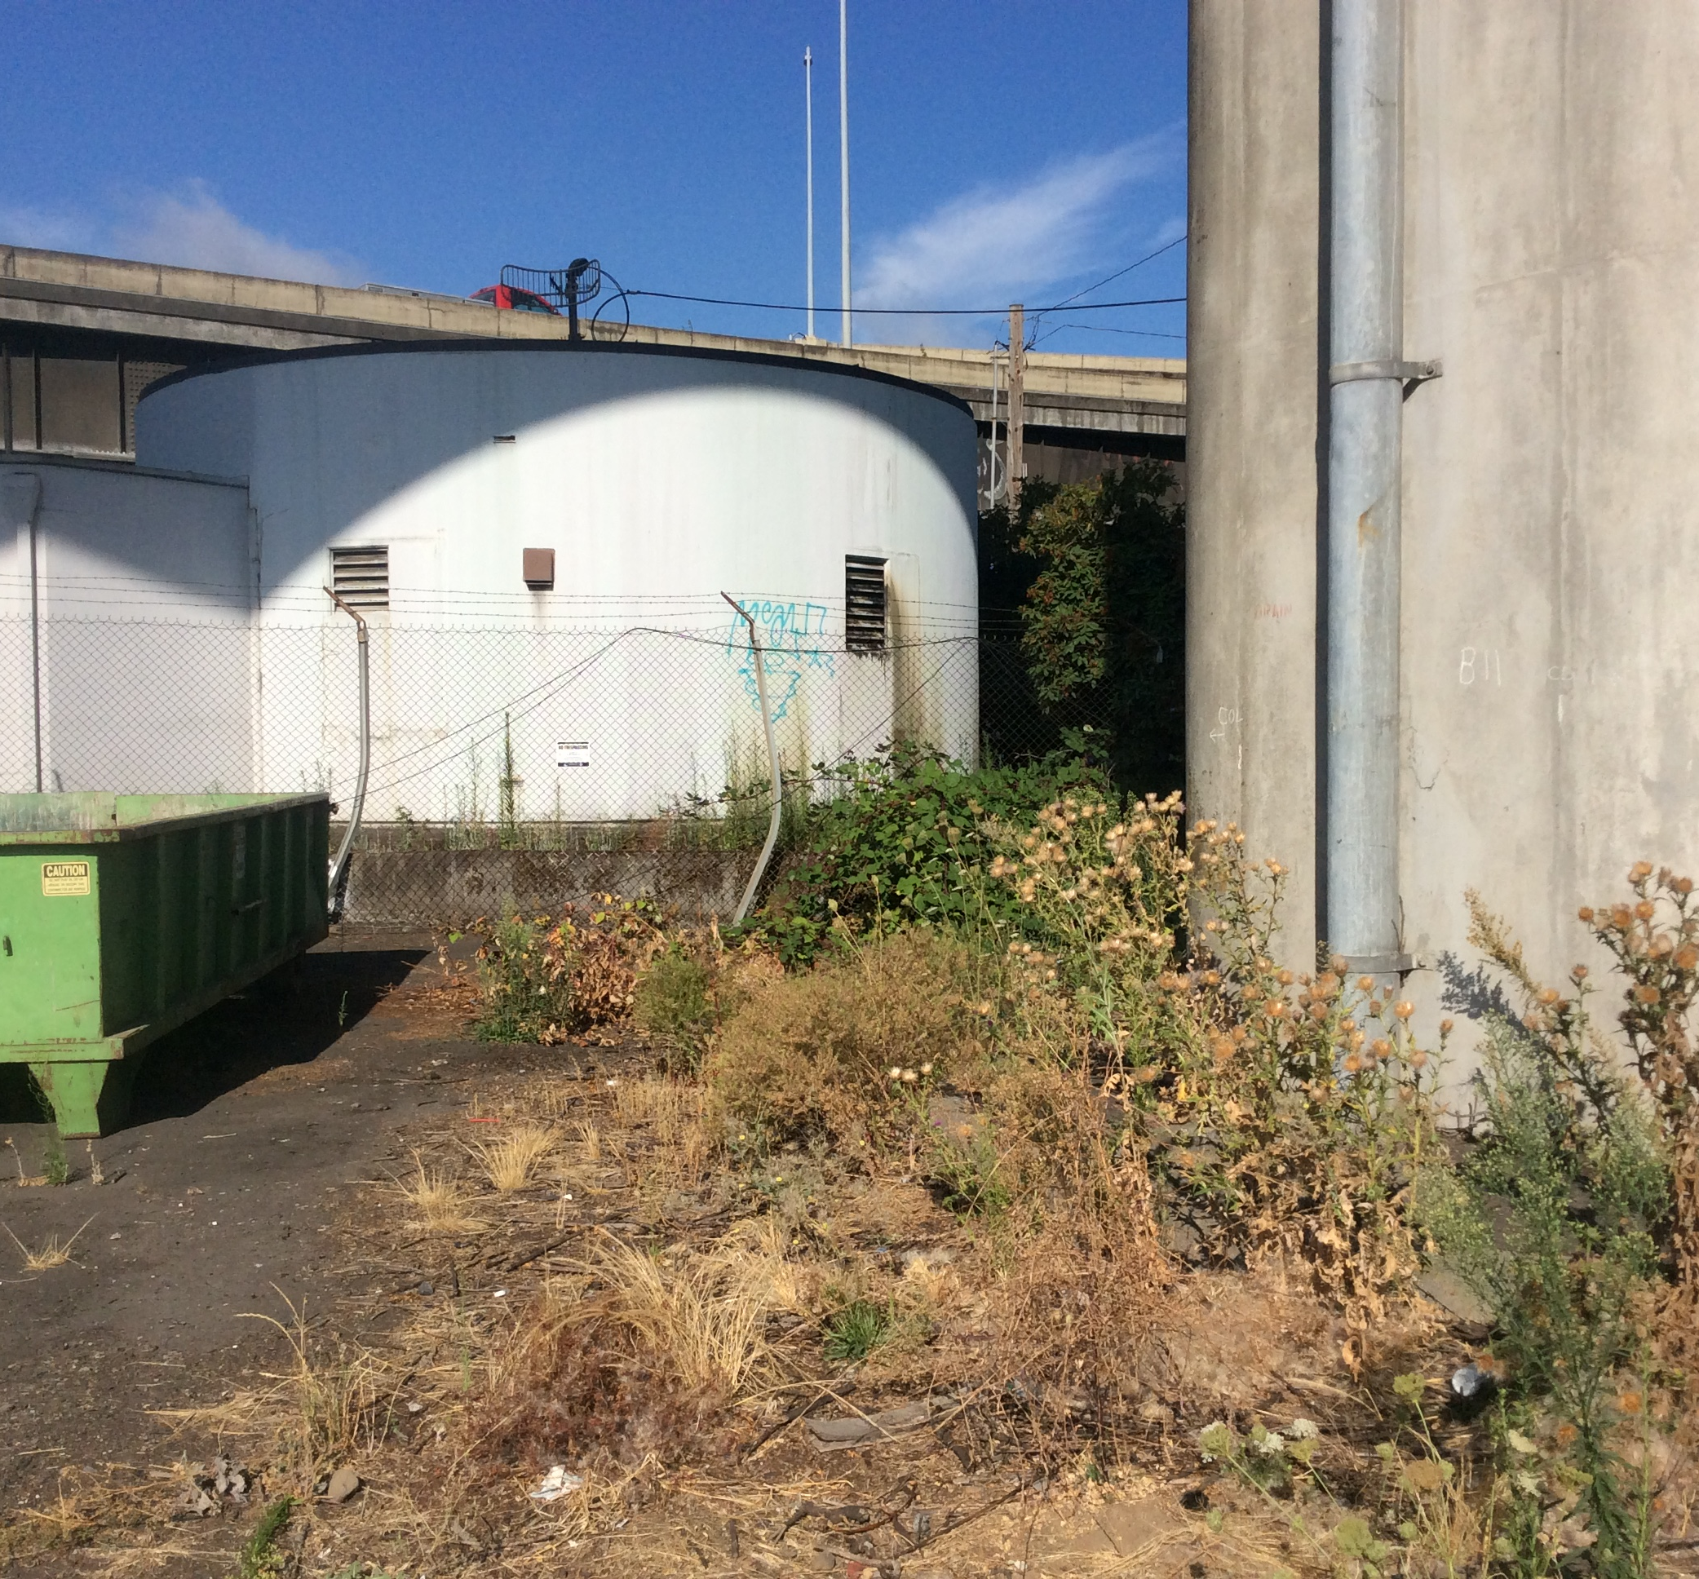
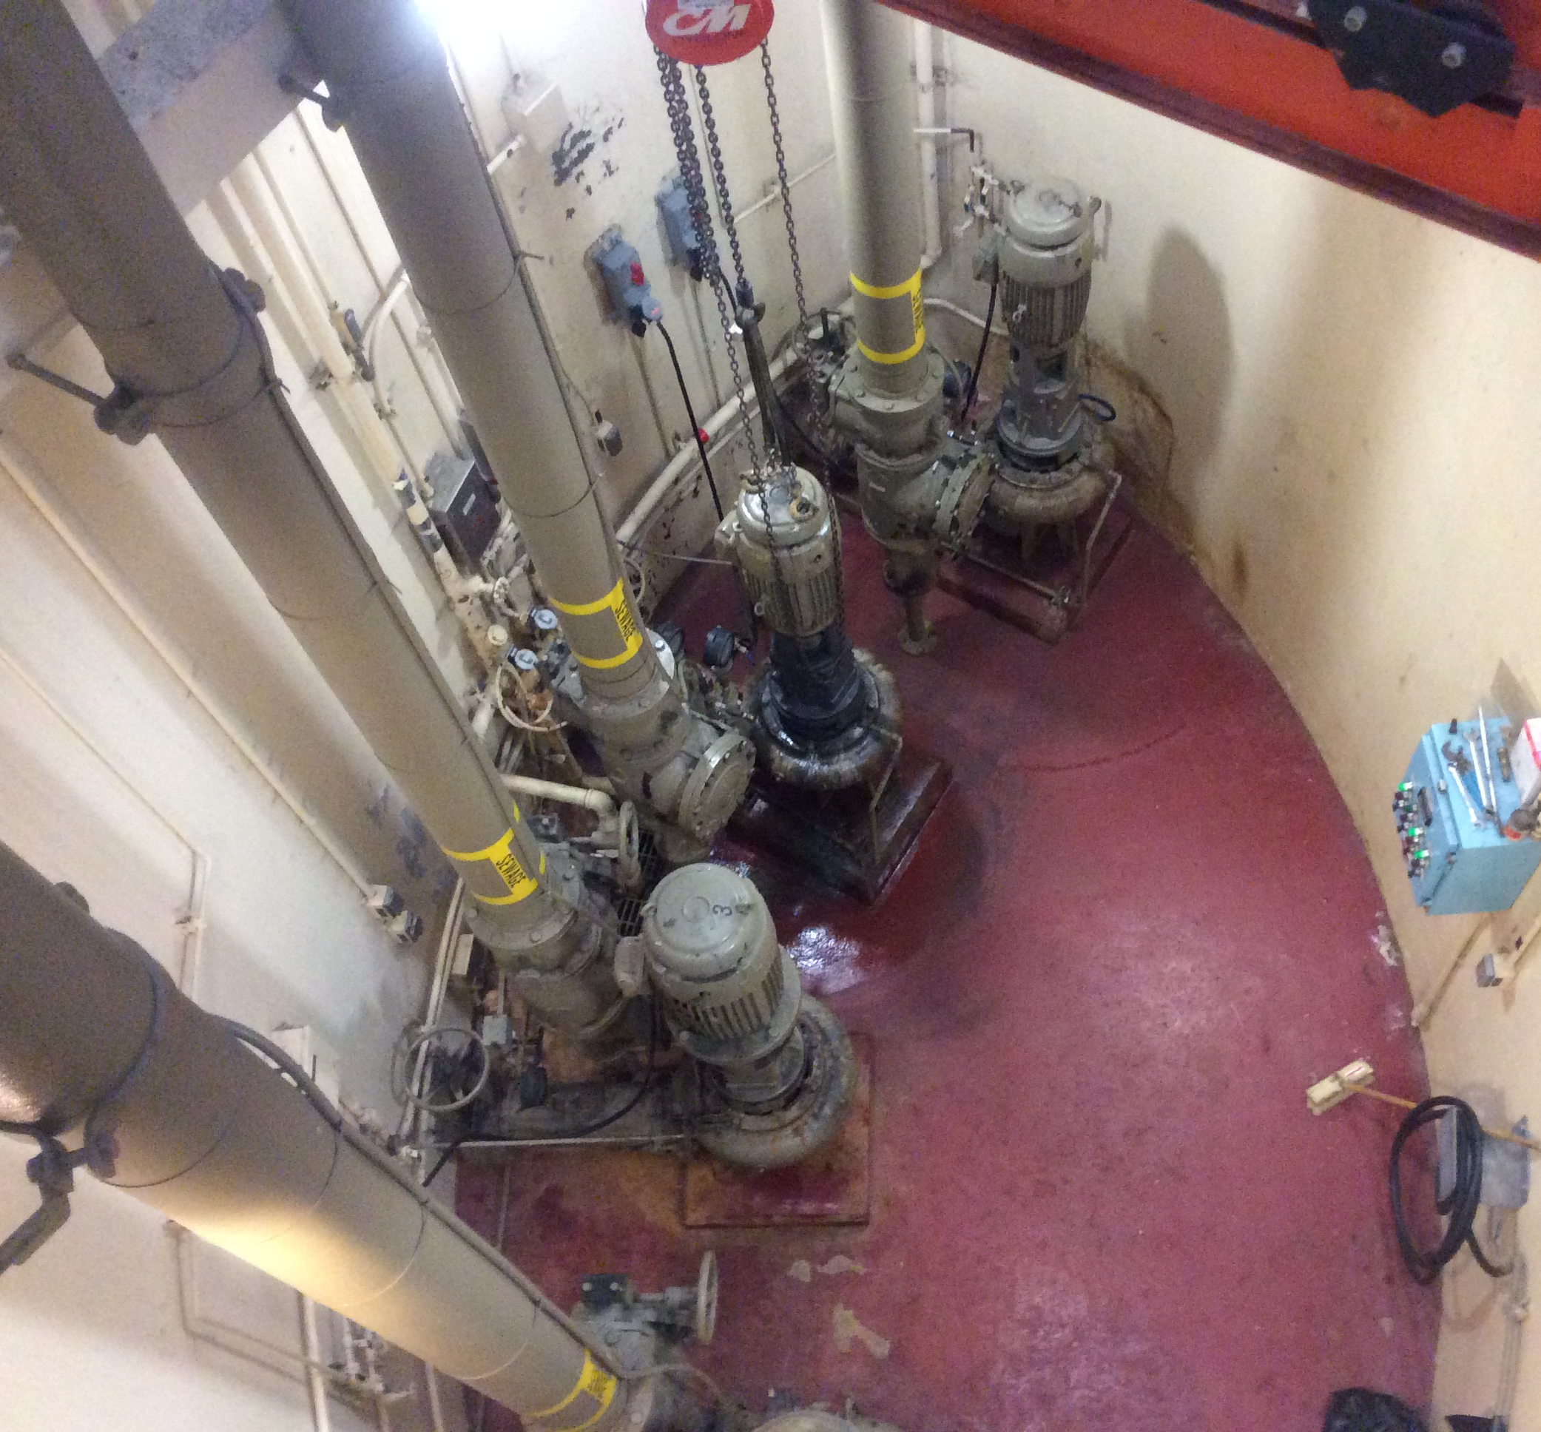
Original Alder Pump Station

Slide 7
Alder Pump Station – Original Configuration
Original construction in 1952
Two existing and separate pumping systems:
  - Sanitary system with a firm pumping capacity of 750-gpm that discharges to the SE interceptor sewer with flow conveyed to the Sullivan PS
  - Storm system with a firm pumping capacity of 1,500-gpm that discharges to Outfall 36
Complicated split sanitary and storm system wet well configuration

Slide 8
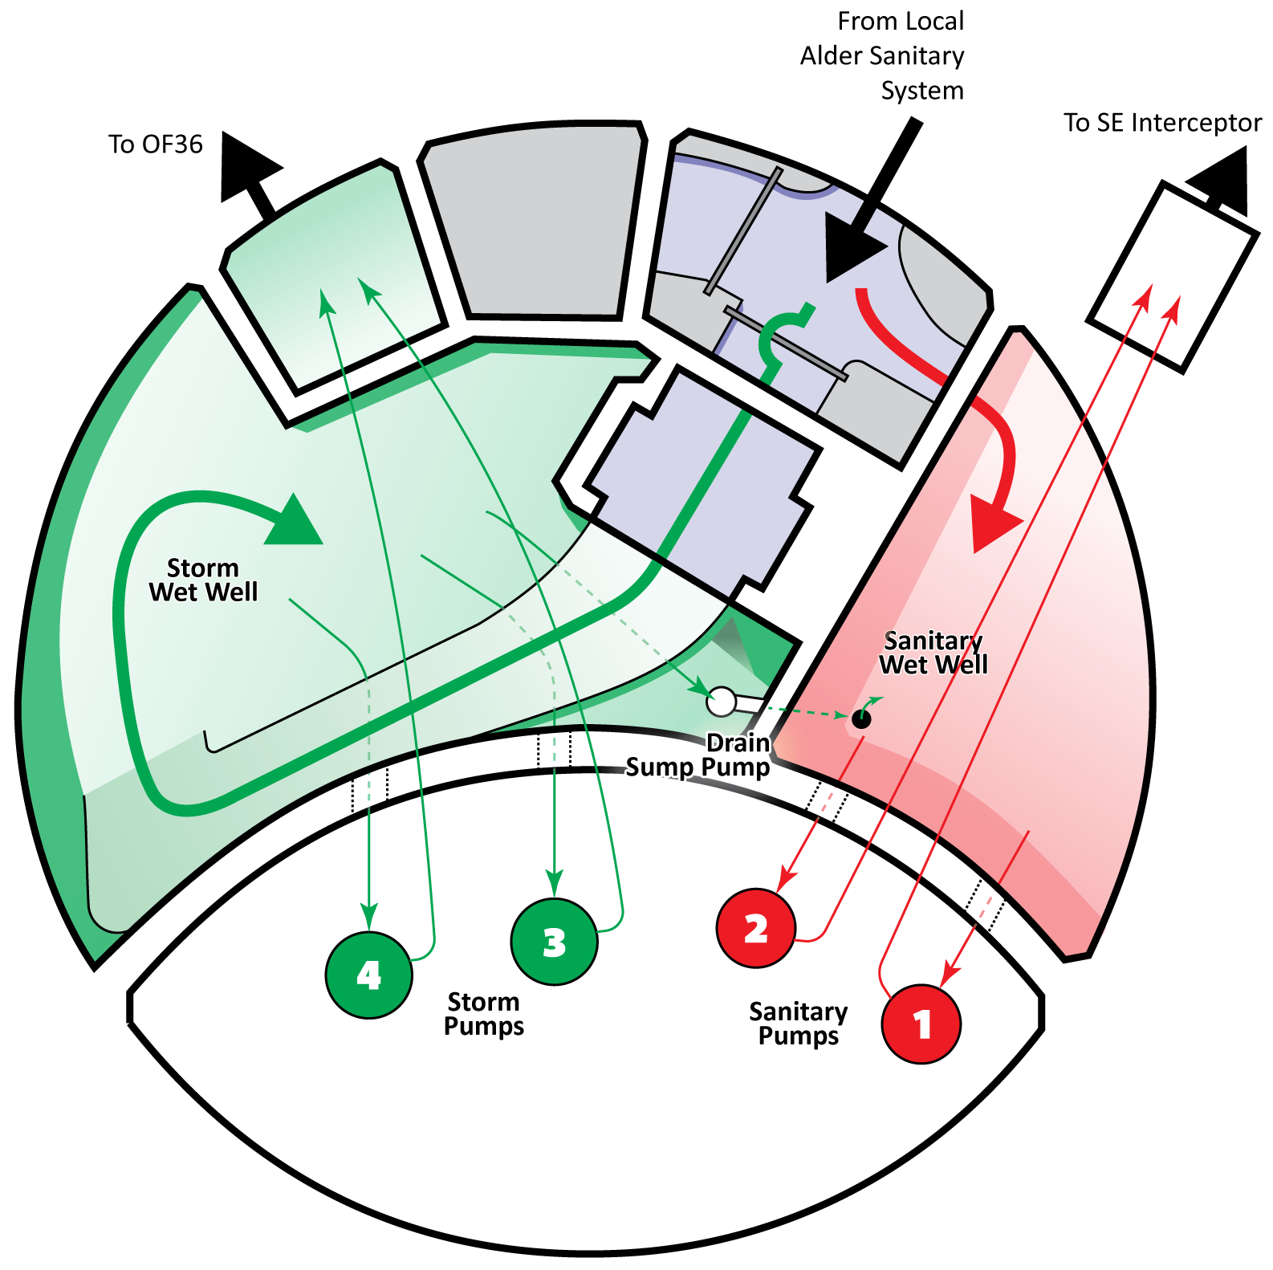
Alder PS – Split Wetwell Schematic

Slide 9
Alder PS – System Schematic
*Source: BES Asset Systems Management Division TM Alder PS Flow Analysis, July 12, 2012

Slide 10
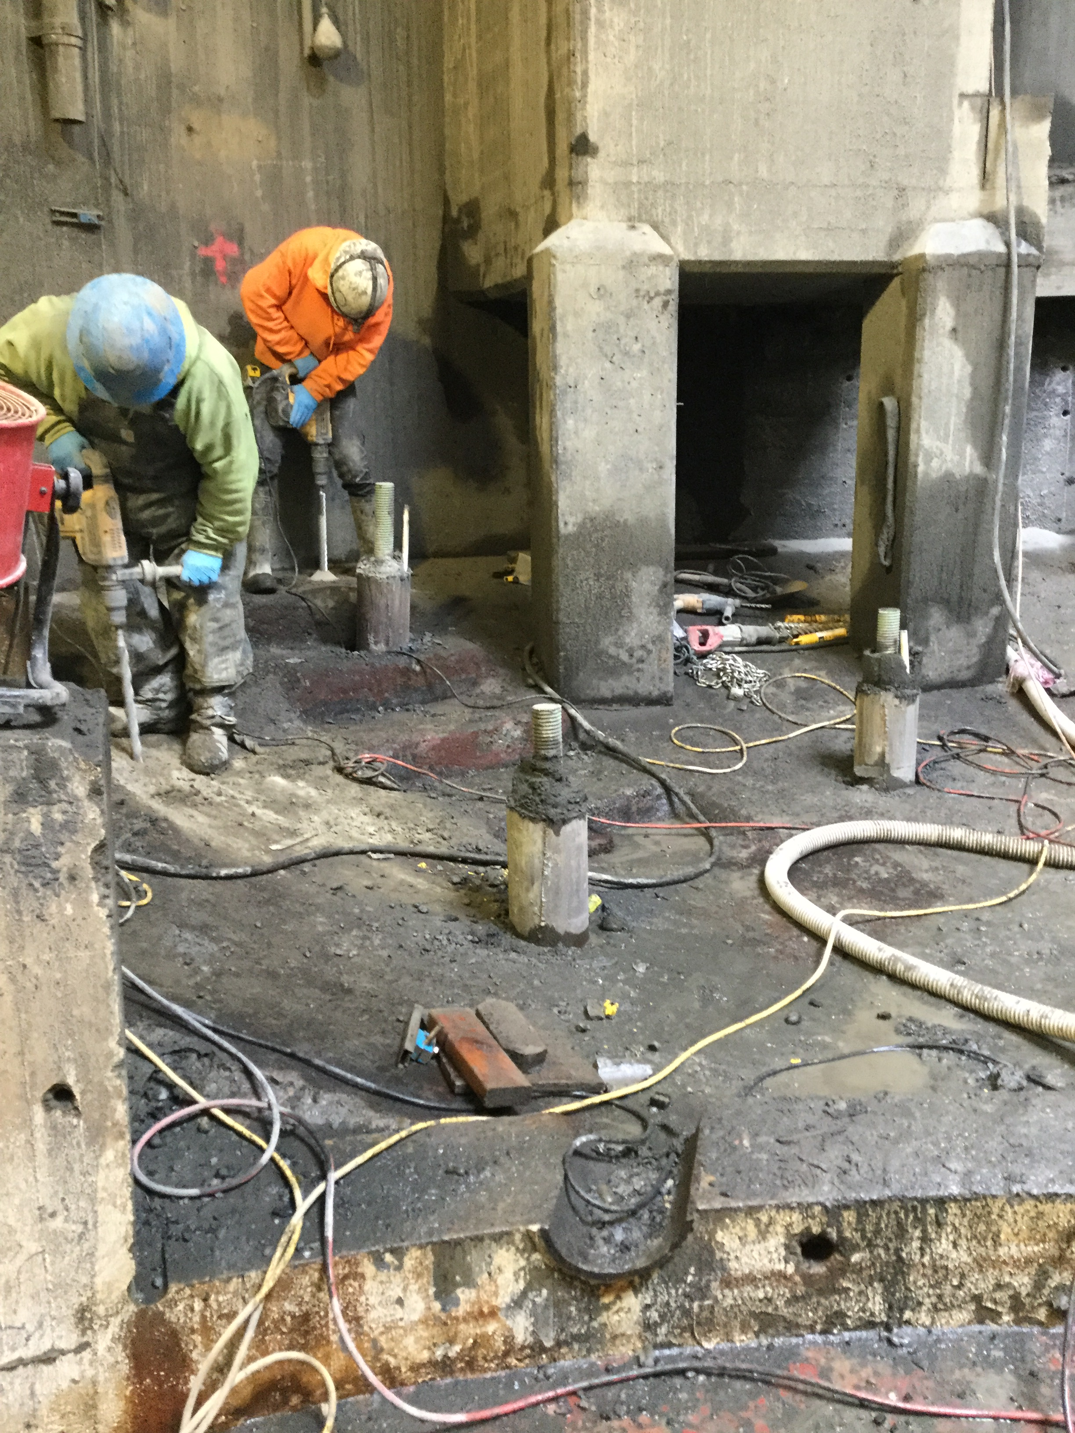
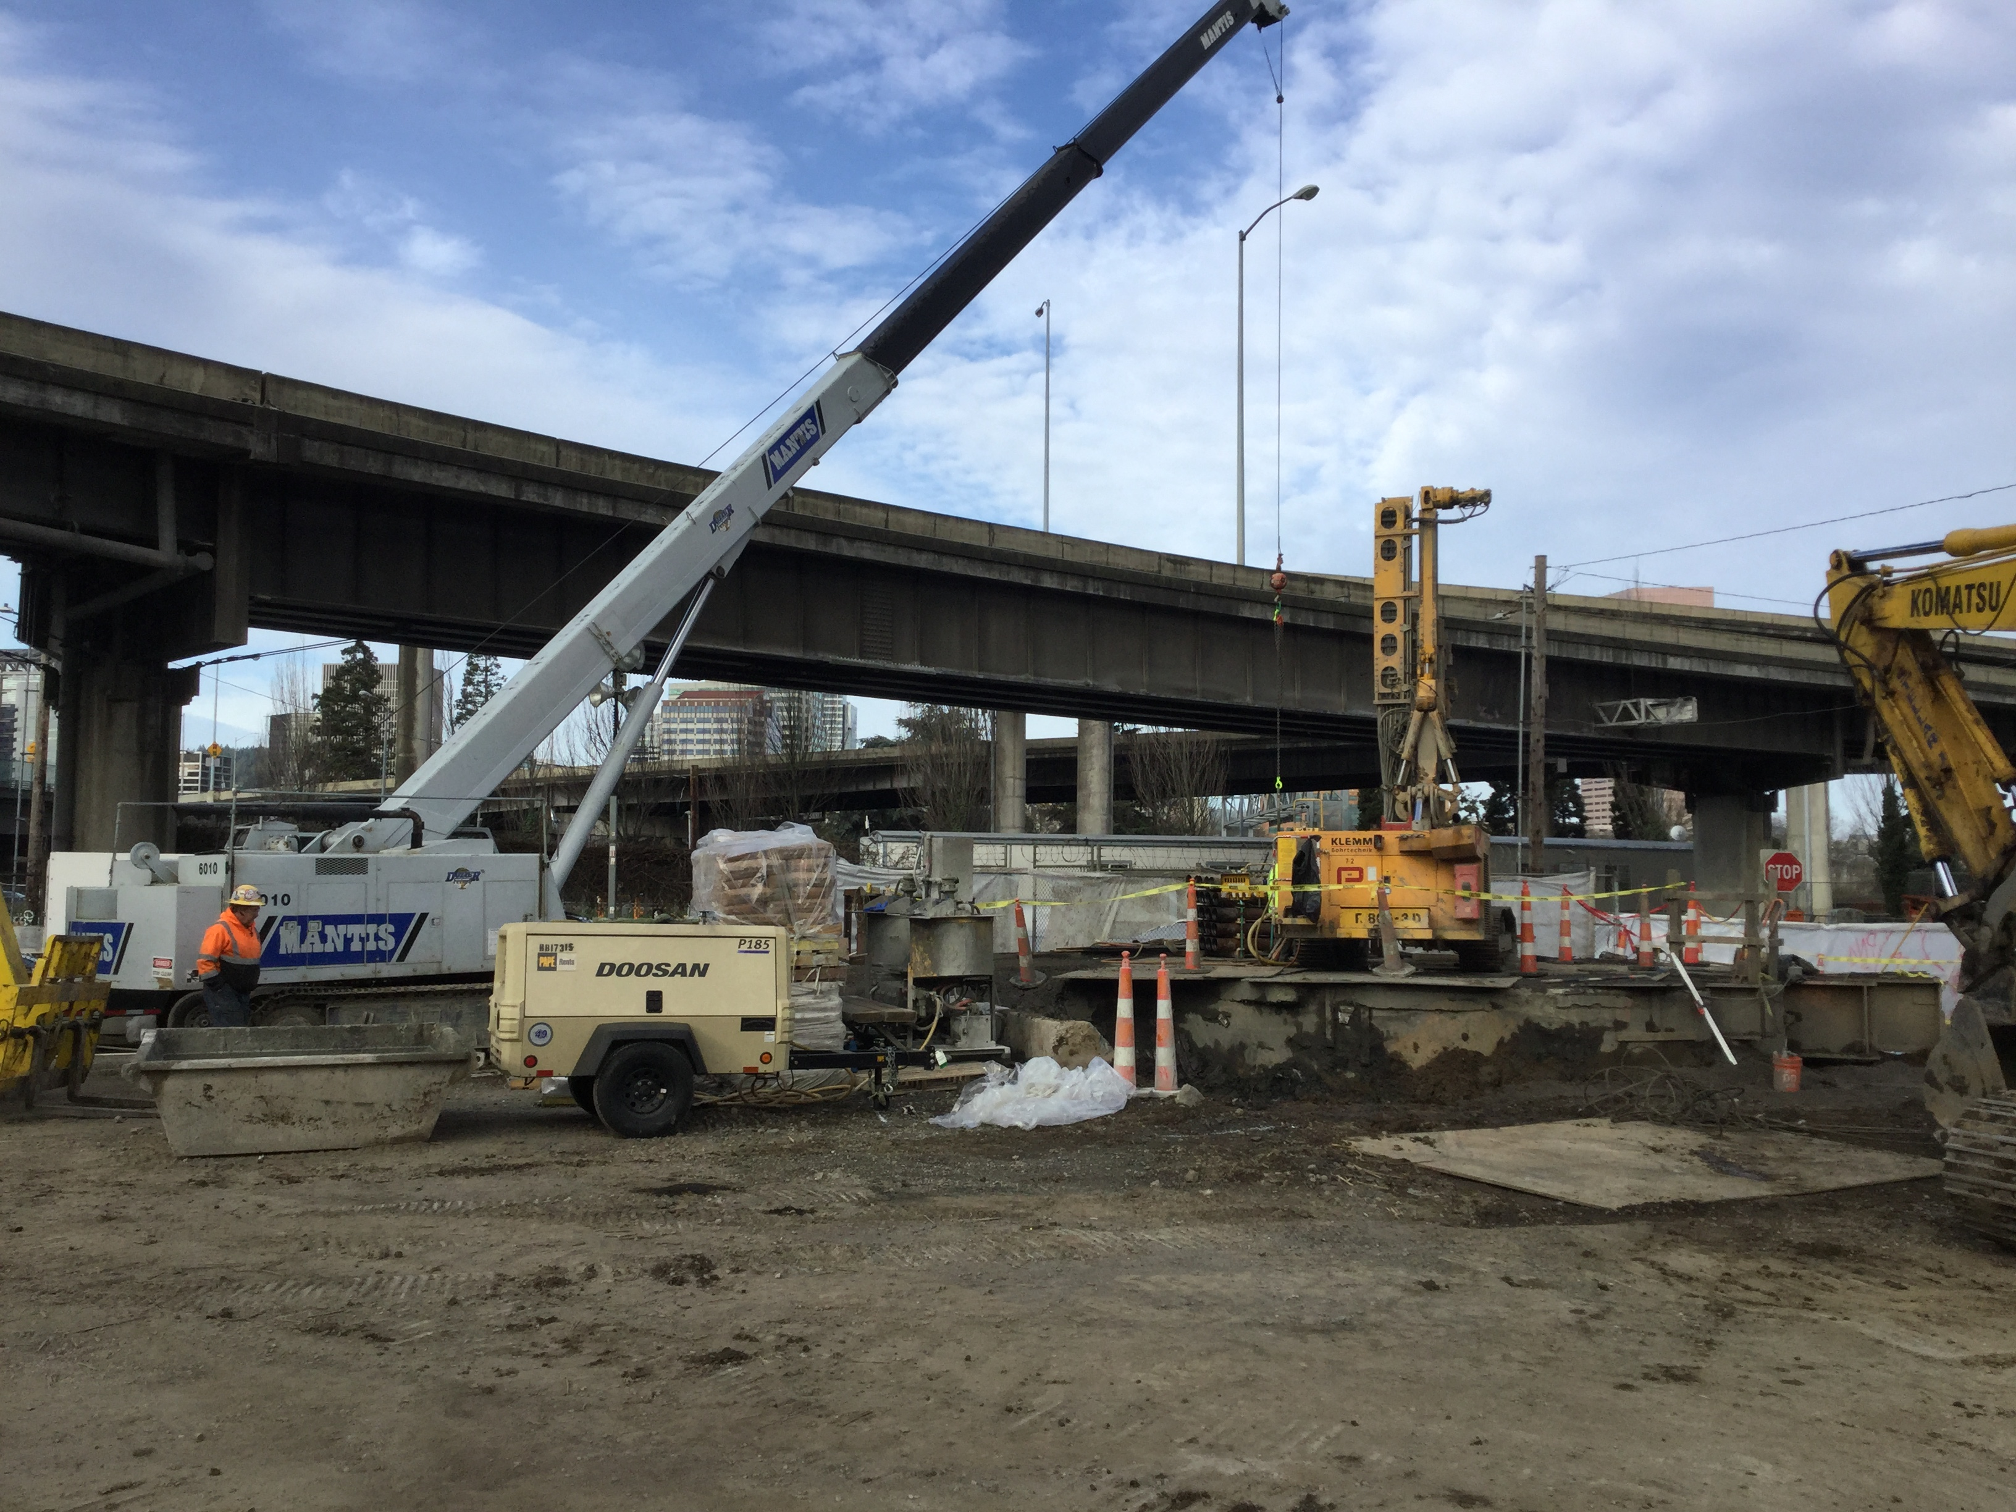
Construction Photos

Slide 11
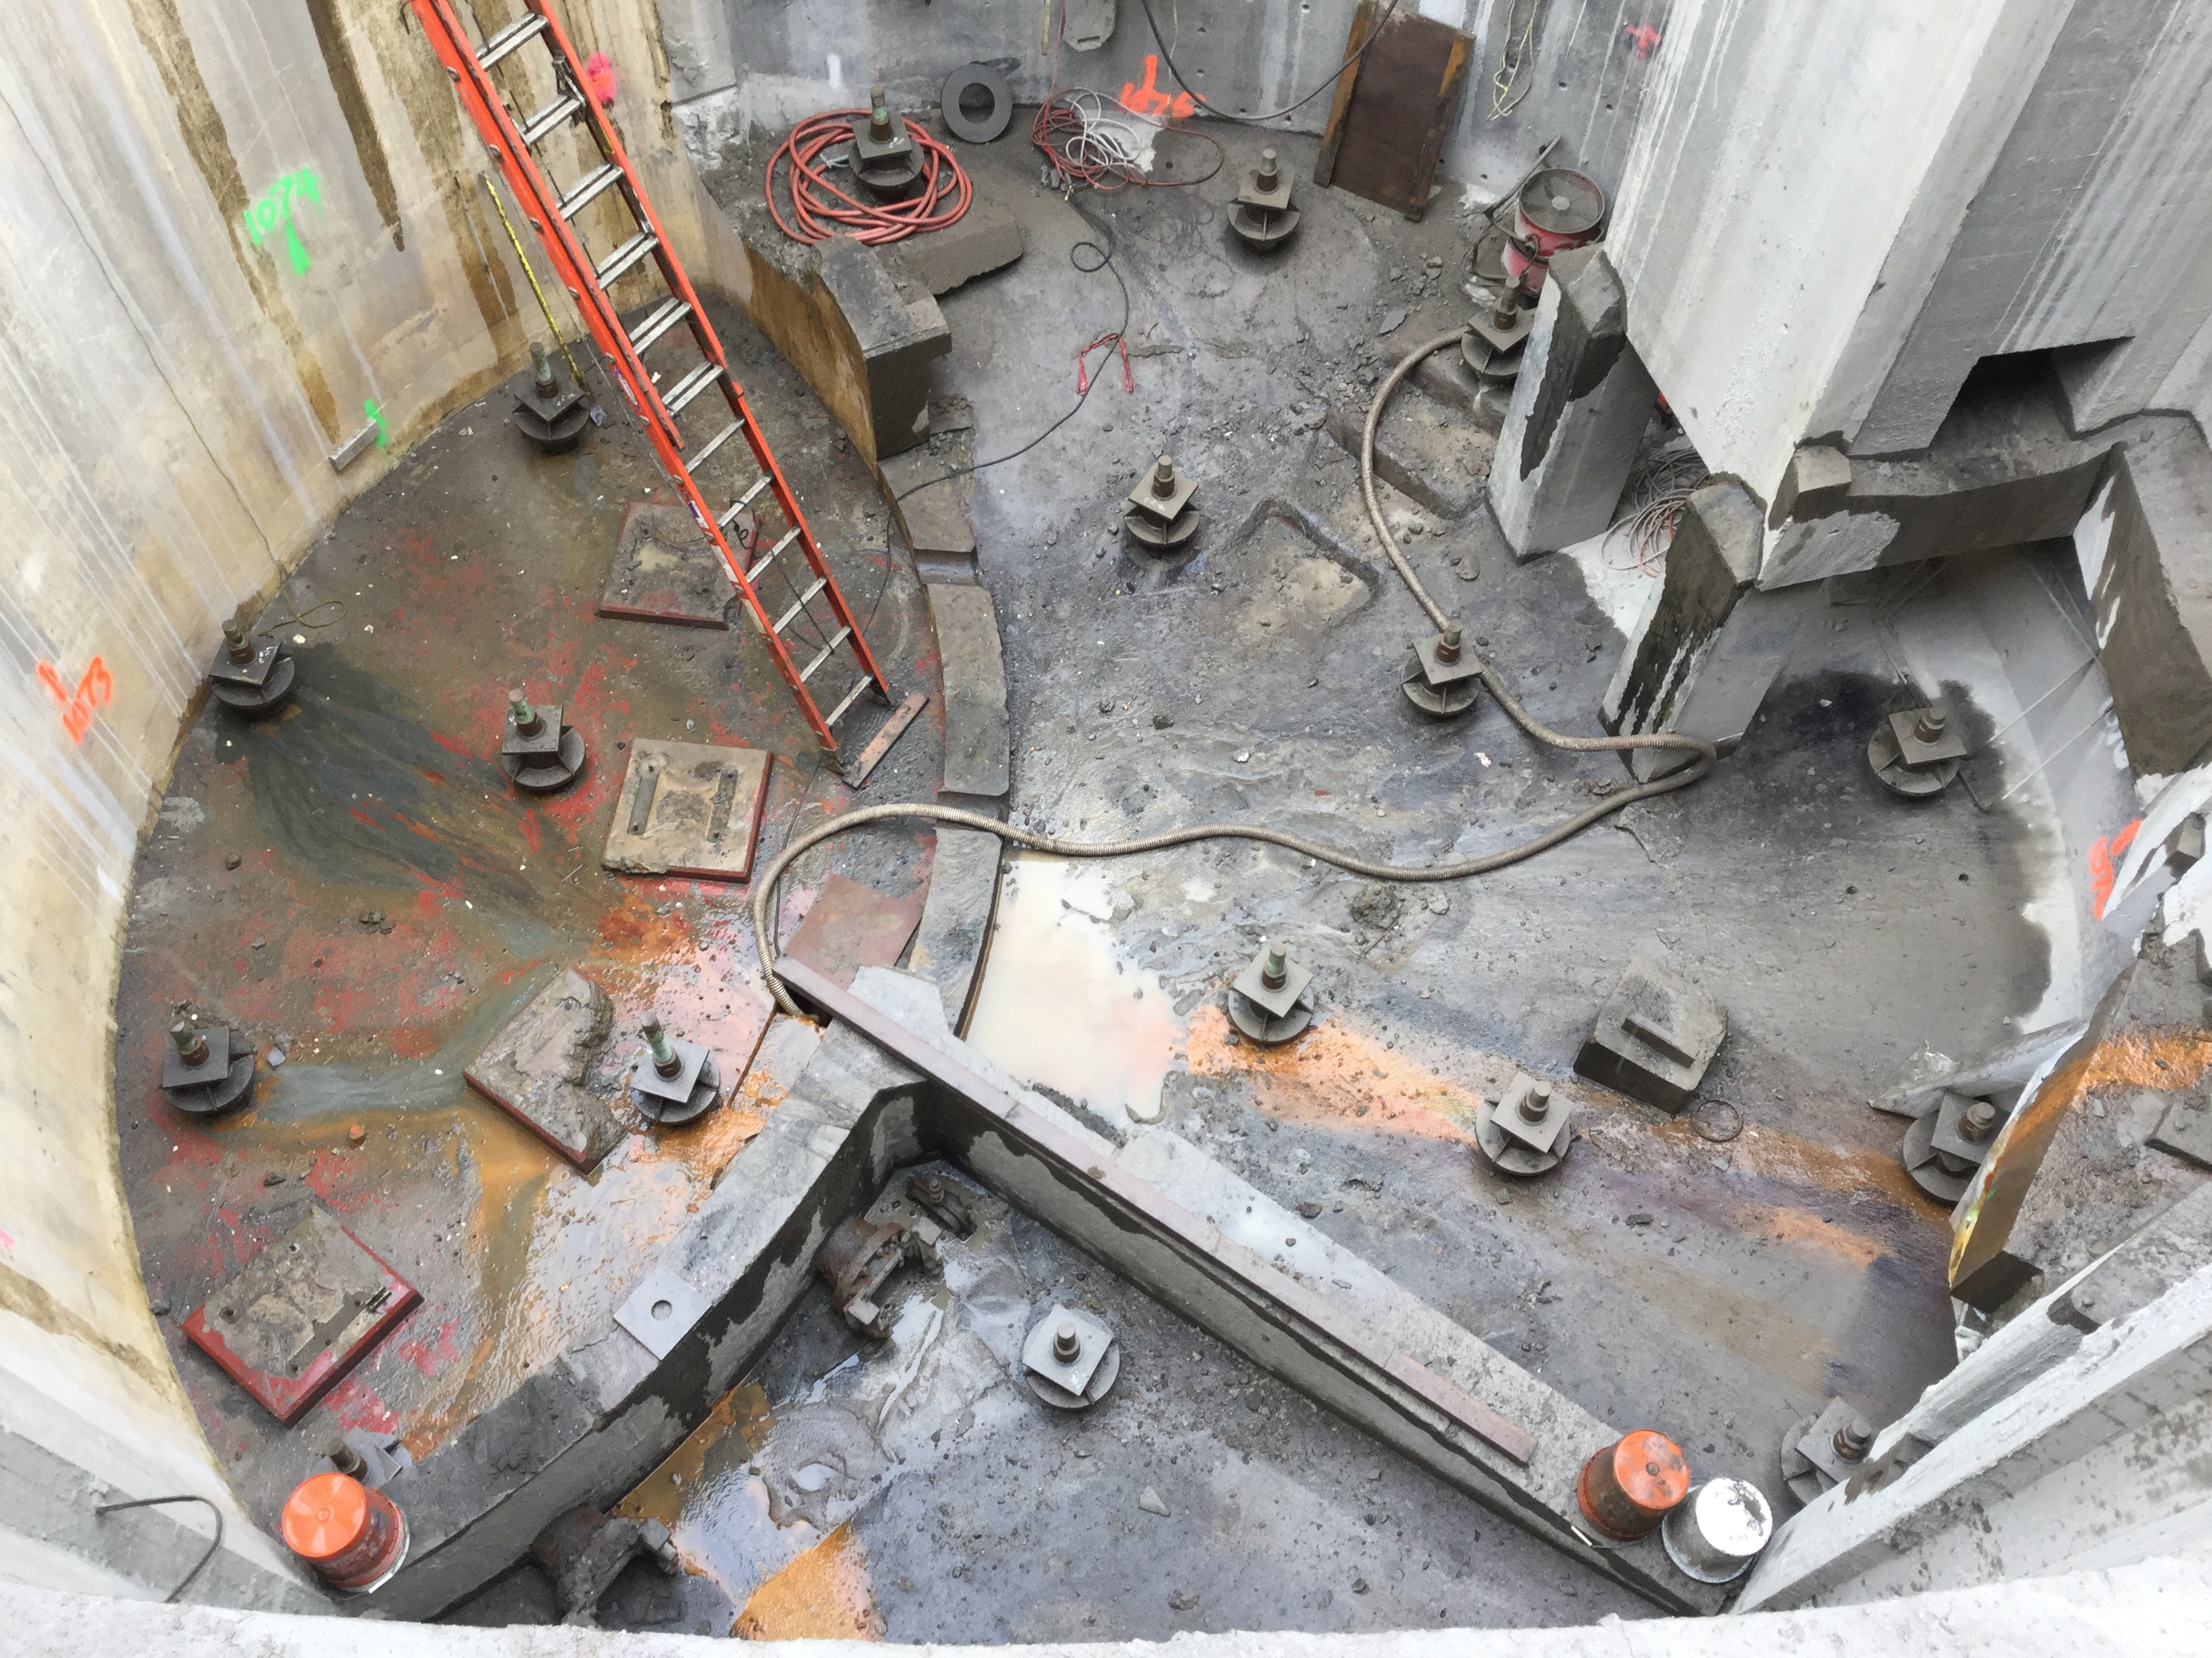
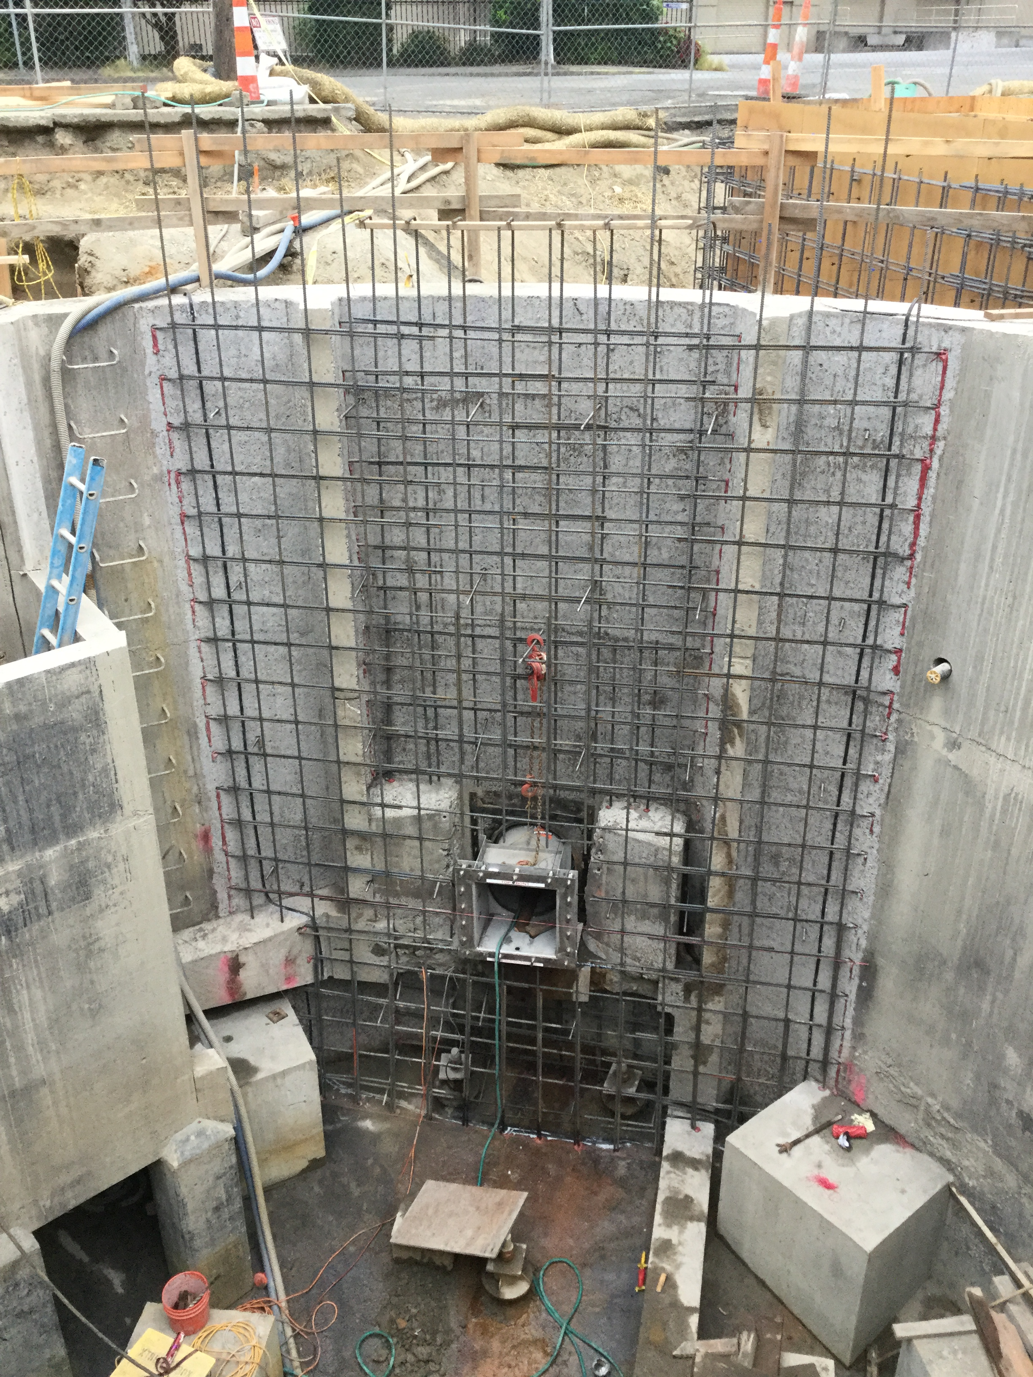
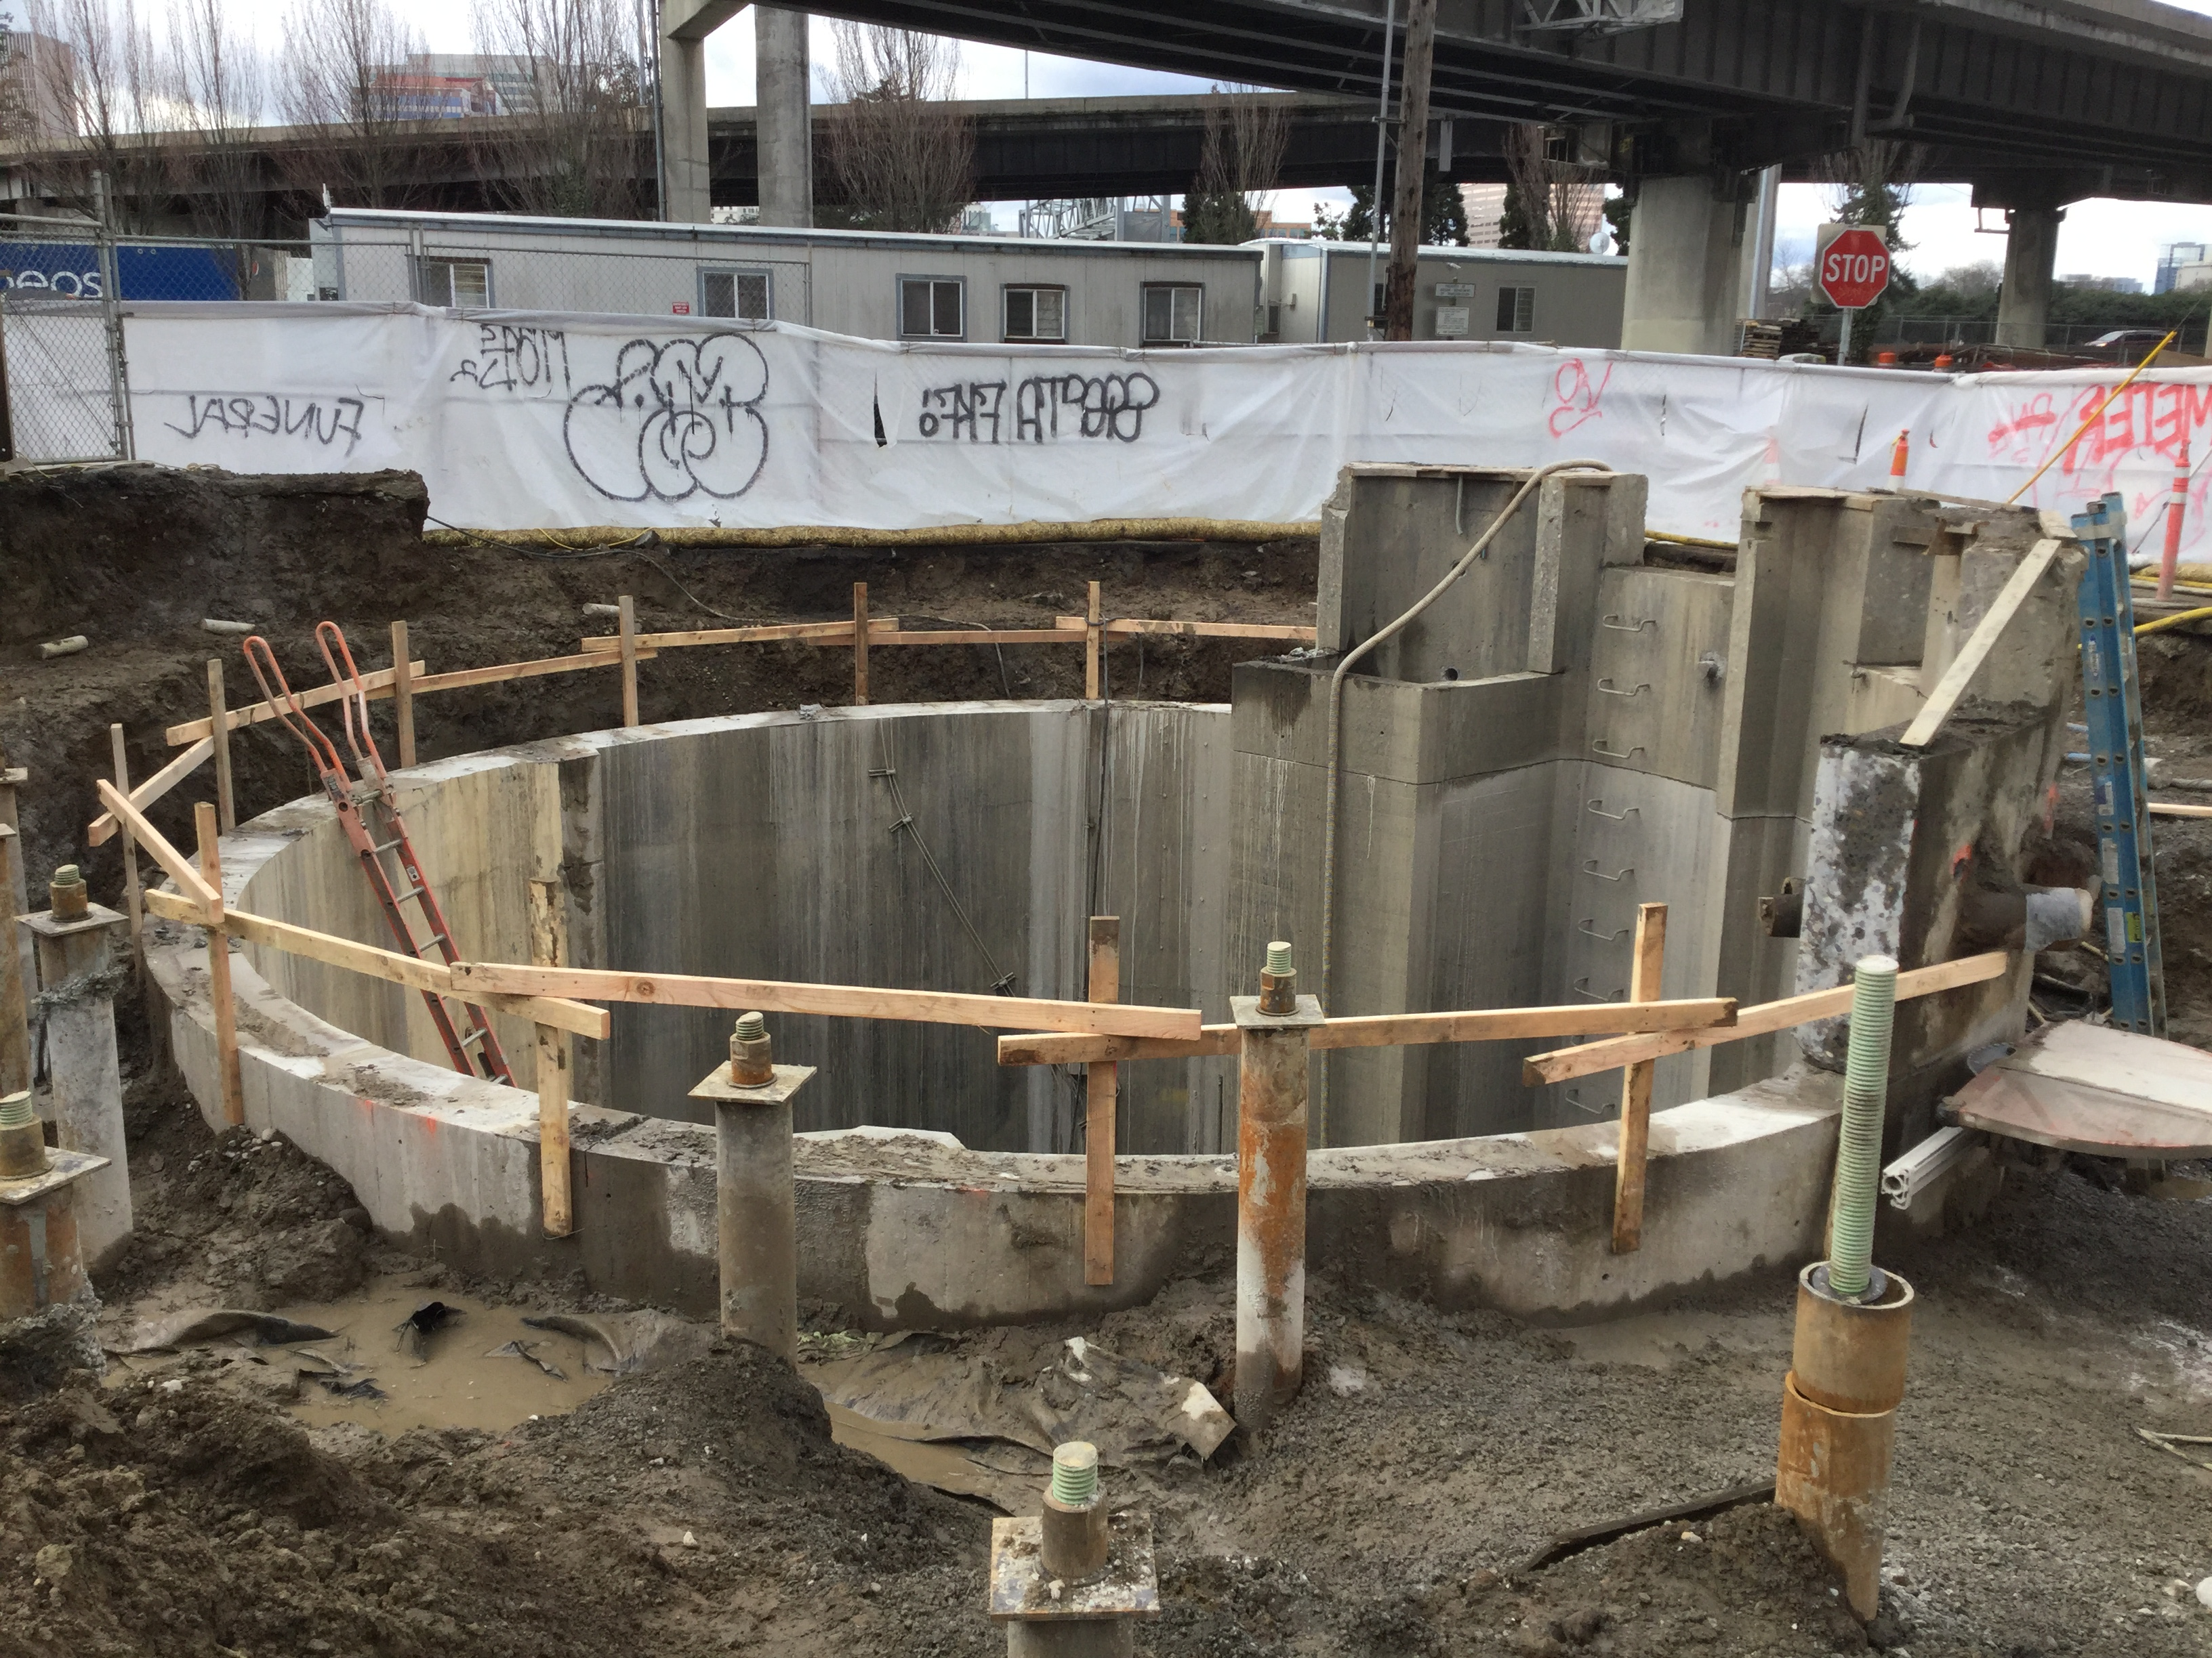

Slide 12
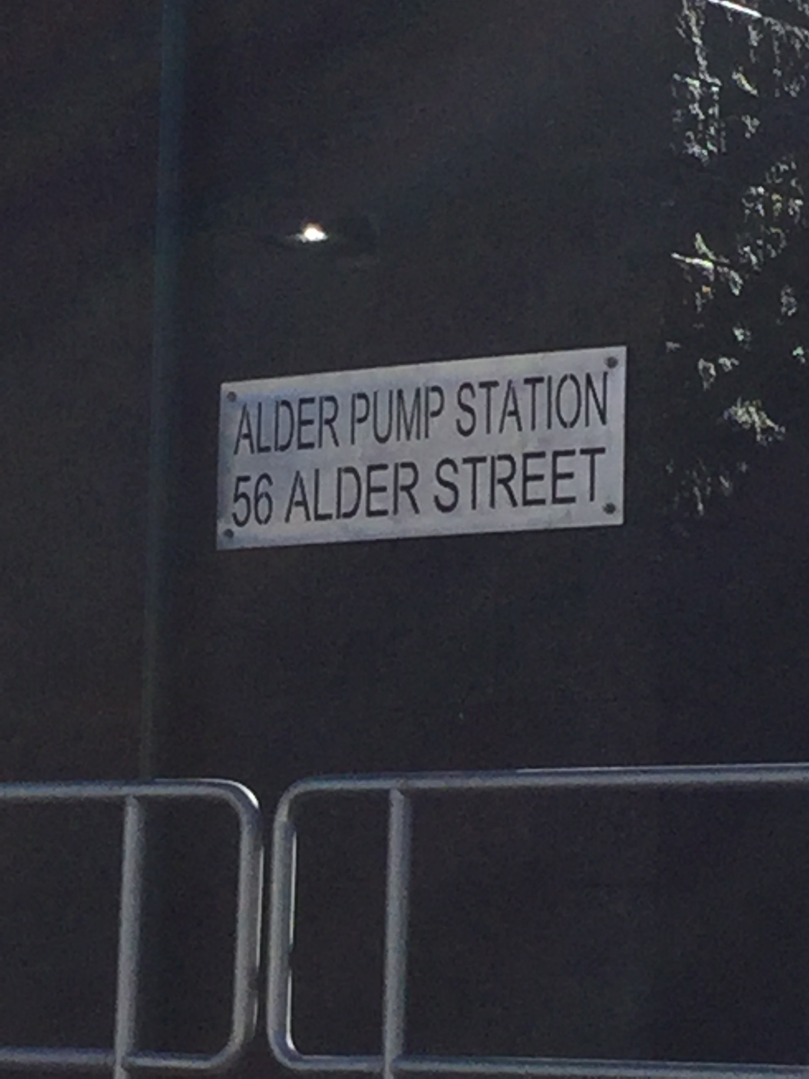
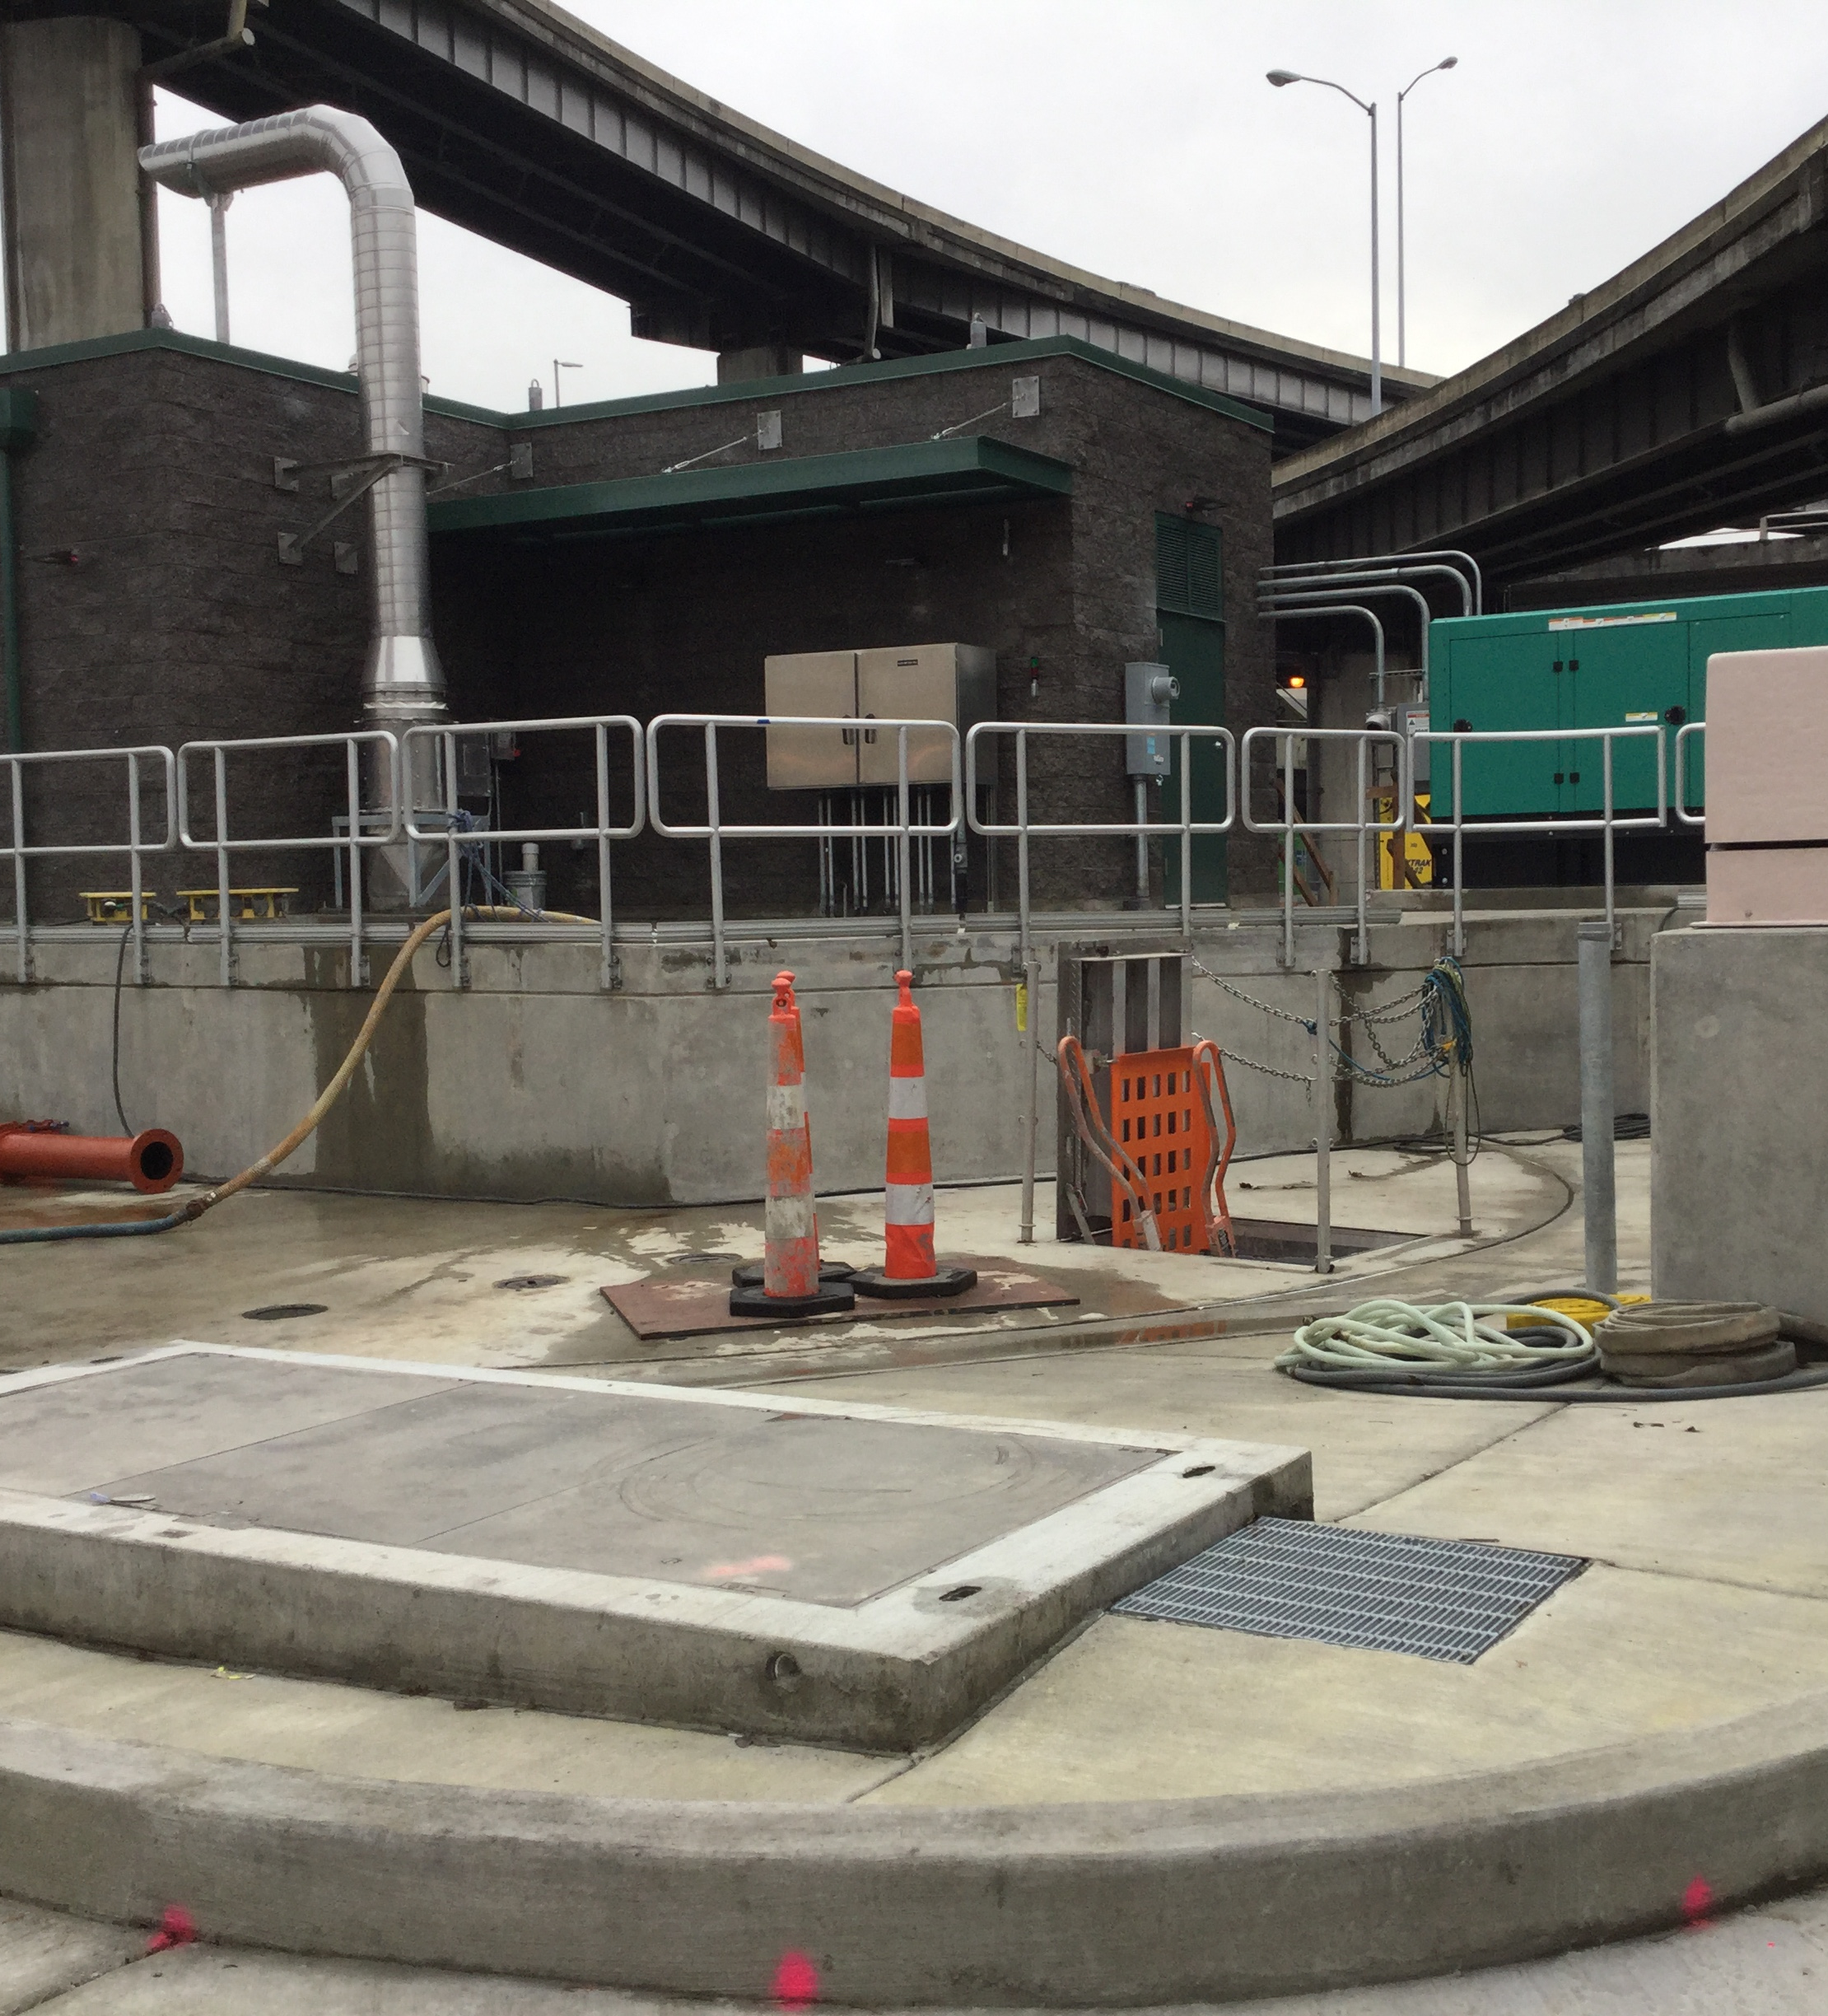
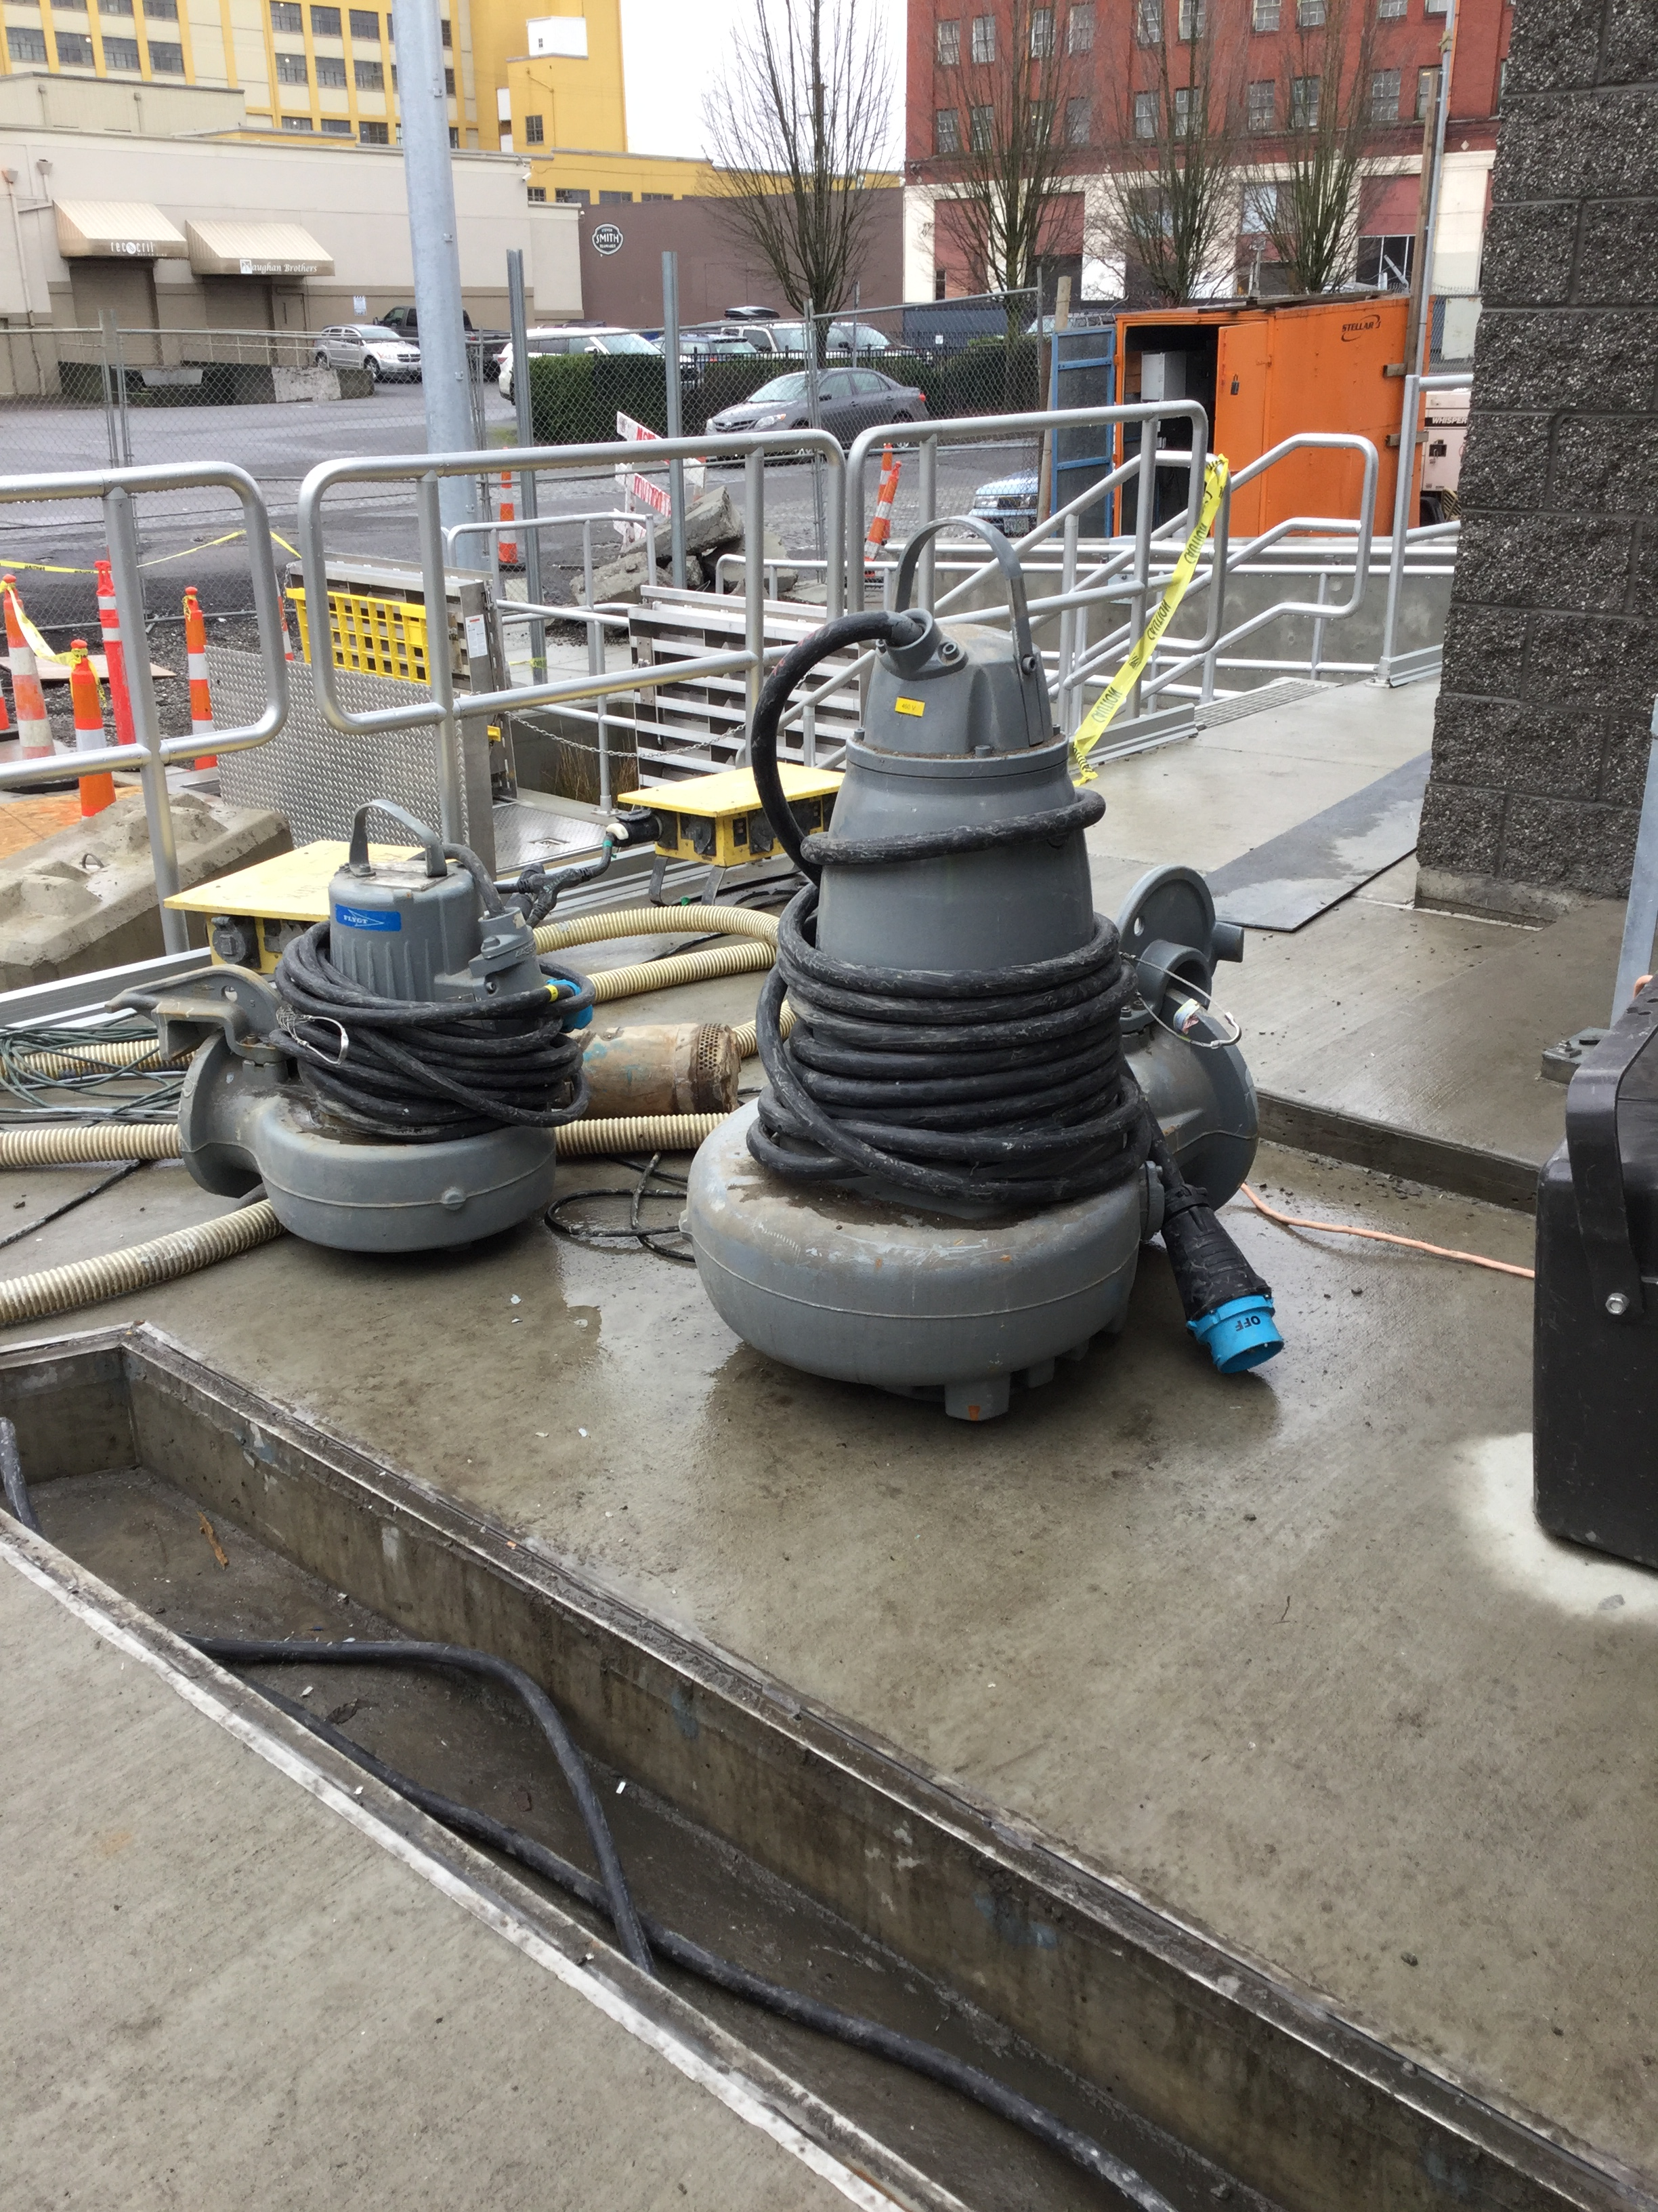

Slide 13
Amendments and Ordinances to Date
Ordinance No: 185681 – Contract Award
  Contract Amount - $357,693
Amendment 1 – Sub-Consultant Change
Ordinance No: 186764 –Contract Amendment No. 2
  Amendment Amount - $352,329
Amendment 3 – Sub-Consultant Change

Slide 14
Amendments and Ordinances to Date
Ordinance No: 188065 –Contract Amendment No. 4
  Amendment Amount - $31,767
Amendment 5 – BES Project Manager Change
Amendment 6 – Contract Duration Extended
Ordinance No: 188131 – Construction Contract Award Authorization
  Authorization Amount: $3,500,000

Slide 15
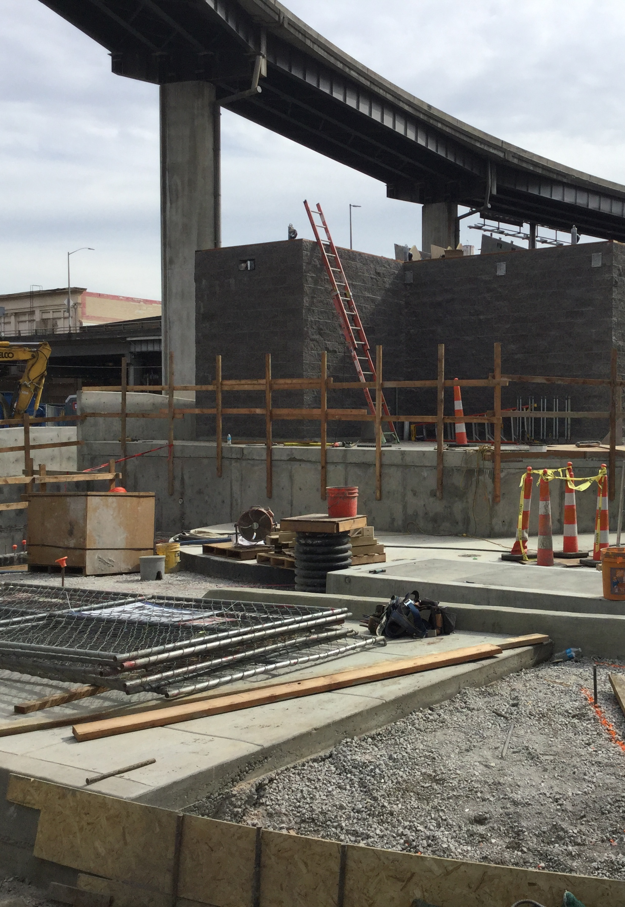
Project Schedule
2011 – Project Initiated
2012 – Brown & Caldwell Awarded PTE Design Contract
2014 – Design Approach Changed to Major Pump Station Upgrade
2017 – Construction Notice to Proceed on 8/1/2017
2019 – Substantial Completion 3/7/19

Slide 16
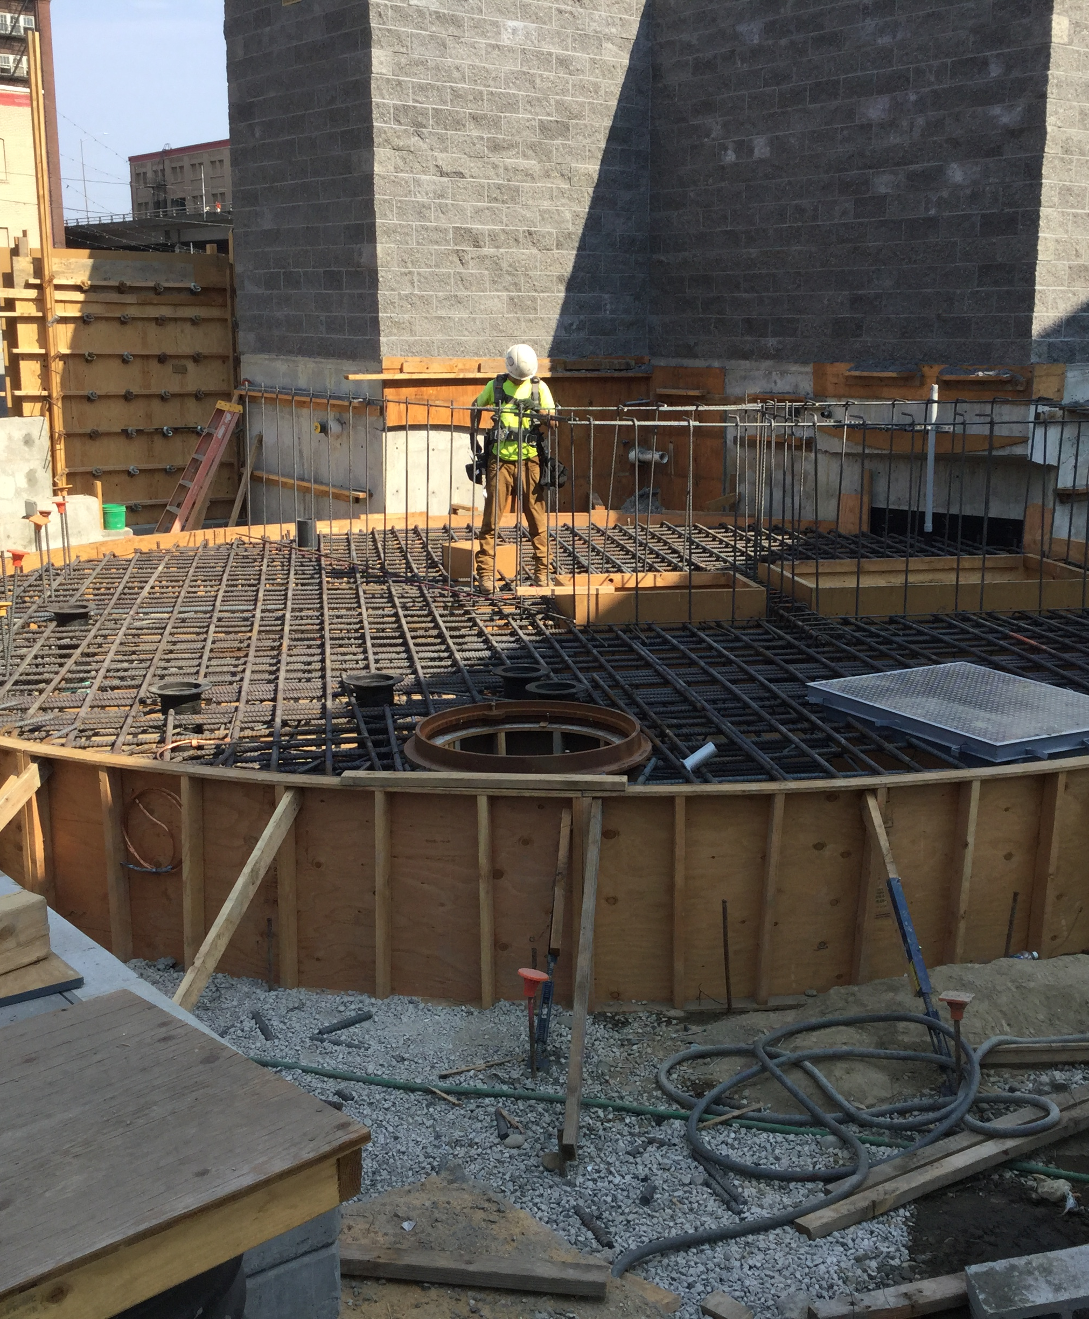
Contract Amount
Current PTE Contract with Prior Council Approval: $741,789
Final Amendment 7 Request to Brown & Caldwell Contract: $85,000
Final Contract Amount: $826,789

Slide 17
D/M/W/ESB
Current Contract Amount: $741,789
  Total D/M/W/ESB Contracts: $251,168
  D/M/W/ESB Participation: 33.9%
Amendment 7 Amount: $85,000
  Amended Contract Amount: $826,789
  Total Amended D/M/W/ESB Contracts: $278,668
  Amended D/M/W/ESB Participation: 33.7%

Slide 18
Recommendation
Authorize Contract Amendment with Brown and Caldwell, Inc. for professional engineering services for the Alder Pump Station Upgrades, BES Project No. E10359, in the amount of $85,000
(ordinance; amend Contract No: 30003063)

Slide 19
Questions
Thank you

