Slide 1
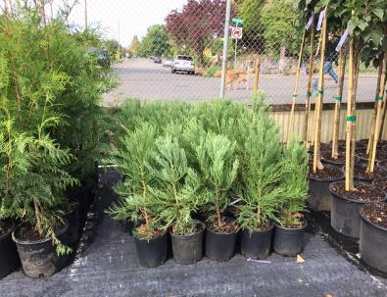
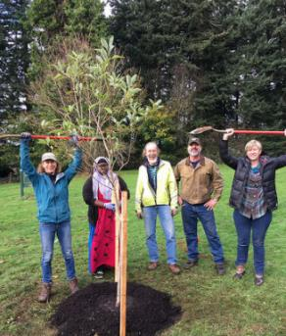
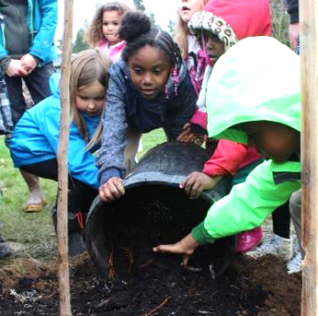
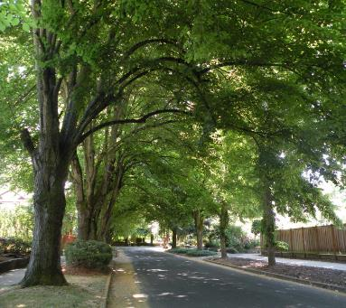
Growing Portland’s Future Forest
Jenn Cairo, City Forester
Angie DiSalvo, Urban Forestry Outreach and Science Supervisor
May 16, 2019

Slide 2
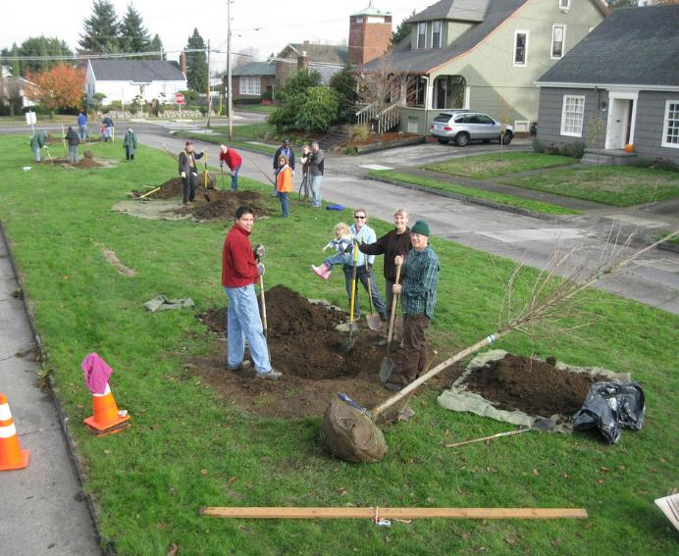
Today’s topics
Urban Forestry overview
Citywide Tree Planting Strategy
Annual Trust Funds Report
Title 11 Amendments

Slide 3
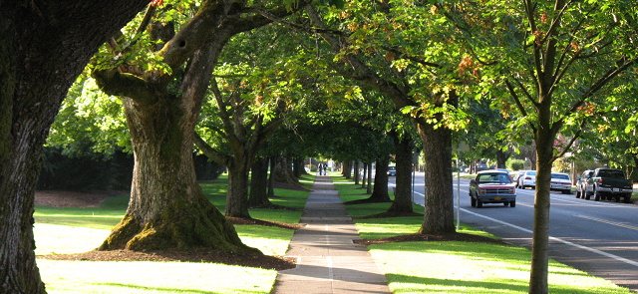
1. PP&R Urban Forestry – the City’s Tree Team
Click to update the date or subtitle – January 1, 2018
Presenter Name, Title

Slide 4
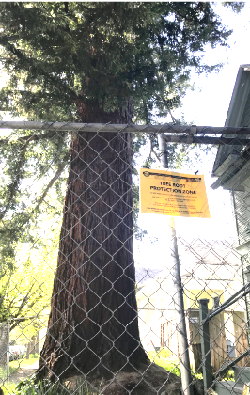
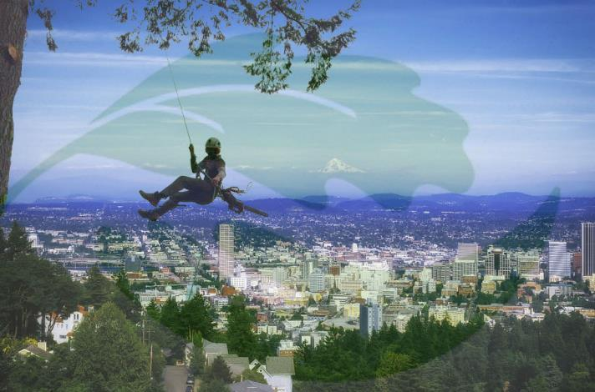
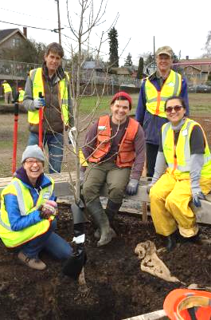
1. PP&R Urban Forestry – the City’s Tree Team

Slide 5
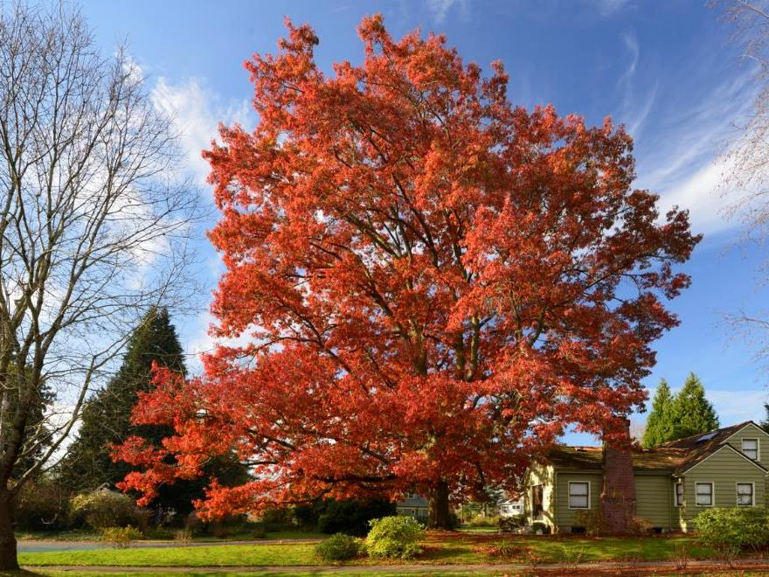
Urban forest infrastructure and services
Public Health
Shade
Community Building
Air Quality
Stormwater Management
Water Quality
Stress reduction
Habitat
Cooling
Energy Conservation
Walkability
Property Value
Jobs
Beauty
Environmental Justice
Climate Action
Heritage Tree #238. Photo by Steve Terrill.

Slide 6
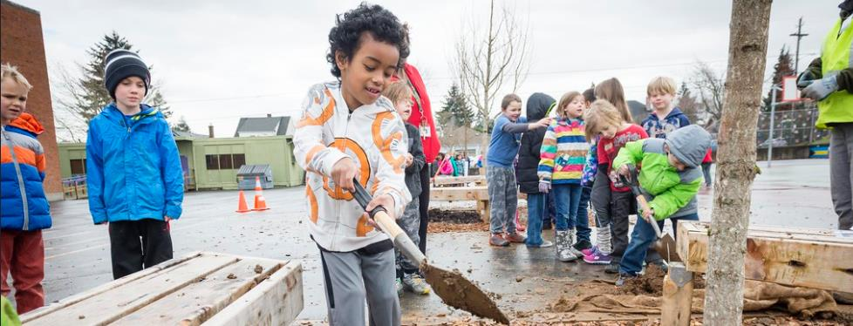
2. Growing a more equitable urban forest
Portland’s citywide tree planting strategy
Click to update the date or subtitle – January 1, 2018
Click to update the date or subtitle – January 1, 2018
Click to update the date or subtitle – January 1, 2018
Presenter Name, Title
Presenter Name, Title
Presenter Name, Title

Slide 7
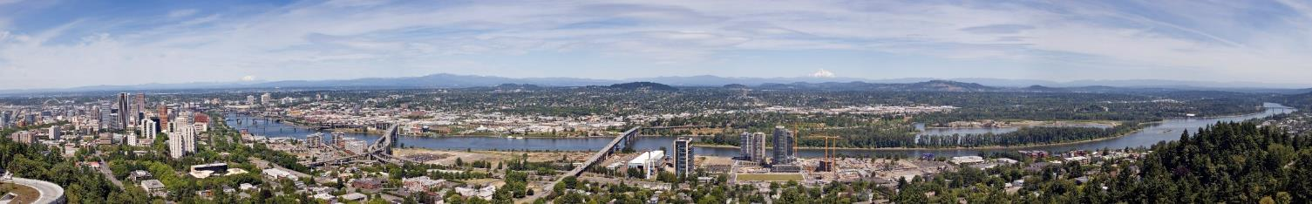
Canopy equity goals:
Urban Forest Management Plan (2004)
Urban Forest Action Plan (2007)
Title 11 Trees (2015)
PP&R Racial Equity Plan (2017)
PP&R Strategic Plan (2017)

Slide 8
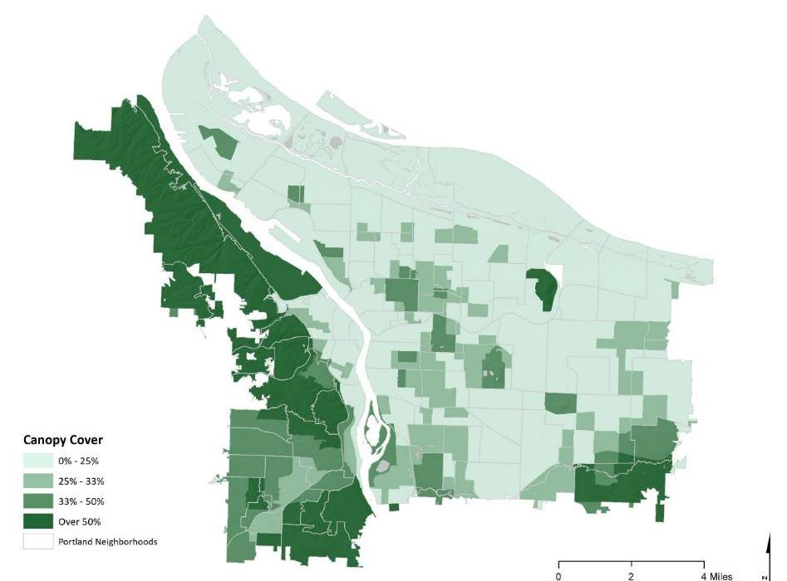
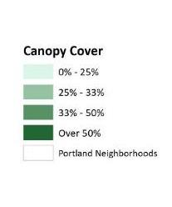
Trees are not distributed equitably

Slide 9
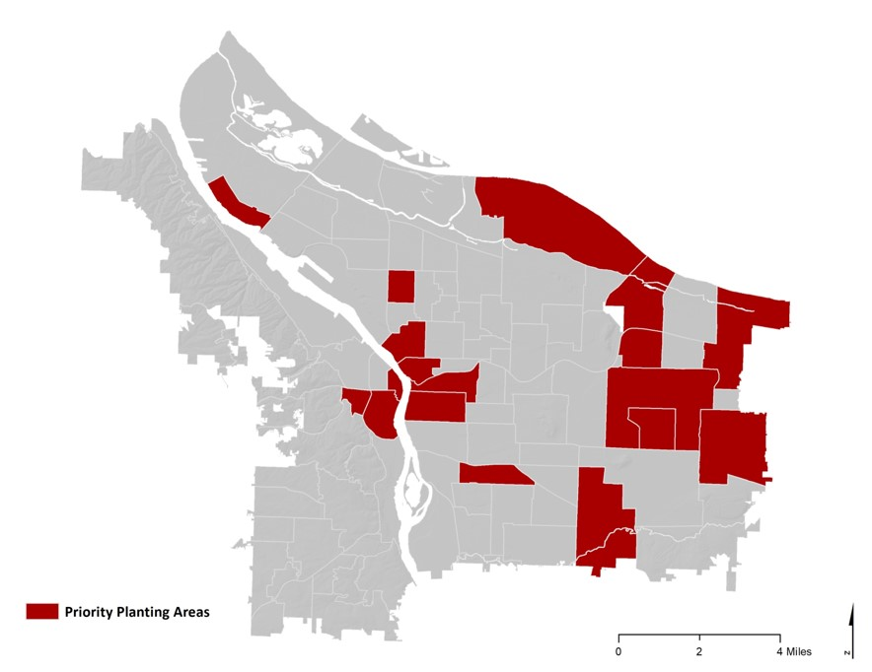
Priority planting areas = lowest canopy + lowest income

Slide 10
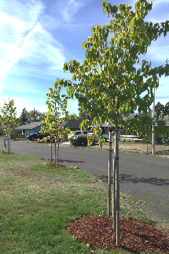
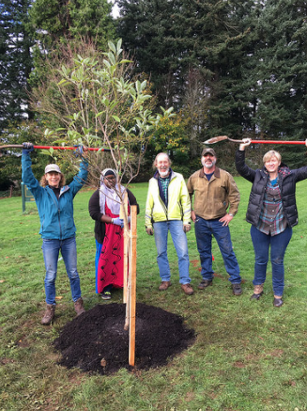
So, do we just plant more trees?

Slide 11

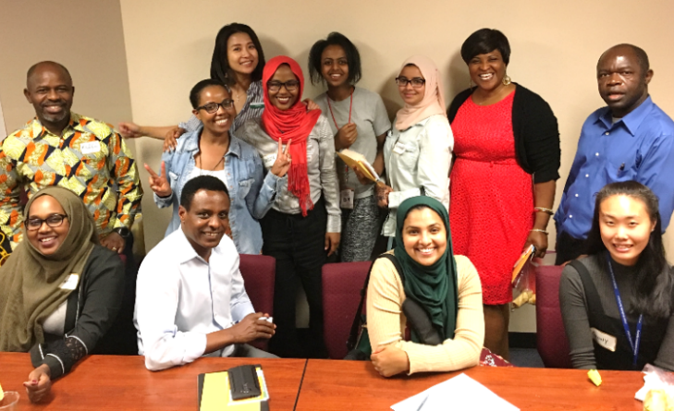
Planting strategy goals:
Engage with communities
Determine barriers and opportunities to tree planting
Develop web tool
Provide recommendations to increase tree equity

Slide 12
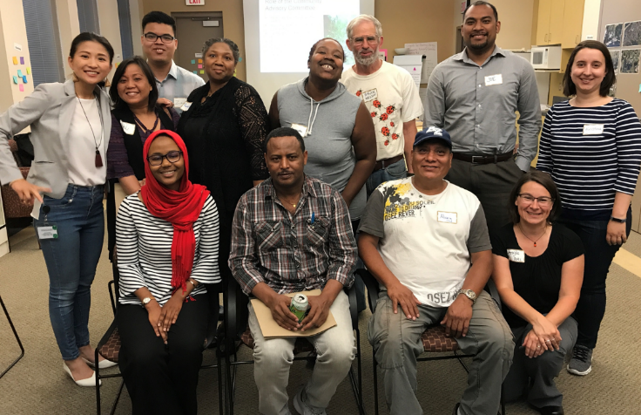
Community Advisory Committee
Anjeanette Brown
Deo Bhandari
Chi Bui
Sumitra Chhetri
Rachelle Dixon
Joe Enlet
Isatou Jallow
Bruce Nelson
Zachary Phan
Kristina Psaris-Weis
Sela Pulotu
Alvey Seeyouma
Hakima Siyad
Thuy Tu, UFC
Desale Woldu

Slide 13
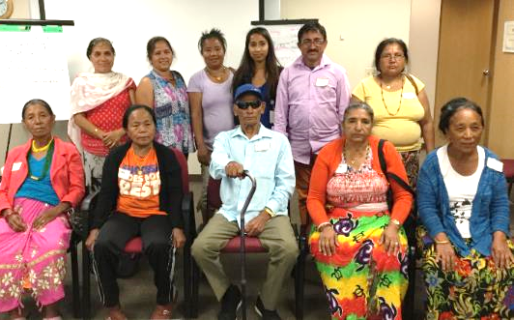
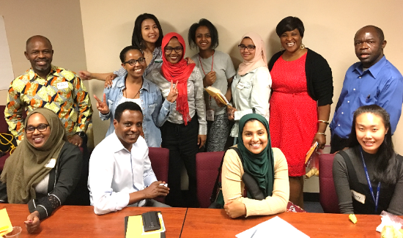
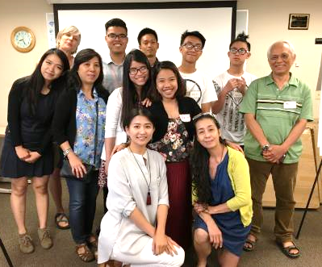
Focus Groups and Public Survey
Bhutanese
Latinx
Pan-African
Slavic
Vietnamese

Slide 14

Technical expert interviews

Slide 15
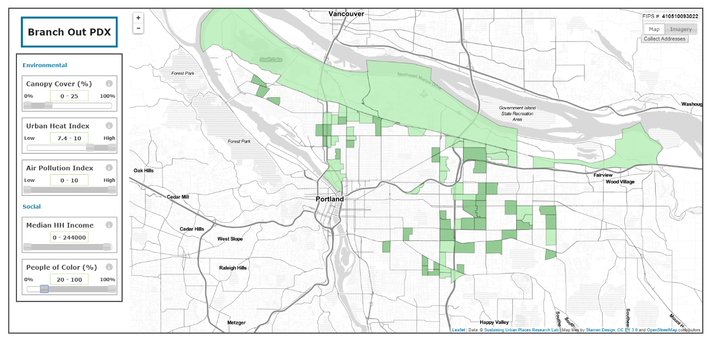
Planting Map Development www.branchoutpdx.org

Slide 16
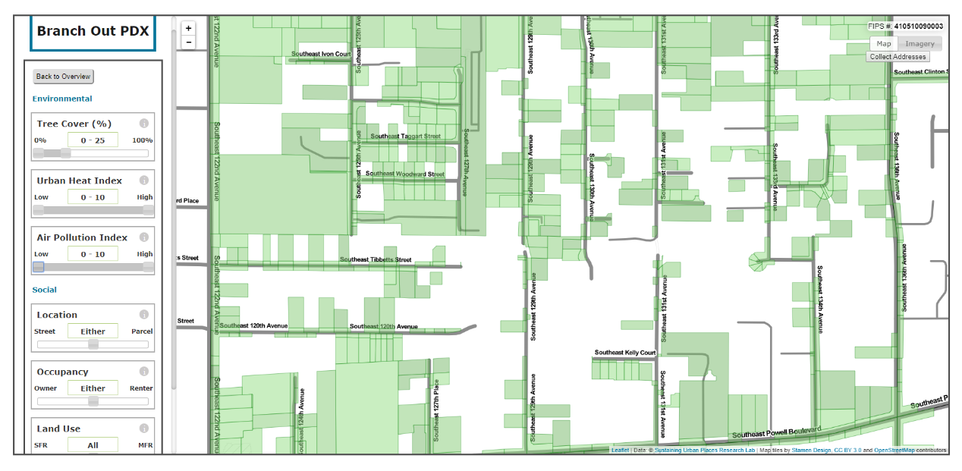
Planting Map Development www.branchoutpdx.org

Slide 17
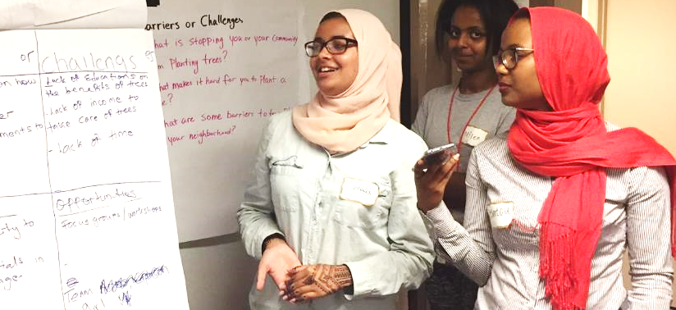
First lesson: Trees are valued

Slide 18
Barriers to tree planting
Varying cultural values and relationships
Competing priorities
Fears and concerns
Cost
Lack of trust
Disempowerment of renters

Slide 19
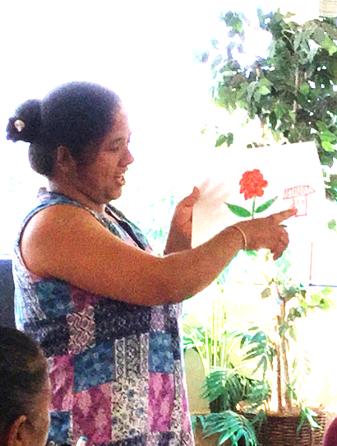

  Immigrants and refugees knowledgeable about trees in their home countries
  Lack of knowledge about Portland’s trees and resources
  High interest in learning more

Slide 20
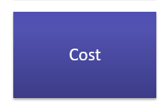
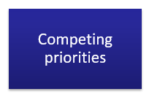
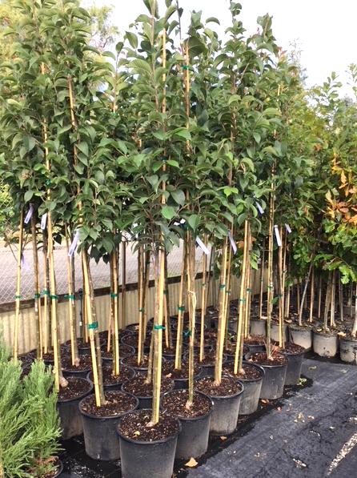
  Initial purchase
  Ongoing maintenance
  Watering
  Pest control
  Leaf clean up
  Sidewalks
  Increased property values

Slide 21
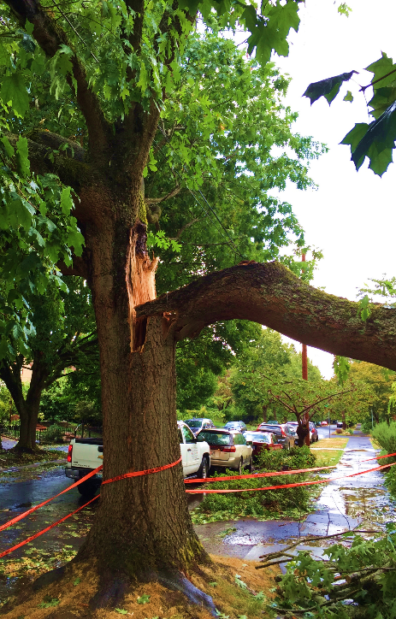

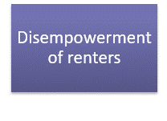
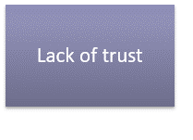
  Initial purchase
  Ongoing maintenance
  Watering
  Pest control
  Leaf clean up
  Sidewalks
  Increased property values

Slide 22
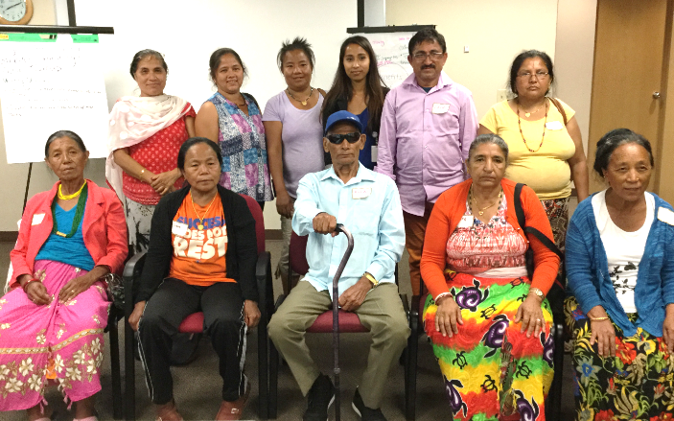

Recommendations

Slide 23
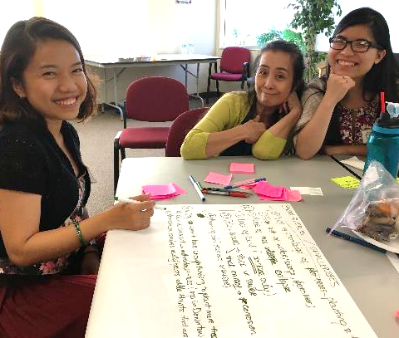
Recommendation:
Fund planting and maintenance
Plant in right-of-way, yards, parks, and schools
Increase planting at rentals
Fund right-of-way tree maintenance

Slide 24
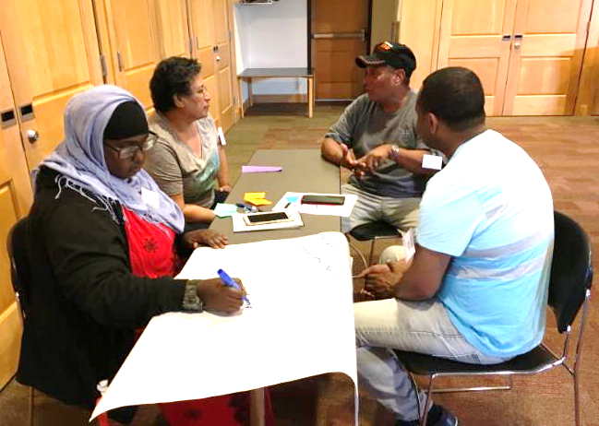
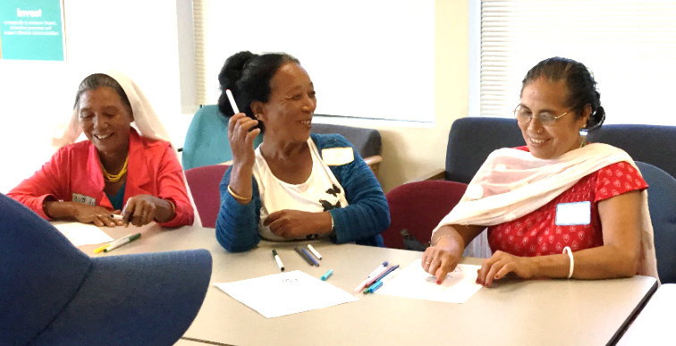
Recommendations:
Conduct culturally-specific outreach and education
Develop partnerships and relationships

Slide 25
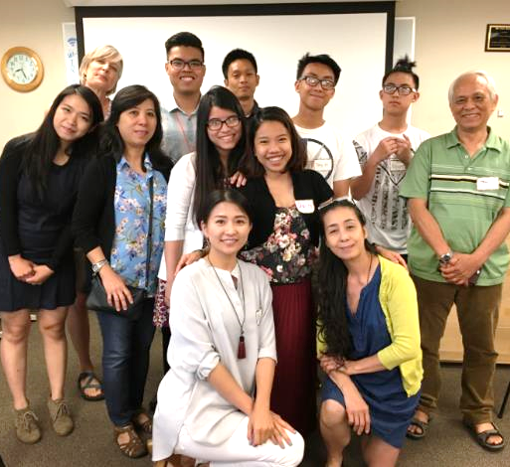
Recommendation:
Improve planning and management
Improve communication and collaboration among bureaus
Promote branchoutpdx.org
Update the Urban Forest Management Plan
Monitor and assess planting efforts

Slide 26

Next steps: let’s make it happen!
Focused planting and outreach in Hazelwood and Mill Park (now through FY20-21)
Council-directed Street Tree Task Force to explore funding street tree maintenance (FY19-20)

Slide 27
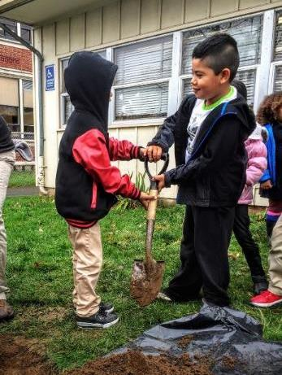
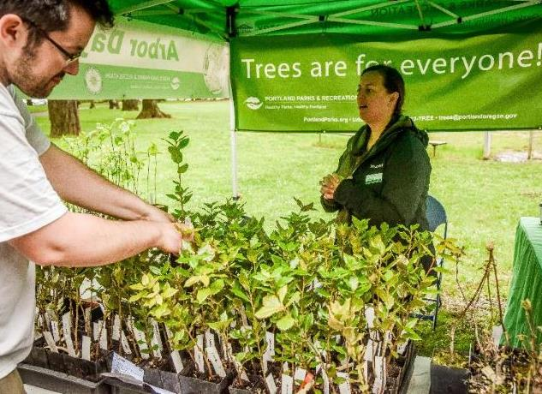
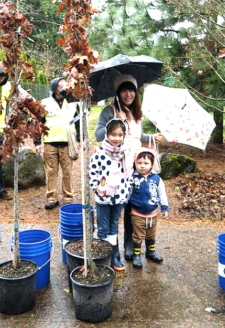
Thank you!
Contact: Angie.DiSalvo@PortlandOregon.gov

Slide 28
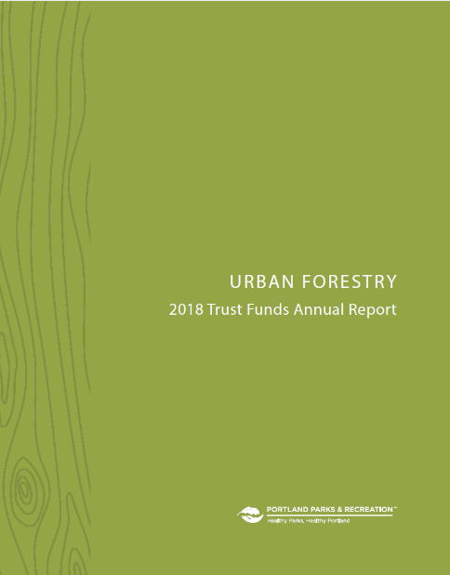
3. 2018 Annual Trust Funds Report

Slide 29
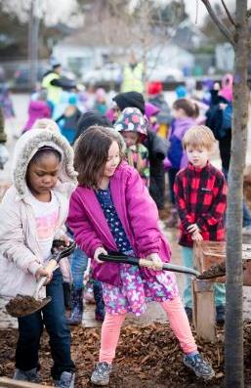
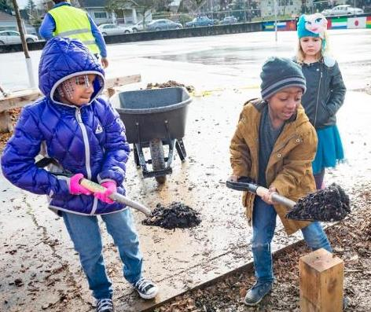
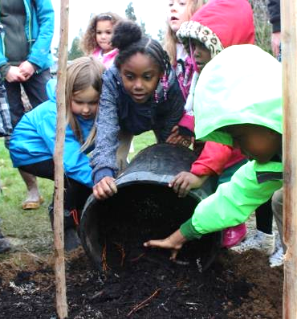
FY17-18 Tree Planting and Preservation Fund
Contributions $1,278,488
Expenditures $ 511,152

Slide 30
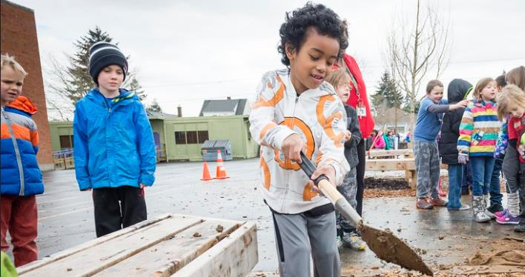
Tree Planting and Preservation Fund
Expenditure highlights
Tree Planting Strategy

Slide 31
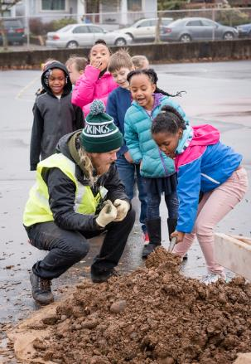
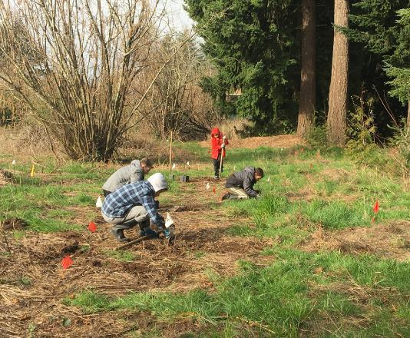
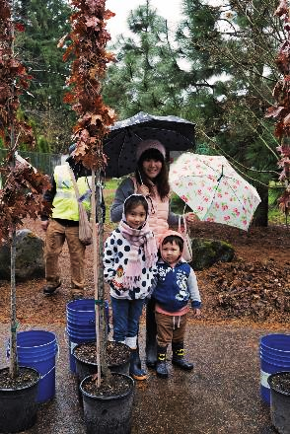
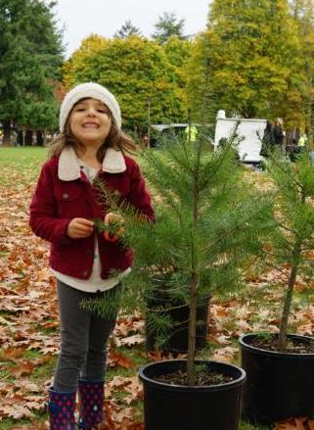
Tree Planting and Preservation Fund highlights
17,988 trees planted

Slide 32
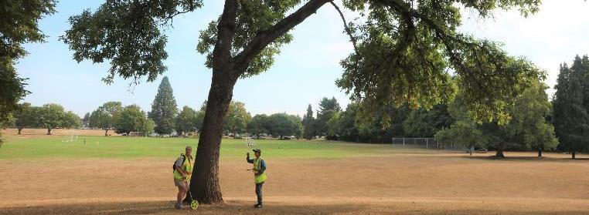
Urban Forestry Fund
Contributions $93,405
Expenditures $84,713

Slide 33




Urban Forestry Fund highlights
Tree inventory Project, outreach, and education

Slide 34

4. Title 11 Amendments
Extend establishment period from 2 years to 5 years
Remove requirement to expend funds in the same watershed where fees are collected

