Slide 1
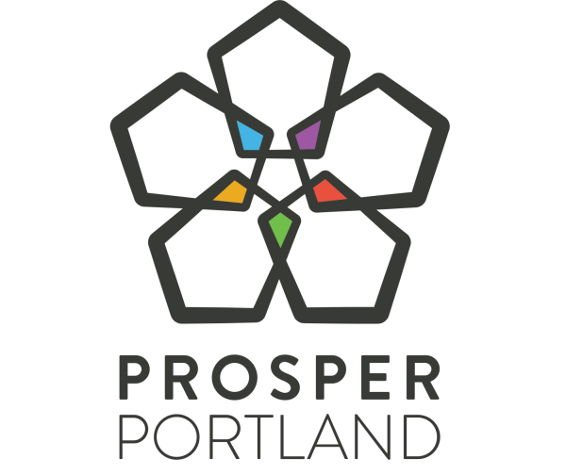
Prosper Portland Proposed Budget
FY 2019-2020
Gustavo Cruz, Chair
Kimberly Branam, Executive Director
Lisa Abuaf, Development & Investment Director
May 9, 2019
Notes:
Thank you, Chair Cruz.
Good afternoon Mayor Wheeler, Commissioners. I’m KB, ED of Prosper Portland.
We appreciate the opportunity to discuss our proposed budget with you. I’m going to focus my presentation on the strategic direction, budget process and resource context and then Lisa is going to provide an overview of the priorities expressed in the budget within each Tax Increment Finance District.

Slide 2

2020 Strategic Plan
Notes:
NEED THEORY OF CHANGE GRAPHIC – BECAUSE OF P2 INTERVENTIONS, WE ADDRESS EACH OF THESE FOUR ACTIVITIES
In response to these trends, the Prosper Portland Board adopted the 2015-2020 Strategic Plan, which guides all of our work. Since the Strategic Plan was adopted, we have initiated new programs, modified others, and are piloting innovative ways of creating great NHDs, growing FW jobs, advancing opps for Prosperity, and convening and collaborating with partners. The Inclusive Startup Fund, the amendments to the Ezone program, and our commercial affordability initiatives are all in response to our Strategic Plan goals.
We have a proven track record of delivering on these goals, as the following slides will demonstrate the prior five years of outcomes of our work.

Slide 3
FY 2017-18 Impacts
Recruitments & Entrepreneurship
Real Estate Projects
2,013
Jobs Created
1,815
Construction Jobs (modeled)*
25%
DMWESB Participation*
Workforce Connections
6:1
Leverage
374
$31.6M
Jobs
Total Investment
Enterprise Zone
Grants
1,068
Jobs Created
$3.2M
Total Grants
$30.86
Hourly Average Wage
$1.6M
Prosperity Investment Program
$97.3M
Private Investment
65%
$ Awarded to POC
$8.9M
Public Investment
*Includes activity from 2017 to present
Notes:
Recruitment + Entrepreneurship
Recruitments/Expansions + small business job creation reporting from IBRN
Workforce Connections
WF Navigator + Worksystems
Ezone
Jobs created – what new Ezone companies estimate their job growth as (Amazon, FXI, Instrument, Nossa Familia, Revant Optics)
Average wage – this is for all companies in Ezone program for the year -- doesn’t include benefits
Private investment – what new to Ezone companies estimate their capital expenditures to be
Public investment – abatement received by these firms
Real Estate Projects
Modeled construction jobs based on ongoing business equity construction reporting: $290M from 2017 - Present
Performance on Lents Commons, Asian Health and Oliver Station -- represents $12.7M to DMWESB subs – we’ve been at 19-20% in the past, this is a high mark for us as an agency
Leverage – every Prosper Portland $1 attracts an additional $6 in outside investment
Total Investment includes CPRL: $9.3M / Com Prop SAG –PSU: $13.3M / Com Redev SAG – Parcel 3: $8.96M
MBE/DBE Breakdown
African-American $17.3M 48.7%
Hispanic $12.3M 34.7%
Asian $2.2M 6.1%
Native American $2.0M 5.5%
White Female $1.8M 5.1%
Total $35.6M 100.0%
Grants
$3.2M total settled grants PIP: $1.6M / CLG: $1.4M / CDIP: $102K
NOTE: no business Loans – 3 EDA loans $395k
N/NE Data (since plan beginning) Has this been updated?
58 total awards. 10 African, 23 African American, 19 Asian, 1 Latino, 3 white, 2 non Profit

Slide 4
Budget Advisory Committee
Arlene Kimura ​ Hazelwood Neighborhood Association​ | Johanna Brickman ​ VertueLab​
Ashley Henry ​ Business for Better Portland​ | Juliana Lukasik ​ Central Eastside Industrial Council​
Bryson Davis ​ Hill Block Project Working Group​ | Kari Naone ​ TiE Oregon​
Cora Potter ​ Lents Neighborhood Association​ | Jenny Glass ​ Rosewood Initiative​
Corky Collier ​ Columbia Corridor Association​ | Michael Harrison ​ Oregon Health Science University​
Dan Zalkow ​ Portland State University​ | Oscar Arana ​ Native American Youth and Family Center​
Duncan Hwang ​ Asian Pacific American Network of Oregon​ | Owen Ronchelli ​ Go Lloyd​
Haben Woldu ​ N/NE Community Development Initiative​ | Rana Uzzaman ​ Council for Economic & Racial Equity​
Helen Ying ​ Old Town Chinatown Community Association​ | Skip Newberry ​ Technology Association of Oregon​
James Paulson ​ Worksystems Inc​ | ​

Slide 5
Budget Outreach
Central Eastside Industrial Council
East Portland Action Plan Economic
Go Lloyd
Hazelwood Neighborhood Association
Lents Neighborhood Association
Lloyd EcoDistrict
N/NE Community Development Initiative
  Old Town/Chinatown Community Association
  Gateway Investment Group/Gateway Area Business Association
  South Portland Neighborhood Association
  SE Uplift
Notes:
Restored full funding to loan match program in N/NE to support eligible Prosperity Improvement Program grant recipients
Explore opportunities to increase TIF resources and community investments in Gateway Regional Center (extending last date to issue debt) and Lents (increasing maximum indebtedness)
Interest in year-long, more interactive Budget Advisory Committee role

Slide 6






FY 2019-20 Budget Dashboard
Resources
Expenditures
Staff
$372.7 M Total
(net of transfers)
91 % Tax Increment Financing +
Beginning Balances
5% Property Income & Revolving
Loan
2% General Fund
1% Community Development Block
Grants
1% Enterprise Zone Community Fund
$158.9 M Total
(net of Housing)
10 % Personnel
3 % Administrative
81 % Capital (infras & redevel)
6 % Economic Dev. Programs
90.2 Total FTE/LTE
Largest staff programs:
27 FTE/LTE
Development & Investment
22.5 FTE/LTE
Economic Development
12 FTE /LTE
Social Equity, Policy & Communications
Notes:
The next slide provides a quick snapshot of our overall budget. Of the $372.7M in resources this year, we anticipate up to $159M in total expenditures.
You’ll note that $7.1M in General Funds – includes the base budget of $5.9M and $1M w/ the Mayors Proposed Packages (note $200K different to get to $7.1M is the amount of Revenue Sharing related to the six NPI districts that the City receives but sends back to the districts per the 2012 agreement. This may seem like a modest portion of the overall budget but it represents about 20% of our operating budget.
The vast majority of resources are existing cash balances in TIF districts and new TIF that will be issued next year.
To support this work, we employ a total 90.2 FTE and LTE– with the staff levels for our three largest external-facing departments noted below. This is approximately 3 positions (LTEs) less than we included in the Requested Budget.
PDC’s total estimated resources are $342 million for next fiscal year.
Approximately half of the resources available is cash on hand represented by the beginning fund balance from prior bond sales and tax increment, land sales, and other program income.
About one-third of the resources will be from new tax increment resources, mainly in Interstate, Lents, River District and North Macadam URAs.
Consistent with prior years, City General Fund resources represents 2% of planned resources or $5.5 million.
General Fund resources combined with Grant resources and Enterprise Zone fees make up the majority of PDC’s citywide economic development programing.
86% of the resources are TIF based

Slide 7
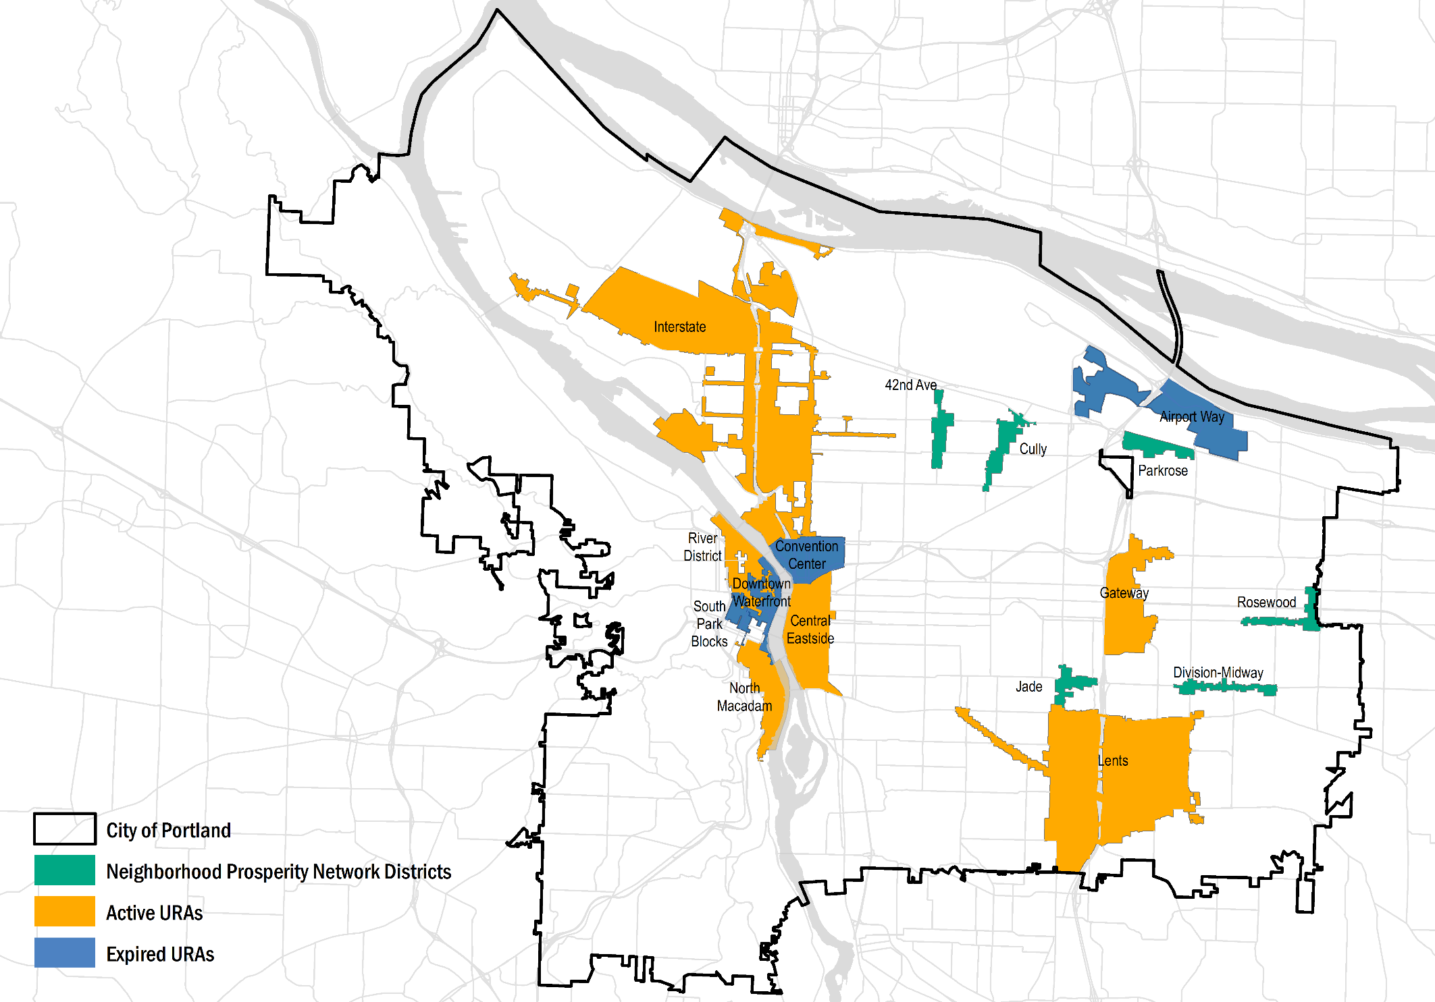
TIF Districts

Slide 8
INDEBTEDNESS & DEFEASANCE
2021/2022
N/A/2023
2025/2029
2020/2026
2013/2025
2008/2024
2022/2030
2008/2024
2023/2023
2011/2020
N/A/2022
Last date to issue long-term debt/Estimated year of bond defeasance
Notes:
This chart illustrates the maximum indebtedness each district and for each district how much of the indebtedness has been issued so far.
The green part of the bar illustrates what’s still available to issue in each district –
All districts are anticipated to reach maximum indebtedness based on their financial capacity with the exception of Gateway (about $64M short). South Park Blocks did not reach maximum indebtedness when the final date to issue debt occurred in 2008.
Finally – the dates show for each district the last date to issue debt as established by each district’s plan along with when the estimated date each district will be defeased – that is when all the bonds are expected to be paid off and new tax increment collections will cease.
Airport Way is the first district that will defease in June of 2020. The last district is estimated to be Gateway in 2030

Slide 9
AFFORDABLE HOUSING SET-ASIDE
Notes:
Since the Set Aside Policy update in 2015, $142M has been spent or allocated in the current year budget to the Housing Set Aside (39% of eligible TIF resources on average).
Central Eastside, Gateway and to a lesser extent River District are trending below what was programmed so far, however, the resources are programmed in the five-year forecast to the Housing Set Aside and will be delivered as Housing projects move foreword (for example, implementation of Broadway Corridor master plan and remaining River District resources.
All together, between 2006 (the beginning of the set aside) and 2025, a total of $540M in TIF resources will be spent on affordable housing.

Slide 10
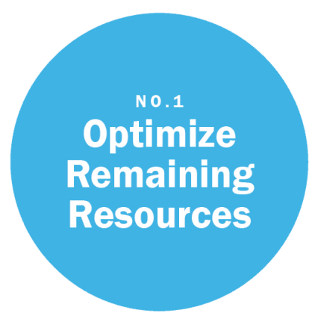
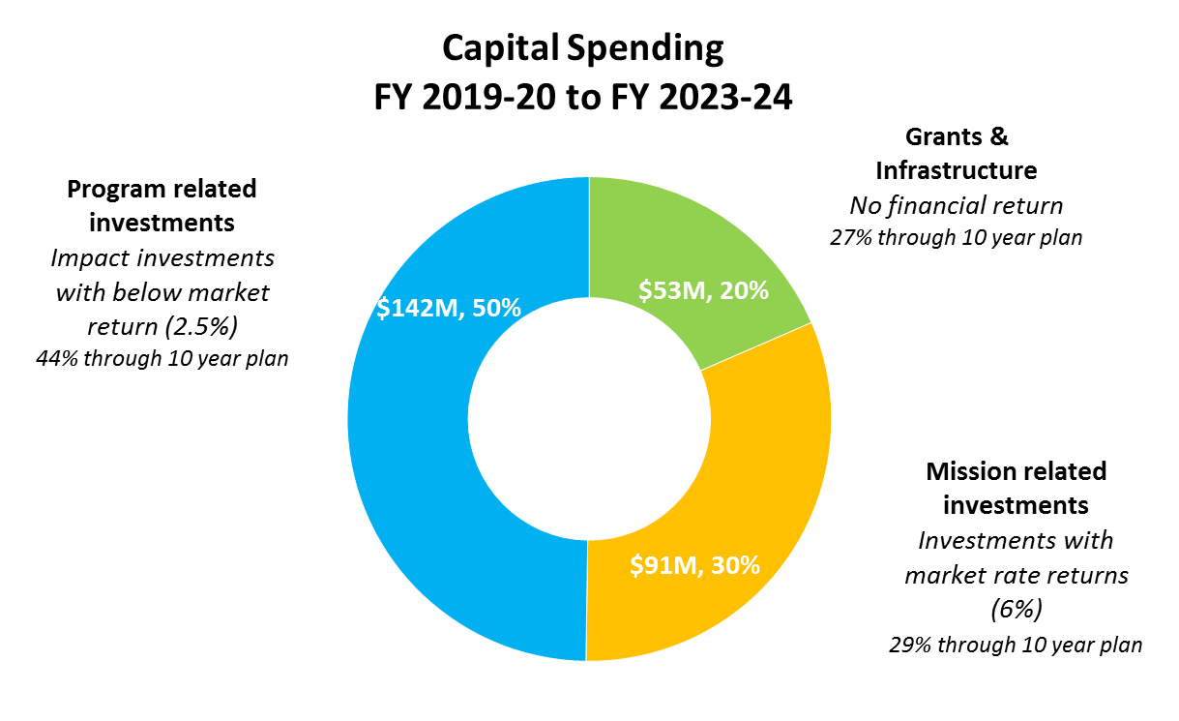
Optimize Remaining TIF
Notes:
Broadway Corridor, ODOT Blocks, Rose Quarter, OT/CT Investments
Updated financial investment policy and asset management approach
Seek public benefits that result in a financial return
Have a leverage target and maximize non-agency resources
Limit grants, infrastructure, and loan forgiveness to annual agency-wide budgets
Implement asset and property management software to increase analytical & forecasting capabilities
Create operating plans for each property
REMOVE $ AND % FROM LABELS, PUT THEM INSIDE DONUT; IN THEIR PLACE, PUT (IMPACT FIRST INVESTMENTS, FINANCIAL FIRST/MARKET RETURN)
GIVE EXAMPLES OF DIFFERENT KINDS OF INVESTMENTS
As we refine the business plan, we have become clearer about how we talk about the types of project and program investments and the public benefit and financial return anticipated to support reinvestment in future years of the business plan.
There are three basic categories:
Grants and Infrastructure – which meet all policy goals and high levels of public benefit and no repayment or return
Program Related Investments which meet all policy goals and high levels public benefit – where we anticipate repayment and no or below market return on investment.
Mission Related Investments which meet all policy goals and there is an anticipated repayment and market return on investment.
Program Related Investments assume average 2.5% return on all new lending and 3% on all other projects…over five-year we have allocated $130M or 45% of URA budgets toward these investments. Includes action plan investments for N/NE, Gateway and Lents, and future projects in North Macadam and Central City investments.
Mission Related Investments assume average 6% return on several projects… over the five-year budget forecast we have allocated $80M or 27% of URA budgets toward these investments. Includes Broadway Corridor, ODOT Blocks, and Oregon Convention Center URA investments.
These categories provide the overall benchmark for how a important component of the business plan revenues are generated – actual implementation will be different over time

Slide 11
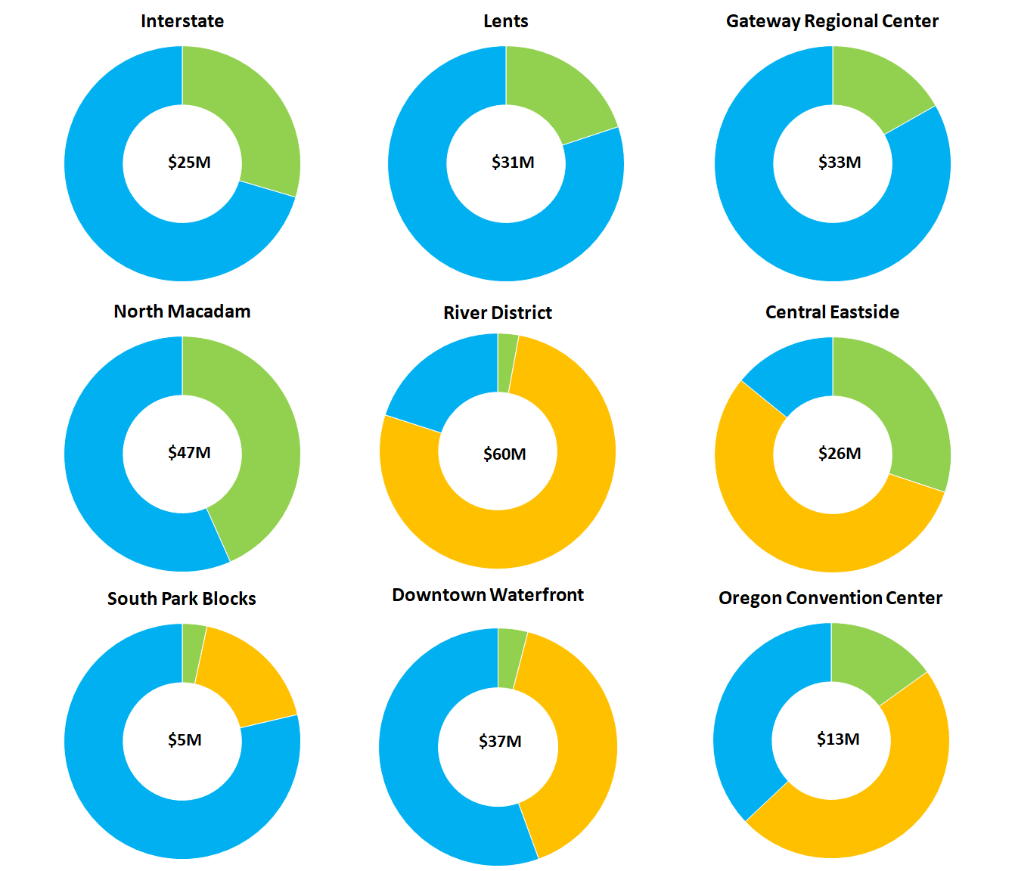
Optimize Remaining TIF by District
Program Related (2.5%)
Infrastructure
& Grants
Mission Related
(6%)
Notes:
IMPACT OF 3% VS 6%?
USE SAME ‘IMPACT FIRST’ LANGUAGE FROM PRIOR SLIDE
Breaking down the investment categories by urban renewal area, we can see how the relative investment programming works.
Neighborhood URAs are primarily Program Related Investments (green) with additional grant and infrastructure investment as show in blue.
Most Central City URAs are currently programmed with more of a mix of investments, River District, Downtown Waterfront and Oregon Convention Center are programmed with higher amounts of Mission Related Investments, where we anticipate more market level returns with some of the projects moving foreword.
This does not include existing real estate assets, however, anticipated programming for those assets basically follow the same structure as the budgeted funds. We’ll be reviewing these allocations and overall impact to the business plan as we continue to finalize the plan in the next month.

Slide 12
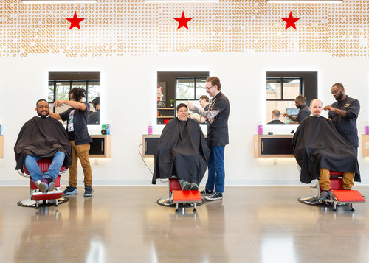
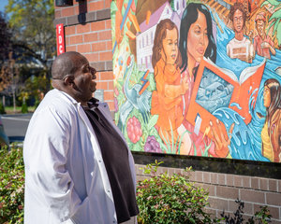
NORTH/NORTHEAST: INTERSTATE CORRIDOR BUDGET SUMMARY
Recent Accomplishments
  N/NE Community Development Initiative
  Alberta Commons construction and affordable commercial tenanting
  Small business & long time property owner assistance
  Community livability grants
Notes:
Page 120
$32 million non-housing set aside Investments guided by the N/NE Community Development Initiative adopted in 2017
Plan developed with significant community input and focuses on Fostering Economic Prosperity Among African Americans and People of Color in N/NE
Primary goals are around supporting businesses, long time property owners, and anchor community nonprofits
Recent accomplishments include completion of the Alberta Commons project and community based affordable commercial tenanting at the Alberta Commons
82% of the construction was performed by Disadvantaged Business Enterprises (DBE) or Minority, Women and Emerging Small Businesses (MWESB) with 67% of that number performed by DBE and MBE firms
Champions Barbershop opened April 20, greenHAUS gallery is scheduled to open shortly and Cason’s Fine Meats will open at the new location in June
Over the past two years, we’ve served approximately 50 N/NE businesses and long time property owners with our Prosperity Investment Program (or PIP) grant, with 90% of those for people of color businesses or property owners

Slide 13
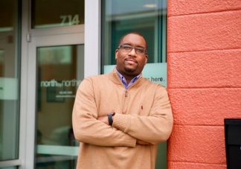
NORTH/NORTHEAST: INTERSTATE CORRIDOR BUDGET SUMMARY
Upcoming Activities
  N/NE Community Development Initiative
  Cultural Business Hub
  Small business & long time property owner assistance
  Asset management
  Alberta Commons master lease
  Nelson properties in Kenton
Notes:
Page 120
We have made strong progress which will continue on our support via small business and property owner grant assistance
This year we will be focusing on the pipeline for larger-scale property development loan projects
We will continue working with the Portland Housing Bureau to provide their Down Payment Assistance and Home Ownership support to a broader range of income levels to buy and improve their homes in N/NE
And we will be coordinating with our Oversight Committee to issue a notice of funding opportunity for the development of cultural business hub projects in the community

Slide 14
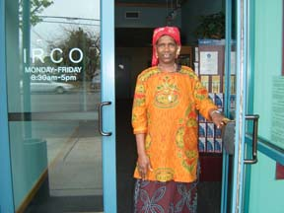
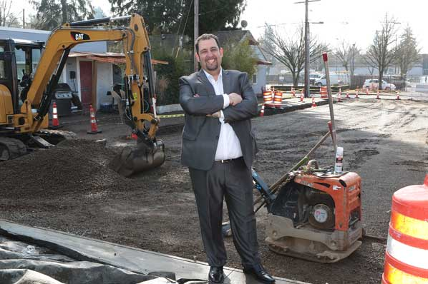
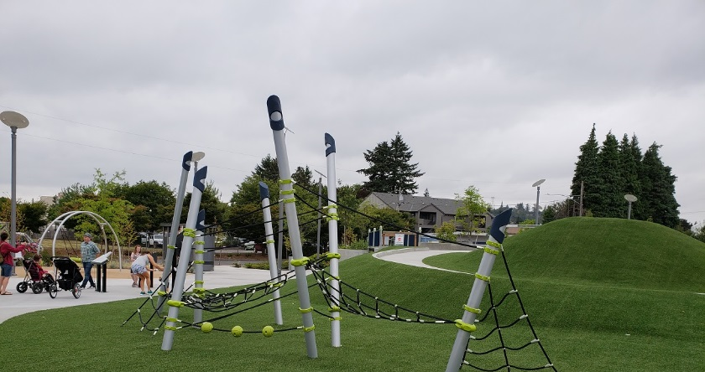
GATEWAY REGIONAL CENTER BUDGET SUMMARY
Recent Accomplishments
  Gateway Action Plan
  Halsey/Weidler street improvements
  Gateway Discovery Park
  106th/Halsey design
  Small business & long time property owner assistance
  Community livability grants
Notes:
Page 118
Gateway has available approximately $32M in non-setaside resources that are similarly guided by the Gateway Action Plan adopted in July 2016
Working with the community, the Action Plan focuses on three geographic areas for Prosper investment
At the Halsey/Weidler couplet, the Gateway Transit Center and in Central Gateway centered around 102nd and Burnside south to Mall 205
Our early focus has been the Halsey/Weidler couplet
Over the past two years, we’ve served approximately 10 Gateway businesses, primarily along the Halsey/Weidler couplet and communitywide with our Prosperity Investment Program (or PIP) grant, with 60% of those for people of color owned businesses or property owners
We’ve partnered with PBOT on the Halsey-Weidler Streetscape Project with the goal of improving safety, operations and multimodal access along the couplet
We’ve partnered with Parks by providing land and investment in the Gateway Discovery Park, Portland's newest Urban Park, which had it’s grand opening last August.
The Park brings inclusive play and wonderful gathering areas to East Portland
And, through our Community Livability Grant program, we’ve supported community nonprofit like IRCO’s Africa House

Slide 15
GATEWAY REGIONAL CENTER BUDGET SUMMARY
Upcoming Activities
  Gateway Action Plan
  106th & Halsey construction
    75 mixed-income units
    Affordable commercial
  Central Gateway
  Gateway Transit Center
  Small business assistance
  Community livability grants
Notes:
Page 118
Over the coming year, we’re excited to partner with the Portland Housing Bureau and Human Solutions on a new mixed use project at 106th and Halsey
The project is located right next to the park and along an important retail area for the Gateway community
The project will bring new residents and businesses to this area and include a breakdown that has shifted by 12 units since the community was last involved – which you may hear testimony about from the community during this budget process.
The shift between market rate and affordable unit was due to the loss of a New Market Tax Credit investor; to keep our commitment of a mixed-income, mixed-use project that helps activate the park and businesses along Halsey, the Portland Housing Bureau and Prosper Portland are prepared to move forward with the proposed mix of units which includes:
52 affordable units
23 market rate units
~10K SF Human Solutions office
And on the ground floor facing the parks plaza, there will ~11K SF retail which we will own and lease under our Affordable Commercial Tenanting Program
We will also be moving forward efforts on the two other community nodes highlighted in the Action Plan
Working with PBOT to support the LID and new development at 97th and Burnside
And working with David Douglas School District, Mt Hood Community College, and other institutional and community partners on the potential for an education and economic development focused project at the Gateway Transit Center

Slide 16
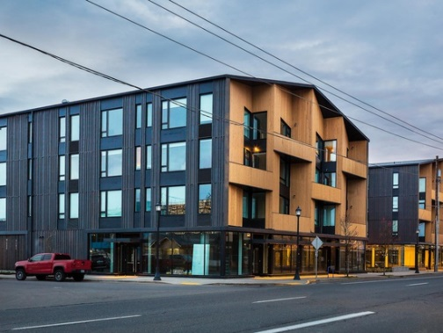
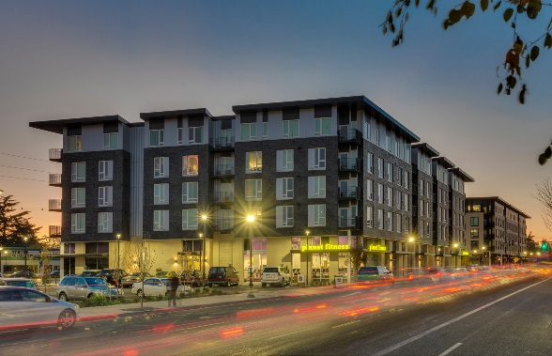
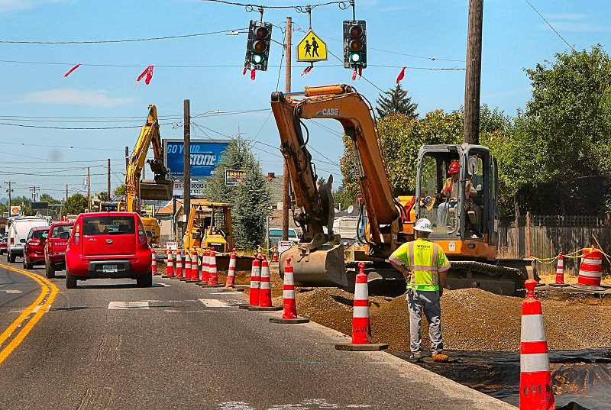
LENTS TOWN CENTER BUDGET SUMMARY
Recent Accomplishments
  Lents Action Plan
  Lents Town Center, 263 new units
    157 units <60% MFI
    48 units 80-100% MFI
    58 units market rate
    Affordable commercial
  Asian Health Services Center
  Foster streetscapes
  Small business & long time property owner assistance
Notes:
Page 122
In Lents, our investments are also guided by a 5 year action plan adopted in May 2014 with a focus on investments in the Lents Town Center; the Foster/82nd/and 122nd Commercial Corridors; affordable housing; and industrial and open space
Our early investments of have focused on the Lents Town Center area and have been in close partnership with the Portland Housing Bureau. Together, we invested approximately $50M to help stabilize the community and the Town Center’s growth.
In total Phase 1 development in the town center added over 260 new housing units, including 205 affordable and income-restricted units (78 percent), and commercial space for 10 businesses, including affordable commercial space opportunities in two of the projects.
Phase 1 projects include:
The new 30,000 SF Asian Health Services Building which opened in August of last year
Oliver Station (145 units, 6 @ 30% MFI, 119 @ 60% MFI, 20 @ market)
Lents Commons (54 units, 16 @ 60% MFI, 38 @ market)
Woody Guthrie (64 units, 16 @ 30% MFI, 48 @ 80-100% MFI)
Collectively, the projects achieved a 26% Business Equity goal in construction, with 21% performed by MBE and DBE firms
We have also partnered with PBOT on the Foster Transportation and Streetscape Project to improve safety within the community – the streetscape project includes
Road reconstruction and repaving
New upgraded traffic signals, wider sidewalks, and median refuge islands with flashing beacons
And new upgraded ADA curb ramps at 69 locations.
To support businesses and property owners stabilize in the face of new construction along Foster and the market changes in Lents, over the past two years we have provided:
20 small business grants, primarily along the commercial corridors with 50% of those supporting people of color owned businesses or property owners

Slide 17
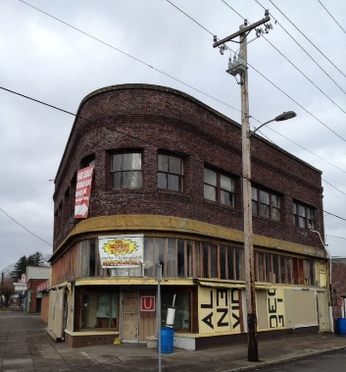
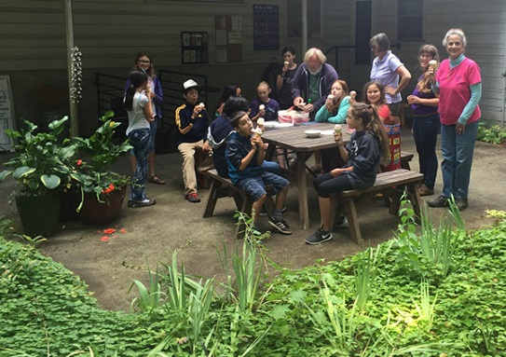
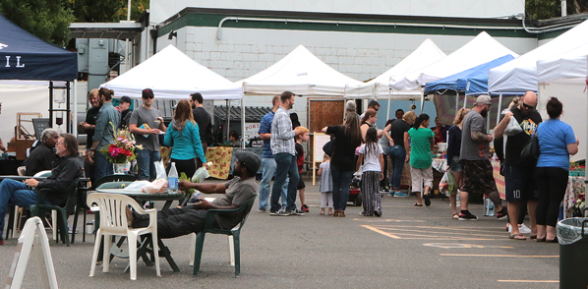
LENTS TOWN CENTER BUDGET SUMMARY
Upcoming Activities
  Lents Action Plan
  Lents Town Center (Bakery Blocks and 92nd/Harold)
  Small business and long time property owner assistance
  Leach Botanical Garden expansion
  Asset management
  Lents Commons (9101 LLC)
Notes:
Page 122
Looking forward, we have been engaging with the community in partnership with the Portland Housing Bureau to help define development goals for Lents Town Center phase 2 development
Based on community input, we anticipate the development to continue to build on Phase 1 and provide a mix of income units to the community, as well as new affordable commercial space, and a plaza that will help provide a long term home for the Lents International Market - the only market in Portland with an intentional international focus, providing fresh, affordable, and culturally appropriate produce to Lents’ diverse communities.
We will continue to support small businesses; community anchors and nonprofits, like Leach Botanical Gardens, Wisdom of the Elders and Rose CDC; as well as long term property owners interested in redeveloping their property – like the owners of the Phoenix Pharmacy

Slide 18
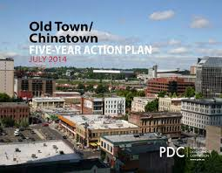
OLD TOWN/CHINATOWN: DOWNTOWN WATERFRONT AND RIVER DISTRICT BUDGET SUMMARY
Notes:
Page 115 and Page 127
In Old Town/Chinatown, our investments have focused on the goals of the 5 year action plan adopted in July 2014, with a commitment of $57M of TIF resources across the River District and Downtown Waterfront budgets
The majority of this commitment is shown as Old Town/Chinatown line items in each of those budgets together with the majority of grant and loan program dollars in each of those areas
Community stakeholders have asked to extend the Action Plan and we anticipate returning to Council this summer with the community association seeking approval of an updated and extended action plan

Slide 19
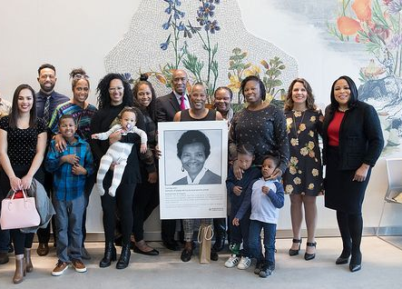
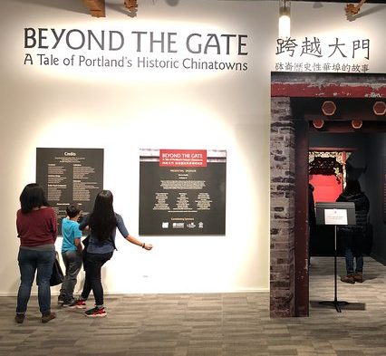
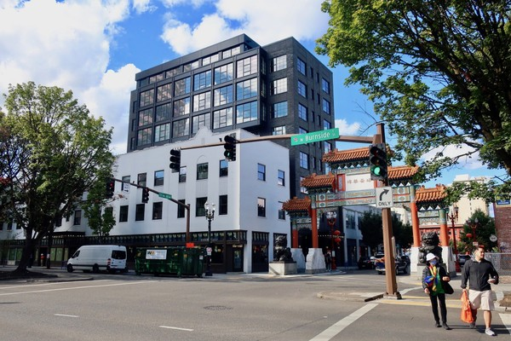
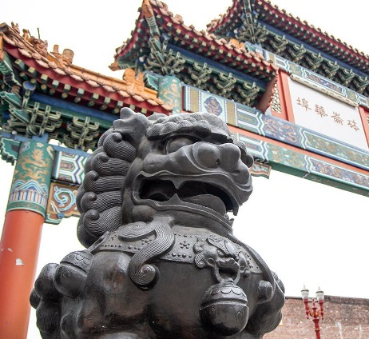
OLD TOWN/CHINATOWN: DOWNTOWN WATERFRONT AND RIVER DISTRICT BUDGET SUMMARY
Recent Accomplishments
  Old Town Chinatown Action Plan
  New mixed-income housing (38 Davis, SW 3rd and Ash, Erickson-Fritz)
  Small business assistance
  Community Livability Grants
  Hoxton Hotel
  Gladys McCoy Health Department Headquarters
  Portland Chinatown Museum
  4th & Burnside and Block 25 Request for Proposals
Notes:
Page 115 and Page 127
The Action Plan focuses investments in three key areas
Neighborhood Investments, business vitality and district livability
Each of these areas have specific measures of success, including
A goal for 500 new moderate-income housing units – to date, 250 new units of housing have been built at the 38 Davis, 108 SW 3rd project currently under construction, and via the renovation of the Erickson-Fritz.
Of these, there are 45 affordable at 38 Davis and 108 SW 3rd and another 52 units at the Erickson-Fritz
Rehabilitation of 5 buildings to support historic renovation and seismic retrofit in the area
To date, resources have been invested in the rehabilitation of the Overland Warehouse, Society Hotel, PNCA, Pine St. Market, and Hoxton Hotel, amongst others
24% of construction at the Hoxton Hotel was performed by MWESB and DBE businesses with 12% of that performed by DBE and MBE contractors
Business vitality goals focused on supporting small businesses and new jobs to the district
Over the past two years, we have invested in approximately 15 businesses in Old Town and the retail core with over 50% of those grants supporting people of color owned businesses
Over the past five years the area has added 614 new jobs and will see even more significant growth with the opening of the Gladys McCoy Health Department Headquarters at Hoyt and 6th Avenue
And honoring and enhancing the district’s multiethnic history
Over the past 5 years, Prosper has invested via our Community Livability Grants in important community anchors like the Lan Su Chinese Garden and supporting new community institutions like the Portland Chinatown History Museum which opened in 2018

Slide 20
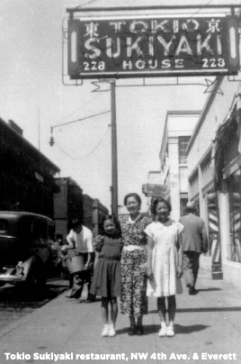
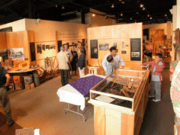
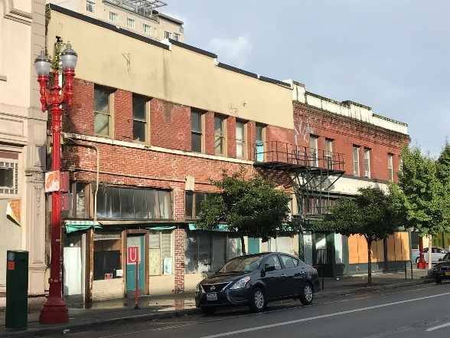
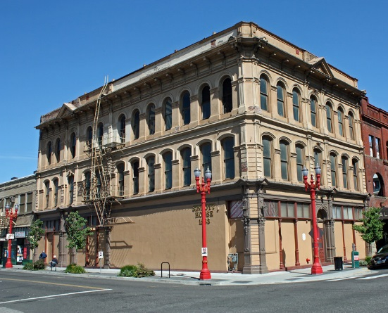
OLD TOWN/CHINATOWN: DOWNTOWN WATERFRONT BUDGET SUMMARY
Upcoming Activities
  Old Town/Chinatown Action Plan
  Neighborhood development:
    Block 33, Block 24 (Downtown Waterfront)
    4th & Burnside, Block 25 (River District)
  Seismic renovations
  District parking opportunities
  Nikkei Legacy Center
Notes:
Page 115 and Page 127
With the extension of the Action Plan, our focus will continue to be on neighborhood, business and community based investments, with increased efforts around district parking and seismic renovation
We are working with the Nikkei Legacy Center to support their efforts to purchase a space currently owned by Prosper Portland at NW 4th and Flanders
This would help stabilize them as Old Town/Chinatown sees new growth and investments
Working with a community based stakeholder group, the 4th and Burnside and Block 25 developments will focus both on celebrating the community’s distinct Chinese-American and Japanese-American history while bringing new vitality to the community

Slide 21
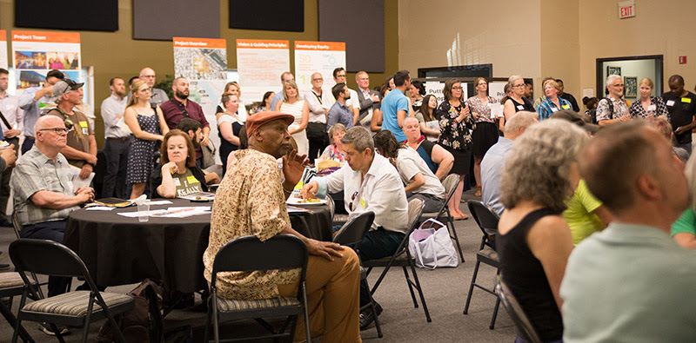
BROADWAY CORRIDOR: RIVER DISTRICT BUDGET SUMMARY
Recent Accomplishments
  Broadway Corridor
    Steering Committee and outreach
    Master Planning
  10th & Yamhill SmartPark Garage Renovation
    Master lease / tenanting of 27,500 sq. ft. of retail space
Notes:
Page127
In addition to the $18M Old Town/Chinatown commitment in the River District budget, we have a number of other priorities – most particularly the Broadway Corridor community outreach and master planning process
Over the past year, we have worked with a community based Steering Committee and with a focus on racial equity, to identify community priorities and develop master plan options
Yesterday, with the support of the Steering Committee, results of a community based survey, and input from all City infrastructure and permitting bureaus, our Board approved the preferred concept of “Play”
The concept extends the park blocks two blocks into the site, identifies two approximately ½ block parcels that will be owned by the Portland Housing Bureau, and provides connections east to Union Station at the north of the site, to Old Town/Chinatown via Johnson Street and to the eastside via the green loop
Over the past year, the Post Office has moved all functions but their retail to Airport Way and we have taken on property management and security responsibilities for the site
We are in active negotiations with USPS to identify retail relocation options that satisfy their needs; this is a critical next step for us as we can’t demolish the USPS building until a new retail location has been agreed upon, constructed or renovated and the USPS retail relocated
As part of our community conversations, we are working with partners like NAMC Oregon and PDBG to ensure a diverse contracting community is aware of the upcoming demolition and environmental clean up contracting opportunities

Slide 22
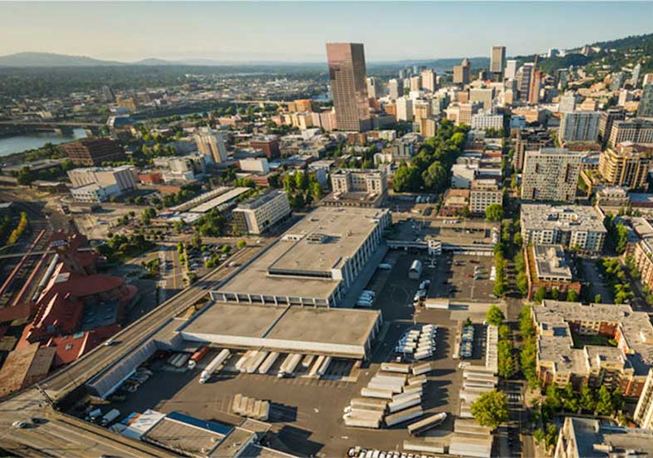
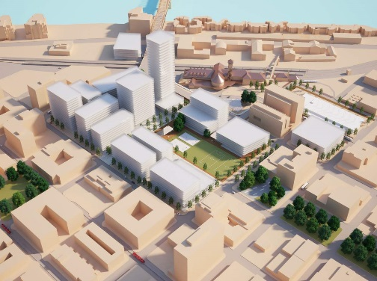
BROADWAY CORRIDOR: RIVER DISTRICT BUDGET SUMMARY
Upcoming Activities
  Broadway Corridor Master Plan
  Centennial Mills
  Asset management
  Union Station
  USPS retail relocation, demolition
  Broadway Corridor parking garage
  10th & Yamhill Master Lease
Notes:
Page127
In the coming fiscal year, we will submit and anticipate approval of the required land use Master Plan with ongoing community engagement
We are scheduled to meet with Design Commission this summer and will continue to work closely with Bureau and Council offices to identify priority public infrastructure improvements and investments
Concurrent with Master Plan review, we’ll begin negotiating a Community Benefit Agreement and Development Agreement with community and development partners;
We’re appreciative of discussions we’ve had to date with the Healthy Communities Coalition regarding the CBA process and goals as well as their participation in the Steering Committee and public process
Perhaps the most important item to note in the River District budget is that we now have better management, maintenance, demolition, clean up, and infrastructure costing for the USPS site as a result of the work we’ve been undertaking over the past year and this has resulted in a negative budget balance in out fiscal years.
You see these costs in the Real Estate Management, Predevelopment and Redevelopment line items for the Post Office.
Options for addressing the gap include:
Land sales within the River District area, including parcels in Old Town, Centennial Mills and at Broadway Corridor
While we’re disappointed that Lynd development has stepped away from Centennial Mills, other firms who bid on the original call for offers have expressed continued interest in acquisition of the site and we are reopening those discussions with our broker

Slide 23
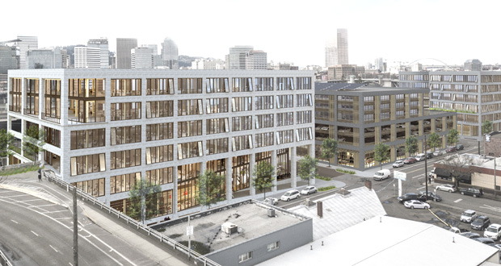
CENTRAL EASTSIDE BUDGET SUMMARY
Recent Accomplishments
  ODOT Blocks acquisition
  Burnside Bridgehead close out
  Small and industrial business assistance
Upcoming Activities
  Employment growth & industrial affordability
  ODOT Blocks
  OMSI Master Plan
Asset management
  District parking: festival lots, ODOT blocks (interim)
Notes:
Page 111
To support small business, and with a particular focus on supporting industrial businesses in the Central Eastside, Prosper Portland has provided approximately 15 small business loans and grants over the past 2 years with a 5:1 leverage of investment from the businesses themselves
We are also focused on investments at key sites to support continued job growth and industrial development in the district including:
New commercial and industrial use @ the three ODOT Blocks and
New mixed-use/commercial redevelopment as part of OMSI’s master planning
Since acquiring the ODOT blocks, we’ve been operating the lots on an interim basis as surface parking to help address the needs of businesses and tenants – particularly those in historic buildings and along SE Water Avenue - for district parking
Over the past year, we issued the ODOT Blocks Request for Proposals and selected Beam development working with Colas Construction to partner on redevelopment of the ODOT Blocks
We’ve convened community groups to discuss contracting and small business goals for the project
Over the coming year anticipate entering into a development agreement for the first phase of development which will focus on inclusive innovation
To support OMSI’s master plan, which will be presented to Design Commission this summer, we’ve convened bureau partners, working closely with PBOT and Parks, to provide feedback to OMSI on major City priorities – including improvements along SE Water Avenue and along the river from Hawthorne Bridge south to OMSI

Slide 24
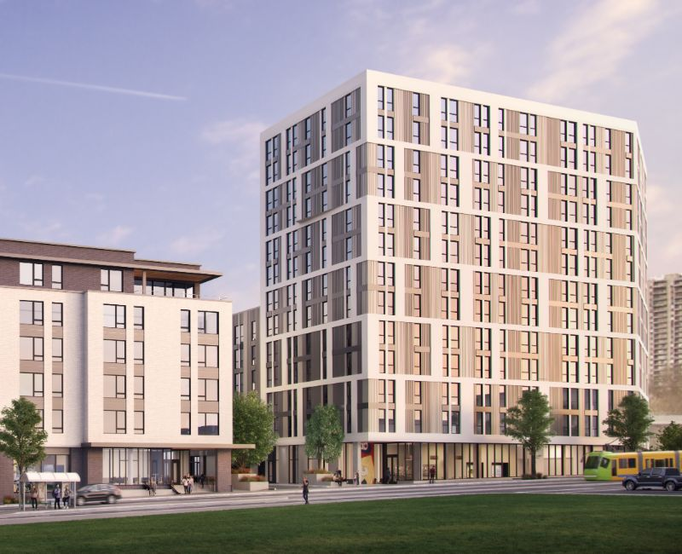
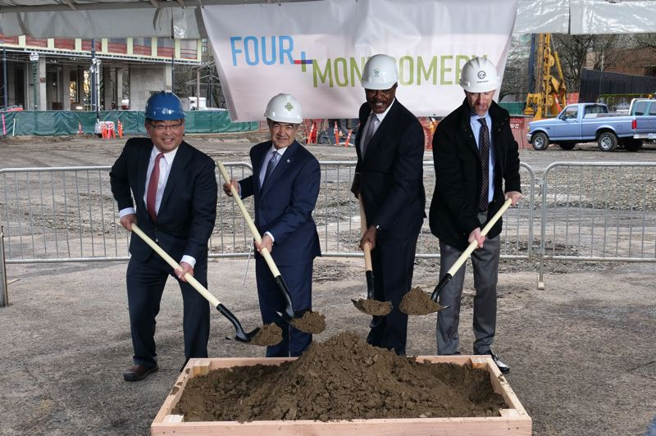
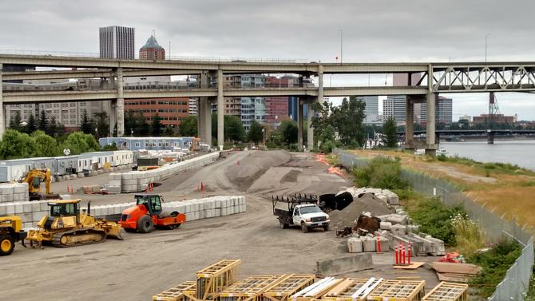
NORTH MACADAM BUDGET SUMMARY
Recent Accomplishments
  RiverPlace Parcel 3 / The Vera
  4th & Montgomery partnership: Portland State University, PCC, OHSU, City of Portland
  SW Bond Avenue north of Tiikum Crossing
Upcoming Activities
  Infrastructure investments to support office, housing and innovation
  PSU partnership: acquisition of property at 4th/Lincoln
Notes:
Page 125
Introduce new South Waterfront commercial growth via ZRZ DA
Partner on South Waterfront development to support OHSU Knight Challenge
Support commercial use at new PSU School of Business

Slide 25
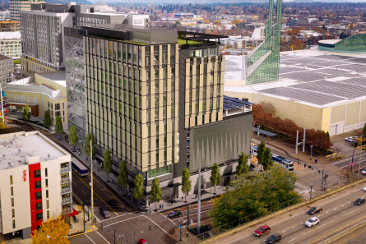
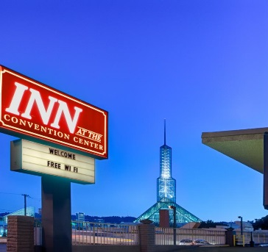
OREGON CONVENTION CENTER BUDGET SUMMARY
Oregon Convention Center Budget Summary
Recent Accomplishments
  Convention Center Hotel & parking garage
Upcoming Activities
  100 Multnomah office tower predevelopment
  Priority areas
  Rose Quarter/NE Broadway
  MLK/Grand
  Asset Management
  Inn at the Convention Center
Notes:
Page 113
Support Convention Center Hotel construction
Strategic tenanting support with Lloyd Mall renovation – connections to My People’s Market and Mercatus

Slide 26
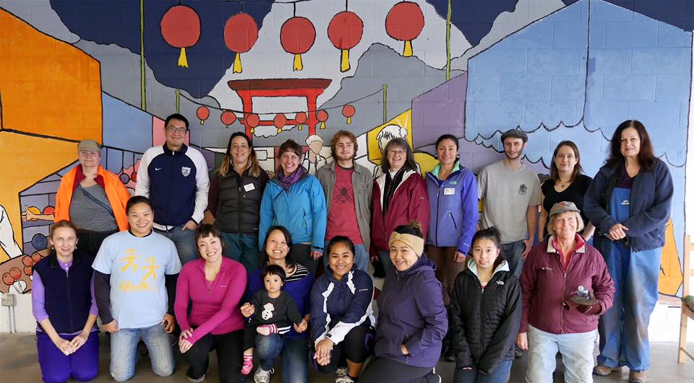
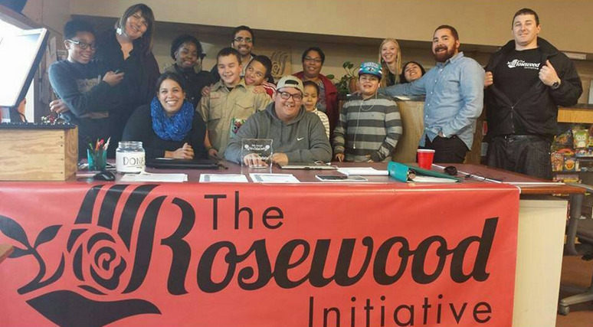
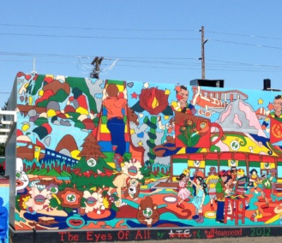
NEIGHBORHOOD PROSERITY NETWORK BUDGET SUMMARY
Recent Accomplishments
  Workforce navigator established in all districts
  Commercial affordability and Community Space
  38 business improvement grants
Upcoming Activities
District improvement & promotion grants
Full time district managers
Capacity building & trainings
Notes:
Accomplishments: 17-19
38 business improvement grants
All 7 districts are served by a workforce navigator
Additional part-time staffing supporting each district in community engagement and program delivery
2 district sponsor Farmers Markets with a focus on food equity
Our 42 Avenue manages 24,000 sq ft of commercial space to ensure commercial affordability
Jade District’s – the Orchards grand opening of housing in April, Community Space in June
The Network participated in an impact evaluation process
Upcoming Activities:
Exploration of Community Center TIF district
3 signature annual events (Jade Night Market, DMA’s Festival of Nations, Taste of Parkrose)
Publishing project impact report of the Network this summer
Page 124
All activities are biz development – note higher amount of resources next year are related to funding via revenue sharing coming back from City and County shares. Provides additional non-TIF resources to boost activities in these district

Slide 27
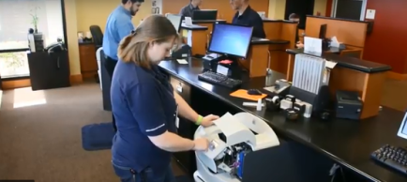
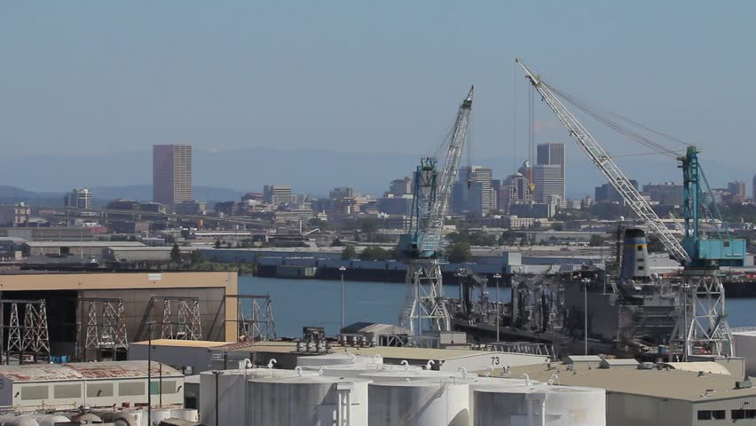
WILLAMETTE & AIRPORT WAY BUDGET SUMMARY
Recent Accomplishments
Cook Security
Land disposition with $8M capital investment
78 new jobs with Public Benefit Agreement via Ezone program
Upcoming Activities
Airport Way land disposition
Employment growth & industrial affordability
Expanding industrial space/land availability
Partnership opportunities with Port of Portland
Notes:
Page 113
Cook Security Public Benefit Agreement:
Reporting out for first time by June 30, 2019. Benefit agreement includes: Internships:Host at least 1-2 Youth (ages 16-24) interns annually from programs which support equity and inclusion such as SummerWorksWork with local colleges and/or universities to provide 2 internship opportunities for college students each year Permanent Workforce Hiring:Develop a comprehensive hiring plan designed to ensure a broad-based job pool for new job opportunities, mirroring the demographics of the City of Portland Hire all new employees at no less than $15.00/hourPartner with local workforce development providers and non-profits to actively seek out local candidatesCook Security will prioritize outreach and improve awareness and access to employment opportunities for diverse and historically underrepresented communities. Community Partnerships and Outreach:Host at least 6 events per year at Cook Security facilities in partnership with groups that represent women or communities of colorParticipate in or sponsor two additional events in the community that represent women or communities of color. Types of events could include: Schools:Speak with and/or host four technology clubs from high schools, alternative high school programs, or GED programs which have a focused population of youth who will reflect the promotion of a diverse and inclusive environment (Ex: N/NE Portland, E/SE Portland, Gresham).

Slide 28
THANK YOU

Slide 29
Economic Development Programs
($ in Millions)
32 %
29 %
25 %
14 %
0 %
% of Total Base Budget
Notes:
Diving further into our economic development programs not restricted to traditional tax increment finance districts, this graph shows our four major business lines as well as associated staff supported with these funds and the how general funds are leveraged by other non-TIF resources. From top to bottom:
WF development funds support 1 FTE to manager our partnership with WSI and 16 community-based organizations supporting youth and adults facing barriers to employment; $1.4M in GF, leverages 1.7M in CDBG and 200k from the Ezone fund;
IBRN funding supports 3FTE who work directly with 14 technical assistance providers who specialize in programs that serve underrepresented. This is our 2nd largest program and our largest use of city general fund at $2M. This leverages both E-zone and CDBG as well.
NPN network funding supports 2FTE working directly with 7 community organizations to ensure connections to the services above, build community capacity and implement small-scale investments; as well as to manager the annual contract with Venture Portland, who provides essential support to the city’s volunteer-run business districts. City General Fund investment of $1.4M leverage $1.1M in NPI funds.
The traded sector business development program resources supports 6 staff positions and direct engagement with cluster companies, Ezone firms, and film producers – to support business competitiveness and inclusive initiatives – like the Techtown Diversity Pledge.
Finally, if funded, the coordinated community planning and development program would compliment both our economic development and our community development effort with two FTE to support cross-bureau efforts in east Portland, N/NE and SW.

Slide 30
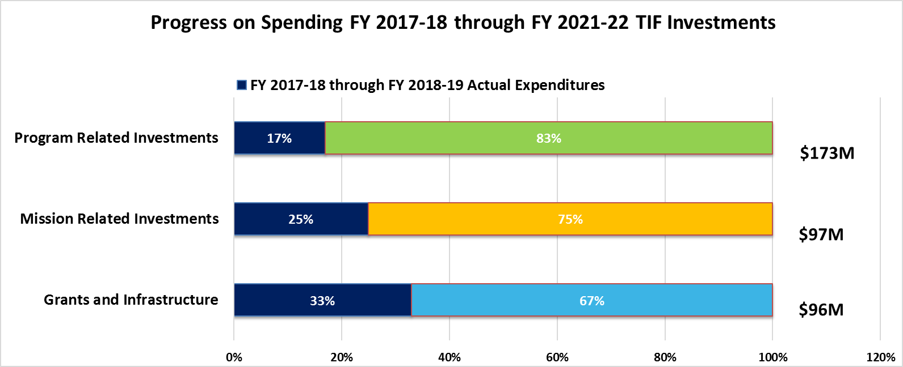
Optimize Remaining TIF
Notes:
Broadway Corridor, ODOT Blocks, Rose Quarter, OT/CT Investments
Updated financial investment policy and asset management approach
Seek public benefits that result in a financial return
Have a leverage target and maximize non-agency resources
Limit grants, infrastructure, and loan forgiveness to annual agency-wide budgets
Implement asset and property management software to increase analytical & forecasting capabilities
Create operating plans for each property
REMOVE $ AND % FROM LABELS, PUT THEM INSIDE DONUT; IN THEIR PLACE, PUT (IMPACT FIRST INVESTMENTS, FINANCIAL FIRST/MARKET RETURN)
GIVE EXAMPLES OF DIFFERENT KINDS OF INVESTMENTS
As we refine the business plan, we have become clearer about how we talk about the types of project and program investments and the public benefit and financial return anticipated to support reinvestment in future years of the business plan.
There are three basic categories:
Grants and Infrastructure – which meet all policy goals and high levels of public benefit and no repayment or return
Program Related Investments which meet all policy goals and high levels public benefit – where we anticipate repayment and no or below market return on investment.
Mission Related Investments which meet all policy goals and there is an anticipated repayment and market return on investment.
Program Related Investments assume average 2.5% return on all new lending and 3% on all other projects…over five-year we have allocated $130M or 45% of URA budgets toward these investments. Includes action plan investments for N/NE, Gateway and Lents, and future projects in North Macadam and Central City investments.
Mission Related Investments assume average 6% return on several projects… over the five-year budget forecast we have allocated $80M or 27% of URA budgets toward these investments. Includes Broadway Corridor, ODOT Blocks, and Oregon Convention Center URA investments.
These categories provide the overall benchmark for how a important component of the business plan revenues are generated – actual implementation will be different over time

Slide 31
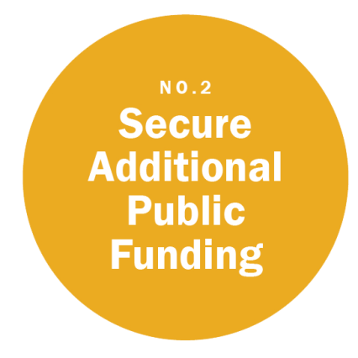
Boomerang Revenue
PROPSER PORTLAND PROPOSED BUDGET, FY 2019-2020| MAY 9, 2019
Notes:
As URAs expire and outstanding debt is repaid, the tax increment generated from the overlapping taxing jurisdictions tax rates are returned to each district.
Based on the City of Portland’s Tax Rate, we estimate $380M will be returned to the City of Portland starting in 2021 going through 2035 as illustrated by the orange line
After discounting based on potential property tax limits (measure 5 compression) and normal discounts and potential delinquencies, the number more conservatively could be $335M as represented by the blue line.
This chart includes 25% of the total coming back as represented by the green line. Later in the presentation, Tony is going to share some different scenarios that include varying levels of boomerang revenue.

Slide 32
Economic Development Programs
Notes:
Diving further into our economic development programs not restricted to traditional tax increment finance districts, this graph shows our four major business lines as well as associated staff supported with these funds and the how general funds are leveraged by other non-TIF resources. From top to bottom:
WF development funds support 1 FTE to manager our partnership with WSI and 16 community-based organizations supporting youth and adults facing barriers to employment; $1.4M in GF, leverages 1.7M in CDBG and 200k from the Ezone fund;
IBRN funding supports 3FTE who work directly with 14 technical assistance providers who specialize in programs that serve underrepresented. This is our 2nd largest program and our largest use of city general fund at $2M. This leverages both E-zone and CDBG as well.
NPN network funding supports 2FTE working directly with 7 community organizations to ensure connections to the services above, build community capacity and implement small-scale investments; as well as to manager the annual contract with Venture Portland, who provides essential support to the city’s volunteer-run business districts. City General Fund investment of $1.4M leverage $1.1M in NPI funds.
The traded sector business development program resources supports 6 staff positions and direct engagement with cluster companies, Ezone firms, and film producers – to support business competitiveness and inclusive initiatives – like the Techtown Diversity Pledge.
Finally, if funded, the coordinated community planning and development program would compliment both our economic development and our community development effort with two FTE to support cross-bureau efforts in east Portland, N/NE and SW.

Slide 33
Economic Development Programs
Notes:
Diving further into our economic development programs not restricted to traditional tax increment finance districts, this graph shows our four major business lines as well as associated staff supported with these funds and the how general funds are leveraged by other non-TIF resources. From top to bottom:
WF development funds support 1 FTE to manager our partnership with WSI and 16 community-based organizations supporting youth and adults facing barriers to employment; $1.4M in GF, leverages 1.7M in CDBG and 200k from the Ezone fund;
IBRN funding supports 3FTE who work directly with 14 technical assistance providers who specialize in programs that serve underrepresented. This is our 2nd largest program and our largest use of city general fund at $2M. This leverages both E-zone and CDBG as well.
NPN network funding supports 2FTE working directly with 7 community organizations to ensure connections to the services above, build community capacity and implement small-scale investments; as well as to manager the annual contract with Venture Portland, who provides essential support to the city’s volunteer-run business districts. City General Fund investment of $1.4M leverage $1.1M in NPI funds.
The traded sector business development program resources supports 6 staff positions and direct engagement with cluster companies, Ezone firms, and film producers – to support business competitiveness and inclusive initiatives – like the Techtown Diversity Pledge.
Finally, if funded, the coordinated community planning and development program would compliment both our economic development and our community development effort with two FTE to support cross-bureau efforts in east Portland, N/NE and SW.

Slide 34
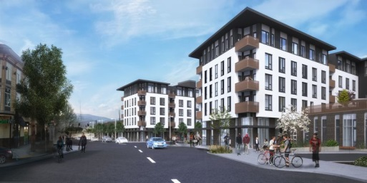
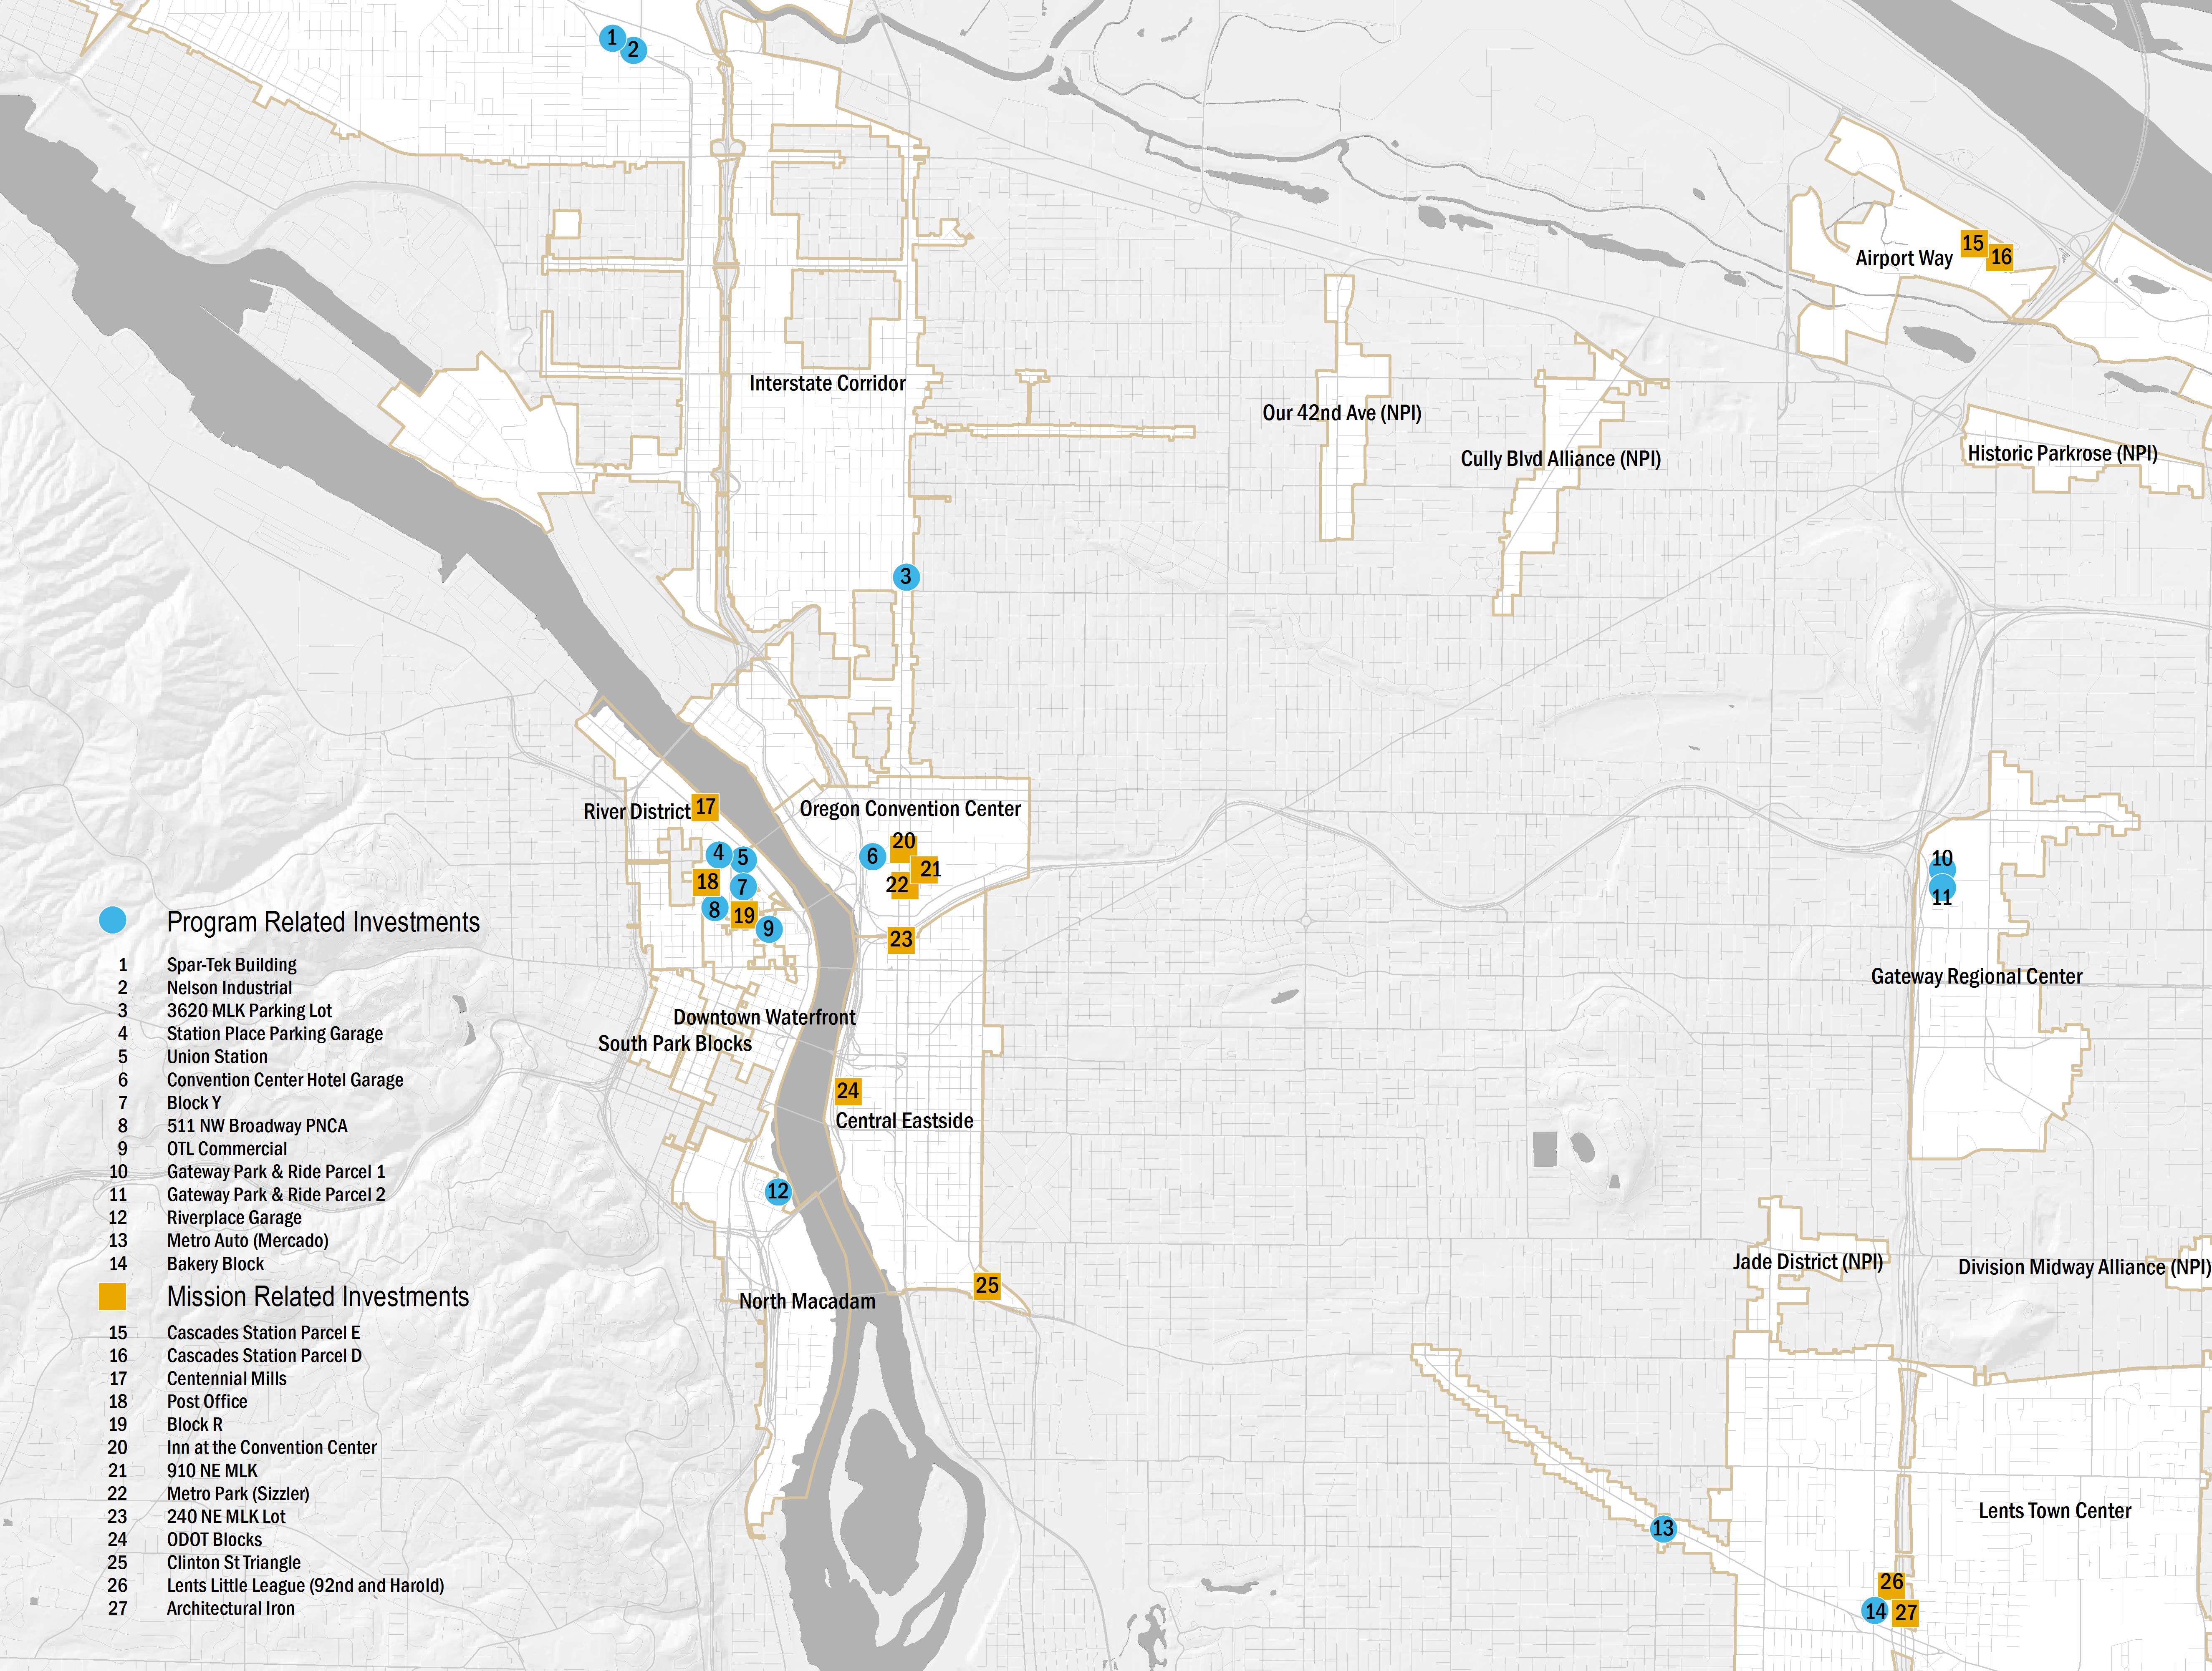
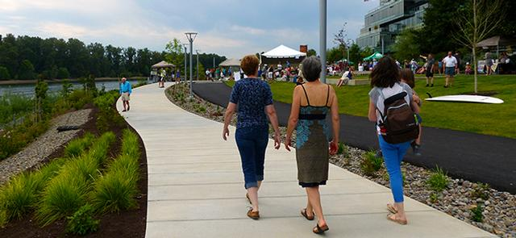
Optimize Real Estate Portfolio
Program Related Investments
Mission Related Investments
Notes:
Broadway Corridor, ODOT Blocks, Rose Quarter, OT/CT Investments
Updated financial investment policy and asset management approach
Seek public benefits that result in a financial return
Have a leverage target and maximize non-agency resources
Limit grants, infrastructure, and loan forgiveness to annual agency-wide budgets
Implement asset and property management software to increase analytical & forecasting capabilities
Create operating plans for each property
REMOVE $ AND % FROM LABELS, PUT THEM INSIDE DONUT; IN THEIR PLACE, PUT (IMPACT FIRST INVESTMENTS, FINANCIAL FIRST/MARKET RETURN)
GIVE EXAMPLES OF DIFFERENT KINDS OF INVESTMENTS
As we refine the business plan, we have become clearer about how we talk about the types of project and program investments and the public benefit and financial return anticipated to support reinvestment in future years of the business plan.
There are three basic categories:
Grants and Infrastructure – which meet all policy goals and high levels of public benefit and no repayment or return
Program Related Investments which meet all policy goals and high levels public benefit – where we anticipate repayment and no or below market return on investment.
Mission Related Investments which meet all policy goals and there is an anticipated repayment and market return on investment.
Program Related Investments assume average 2.5% return on all new lending and 3% on all other projects…over five-year we have allocated $130M or 45% of URA budgets toward these investments. Includes action plan investments for N/NE, Gateway and Lents, and future projects in North Macadam and Central City investments.
Mission Related Investments assume average 6% return on several projects… over the five-year budget forecast we have allocated $80M or 27% of URA budgets toward these investments. Includes Broadway Corridor, ODOT Blocks, and Oregon Convention Center URA investments.
These categories provide the overall benchmark for how a important component of the business plan revenues are generated – actual implementation will be different over time

Slide 35
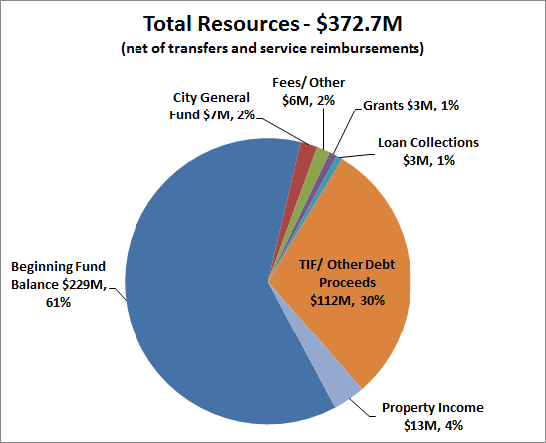
FY 2019-20 RESOURCES
Notes:
PDC’s total estimated resources are $342 million for next fiscal year.
Approximately half of the resources available is cash on hand represented by the beginning fund balance from prior bond sales and tax increment, land sales, and other program income.
About one-third of the resources will be from new tax increment resources, mainly in Interstate, Lents, River District and North Macadam URAs.
Consistent with prior years, City General Fund resources represents 2% of planned resources or $5.5 million.
General Fund resources combined with Grant resources and Enterprise Zone fees make up the majority of PDC’s citywide economic development programing.
86% of the resources are TIF based

Slide 36
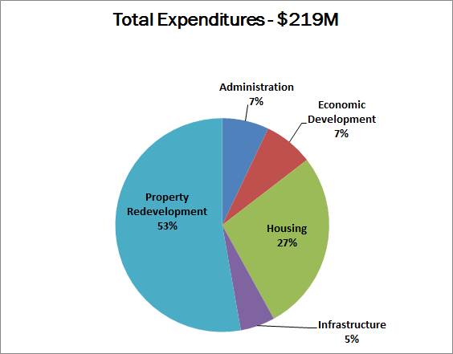
TOTAL BUDGETED EXPENDITURES

