Slide 1
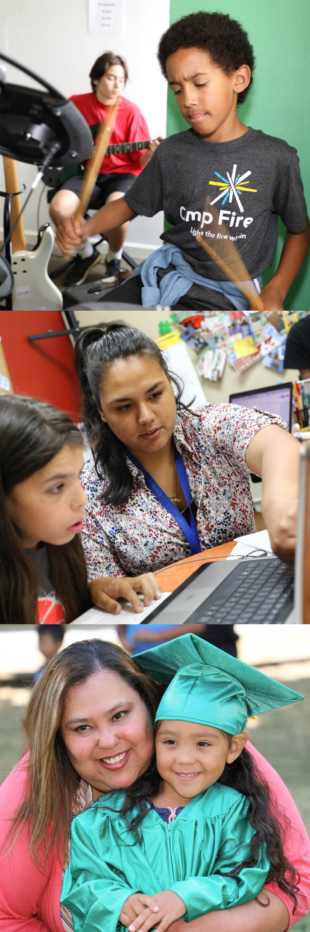

Grant Renewal

Slide 2

One-Year Grant Renewal
Competitive grant round delayed one year to:
  Review and improve grantmaking process
  Engage broader community on needs and preferred services/solutions
All current grants considered for 1-year renewal
Process includes performance assessment on:
  Service goals
  Participation goals
  Outcome goals
  Staff turnover
  Financial review

Slide 3
One-Year Grant Renewal
Allocation Committee recommends renewing all but two current grants
Recommended renewal amounts were based on 2018-19 budgets plus a 3.9% COLA
Three grants recommended for conditional renewal

Slide 4
2019 Community Report Highlights
Spotlights long term results for children and families who participated Levy-funded programs

Slide 5
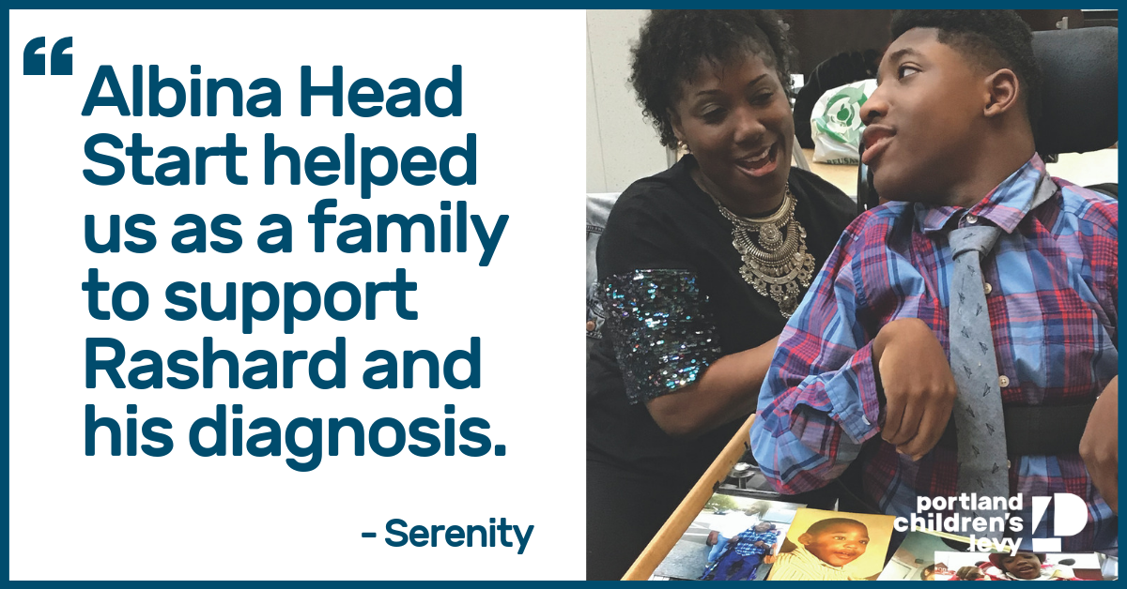
Early Childhood
Helping children prepare for kindergarten. Early childhood programs lead to better reasoning and language skills as well as healthy social and emotional development.

Slide 6

Child Abuse Prevention and Intervention
Empowering the development of strong families. Children thrive when parents gain parenting skills and are supported in their role of parent.

Slide 7
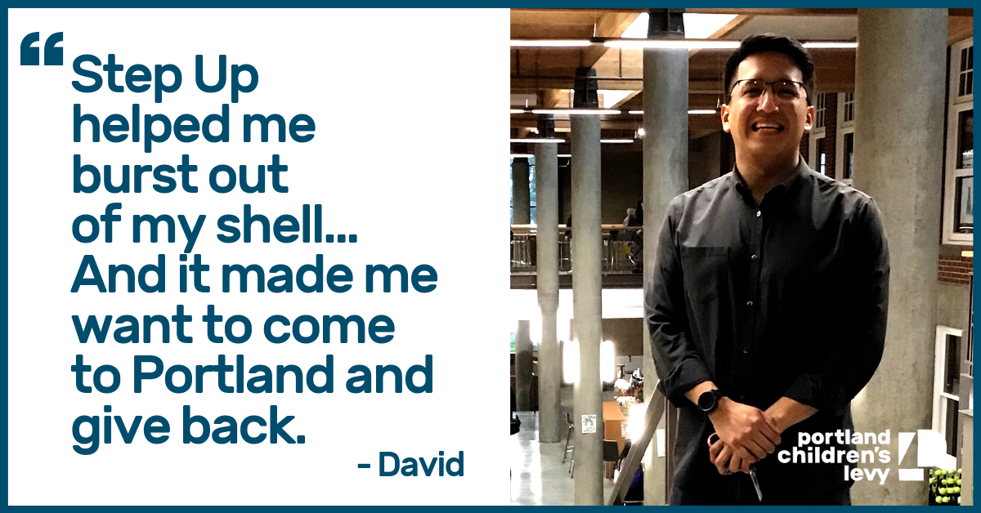
After School
A safe place for students to learn and have fun. Students gain self-esteem, confidence and leadership skills with caring adults who provide academic support and fun activities.

Slide 8
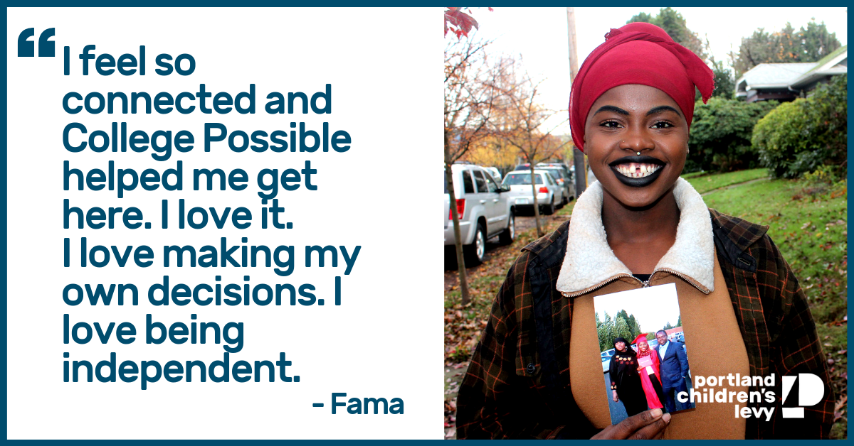
Mentoring
Positive, caring, consistent adult role models support students’ engagement in school and help them realize their academic and life goals.

Slide 9
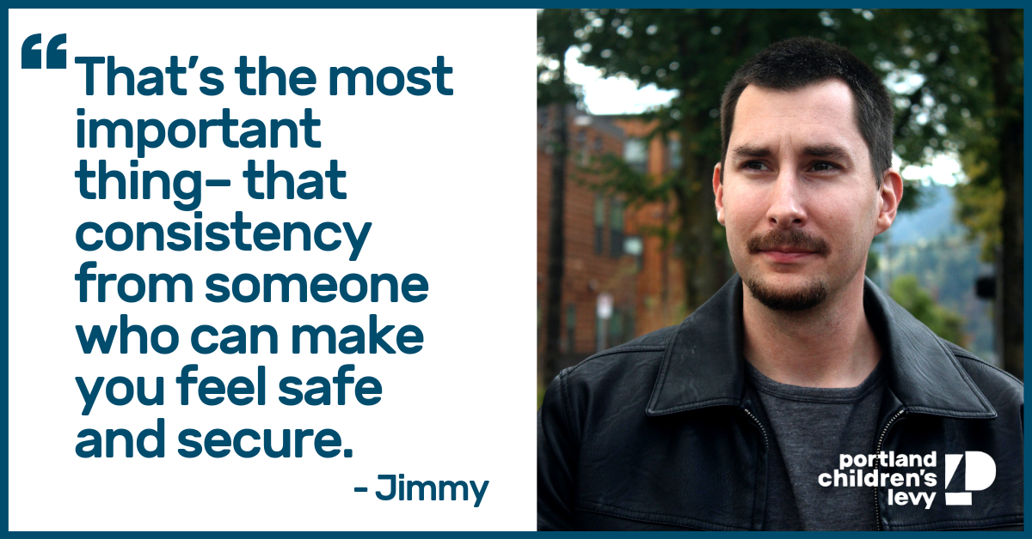
Foster Care
Supporting the wellbeing and development of children and youth in foster care. Programs work with children and youth to strengthen academic and life skills and assure the presence of caring adults.

