Slide 1
Foreclosure List 2019-01 May 1st , 2019
Revenue Division
Notes:
Good morning Mayor, Commissioners!
Marco Maciel, Foreclosure Manager in the Bureau of Revenue and Financial Services, Revenue Division
Mike Liefeld, Supervising Planner with BDS
Brigid O’Callaghan, City Treasurer and
Dan Simon, Deputy City Attorney.
We are here as partners in this effort.
If you have any questions we are happy to answer following the presentation.

Slide 2
City Foreclosure Focused on Vacant and Distressed Properties
Focused effort to resolve nuisance properties
Minimize the adverse effects caused by these properties in the community
Bring these properties into productive use
Used as a last resort
Notes:
This is the sixth foreclosure list we have brought to Council since focused efforts began in 2016.
The objectives of the process are to resolve the nuisance properties that we have throughout the City!
Minimize the adverse effect caused by these properties in the community and bring these properties to a productive use.
Foreclosure is used as the City’s last resort to address vacant and distressed properties.

Slide 3
The City’s Foreclosure Efforts
Bureau of Development Services (BDS): recommends priority properties to the Revenue Division for foreclosure
Revenue Division: examines properties, determines which properties to submit to Council for foreclosure consideration, submits lists to Council
City Treasurer: conducts the foreclosure sale
City Attorney: identifies barriers to foreclosure and advises on legal matters
Notes:
These is a cooperative effort by the Bureau of Development Services, The Revenue Division of the Bureau of Revenue and Financial Services, the City Treasurer and the City Attorney’s Office.

Slide 4
Characteristics of Vacant and Distressed Properties
No contact from property owners
No efforts to make corrections
Property owners demonstrate no interest in maintaining properties to the City’s minimum standards
Citizen complaints and code violations often increase in number
A property with uncorrected violations may get worse over time
The City’s incentives do not motivate the property owner
Monthly code enforcement fees have no influence on the property owner to take corrective action
Owners may have walked away from their properties
Owners show little regard for the negative impacts caused by their properties to the neighborhood through their inactions, and leave the City with the responsibilities of housing maintenance and management of their properties
Notes:
The City of Portland and the community at large have the reasonable expectation that property owners are responsible for the maintenance of their properties.
The City, through its Property Compliance Division in BDS, adopted a property maintenance minimum standard. To achieve compliance when a property doesn’t meet the minimum standard, BDS’ approach includes appeals, a host of waivers that property owners may qualify for to avoid liens, and the opportunity to connect property owners with available repair assistance programs for their situation.
Only after these opportunities or incentives to correct the violations are exhausted, monthly code enforcement fees are adopted.
However, the characteristics of Vacant and Distressed Properties cannot be easily justified. Properties deteriorate, code violations increase, opportunities to correct violations or take advantage of the City’s incentives are not responded to, and there’s largely no communication from the owners or their representatives with the City - even after the City uses different and repeated approaches over extended periods of time.
Additionally, it is difficult to explain how it would be in a property owner’s best interest to own inhabitable investment properties that are not producing cash flow.

Slide 5
Results of the Foreclosure Process
78 properties proposed for foreclosure by BDS
22 brought to Council for consideration
58 have paid in full
Over $2.4M recovered
Foreclosure activity has motivated resolution on many property owners
Over 74% of the proposed properties have been paid off or payment arrangements made
Notes:
Since 2016, the efforts of the foreclosure process have resulted in
78 properties proposed for foreclosure by the Bureau of Development Services of which 22 have been brought to Council for vote and 58 have been paid in full.
The amount recovered exceeds $2,440,000 million dollars and the process has motivated many property owners to find a resolution to their properties.
The recovery rate is over 74%

Slide 6
Properties Recommended for City Foreclosure
Five properties
42 liens
$272,205 owed
Two Extremely Distressed Properties Enforcement Program (EDPEP) cases and one distressed property with chronic maintenance violations
One property has a sidewalk repair lien
Notes:
Today the Revenue Division is submitting to Council a list with five vacant and distressed properties with a recommendation to be foreclosed.
Each of the properties is vacant and distressed and has been consuming the limited resources that the City has to continue working toward improving livability, health and safety in our community.

Slide 7
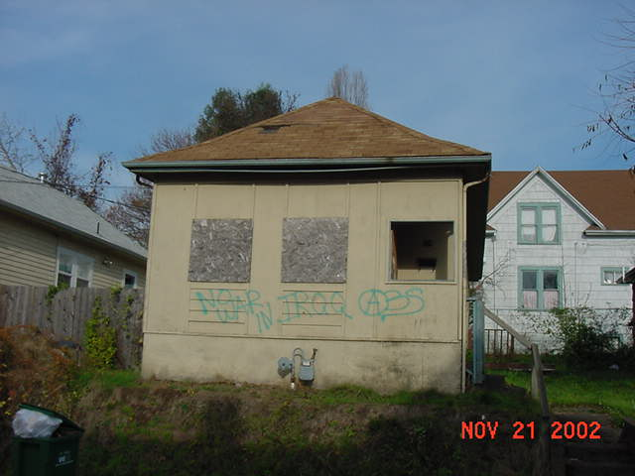
529 NE Skidmore St.
Eight liens placed against the property
Delinquency ranges from 1996 - 2019
Total amount owed on liens: $30,210.59 (as of April 12, 2019)
Ownership: Penny Livingstone & Trygve Fotland since November 1, 1992
Determined by BDS as a Chronic Offender
3 police calls for service to the address and 134 calls for service within 200 ft of the property
Notes:
This is a property located at 529 NE Skidmore St.
There are 8 liens against this property
23 years of delinquency and between May of 2011 and August of 2018, police intervened 137 times – Directly to the property or its vicinity.
This property belongs to Penny Livingstone and her late husband Trygve Fotland. The next 2 properties also belong to them.

Slide 8
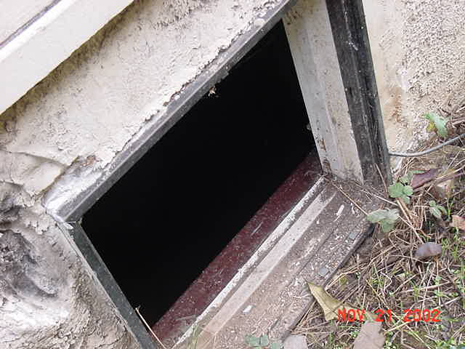
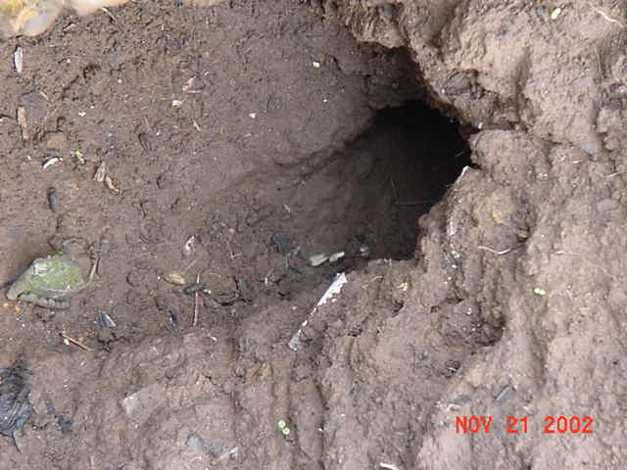
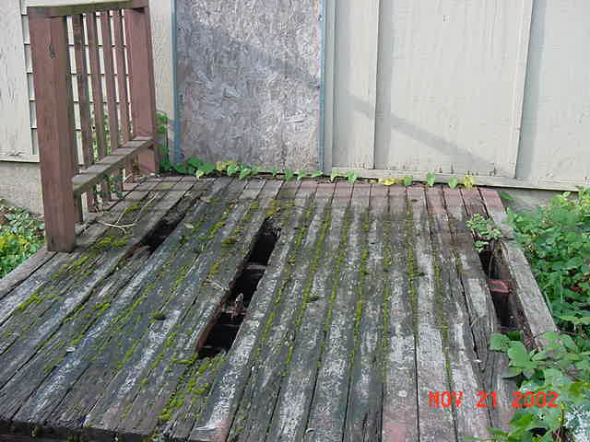
529 NE Skidmore St.
Multiple Fire/Life/Safety violations
Health Sanitation Violations
Front entry with hole to inside basement
Rotted and damaged decking
Attractive for unlawful occupants, garbage dumping

Slide 9
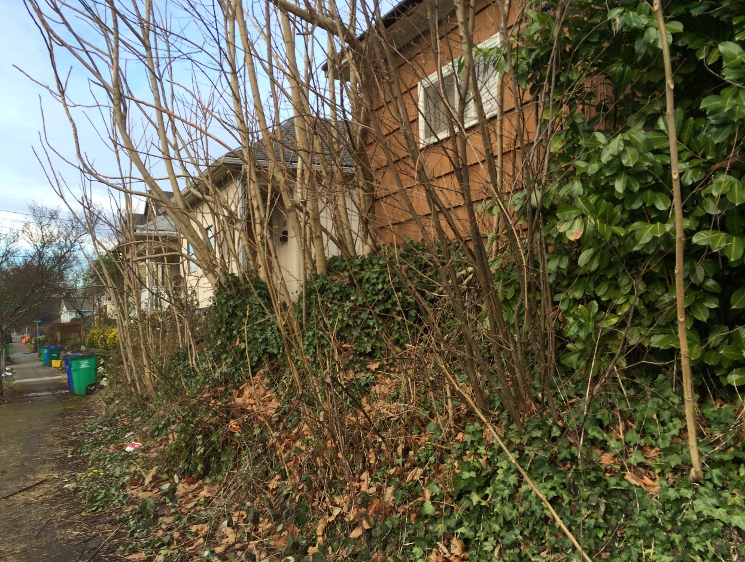
537 NE Skidmore St.
Ten liens placed against the property
Delinquency ranges from 1999 - 2018
Total amount owed on lien: $61,396.19 (as of April 12, 2019)
Ownership: Penny Livingstone & Trygve Fotland since October 8, 1989
Extremely Distressed Property Enforcement Program (EDPEP) case
5 police calls for service to the address and 119 calls for service within 200 ft of the property
Notes:
This property is located at 537 NE Skidmore St.
There are 10 liens against this property
20 years of delinquency and between May of 2011 and August 2018 police intervened 124 times directly to the property or its vicinity.
This property belongs to Penny Livingstone and her late husband Trygve Fotland. They own this property for 30 years

Slide 10
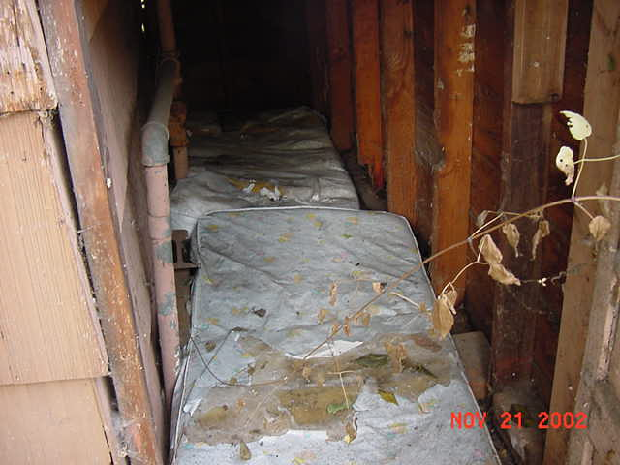
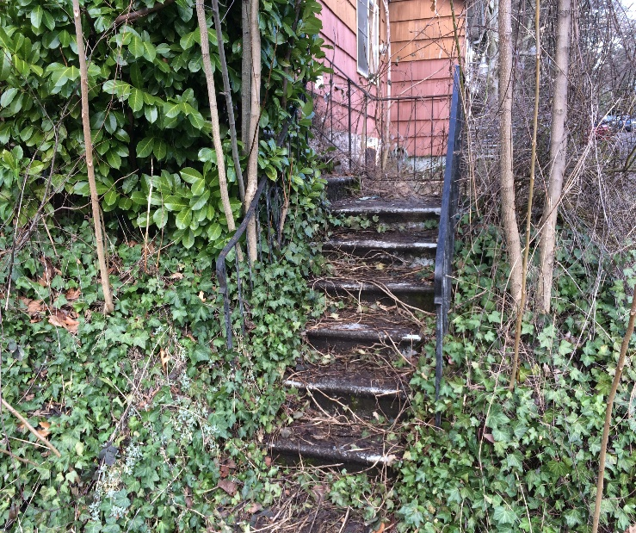
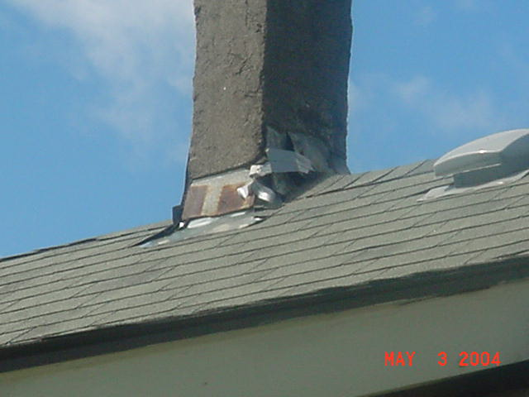
537 NE Skidmore St.
Fire/Life/Safety violations
Health Sanitation violations
Front porch deteriorated or damaged
Chimney is deteriorating and falling apart held by duct tape
Roof drainage violations
Attractive for unlawful occupants

Slide 11
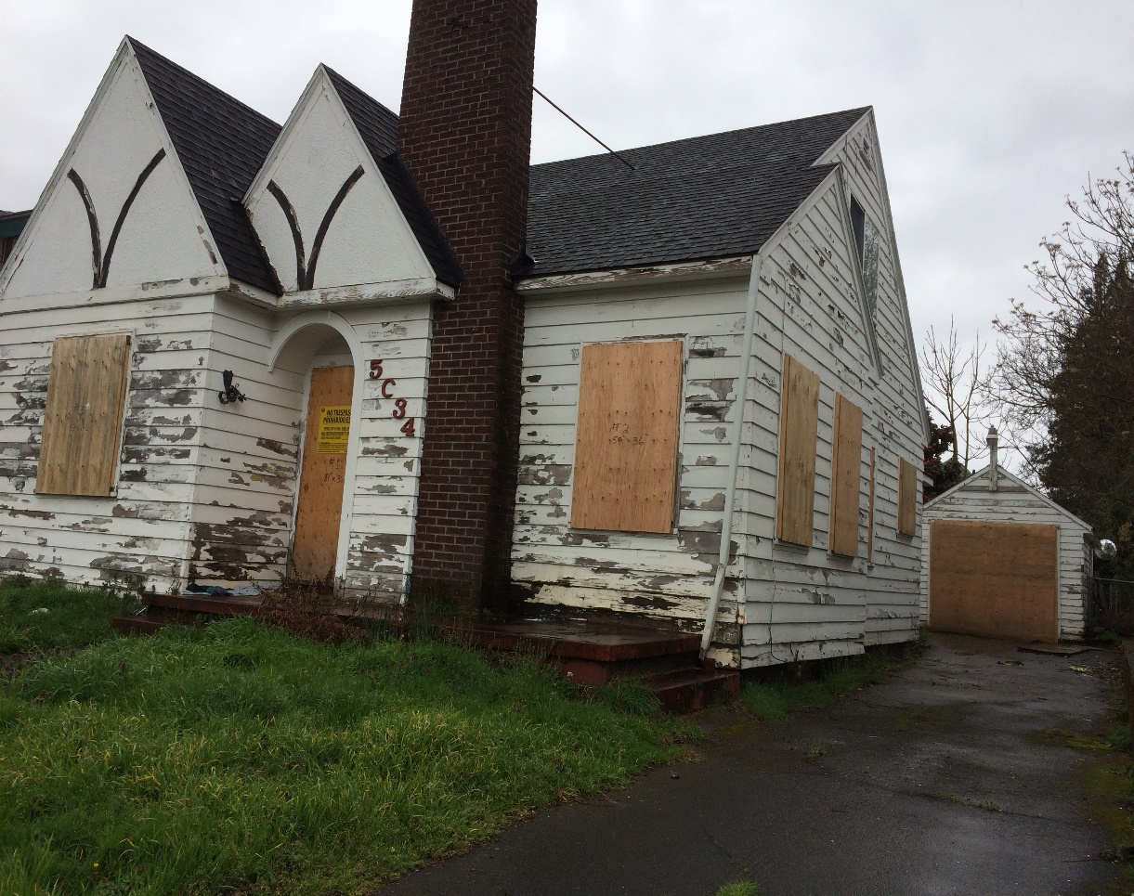
5034 NE Grand Ave.
Eight liens placed against the property
Delinquency ranges from 2013- 2018
Total amount owed on liens: $79,849.86 (as of April 12, 2019)
Ownership: Penny Livingstone & Trygve Fotland since June of 1991
Extremely Distressed Property Enforcement Program (EDPEP) case
11 police calls for service to the address and 385 calls for service within 200 ft of the property
Notes:
This property is located at 5034 NE Grand Ave.
There are 8 liens against this property
5 years of delinquency and between April of 2013 and August of 2018 police intervened 396 times – Directly to the property or its vicinity.
This property also belongs to Penny Livingstone and Trygve Fotland for 28 years.

Slide 12
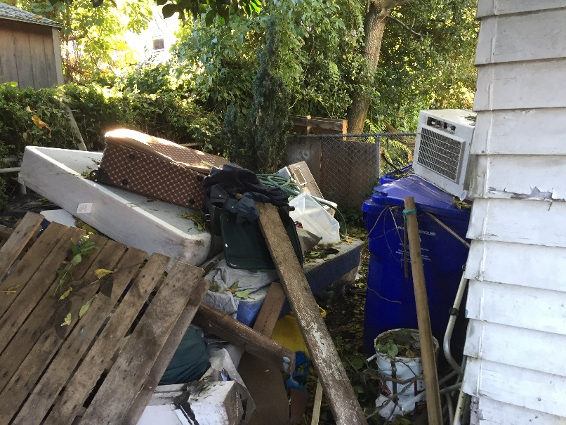
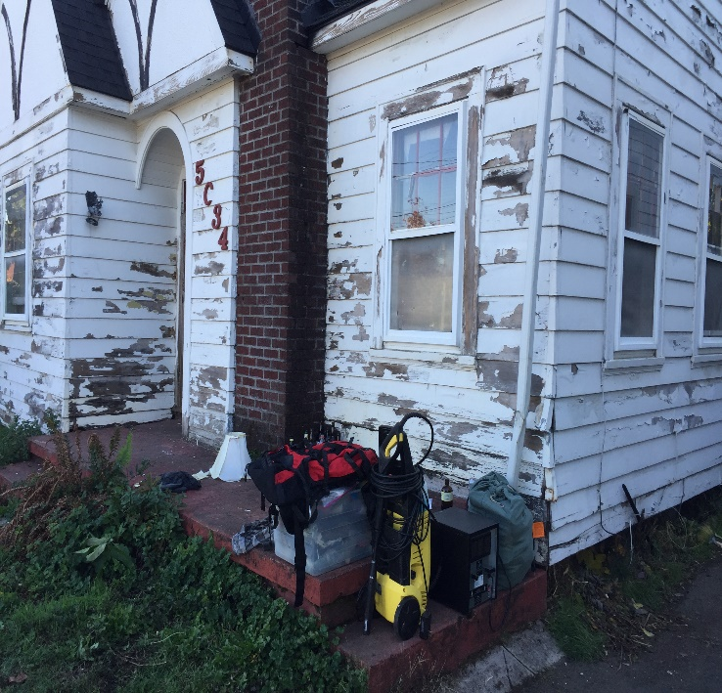
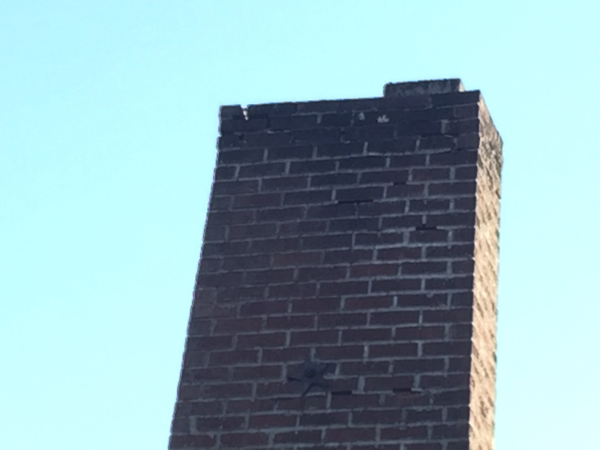
5034 NE Grand Ave.
Fire/Life/Safety violations
Health Sanitation violation
Front exterior door damaged and deteriorated
Paint peeled to bare wood
Damaged chimney, loose bricks, missing mortar joints
Attractive for unlawful occupants

Slide 13
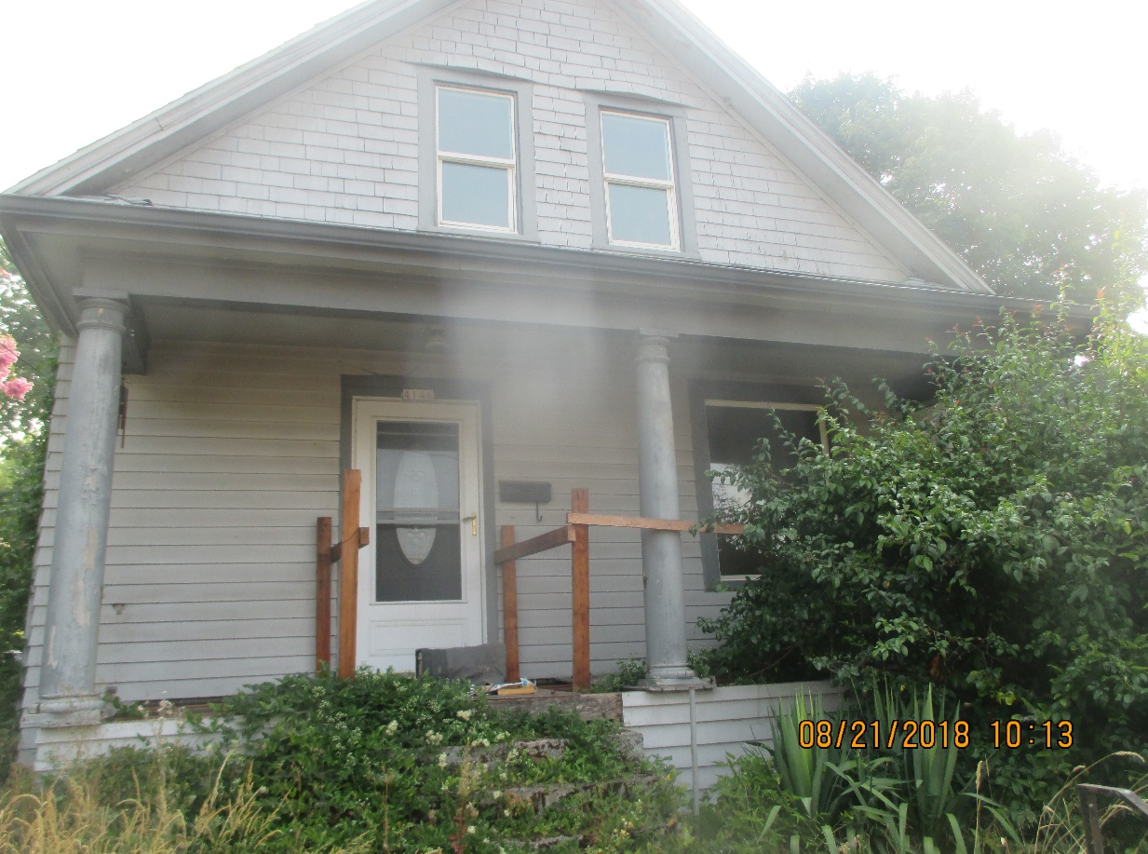
4146 NE 14th Ave.
Three liens against the property
Delinquency ranges from 2017 – 2019
Total amount owed: $16,291.72 (as of April 12, 2019)
Ownership: Meadows 132 LLC since April of 2016
3 police calls for service to the address and 7 calls for service within 200 ft of the property
Notes:
This property is located at 4146 NE 14th Ave.
There are 3 liens against this property
2 years of delinquency and between February of 2016 and August of 2018 police intervened 10 times - Directly to the property or its vicinity.

Slide 14
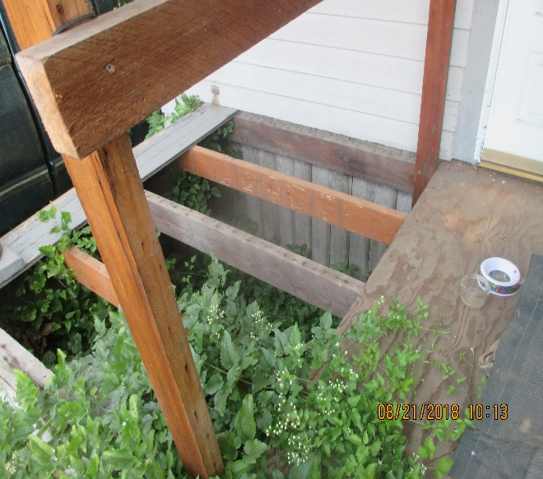
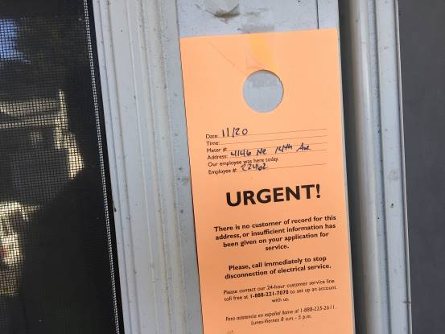
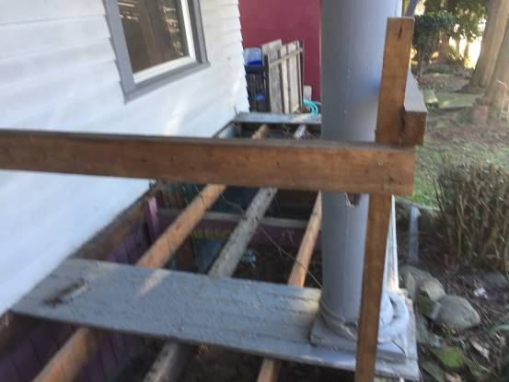
4146 NE 14th Ave.
Fire/Life/Safety violations
Health Sanitation Violations
Front porch flooring missing
Parking/maneuvering vehicles where not allowed
Lacks required safety handrail
Attractive for unlawful occupants
Notes:
12 inspections have been performed by the City to this property
Front porch steps lack a required approved safety handrail that is continuous the full length of the stairs

Slide 15
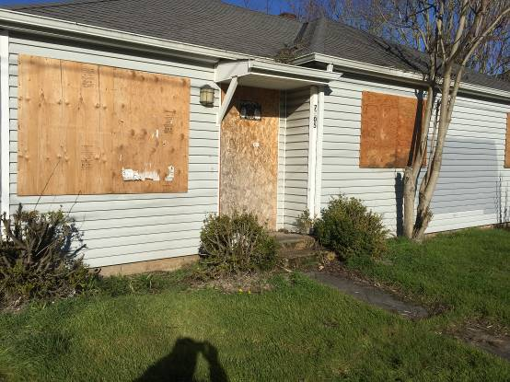
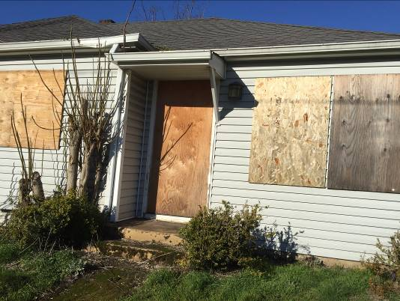
7405-7415 NE Fremont St.
Thirteen liens against the property
Delinquency ranges from 2012 - 2019
Total amount owed: $84,456.64 (As of April 12, 2019)
Ownership: Margaret J Bogart since May of 1998
Property has been legally unoccupied for 8 years
24 police calls for service to the address and 192 calls for service within 200 ft of the property
Notes:
This property is a duplex located at 7405-7415 NE Fremont St.
There are 13 liens against this property
7 years of delinquency and between April of 2011 and August of 2018 police intervened 216 times – Directly to the property or its vicinity.

Slide 16
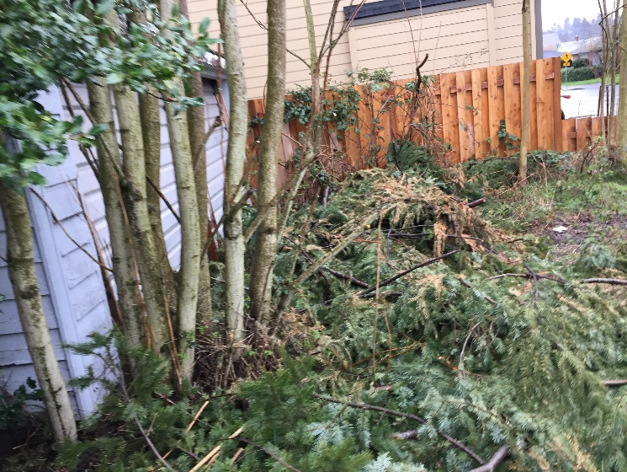
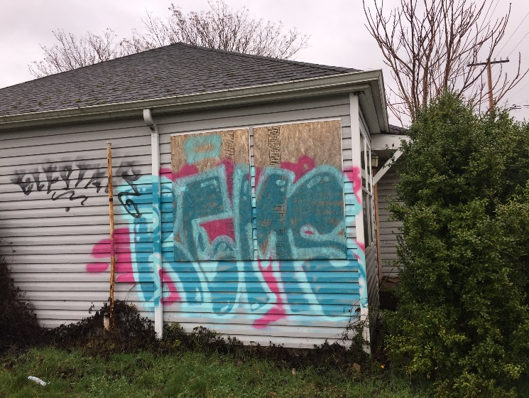
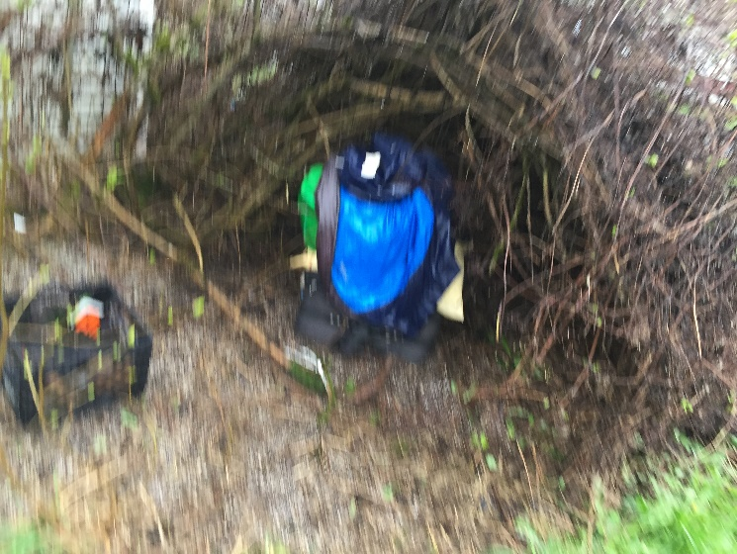
7405-7415 NE Fremont St.
Fire/Life/Safety violations
Health Sanitation Violations
Portions of the chimney above the roof line have deteriorated
Trash and debris accumulated on exterior, interior and garage
Attractive for unlawful occupants

Slide 17
History of Violations/Delinquencies
Violations going back to 1996
Currently there are 5 properties in violation of City Code
Over 120 complaint cases responded to by BDS
Properties have created 42 delinquent liens
46 police calls for service and 837 within 200 ft of the properties
One property owner who had a property included in previous City foreclosure list
Notes:
The property owners have a long history of City Code Housing Maintenance violations with their investment properties.
Here we have the summation of 5 properties that combined have generated 120 complains, 42 delinquent liens, caused 883 police interventions and combined the properties were inspected 120 times.
This summary, gives us a perspective of the negative effect to the neighborhoods and the costs incurred by the City.

Slide 18
Opportunities to Correct Violations/Delinquencies
Request review of the case/potential reduction of amount owed
Waivers
Catch Up Payment Plan Agreement
Amnesty Program (BDS)
Collections Committee
Stipulated Agreement
Notes:
The City offers many opportunities to property owners to correct the violations and solve the delinquencies on their properties.
As an example, when property owners are willing to resolve the violations, they can contact the Bureau of Development Services and request a review of their cases. Once the review is complete, the amount owed is decreased then the Revenue Division will provide a payment plan that allow the property owners to repay the amount owed in up to 60 monthly installments.
Another example is the Bureau of Development Services’ Amnesty Program where if the property is free of code violations the property owner can enroll and pay a portion of the amount owed and/or pay the remainder in monthly installments.
As discussed, the City has made many attempts to assist the property owners to rehabilitate their properties but our efforts have gone answered.
Therefore, the Revenue Division of the Bureau of Revenue and Financial Services recommends that Council approves these properties for foreclosure.

Slide 19
Next Steps in the City’s Foreclosure Process
Council votes on whether to foreclose
Revenue Division transfers responsibility to City Treasurer to conduct the foreclosure sale
Property owner can pay amount owed up to the sale date
After the sale is conducted, the current owner has a one year redemption period
Notes:
The next steps in the City’s foreclosure process are for the Council to vote on whether to foreclose on the properties within this proposed ordinance.
If the ordinance is approved, the Revenue Division will transfer the responsibility to the City Treasurer to conduct the foreclosure sale. The property
owner can pay the amounts owed up to the sale date. After the sale is conducted, the current owner has a one year redemption period.
This is the end of the presentation and we are happy to answer any questions that you may have.

