Slide 1
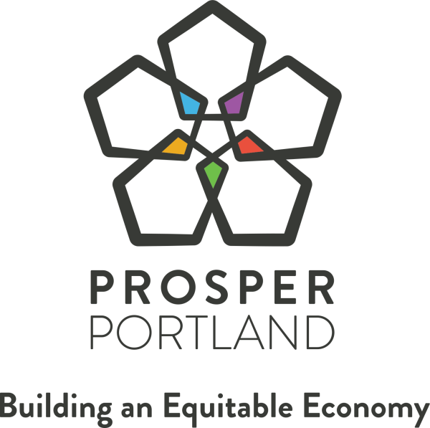
Portland Enterprise Zone Program
10-Year Reauthorization
May 1, 2019
Gustavo J. Cruz. Jr., Commission Chair
Kimberly Branam, Executive Director
Andy Reed, Enterprise Zone Program Manager
Notes:
Slide 1: Commissioner Cruz
Good afternoon Mayor Wheeler, Commissioners. I’m Tavo Cruz, chair of the Prosper Portland Board of Commissioners. I’m glad to be here to present the Board’s recommendation to reauthorize the Portland Enterprise Zone, one of the city’s most powerful tools to create and grow jobs and income.
As a member of the Prosper Portland Commission, former chair of the Hispanic Metropolitan Chamber of Commerce, and an attorney that works with local businesses at all stages, I’m acutely aware of the critical role that innovative partnerships play in the success of our local economy.

Slide 2
Summary
Review Portland Enterprise Zone Program (2008-2019)
Enterprise Zone State Statute overview
Proposed Enterprise Zone boundary map and City Council request
Discussion and feedback
Notes:
Slide 2: Commissioner Cruz
The presentation today is intended to provide a look back at the last 10 years of partnership and innovation within the Enterprise Program. And to set forward a path for the next 10 years of programming at the City of Portland and Prosper Portland.
Prosper Portland focuses our work on building an equitable economy, especially for communities of color and those who have been historically underserved based on geography or income profile. And the E-Zone has been a testing ground for numerous innovations across the organization.
To achieve these goals, we are committed to continual evolution and learning, and to operating in an equitable, innovative, and financially sustainable way. And through your action today, we hope to continue the use of the E-Zone tool to advance our objectives.
With that, I’ll turn it over to our Executive Director, Kimberly Branam.

Slide 3
Adaptation and Evolution
Portland Enterprise Zone established, 10-year designation
Aligning Enterprise Zone with Strategic Plan
New Enterprise Zone policy established for Portland and East Portland Enterprise Zones
Policy Assessment & Program Reorganization
Policy updates w/ Public Benefit Agreements
East Portland Enterprise Zone established
Identified as key
Financial Sustainability Plan resource
Requested 10-year
reauthorization
10+ Public Benefit Agreements signed
2008
2010
2012
2015
2017
2018
2019
2020
Notes:
Thank you, Chair Cruz. Good afternoon Mayor Wheeler and Commissioners.
I’m going to spend the next few minutes talking about how the program has evolved and its impact – and then Andy Reed, who manages the program at Prosper Portland, will dig into some of the mechanics of the program and the proposed action before you.
The program has been in place since 1986 and was most recently reauthorized in 2008.
In 2010 we reorganized the program administration to prioritize quality customer service and increase the ability for small businesses to access the program.
In 2012 we established the East Portland E-Zone, bringing in property east of Cesar Chavez to the border of Gresham and increasing job creation opportunities throughout East Portland. The East Portland Enterprise Zone will come back to you for reauthorization in 2022.
More recently, with the adoption of our 2015-2020 Strategic plan and its focus on creating widely shared prosperity, we’ve adjusted and deployed this program to help deliver on our strategic priorities of:
increasing access to quality employment - especially for people of color and people in East Portland
increasing wealth creation opportunities for local, diverse entrepreneurs, and
encouraging community/business partnerships
For example, we:
In 2015 we added the Employee Support Fund which requires companies to provide child care or transit support if realizing more than $1M in tax savings; and
In 2017 we added the first in the country 'public benefit agreement' requirement of an Enterprise Zone policy to ensure we achieve the desired impacts of the program
Since then 10+ companies have agreed to PBAs and our learning from this approach is being applied to other business lines at Prosper Portland such as the Portland Means Progress initiative
Because the program guidelines were so recently amended, we are not proposing any additional changes to the policy as part of this reauthorization request.
We are here before you requesting reauthorization of the Portland Enterprize Zone of 10 year and direction staff to submit an application to the state of Oregon.

Slide 4
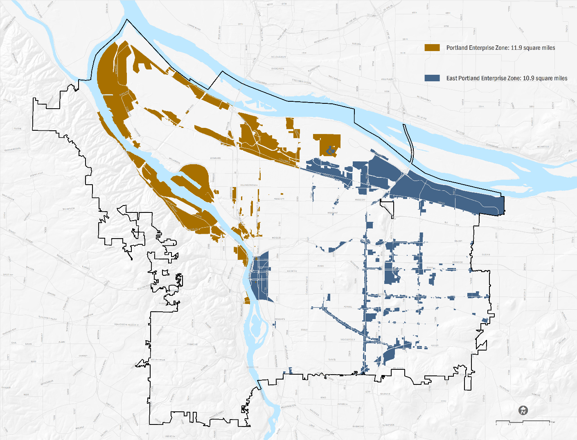
Current Enterprise Zones
Portland Enterprise Zone (2008)
East Portland Enterprise Zone (2012)
Enterprise Zone Policy: 2017 (revised)
Notes:
This map shows visually the Portland Enterprise Zone and East Portland Enterprise Zones
You’ll note that many of the city’s industrially and commercially zoned portions of N/NE and outer East Portland are within one of the two Enterprise Zones.
I’ll also note that while we have two enterprise zones in Portland, a single policy applies to both – so businesses in each zone have identical experiences and expectations.

Slide 5
Enterprise Zones Program Activity
90
53
36%
of active projects are small businesses
Total projects
Active projects
10
YEARS
Notes:
Over the last ten years, we’ve supported 90 projects – with 53 active now from both enterprise zones
You’ll be hearing from one of those firms—McKenna Metal – shortly.
By simplifying access to the program and increasing a focus on customer service, enrollments now include significant number of small businesses, which we define as those with less than 50 employees.

Slide 6
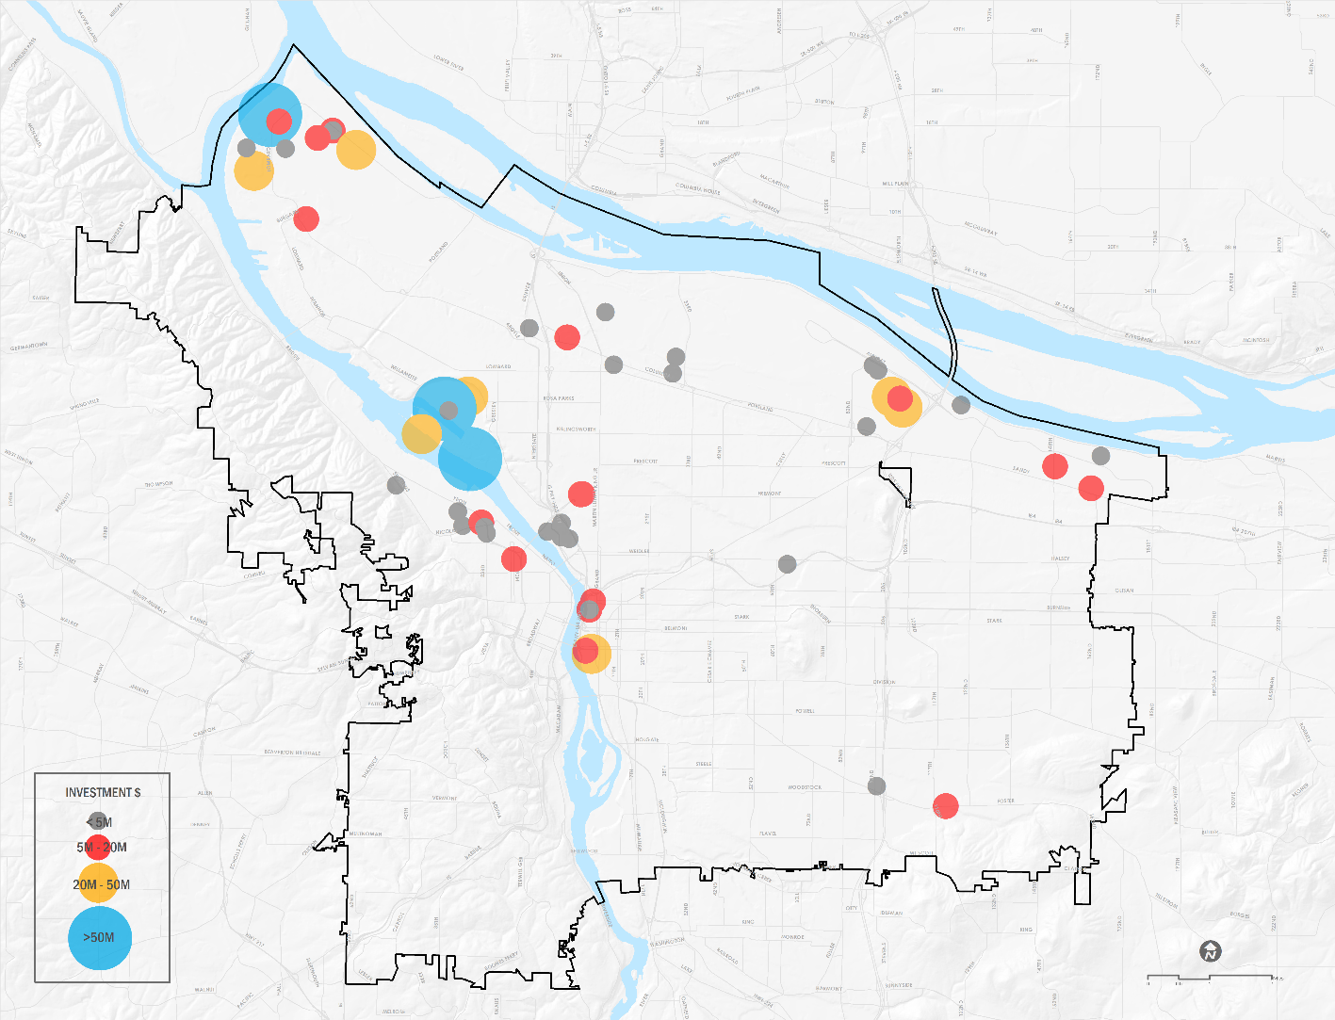
Portland Enterprise Zones Activity Map
Notes:
This map highlights the location of investments and job creation in industrial and commercial locations through the City.
Investments in East Portland have picked up steadily since the creation of the East Portland Enterprise Zone in 2012. Some of those have included manufacturers of products such as granola bars, foam mattresses, and pharmaceuticals to help people who have diabetes.
Other areas of significant investments include Rivergate in the North., Swan Island, NW Industrial area, and the Central Eastside.
The three largest investments came in from Vigor Industrial’s dry dock,
Daimler’s Headquarter expansion, and
Canpotex’s distribution facility.

Slide 7
Active Companies in Portland & East Portland Enterprise Zones
Ajinomoto Frozen Foods | Daimler Trucks NA | Mary's Fresh Harvest | Sun Edison
Ajinomoto Windsor | Dealer's Supply | McKenna's Metals | TEC - Headquarter
Archer Daniels Midland | FedEx Ground | New Seasons Market | TEC - Service Center
Ardon Health | FXI | Olympia Provisions | Treehouse Island
Bob's Metals | GXI | Portland Vital Signs | Triad Machinery
Bridge City Steel | House of Antique Hardware | Profile Laser | United Stationers Supply
Bridgetown Natural Foods | Instrument Marketing | RB Recycling | UPS Distribution HUB
Calbag Metals | Jaguar Land Rover | Rentrak | UPS Driver Training
Canpotex | KeHe Distributors | Simple Finance | UPS Integrated
Cascade Energy | King Cycle Group | Streimer Sheet Metal | Viewpoint Software
Cummins | LKQ Foster Auto Parts | Subaru | Vigor Industrial
Notes:
Drilling down further:
Here is a list of those companies that had an active exemption in place during 2015-2018.
Those noted in bold are smaller businesses
New companies entering the program in 2019 include: Salt and Straw, City of Roses and Recycling, Cook Security, Group, Adpearance, Gunderson and Nossa Familla.
We currently have an additional 9 projects in the pipeline that have finished new E-Zone applications and have begun investments with anticipated exemptions to begin in 2020.

Slide 8
Impact | Investments in Portland
$1,037,383,430
Total Capital and Procurement Investment, 2015-2018
$672 million
$365 million
Notes:
Talking Points: Kimberly
During the same period of 2015-2018, the Portland Enterprise Zones catalyzed a total of more than $1 Billion in investments:
With $672M for expansions of Daimler, Vigor Industrial, Salt and Straw, Olympia Provisions, Instrument Marketing, Simple Finance and others.
And $365M is purchases for goods and services inside the City of Portland boundaries.
Starting in 2017, the Public Benefit Agreements have specific efforts to procure from entrepreneurs of color – utilizing both the Inclusive Business Resource Network and the Mercatus Collective as vehicles to support local diverse businesses and create connections.

Slide 9
Impact | Jobs, wages & compensation
2,834
$41.95
$38.18
1,810
$33.98
Benefits
1,346
$25.14
$27.98
$30.86
Wages
2015
2016
2017
2015
2016
2017
NEW JOBS (from baseline)
AVERAGE TOTAL COMPENSATION
Notes:
Talking Points: Kimberly
That investment led to significant new quality jobs – the majority of which are middle-wage, high quality employment opportunities.
For projects active in 2017 (the most recent verified data), they created 2,834 new jobs post enrollment in the program.
And we’re seeing average total compensation increase – both as a result of increased wage requirements within the policy and a tighter labor market creating competition – and increased salaries – for employees.
So – with that, I’ll turn it over the Andy to discuss how the program works, the process ahead, and some proposed boundary amendments.

Slide 10
Value to Community
12 to 16 public benefits from every project (including jobs & investment)
* $15.00 an hour minimum pay or $20.00 an hour total compensation
* Workforce Training and Business Development Fund Contributions
* Child care and transit support
* Equity Training
* Yearly compliance and outcome tracking: Department of Revenue and public benefit compliance with both quantitative and qualitative data on performance
* Minority contracting
* Career ladder opportunities
* First Source Hiring Agreements
* Local procurement
* 2-6 additional public benefits from our menu
Notes:
Talking Points: Andy
Thank you Kimberly. On the question of how the program works…we aim to deliver benefits to the community, business, and the city through numerous methods. To start with the value to the community—both residents and employees of companies—are benefiting in many ways.
To highlight a few of these benefits, we have a wage floor of $15.00 an hour for all jobs.
Companies pay 15% of actual tax savings into an economic development fund to support programs. We’ll highlight this in a couple slides.
All new companies will be providing equity training to employees.
Additionally, they now have to make good faith efforts to increase goods and services purchased within Portland and specifically owned by people of color and in priority neighborhoods
And now extra public benefit agreement have been added to our agreements, where 2-6 additional community engagements
are creating diversity hiring plans,
pro bono support for entrepreneurs of color and women,
and creating pipeline opportunities for youth of color from our high schools in Portland.
Lastly, companies do yearly compliance: with Prosper Portland, Multnomah County, Business Oregon, and the Department of Revenue. We taking compliance very serious.

Slide 11
Value to Business
Enterprise Zone five-year property tax abatement on new capital investments
Benefit Agreements Resources
Portland is a good place to do business
Business culture change
Notes:
Talking Points: Andy
We believe the value to business and community is shared. The competitive of the business and the health of the community are tied together.
On the question of competitiveness, businesses that join the program can receive a 5 year tax exemption only on new capital investment. Existing land, buildings, and personal property on the tax rolls continue to be taxed.
Apart from the financial incentive, businesses benefit in other ways through workforce development programming, boost to their public image, and a better businesses culture that lead to a diversified workforce and employee retention.
Interestingly, site selectors around the U.S. have commented that we have more requirements than any other jurisdiction they’ve worked with across the country. They also say it fits Portland brand, and that because we have created a clear set of expectation with return on investment back to business, they will continue to send projects our way.

Slide 12
Economic Development Value Proposition
4 year average forgone Property Tax Revenue: $1.6 million City General Fund (Total= $6.5M)
In return for forgone revenue, over 4 years:
$2,486 Cost Per Job
2.2% City Business Tax on applicable revenue
$36.6M Income tax to the State of Oregon
$2.75M Workforce Training & Business Development Fund
Public benefit agreements with 100+ engagements each year
Estimated ‘payback’ of forgone revenue = 5 years after abatement expires
Notes:
So pivoting a bit from the business culture change, public benefit agreement conversations, the program has other financial impacts to note.
In exchange for $6.5M in forgone tax revenue, in addition to procurement and job creation we’ve seen $36M in Oregon income tax revenue, $2.75M in workforce training and business development funds (we’ll show where this fits in the next slide).
Over the years we’ve done analysis…we believe the financial payback to local jurisdictions is about 5 years after the tax incentives come back on the rolls, apart from all of the numbers represented here.
Back Pocket:
2015-2018: 8,990 FTE x $27.99 =523,410,023
gross wages = $36.6M
Estimated income tax generated @7% tax rate: $36.6M in income tax over 4 years

Slide 13
Economic Development Programs Leverage
Notes:
This slide shows how enterprise zone funds are playing out the overall economic development programming. Diving further into our economic development programs not restricted to traditional tax increment finance districts, this graph shows our four major business lines and how general funds are leveraged by other non-TIF resources. From top to bottom these include:
Workforce development funds
Inclusive Business Resource Network funding.
Neighborhood Prosperity Initiative and Venture Portland
The traded sector business non-profits and programs
All told, approximately 40 non-profits receive funds to deliver on key economic development priorities for the city.

Slide 14
Oregon State Statute/Administrative Overview
1985
70+
10 years
Enacted by legislature, continuously supported by nearly all legislators, both urban & rural, for decades
Enterprise Zones across the state; nearly every medium/ large city in Oregon has a zone
10-year designations must be approved by local zone sponsor, port, and state
Allows for local conditions/community benefits, but not required for 3-year exemptions
Notes:
Moving on to the request before you.
The program started in 1985 through the Oregon Legislature
There are now 70+ zones across the state. It’s now being used extensively, and many of our partner city and counties see the E-Zone as the only significant incentive to attract new business and encourage growth by existing firms.
Each designation is for 10 years, and our current Portland E-Zone will expire in two months without this action today.

Slide 15
Proposed next 10-year reauthorization
The Enterprise Zone must:
Meet state income/poverty standards for qualifying
Stay within statutory limits on total square miles and point-to-point distances (max = 24 sq. mi.; current = 21.43 sq. mi)
Be located in or near low income areas
Be authorized by Portland City Council and Port of Portland Commission by resolution
Notes:
Just like the previous E-Zone authorizations, we are held to standards as described in the slide when seeking a new authorization.
Our E-Zones are located in or near many of our high poverty areas of the city.
Meet state income/poverty standards for qualifying
Stay within statutory limits on 12 square miles
Be located in or near low income areas
And receive local authorizations
///////////////////////////////
Back Pocket
We us a combination of American Community Survey modeling software to allow us to report on non-conforming census geographies.
unemployment rate, two percentage points or more above the statewide rate,
income level of 80 percent or less of the equivalent income level for the state in terms of per capita, median household or comparable figures,
percentage of persons or families below the federal poverty level that is at least five percentage points higher than the statewide poverty incidence rate, or
ten-year change in population that is at least 15 percentage points below the state’s corresponding population change.
Max combined E-Zone acreage allowed = 24 sq. mi.; current = 21.43 sq mi.

Slide 16
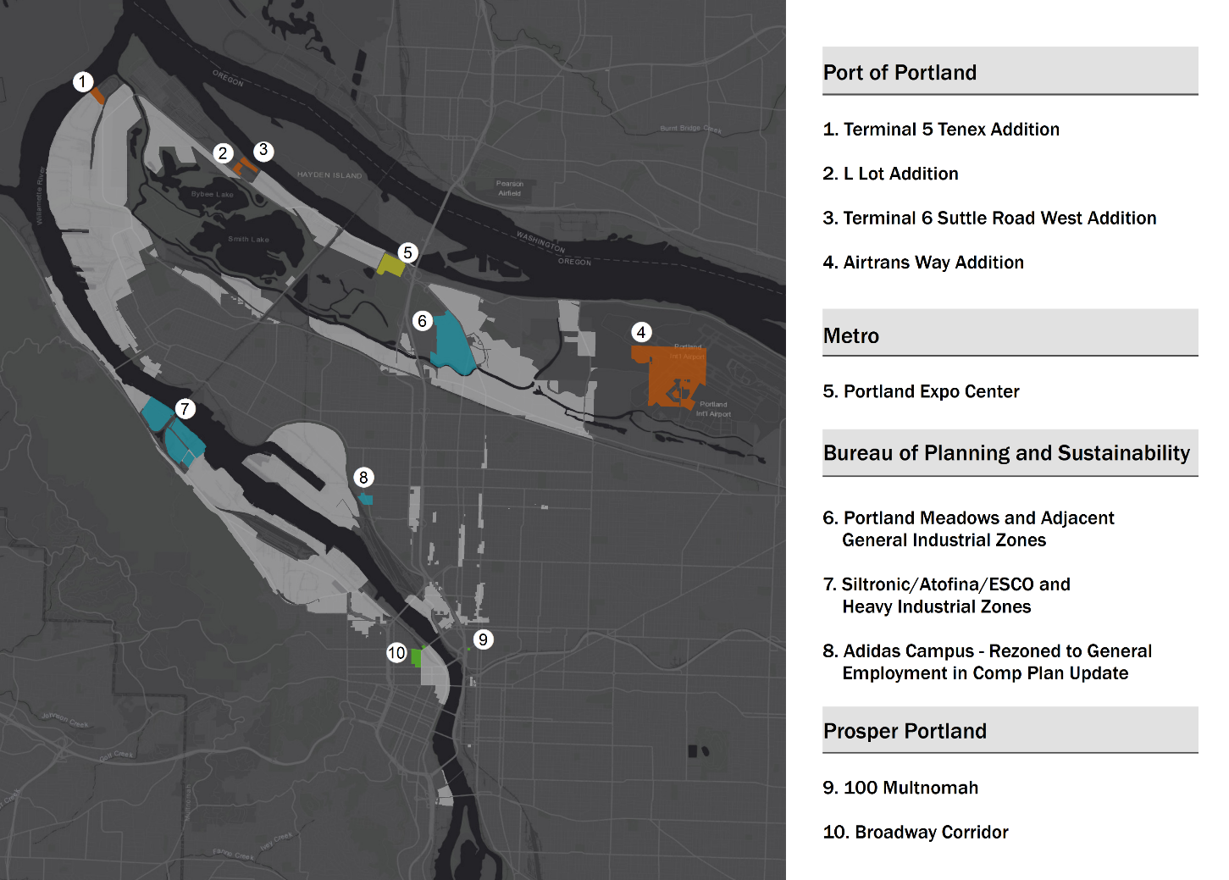
Proposed Enterprise Zone Map and City Council Request
Notes:
And this is proposed Enterprise Zone Map for the next 10 years.
Through multiple meetings with taxing jurisdiction partners, we identified alignment in economic development priorities among our partners.
Then determined a list of properties that met those priorities. Technically, we have a limit of 12 square miles for the Portland E-Zone, so not all properties considered can be brought into the E-Zone. Only those that received consensus and fit within the statutory limits.
To highlight some of the decision points, the Port is taking a fresh look at how the promote their industrial properties and the PBS had interest in adding sites that are affected by Superfund issues to spur potential development.
Across the board, we believe these additional are in alignment with the Comprehensive Plan as we as our partners objectives of growing quality jobs.
In Summary: WE ARE REQUESTING CITY COUNCIL REAUTHORIZE THE PORTLAND ENTERPRISE ZONE FOR TEN YEARS AND DIRECT STAFF TO SUBMIT AN APPLICATION TO THE STATE OF OREGON.
Back Pocket:
Approximately 13% of the existing E-Zone area would be added.
Current Zone acreage: Portland E-Zone currently at 10.47 sq miles. Proposed zone would be: at near the max at 11.9 sq miles

Slide 17
Discussion & Questions
Notes:
Talking Points

