Slide 1
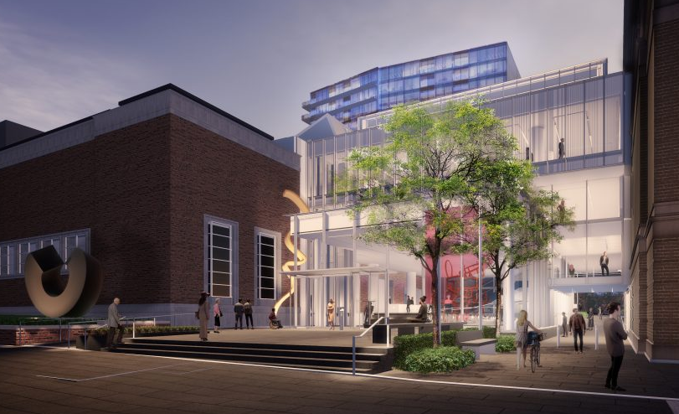
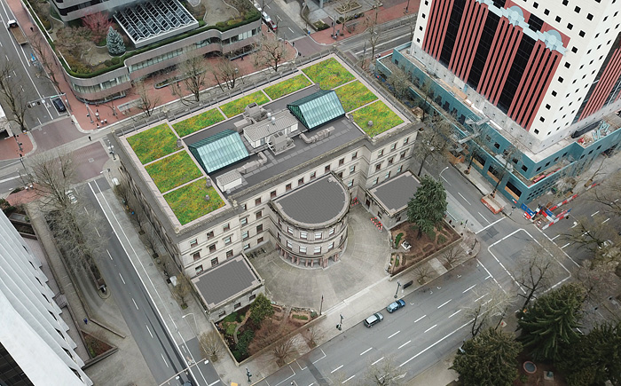
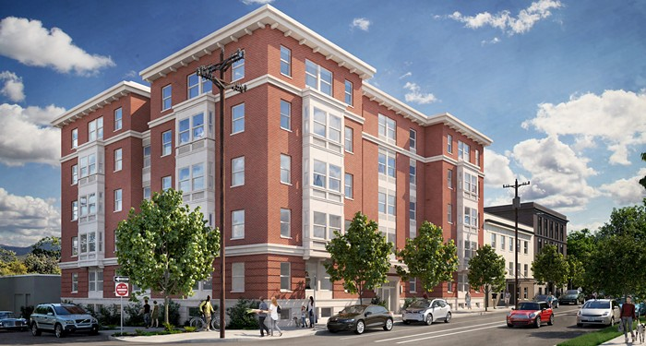
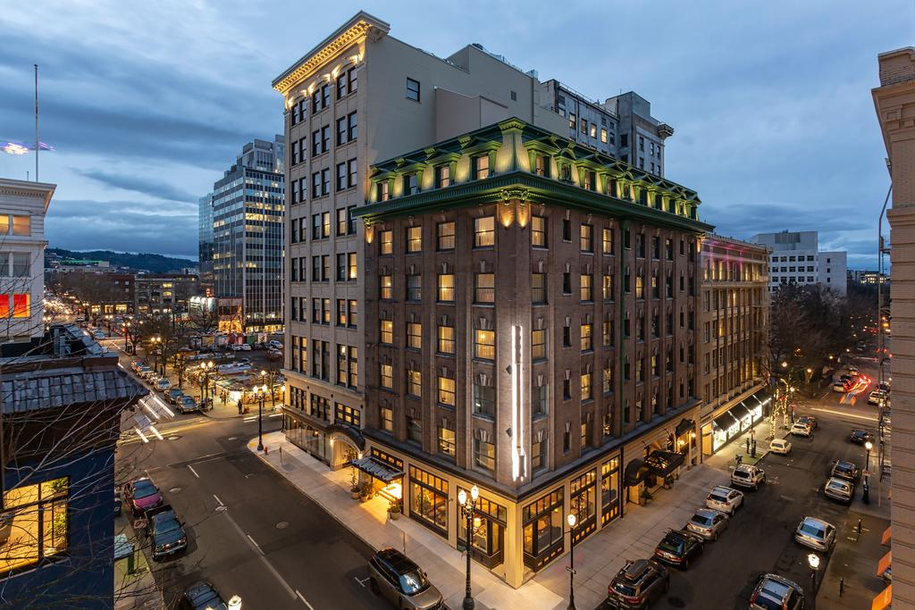
State of the City Preservation Report 2018 (Part B)
Portland Historic Landmarks Commission

Slide 2
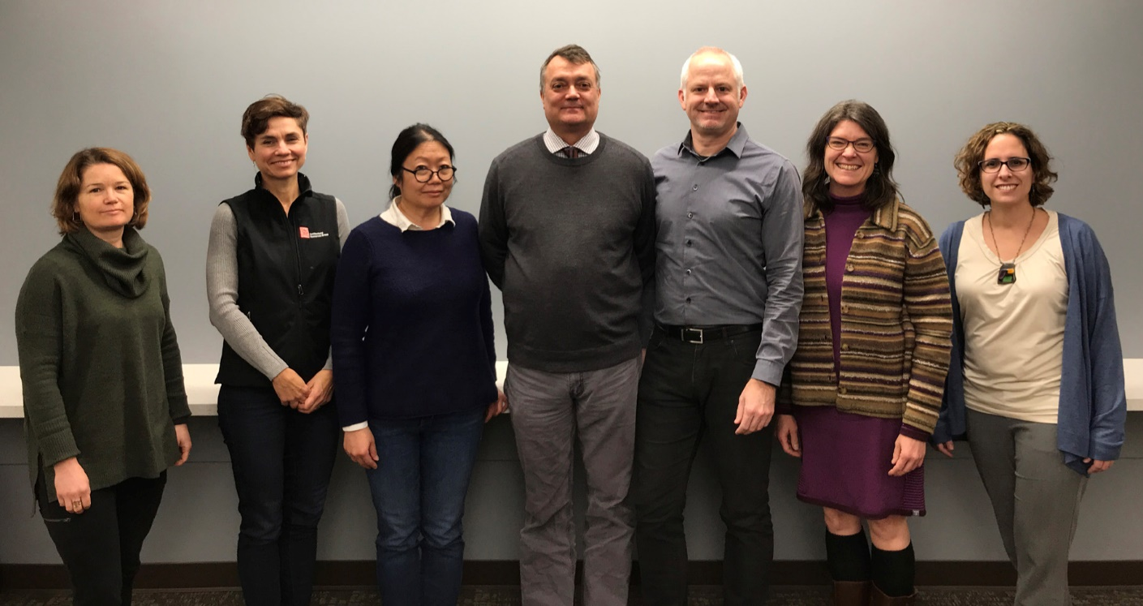
WHO ARE WE?
Portland Historic Landmarks Commission 2019
Annie
Mahoney
Architect
Vice Chair
Maya Foty
Preservation Architect
Matthew
Roman
Designer
Andrew
Smith
Historical Architect
Chair
Kristen Minor
Preservation Planner
Ernestina
Fuenmayor
Historian/ Architect
Wendy Chung
Attorney
With special thanks to: Hillary Adam, primary staff to PHLC; BDS Design & Historic Review staff;
Kara Fioravanti who supervises that team; and Brandon Spencer-Hartle, liaison from the Bureau of Planning and Sustainability.

Slide 3
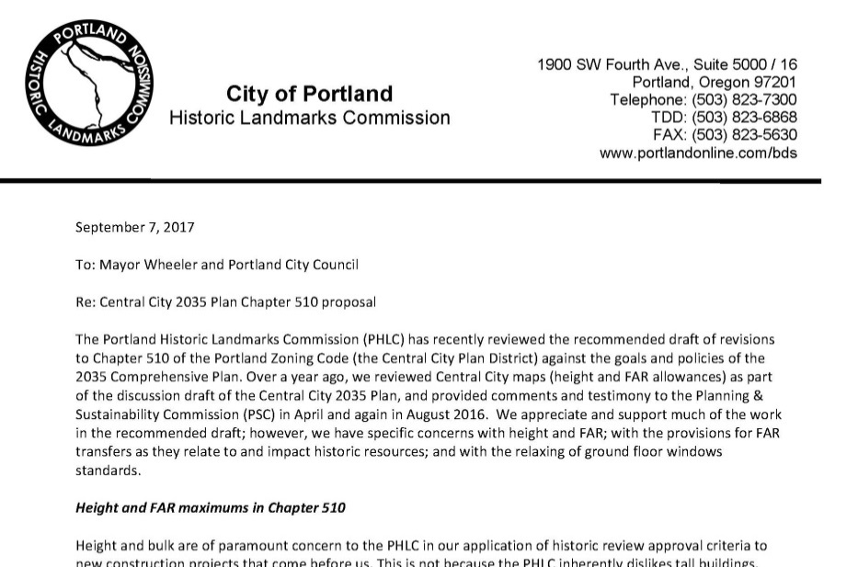
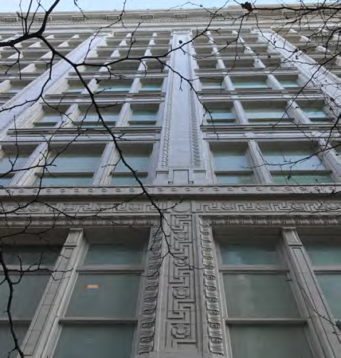
WHAT DO WE DO?
Decide Land Use Applications
- Type III Alterations, Demolitions, and New construction in Historic Districts
- Type II Appeals
Make Recommendations to City Council
- Establishing, Amendment, or Removal
of Historic Districts
- Adoption of new Guidelines for Districts
- Type IV Demolition Reviews
Provide Advice on Historic Preservation Matters
- Design Commission
- Hearings Officer
- Planning & Sustainability Commission
- Portland Development Commission
- Portland City Council
- City Bureaus and other committees
Initiate and coordinate preservation and outreach programs within & outside of the city

Slide 4
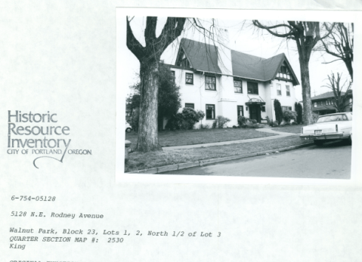
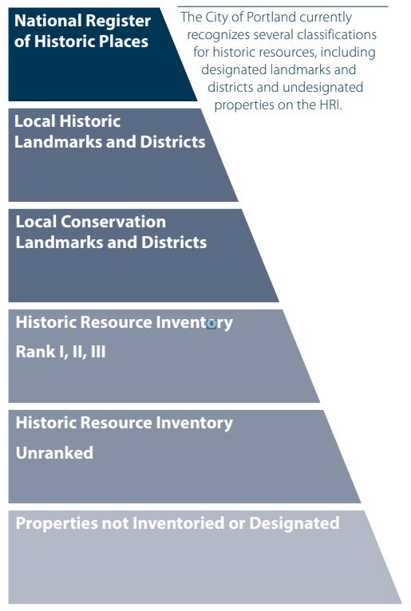
WHAT WE SEEK FROM CITY COUNCIL
BUDGET REQUESTS:
GENERAL FUND
The PHLC relies on BDS staff to do the legwork to provide us with the best possible information.
We request funding the budget for adequate staffing levels.
Without an adequately funded staff, BDS will not be able to provide the level of support we have received and appreciated thus far.
HISTORIC RESOURCES INVENTORY (HRI)
Listing in the HRI is not a designation, but a determination of historic significance without protections.
Simply put, the HRI helps us do our job.
The HRI is a living document that will be evolving as structures and places age into eligibility.
Funding for it must be on an annual basis.
Notes:
Express support of the Type I fees that are proposed in the fee changes that will be in front of City Council in mid-May. It’s a separate fee request then the General Fund.

Slide 5
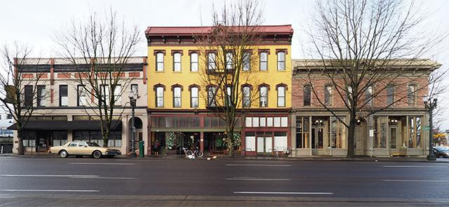
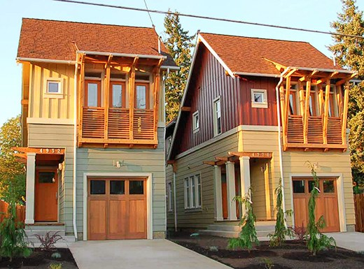
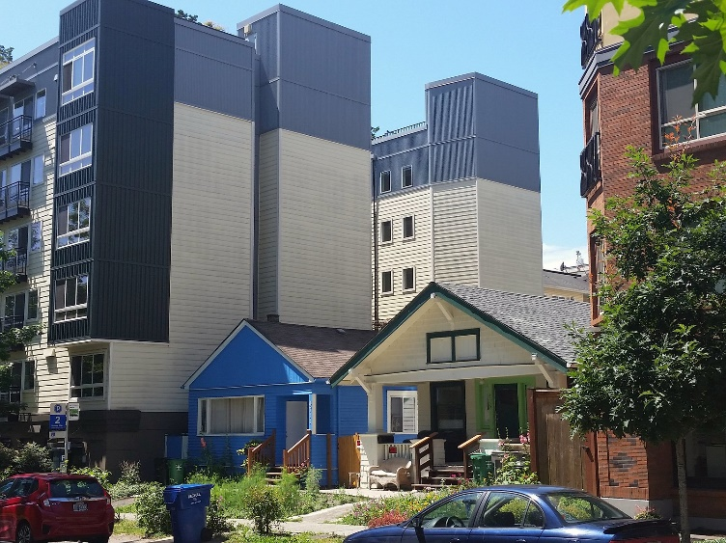
WHAT WE ARE REVIEWING
CITY LEGISLATIVE PROJECTS:
HISTORIC RESOURCES CODE PROJECT (HRCP)
The project aligns code with new State regulations. It includes new processes, levels of historic designation, and much-needed incentives for historic properties.
RESIDENTIAL INFILL PROJECT (RIP)
PHLC is overall in favor of project BUT should be revised to include incentives for preserving historic structures.
Move away from residential “unit counts” to form- or volume-based allowances.
Stop developer-led demolitions and cookie-cutter construction that doesn’t offer affordability or quality.
BETTER HOUSING BY DESIGN (BHBD)
We generally support BHBD with certain concerns:
Projects in Historic Districts were allowed to earn bonus FAR values above what may be approvable.
They should instead be allowed to market such FAR outside of the historic or conservation district.

Slide 6
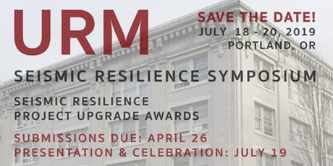
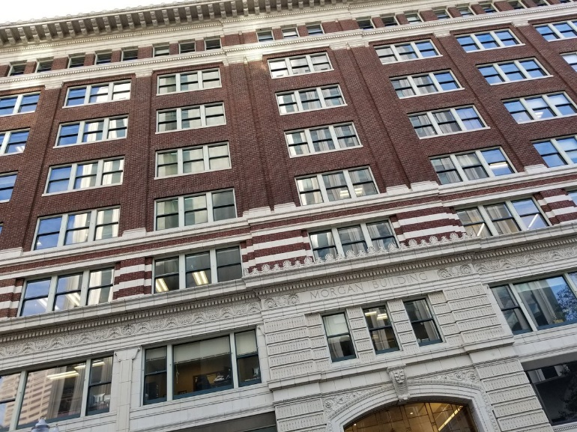
WHAT WE ARE REVIEWING
CITY LEGISLATIVE PROJECTS:
DESIGN OVERLAY ZONE AMENDMENTS (DOZA)
The “city wide” focus of the standards and guidelines being proposed do not provide sufficient guidance needed to define and measure compatibility area by area.
“Point” system not necessarily tied strongly enough to good design.
DARs are critical to ensuring successful projects.
URM ORDINANCE
1650 unreinforced masonry buildings in Portland.
Current mandated upgrades limited to preventing loss of life.
Great burden on communities and owners that can’t afford such retrofit projects.
Helping organize URM Symposium – Summer 2019
PHLC representative anticipated to sit on newly work group created by City to craft URM policy.

Slide 7
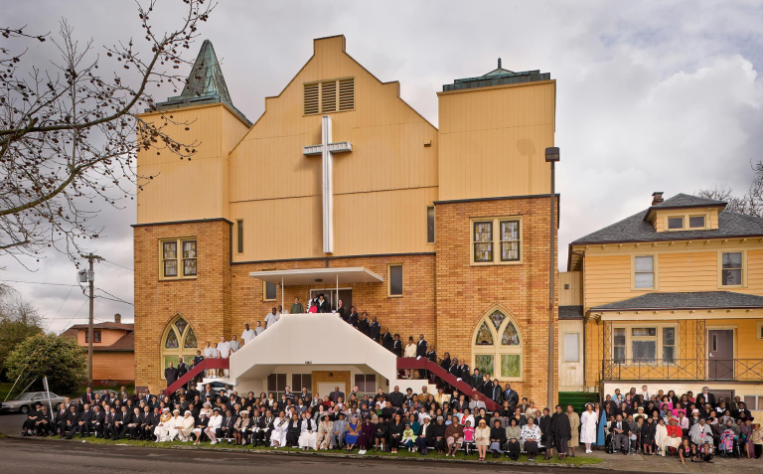
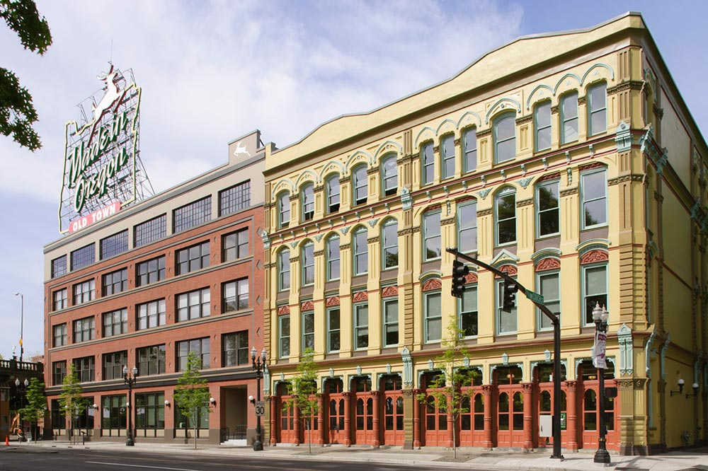
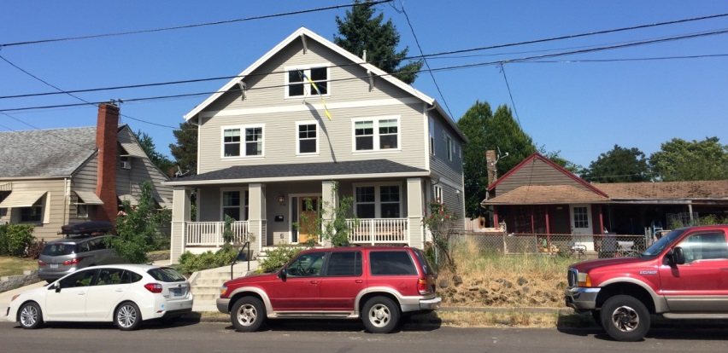
2019 PRIORITIES AND GOALS
A
ENSURE HISTORIC PRESERVATION BENEFITS ALL CITIZENS
Recognize and protect important places.
ENGAGE WITH OUR COMMUNITY
Ensuring that historic preservation is part of the solution to growing community needs.
ADVOCATE FOR LOCAL/ STATE INCENTIVES
Support rehabilitation & adaptive reuse.
SUPPORT PORTLAND’S UNIQUE PLACES
Developer- and development-driven solutions by themselves are not working. Density should first be achieved through additions and adaptive reuse rather than demolitions.
PRIORITIZE SUSTAINABILITY
We must act to reduce construction industry CO2 emissions. Adaptive reuse & retrofits are the best ways to achieve this.
B
C
D
E

Slide 8
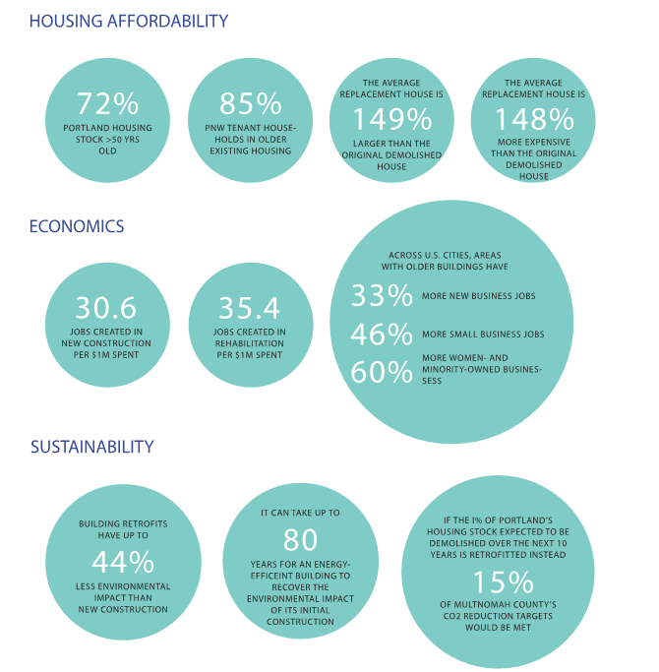
BENEFITS OF PRESERVATION

Slide 9
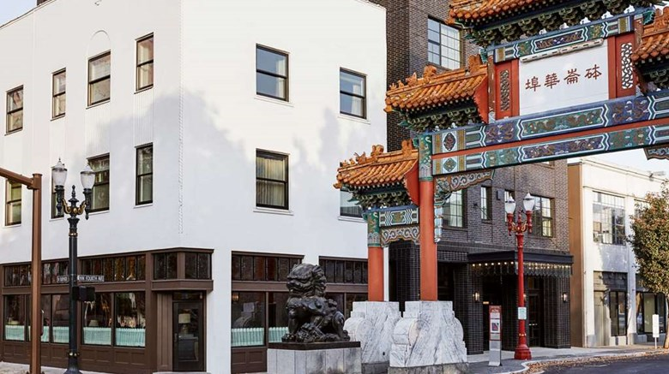
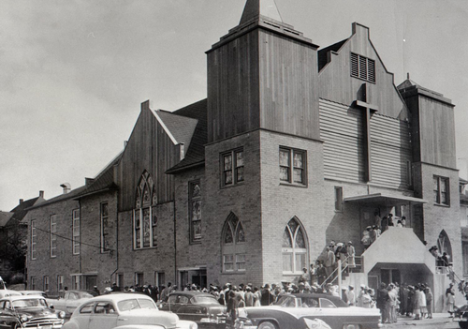
2019 WATCHLIST
AT-RISK RESOURCES THAT THE COMMISION IS ACTIVELY CHAMPIONING:
NEW CHINATOWN / JAPANTOWN HISTORIC DISTRICT & THE ORIGINAL BLANCHET HOUSE
New smart investment needed in the neighborhood that is respectful of the historic character such as the newly restored Grove Hotel, now Hoxton Hotel.
URM BUILDINGS/ STREETCAR-ERA
NEIGHBORHOOD COMMERCIAL HUBS
The Commission supports the City’s efforts to mandate seismic reinforcement of all URM buildings in order to minimize loss of life during a significant seismic event.
CORNERSTONES OF COMMUNITY RESOURCES
The Bosco-Milligan Foundation report identifies potential historic resources associated with Portland’s African American heritage such as the Vancouver Avenue First Baptist Church.
1
2
3

Slide 10
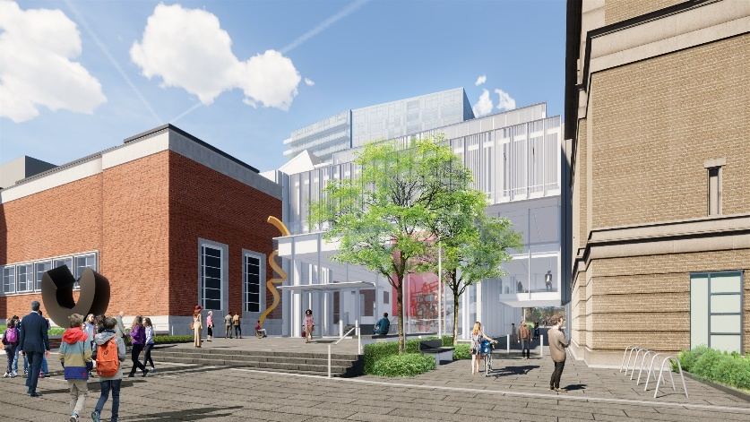
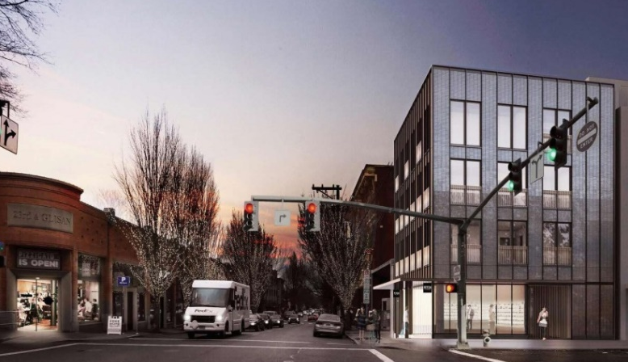
PROJECT HIGHLIGHTS
PAM ROTHKO PAVILION
An infill addition to the Portland Art Museum bridging two Historic Landmarks. It is a case study for adding equity and accessibility to a cultural institution - issues that many historic buildings face. The PHLC invited the Design Commission for a joint Design Advice to take advantage of their expertise. (Image by Hennebery Eddy Architects)
PORTLAND CITY HALL
The Landmarks Commission reviewed and approved the installation of a new eco-roof on top of City Hall. The Commission also provided advice on elements related to restoration of the historic balustrade, doors, and windows.
(Image by Mayer/Reed Landscape Architects)
500 NW 23RD
This 4 story mixed-use building by Allied Works replaces the Burkhardt house in the Historic Alphabet District with a properly scaled structure with thoughtful detailing. The house was previously destroyed by a gas explosion in 2016. (Image by Allied Works Architecture)

Slide 11
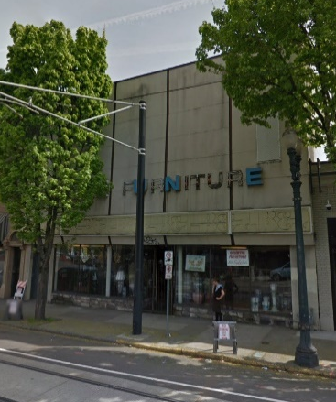
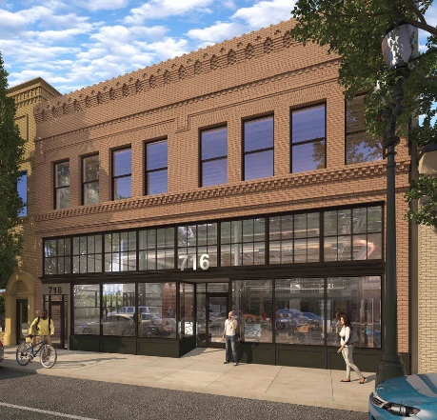
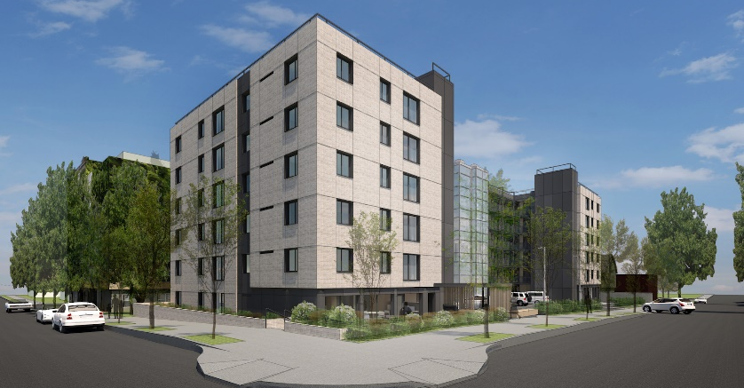
PROJECT HIGHLIGHTS
716 SE GRAND
The project restores the building original façade, currently cladded by a 1970s renovation. After receiving staff approval for the work, the property owner wished to reclassify the building from a non-contributing resource to a contributing resource in the East Portland / Grand Avenue Historic District. (Image by BKL|A Architecture)
EXISTING
PROPOSED
WOODLARK / CORNELIUS HOTEL
Commission approved the rehabilitation of these two landmark buildings which promised to restore much of the historic fabric while also providing a full seismic upgrade for the purpose of opening a new hotel occupying both buildings which now function as a single building.
MEDALLION APARTMENTS
Over the past few years, the Landmarks Commission has reviewed a handful of proposals for recladding existing large-scale residential buildings. This one, in the Alphabet Historic District, included a new skin of thin brick and fiber cement panels, new windows, and the conversion of three garage bays to a community room with an enhanced garden entry sequence. (Image by Holst Arch.)

Slide 12
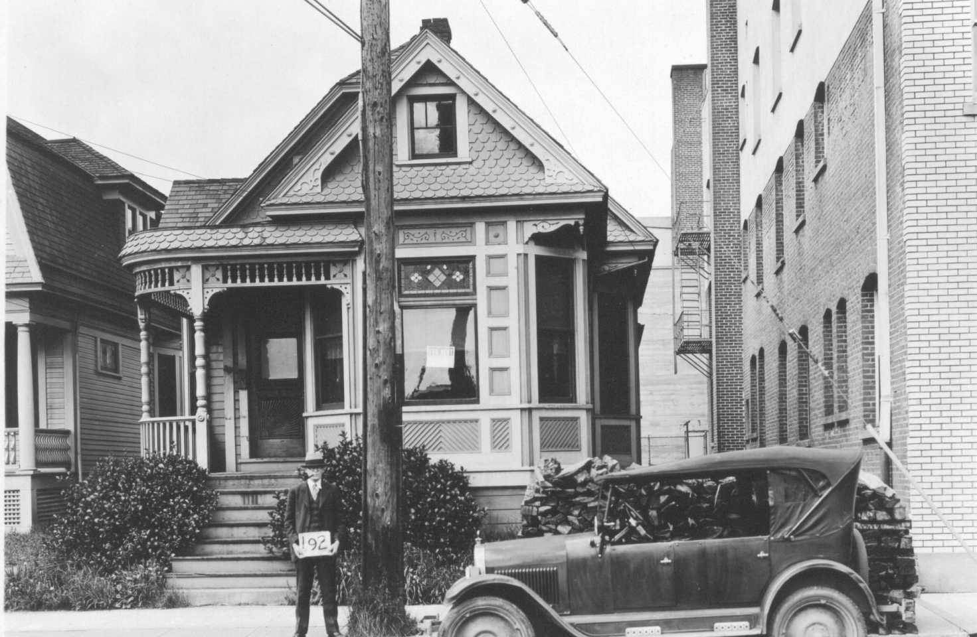
PORTLAND PRESERVATION STORIES
MAYO HOUSE
While the Historic Landmarks Commission was not involved with the relocation of the Mayo House, the Commission acknowledges the hard work done to make this preservation story possible. The saved relocated house is intended to serve as a community space where the art and culture of Portland’s African-American community can be preserved and continually created.

Slide 13
PROJECT OF THE YEAR
BUCK-PRAGER
Once slated for demolition by developers and saved by City Council following the advocacy of neighborhood members, Buck-Prager serves as a model for how historic preservation can contribute to providing low income housing in one of the densest neighborhoods in Oregon. (Image by Carleton Hart Arch.)

Slide 14
Thank you
Questions?

