Slide 1
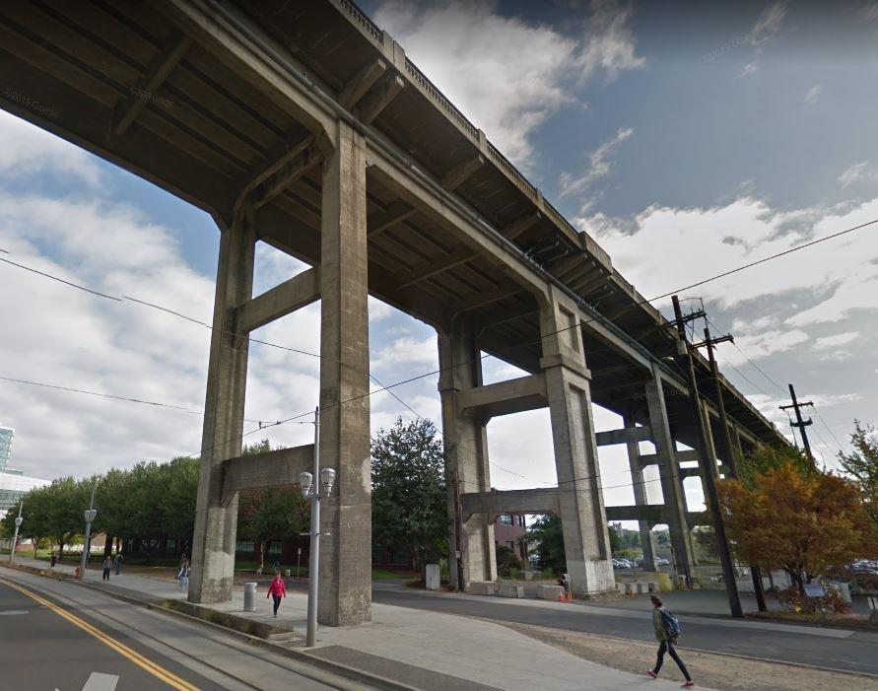
City of Portland
Design Commission
Type III Land Use Review
LU 19-102941 DZ
Ross Island Bridge
May 02, 2019
Staff Presentation

Slide 2
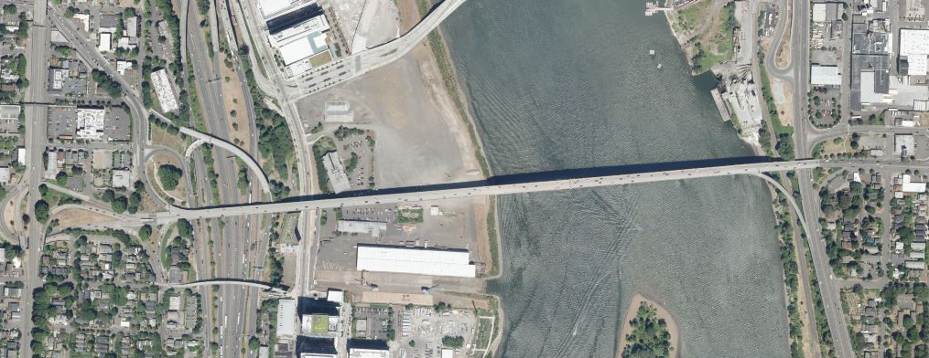
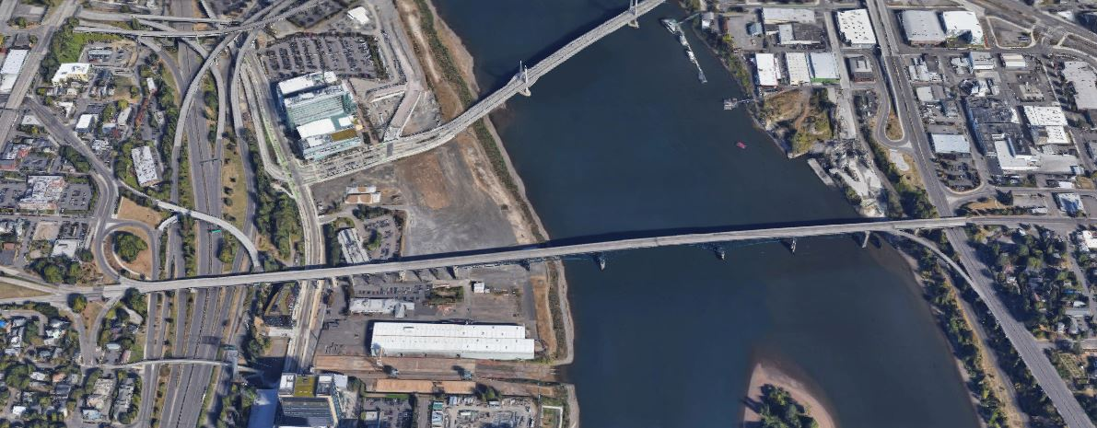
Site
Ross Island Bridge

Slide 3
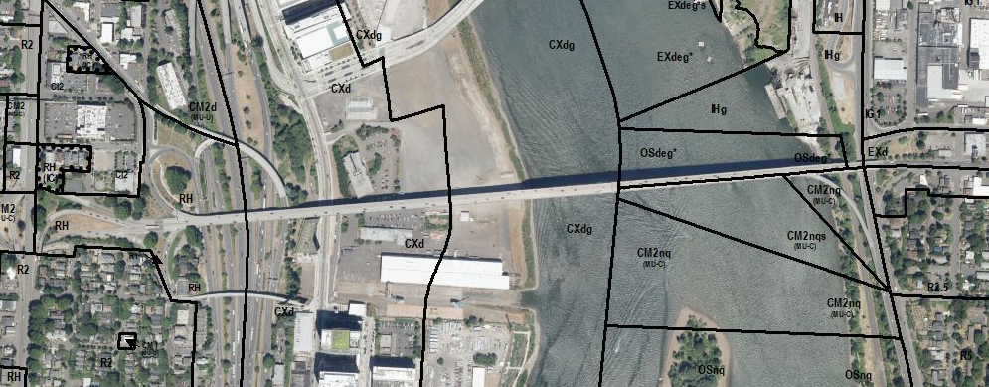
Site
Ross Island Bridge
Zoning:
Plan District: Central City
Base Zones: CX (Central Commercial)
Overlay Zones: d (Design Review), g (Greenway – River General)
Approval Criteria:
Central City Fundamental Design Guidelines
South Waterfront Greenway Design Guidelines
Oregon Statewide Planning Goals

Slide 4
Staff recommends approval

Slide 5
Questions

