Slide 1
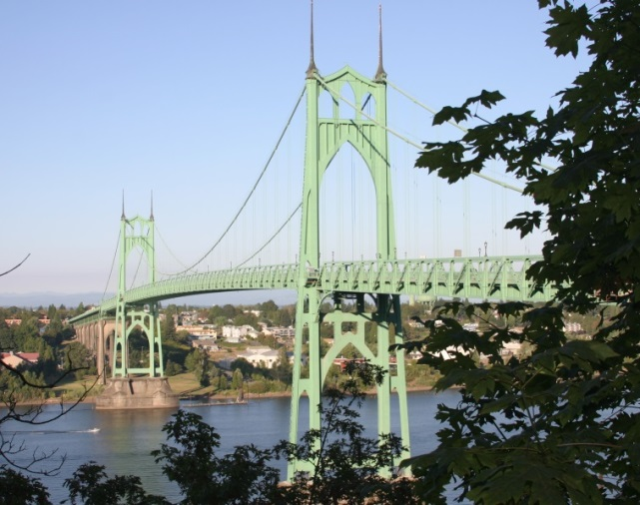
Hillsdale South Sewer Rehabilitation Project Council Item 311 Portland City Council April 10th, 2019
Joe Dvorak, P.E.,
Design Division Manager
Margaret Russell, P.E., Project Manager

Slide 2
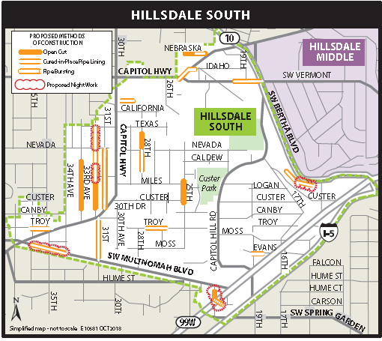
Project Overview
~7200 linear feet of pipe
6” to 15” diameter pipe
Pipe installed between 1920-1960
Located in primarily residential streets

Slide 3
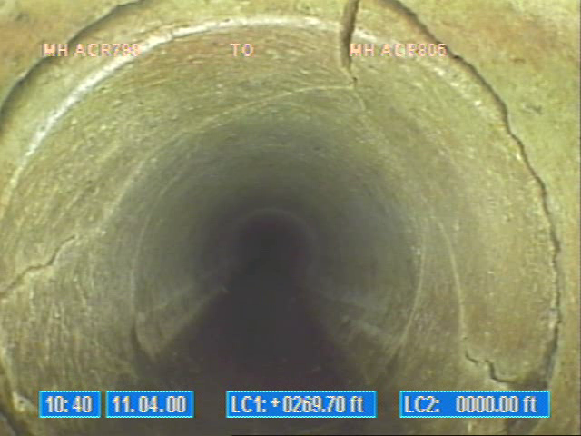
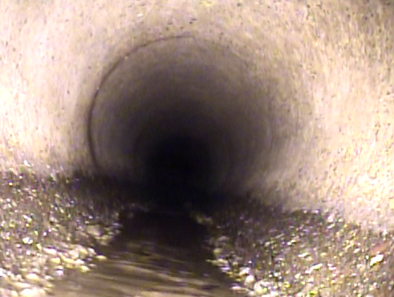
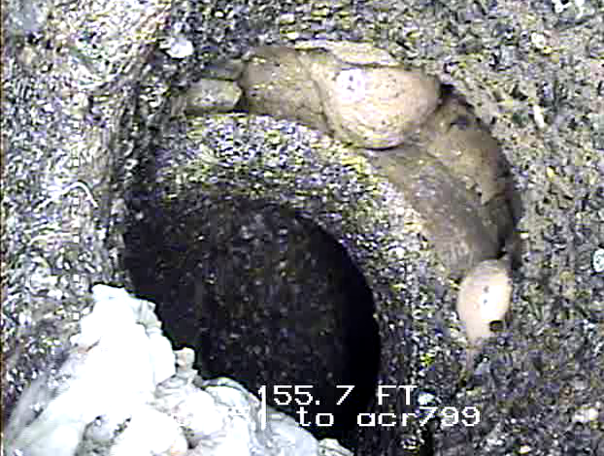
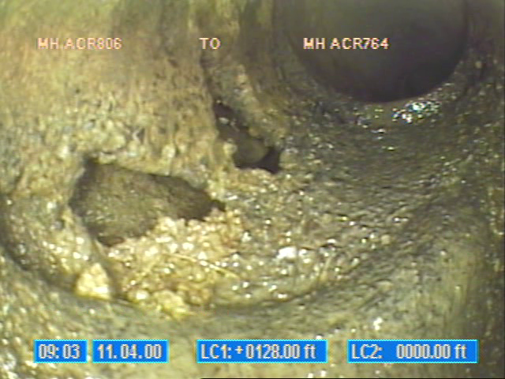
Mainline and Service Connection Defects
Mainline
Service Connection

Slide 4
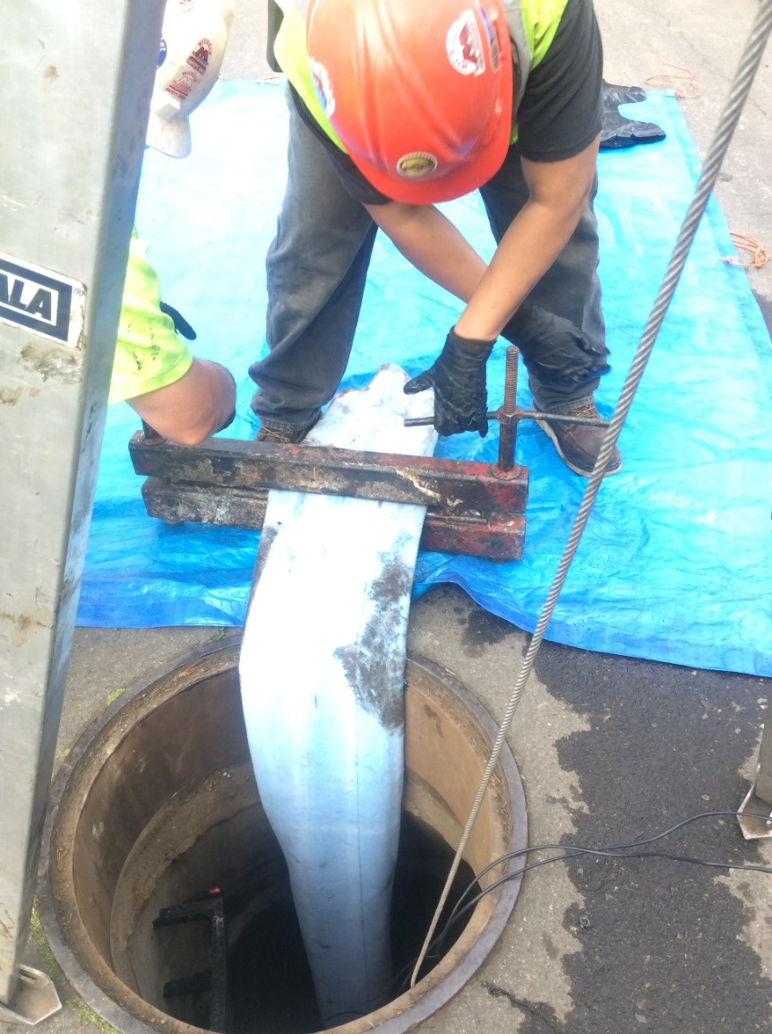
Construction Methods
Trenchless Rehabilitation
Open cut excavation and replacement

Slide 5
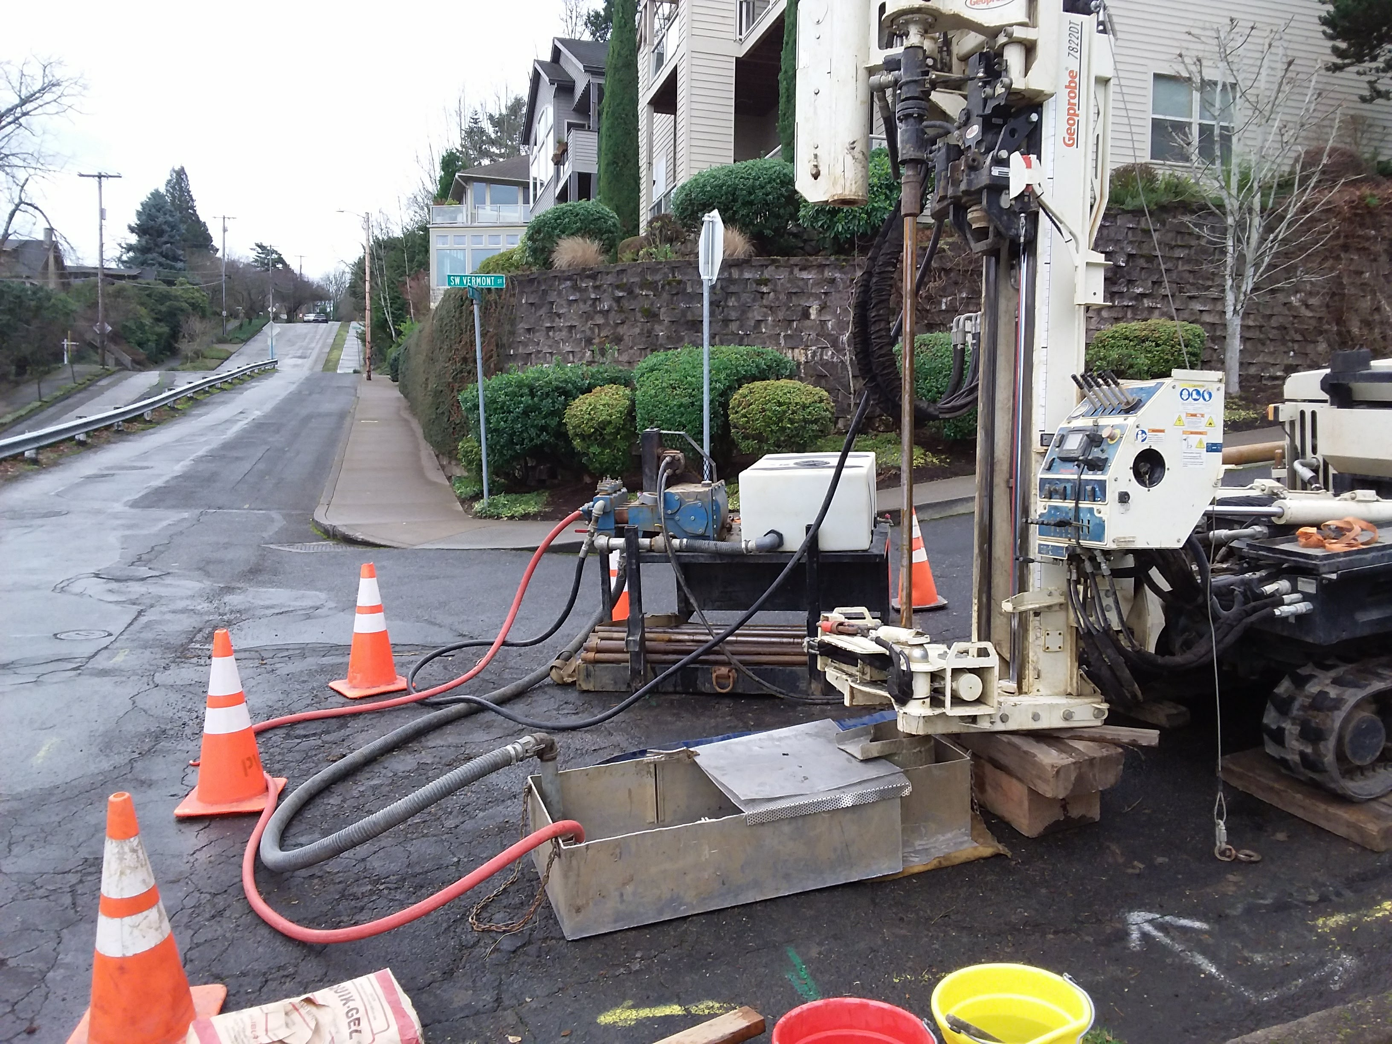
Engineer’s Estimate
Engineer’s Estimate: $2,065,000
Level of Confidence: High

Slide 6
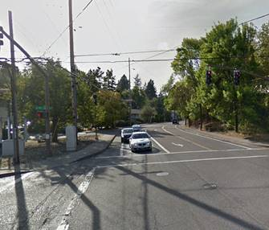
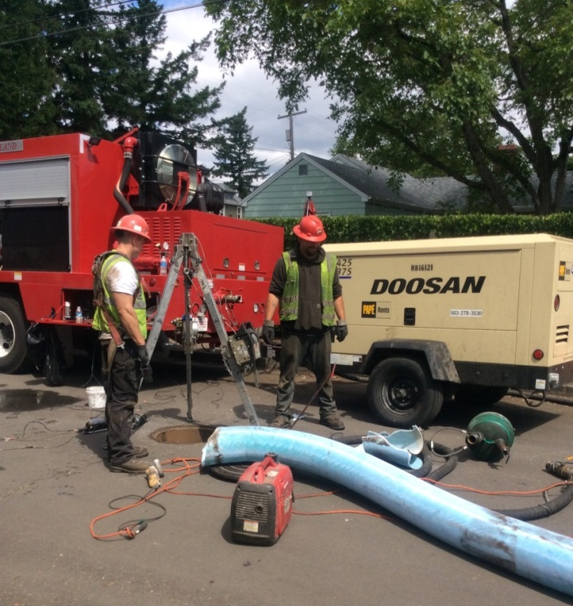
Project Schedule
Advertise Contract: July 2019
Begin Construction: Nov. 2019
Construction Duration: 12 mo.
Questions?
Questions?

