Slide 1

Fair Housing Month April 2019
Kim McCarty, Senior Rental Services Program Coordinator
April 17, 2019

Slide 2
BPS Commitment to Racial Equity
Portland Plan
Climate Action Plan
Comprehensive Plan
Notes:
The Portland Plan put forward the idea of an Equity Framework that drives everything we do: with an emphasis on race and disability.
The Climate Action Plan was updated in 2015 with a more explicit focus on equity.
The Comprehensive Plan is also one of the implementation tools for this work because it drives how we manage growth and change.
For BPS this means reconsidering our practices and forming new community partnerships.

Slide 3
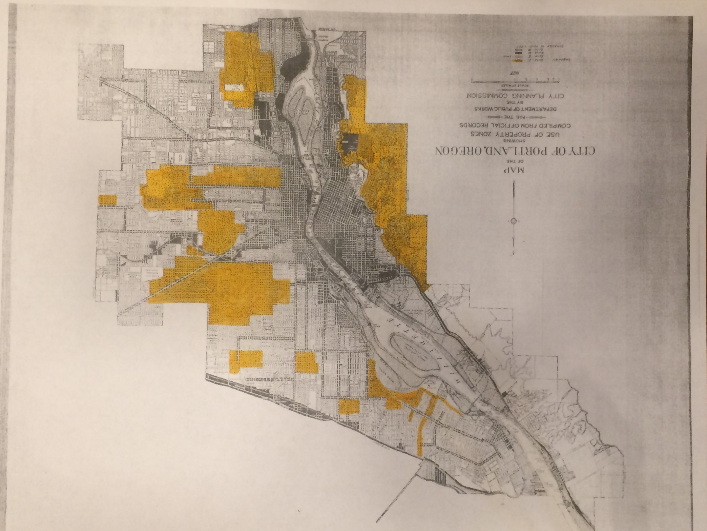
1927 Portland map of Zone I single-family residential areas
Notes:
The Bureau understands that historically zoning has been used as a tool of exclusion.
With that understanding, we know that we have an obligation to look critically at legacy zoning patterns, and break down barriers to housing choice as we do our planning work.
As we consider new plans, we need to ask ourselves if the changes we make are expanding housing choice, or will they serve as a barrier?
Are single dwelling zones having an exclusionary impact?
When we up-zone an area, will the subsequent development cause displacement?
Are we treating different areas of the City differently?
The new Comprehensive Plan includes policies that specifically call for this kind of analysis.
Of course, this work is not confined to BPS. Prosper, PBOT, Housing are critical partners.
This is a picture of one of the earliest city-wide zoning maps with the yellow areas highlighting where the first single family zoning existed.

Slide 4
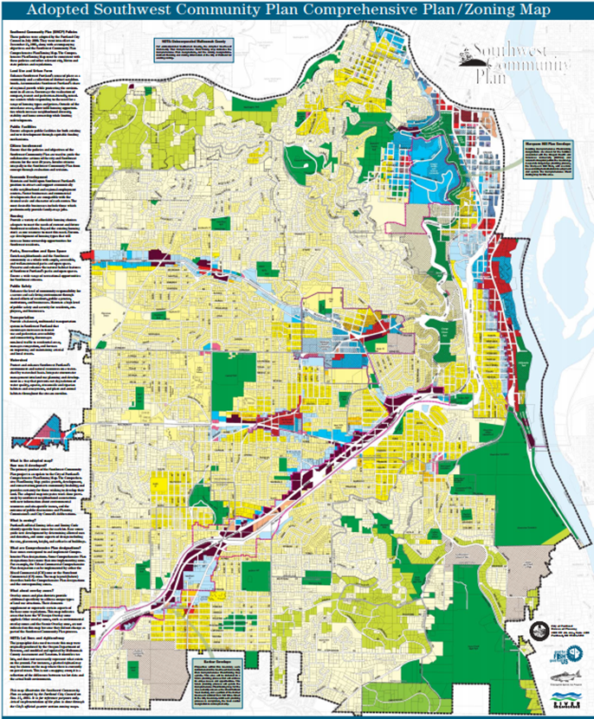
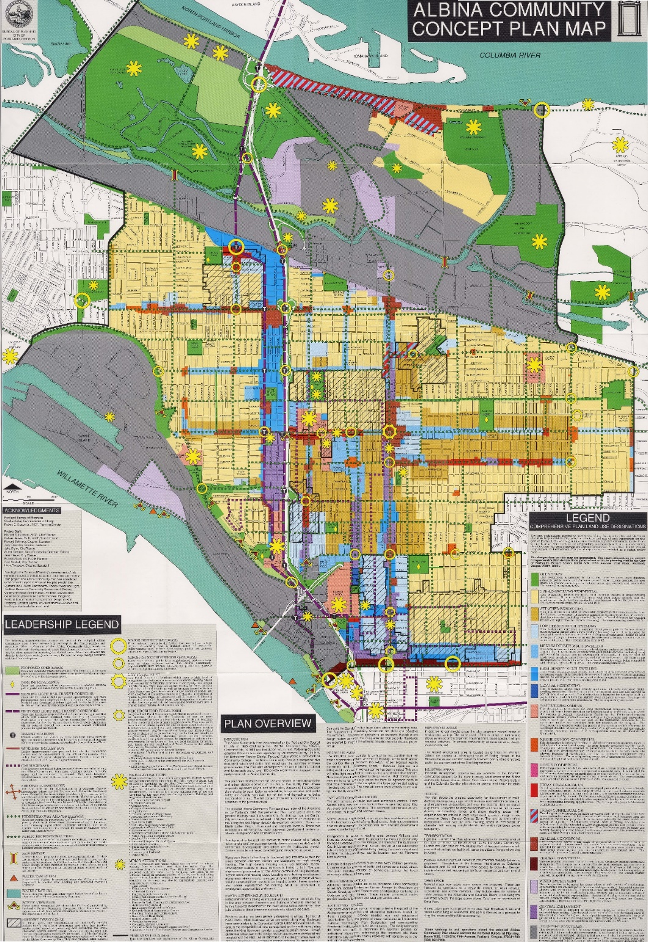
Notes:
We know that community plans have had different impacts on different communities.
For example, the 1993 Albina Community Plan and the 2001 SW Community Plan.
Since 2000, there have been almost 8,500 new housing units built in the Albina Community Plan area, and only about 4,000 new units in the SW Plan Area (and almost half of those were in South Portland Neighborhood)
Arguably, zoning is limiting housing choices in SW Portland, an area with great schools and access to quality jobs.

Slide 5
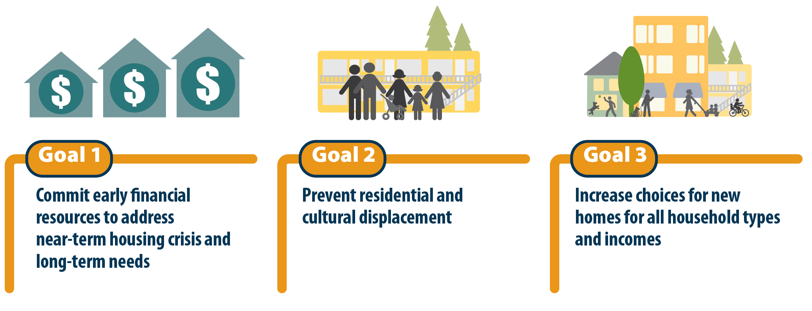
SW Corridor Equitable Housing Strategy
Notes:
Now we have a new opportunity to affirmatively further fair housing in SW and that is what we plan to do.
The SW Corridor Equitable Housing Strategy adopted last year includes goals for anti-displacement as well as fair housing including an action to “conduct station area planning using a healthy equity and fair housing lens”.
That is what we are doing through the West Portland Town Center planning process that is just getting underway.
For example, before embarking on the SW Corridor Equitable Housing Strategy we first looked at the history of redlining and the use of racial covenants in the corridor.
We provided staff and our advisory group with an orientation to understand the history.

Slide 6
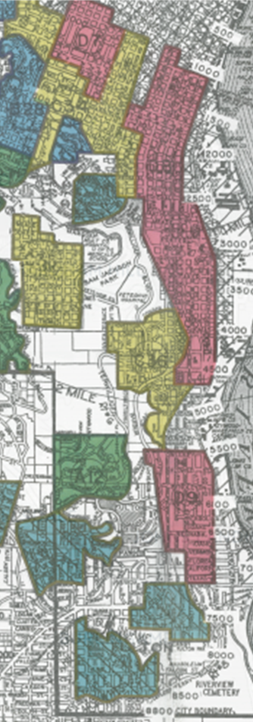
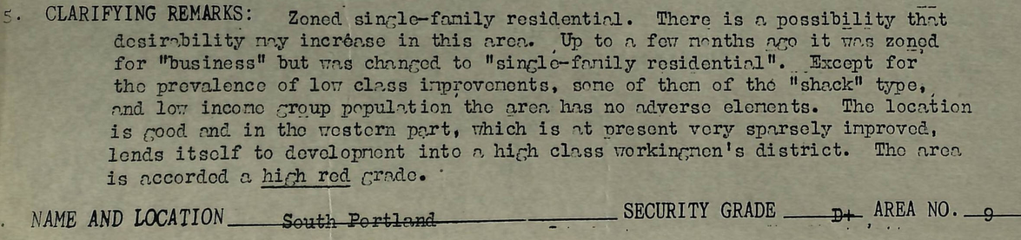
Southwest Corridor Redlining
“…possibility that desirability may increase in this area. Up to a few months ago it was zoned “business” but was changed single-family residential”…”
“Infiltration of subversive races has occurred”
“Detrimental influences: Presence of subversive foreign populations. Heterogeneous character of district”
Notes:
This last slide shows some material from the historical redlining documents for South Portland.
While we hope we are making more equitable decisions today, we need to remember that our zoning map looks the way it does today because it has this history.

Slide 7
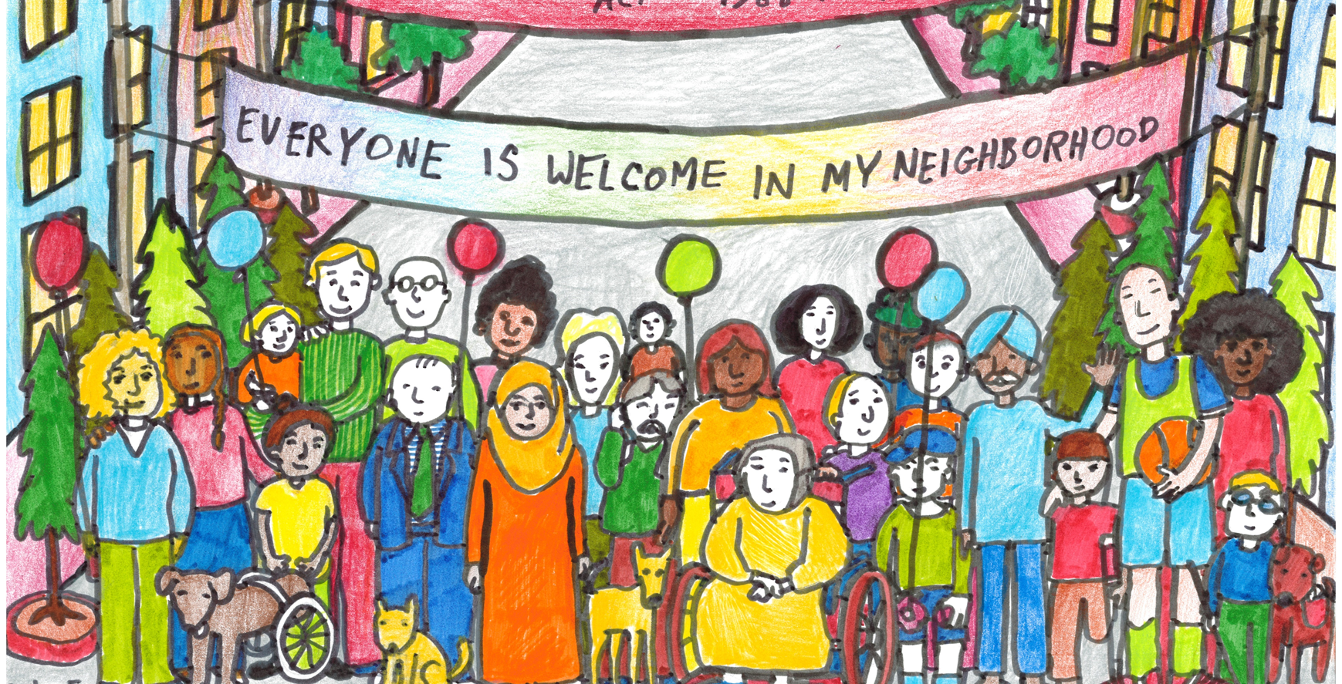
Jaytee Franko - Grand Prize Winner

Slide 8

Grace Vaupel – 1st Place, 4-5 grade

Slide 9
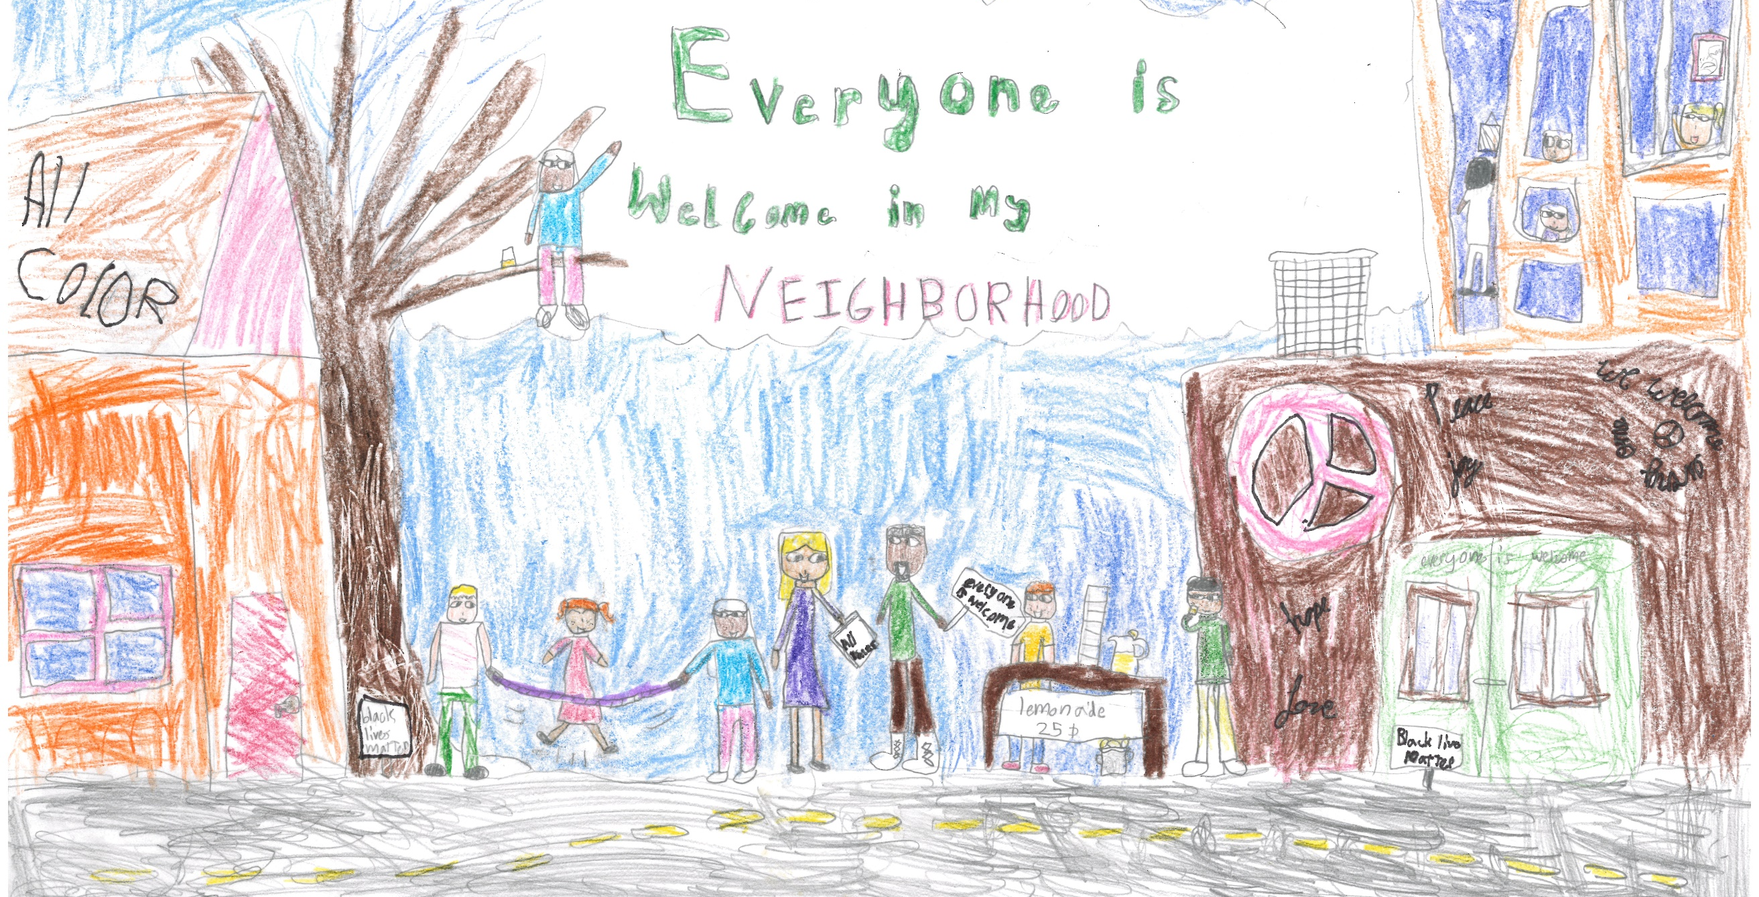
Maya Riojas – 3rd Place, 1-3 grade

Slide 10
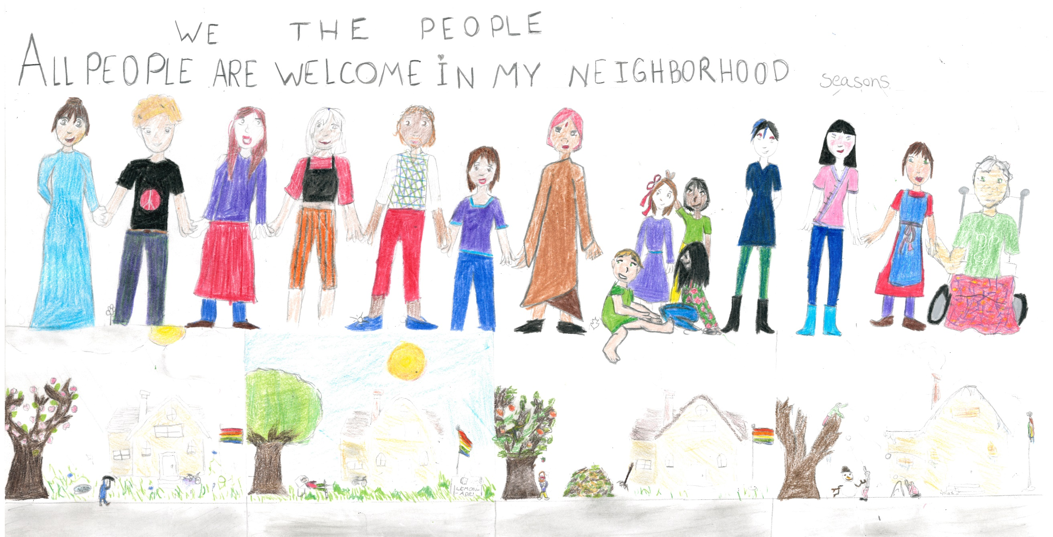
Ursala DeCastro and Zella Ramirez – 3rd Place, 6-8 grade

