Slide 1

Advisory Bodies Program
First Annual Report
April 17, 2019
Advisory Bodies Program
First Annual Report
April 17, 2019
Ashley Tjaden
Advisory Bodies Program Analyst
AdviosryBodies@portlandoregon.gov

Slide 2

Today’s presentation
  Resolution 37328 & Advisory Bodies Program Report
    Background
    Implementation Update
    Upcoming Collaborations

Slide 3
Presentation Speakers
    Ashley Tjaden
      Analyst
      Office of Civic & Community Life
    Tony García DesChamps
      Deputy City Attorney
      City Attorney’s Office
    Monique Harrison
      Workforce Recruitment & Training Supervisor
      Bureau of Human Resources
    Danielle Brooks
      Civil Rights Title VI & Equity Manager
      Office of Equity & Human Rights

Slide 4

Civic Participation & Volunteerism
  “The Office of Community & Civic Life is a gateway
  to city government and civic participation
  for Portlanders from across the city.”
  – Commissioner Eudaly, 2018

Slide 5
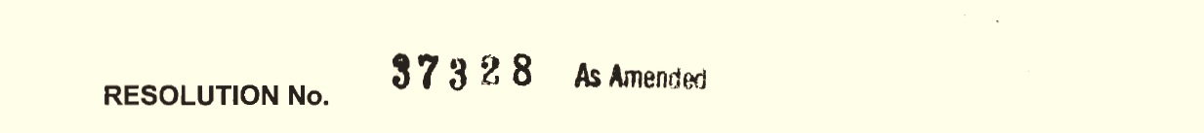
Background: Resolution 37328
  Uniform application, including mandatory conflict of interest disclosure form.
  Bylaws template, including recommendations regarding mandatory term limits, staggered terms, and subcommittee participation.
  Training materials for members of advisory bodies and their staff liaisons.
  Options to track the delivery of training.
  Survey to be completed by members at the end of their service.
  Values to guide transparent selection processes.

Slide 6
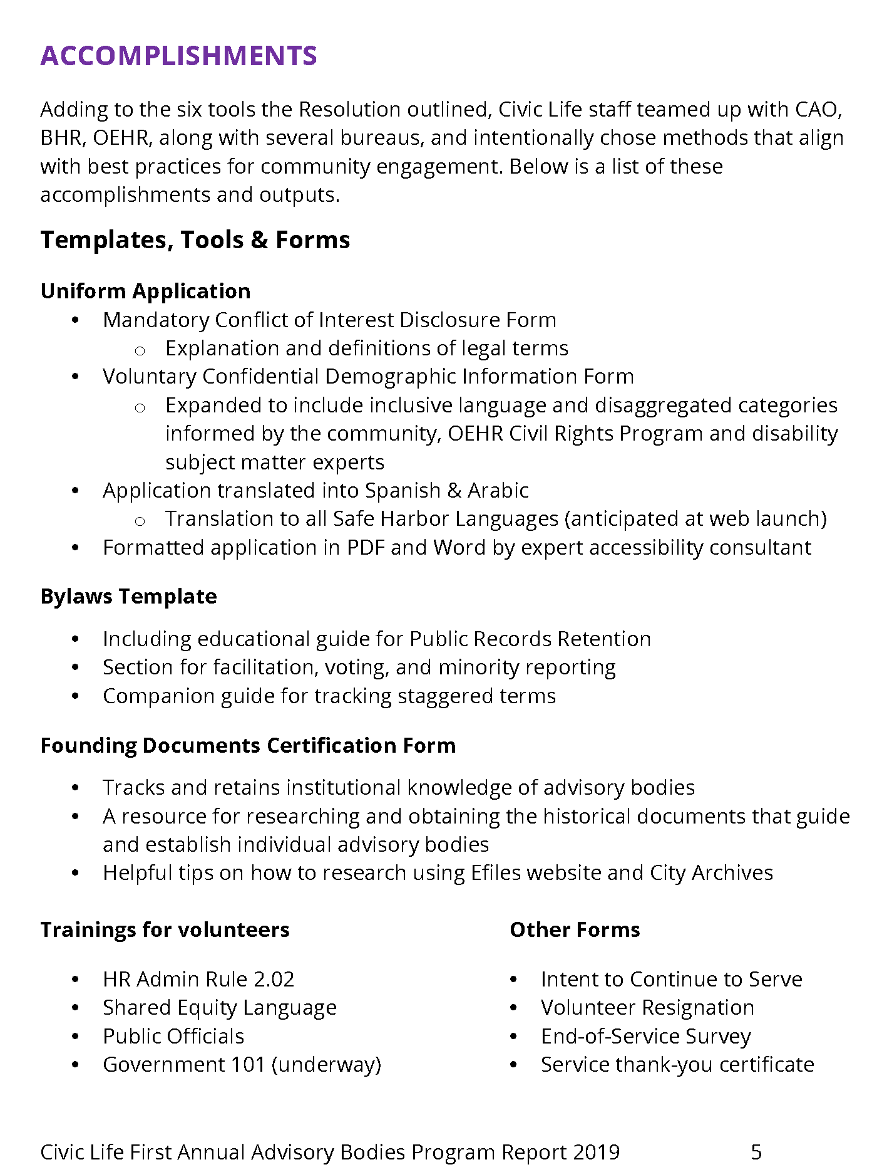
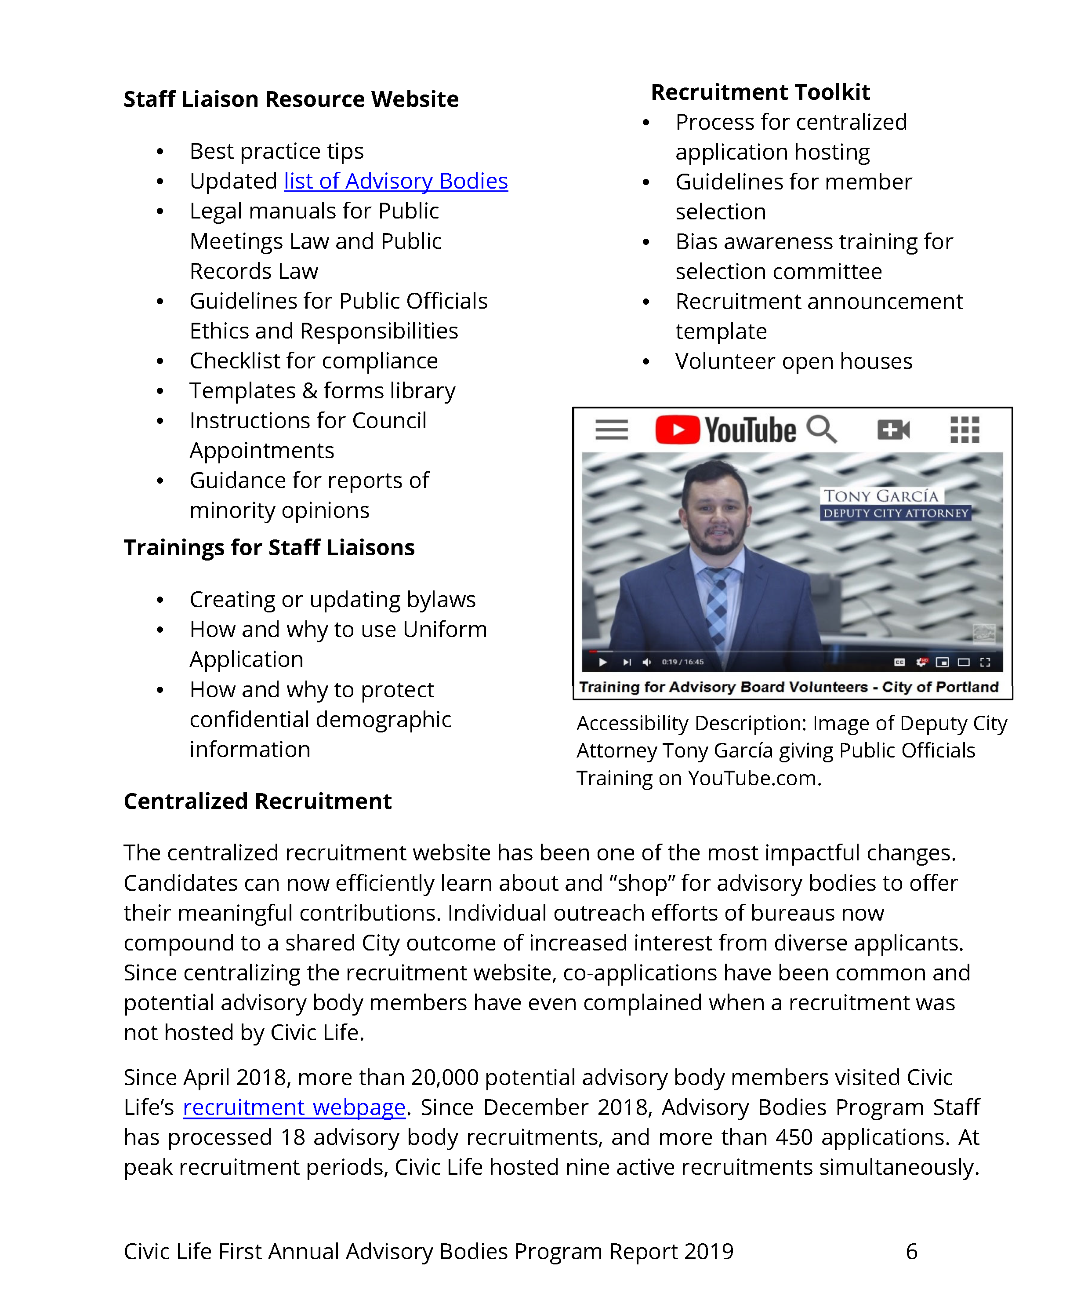
Implementation Update
Civic Life created a growing list of resources in addition to those called out in the Resolution.
Resources were developed in partnership with bureaus, offices, and subject matter experts.

Slide 7
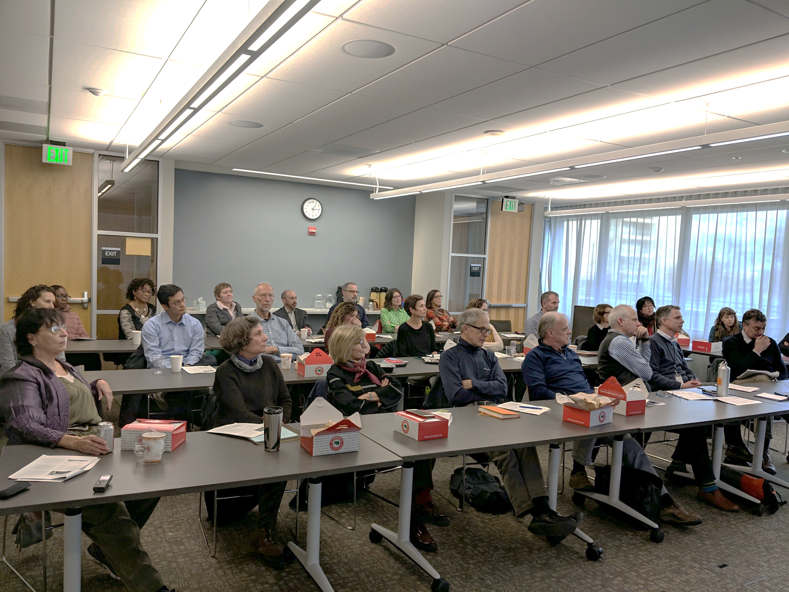
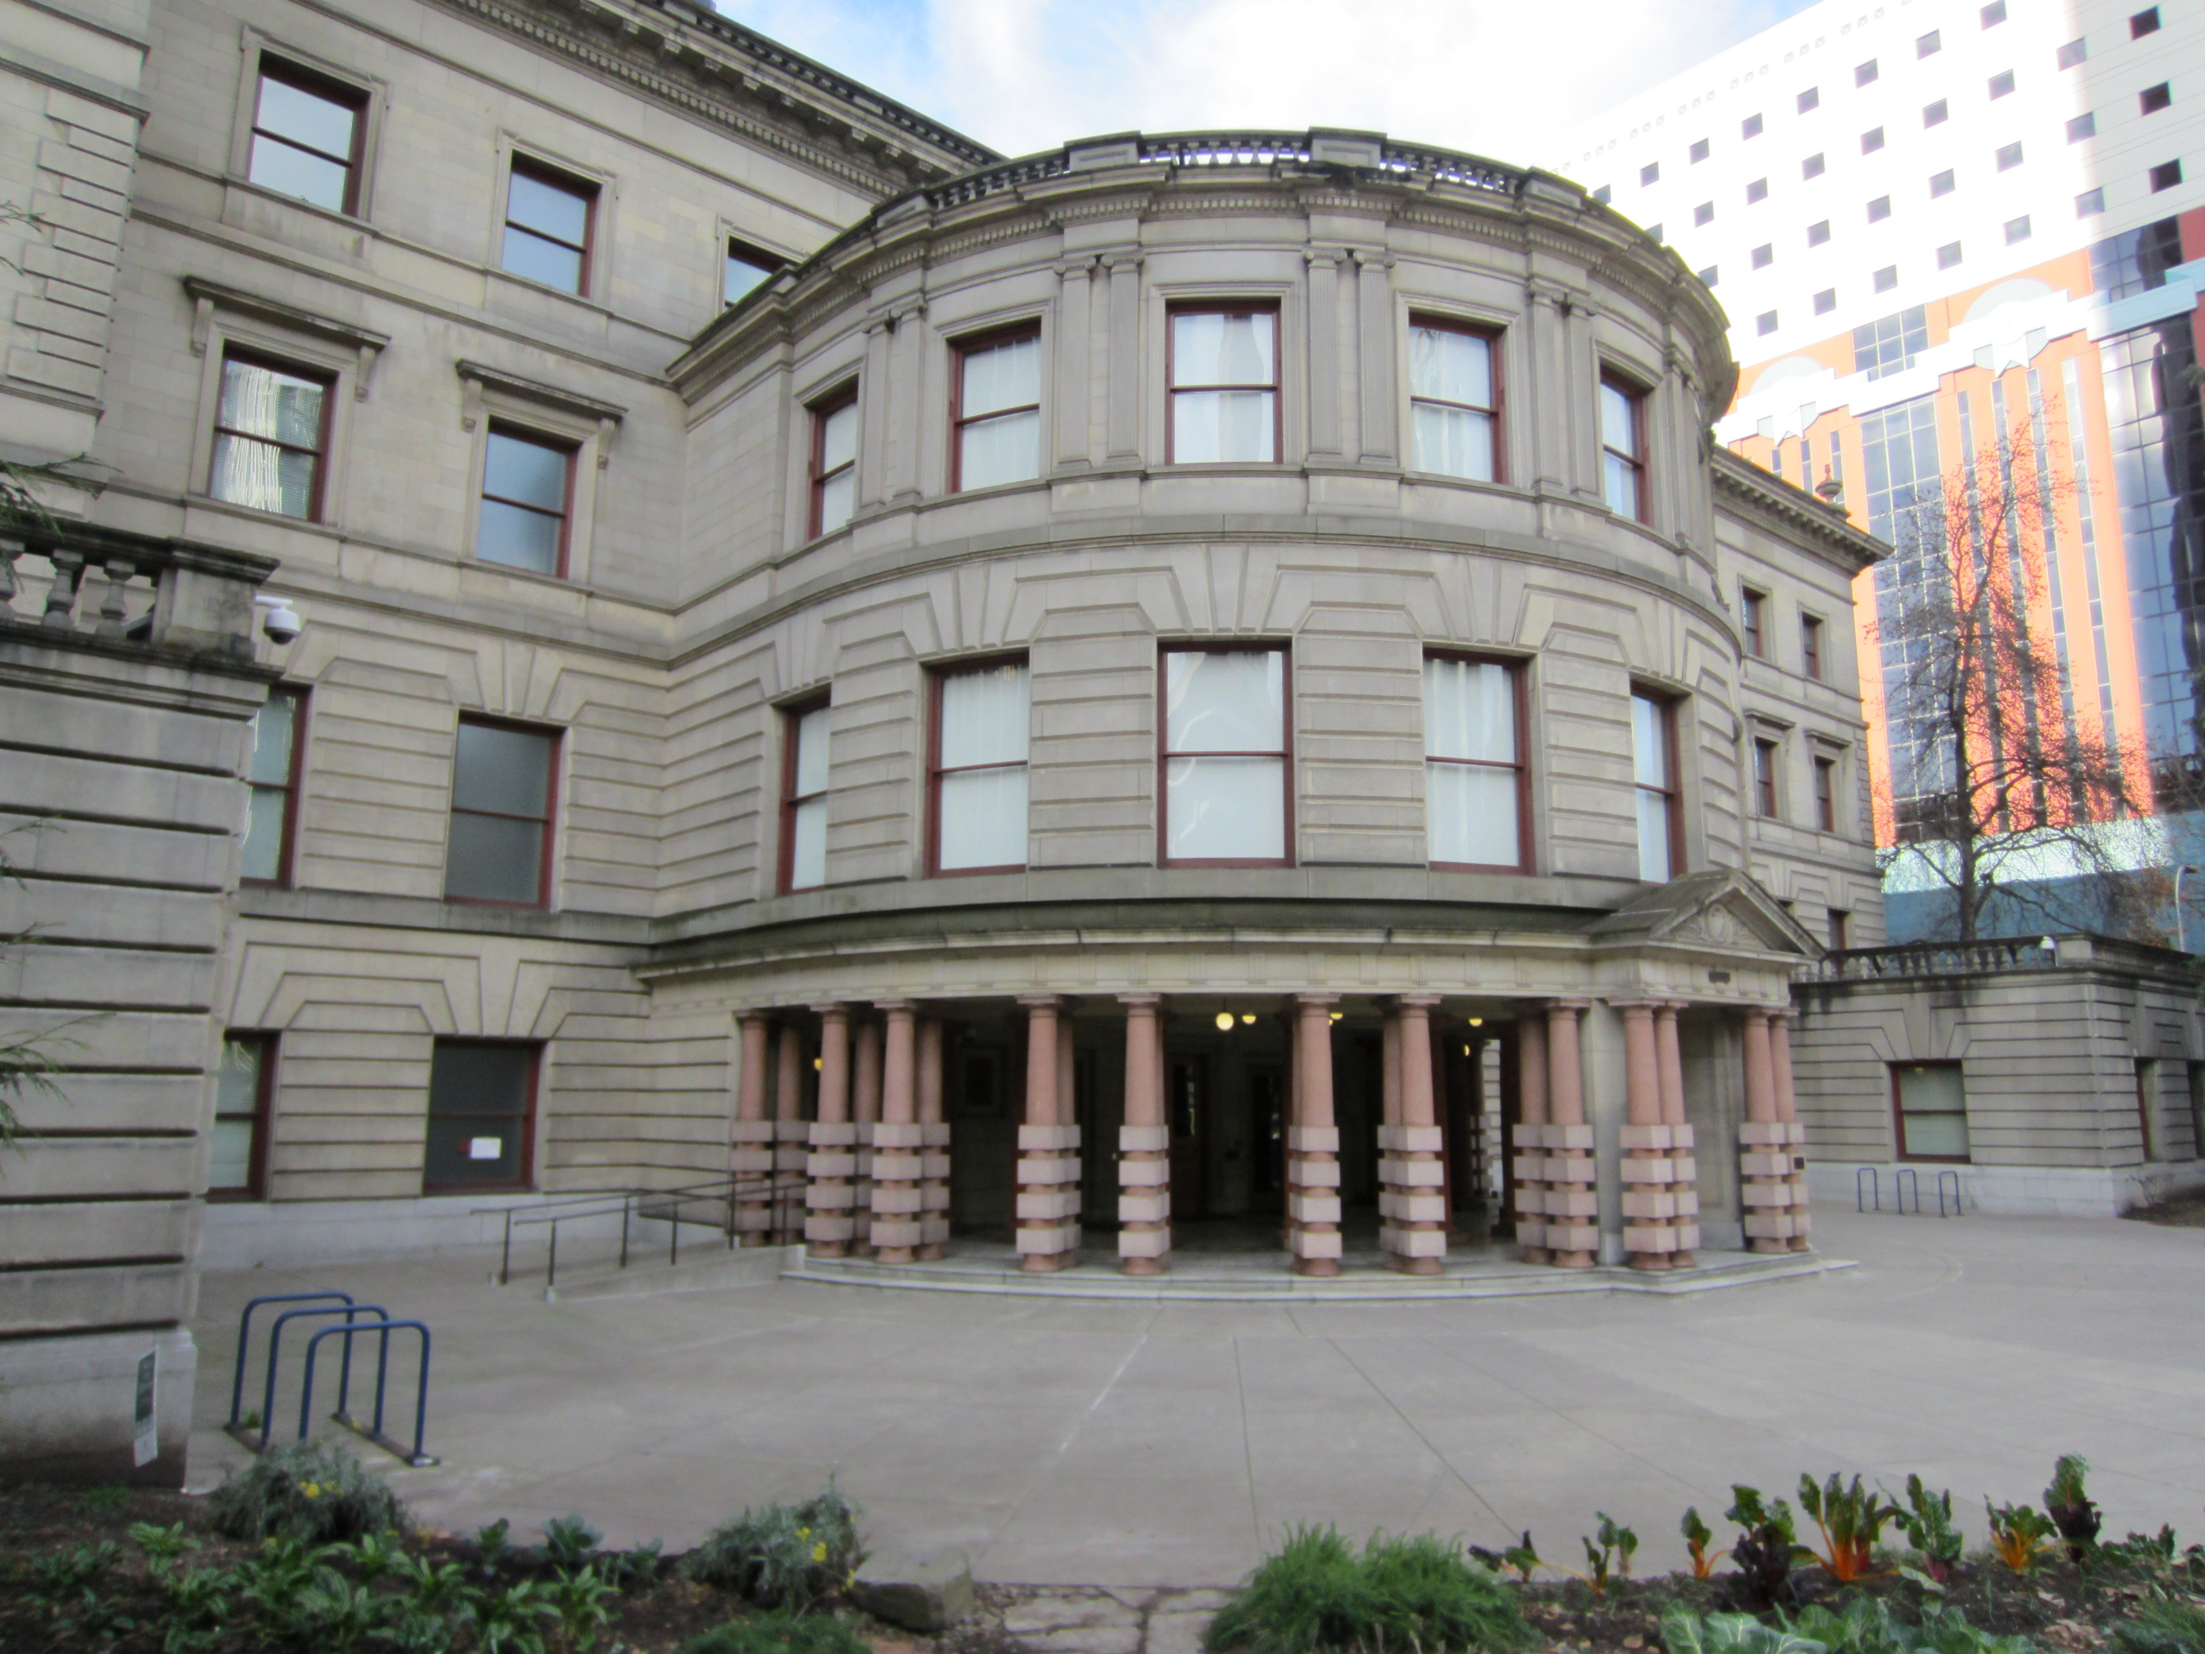
Implementation Update
Accountability
Accessibility
Equity
Transparency
Trust
This photo of Development Services commissioners at their Equity Training.
  Public Meetings Law Compliance
  Public Records Law Compliance
  Conflict of Interest Disclosure Form
  Bylaws (operations & structure)
  Centralized Uniform Application
This Photo by Unknown Author is licensed under CC BY-SA

Slide 8

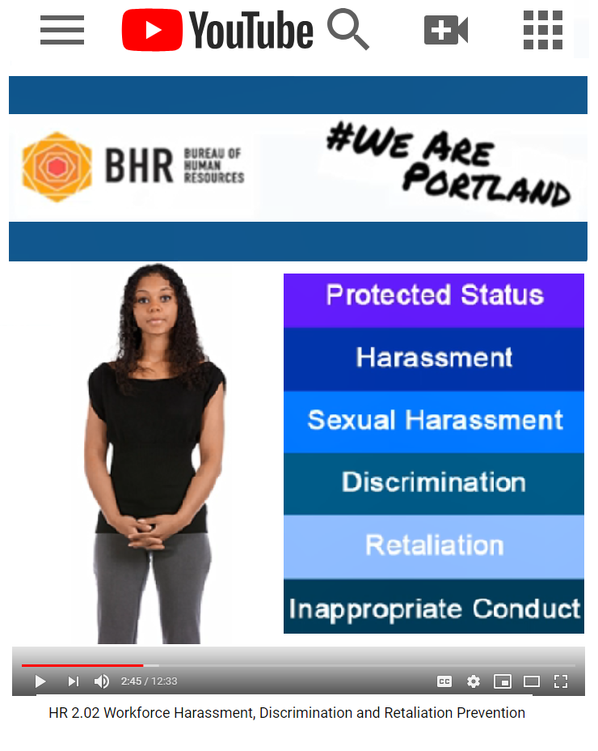


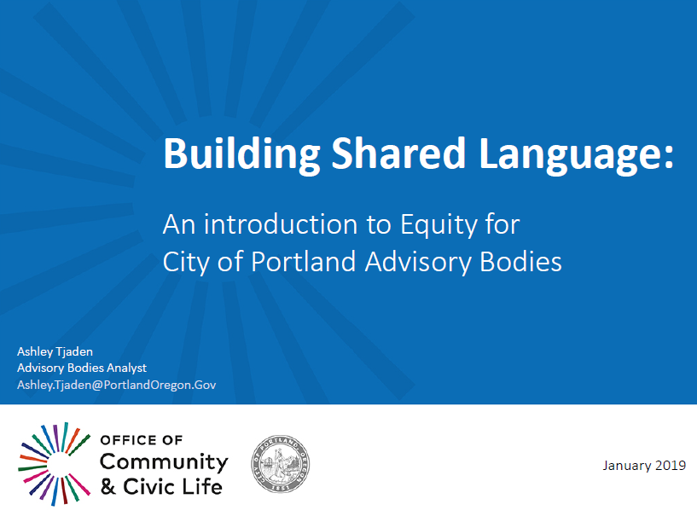
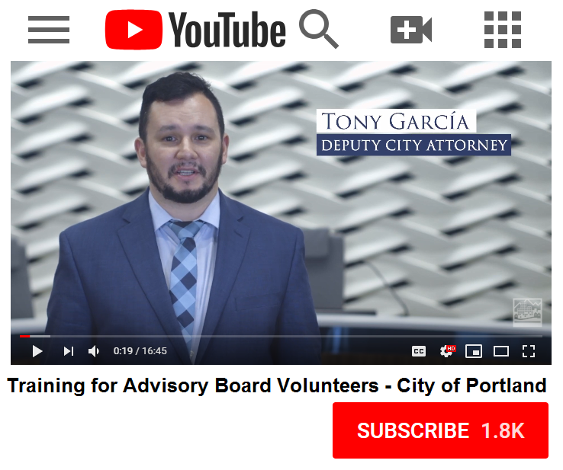
Implementation Update
Translated trainings, in multiple formats
This Photo by Unknown Author is licensed under CC BY-NC

Slide 9

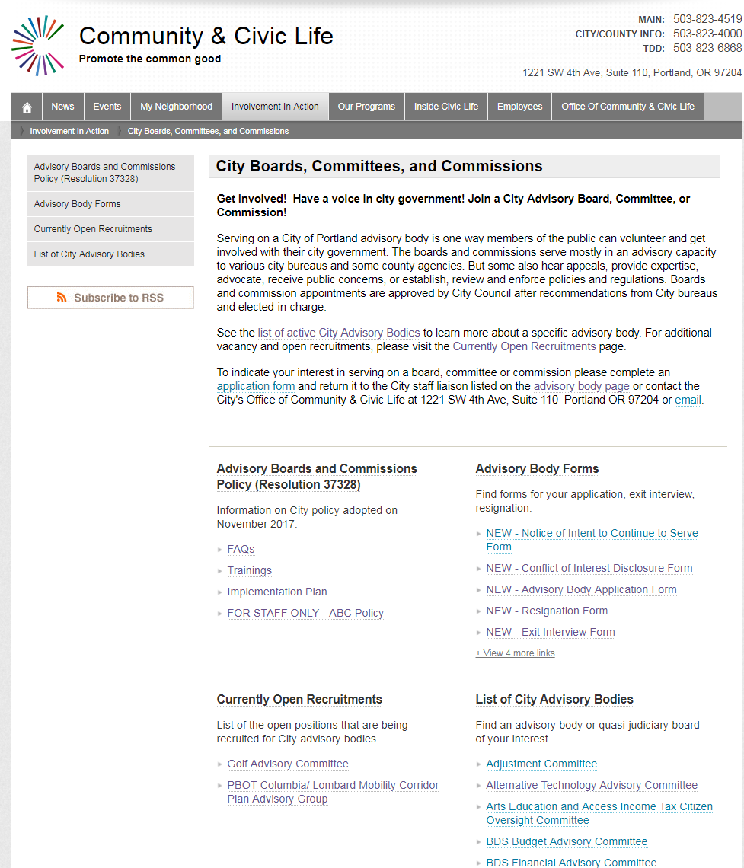
Implementation Update: Centralized Website
Recruitment Announcements
Uniform Application
Public Training
List of all Advisory Bodies
Staff resources & forms

Slide 10
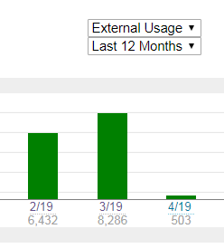
Implementation Update: Centralized Website
Unique Website Visitors
Impact
Web hits
Simultaneous recruitments draw more attention to all
500 applications processed by one staff person in four months

Slide 11
Upcoming
Staff trainings on disability and mental health utilizing Civic Life’s Adapt To Impact Program
Recruit people with disabilities for and adapt to multigenerational membership
Implement innovative, web-based tools that track progress and reduce staff administration

Slide 12
Next up
    Tony Garcia DeChamps
      Deputy City Attorney
      City Attorney’s Office
    Monique Harrison
      Workforce Recruitment & Training Supervisor
      Bureau of Human Resources
    Danielle Brooks
      Civil Rights Title VI & Equity Manager
      Office of Equity & Human Rights

Slide 13
    Tony García DesChamps
    Deputy City Attorney
    City Attorney’s Office

Slide 14
    Monique Harrison
    Workforce Recruitment & Training Supervisor
    Bureau of Human Resources

Slide 15

    Danielle Brooks
    Civil Rights Title VI & Equity Manager
    Office of Equity & Human Rights

Slide 16
Advisory Bodies Program
First Annual Report
April 17, 2019
Thank you
AdvisoryBodies@PortlandOregon.gov

