Slide 1
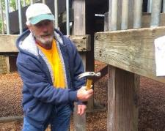
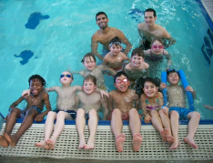
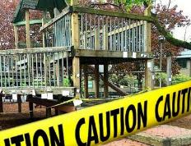
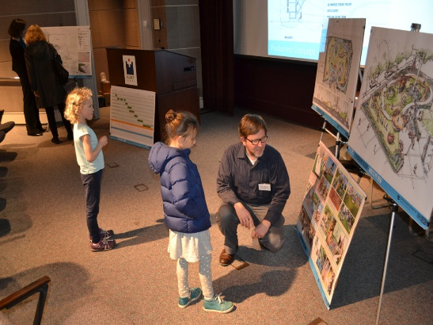
PARKS
REPLACEMENT
BOND
Glenhaven Park Play Area Improvements Project
CITY COUNCIL - Wednesday April 17, 2019
Commissioner Fish | Director Adena Long
Notes:
(RML)
Hello Mayor Wheeler and members of Council. My name is Robin Laughlin, I am the Bond Program Manager with Portland Parks & Recreation
With me today is Gary Datka, Capital Project Manager with PP&R. Gary will be giving a brief presentation on the Glenhaven Park Playground project.
We are here today to request Council accept the bid from Faison Construction, Inc for the Glenhaven Park Playground Project for the amount of $1,179,000.

Slide 2
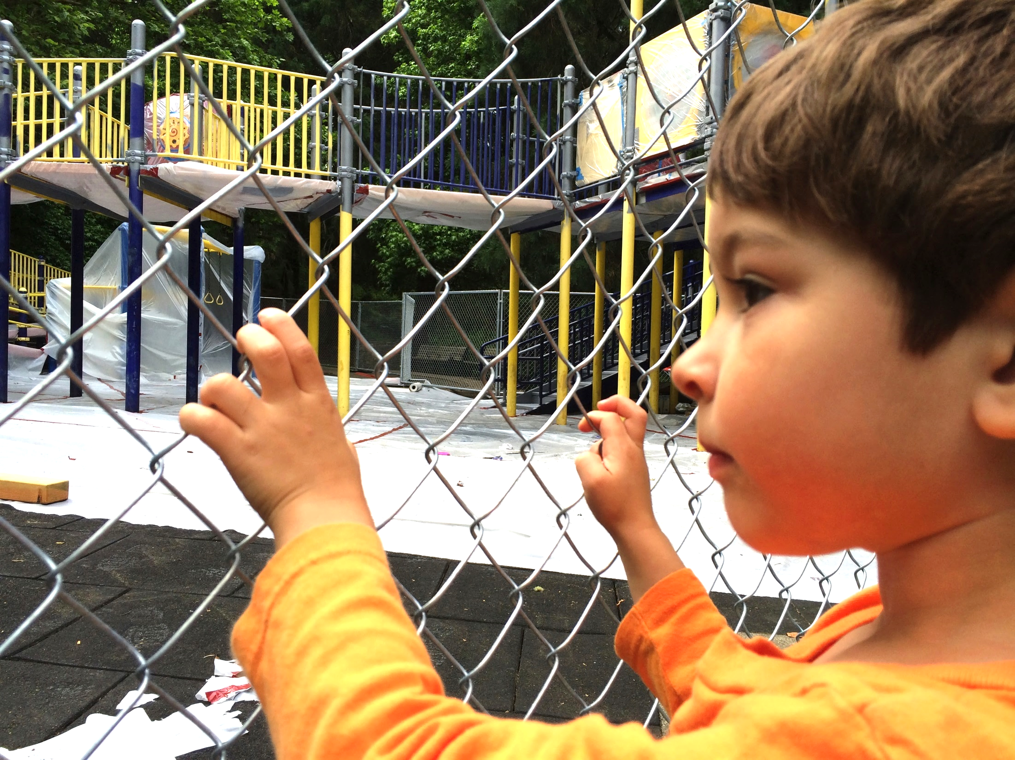
FOCUS
PLAYGROUNDS
Fix, improve play areas that are closed, at risk of closure, or deficient.
Notes:
(RML)
The Glenhaven Park project is part of the 2014 Parks Replacement Bond Program that was generously passed by voters who approved the $68 million bond measure to address critical park needs without increasing tax rates.
As you know the bond funding goes towards Park’s most urgent needs in seven priority areas.
Playgrounds
Trails and Bridges
Pools
Accessibility
Protecting Workers
Pioneer Courthouse Square
Restrooms and Other Facilities
This project fits into the Playgrounds focus area and will renovate the existing deficient playground. This is the 8th Replacement Bond Playground Project to go into construction.
In addition to Bond funding of $1.45 million, the project also received funding from PP&R System Development Charges in the amount of $250,000 (Total budget is $1.7M).

Slide 3
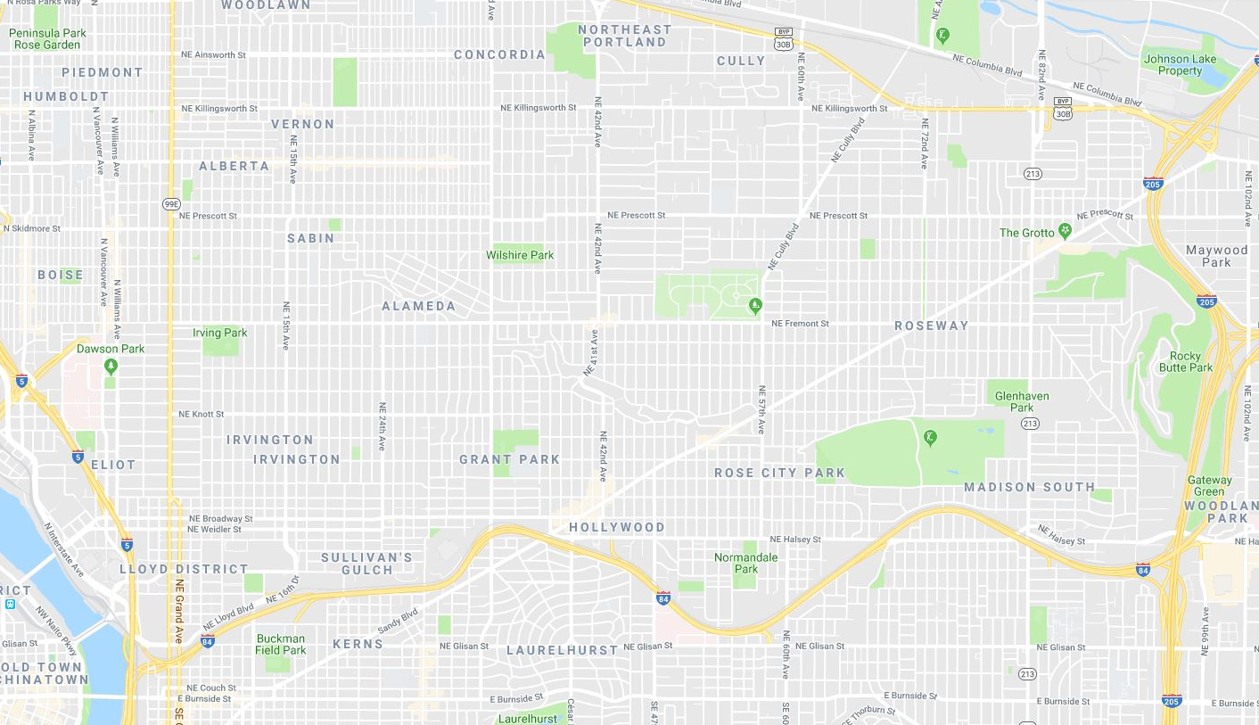
PROJECT LOCATION
NE 82nd Ave & and Siskiyou St.
Roseway Neighborhood
½-mile radius
Census Tract 29.03
Census Tract 29.02
Notes:
(GD)
Mayor Wheeler, Commissioners, thank you for having me here today, my name is Gary Datka, I am a Capital Project Manager for Portland Parks & Recreation.
Glenhaven Park, located in North East Portland at the major intersection of NE Siskiyou Street and NE 82nd Avenue is a Community Park in the Roseway Neighborhood, and is adjacent to the PPS Madison HS campus and Roseway Heights Middle School.
This map shows the park location just west of I-205 and south of Sandy Boulevard. The park serves two census tracts split by 82nd avenue within its ½ mile radius, or 15 minute walk boundary. It is a diverse community, with combined census data indicating residents identifying as:
64% white
12% Asian/Pacific Islander (with 64% of those identifying as Vietnamese)
7% African American/Black
7% Hispanic/Latino
1% Native American
6% Two or More Races
And 3% identifying as other race
This is an important park and community asset for this neighborhood.

Slide 4
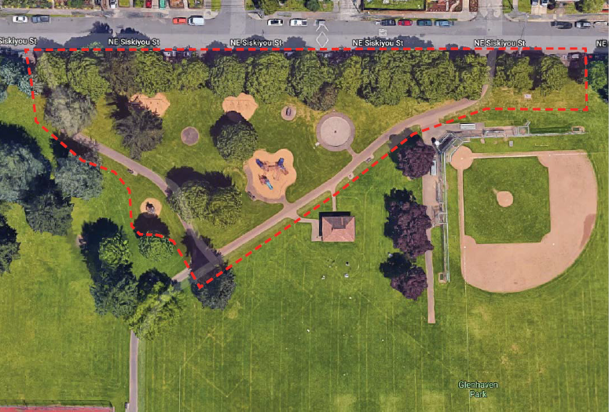
PROJECT SITE
GLENHAVEN PARK
Notes:
(GD)
Acquired by PP&R in 1948, Glenhaven Park is a very active 15.69 acre park featuring sports fields, court sports, skatepark, restrooms, paved paths, and a decommissioned concrete wading pool. The restroom and play area receive heavy daily use.
The playground is located nearest NE 79th and NE Siskiyou, on the north side of the park. The project boundary, as shown here in the red box, will make improvements to a little more than an acre of the park.
The new playground and picnic spaces will provide much needed improvements for this park.

Slide 5
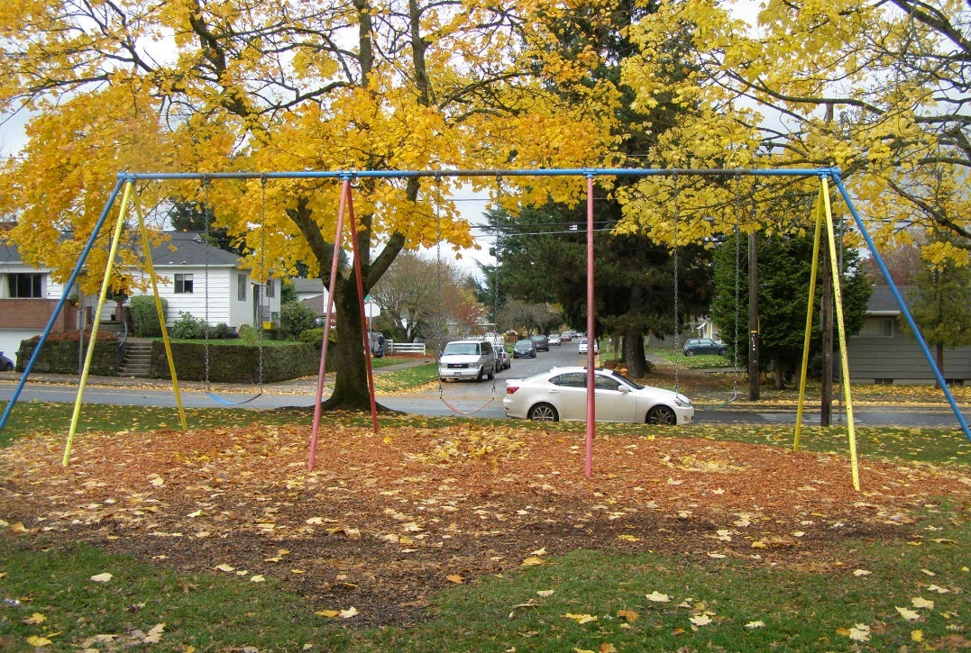
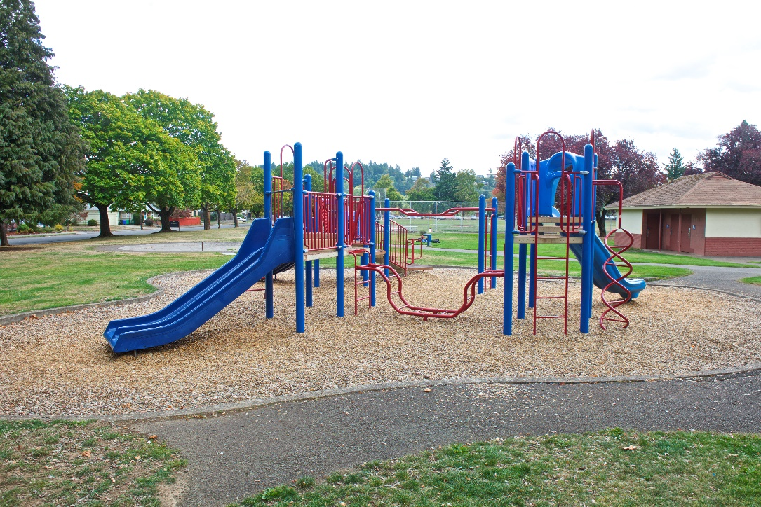
EXISTING CONDITIONS
Notes:
(GD)
Currently, the existing playground suffers from several non-accessible and disjointed play components, spaced too far apart for kids to make a play circuit, and for supervision.
The existing post and platform play structure and wood fiber safety surfacing, installed as part of Portland Parks & Recreations GOBI bond initiative in 1998, has served its useful life, and now has many ADA deficiencies and maintenance concerns.
The parks swings were removed in summer 2017 as part of the lead paint removal program and have been a big missing link in this play area.
The playground also has a decommissioned concrete wading pool, that will be removed as part of this project.

Slide 6
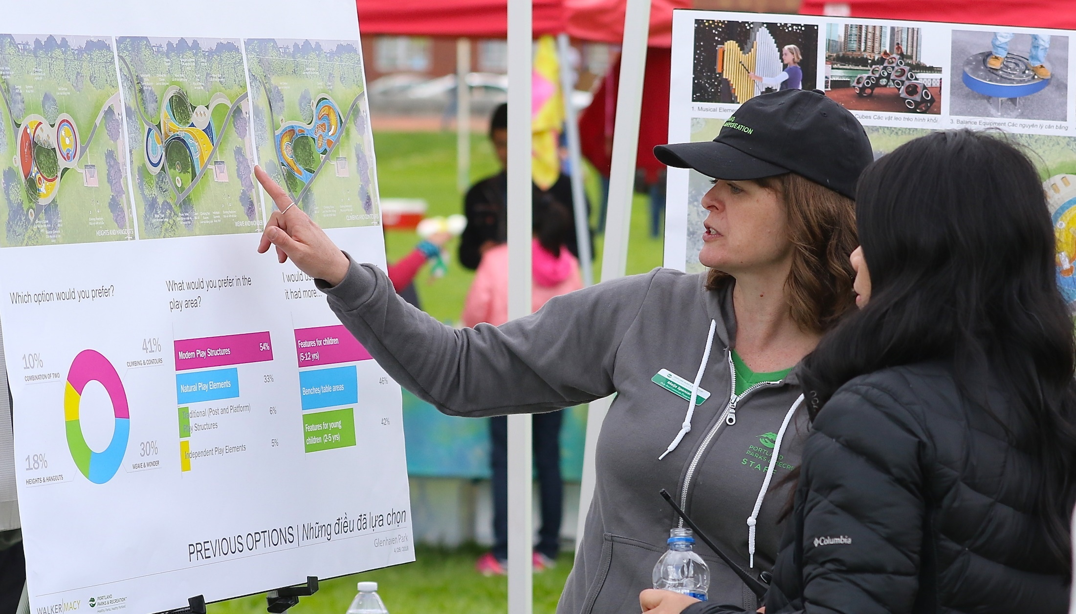
PUBLIC INVOLVEMENT
One community focus group meetings
Two Open Houses
Notes:
(GD)
Through a community focus group meeting and two public open houses, PP&R conducted public involvement with students and neighbors in a positive manner in order to:
Understand their perspective regarding the current use of the park: what’s missing from the playground, and what activities neighborhood children want most in play,
Connect with neighbors about the positive aspects of making improvements to the park, and
Solicit feedback and gain support for the design of the play area, play components, and other community assets.
The second open house was held during the Southeast Asian Cultural and Heritage New Year festival at Glenhaven Park, with overwhelming support and interest.
At all meetings PP&R provided translation services in Chinese and Vietnamese, reaching out to a community often felt left out of public projects planning.

Slide 7
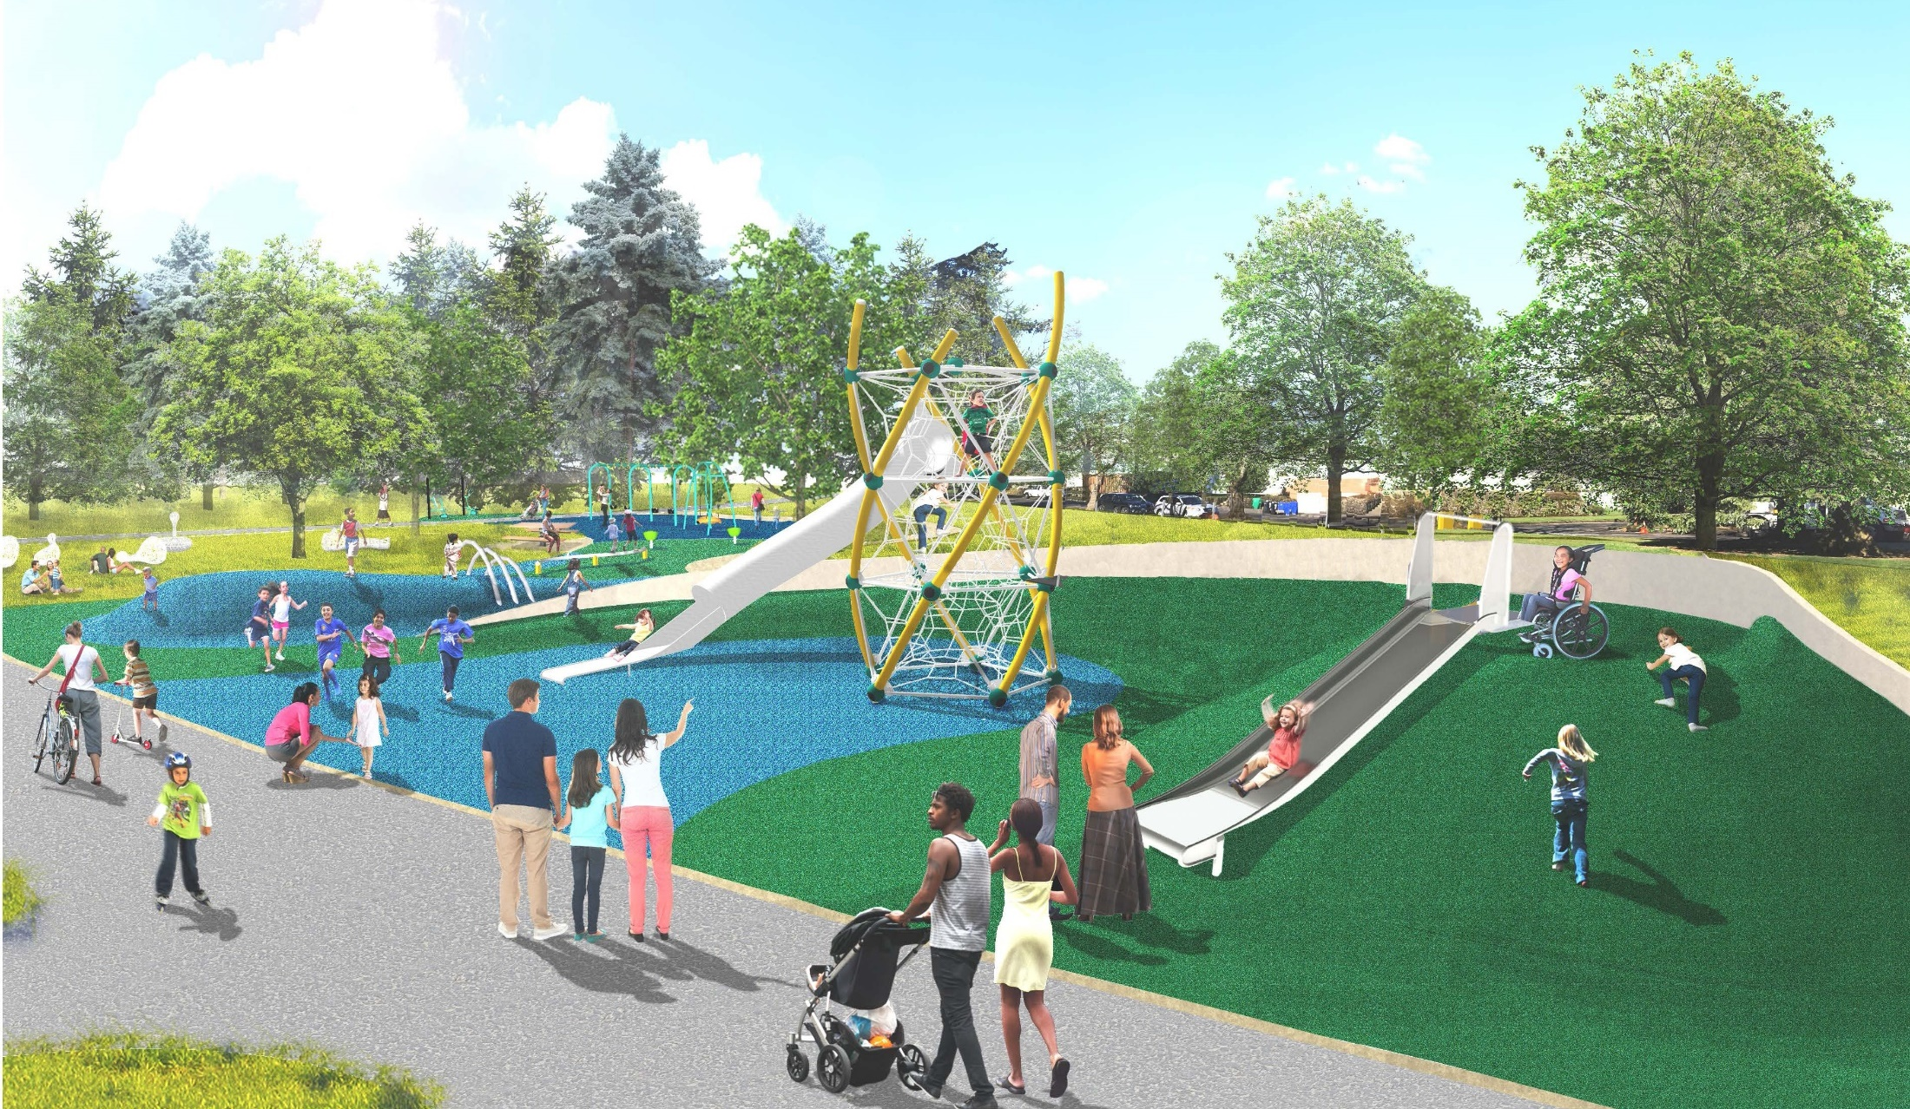
PROJECT DETAILS
Play area with ADA features
Picnic tables and benches
Pathway renovations
Public art
Notes:
(GD)
With community input and support, PP&R developed a design that will construct key park improvements focusing on:
Play features and play opportunities for all users such as slides, climbers, swings, balance, and spinning elements
Durable, accessible rubber safety surfaces that provide access to all play equipment
Picnic tables and other accessible seating and gathering spaces
Other site amenities such as, new accessible drinking fountain, trash receptacles, and much needed bike racks,
ADA accessibility improvements at the two park entries from NE Siskiyou and interior pathways around the play area and to the existing restroom
Continued development of Portland's urban tree canopy with new deciduous and evergreen trees, and lastly.
A new creative art installation through the Regional Arts and Culture Council.

Slide 8
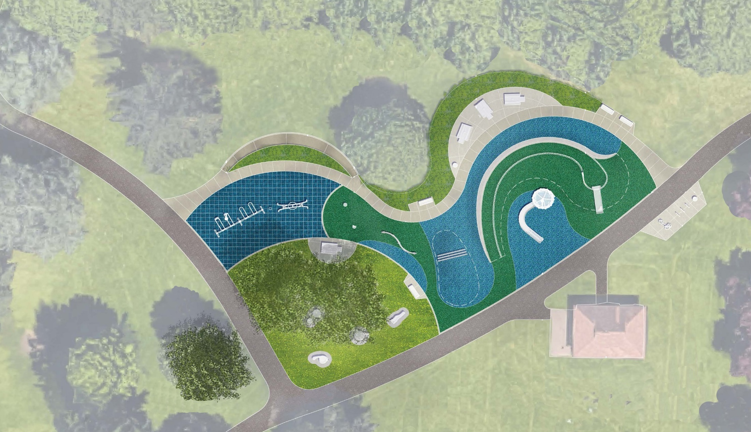
WHY ARE WE HERE?
Accept bid by Faison Construction, Inc. for Glenhaven Park Play Area Improvements Project for $1,179,000
Notes:
(GD)
We are here to ask Council to accept the low bid from Faison Construction for the Glenhaven Park Play Improvement Project for $1,179,000.
With the acceptance of this bid by Council, we would then proceed with construction of the project set to begin early this summer. We have an anticipated completion date by the end of this year 2019.
I am happy to answer any questions you might have at this time.
Thank you!

