Slide 1


Bond Oversight Committee’s
Progress Report
2017 - 2018
City Council Presentation, Thursday, April 11, 2019
Notes:
Shannon – Introduction

Slide 2
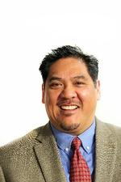
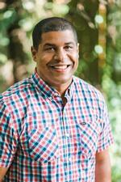
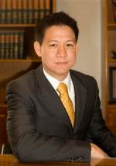
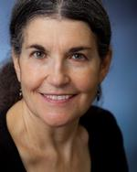
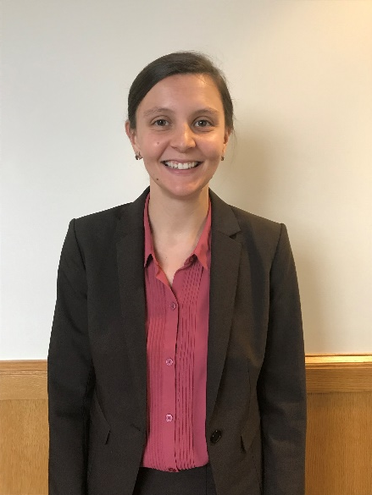
Members
Stephen Green
Chair
(Appointed by
Mayor Wheeler)
Anneliese Koehler
(Appointed by
Commissioner Hardesty)
Allan Lazo
(Appointed by
Commissioner Eudaly)
Todd Struble
(Appointed by
Commissioner Fish)
Susan Emmons
(Appointed by
Commissioner Fritz)
* Jes Larson (appointed by Commissioner Salzman, served as Vice-Chair from July 2017 to December 2018
Notes:
Shannon
5-member Bond Oversight Committee appointed with a representative from each City Council member.
New member Anneliese Koehler (pronounced “Analisa Curler”), appointed to committee on April 3.

Slide 3
Committee Role
  Adherence to the Bond Framework
  Engaging Communities
  Fiscal Accountability
Notes:
Shannon
Responsibilities:
Alignment to policy framework, including track progress towards policies and goals
Oversight of bond expenditures
Gather public comment
Provide an Annual Report

Slide 4
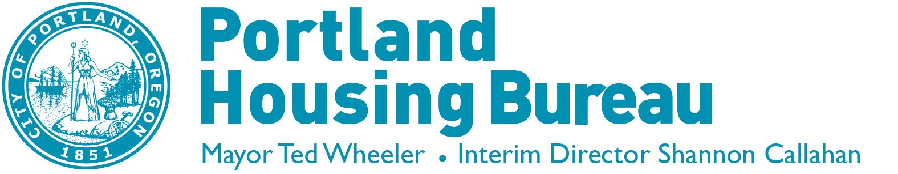
Overview of
Bond Framework
BOC Progress Report | 04/11/19 | Portland's Housing Bond
Notes:
Allan
Framework was developed by a stakeholder advisory group comprised of 22 community members, of which I was a part. We met over six months, identifying and deliberating our community’s most pressing needs and priorities.
The result of that process was our Bond Framework, which sets the goals and priorities for how we invest Bond funds.

Slide 5



Production Goals
Overview
600
Units at 0-30% AMI
Units at 31-60% AMI
Supportive Housing units
Family sized units
$258.4 M
Bond to purchase land and buildings to develop new affordable housing
Units of affordable housing for households with incomes at or below 60% of the Area Median Income (AMI)
700
1,300
300
650
Notes:
Allan

Slide 6

Priority Communities
  Communities of Color
  Families, including families with children, immigrant and refugees, and intergenerational households
  Households experiencing homelessness or at imminent risk
  Households facing displacement
6
Notes:
Allan
The Framework calls out a commitment to further our communitywide goals of:
preventing displacement,
advancing racial equity, and
making a visible impact on ending homelessness.
Through alignment with homeless service providers, culturally specific agencies and other community organizations, we will create housing for communities disproportionately affected by the housing crisis:
Communities of Color
Families, including families with children, immigrant and refugees and intergenerational households
Households experiencing homelessness or at imminent risk
Households facing displacement

Slide 7
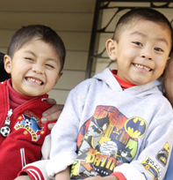
Location Priorities
Balance investments throughout the city
Assess acquisitions with a racial equity lens
Invest where limited affordable housing resources
Consider school catchment areas, and planned transit and infrastructure projects
Notes:
Allan
Projects will be selected by:
Prioritizing investments throughout the city
Assessing opportunities using a racial equity lens
Investment where these is little or no existing housing resources
Considering school catchment areas, planned transit and infrastructure projects, when making decisions

Slide 8
Goal 1:
Adherence to the Bond Framework
Notes:
Todd
As outlined in our report to Council, our committee reviewed progress on three goals.
The first was determining how Bond activities and investments align to the Bond Framework.
At our quarterly meetings we review progress being made on the number of units completed or in progress, and the extent to which we are on track to reach our end goals.

Slide 9
Production Goals and Progress
Completed Projects | Proposed Projects
BOC Progress Report | 04/11/19 | Portland's Housing Bond
Notes:
Todd
This table summarizes our progress, indicating we are on track to meet our goals.
The darker green reflects our two existing projects (Ellington and East Burnside) and the lighter shade green reflects the three bond projects that were identified in 2018 to be developed with Bond funds (3000 Powell, NE Prescott and Westwind).
By keeping close watch over our progress, we are using the information to better strategize how to invest remaining funds in the upcoming years.

Slide 10
Framework Priorities
  86% of new units in high opportunity areas
  All new units in areas at high risk for gentrification
  Service partners established with culturally specific and homeless service providers
Notes:
Todd
In addition to closely following progress on our production goals, the committee has also been reviewing where new units are being created, to ensure they are meeting the intent of increasing opportunity, community partnerships and preventing displacement, as outlined in our Framework.
86% of the 351 new units constructed or planned for construction are located in high opportunity areas. These new homes are located in areas with access to transportation, jobs, open spaces, high-quality schools, services and amenities.
All (100%) of the 614 units purchased, constructed or planned are located in areas at high risk for gentrification.
Service partnerships established with Multnomah County Homeless Family System for the Ellington Apartments and East Burnside. Of the total 159 new households placed in Bond housing, 71% of households (113 families) were referred through culturally specific and/or homeless service community partners.
Through these partnerships we’ve been able to increase access for communities.

Slide 11
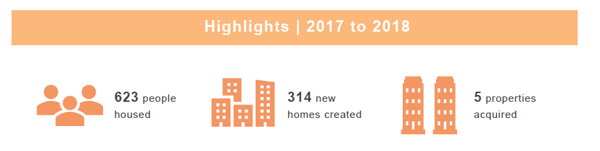
Notes:
Todd
Highlights from first two years:
623 people in housed
314 new homes created
5 properties acquired as Bond projects

Slide 12
Goal 2:
Engaging Communities
Notes:
Susan
One of our guiding principles is ensuring Transparency in how we make decisions and communicate to the public about Bond projects and opportunities.
This is the second goal our committee, which has been asking how are we engaging communities and how well are these efforts meeting our intended goals?
In the first two years of Bond implementation, we have several highlights to share.

Slide 13
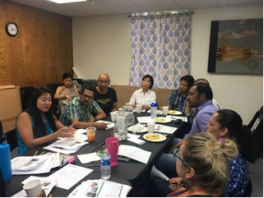
Engagement Opportunities
  Framework Plan development (2017)
    22 member Stakeholder Advisory Group
    16 linguistically diverse communities and nearly 1,000 members reached
  BOC Community Meeting (2018)
    Public comment on draft screening criteria and over-income policies
  Bond Community Engagement Plan adopted (2018)
BOC Progress Report | 04/11/19 | Portland's Housing Bond
Notes:
Susan
In 2017, a Stakeholder Advisory Group developed a Bond Policy Framework rooted in community priorities and values. As part of the work, the City reached out to community members, including 16 linguistically diverse communities and nearly 1,000 individuals representing agencies, neighborhoods and other perspectives, to receive input to inform the draft plan before it was finalized.
Last year, we as a BOC convened a meeting in the community at IRCO in East Portland, to hear from community members their thoughts on draft screening criteria and over-income policies to prevent displacement.
Also last year we reviewed and approved a Community Engagement Plan to focus on providing frequent communication, using multiple methods of outreach, and culturally and linguistically appropriate approaches to reaching priority communities.

Slide 14
Goal 3: Fiscal Accountability
BOC Progress Report | 04/11/19 | Portland's Housing Bond
Notes:
Susan
The third goal from our report is maintaining fiscal accountability. Reviewing expenditures and ensuring financial accountability is a core responsibility of the BOC.
Bond dollars spent are clearly and separately tracked.

Slide 15
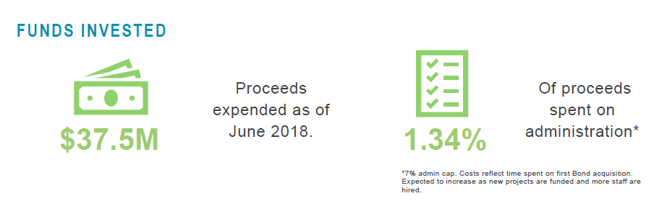
BOC Progress Report | 04/11/19 | Portland's Housing Bond
Notes:
Susan
As of June 2018, $37.5 Million of bond funds were expended.
Of that amount, 1.34% was spend on administration (far below from the allowed 7% cap). Admin expenses are anticipated to rise as new projects are funded and more staff hired/allocated to Bond implementation.
The City Auditor is currently in process of completing a performance audit, and in 2019, the City will hire an independent auditor, Harvey M. Rose Associates, to perform a financial audit.

Slide 16
Looking Ahead
Notes:
Susan – share resident success story
As we look to the year ahead, we are so excited for opportunities to create more affordable homes.
Before I hand it back to Shannon to share more about “coming attractions,” I’d like to share a story from a family who found a permanent home at the Ellington Apts, one of the Bond funded housing communities.
(transition back to Shannon)

Slide 17
Upcoming Bond Opportunity Solicitation
  February-April 2019: Outreach
  April 2019: Solicitation Issued
  June 2019: Proposals Submitted
  August 2019: Awards Issued
Notes:
Shannon

Slide 18
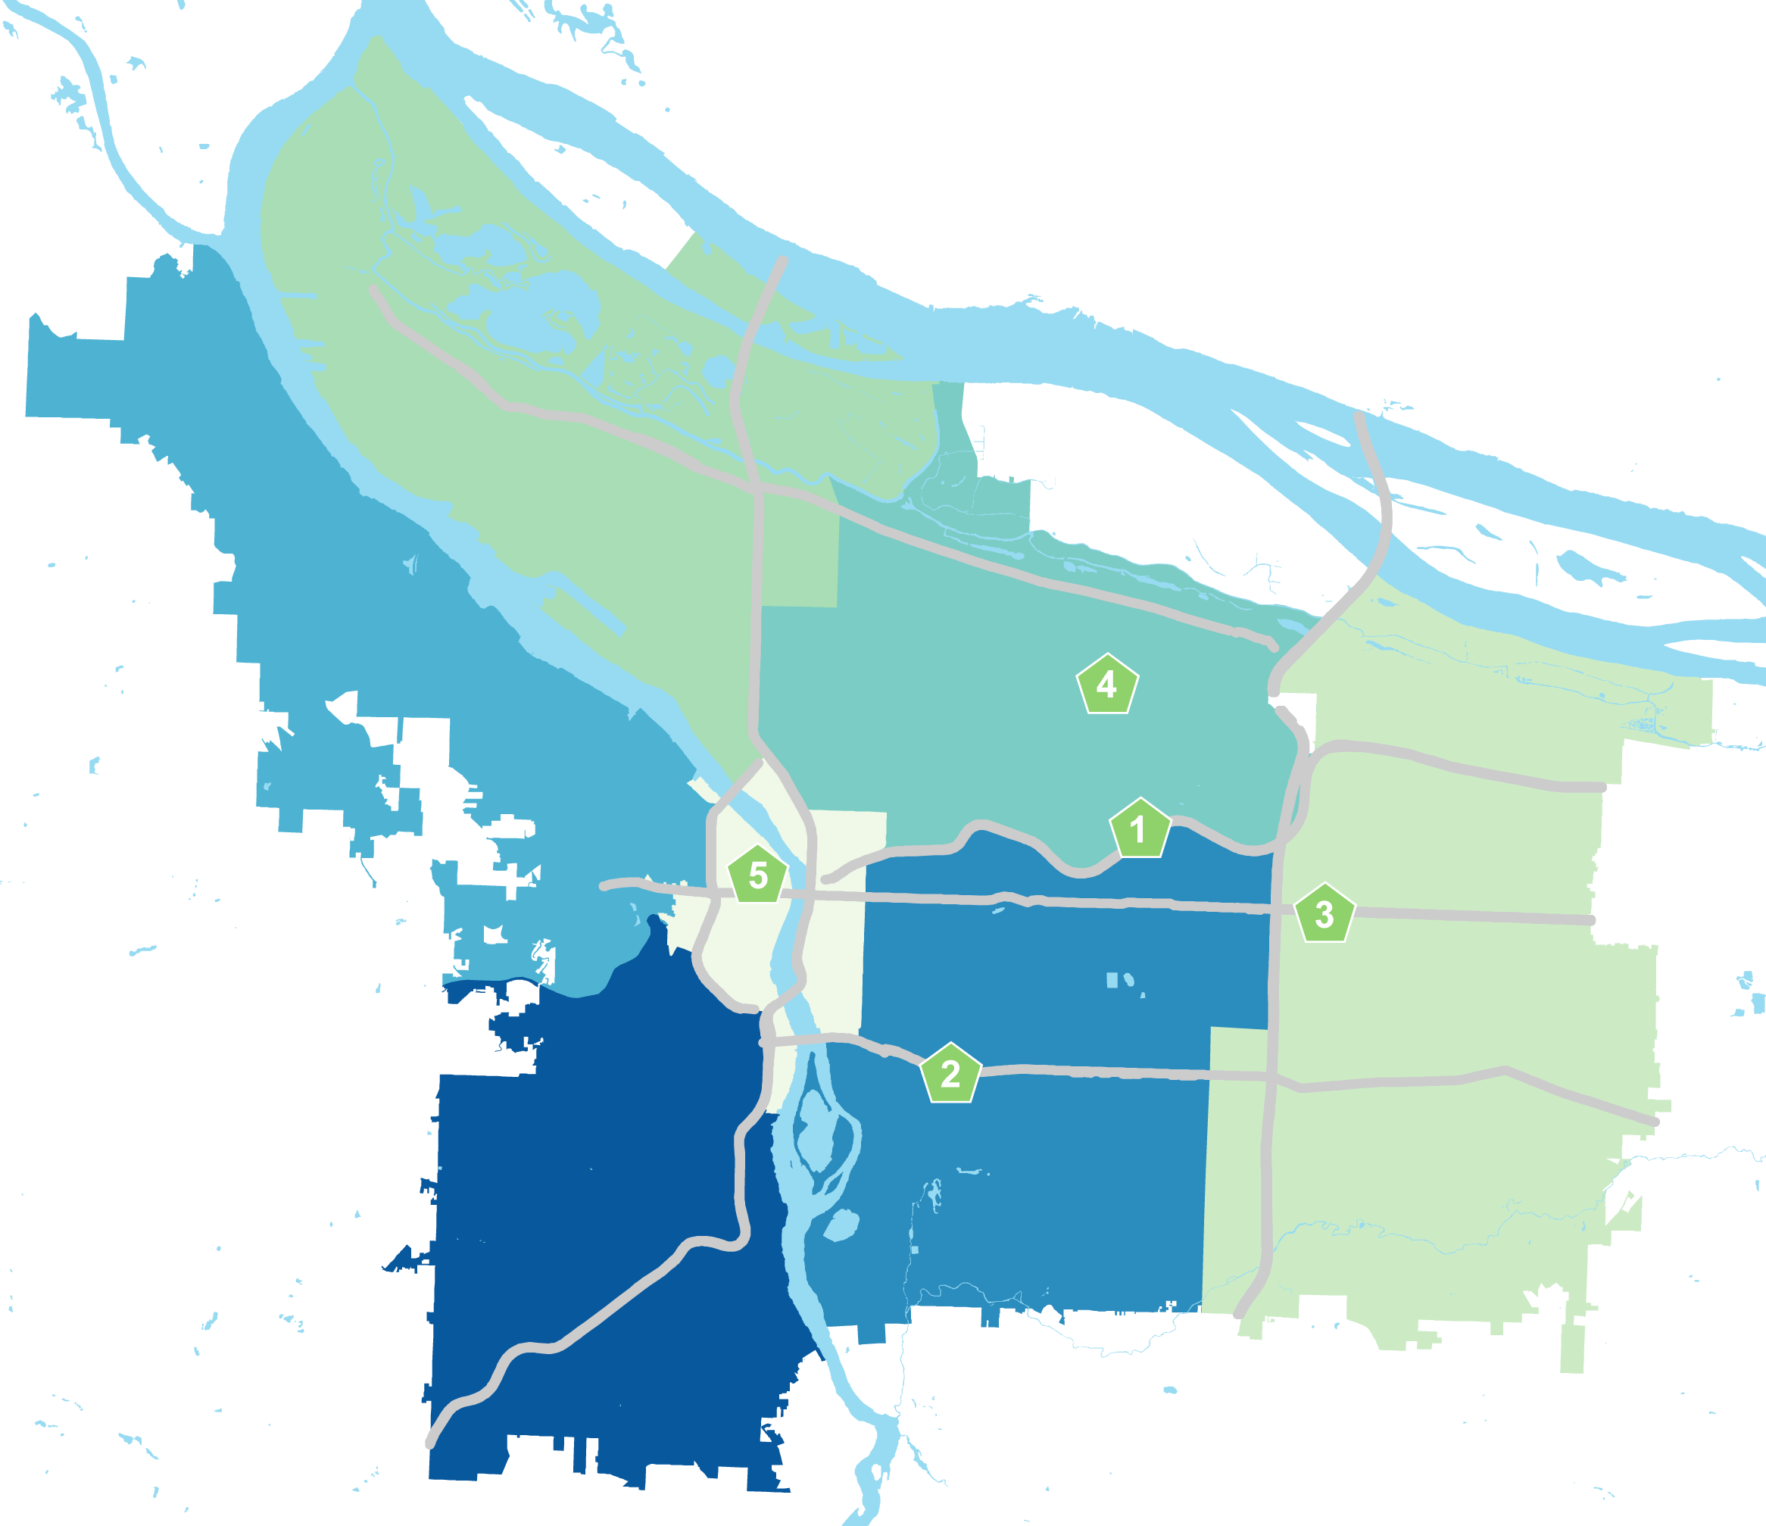
Bond Properties
  The Ellington
  3000 SE Powell
  10506 E Burnside St
  5827 NE Prescott
  NW 6th Ave (Westwind)
  SW 11th Ave. (Joyce Hotel)
6
8
Notes:
Shannon

Slide 19
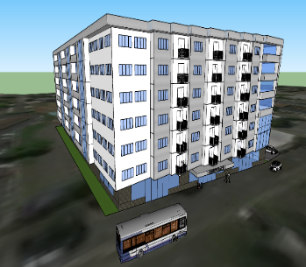
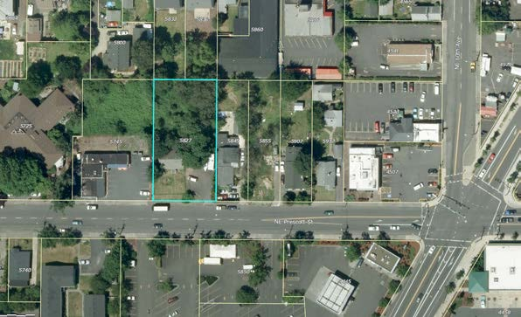
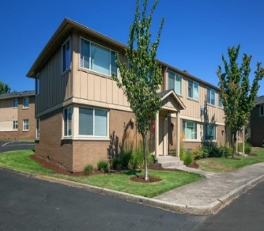
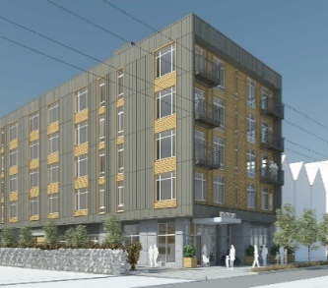
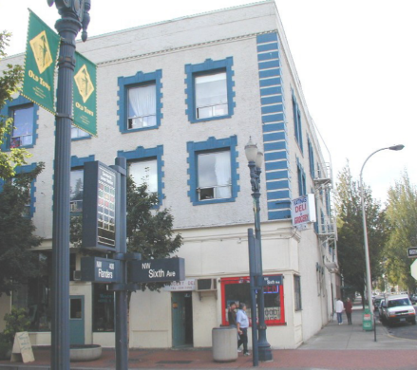
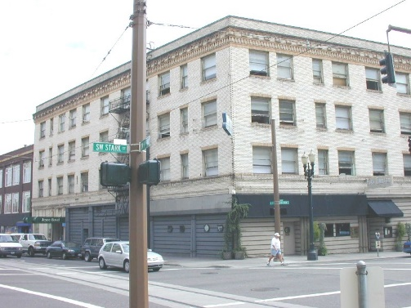
Completed Projects
Proposed Projects to be Developed
30th & Powell
NE Prescott
~160 units
~50 units
The Ellington
105th & Burnside
262 units
51 units
~662
Total Units*
Westwind
The Joyce
~70 units
69 units
*subject to change
Notes:
Shannon
Most recent/relevant update is the addition of the Joyce Hotel as a Bond-identified project. This project was approved by the Bond Property Review Committee on February 22nd.
Of the Proposed Projects to be Developed, we plan to include three properties: NE Prescott, Westwind and the Joyce. The 30th & Powell project will continue to be developed by Home Forward as a Bond project.
Also, I want to emphasize that the unit numbers under each project, with the exception of the Joyce Hotel, are only estimations. These totals are subject to change and dependent upon several factors, including final design, development costs and financing.

