Slide 1



SW Corridor Light Rail Project – Marquam Hill Connector
Design Commission Briefing
April 18, 2019
Teresa Boyle, PBOT Dave Unsworth, TriMet
Carol Mayer Reed, Urban Designer, ZGF-VIA-Mayer/Reed Joint Venture
Notes:
Two things – project overview and partnership with DC

Slide 2
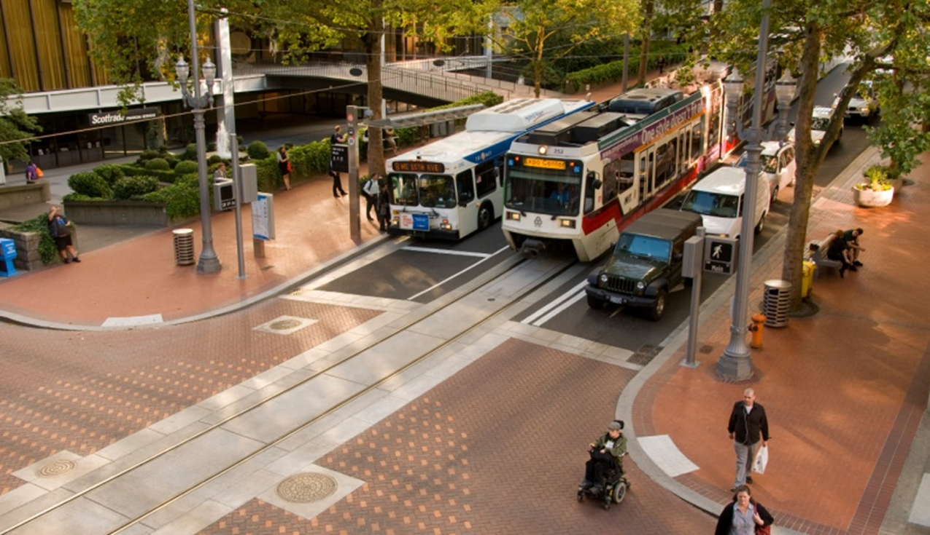
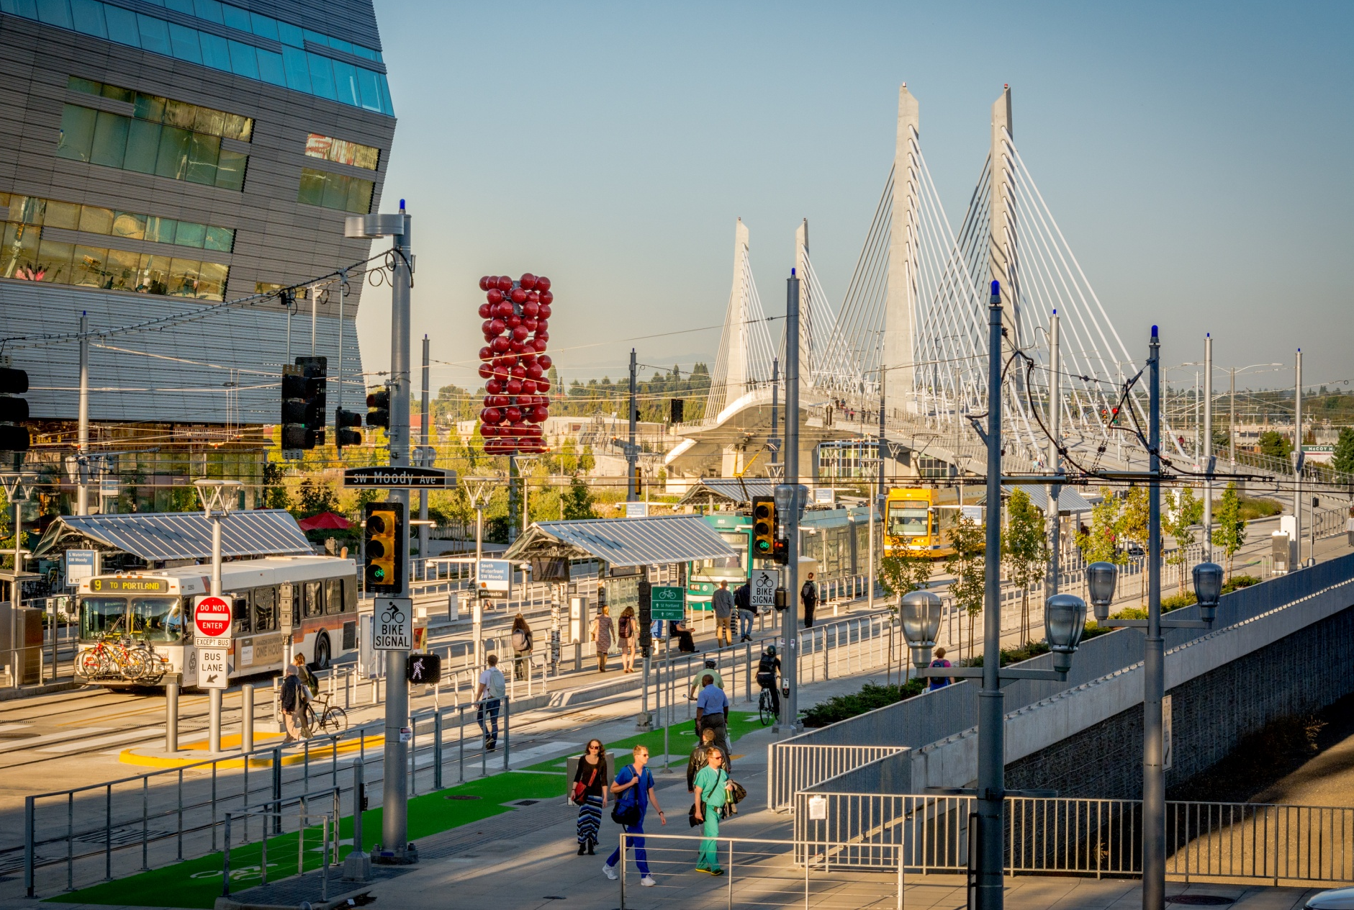
Design Commission – Transit Projects
Collaboration
Notes:
These discussions help us hone our design options into plausible and approvable Final Design strategies. Once we establish agreement on the use of our benchmark Standard elements…establishing an acceptable design quality…we can then focus on new elements, or Non-Standard elements.

Slide 3
SW Corridor Light Rail Project
Coordination with Design Commission
Project briefing June 2018
  Project overview & status
  Some unique elements – Marquam Hill Connector
  Standard Transit Elements in ROW
Ongoing briefings do not replace regulatory processes

Slide 4
Marquam Hill Connector
Near Term Next Steps
City Council Work Session May 7th
Green Ribbon Committee recommendation early May
Project Steering Committee selects alignments mid May
for further study
Environmental Analyses complete early 2020

Slide 5
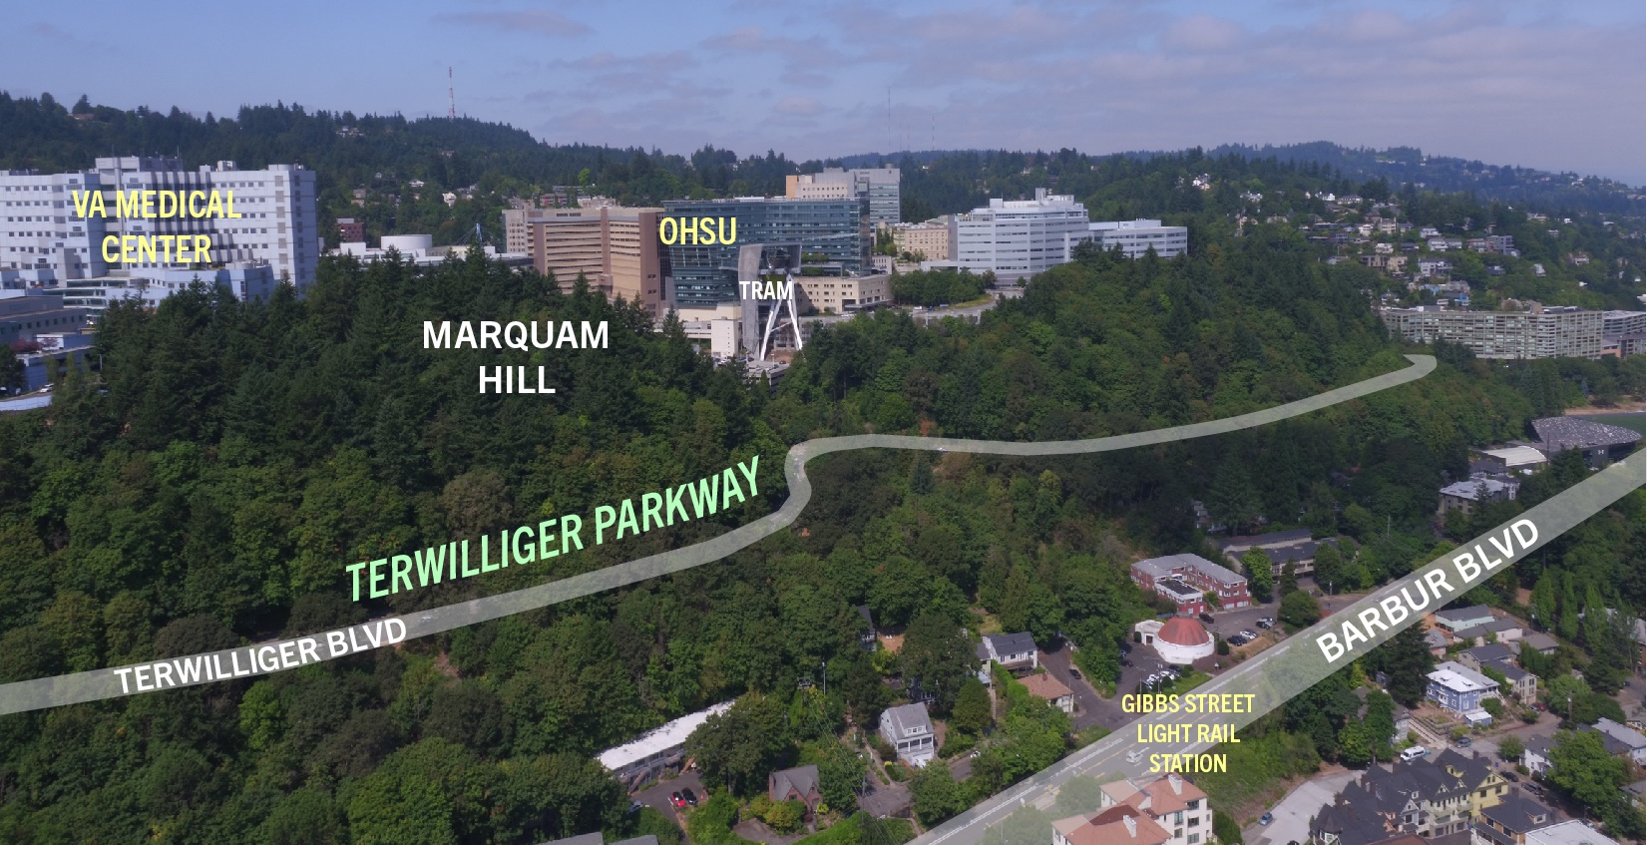
Marquam Hill Connector

Slide 6
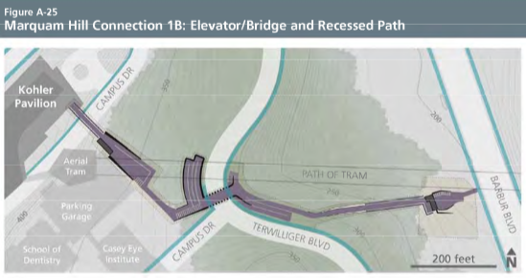
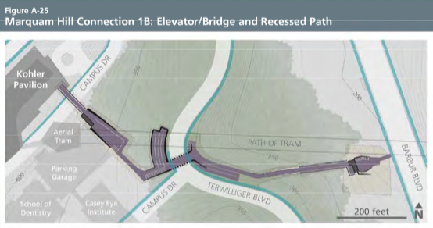
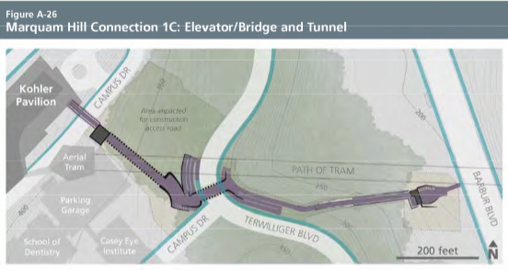
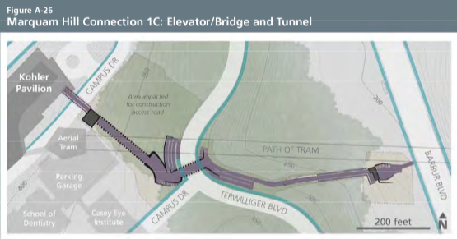
DEIS Options

Slide 7
Preferred Alternative
August 2018 Steering Committee Report:
“Multiple options for [the Marquam Hill] connection are included in the Draft EIS; the committee recommends a public process later in 2018 for the selection of the preferred option to be studied in the Final EIS.”

Slide 8
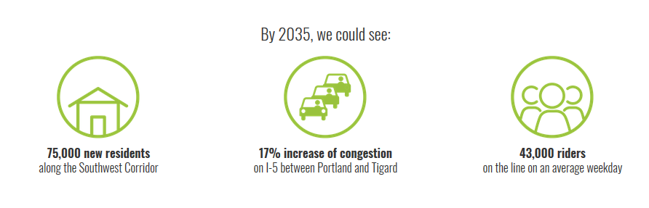
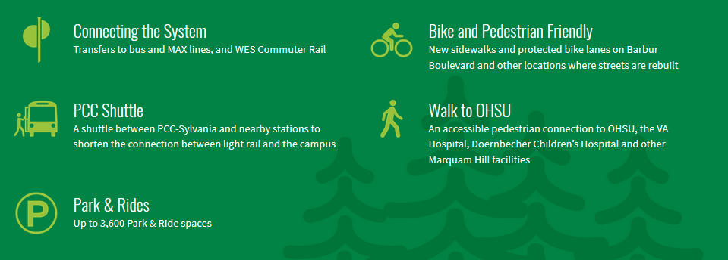
SW Corridor Light Rail

Slide 9
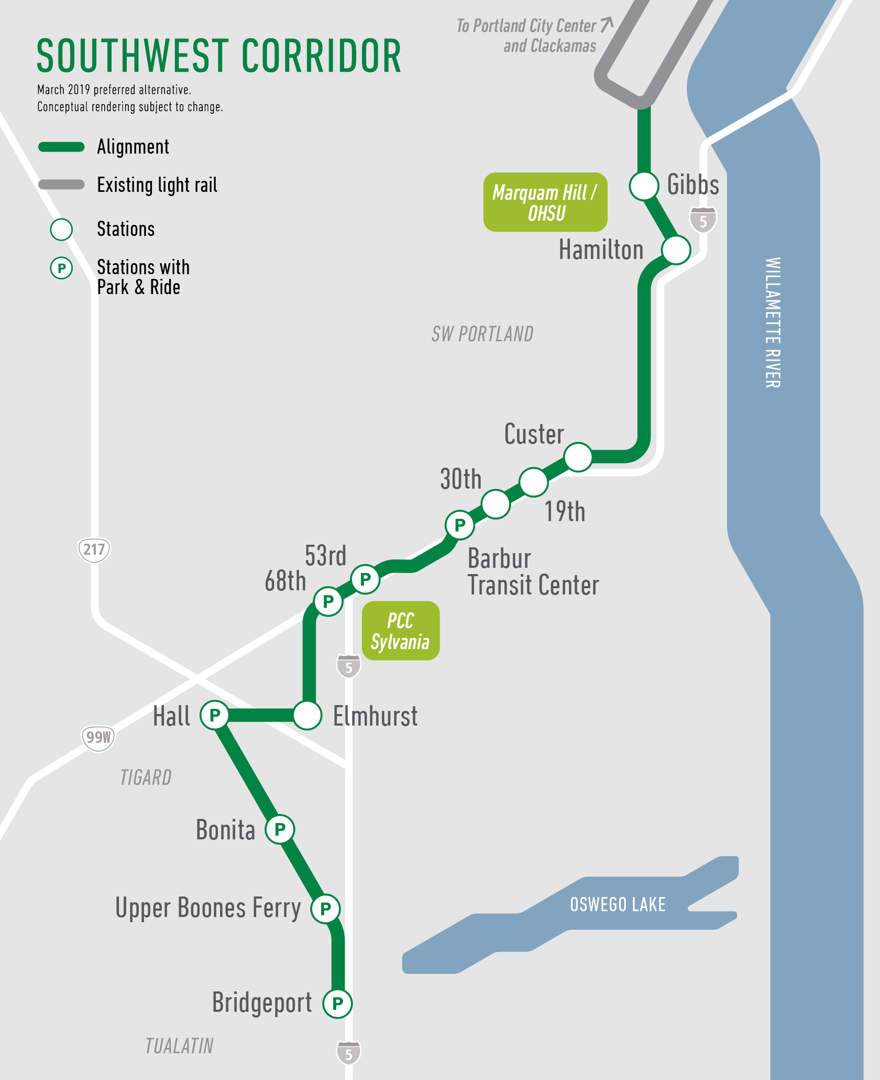
SW Corridor Light Rail

Slide 10
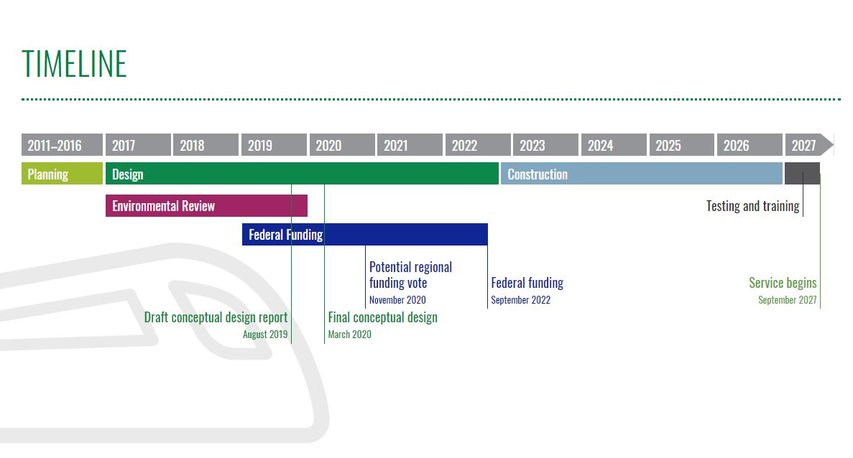
SW Corridor Light Rail

Slide 11
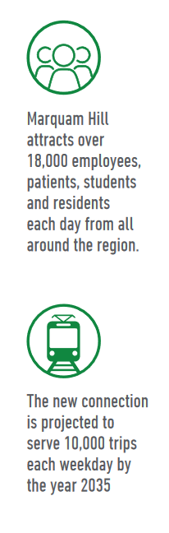
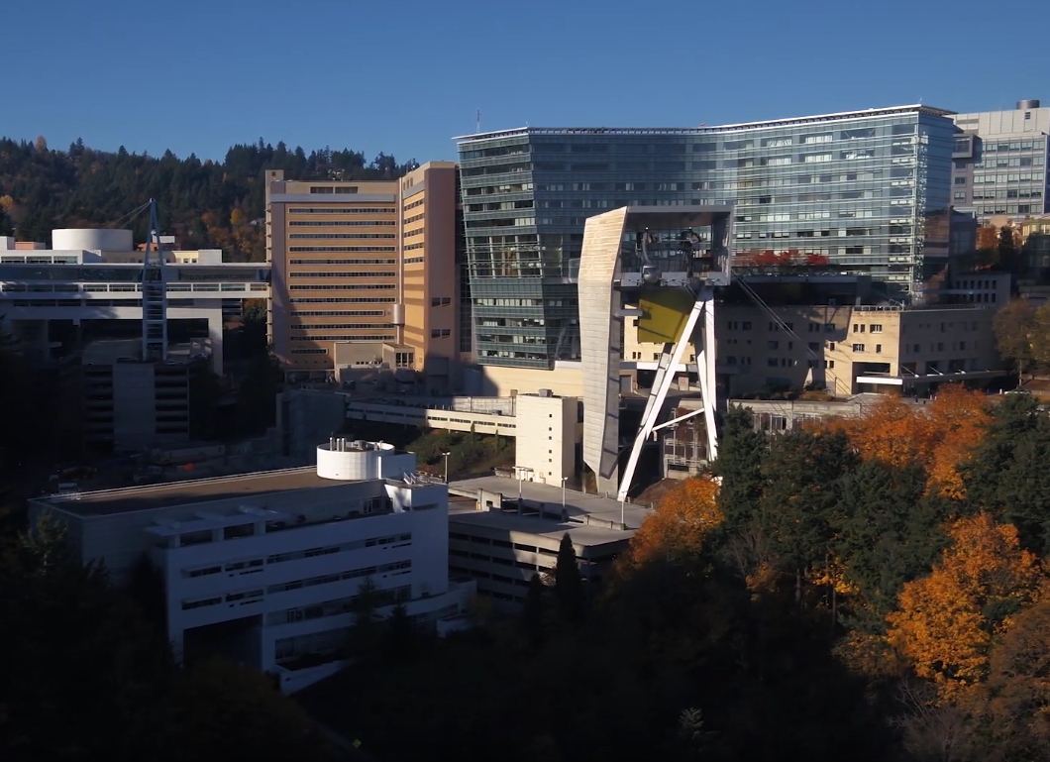
Marquam Hill Connector

Slide 12
Introduction Video

Slide 13
Green Ribbon Committee
Fred Miller, Chair
Councilor Bob Stacey, Metro
Doug Kelsey, General Manager, TriMet
Jamey Duhamel, Office of Commissioner Eudaly, City of Portland
Todd Lofgren, Office of Commissioner Fish, City of Portland
Zari Santner, Portland Design Commission
Skai Dancey, OHSU
Chet Orloff, Historian
Don Stastny, Architect
Anton Vetterlein, Friends of Terwilliger

Slide 14
Green Ribbon Committee
“The committee’s goal will be to select a type of connector type that is safe, accessible, efficient, sensitive to Terwilliger Parkway’s historic context and natural resources, and affordable to build and maintain.”
“The Marquam Hill Connector provides an opportunity to create a signature connection that reflects the beauty of its surroundings and inspires civic pride.”

Slide 15
Working Group
Anton Vetterlein, Friends of Terwilliger
Ed Fischer, Homestead Neighborhood
Jim Gardner, South Portland Neighborhood
Don Baack, SW Trails
Michael Harrison, OHSU
John Dodier, Veterans Affairs Hospital
Teresa Boyle, Portland Bureau of Transportation
Brett Horner, Portland Parks & Recreation
Hillary Adam, Portland Bureau of Development Services
Chris Ford, Metro
Jeb Doran, TriMet

Slide 16
City Approvals
Anticipated 2023
  Design Review
  Environmental Review
  Landmarks Reviews
  Permitting

Slide 17
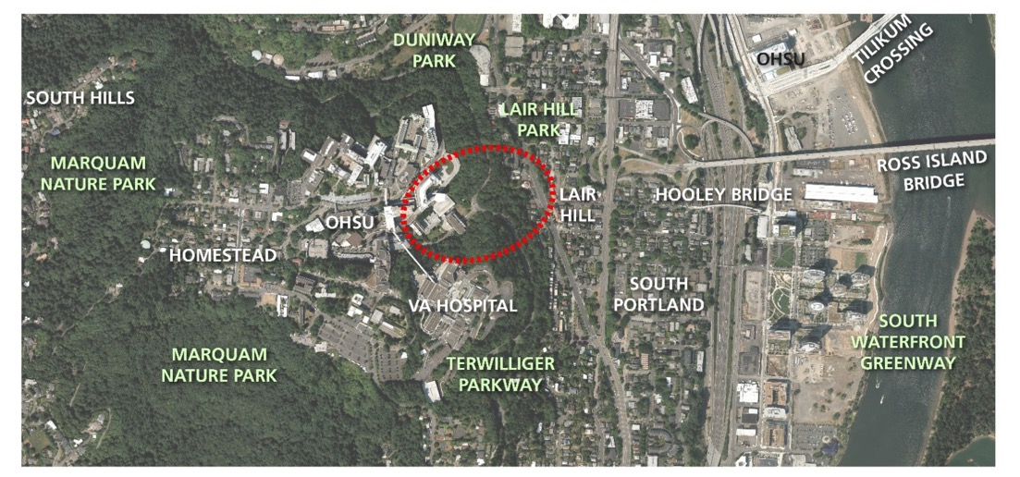
Context
Marquam Hill & Gibbs St. Station Vicinity
Southwest Corridor

Slide 18
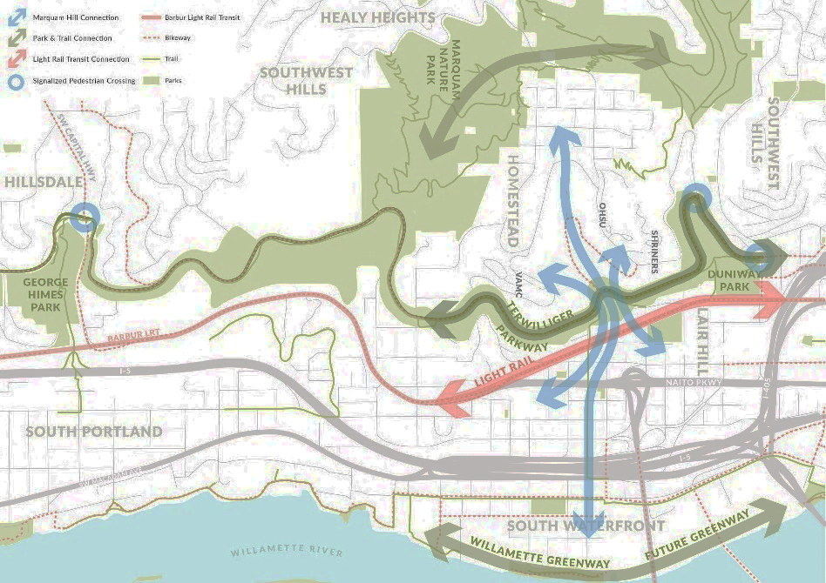
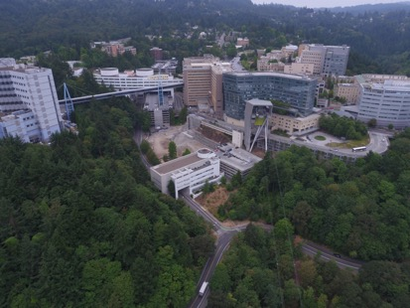
Purpose
To connect the Gibbs St. Station to the many destinations on Marquam Hill & bus routes as well as the neighborhoods & Terwilliger Parkway
Southwest Corridor
Southwest Corridor

Slide 19
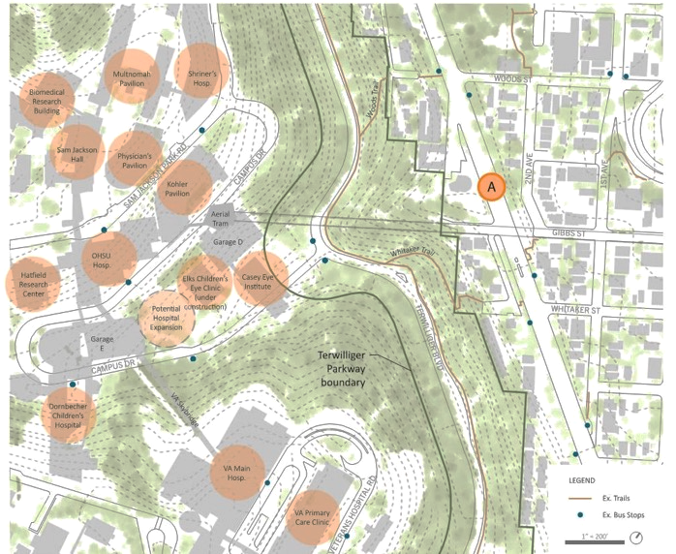
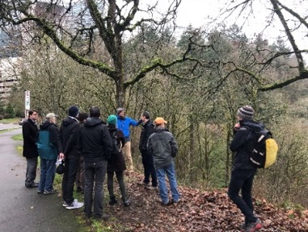
Marquam Hill Destinations
Southwest Corridor
Southwest Corridor

Slide 20
Goals & Summary of Criteria
• Access: Develop equitable, efficient, convenient connections for all users to a number of destinations.
• Safety: Create a safe & secure, 24/7 connection for all users.
• Context: Enhance & improve historic, scenic & recreational resources; consider unique character of the area in the design.
• Environmental: Protect & enhance natural resources & habitat.

Slide 21
Goals & Summary of Criteria
• Operational: Provide a long-term, sustainable connection for current & future users.
• Budget/Schedule: Be cost effective & timely within the SW Corridor Light Rail project.
• Experience: Create a connection that provides a high-quality user experience & inspires civic pride.

Slide 22
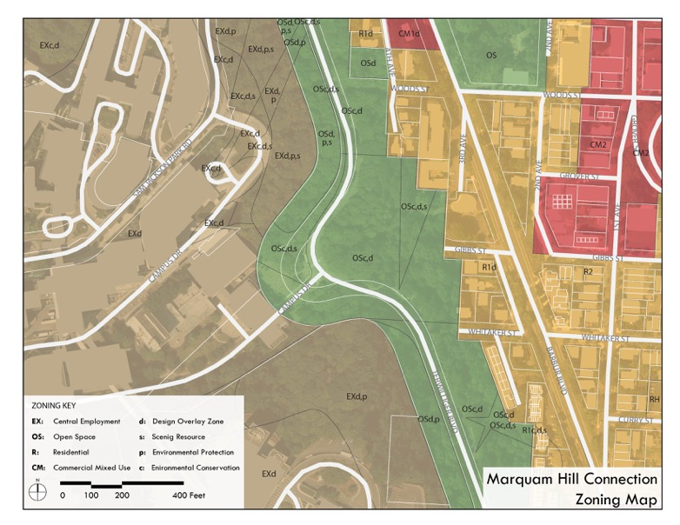
Zoning
Southwest Corridor
Southwest Corridor
Southwest Corridor

Slide 23
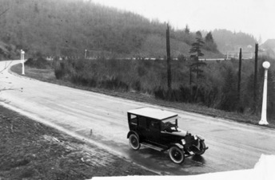
Special Considerations
• Distance of about 1,000 horizontal ft. & 330 vertical ft.
• Historic Olmsted Brothers Boulevard & Parkway
Historic Terwilliger Boulevard - 1906
Site Section: Marquam Hill to Gibbs St. Station on Barbur Blvd.
Southwest Corridor
Southwest Corridor
Southwest Corridor

Slide 24
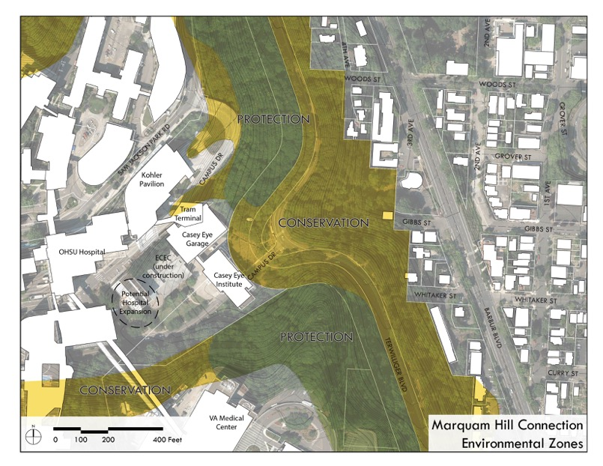
Special Considerations
Southwest Corridor
Southwest Corridor
Southwest Corridor

Slide 25
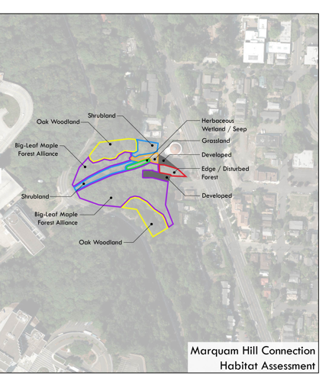
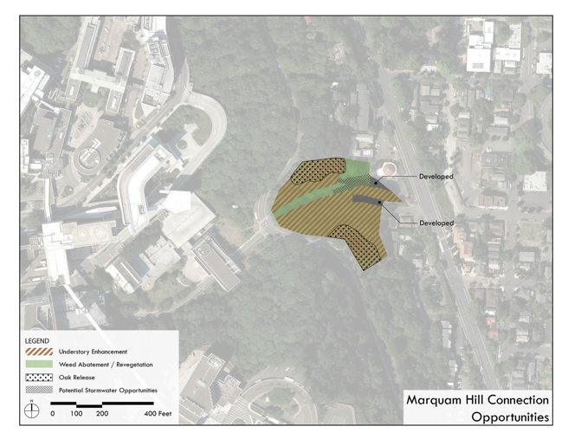
Special Considerations
Southwest Corridor
Southwest Corridor
Southwest Corridor

Slide 26
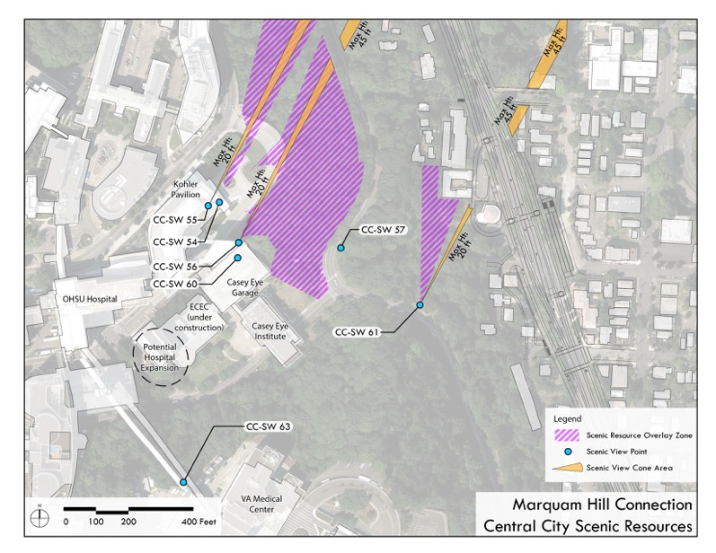
Special Considerations
Southwest Corridor
Southwest Corridor
Southwest Corridor

Slide 27
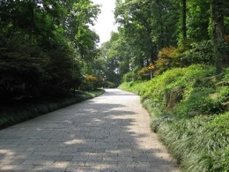
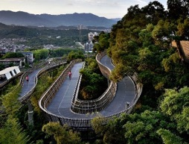
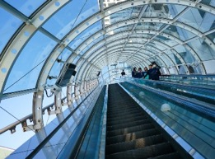
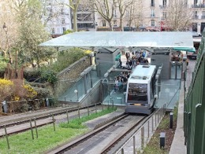
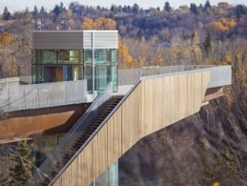
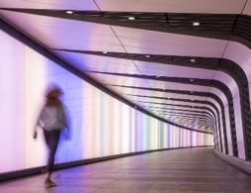
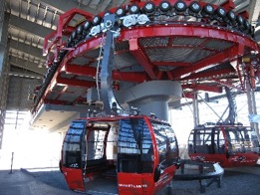
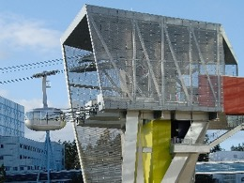
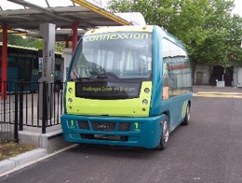
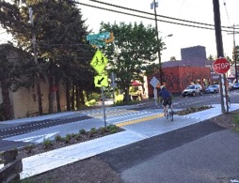
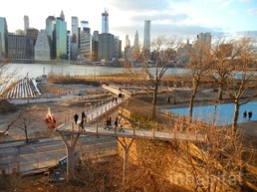
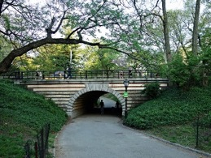
Many Options Considered

Slide 28
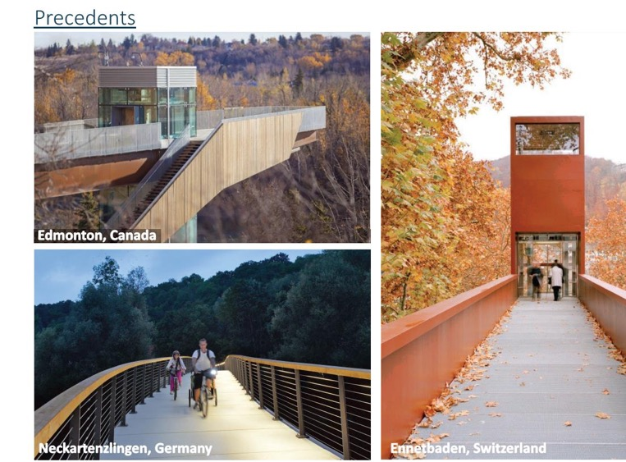
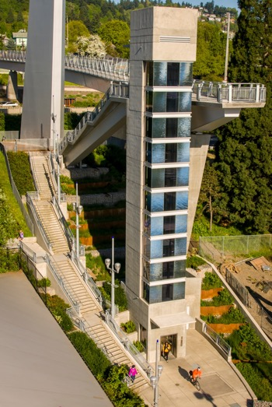
Bridge + Elevator
[funicular photos]
Darlene Hooley Bridge, Portland, OR

Slide 29
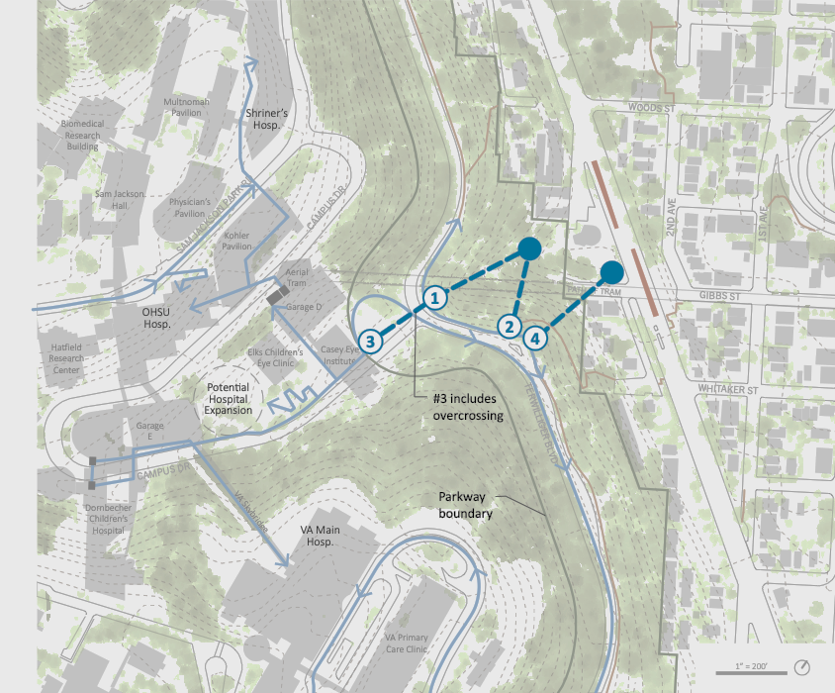
Bridge + Elevator

Slide 30
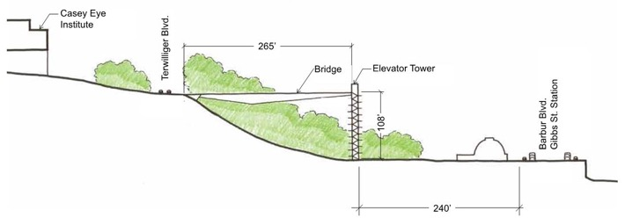
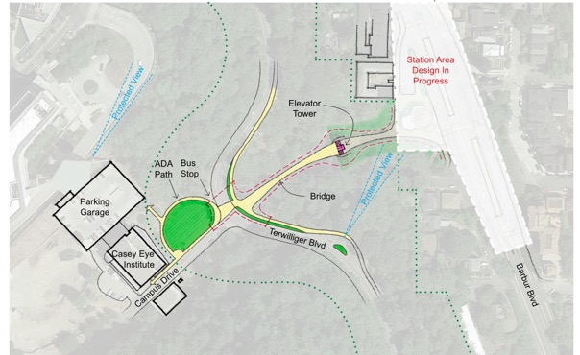
Bridge + Elevator

Slide 31
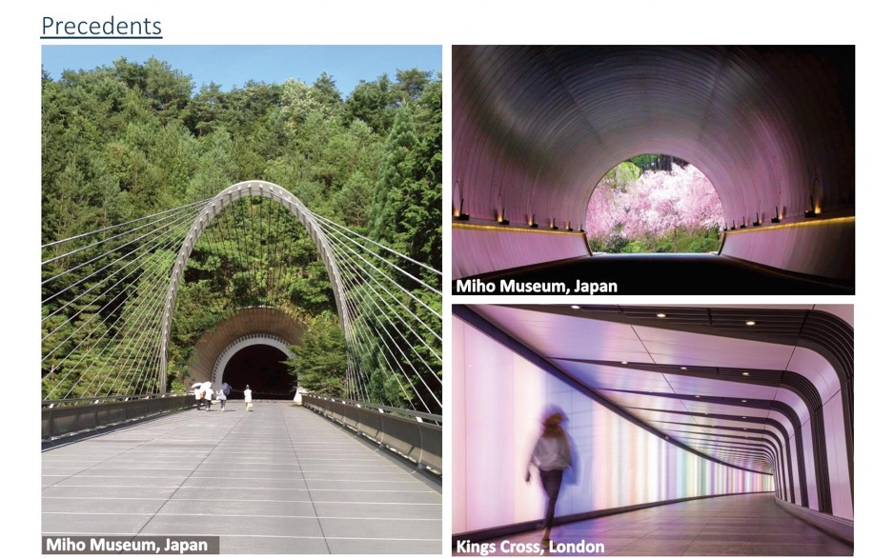
Tunnel + Elevator

Slide 32
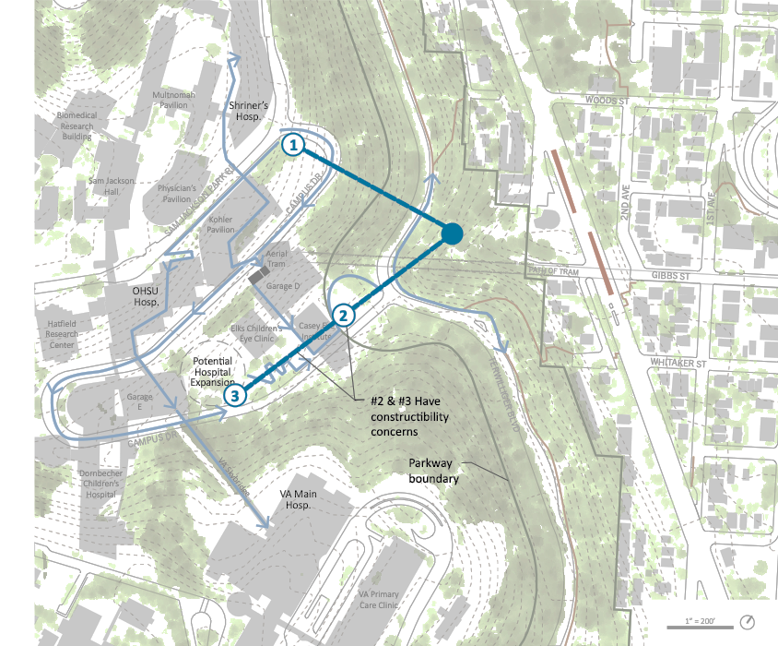
Tunnel + Elevator

Slide 33
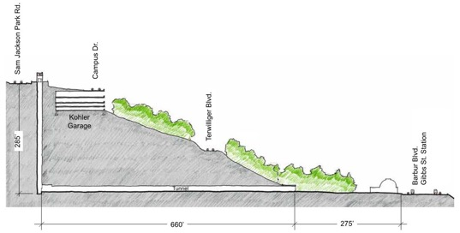
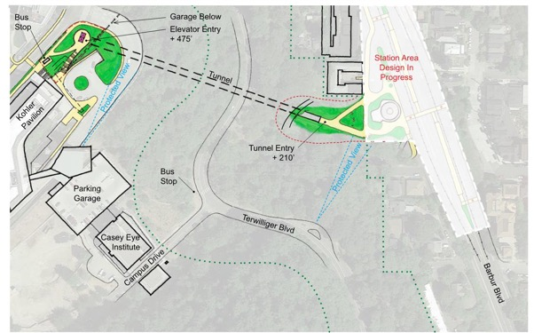
Tunnel + Elevator

Slide 34
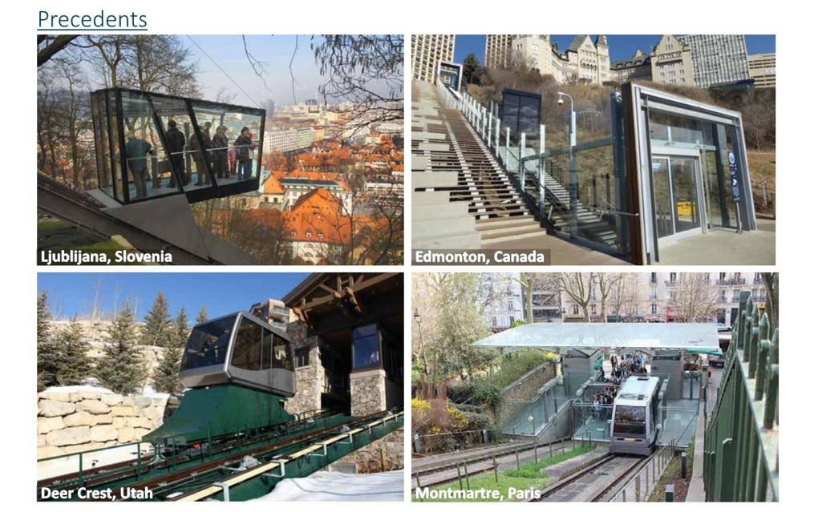
Inclined Elevator

Slide 35
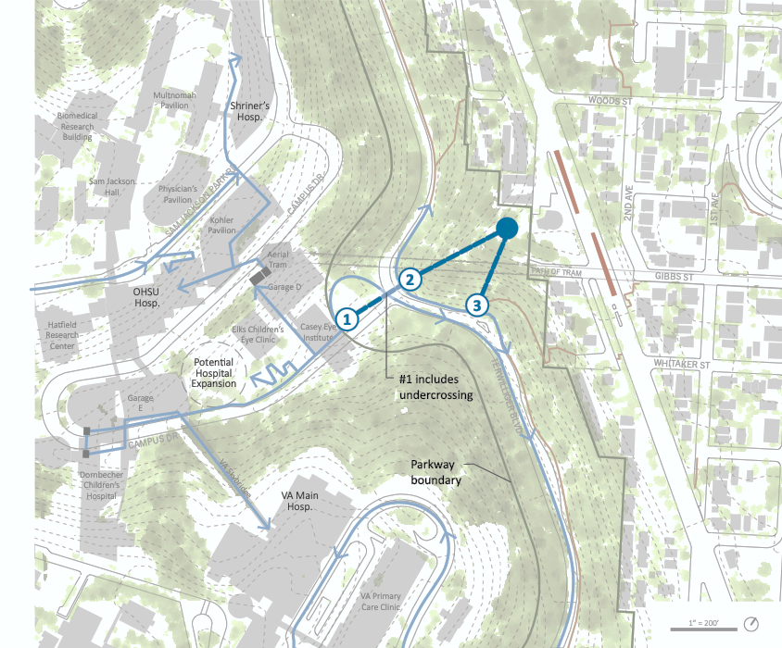
Inclined Elevator

Slide 36
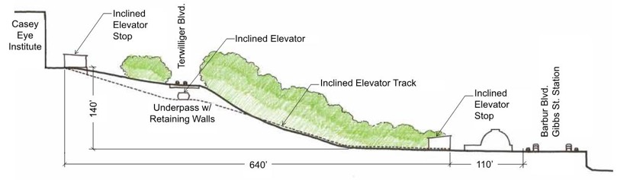
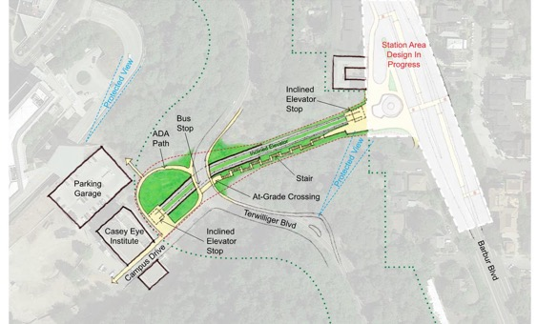
Inclined Elevator

Slide 37
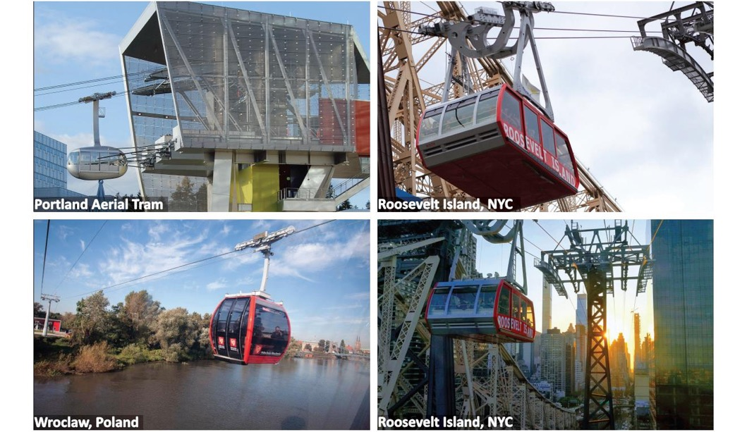
Aerial Tram

Slide 38

Aerial Tram

Slide 39

Marquam Hill Connections

