Slide 1
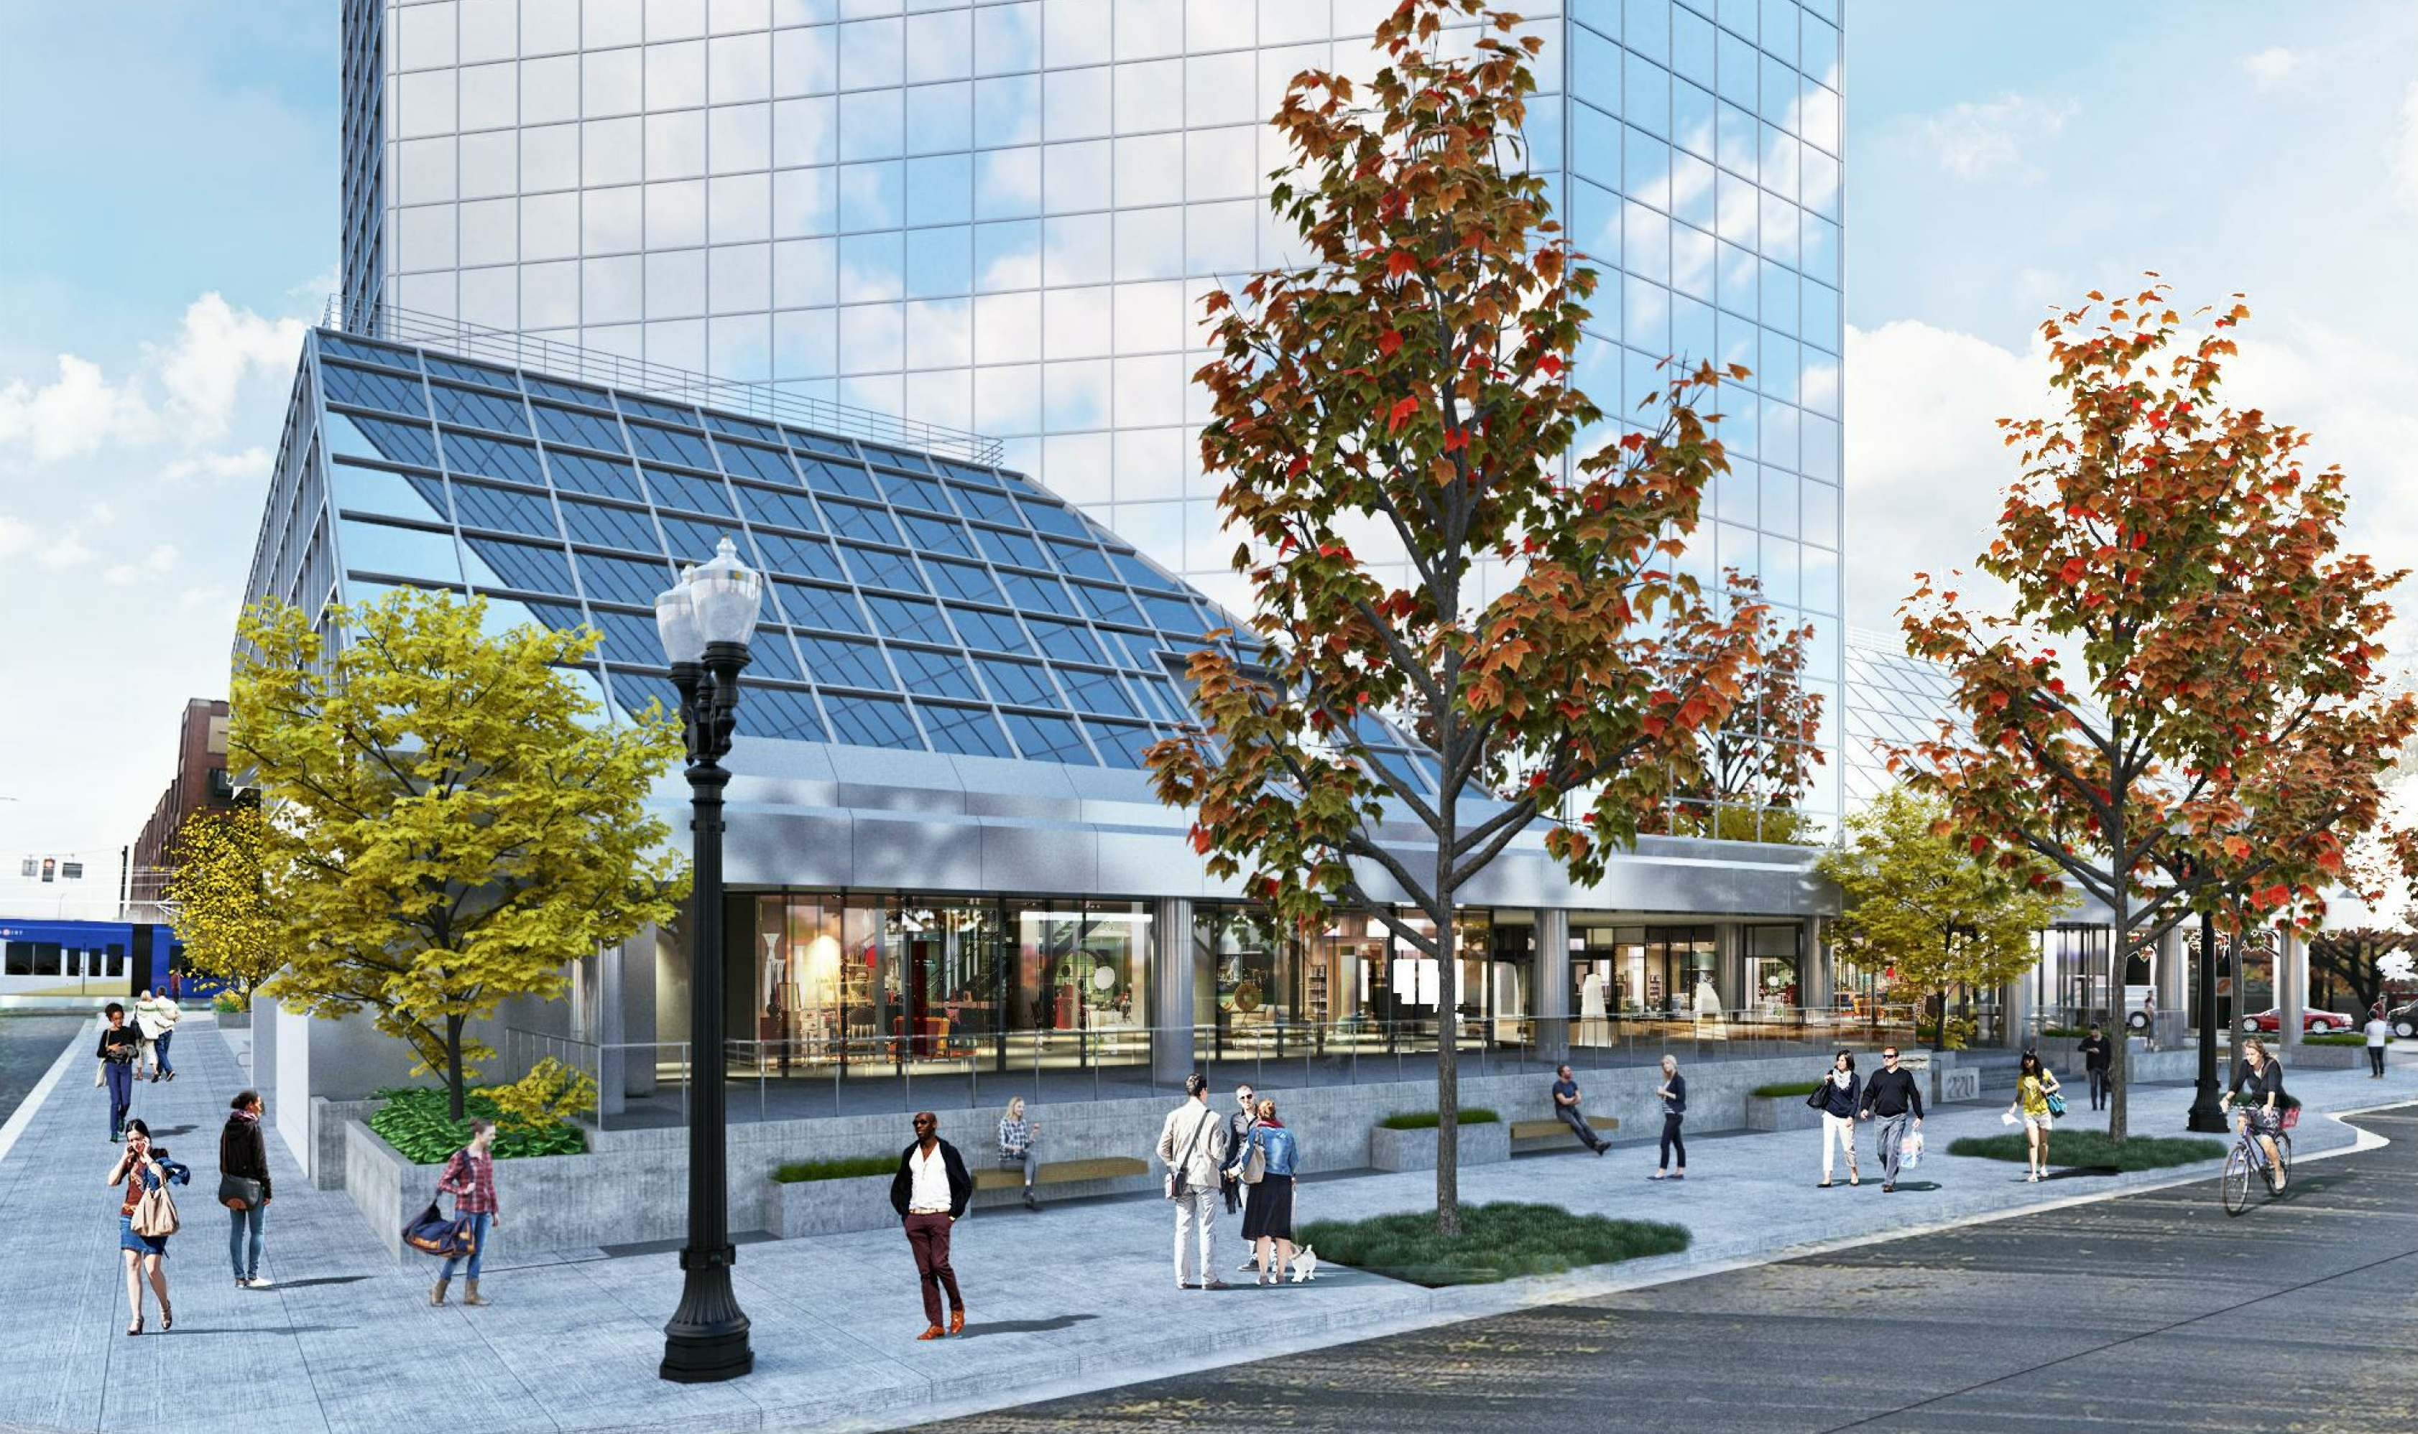
City of Portland
Design Commission &
Landmarks Commission
Type III Land Use Review
LU 18-277253 HR & LU 19-101014 DZ
One Pacific Square
Ground Floor & Plaza Alterations
April 11, 2019
Staff Presentation

Slide 2
Context & Staff Recommendation
Location
Zoning
Approval Criteria
Staff Recommendation
Next Steps
Questions for Staff
Applicant Presentation
Questions for the Applicant

Slide 3
Context

Slide 4
Location
Entire Site
Central City Plan District
Old Town/ Chinatown Subdistrict
South Half of Site
Skidmore/ Old Town Historic District

Slide 5
Zoning
Base Zone:
CX – Central Commercial
Overlays:
d - Design Overlay
Historic Resource Protection Overly (south half of block)
Floor Area Ratio:
4:1 base, 6.2:1 existing
Height:
250’ max (north half)
75’ max (south half)
188’ existing

Slide 6
Approval Criteria
Entire Site
Central City Fundamental Design Guidelines; and
Oregon Statewide Planning Goals
North Half of Site
River District Design Guidelines
South Half of Site
Skidmore/ Old Town Historic District Design Guidelines

Slide 7
Staff Recommendations

Slide 8
Staff Recommendations
Approval with Recommended Conditions (D-K)
Staff recommends Approval with Conditions
The proposed composite metal panel wrap shall match the color of the mullions on the upper stories of the building.
[CCFDGs: C2, C3, and C5; and Skidmore/ Old Town HD: A4]
Proposed raised precast concrete planters along the east and west property lines shall be limited to areas with the “exposed aggregate paving” aligned with building columns.
[CCFDGs: C3, and C5] (DZ only)
At the northwest and northeast corners the proposed timber benches shall be lengthened to extend the full width between the areas of “exposed aggregate paving”.
[River: B1-1] (DZ only)
The score pattern for the proposed sand-finish concrete shall be reduced in frequency as shown on Exhibit C-3.
[CCFDGs: C2, and C5; and Skidmore/ Old Town HD: A1.a, and A1.b]

Slide 9
Staff Recommendations
Approval with Recommended Conditions (D-K)
Staff recommends Approval with Conditions (cont.)
The applicant shall successfully resolve concerns with the design of the west entry at the April 11th hearing, otherwise the design of this area shall be resolved through follow-up Historic Resource and Design Reviews.
[River: A9-1; and Skidmore/ Old Town HD: A1.a, A1.b, and A2]
Non-exempt artwork and signage shall be subject to a follow-up review(s).
[River: A5-4]
The raised section of the “outdoor seating area for café” as shown on Exhibits C-2, C-3, C-4, C-6, and C-12 shall be removed and replaced with a run of integrated stairs.
[Skidmore/ Old Town HD: A1.a, A1.b, and A2] (HR only)
The proposed operable storefront shall integrate within the existing storefront rhythm, maintain the large panes of glass between mullions, and the one (1) “sliding storefront window” shall be expanded to all west facing storefront at the southwest café.
[Skidmore/ Old Town HD: A1.a, A1.b, and A2] (HR only)

Slide 10
Next steps
Design Commission & Landmarks Commission Options
Accept revised staff report and approve the proposal with all recommended conditions;
Accept revised staff report and approve the proposal with amended conditions;
Request the applicant to return with revisions; or
Reject revised staff report and ask staff to return with a revised report recommending denial.

Slide 11
Questions for Staff?

Slide 12
Applicant Presentation

Slide 13
Additional Slides (If Needed)

Slide 14
Previous Design

Slide 15
Previous Design

Slide 16
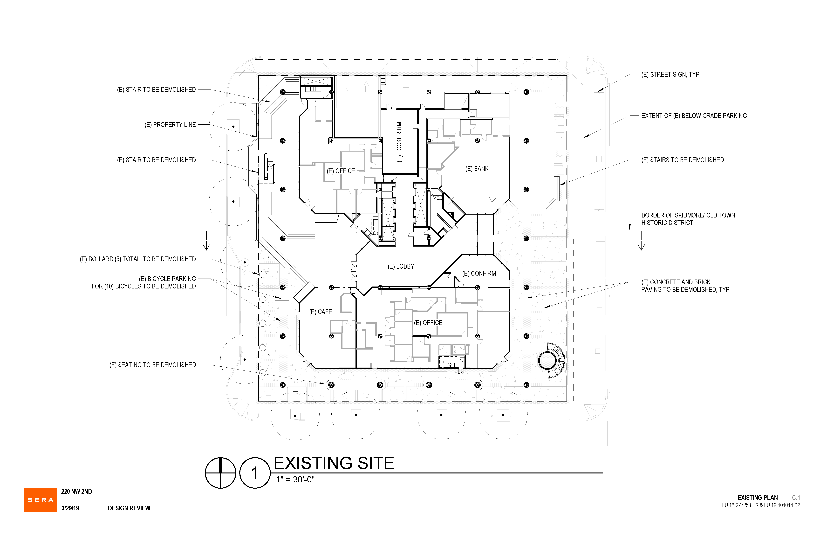

Slide 17
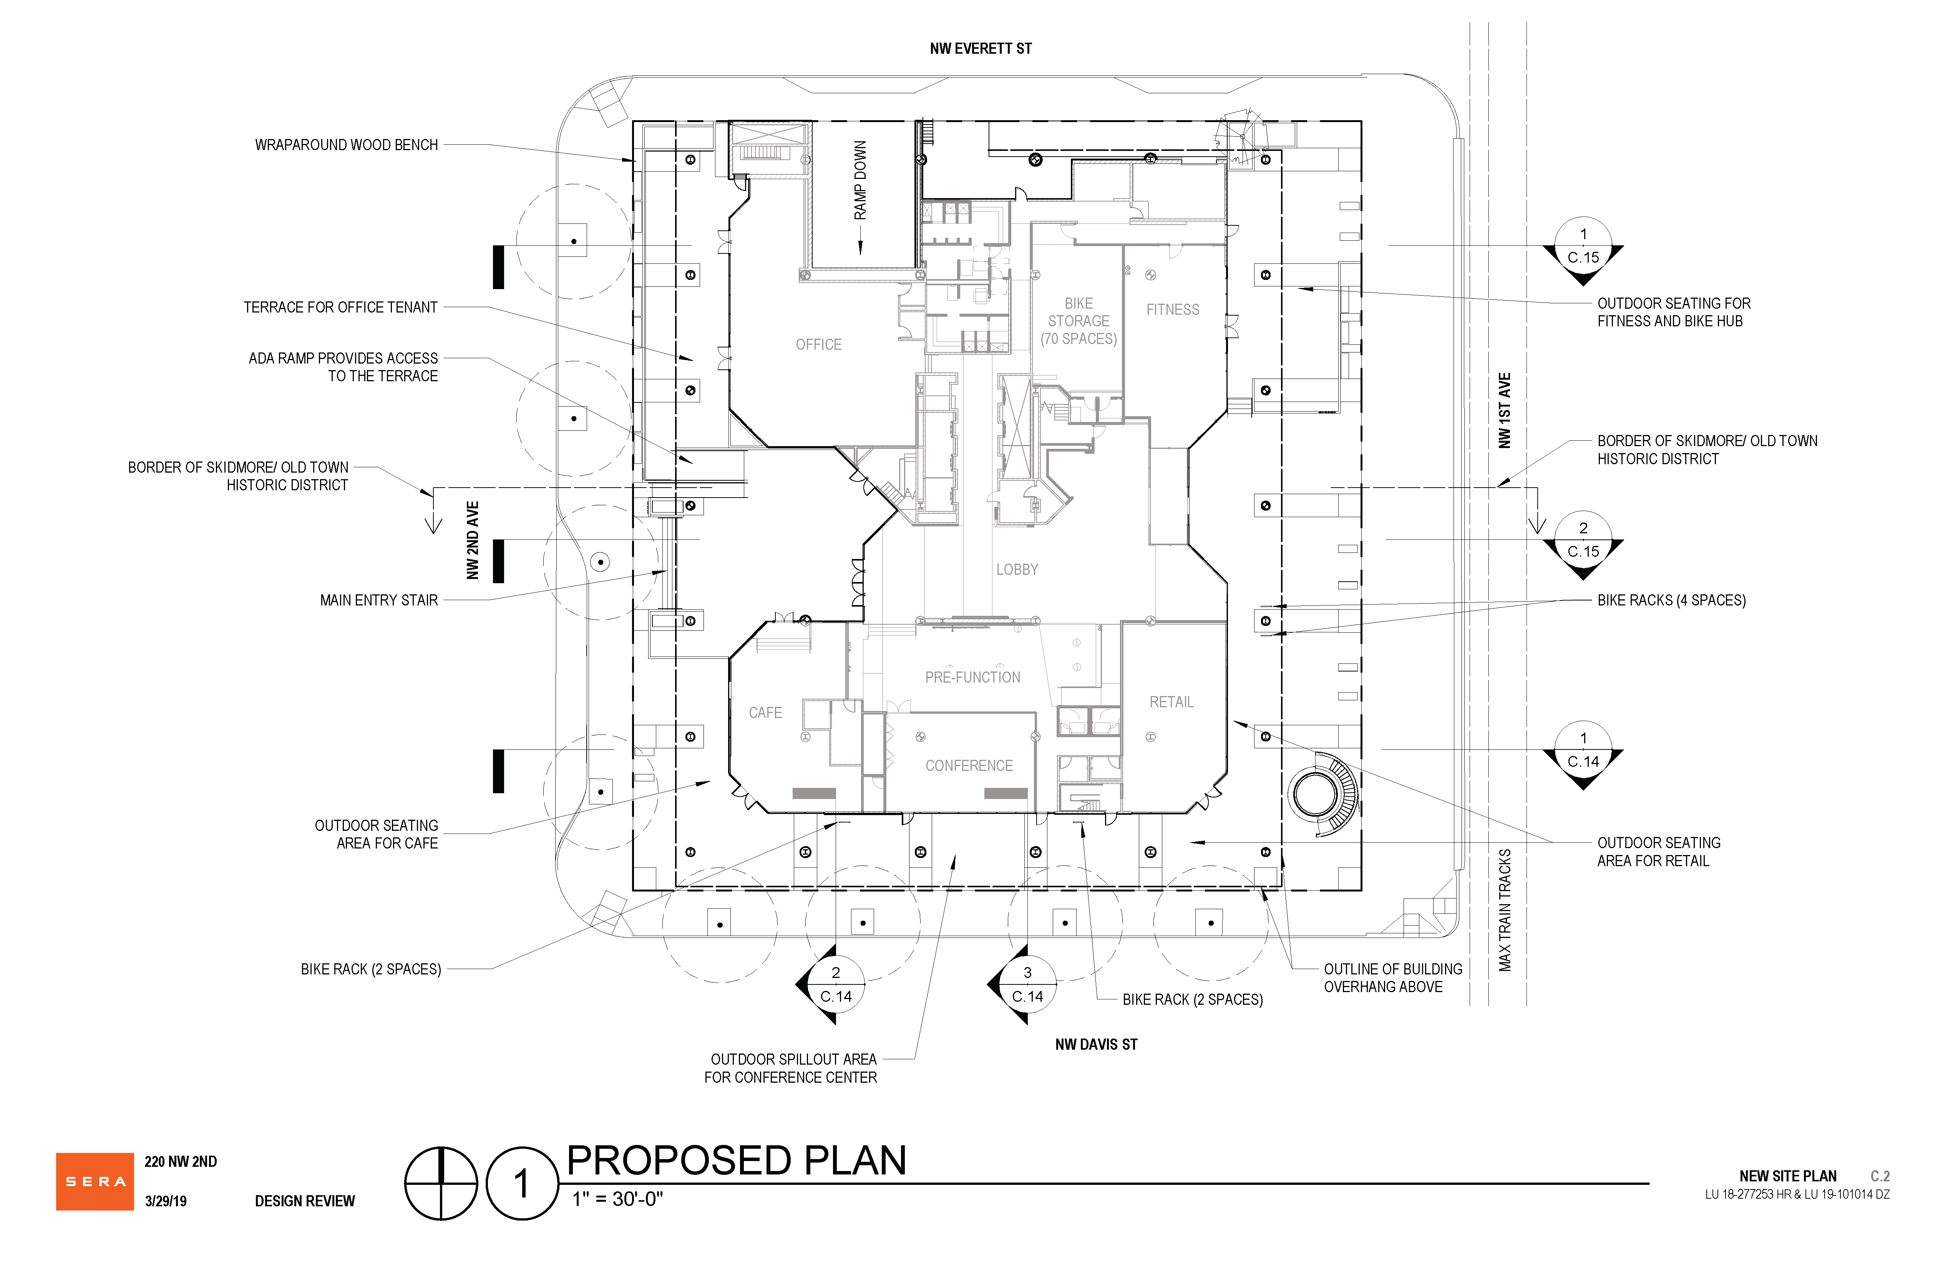

Slide 18
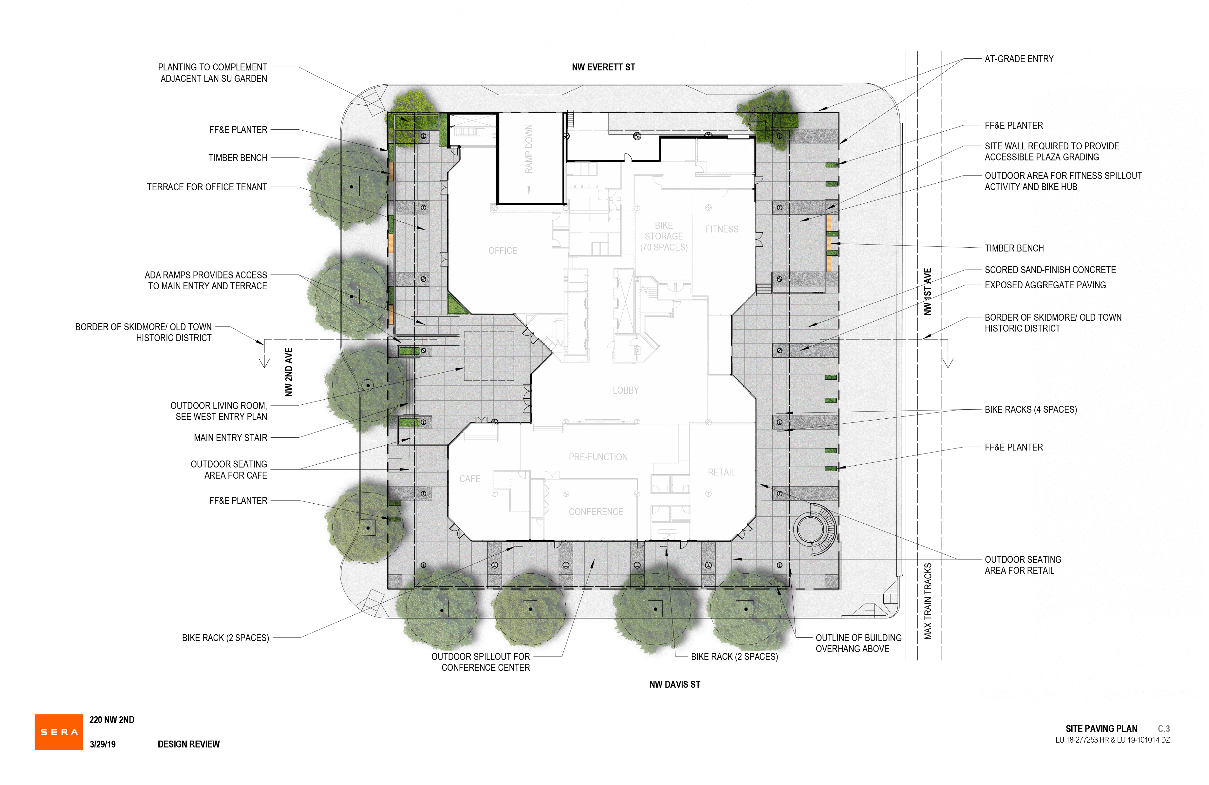

Slide 20
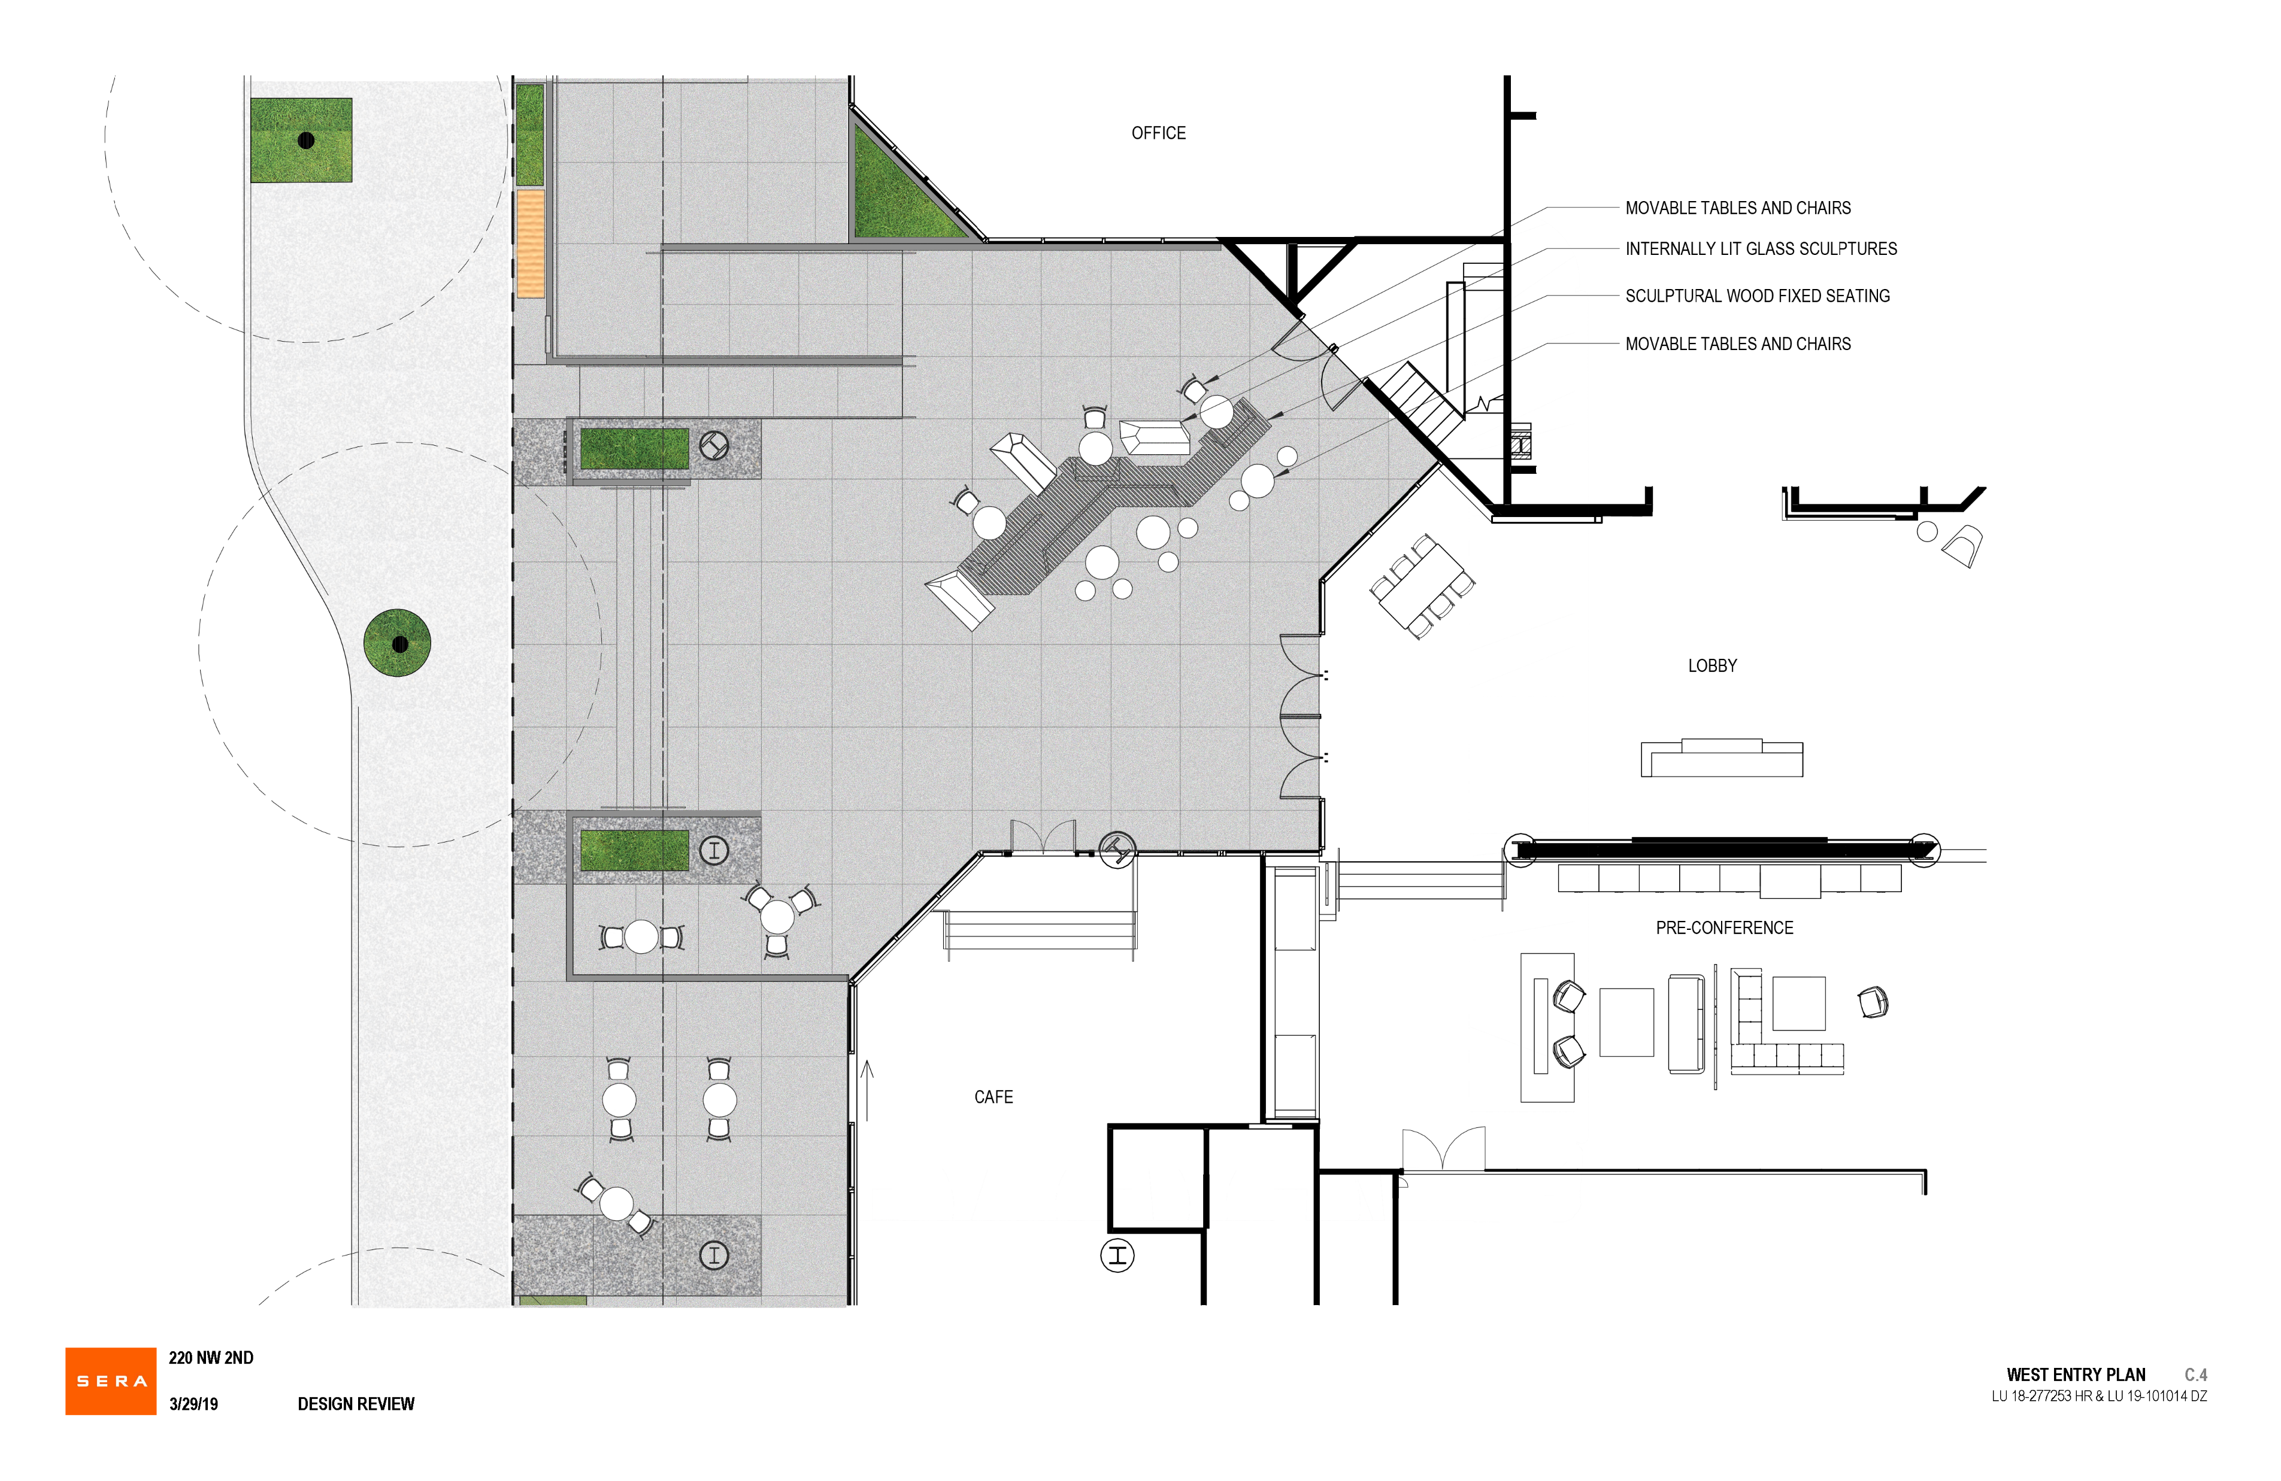

Slide 21
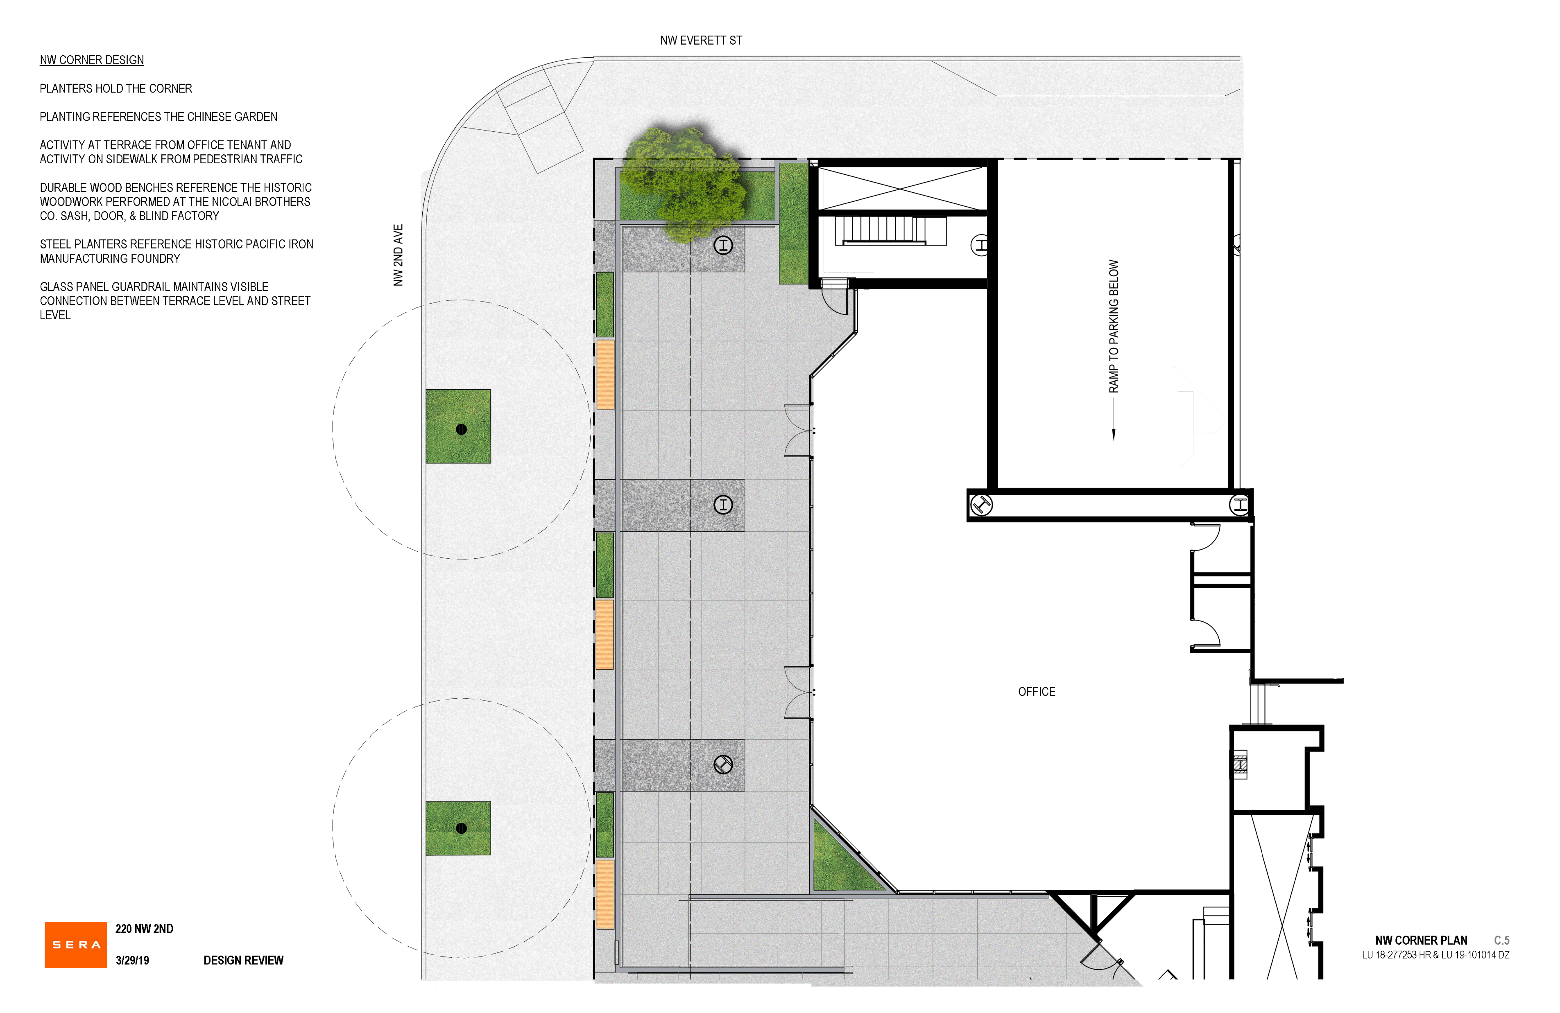

Slide 22
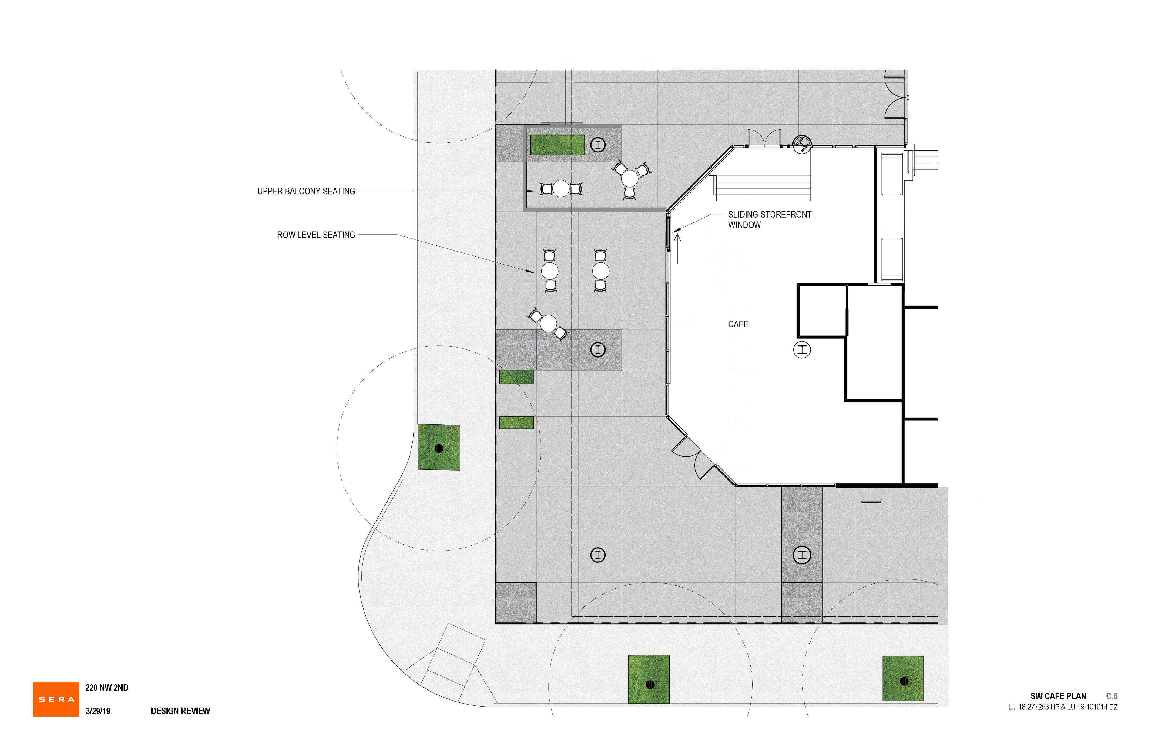

Slide 25
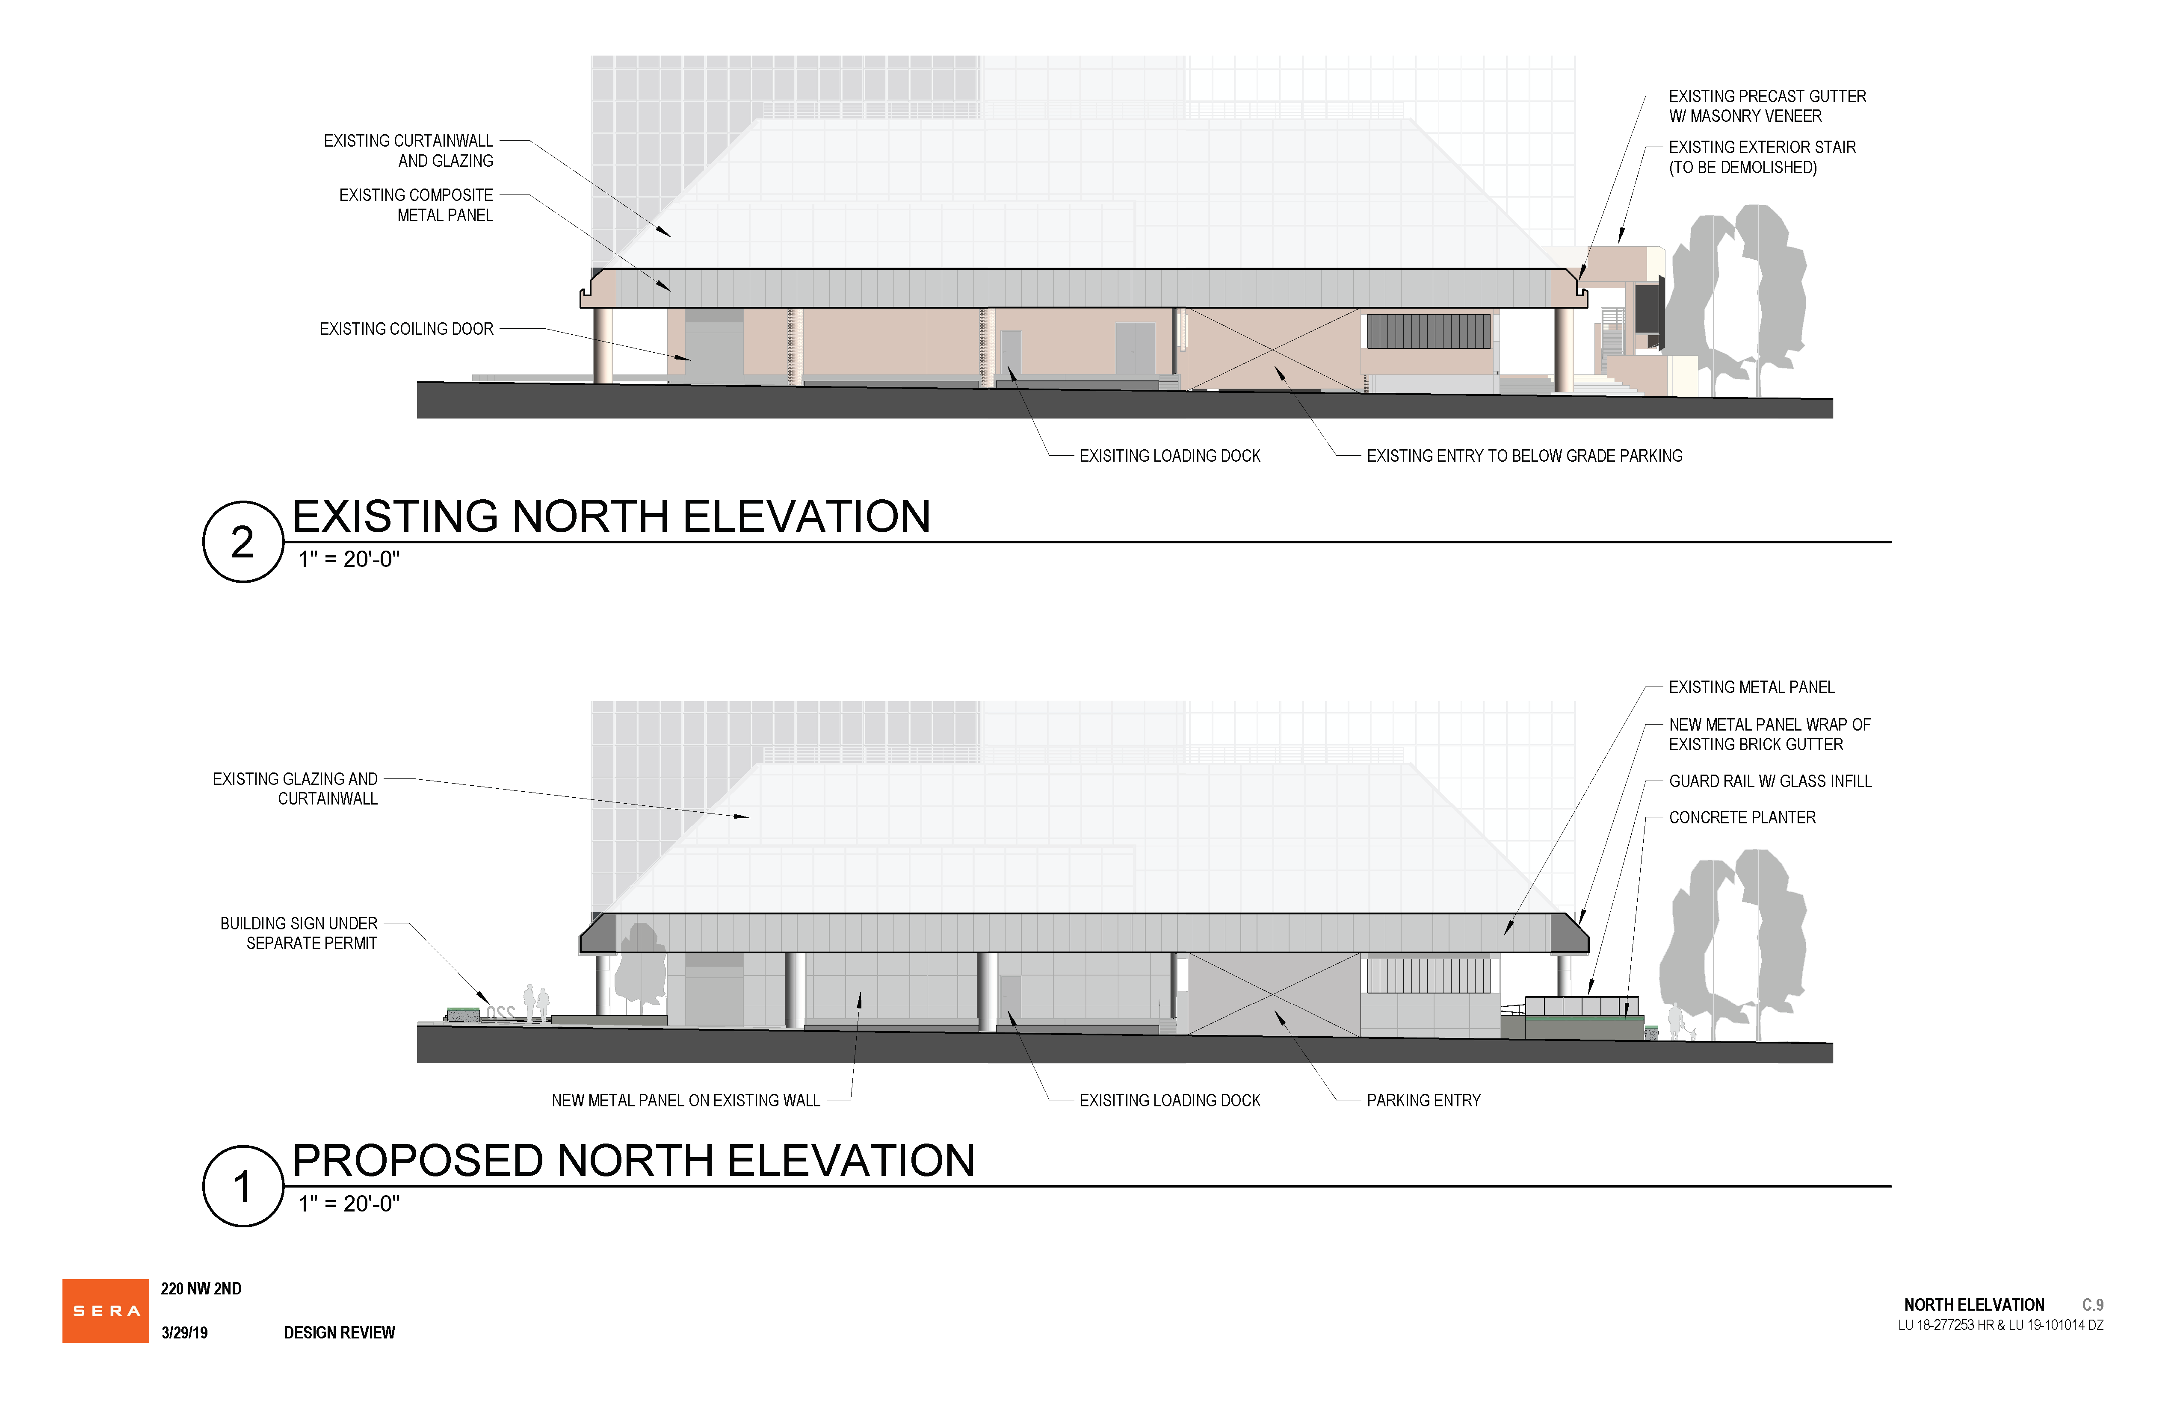

Slide 26
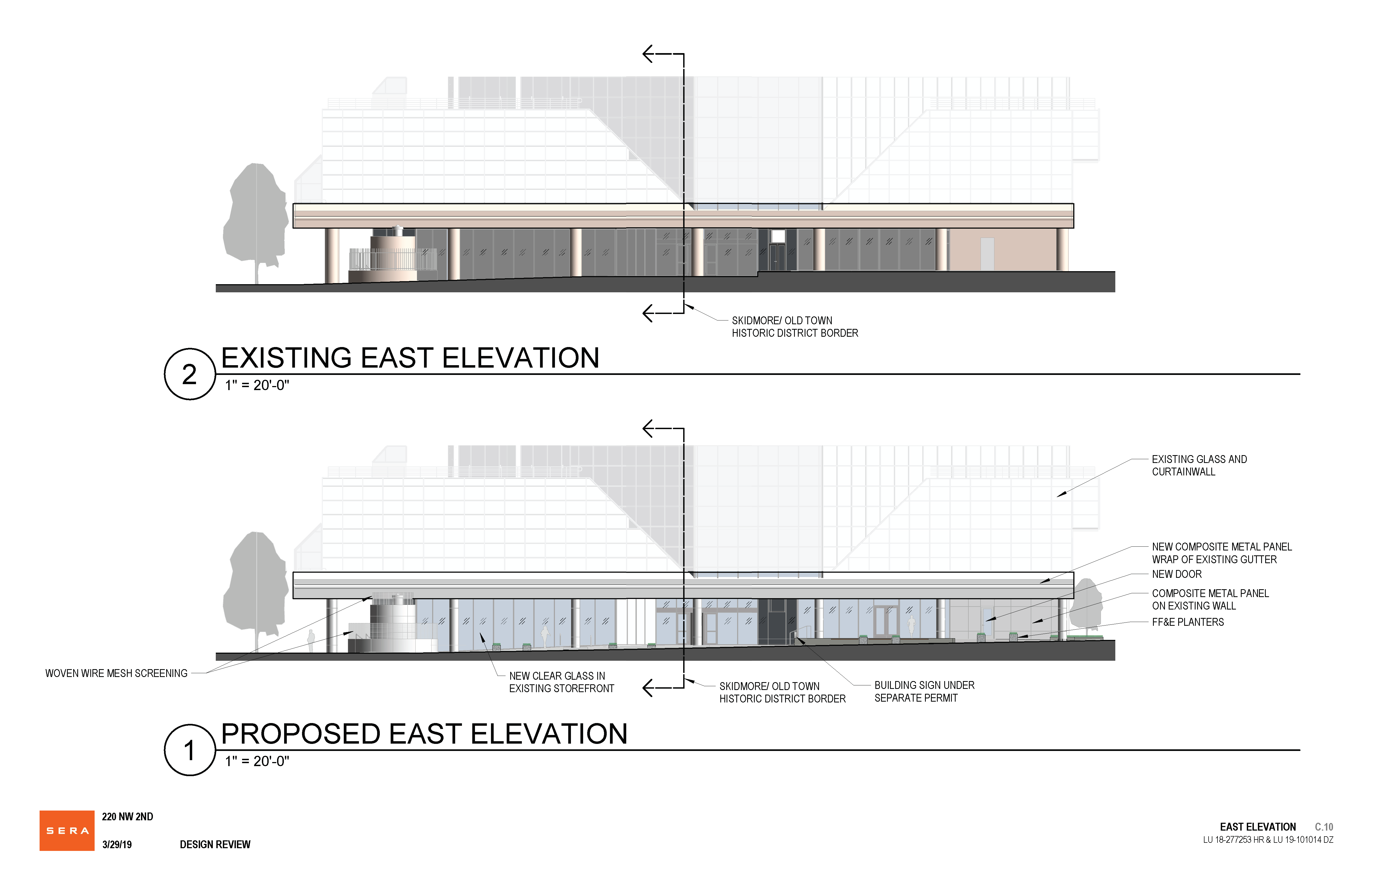

Slide 27
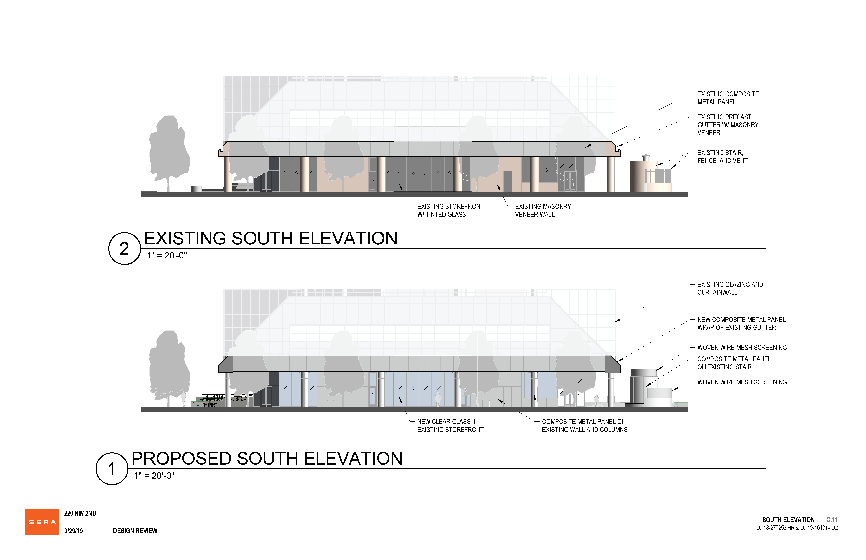

Slide 28
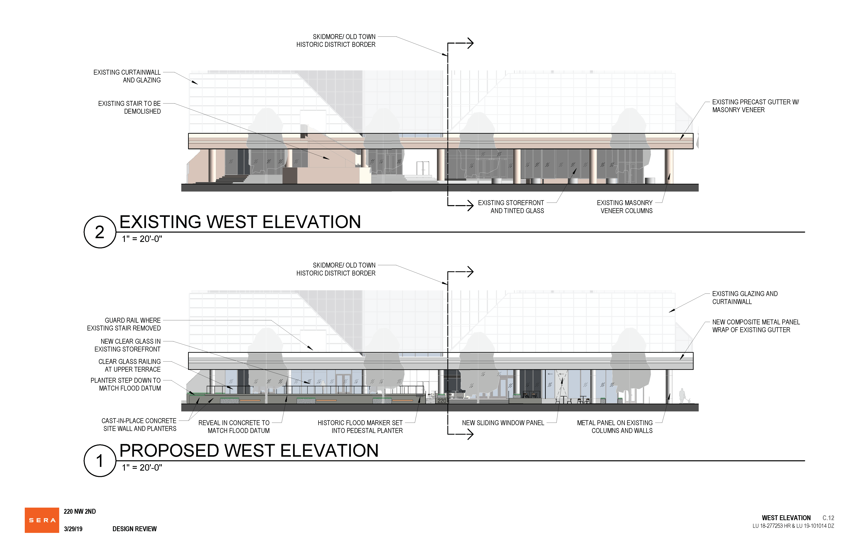

Slide 29
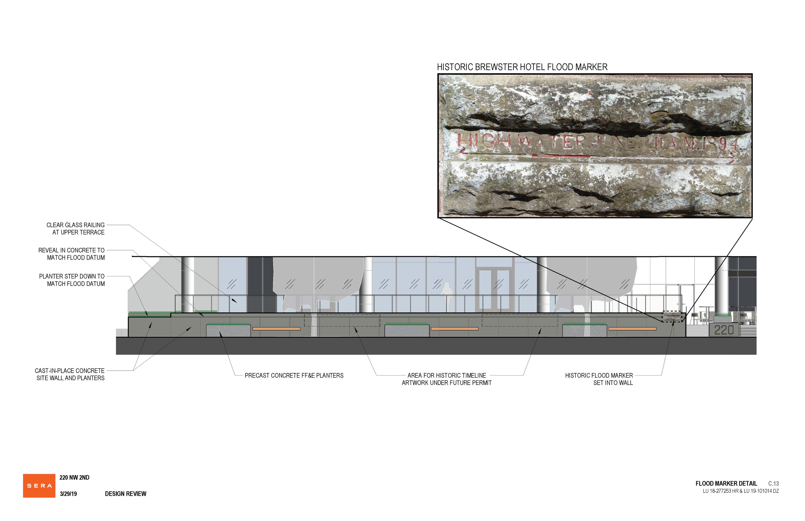

Slide 30
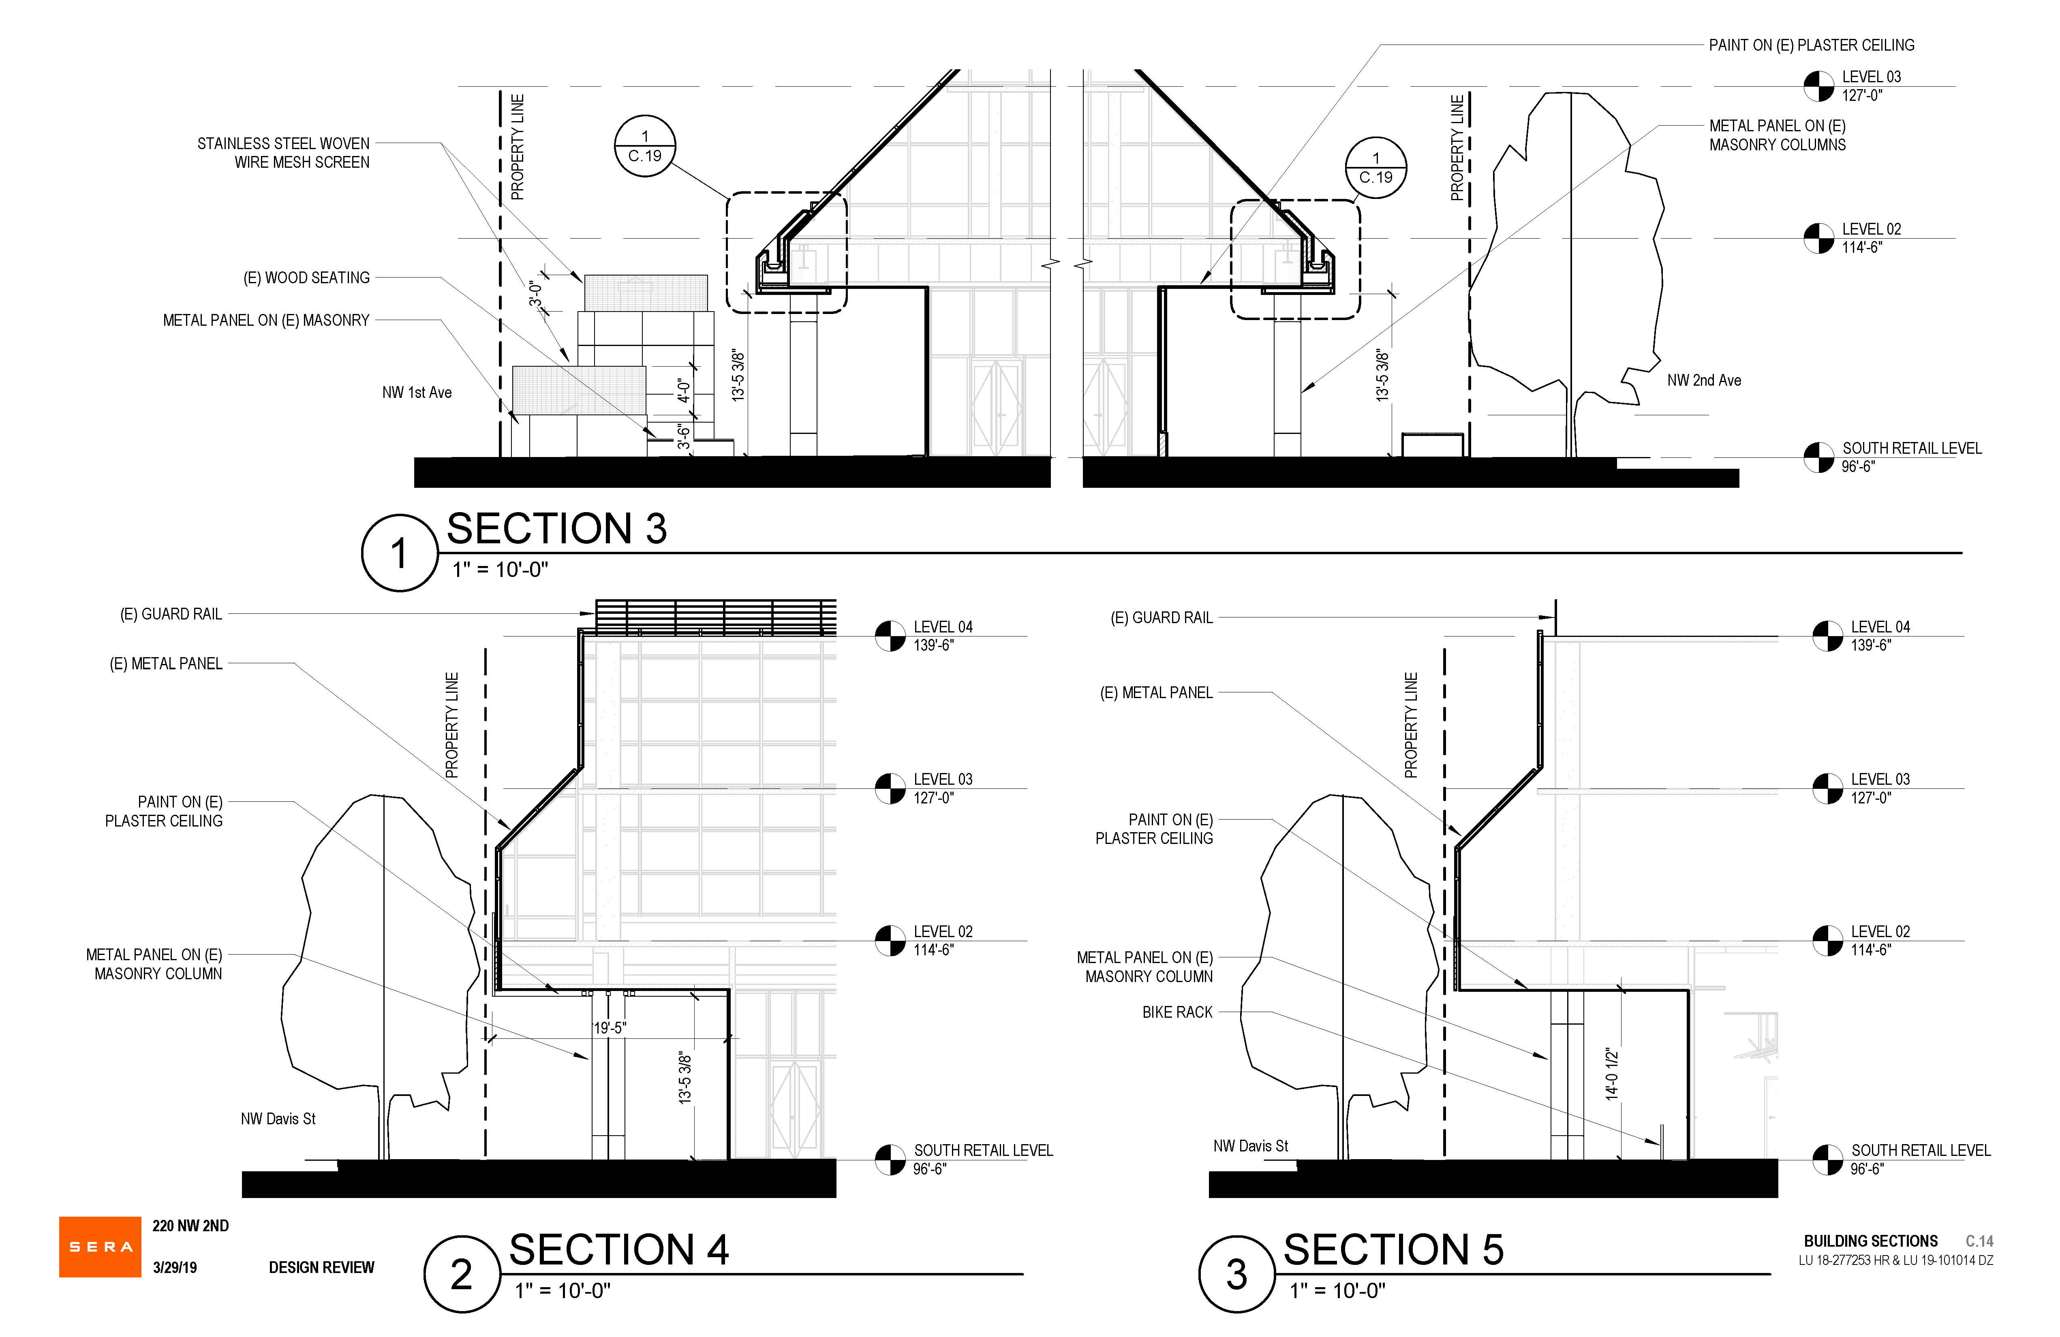

Slide 31
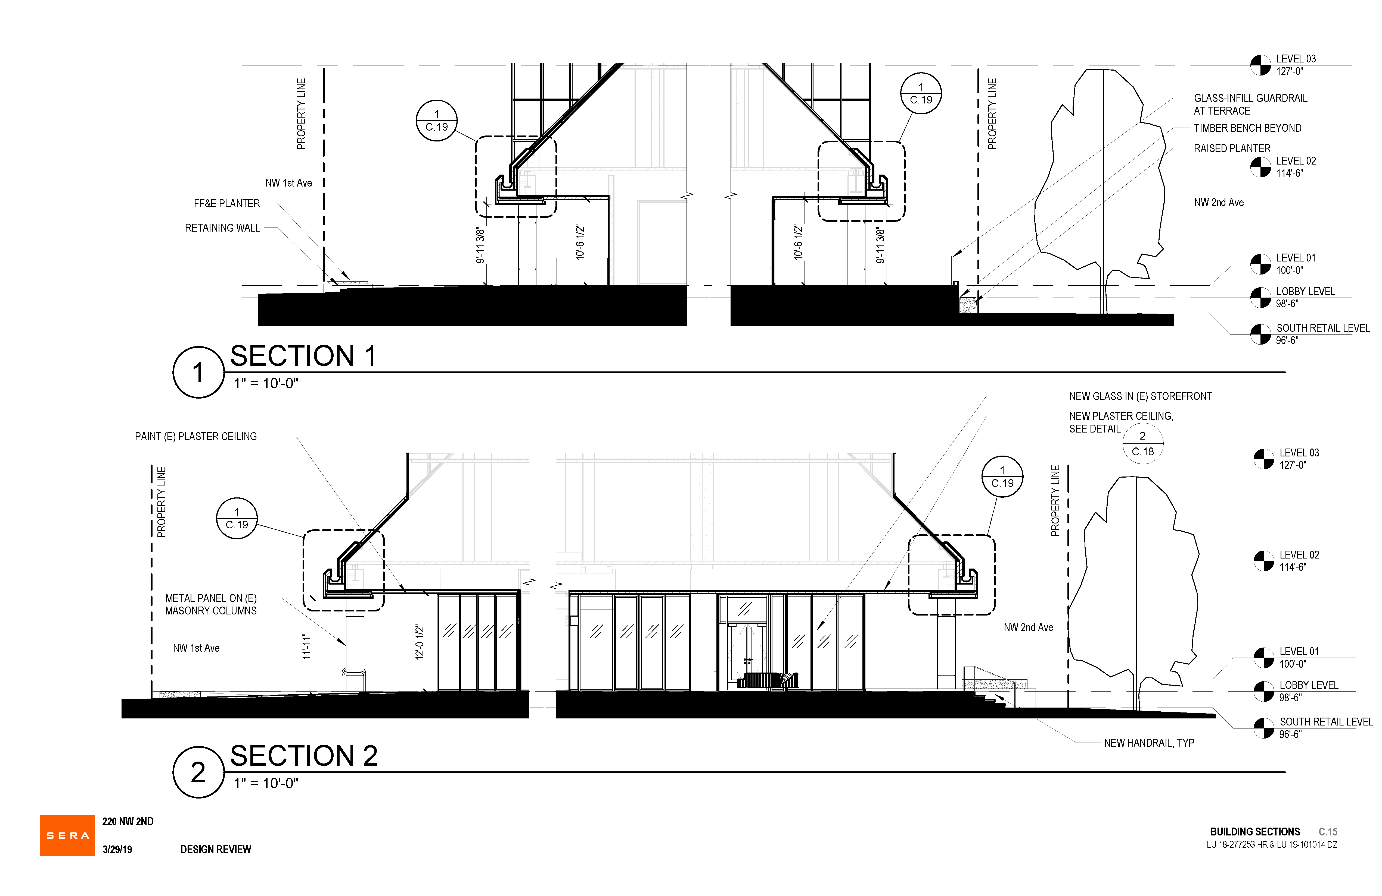

Slide 35
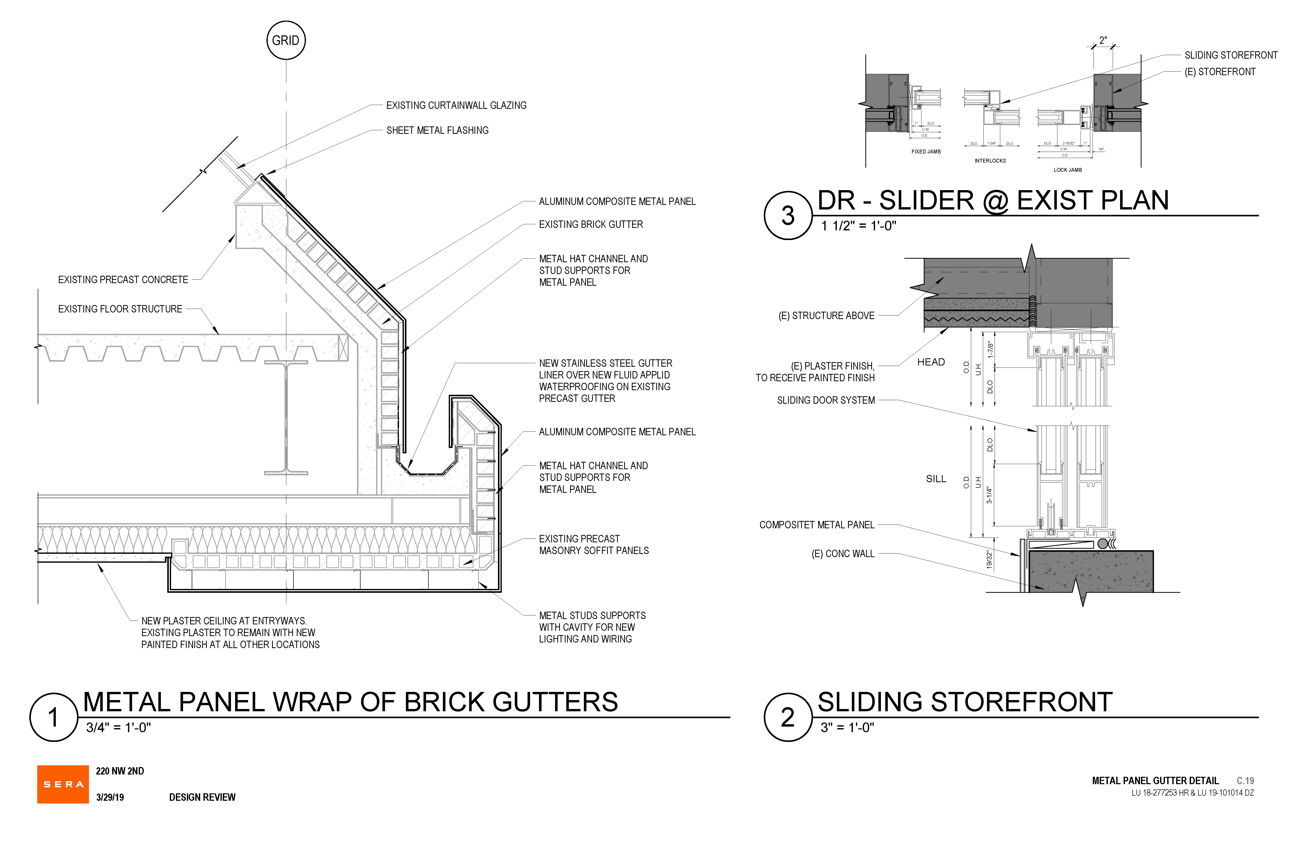

Slide 36
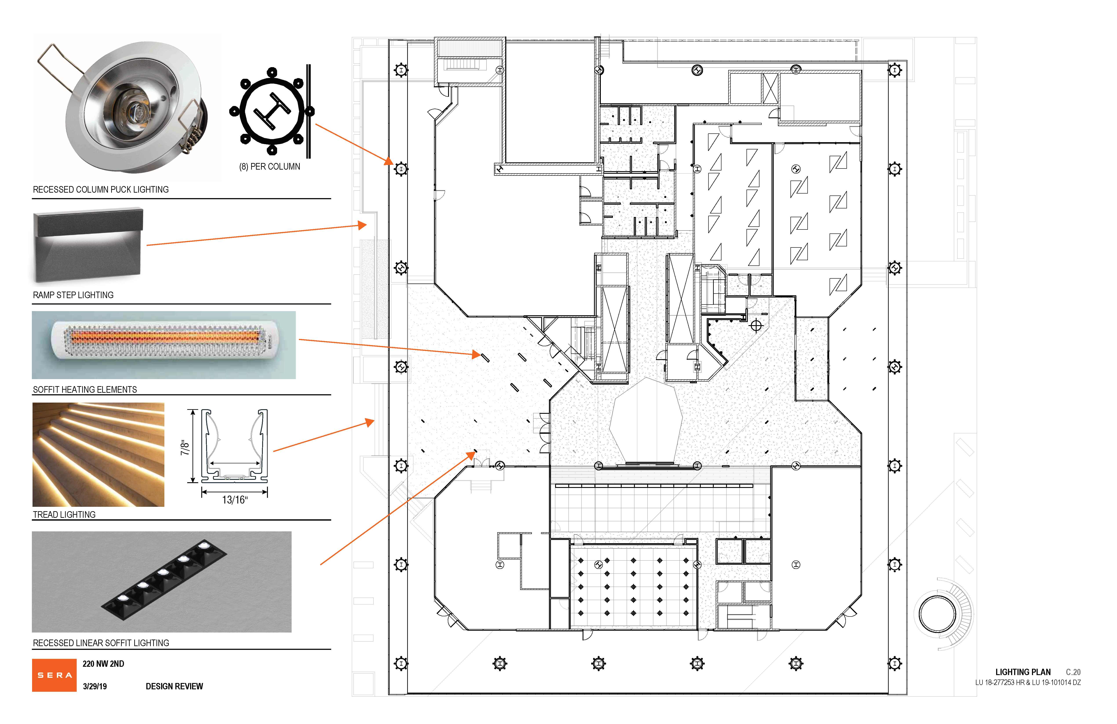

Slide 40
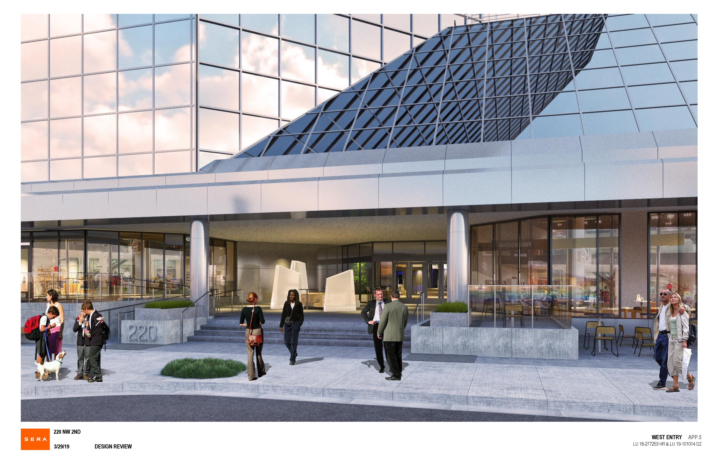

Slide 41
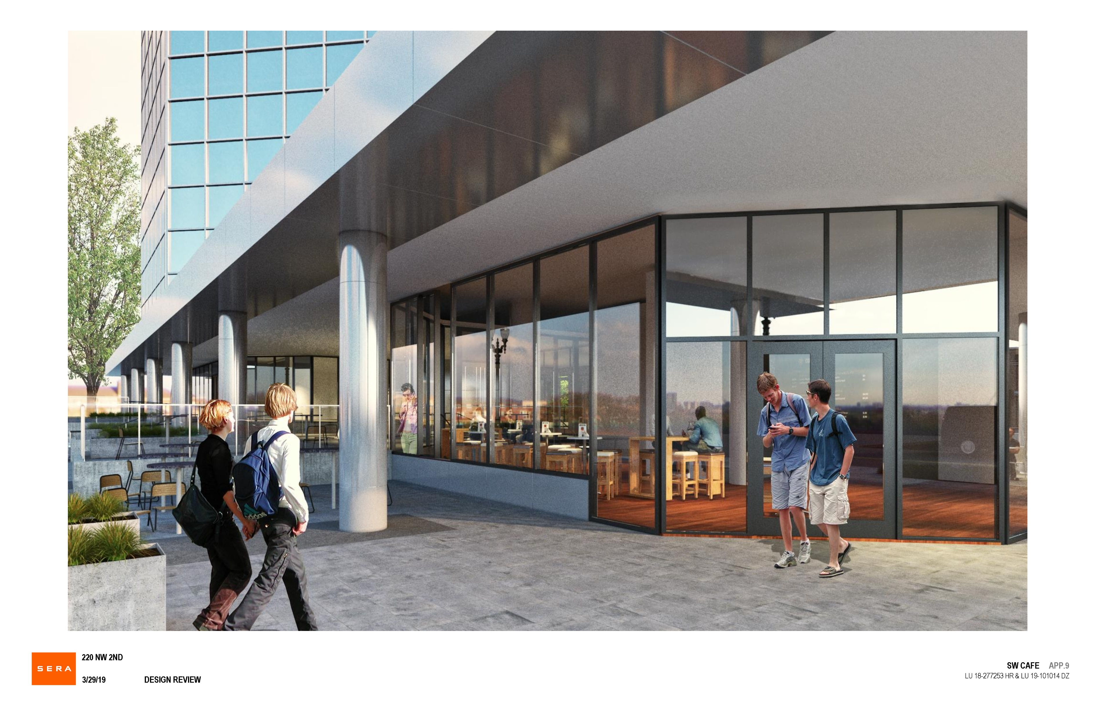

Slide 42
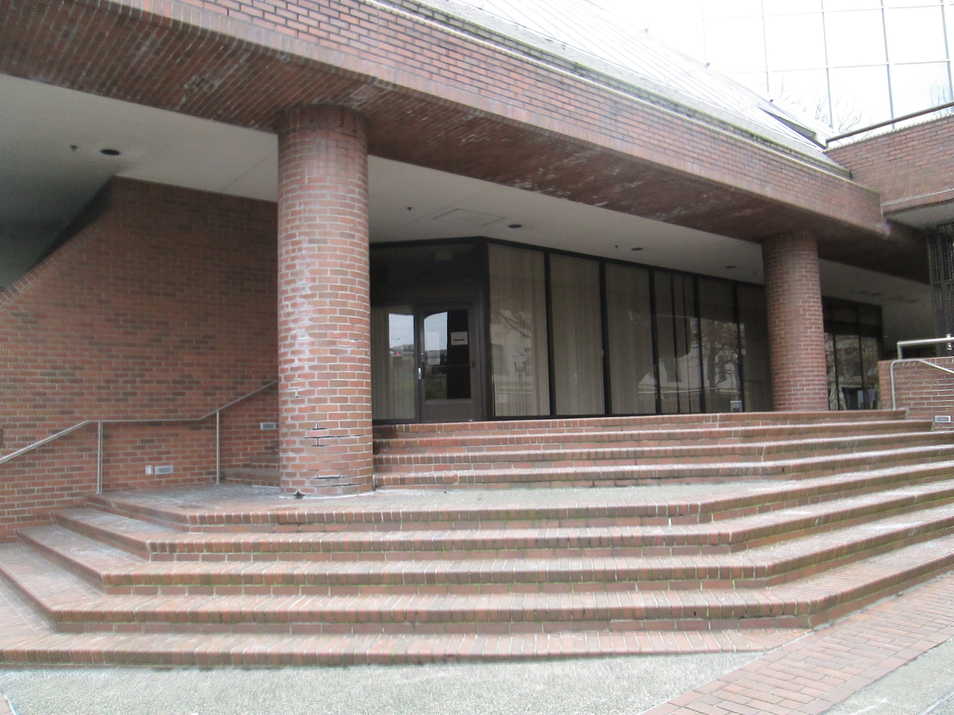

Slide 43
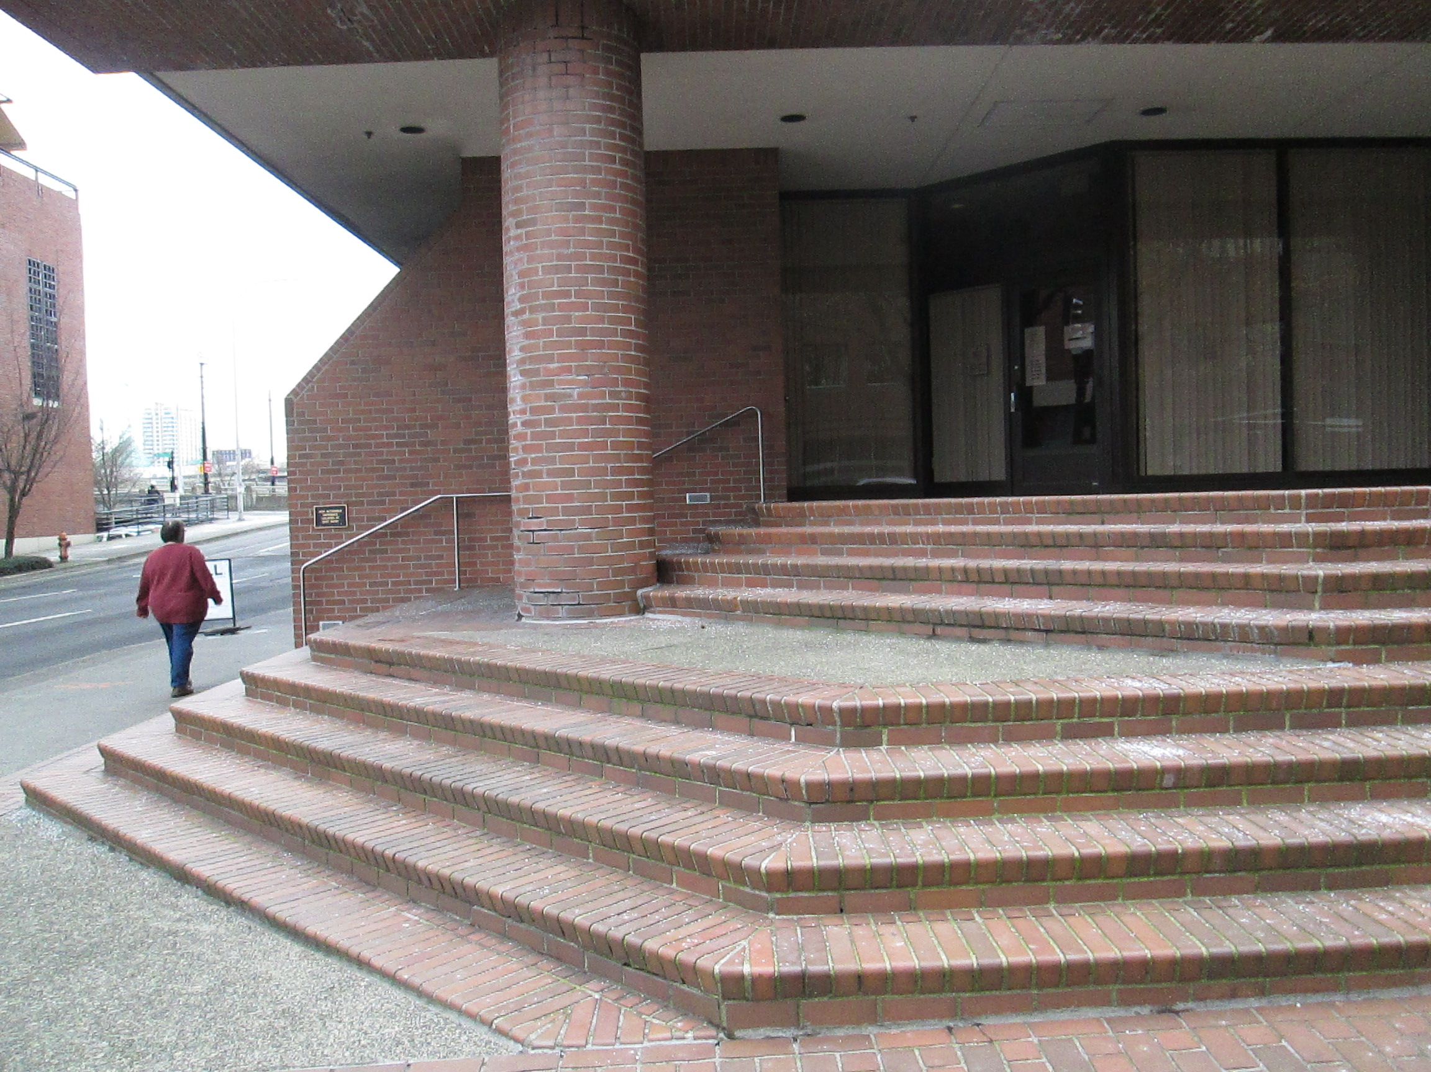

Slide 44
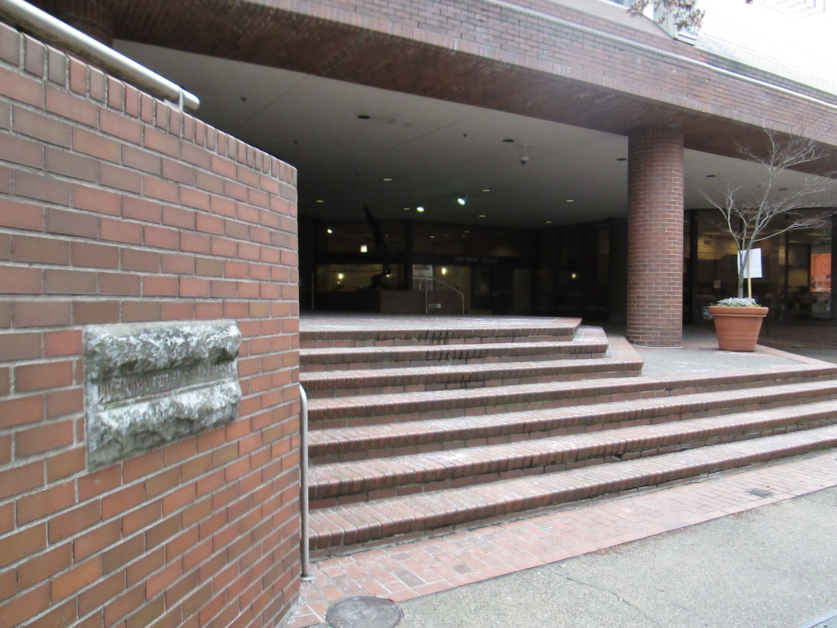

Slide 45
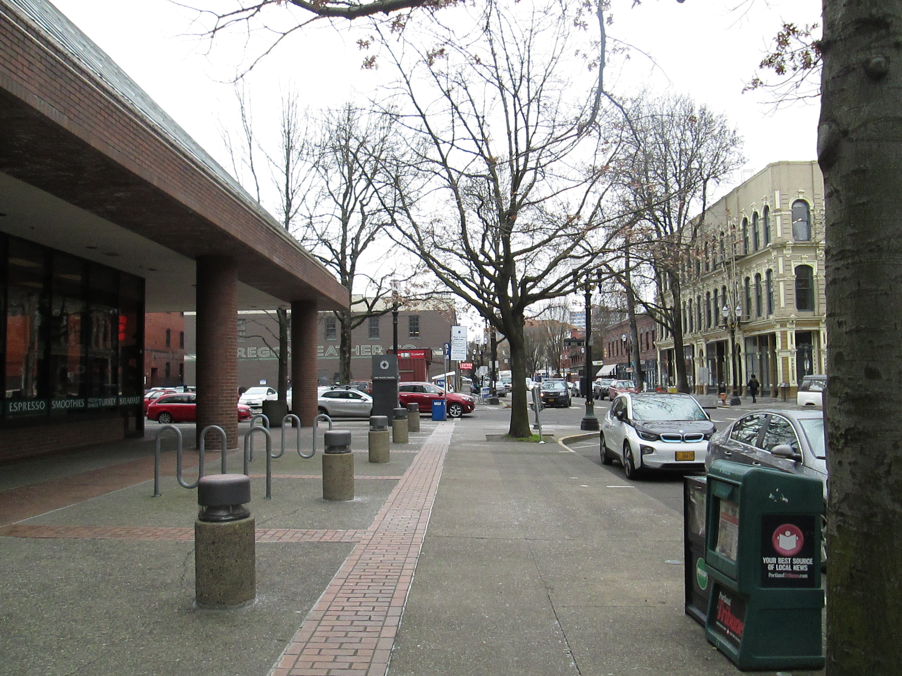

Slide 46
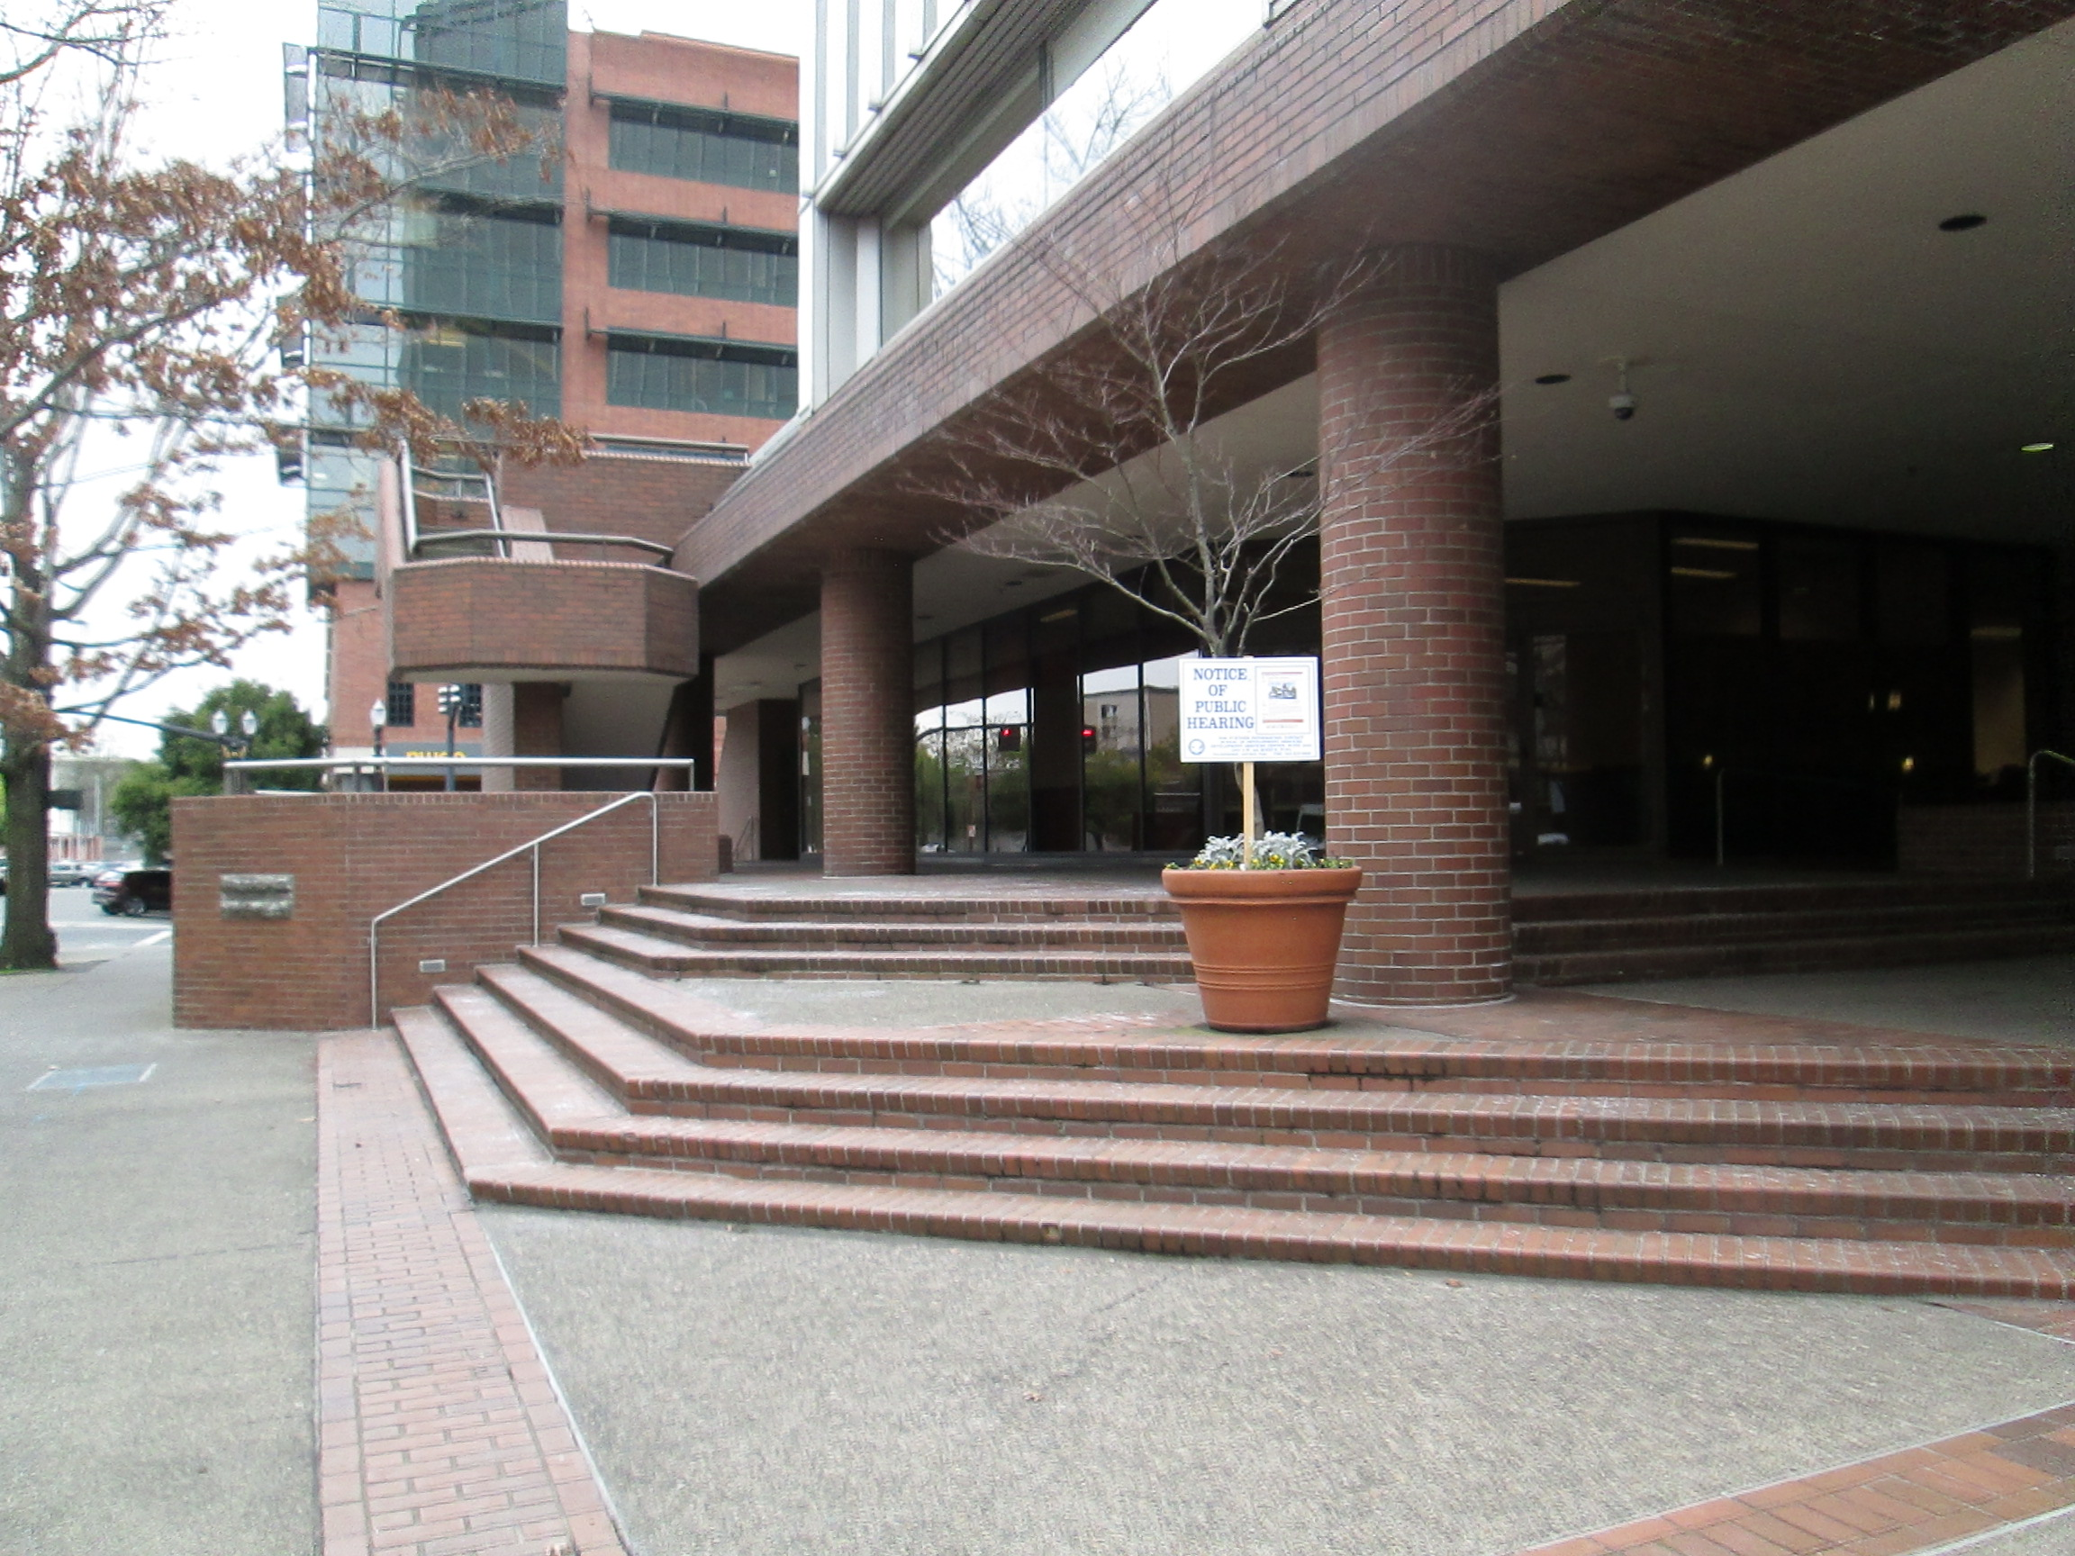

Slide 47
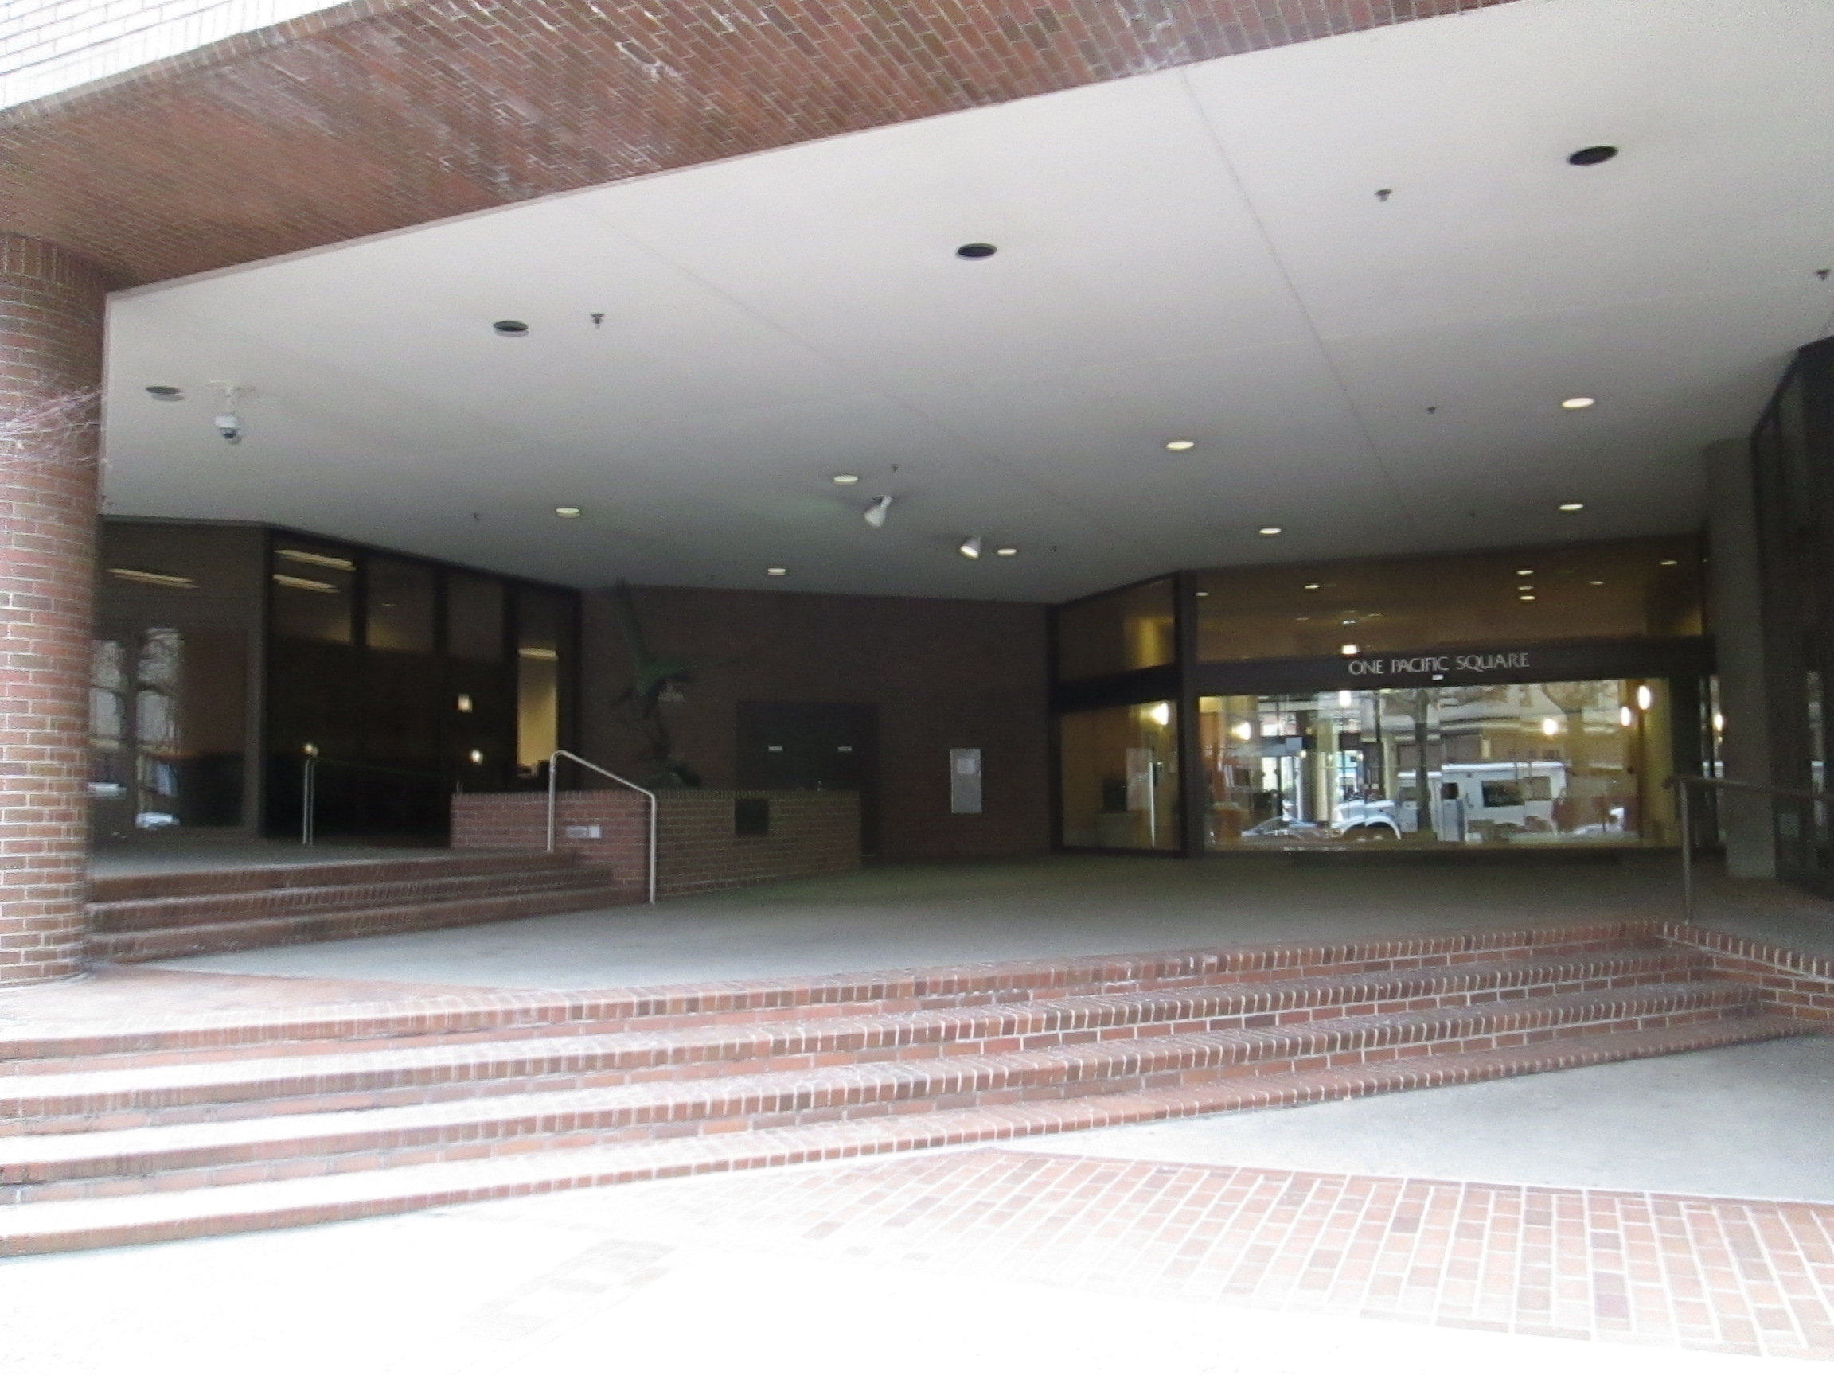

Slide 48
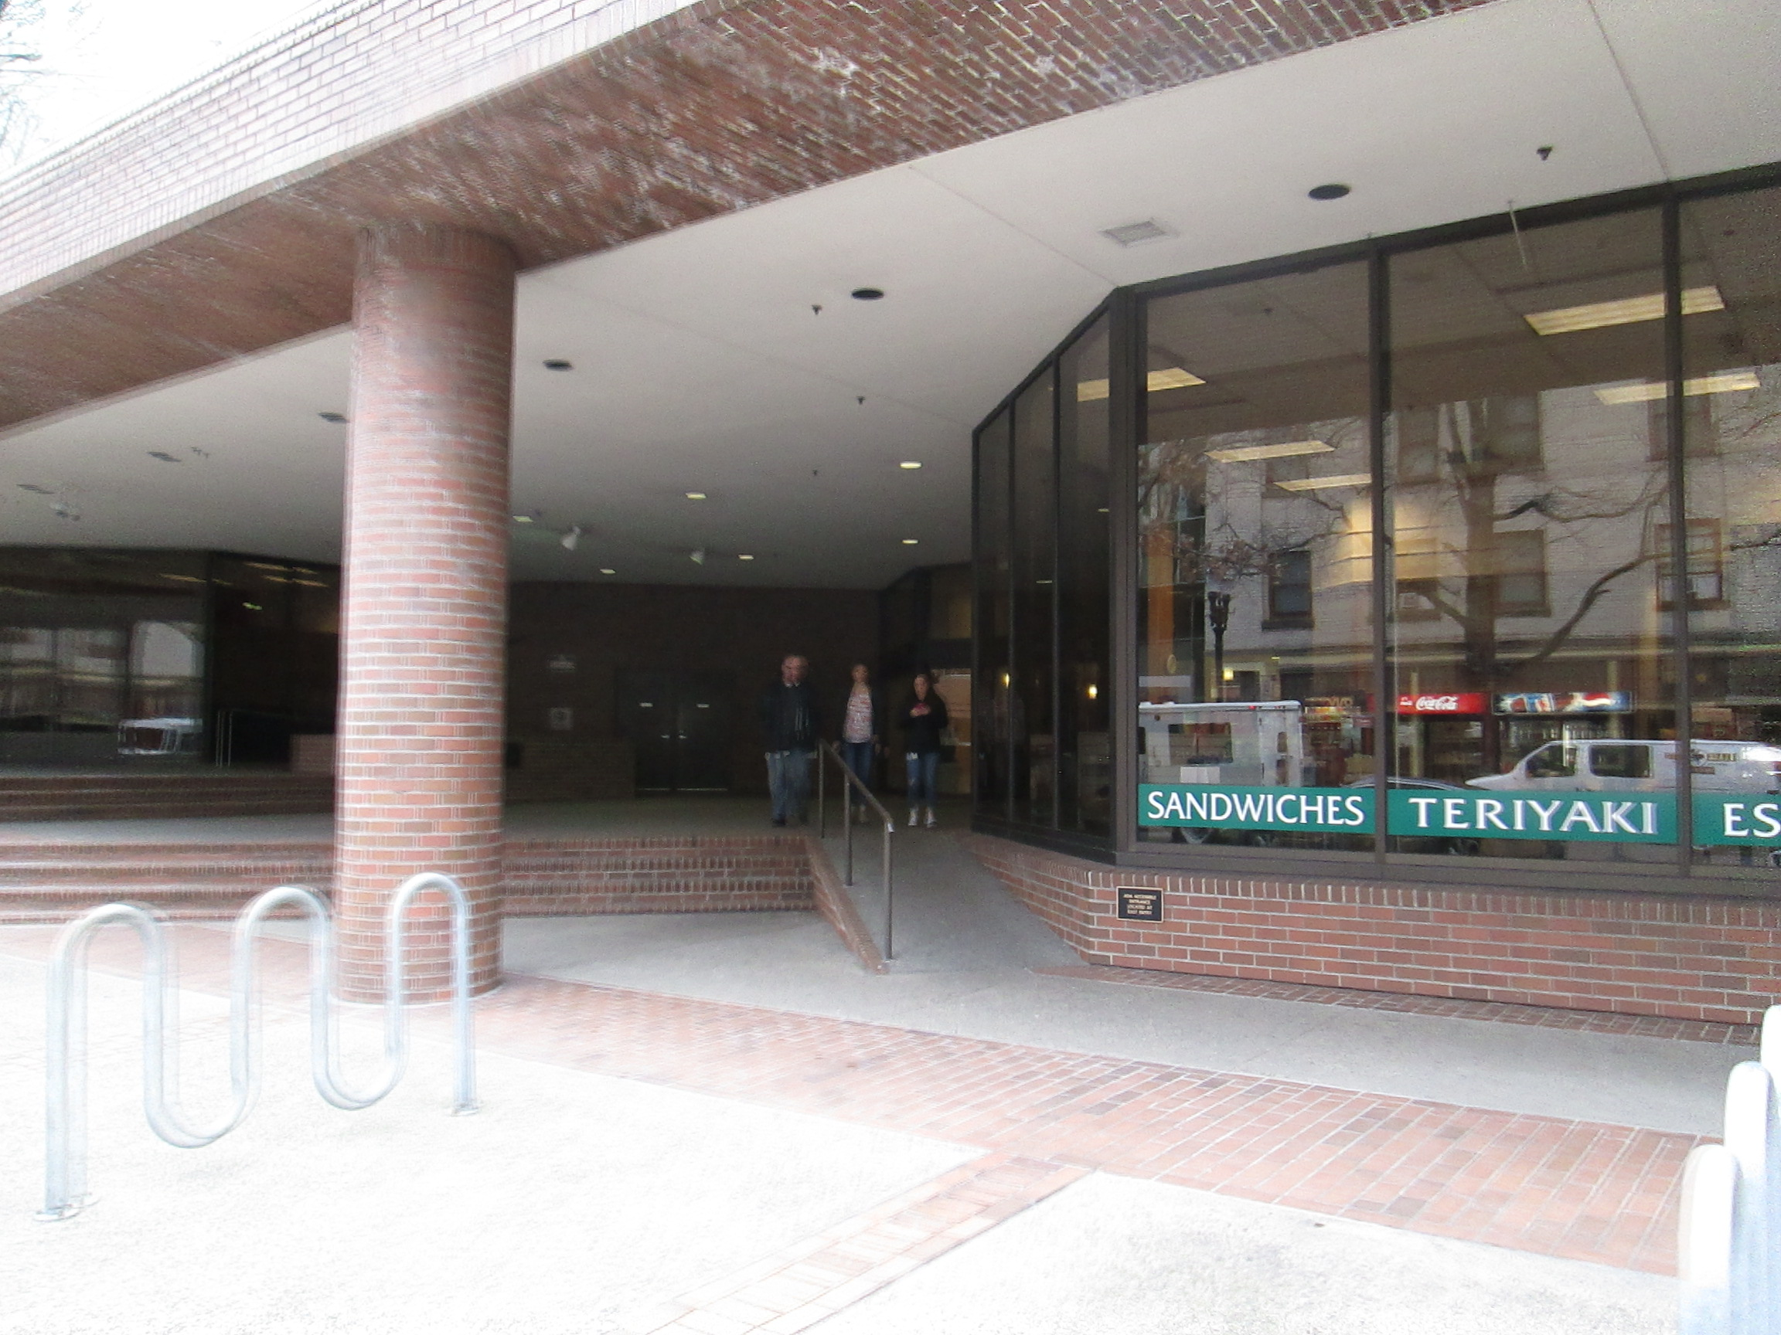

Slide 49
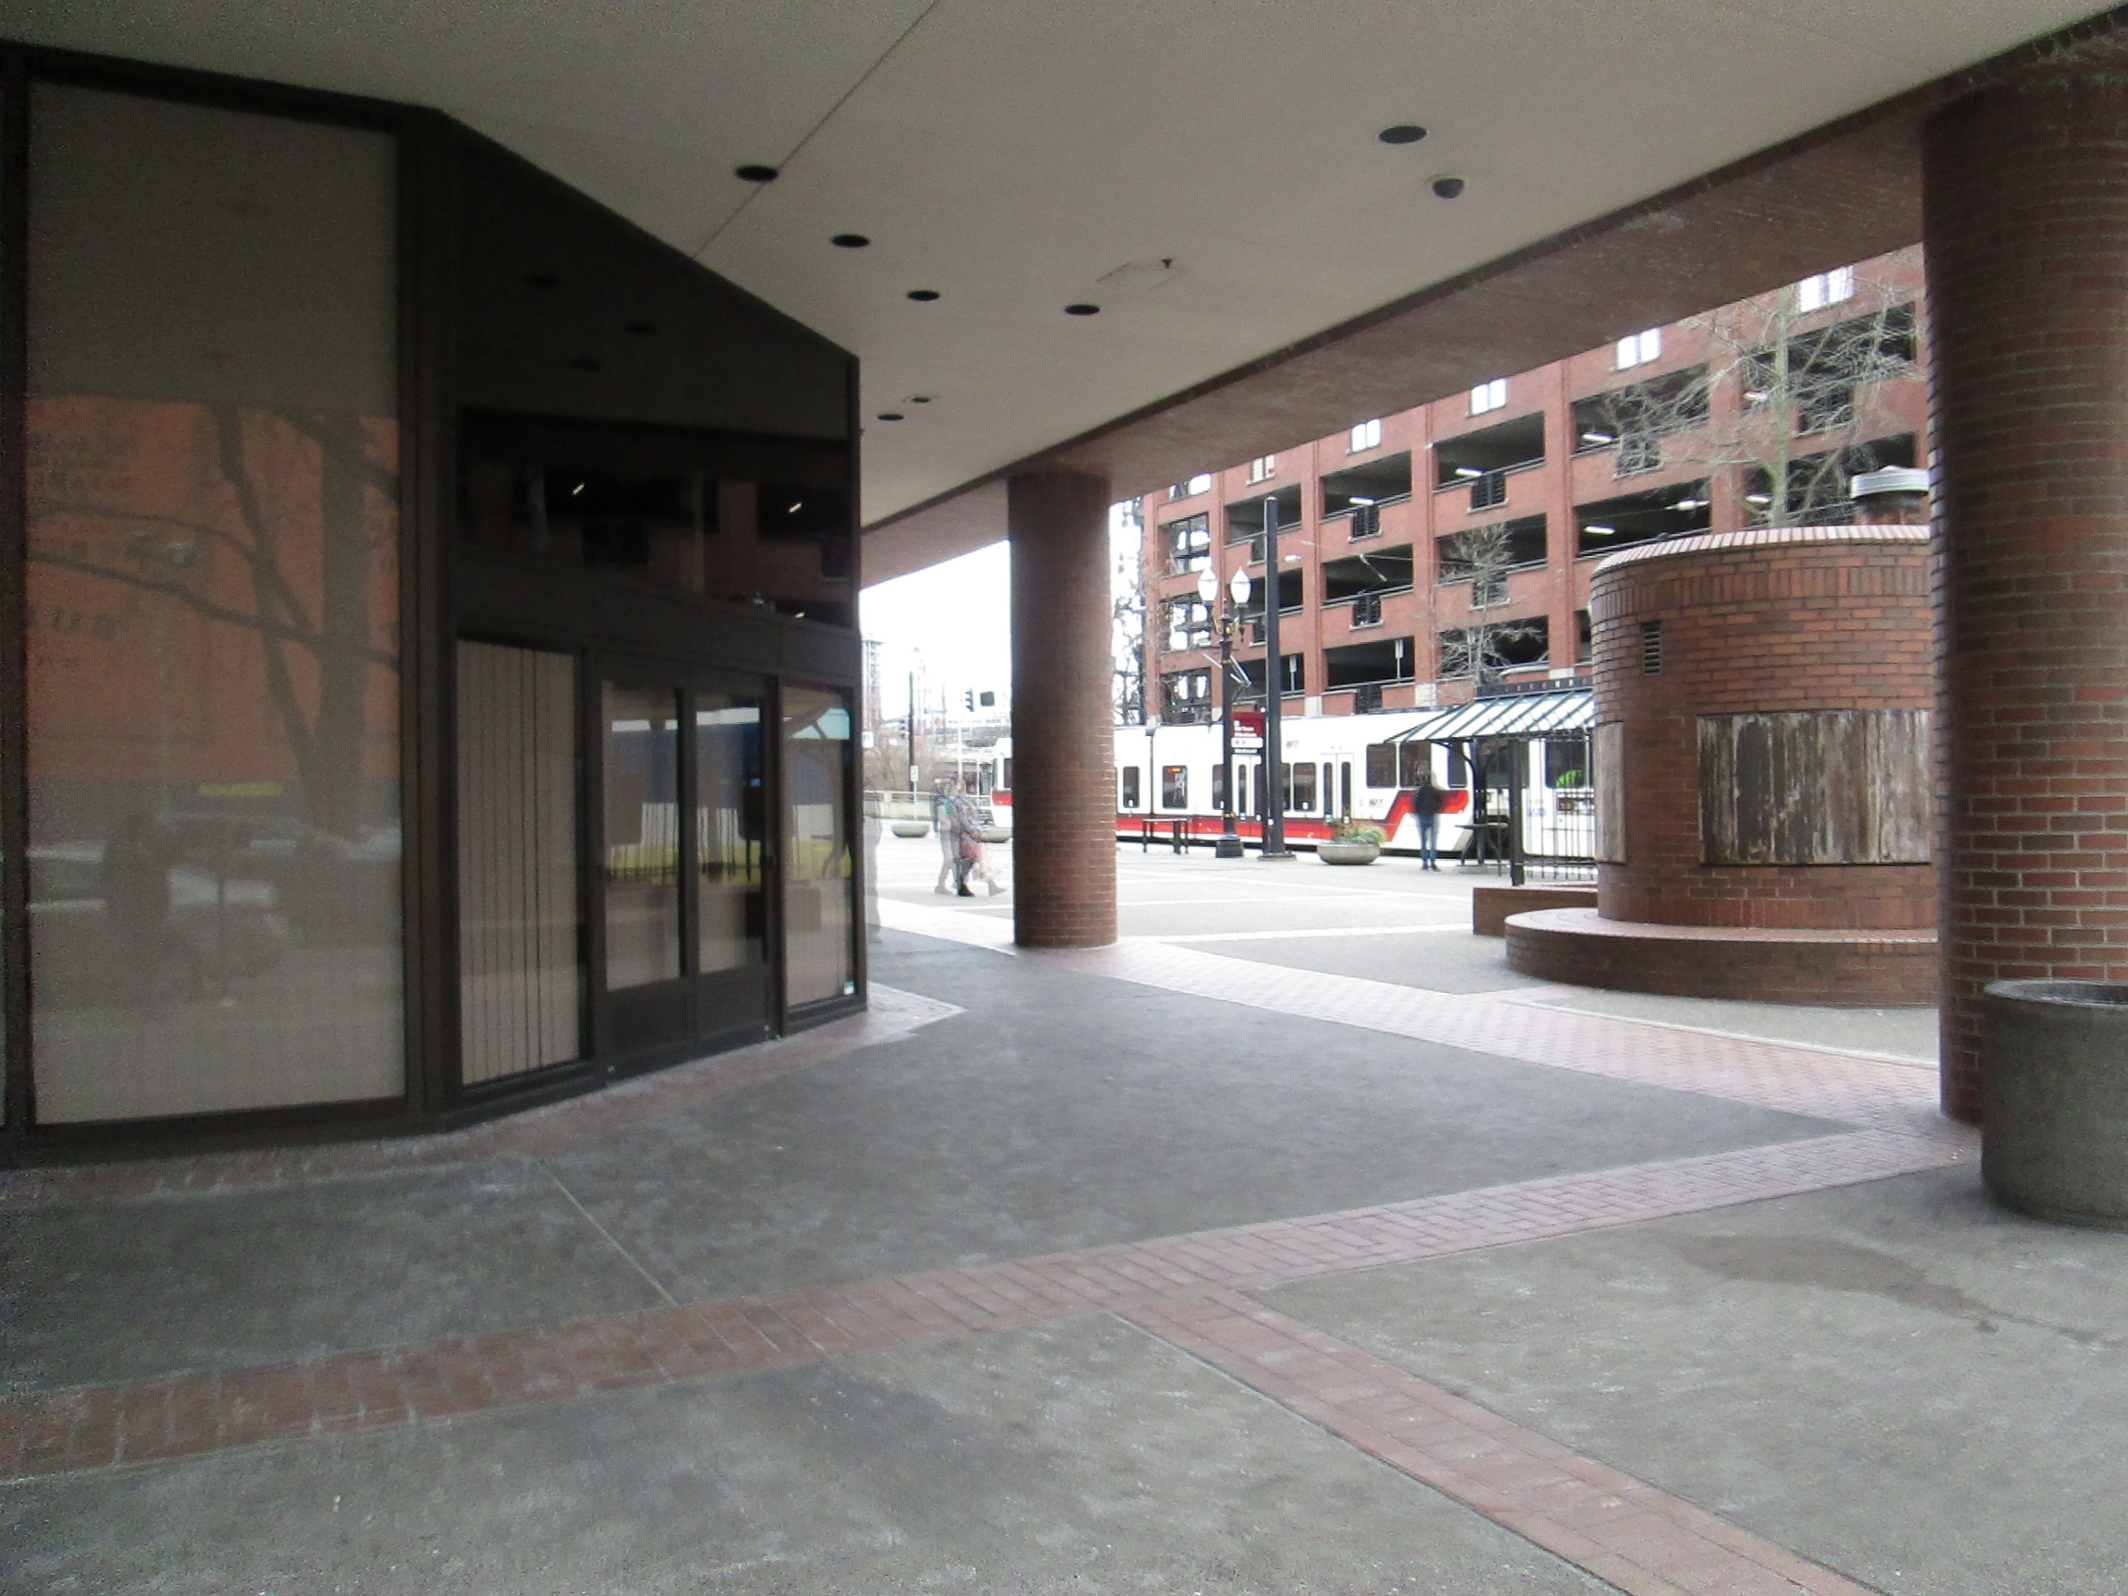

Slide 50
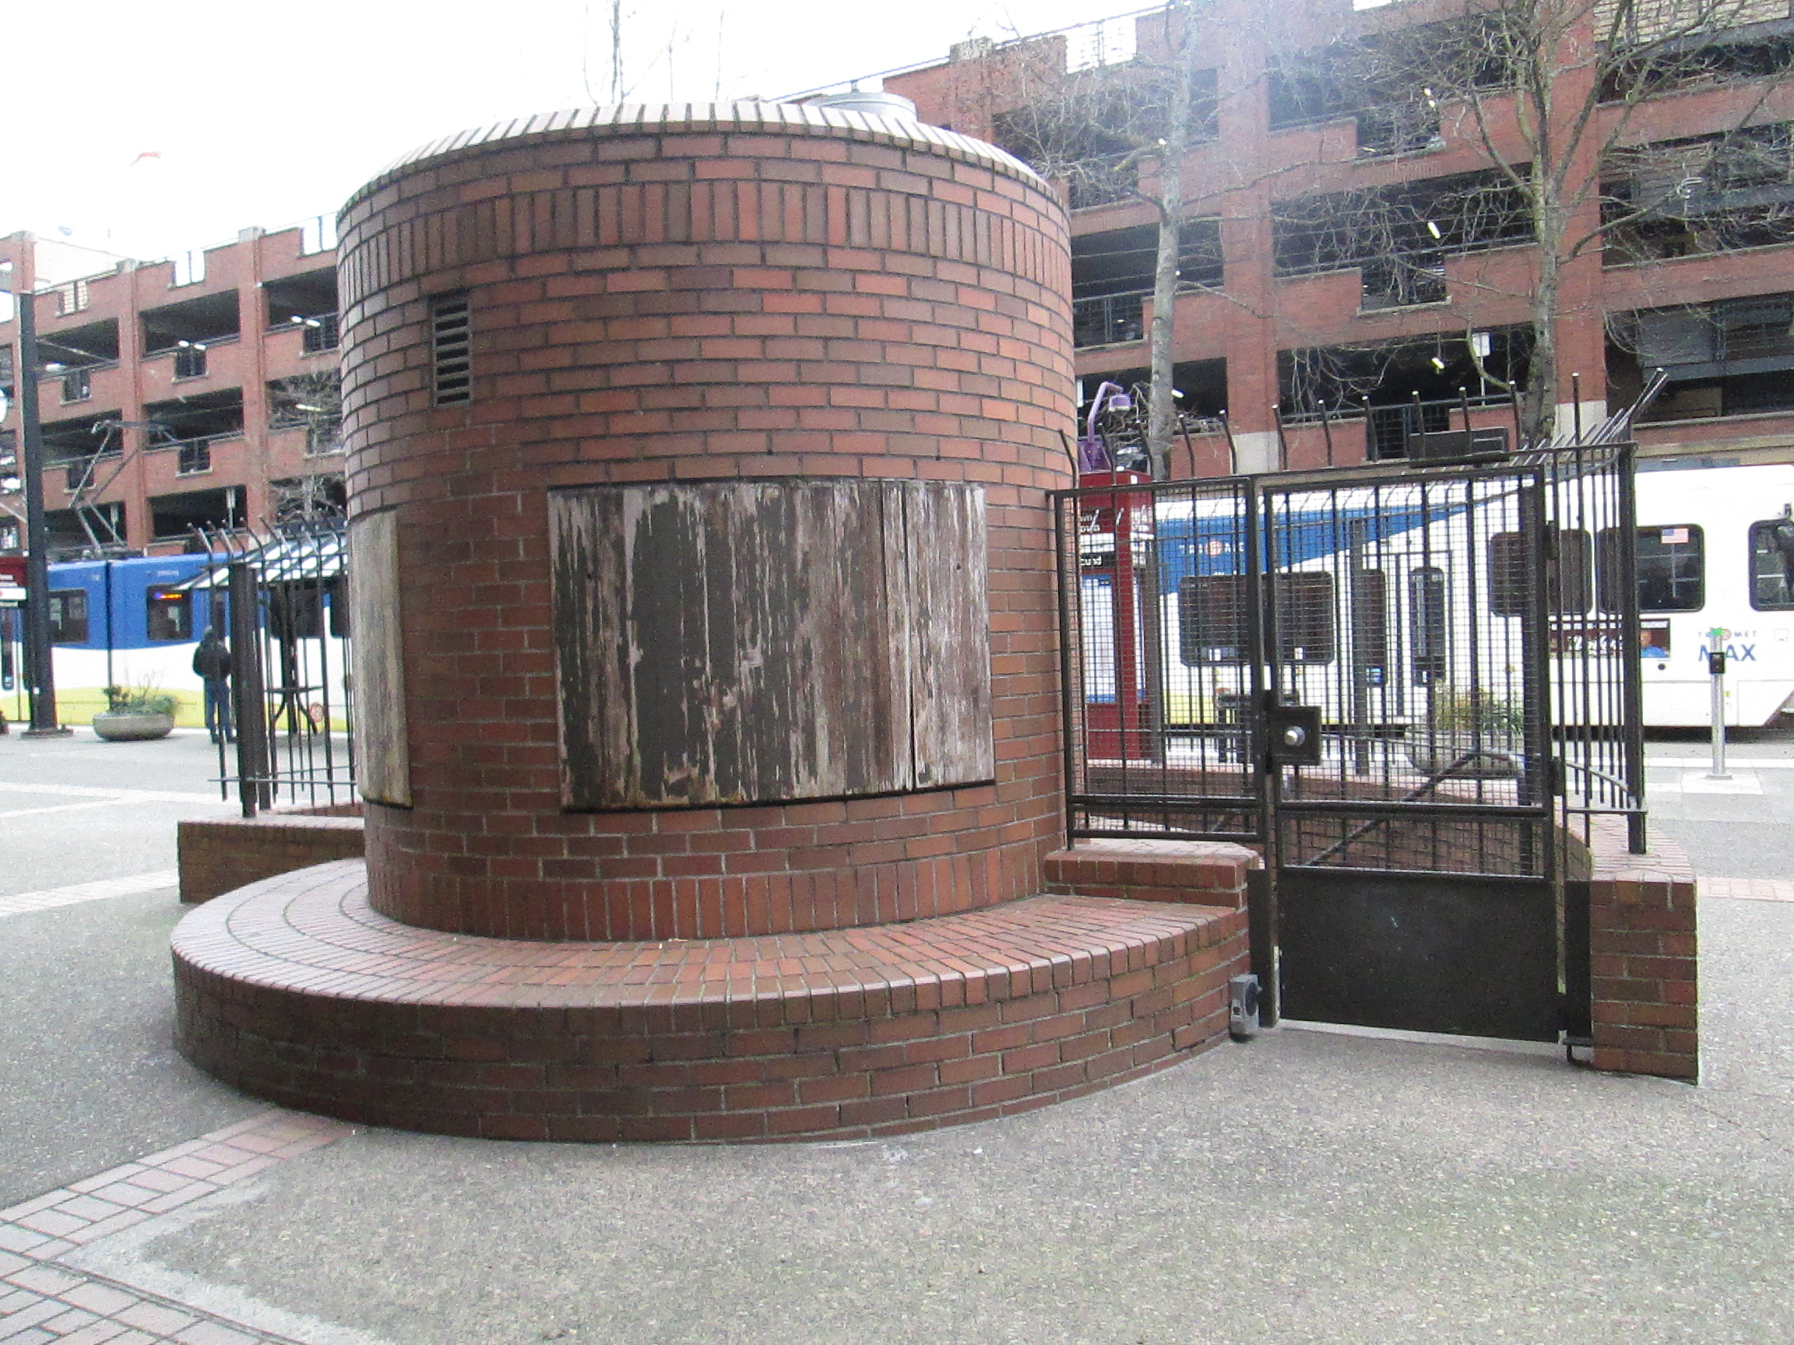

Slide 51
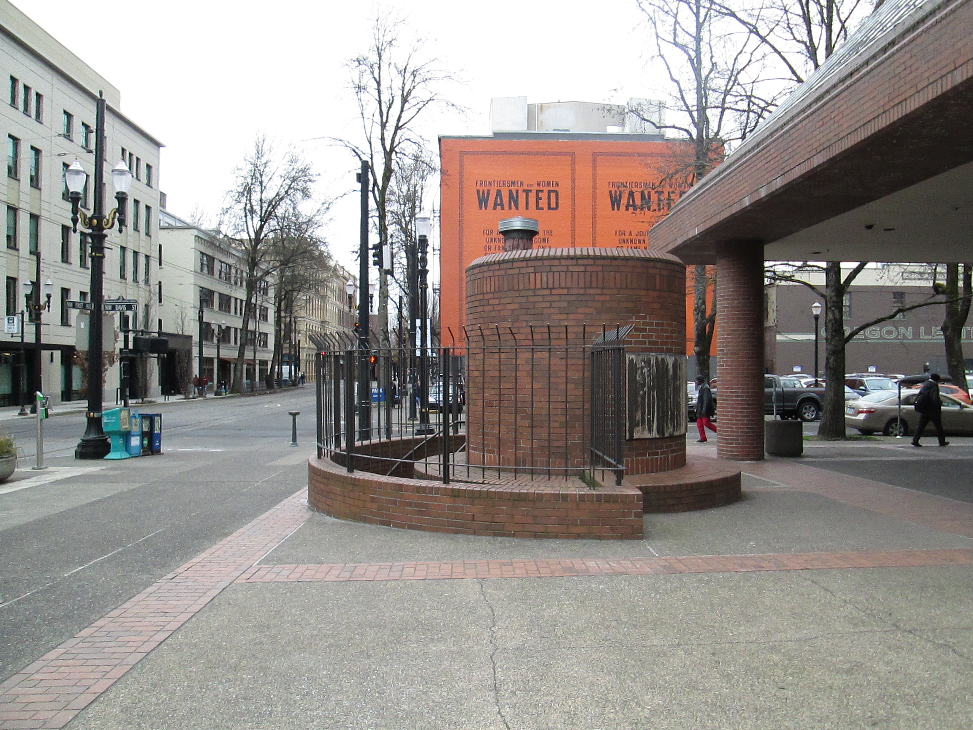

Slide 52
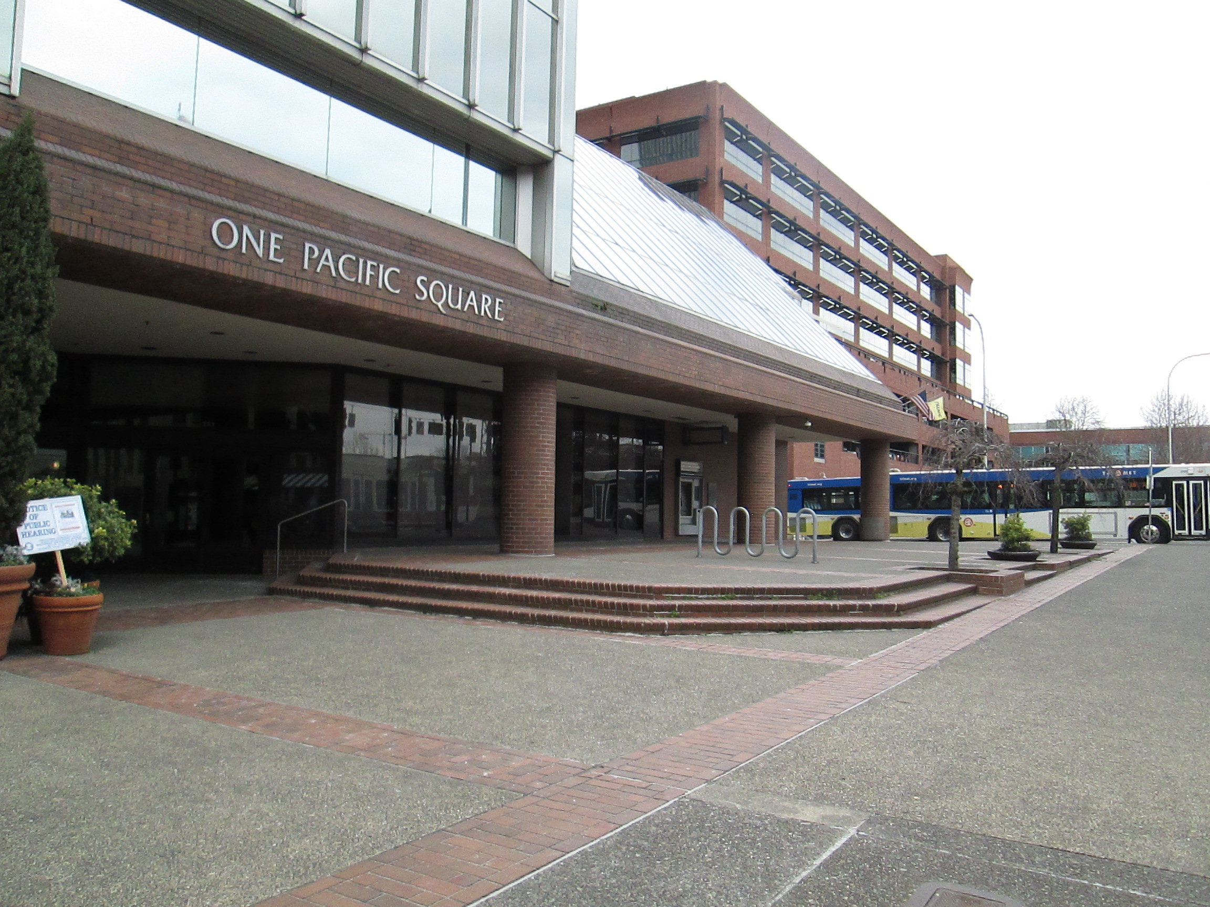

Slide 53
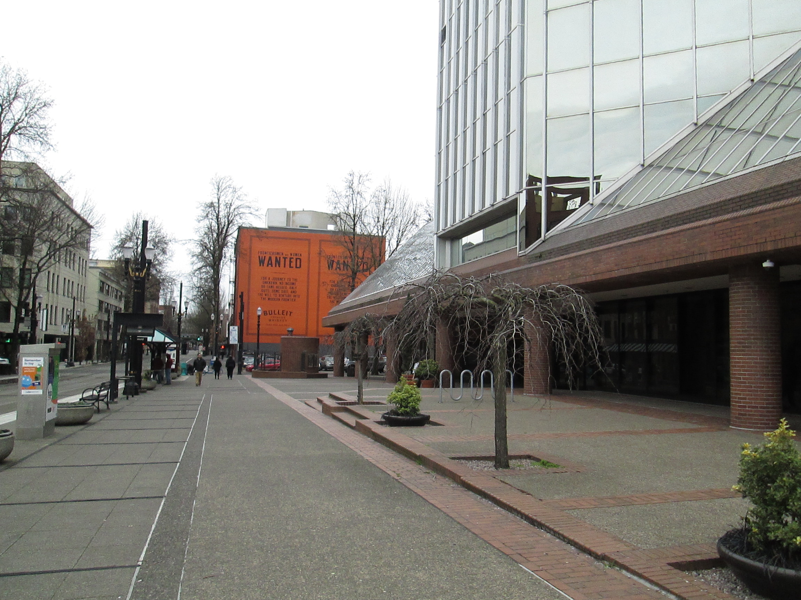

Slide 54
