Slide 1

City Council Briefing
Mary Hull Caballero
City Auditor
Data Loss Prevention
(November 2018)
Restoration Projects and Green Streets
(December 2018)
Homeless Camp Cleanups
(March 2019)

Slide 2

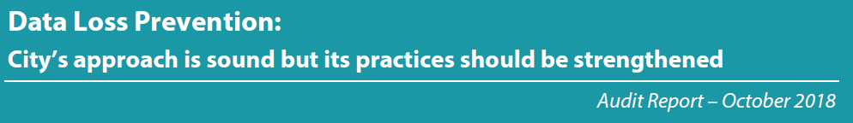
Data Loss Prevention
Assessed Bureau of Technology Services overall approach to data security
Reviewed data security practices at Bureau of Human Resources

Slide 3


Data Loss Prevention
Policies and procedures
Hard copy data protection
Access controls
Intrusion detection

Slide 4

Data Loss Prevention
Overall, City’s approach to data loss prevention is sound
27 recommendations to reduce the risk of data losses

Slide 5
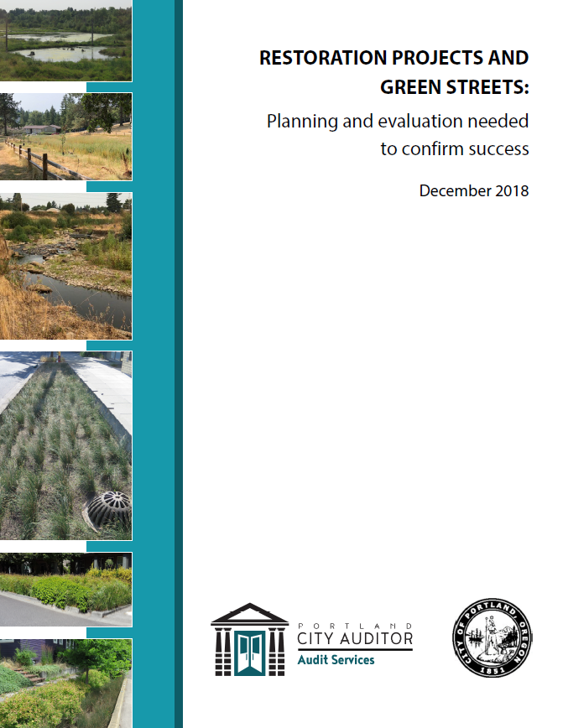






Restoration & Green Streets
Improve water quality
Restore wildlife habitat
Prevent flooding
$13million

Slide 6
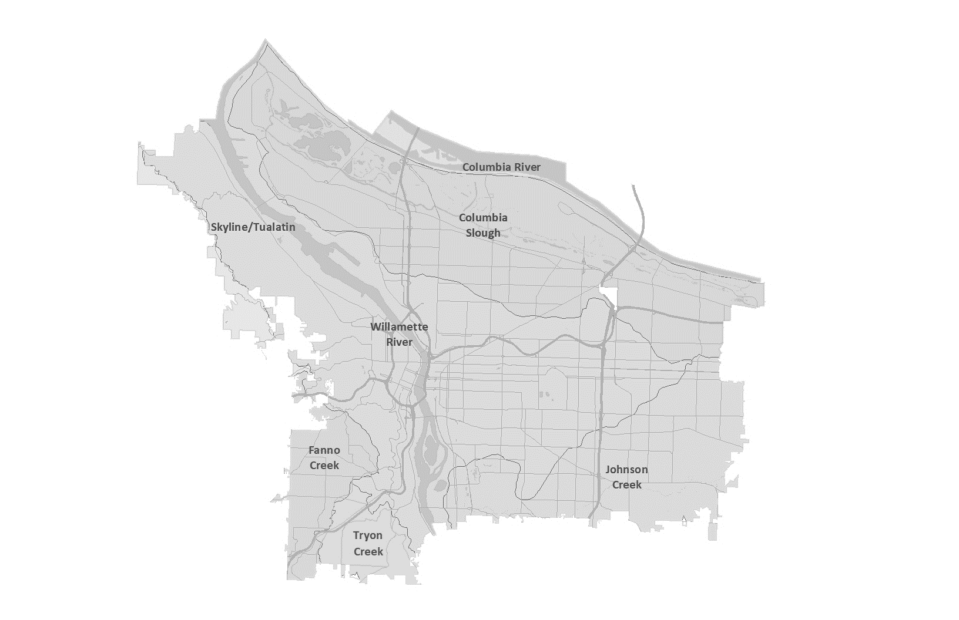
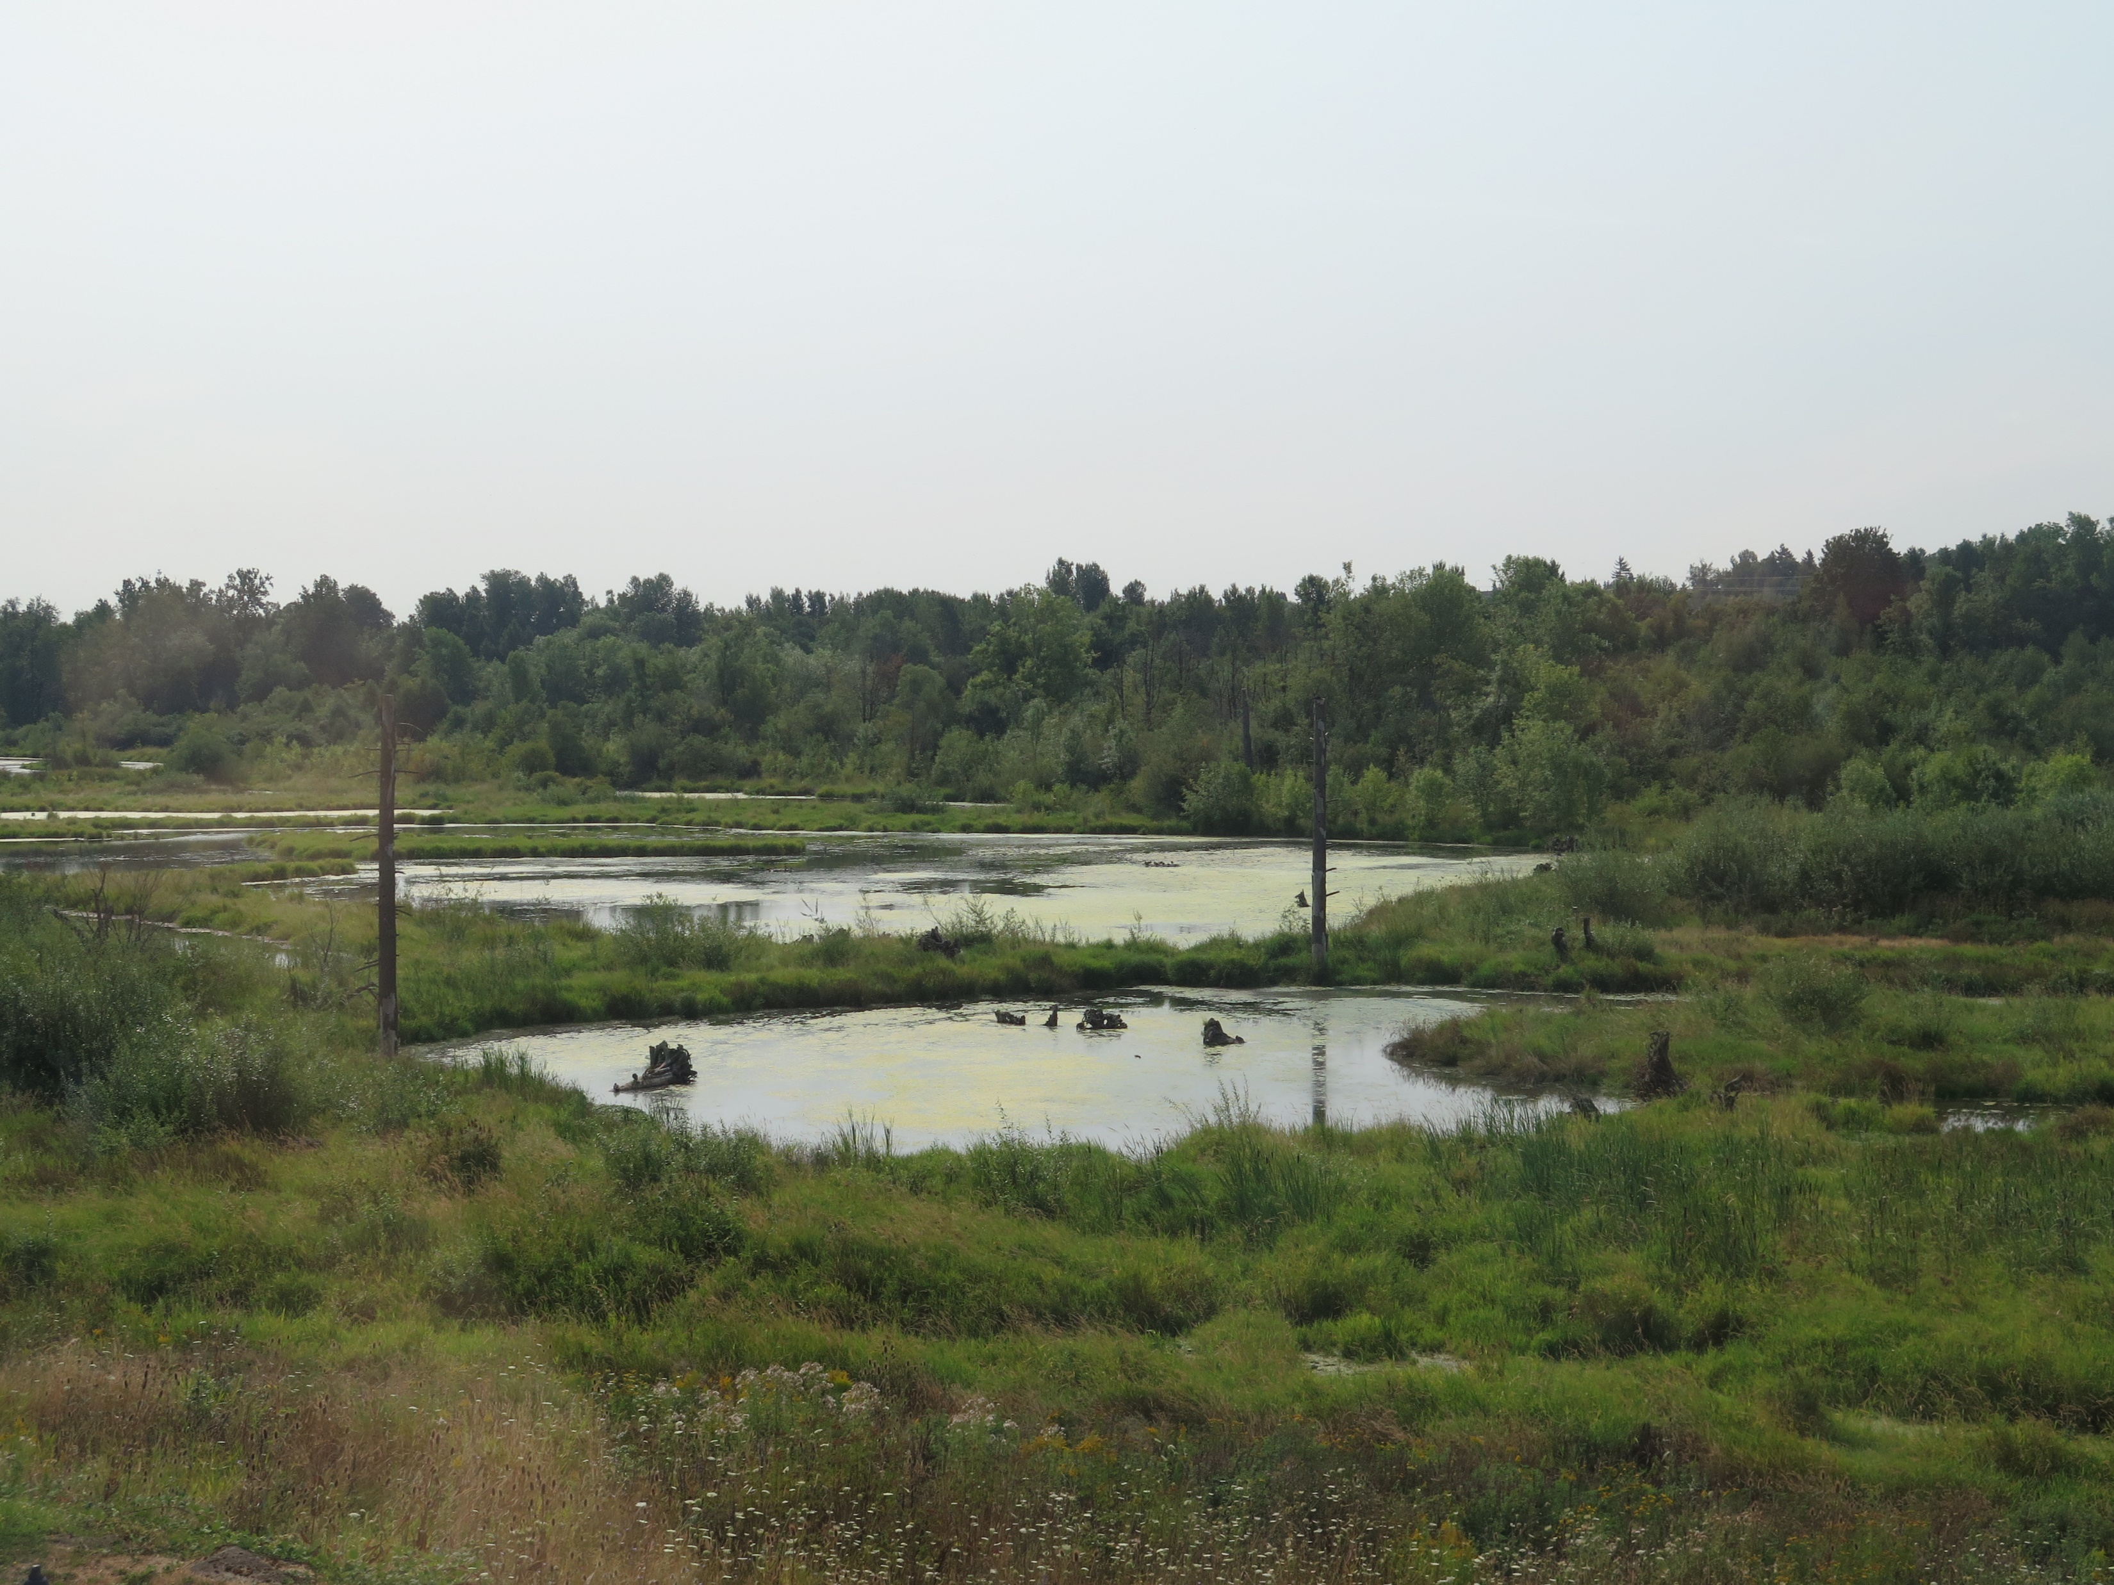
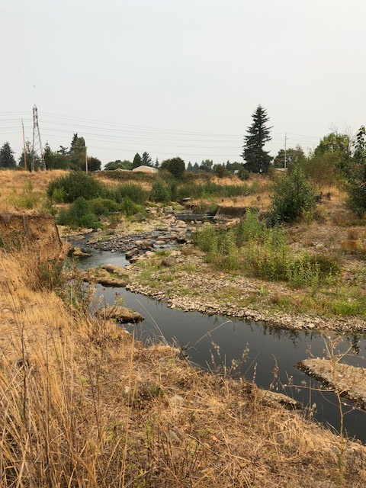
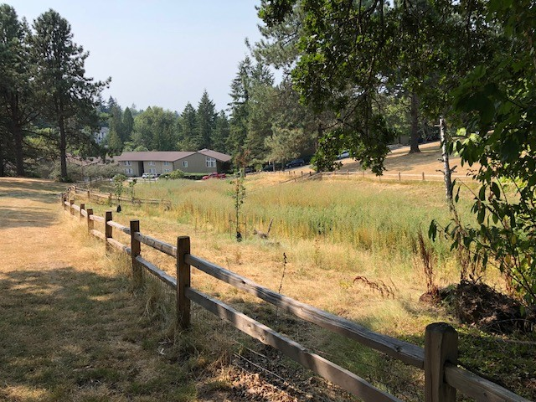
Restoration & Green Streets
Portland ↑N
Mason Flats
Luther Road
Albert Kelly Park

Slide 7
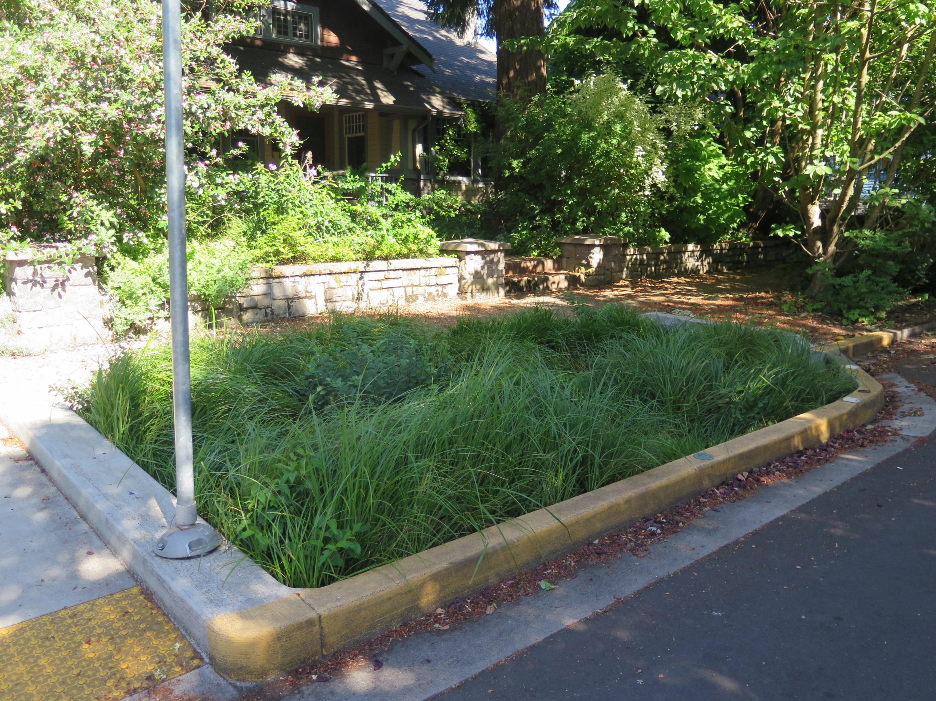
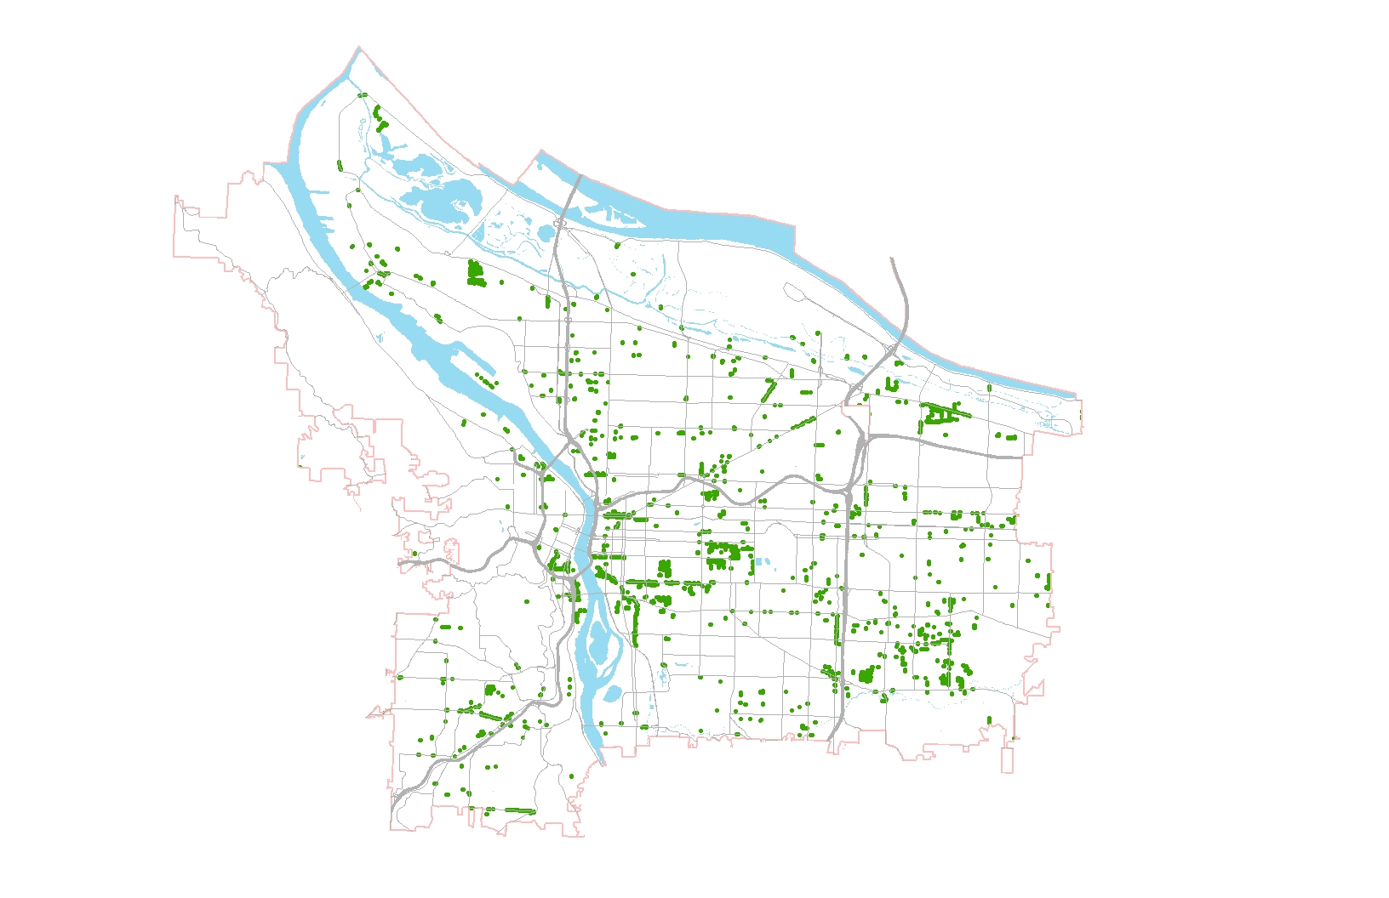
Restoration & Green Streets
Portland ↑N

Slide 8



Restoration & Green Streets
Restoration projects and green streets may not have addressed the highest needs.
Planning document should
Be city-wide in scale
Define risks
Prioritize projects based on risk

Slide 9
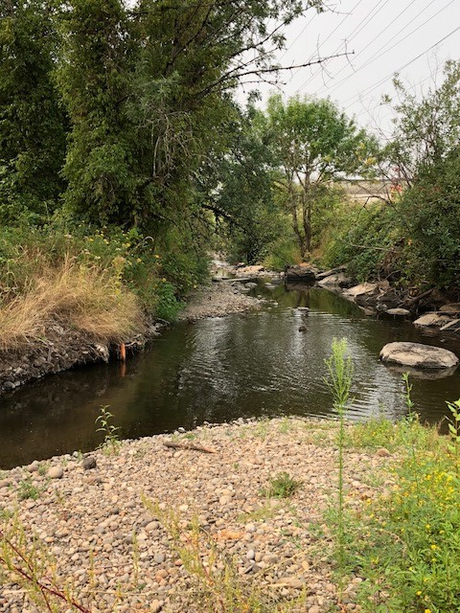
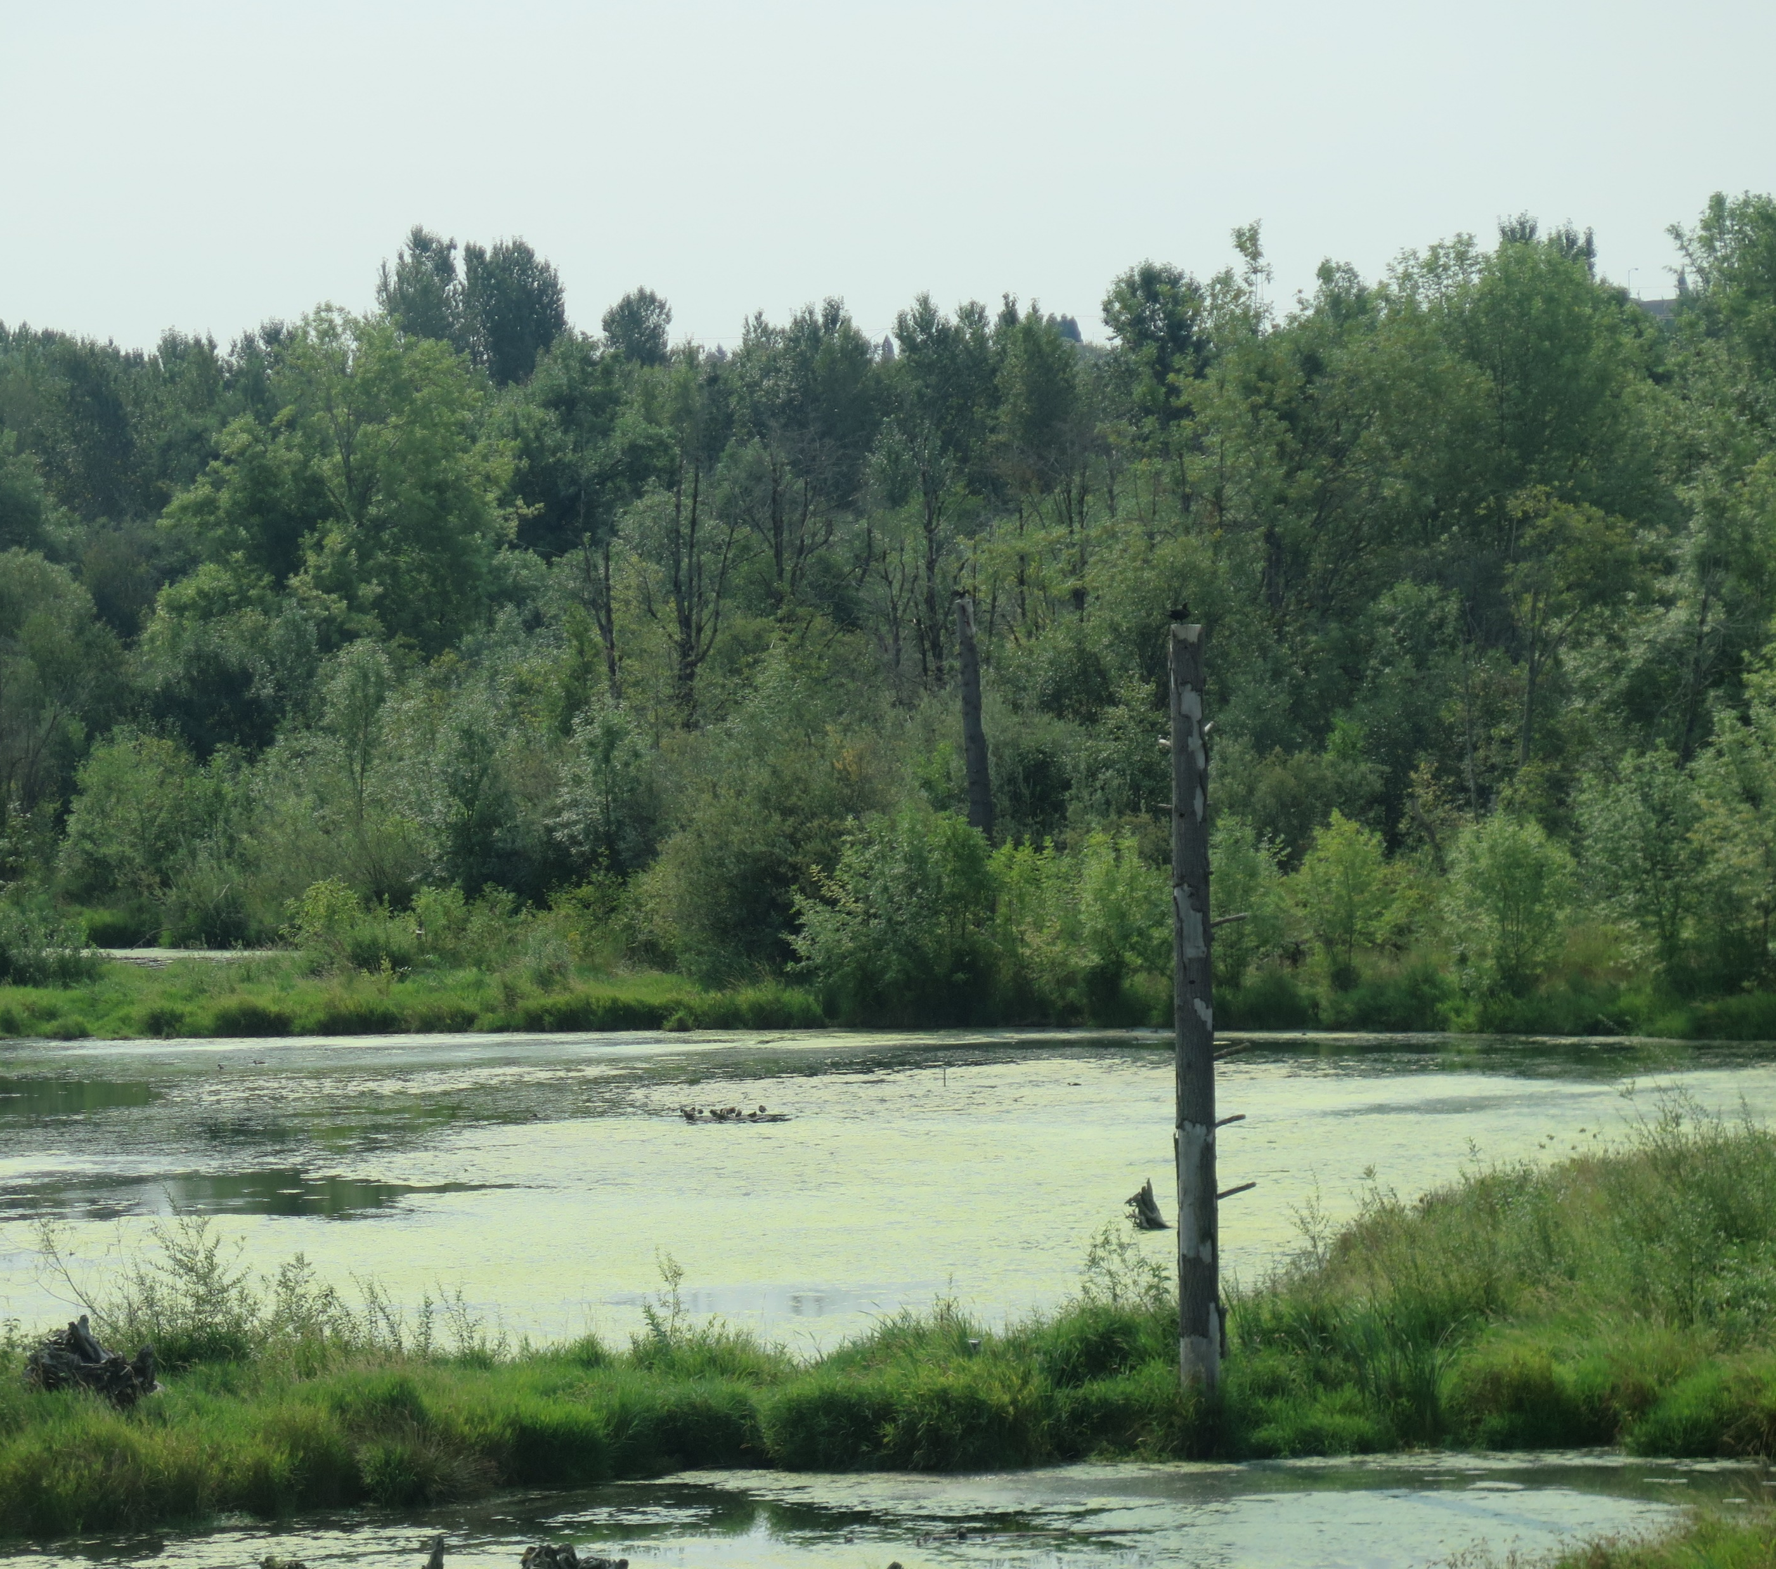
Restoration & Green Streets
It is not clear that restoration projects met environmental and water management goals.

Slide 10
Restoration & Green Streets
There was no reporting on green street condition to ratepayers or regulators.
Excellent
Good
Poor

Slide 11
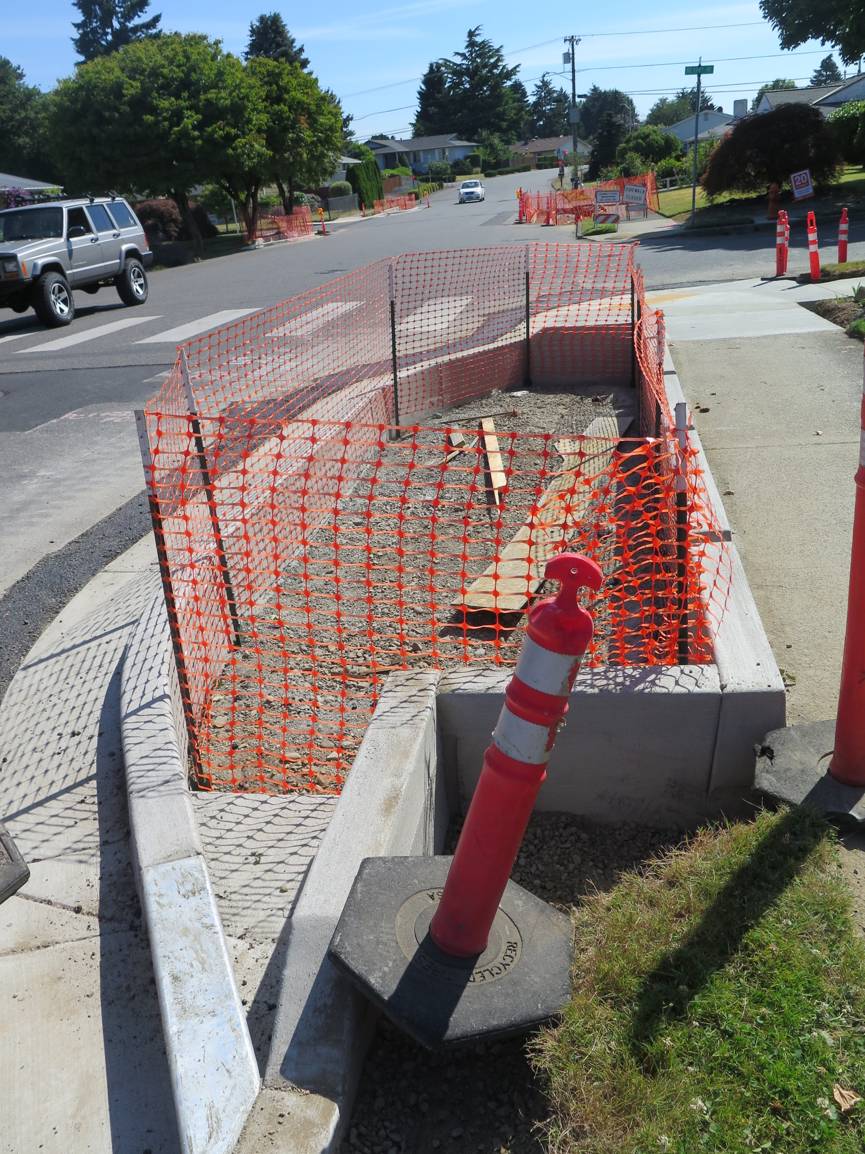
Restoration & Green Streets
To ensure that projects are sited in the highest priority areas:
Create a schedule for components of the stormwater system plan.
Use risks to evaluate proposed restoration projects and green streets.

Slide 12
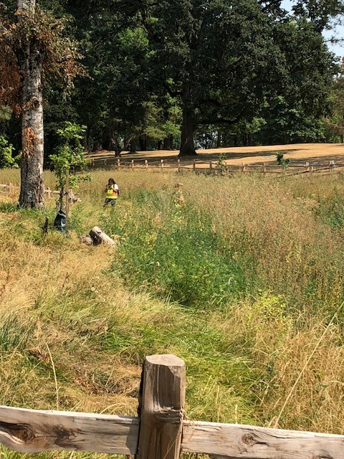
Restoration & Green Streets
To demonstrate that restoration projects successfully meet goals.
Develop an inventory of restoration projects.
Ensure that all projects have quantifiable goals.
Regularly report project results.

Slide 13
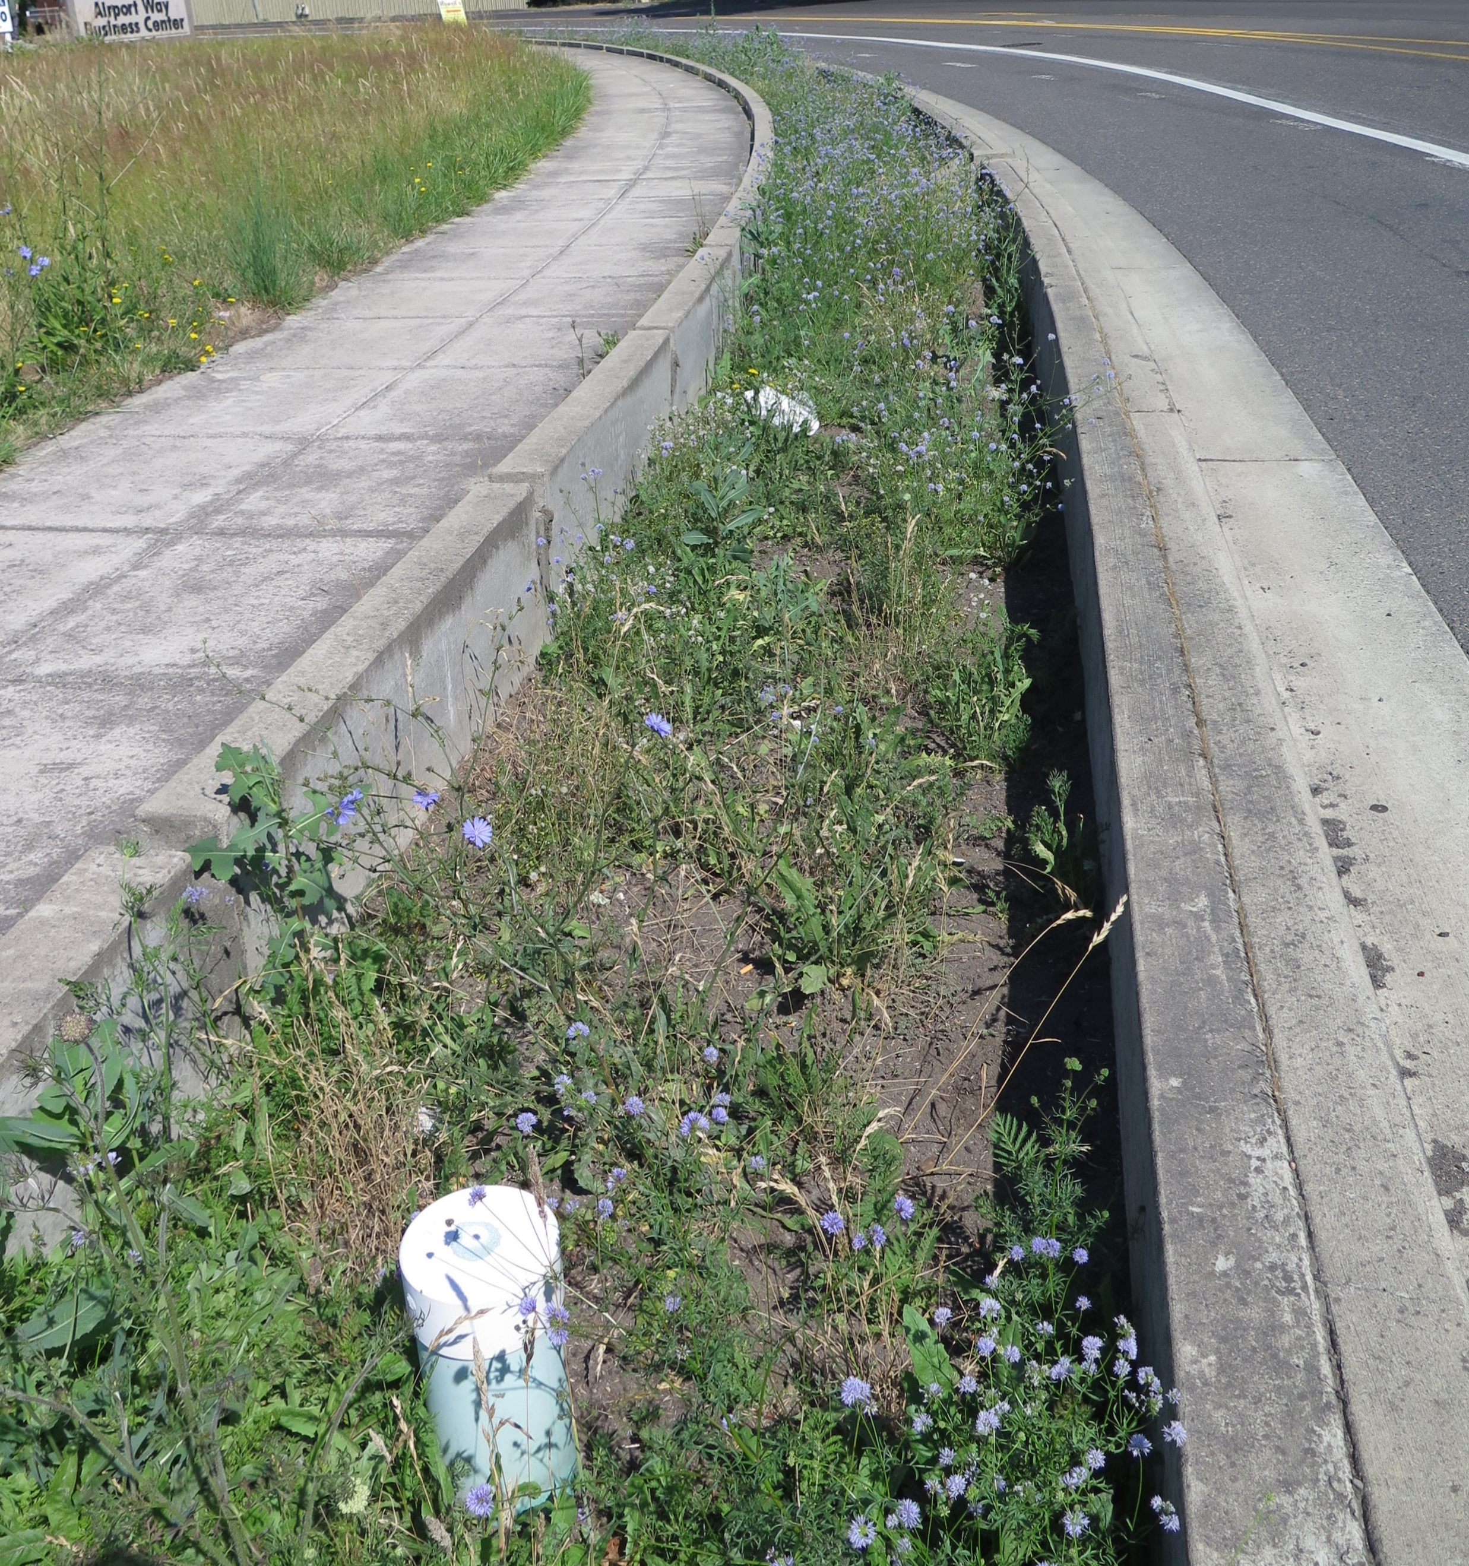
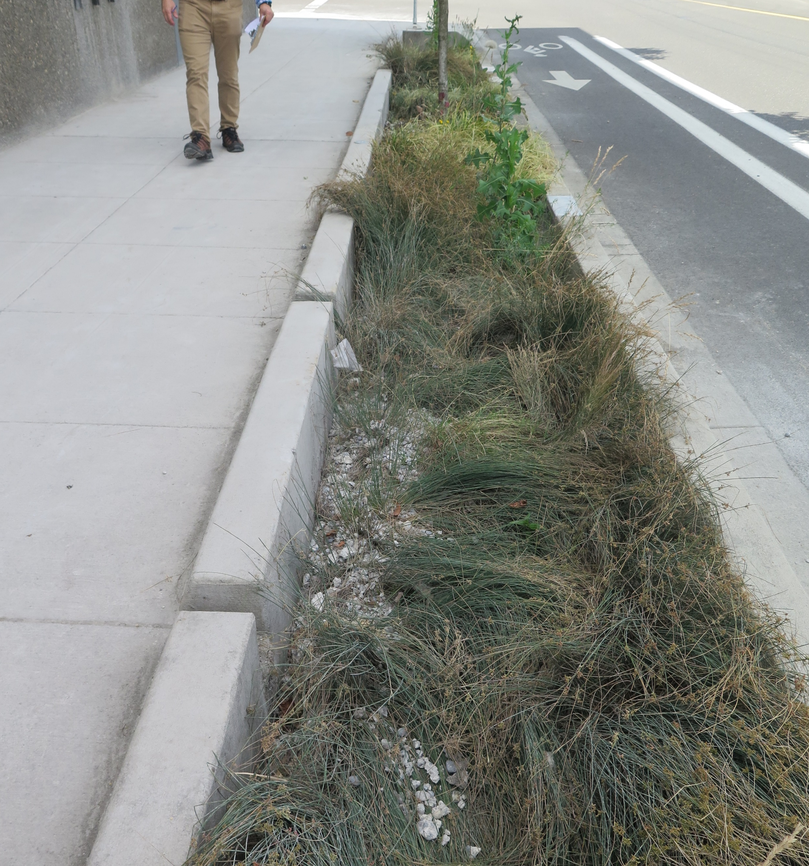
Restoration & Green Streets
To provide reliable reports about green street condition to ratepayers and regulatory agencies.
Define functioning condition for green streets.
Update Operation and Maintenance guidelines.
Create oversight procedures.

Slide 14
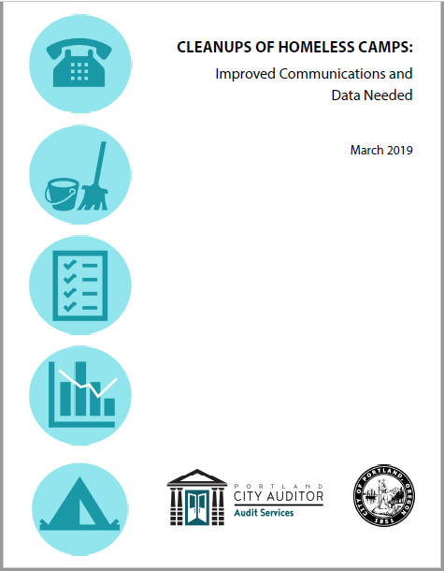
Homeless Camp Cleanups
Audited to see if:
Sites were cleaned well
Legal requirements were met
Crews were respectful
Program was responsive to complaints

Slide 15
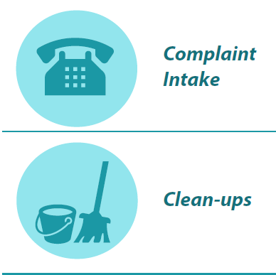
Homeless Camp Cleanups
The program improves living conditions for some people living in the camps, but communication and program data needed improvement

Slide 16
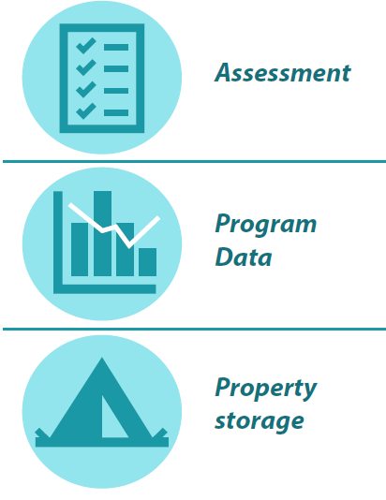
Homeless Camp Cleanups

Slide 17
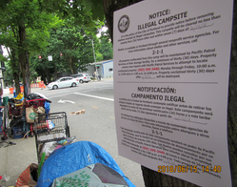
Homeless Camp Cleanups
We recommend improving the program’s communication, data, and internal policies:
Improve communication on when crews will be in the camps and durability of the notices.
Ensure crews have a common understanding of what is personal property
Improve storage policies and procedures
.

Slide 18
Homeless Camp Cleanups
4) Give complainants status updates
5) Improve data quality and reduce manual processes
6) Use data to analyze and improve effectiveness, efficiency, and timeliness of the cleanups.
7) Clarify the assessment risk factors and scoring.

Slide 19
City Council Briefing
For copies of the reports, go to the
Audit Services Division webpage at:
www.portlandoregon.gov/auditservices

