Slide 1
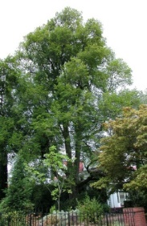
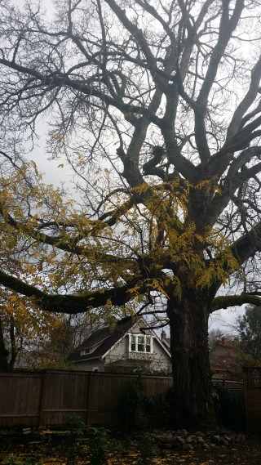
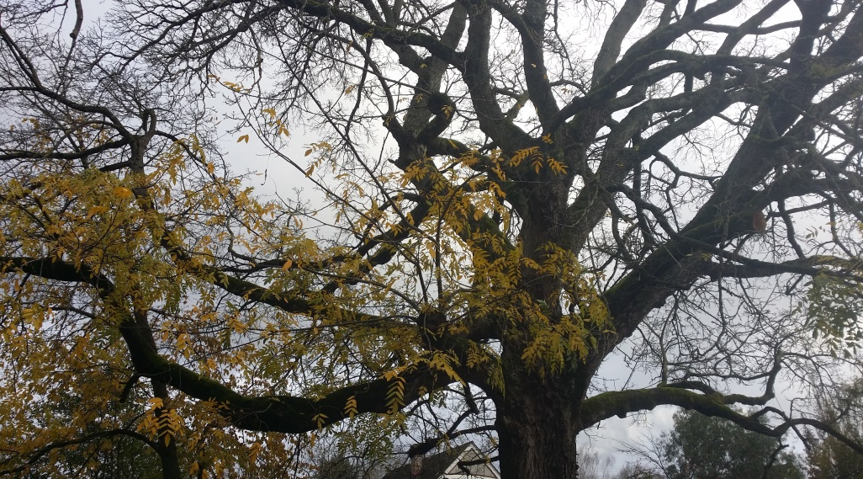
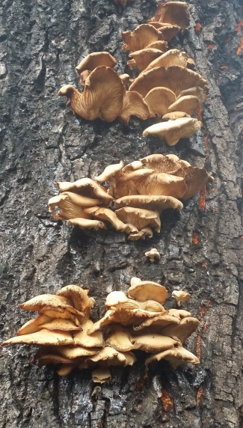
Heritage Tree De-Listings Heritage Tree Committee presentation to Portland City Council 3/27/2019 by Gregg S. Everhart, HTC chair
Photo by Phyllis Reynolds
Photos by Gregg Everhart
Notes:
The Heritage Tree Committee is saddened to bring two trees to Urban Forestry Commission for removal from the City’s Heritage Tree Program. Under Title 11.20.060 Subsection F “Heritage Trees may be removed only with the consent of the UFC, except as provided in Subsection I,” which further states, “If the City Forester determines that a Heritage Tree is dangerous and is a threat to public safety, the City Forester may order the tree to be removed without prior consent from the UFC.” Both of these trees were deemed dead, dying, and dangerous and emergency removal permits were issued under Title 11.20.060 Subsection I.
No other trees were in poor condition, had a history of limb failures, declining health, or were potential hazards. The committee did not need to visit either tree to determine whether they might recover. Under Title 11.20.060 Subsection E, which states, “The Urban Forestry Commission (UFC) makes a recommendation to City Council as to whether the Heritage Tree designation should be removed from a tree. A recommendation to remove the designation shall be supported by at least six members of the UFC. City Council may remove the designation if it finds that the designation is no longer appropriate.” There was no need for the UFC to hold public hearing for either tree to determine whether either should be formal delisted.

Slide 2
Hollandica Dutch Elm Ulmus x hollandica (5 HTs)
Circumference: 13’
(dbh = 50”)
Height: 105’
Spread: 70’
Designated in 2004
Heritage Tree #266
Private tree at 8705 1719 NE Knott – removal permit 7/5/18
(28 HTs in Irvington NA)
Photo by Phyllis Reynolds
Notes:
Heritage Tree #266, a 13’ circumference Hollandica Dutch Elm (Ulmus x hollandica) was designated in 2004.
Elm monitor found it had several signs (such as branch flagging) of Dutch Elm Disease
DED confirmed by OSU laboratory which noted brown streaking in wood and cultured the fungus
Important to remove these rapidly so bark beetles don’t spread the infection.

Slide 3
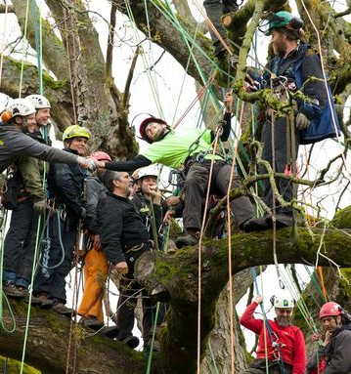
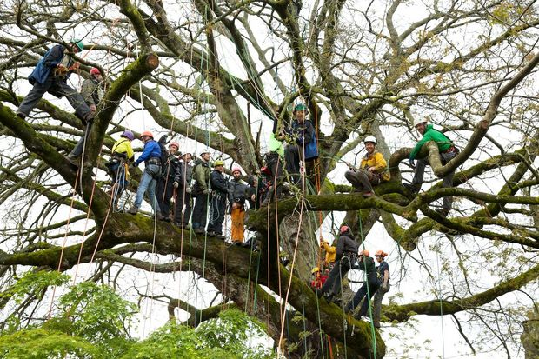
Paradox walnut Juglans x paradox (1 HT)
Circumference: 16’
(dbh = 61”)
Height: 80’
Spread: 116’
Designated in 2015
Heritage Tree # 323
5024 SE Mill Street
(12 HTs in Mt Tabor NA)
“Earth Day 2014: 22 arborists climb giant paradox walnut tree to advocate for its protection” by Melissa Binger for The Oregonian / Oregonlive
Notes:
Heritage Tree #323, a 16’ circumference Paradox walnut (Juglans x paradox) was designated in 2015. There had been a dramatic campaign to save it from development that was documented in local papers. The developer did some redesigns and a substantial area was reserved for the tree. It was a wonderful space shaded by huge tree.
South side defoliated in the spring of 2018
The balance of the foliage appeared stunted and dropped early
HTC and UFC arborists visited the tree; local arborists climbed the tree and took sample and professor Pscheidt visited and analyzed samples
Analysis suspects Thousand Canker Disease although the spores were gone once tree died; beetles indicated
Great sadness for residents, neighbors, all those who advocated saving the tree
Does reflect the size of space necessary to support a large tree – concern that maximizing housing development may squeeze out all but small flowering trees

Slide 4
Paradox walnut Juglans x paradox (1 HT)
Jay W. Pscheidt, OSU Extension Plant Pathology Specialist and Professor of Botany and Plant Pathology visited the tree and analyzed samples for cause of death
Circumference: 16’
(dbh = 61”)
Height: 80’
Spread: 116’
Designated in 2015
Heritage Tree # 323
5024 SE Mill Street — removal permit 1/22/19
(12 HTs in Mt Tabor NA)
Photo by Gregg Everhart
Notes:
Heritage Tree #323, a 16’ circumference Paradox walnut (Juglans x paradox) was designated in 2015. There had been a dramatic campaign to save it from development that was documented in local papers. The developer did some redesigns and a substantial area was reserved for the tree. It was a wonderful space shaded by huge tree.
South side defoliated in the spring of 2018
The balance of the foliage appeared stunted and dropped early
HTC and UFC arborists visited the tree; local arborists climbed the tree and took samples; OSU professor Jay W Pscheidt visited the tree and analyzed the samples
Analysis suspects Thousand Canker Disease although the spores were gone once tree died; beetles were already at work
Great sadness for residents, neighbors, all those who advocated saving the tree
Does reflect the size of space necessary to support a large tree – concern that maximizing housing development may squeeze out all but small flowering trees

Slide 5
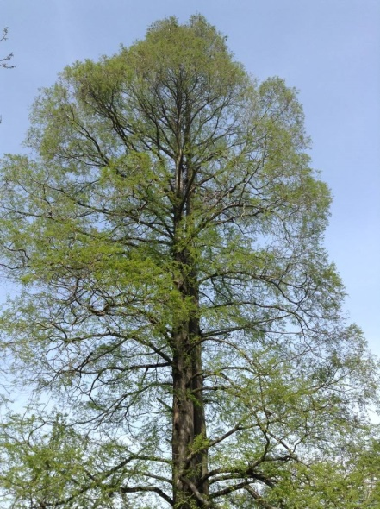
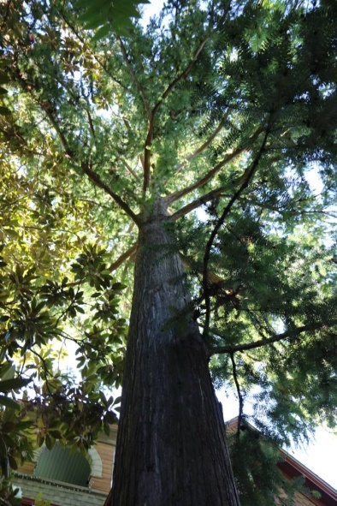
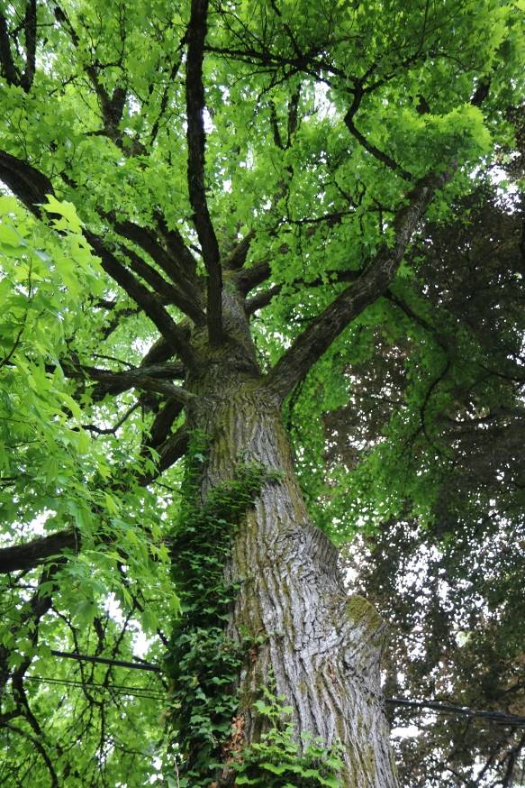
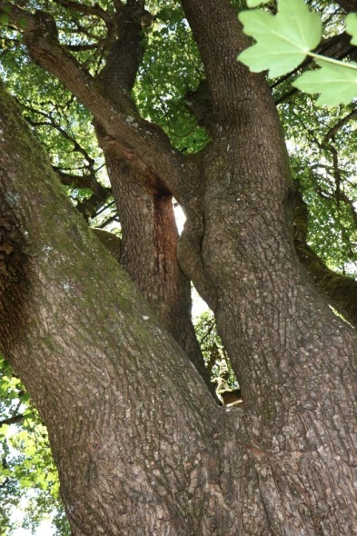
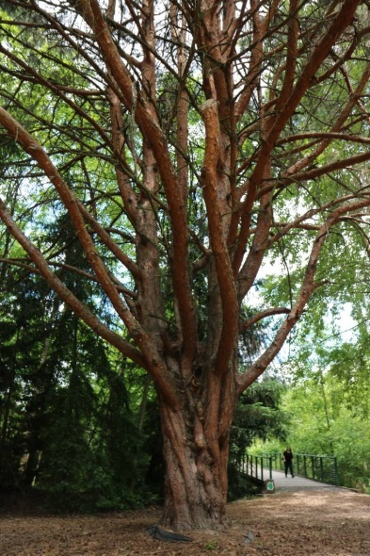
Proposed Heritage Trees
Heritage Tree Committee presentation to Portland City Council
3/27/2019
Notes:
The Heritage Tree Committee is pleased to bring a list of 12 trees to City Council for nomination into the City’s Heritage Tree Program. Of these trees, 4 are privately-owned, 4 are in the ROW, and 4 are located on City property.
Because of better outreach, this year we had _41_ trees nominated in _38_ sites (compared to 87 trees in 64 sites last year). We think part of the decrease was due to an improved nomination form. It has more comprehensive information to help exclude nominations that lack adequate growing space, owner consent for private trees, or trees smaller than existing HTs.
Heritage Trees are of special importance to the city because of their age, size, type, historical association or horticultural value. These trees have been nominated by members of the public, and if privately owned, consent to designation was given by their property owners.
Only a few nominations make it through the rigorous selection process, which weighs the above factors along with the tree’s health, available growing space, and distribution of trees throughout the city, (and owner consent).
Once designated, it is against the law for any person to remove, destroy or injure a heritage tree. Of all the programs in Oregon celebrating significant trees, Portland has the only one with legal teeth. This program expresses the pride that Portlanders take in their significant trees and their determination to celebrate and protect them.

Slide 6
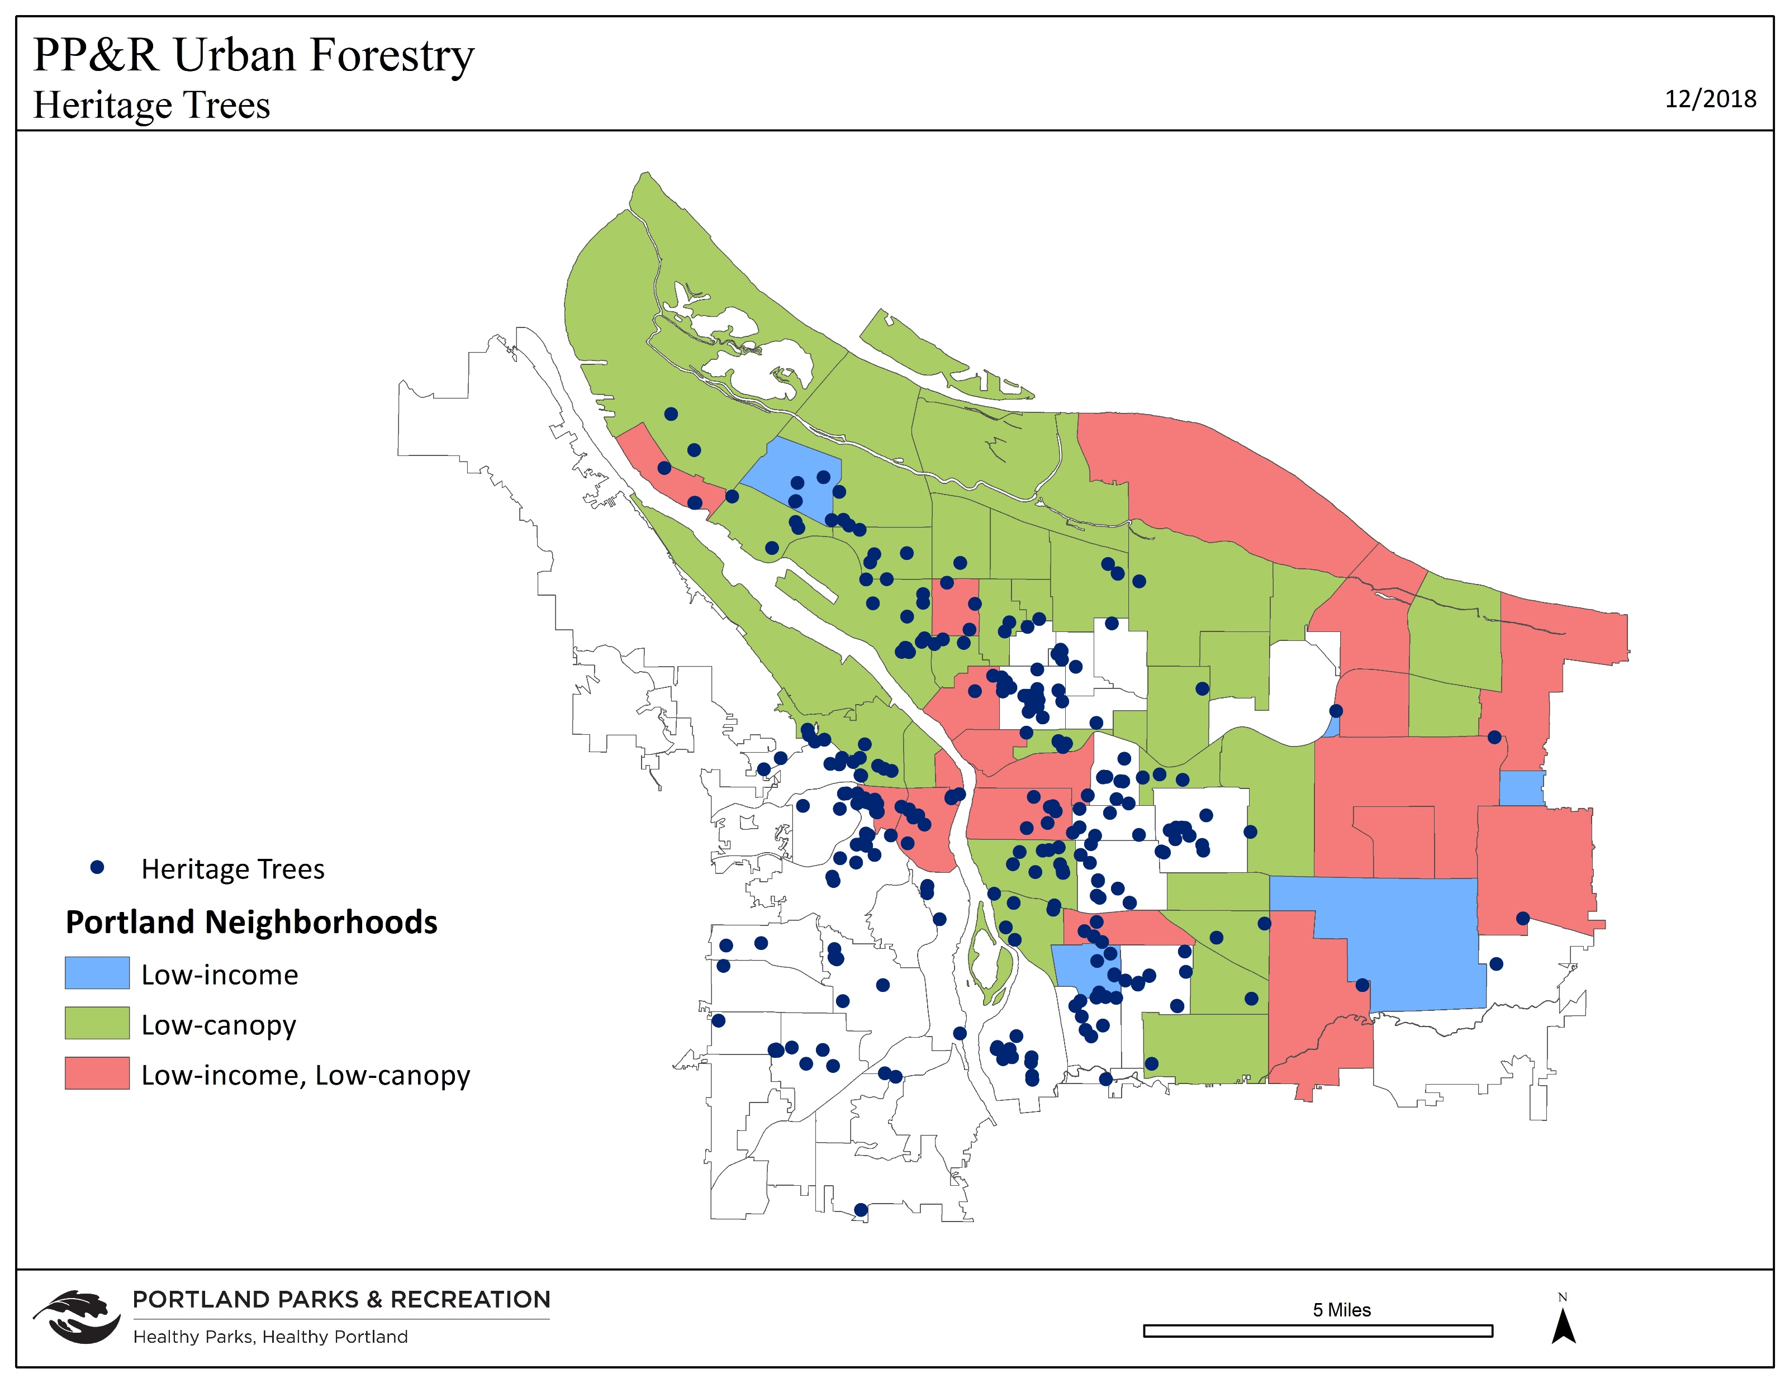
Notes:
These are where HTs are currently located. We are still concerned that not every neighborhood has a HT. For instance, there are only 5 HTs east of I-205 and none in several neighborhoods in the south portion of SW.

Slide 7
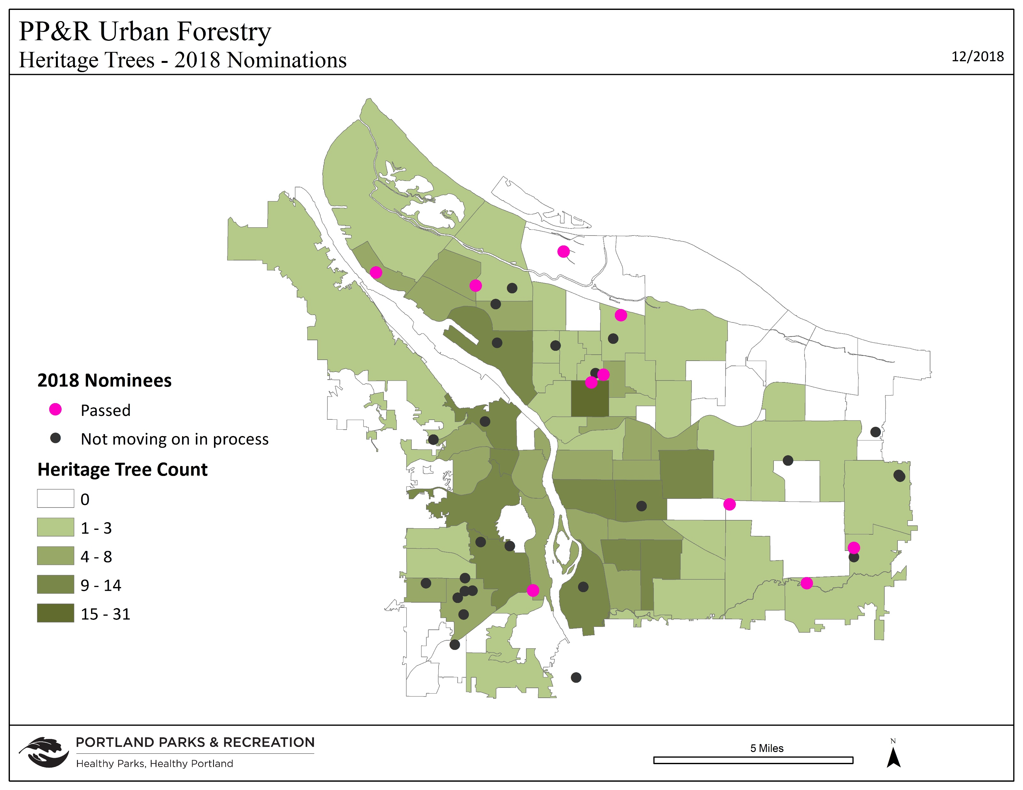
Notes:
Because of better outreach, this year had _41__ trees nominated in _38_ sites (compared to 87 trees in 64 sites last year). We think part of the decrease was due to an improved nomination form. It has more comprehensive information to help exclude nominations that lack adequate growing space, owner consent for private trees, or trees smaller than existing HTs.

Slide 8
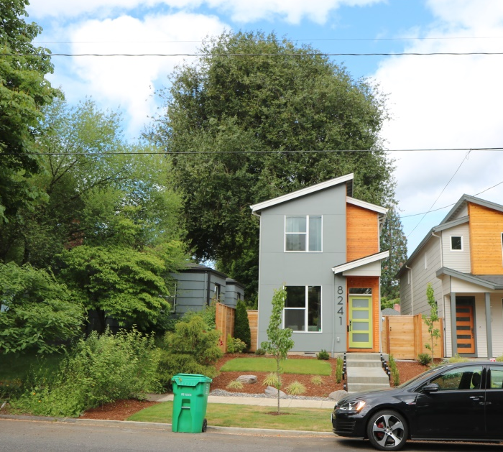
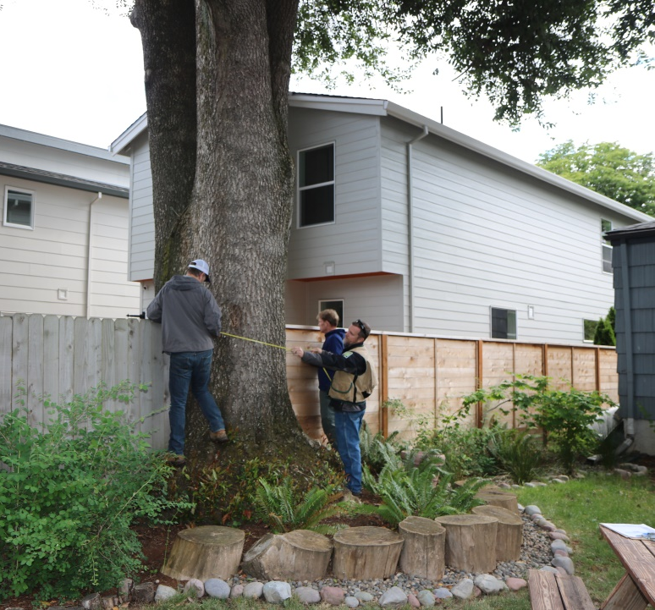
Oregon myrtle Umbellularia californica (2 HTs)
Circumference: 14.3’
(dbh = 55”)
Height: 54’
Spread: 68’
Privately owned tree
8235 & 8241 N Chautauqua Blvd
(5 HTs in Portsmouth NA)
Notes:
This tree was nominated in 2017 and the HTC recommended that it be designated as a HT. However, the tree is located on the property line and the developer of the north property was not willing to sign a consent form. The neighbors with south portion of the tree, Jenny and Joe Dezso, worked with the developer to modify the site plans to reduce impacts to the tree. They also worked with the contractor to maintain construction fencing and protect the tree during construction. Once the new home on north side of tree was sold, they met their new neighbors and encouraged them to sign on to resubmission of the nomination. Owners of both properties signed the nomination form, citing beauty, shade, size, and history. Most of the canopy is visible from street, but we might add 2nd plaque on alley side where lovely trunk and branch structure is more visible. It has a very wide base that is typical of this species when it matures – although it is likely to be partially hollow, it is still structurally sound.

Slide 9
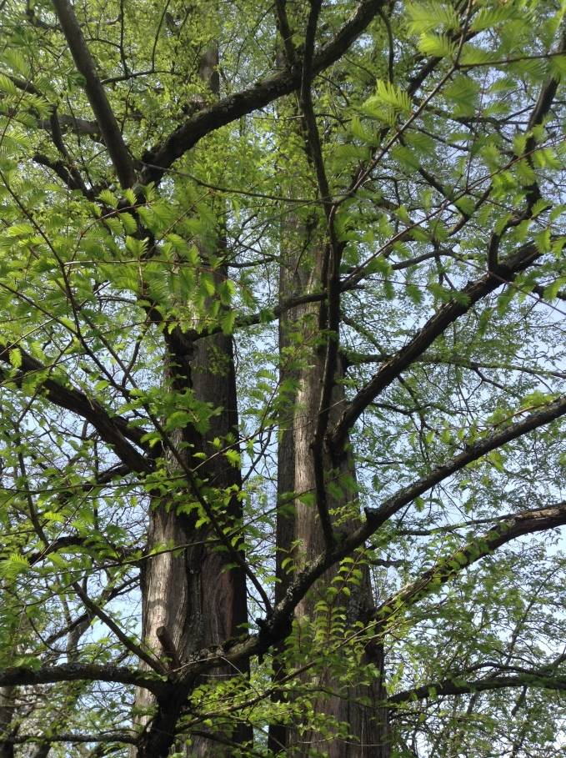
Dawn redwood Metasequoia glyptostroboides (6 HTs)
Circumference: 15.1’
(dbh = 58”)
Height: 86’
Spread: 42’
Privately owned tree
6805 NE 32nd Avenue
(3 HTs in Concordia)
Spring leaves by Gregg Everhart
Spring leaves by Gregg Everhart
Notes:
This is a private tree that was recommended by Brian and nominated by its owner, John Terry. In overall history, this species was thought to be extinct until rediscovery in 1946. Portland got seeds in 1947 and in 1951 HT #313 at Hoyt Arboretum was the first to produce cones in North America in centuries. John is an Oregon historian, with 30 year career as a journalist at the Capital Journal and The Oregonian. He is still a member of the Oregon Geographic Names Board. He doesn’t know specifics of this tree but he thinks that Edgar Francis Averill (1881-1955), conservationist, and father of Portland mayor Connie McCready may have planted it when he lived in the house. In some brief additional research by Gregg, Averill was active in the Portland City Club and Audubon Society and knew William Finley (1876-1953), so this tree might be related to the pair of dawn redwoods at the Audubon Sanctuary on Cornell Road. Averill’s daughter, Constance McCready was a public figure that also might have secured an early specimen. She was a journalist at The Oregonian (news reporter and Home & Garden editor between 1943 and 1962), served two terms in Oregon House of Representatives in 1967 and 1969, then 10 years on City Council (March 1970-then appointed as major in 1979 when Neil Goldschmidt resigned to become US Secretary of Transportation). John Terry indicates that the home was relocated from Vanport after the 1948 flood. The Multnomah County Assessors records indicate the home was built in 1938.
This tree has a larger girth than other current HTs because it has two trunks. Our arborists did not decide whether this was two individual trees or a single tree that developed two co-dominant trunks from the base. Although it is located in the backyard, it is visible from Columbia Boulevard, NE 32nd Ave and other nearby streets. There is a dramatic root flare and it would be ideal to have a “peephole” that allowed view of base and lower trunk.
.

Slide 10
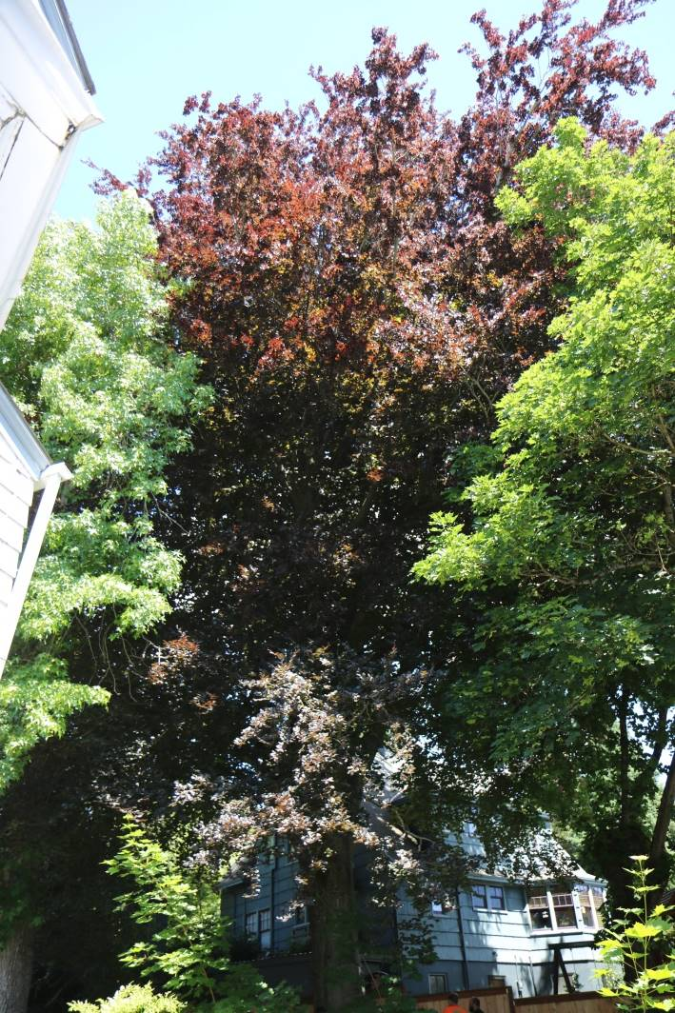
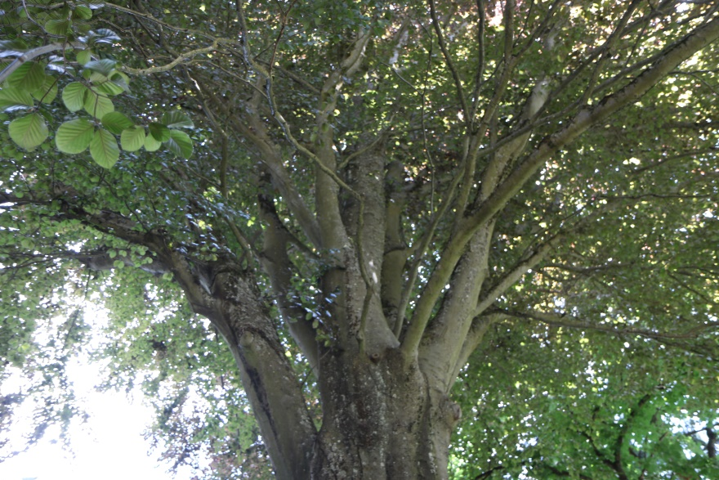
Copper Beech Fagus sylvatica f. purpurea (7 HTs)
Circumference: 12.5’
(dbh = 48”)
Height: 103’
Spread: 70’
Privately owned tree
3823 NE 23rd Avenue
(3 HTs in Alameda)
Notes:
This tree was nominated as a private tree by its owner, Mary Jean Young, and her daughter, Desiree Young, for its beauty, shade, size, kind, age, and history. Mary Jean thinks it might have been planted by the home’s first owner and be 100 years old. She has owned her home since 1960 when she became first African American property owner of Alameda. This tree is not fully visible from the street. Although there is one point where the trunk and base are visible between homes, the backyard is so shady as to not be that apparent. However, it is so tall and the purple leaves so dark that it dominates the skyline.

Slide 11
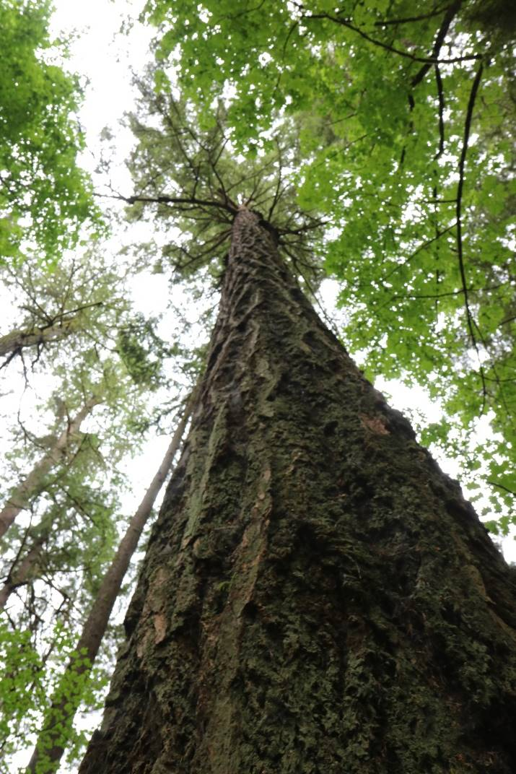
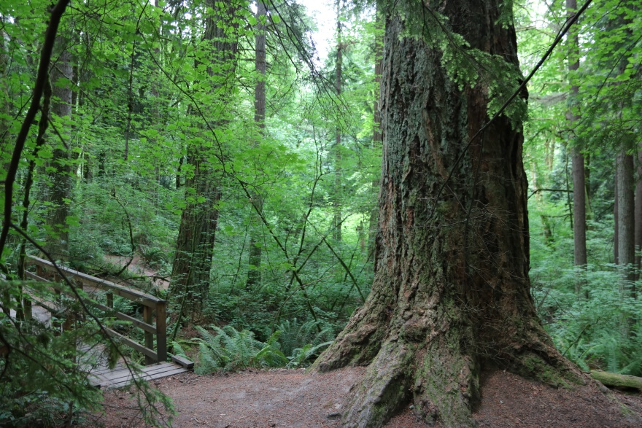
Douglas-fir Pseudotsuga menziesii (6 HTs)
Circumference: 18.7’
(dbh = 71”)
Height: 268’
Spread: 60’
Privately owned tree
5151 NW Cornell Road
25 HTs in Forest Park NA)
Notes:
This tree was nominated as a private tree by Gregg Everhart on behalf of the Audubon Sanctuary Committee. Executive Director Nick Hardigg signed the form for the Audubon Society of Portland. They feel that the tree qualifies for beauty, shade, and size. Gregg noted that Brian French has investigated each of the large Douglas firs in this area, known as the “Grove of the Ancients” and this is the tree he recommended. Since this is likely to be the new tallest HT, it would be great to climb and measure height again. It also appears to be more healthy than the current tallest HT, another Douglas fir (HT #134, 242’ high) that is in nearby Macleay Park.

Slide 12
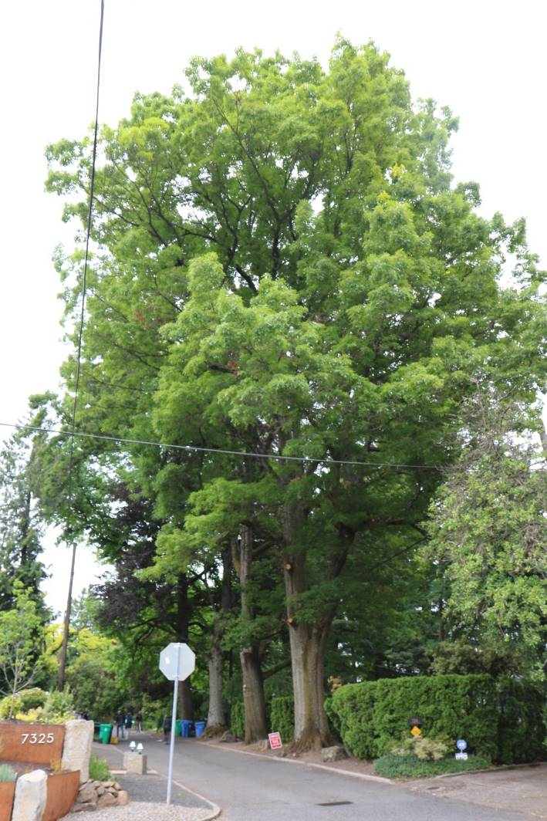
Sweetgum Liquidambar styraciflua
(3 HTs)
Circumference: 10.9’)
(dbh = 42”)
Height: 104’
Spread: 60’
Tree located in ROW
7300 SW Brier Place
(5 HTs in South Portland NA)
Notes:
This tree was nominated as a public tree by Emma Dugan. She nominated it for beauty, shade, and size. The committee was pleasantly surprised by this specimen since the same species in prior tour was found to have grown too large, too fast and arborists on the committee had explained that this species really is not appropriate in our climate and soils. However, although quite large and probably pretty old, this specimen seems to have avoided the common structural problems of this species, possibly because it is constrained by neighboring large trees and pavement at base of trunk. Most members felt it had outstanding form with good pruning around wires and nice branch angles. As a street tree, it also has great visibility.

Slide 13
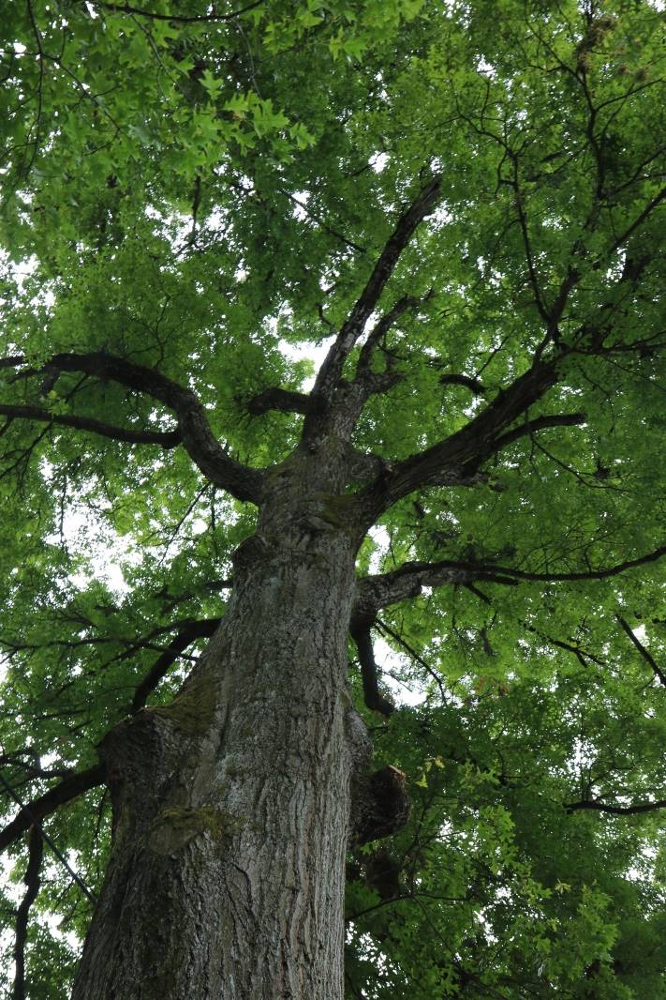
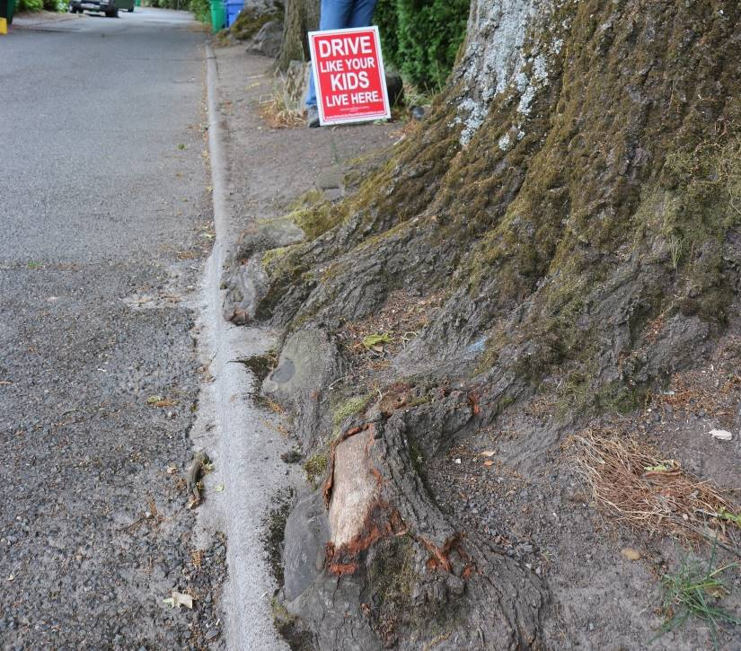
Pin oak Quercus palustris (2 HTs)
Circumference: 13.4’
(dbh = 51”)
Height: 114’
Spread: 65’
Tree located in ROW
7326 SW Brier Place
(5 HTs in South Portland NA)
Notes:
This tree was nominated as a public tree by Emma Dugan. She nominated it for beauty, shade, and size. Most of the committee liked this tree, feeling that it was a good example of mature form. There were some concerns: root flare is repeatedly damaged by vehicles on the adjacent pavement; two conks on upper branch; three recent substantial pruning cuts that might have removed disease rather than broken branches. Most felt that the tree’s longevity would not be affected and that there was a great view of it from below and the southwest. Two of the three city arborists voted against it but 8 of 10 supported HT designation. One arborist suggested that if UFC and City Council support the designation, UF might consider giving this tree more space by removing the tree to its north.

Slide 14
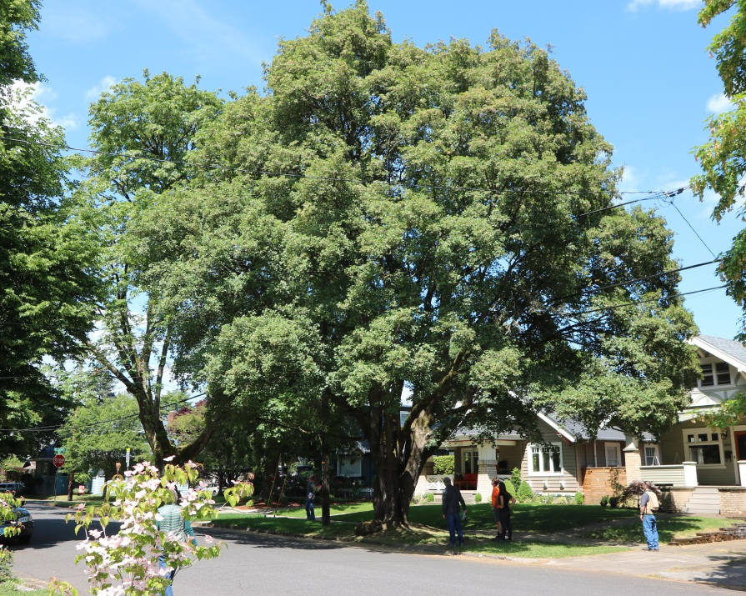
Hedge maple Acer campestre (2 HTs)
Circumference: 12’ (dbh = 46”)
Height: 66’
Spread: 56’
Tree located in ROW
3424 NE 17th Avenue
(1 HT in Sabin NA/28 HTs in Irvington)
Notes:
This street tree was nominated as a public tree by Brian French. This is one of several potential HTs that was known to several members of the HTC though no one ever made the nomination. Brian and Gregg felt that it qualified for beauty, shade, size and kind. The adjacent home is 102 years old but the current owner has only been there 16 years and does not know any tree history. Although there are some communication wires in the canopy the tree has had good care. It is quite photogenic since it is a smaller species – many other HTs are so large it is difficult to get a photograph of whole tree without other trees or wires in view.

Slide 15
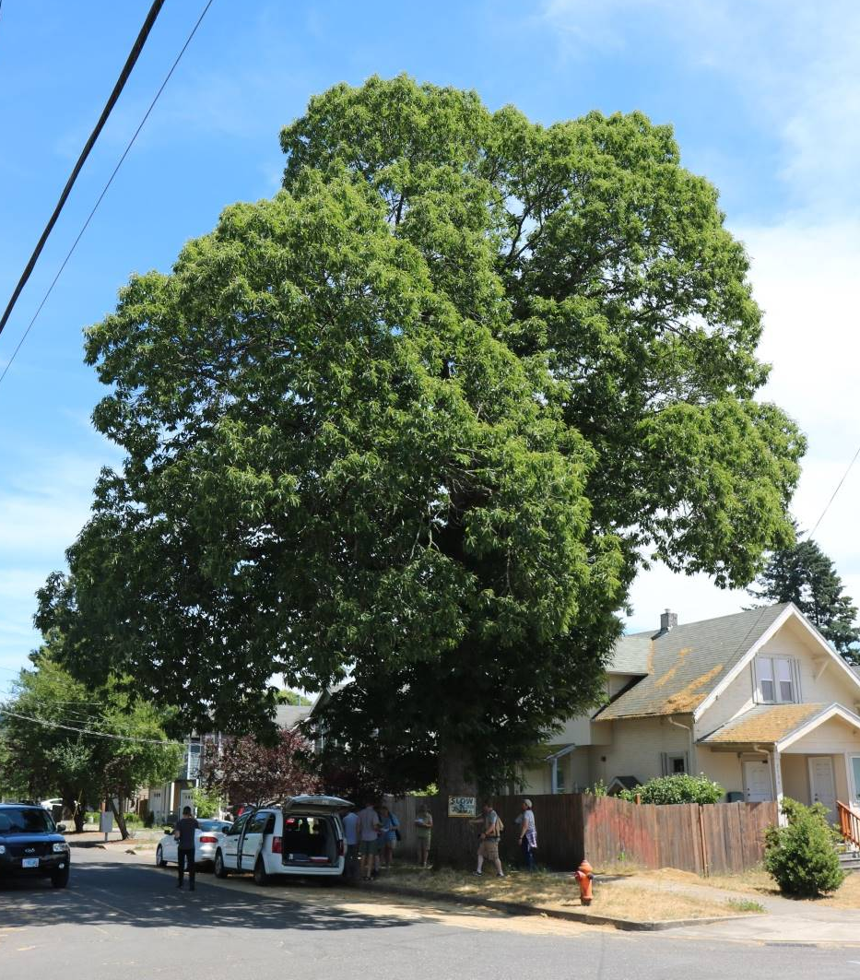
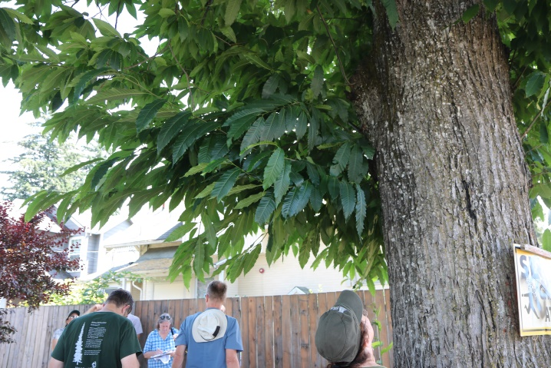
Spanish Chestnut Castanea sativa (3 HTs)
Circumference: 10.1’
(dbh = 39”)
Height: 72’
Spread: 58’
Located in ROW
2704 SE 84th Avenue
(0 HTs in Powellhurst-Gilbert NA)
Notes:
This tree was nominated as a public tree by Damon Schrosk after he and Catherine Mushel had some interesting talks with neighborhood residents. As UFC commissioners, they were trying to clarify barriers to planting trees with activists in the Jade District and APANO (Asian Pacific American Network of Oregon). One of the things they learned is that in several Asian cultures, “trees need to work,” as in being productive, particularly in terms of producing fruits or nuts. This particular tree was identified as one where “grammas” pick up the nuts in fall. Several committee members felt the “story needs to be told,” particularly in this neighborhood. The opportunity to have first HT in the neighborhood and to honor the story were important to the committee. Martin took some leaf samples but will need to send buds in November for genetic analysis in order to confirm species.

Slide 16
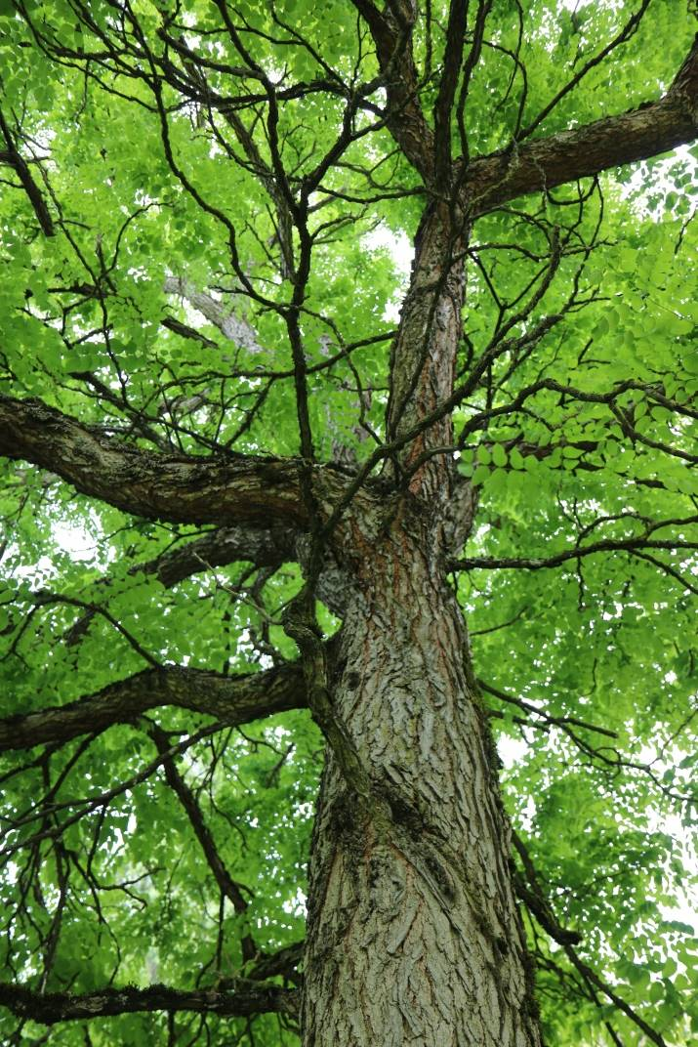
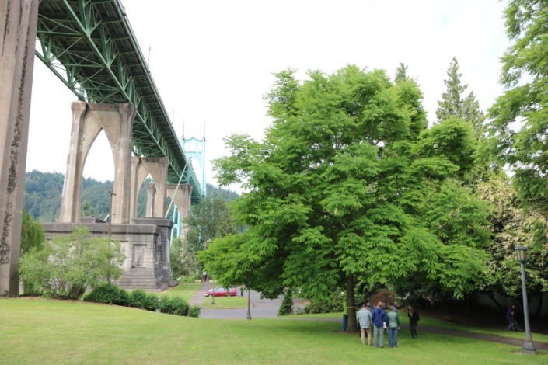
Kentucky coffeetree Gymnocladus dioicus (0 HTs)
Circumference: 4.2’
(dbh = 16”)
Height: 50’
Spread: 53’
Tree located near Crawford & Philadelphia, nearly under bridge
Cathedral Park
(3 HTs in Cathedral Park NA)
John Warner 1935-2018
Notes:
This tree was nominated as a public tree by both Steve Roskoski and Dave Hedberg. Dave had done research on Cathedral Park during the 2017 park tree inventory project. He cited two periods of historical significance. First was the original planting plan of the park, done by landscape architect John Warner who passed away on April 9, 2018. John was an initial founding member (with Bill Naito) in the Portland Street Tree Advisory Committee – the precursor to the Urban Forestry Commission, so that John helped shape the makeup and future of Urban Forestry from before its creation. John’s planting plan for the park received an Honor Award from the Oregon chapter of the American Society of Landscape Architects. Dave found the tree planting plan at Portland city archives and this tree is among the many shown. Dave also discovered that when Cathedral Park was dedicated in 1980, individuals donated funds to make each tree a memorial tree. “Mary J. Sharples dedicated the Coffee Tree to Gloria M.D. Sharples, Caspar Wistar Sharples, Marian-Shawn Sharples Fitzgerald and Catherine E. Sharples.
Dave’s nomination also noted an interesting educational opportunity regarding this species. It is rare and declining, considered “anachronistic” because it “evolved with the Pleistocene megafauna and needed large-mouthed animals to spread its seeds.” Both male and female flowering trees are needed and male trees are more commonly planted. When seeds are actually produced, they are really hard and need scarifying to germinate. Since it can take several years in a wet area for outer layers to decay naturally, the only naturally reproducing stands are in limited boggy areas. Hoyt Arboretum had one of their two female trees blow down more recently. They are more common in landscape in Midwest and east coast.
The previously designated HT of this species was in Laurelhurst Park and was much larger. However, it was damaged and removed several years ago. This tree is a male with nice structure planted in 1980. We recommend it be a HT based on horticultural type, history of Cathedral Park design and John Warner.

Slide 17
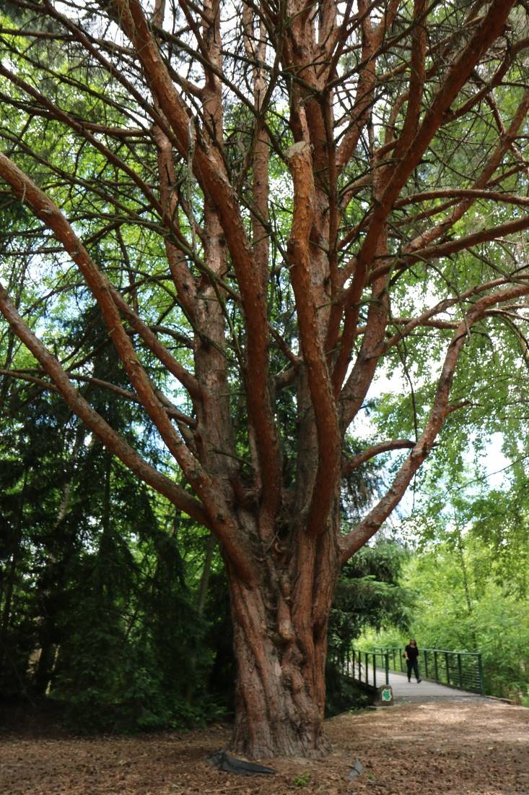
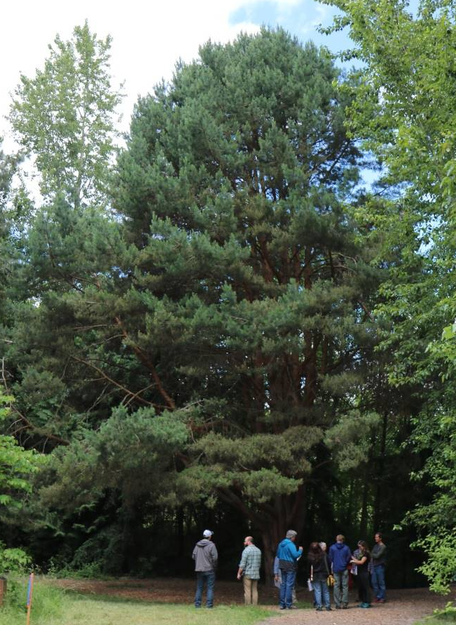
Japanese red pine Pinus densiflora (1 HT)
Circumference: 11.8’
(dbh = 45”)
Height: 75’
Spread: 61’
Columbia Children’s Arboretum
10040 NE 6th Drive
(0 HTs in East Columbia NA)
Notes:
This public tree was spotted by Martin on our 2017 visit to another nominee. Ginger helped Gyrid Hyde-Towle with the nomination. Gyrid and her husband helped create the Columbia Children’s Arboretum in the early 1970s. At that time they worked with schools in Portland to plant a tree from every state in the USA, usually the state tree of each state. They also planted trees from other countries. Unfortunately, the records for the Children’s Arboretum are scattered with various people knowing different aspects of its history. Gyrid believes this tree to have been planted in 1972 or 1974. It was nominated for beauty, size, and horticultural interest. It would also qualify as historically interesting because of how CCA was started.
Hoyt Arboretum has several specimens but its largest have suffered ice/snow damage. This specimen has a gorgeous form and very visible next to a path that is going to be improved for accessibility. It is substantially larger than the current HT which is constrained by its site next to a busy street.

Slide 18
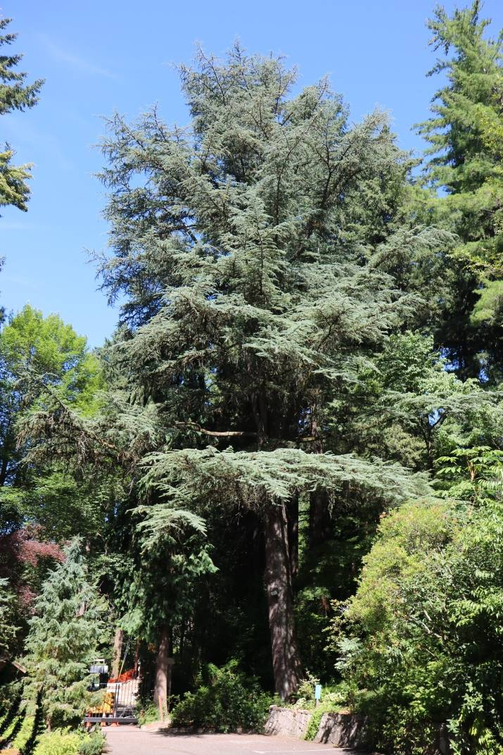
Blue Atlas cedar Cedrus atlantica (3 HTs)
Circumference: 13.5’
(dbh = 52”)
Height: 135’
Spread: 70’
Leach Botanical Garden
6704 SE 122nd Avenue
(1 HT in Pleasant Valley NA)
Notes:
This tree was nominated as a park tree by the Executive Director of Leach Botanical Gardens, David Porter. He chose it for beauty, size, kind, age and history. He thinks it is about 80 years old and was part of the collection planted by Lila and John Leach. This particular tree is particularly tall in relation to its girth and spread, probably because of the forested site. The form is nice since it is showing some of the layering that is common in its homeland. Although the garden will eventually have a second entry, this location has great visibility. Visitors can see the trunk and structure up close from the original driveway and the whole tree from the Manor House.

Slide 19
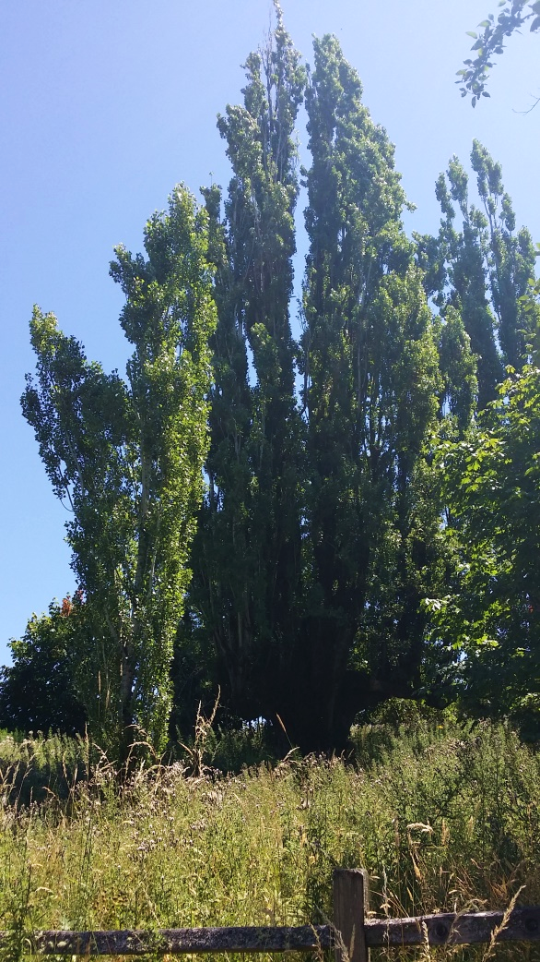
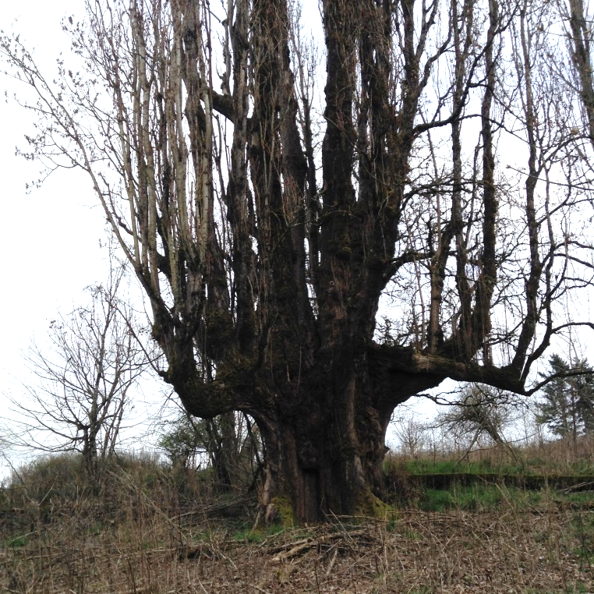
Lombardy poplar Populus nigra (0 HTs)
Circumference: 32’
(dbh = 122”)
Height: 115’
Spread: 41’
Powell Butte Nature Park
16160 SE Powell Boulevard
(1 HT in Pleasant Valley NA)
3-2018 visit by Gregg Everhart
7-2017 visit by Gregg Everhart
Notes:
This tree was nominated as a public tree by Darvel Lloyd. It was measured by Jerry Black, Volunteer Data Manager/Verifier for Oregon Champion Tree Registry. Jerry Black nominated it for beauty, shade, size, kind and history. He estimated it to be 90 - 136 years old and stated that it could have been planted as early as 1880s by Camp Family, cattle ranchers and orchardists. The application noted that this is the largest known and verified Lombardy poplar in Oregon.
This tree is located up the hill from the accessible path between the Visitor’s Center and top of butte. It is so large that it is visible from the Visitor’s Center. The trunk has huge buttresses, possibly to help resist winds at this site. None of the committee members imagined a Lombardy poplar could live this long or grow so large. While the tree has some dying branches at the very top and substantial deadwood, its size and branching structure is quite remarkable. The girth is actually larger than that of our HT giant sequoias!
The Land Stewardship staff that manage this site note that the tree is in a sensitive area. They request that the HT plaque be placed on fence that excludes visitors and supplemented by another explaining that the area is closed to visitors.
Statistics:
41 nominations
14 recommended as HT
11 or 14 forwarded to Council (3 do not have consent forms)
4 Trees of Merit (Western larch, Incense cedar, Giant sequoia, Japanese pagoda tree)

Slide 20
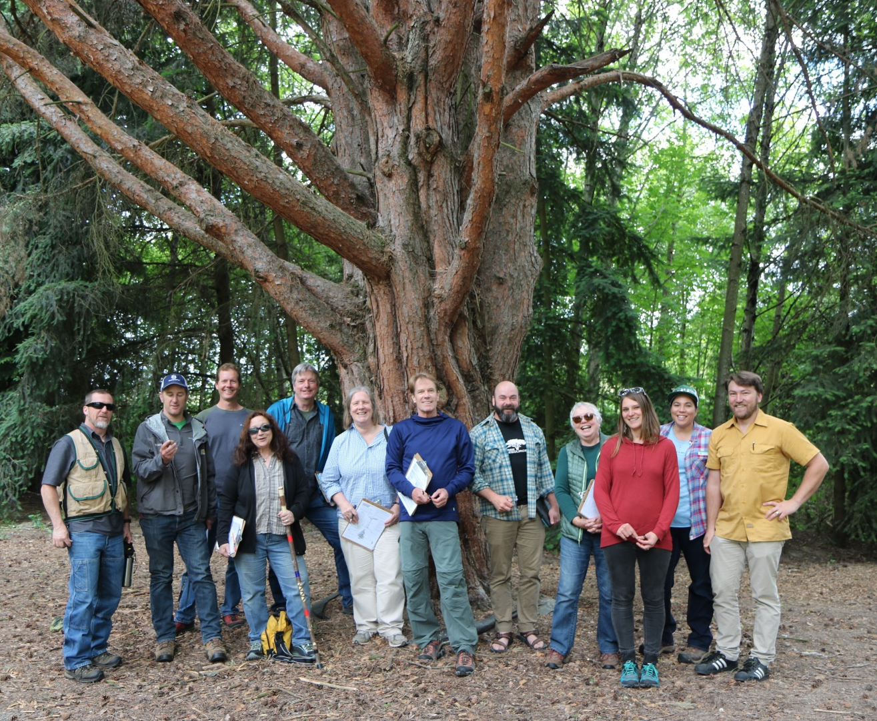
Questions?
Thanks to HTC members:
Gregg Everhart (chair)
Jennifer Baxter
Gina Dake (PP&R)
Ginger Edwards
Brian French
Dave Hedberg
Frank Krawczyk (PP&R)
John Mills
Martin Nicholson (PP&R)
Stephen Peacock
Damon Schrosk
Thea Weiss Hayes

