Slide 1

North/Northeast Neighborhood Housing Strategy Oversight Committee
N/NE Neighborhood Housing Strategy Oversight Committee Annual Report for Calendar Year 2018
Wednesday March 20, 2019

Slide 2
Dr. Steven Holt, Sr. Pastor Kingdom Nation Church, Chair
Dr. Lisa K. Bates PhD, Associate Professor Portland State University
Dr. T. Allen Bethel, Sr. Pastor Maranatha Church
Triston Dallas, Attorney, Epiq Global
Dr. Karin Edwards EdD, Cascade Campus President, Portland Community College
Jilian Saurage Felton, Saurage Consulting
Sheila Holden, Regional Community Manager, Pacific Power
Marlon Holmes, Community Member
Virgie Ruiz-Houston, Community Member
Felicia Tripp, Deputy Director, Portland Housing Center
Committee Members
SCOPE OF THE OVERSIGHT COMMITTEE
This committee, working with the Portland Housing Bureau as well as its contractors, shall:
Advise on, and review, program proposals and plan development;
PHB will inform the oversight committee of decisions, plans, proposals prior to implementation
Monitor the implementation of policy and programing, and associated outcomes;
And advise the housing director and housing commissioner on progress, issues, and concerns associated with the North/Northeast Neighborhood Housing Strategy and Interstate Urban Renewal “TIF Lift” funds
Stemming from the development and implementation of the policies and programming associated with the North/Northeast Neighborhood Housing Strategy Interstate Urban Renewal Funds. This scope applies to PHB and any contractors receiving funding from this initiative.

Slide 3
2018 Accomplishments
Two multifamily-rental buildings were completed and opened in 2018, the Beatrice Morrow Cannady 80 units and Charlotte B. Rutherford 51 units.
The preference policy was utilized to lease three buildings: Garlington Plaza, Charlotte B. Rutherford and the Beatrice Morrow
Down Payment Assistance Forgiveness – Council approved on September 19, 2018.
Increased the boundary for Home retention funds to be utilized throughout the entire Interstate URA.
Interstate projects received LIFT funds from OHCS: Bridge/Williams project; IHI/Magnolia II; Proud Ground/5020 N. Interstate Condos

Slide 4
N/NE Neighborhood Housing Strategies
Strategy 1 – Preventing Displacement
        Home repair grants
        Home repair loans
Strategy 2 – Creating New Homeowners
        Down Payment Assistance Loans (DPAL)
        Home ownership unit development
Strategy 3 – Creating New Rental Homes
Strategy 4 – Land Banking

Slide 5
The Oversight Committee received updates on the distribution of home repair loans and grants, this program is an effort to help current homeowners maintain necessary upkeep on their homes and prevent displacement. While we are very pleased to see an increase in the number of grants awarded, we have not seen parity in the number of loans awarded to communities of color.
Committee Assessment
Strategy 1: Preventing Displacement

Slide 6
Committee Assessment
Strategy 2: Creating New Home Owners - DPAL
The OC expressed concern in last year’s report regarding the pace at which new home owners were being created; in 2018 10 more families became home owners through the preference policy. Two additional families will be closing on their homes within a few weeks.
100% of the Home Buyers utilizing N/NE, Prosper or Construction Excise Tax (CET) funds are Black/African American

Slide 7
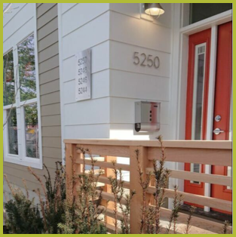
Committee Assessment
Strategy 2: Creating New Home Owners - Development
Portland Housing Bureau is working with community partners Habitat for Humanity, Proud Ground and PCRI to build affordable units for preference policy applicants within the district. The units are currently under construction and some will be available as early as March 2019.
PCRI
Williams Townhomes
Habitat for Humanity
Olin Townhomes

Slide 8

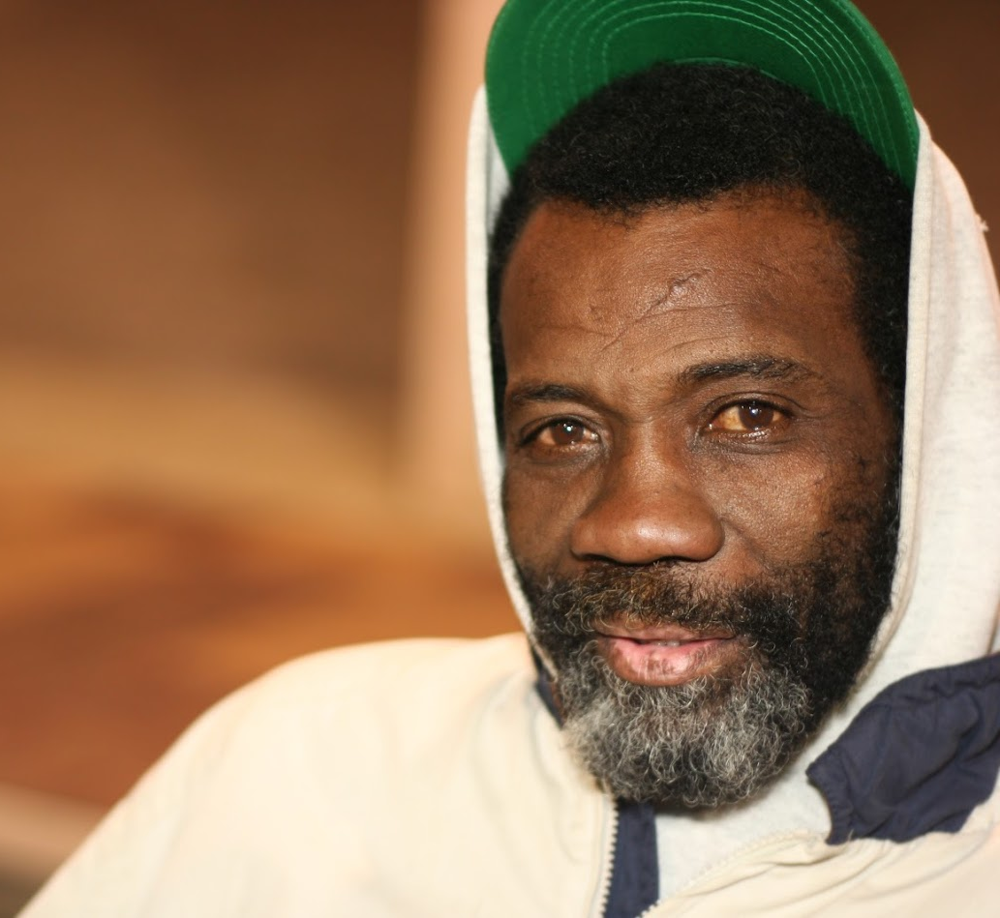
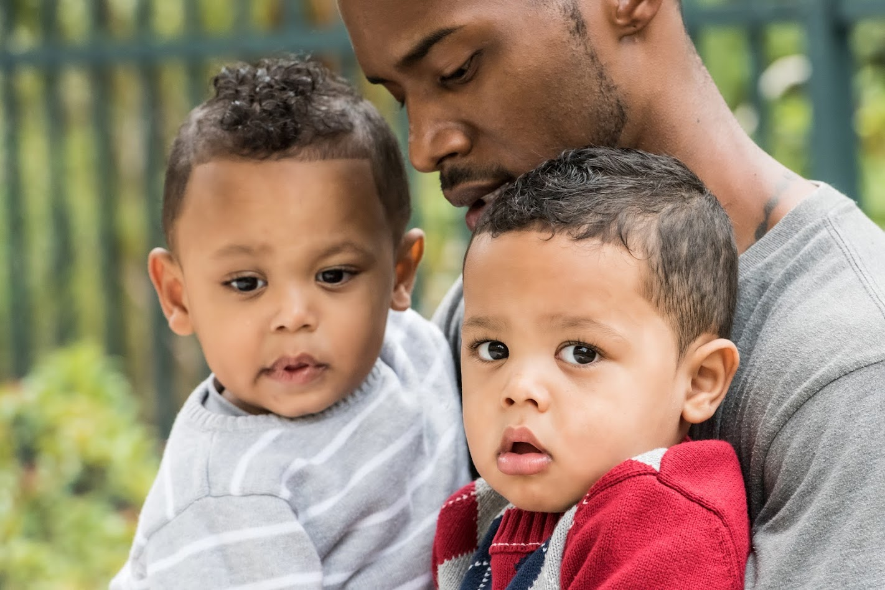
Strategy 3: Creating Rental Homes
Committee Assessment
CCC/Charlotte B. Rutherford – 51 Units Leased
PCRI/Beatrice Morrow – 81 units currently leasing
IHI/Magnolia II – under construction scheduled for completion January 2020
PCRI/King/Parks – broke ground February 15th
Bridge/Williams site – breaking ground March 2019
Reach/Argyle – construction has begun, scheduled for completion in 2020; community event planned for June 2019
There are 501 potential dwellings within the Rental Unit Pipeline. Of those 501, there are 146 dwellings under construction and 131 available to lease now between the Beatrice Morrow and Charlotte B Rutherford locations. Within the Rental Unit Pipeline, there was an emphasis on dwellings for families; creating 49 units that are 2+ bedrooms.

Slide 9
Strategy 4: Land Banking
Committee Assessment
PHB is currently in negotiations with a long-time property owner to purchase property within the district.
PHB purchased the Carey Blvd property from the Water Bureau for future homeownership development. A proposal for the property to be included in the district will be heard by Prosper Portland’s Board on April 10th.
Securing property for land banking continues to be a high priority for the OC. We must take advantage of every opportunity to do so.

Slide 10
Committee Assessment
MWESB – Rental Development
It has also been important to the Oversight Committee that minority and women owned business are involved in the development of the properties within the Rental Unit Pipeline.
28% of the construction dollars are going to minority and women owned businesses
50% of the workforce of those working on these projects are minorities.
The Oversight Committee will look to increase the number of MWESB businesses involved in future development construction.

Slide 11
Committee Assessment
MWESB – Home Retention
We have significant concern for the MWESB participation in home retention efforts. In 2018 less than 1% of home repair loan services were provided by African American contractors. The OC would like to see these numbers exponentially increase for 2019 and beyond.

Slide 12
Opportunities for 2019
Improve advertisement and marketing efforts to increase awareness and participation of communities of color, especially African Americans, with the home repair loan and grant program.
Re-establish the quarterly newsletter to keep people informed of the work of the committee, partners and Portland Housing Bureau.
Decrease barriers and increase opportunities for MWESB participation at all levels of construction and development, from multifamily rental to single family home repairs.
Increase initiatives for economic development via Prosper Portland and the NE CDI.
There is a gap for community development services and programs that cannot be funded through TIF dollars.
Maximize indebtedness of the URA; carries community impacts and implications
Reduce communication barriers with community partners
The oversight committee continues to press all partners to present their work and learning about serving families who have experienced the root shock of displacement, and to be specific in how they are serving and will be serving Black/African-American families, in their reports to the committee.

Slide 13
Conclusion
We have an incredible opportunity to do generational good. It is incumbent upon all of us (City of Portland, PHB, Partners and Oversight Committee) to recognize and understand that this work is not about any one of us. This is about and for the community of people who have been negatively impacted by intentional acts of displacement and gentrification. This work is about offering hope to some of the many who want to take advantage of these possibilities and return to their historic roots. The community deserves the best efforts of all participants to achieve our goals.
The preference policy continues to be the best tool for ensuring this aim. It is imperative that we function with emotional intelligence and clear vision. Our time is limited, this moment won’t last forever. We implore you to give your best effort so that the “promises made will be promises kept.”

