Slide 1
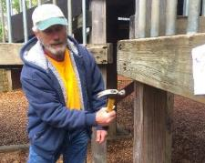
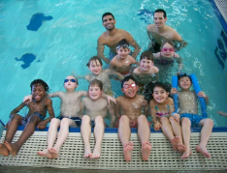
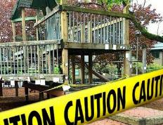
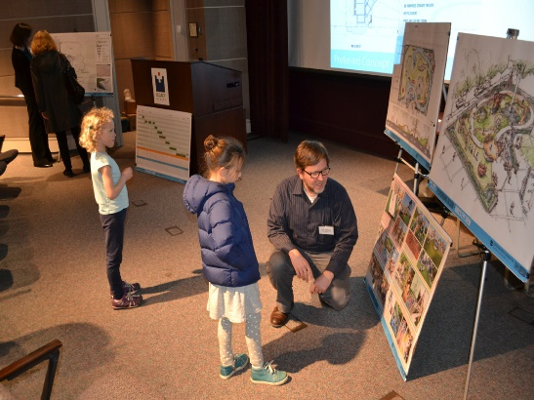
PARKS
REPLACEMENT
BOND
CITY COUNCIL - Wednesday March 20, 2019
Commissioner Nick Fish | Director Adena Long
Notes:
(RML)
Hello Mayor Wheeler and members of Council. My name is Robin Laughlin, I am the Bond Program Manager with Portland Parks & Recreation
With me today is Gary Datka, Capital Project Manager with PP&R. Gary will be giving a brief presentation on the Lynchview Park Playground project.
We are here today to request Council accept the bid from Paul Brothers for the Lynchview Park Playground Project for the amount of $2,007,457.

Slide 2
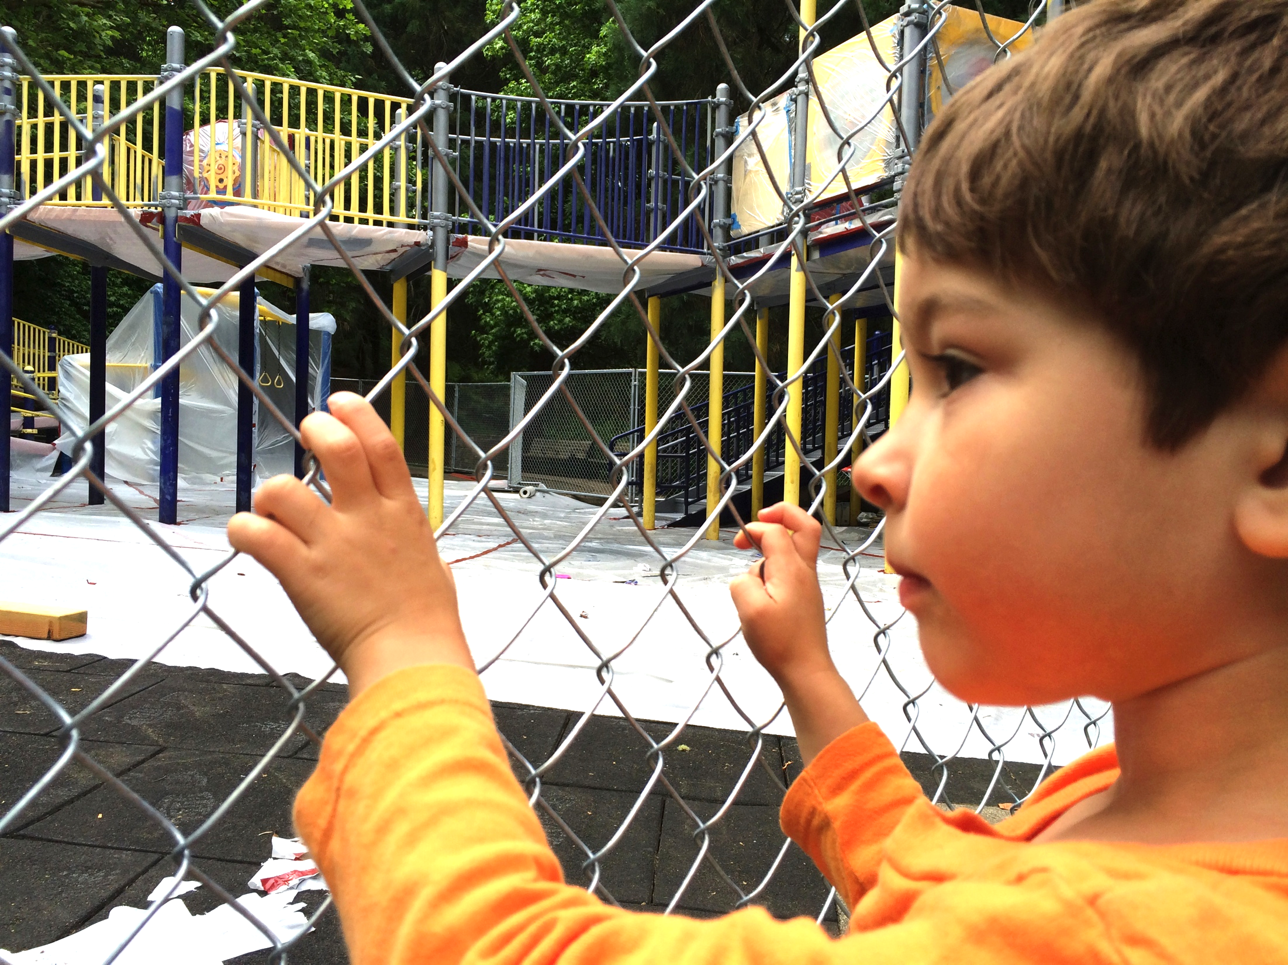
FOCUS AREAS
PLAYGROUNDS & OTHER
Fix, improve play areas that are closed, at risk of closure, or deficient.
Fix or replace systems and other urgent repairs.
Notes:
(RML)
The Lynchview Park project is part of the 2014 Parks Replacement Bond Program that was generously passed by voters who approved the $68 million bond measure to address critical park needs without increasing tax rates.
As you know the bond funding goes towards Park’s most urgent needs in seven priority areas.
Playgrounds
Trails and Bridges
Pools
Accessibility
Protecting Workers
Pioneer Courthouse Square
Restrooms and Other Facilities
This project fits into two focus areas Playgrounds and Others. And, is the seventh Replacement Bond PLAYGROUND project to go into construction.
In addition to Bond funding of $1.4 million, the project also received funding from PP&R System Development Charges in the amount of $1.8 million.

Slide 3
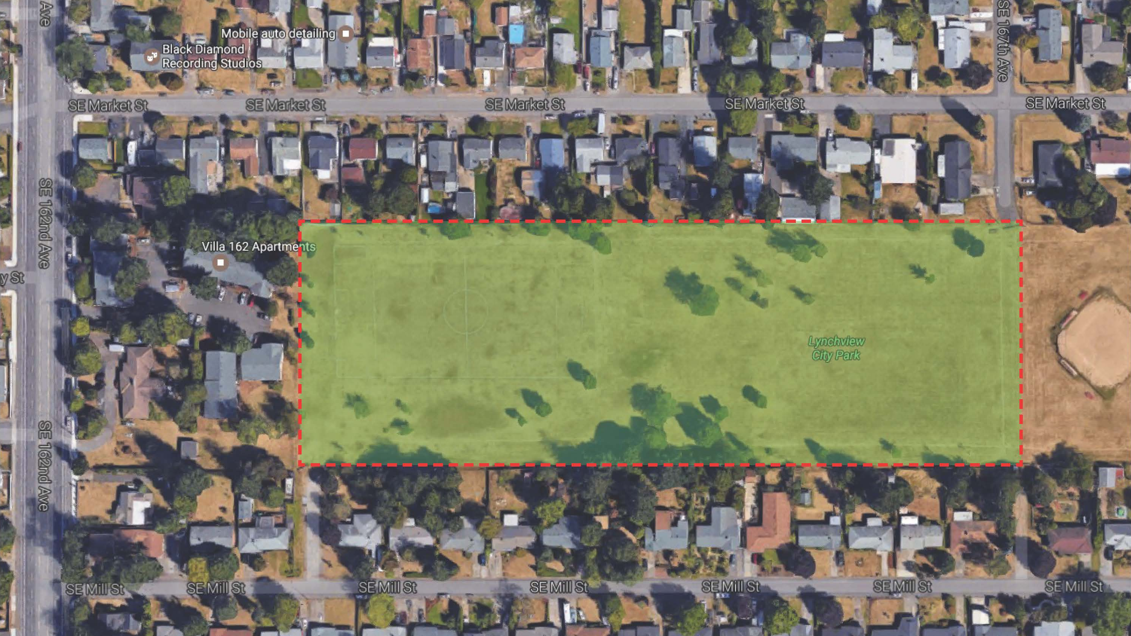
PROJECT LOCATION
Lynchview Park
SE 167th Avenue and SE Market Street
Centennial Neighborhood
Notes:
(GD)
Mayor Wheeler, Commissioners, thank you for having me here today, my name is Gary Datka, I am a capital project manager for Portland Parks & Recreation.
Lynchview Park, acquired by PP&R in 1993, is a 7.6 acre park located in outer SE Portland between SE164th and SE167th and SE Market St and SE Mill St. in the Centennial Neighborhood and is part of the East Portland Community Office.
The park is shown here in the red box has limited street frontage and the main entry will be from SE 167th .
The park is bordered by single and multi-family homes and is adjacent to Centennial School District - Patrick Lynch Elementary School to the east.
The new playground and picnic spaces will provide a much needed play area and community gathering space for this neighborhood.

Slide 4
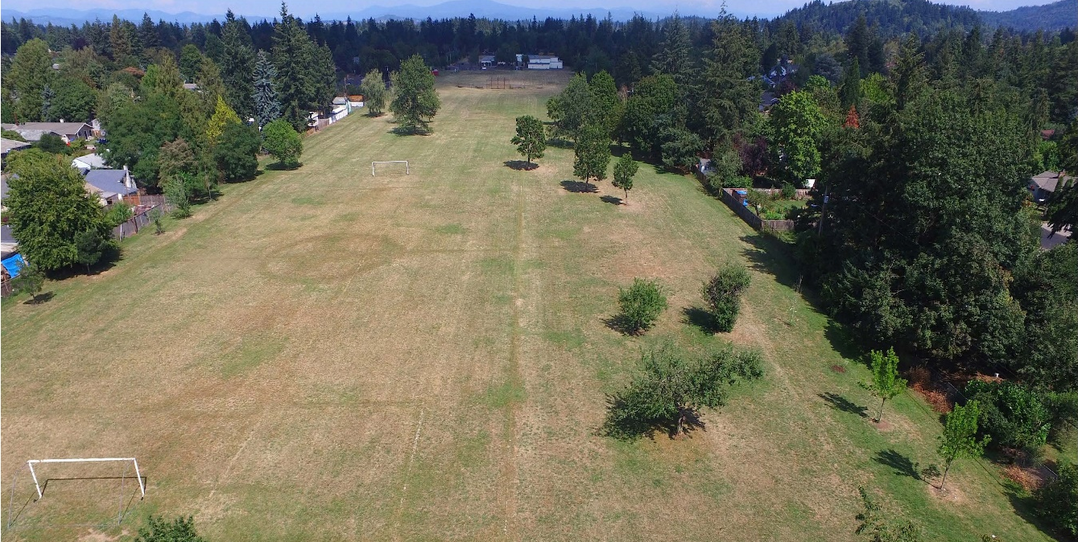
PROJECT DETAILS
Lynchview Park Today
Open lawn
No playground
Heavy-use soccer field without irrigation system to support high use and maintenance needs
No multi-modal connections through park
Few trees, lacks shade
Notes:
(GD)
Currently, there is no playground or community assets in Lynchview Park, and its lack of mature trees and shade leave it informally used by neighbors as a open play space and an dogs off-leash area.
The most used feature in the park is the non-reservable soccer field that is heavily used for drop-in soccer matches, but it lacks the infrastructure to maintain the field long-term in a safe and usable way.
Additionally, like much of East Portland, the neighborhood surrounding Lynchview Park lacks sidewalks, and no multimodal connections through the park exist, making the park with its limited street frontage difficult to access.

Slide 5
PROJECT DETAILS
Public Involvement
Five Project Advisory Committee meetings
Four Open Houses
Notes:
(GD)
Lynchview Park does not have a masterplan to guide the development of the park; therefore,
Through a series of 5 project advisory committee meetings and 4 public open houses, PP&R conducted an extensive public involvement activities with neighbors to:
Understand the current use of the park,
Connect with neighbors about the positive aspects of developing the park, and
Develop a framework plan to solicit feedback and gain support for the siting and design of the play area and other community assets.
At all open houses, PP&R provided translation in Spanish and Russian to reach as many community members as possible.

Slide 6
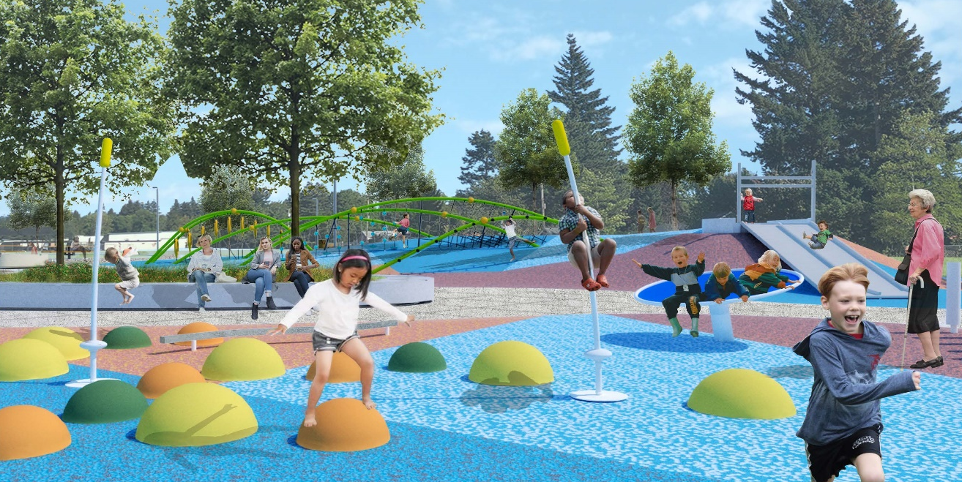
PROJECT DETAILS
Key Park Improvements
Play area with ADA inclusive and adaptive play features
Picnic shelter and tables,
Pedestrian plaza and pathways
Multi-modal access through park
Soccer field renovations including an automatic irrigation system
Pedestrian lighting and other site infrastructure improvements
Public art through RACC
Notes:
(GD)
Through this framework plan, PP&R developed a design that will construct key park improvements focusing on:
Play area with ADA inclusive and adaptive play features,
Community gathering spaces,
Establishing formal access and entries into the park, pedestrian and vehicular circulation, and making a multimodal connection through the park, linking the play area and the soccer field,
Improving safety with pedestrian level lighting around the play area, and
Improving the soccer field playability with an automatic irrigation system and field renovations,
Adding an imaginative art installation through Regional Arts and Culture Council

Slide 7
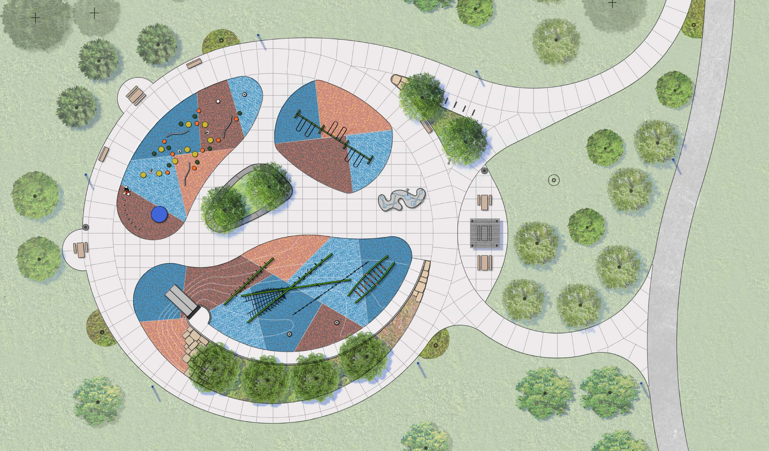
WHY ARE WE HERE?
Accept bid of Paul Brothers, Inc. for Lynchview Park Play Area Improvements Project for $2,007,457
Notes:
(GD)
With the acceptance of this bid, construction is set to begin late this spring and have an anticipated completion date late fall 2019.
We have one invited guest today in support of this project, Brian Flores Garcia, and I have three letters written by community members of our Project Advisory Committee who were not able to be here today that I would like to read.
First, I would like to introduce Brian. Brian is a superstar for Parks, working as a youth ambassador in East Portland. He also served as a member of our Project Advisory Committee and on the Art selection panel. We appreciate him being here today.
(Brian)
(letters)
I am happy to answer any questions. If none, please support this Replacement Bond project by accepting the bid by Paul Bros.
Thank you

