Slide 1
Presentation to Council – March 20th 2019
Notes:
CHRIS: Thank you for giving us this opportunity to present this progress report on the Fixing our Streets program.

Slide 2
Fixing Our Streets Overview
Notes:
CHRIS: I'm going to begin by sharing an overview before we hear from our Program manager and members of the public who have been a critical part of the implementation of this program

Slide 3
Made possible by
10 cent fuels tax
Heavy Vehicle Use Tax
Notes:
CHRIS: The Fixing our Streets program has been made possible by voters and by you. In May 2016, voters put their trust in us and passed Measure 26-173. That same month, you passed the Heavy Vehicle Use Tax. Together these two measures created Portland’s first-ever local source of funding for maintaining our streets.

Slide 4
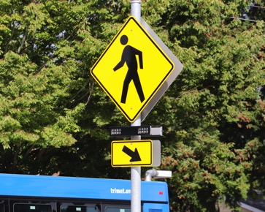
Dedicated funds
Notes:
CHRIS: As mandated by the voters, Fixing Our Streets dedicates 56% of funds to maintenance projects and 44% to safety projects.

Slide 5
Measure 26-173
Measure 26-173 also created a Citizen Oversight Committee to monitor and report on the program.
We promised voters and you that we would deliver better streets, new sidewalks, improved bike lanes and safe routes to school across the city.
Notes:
CHRIS: Measure 26-173 also created a Citizen Oversight Committee to monitor and report on the program.
We promised voters and you that we would deliver better streets, new sidewalks, improved bike lanes and safe routes to school across the city. Today, I’m happy to report that we are keeping our promise. We'll be hearing from Jennifer Rollins, a member of our Oversight Committee later in our presentation. We've also invited members of the public who will be able to share the impact the program is having in neighborhoods across Portland.

Slide 6
The Start of a Busy Construction Season
Notes:
CHRIS: Next, our Program Manager Mychal Tetteh will share some of what we can expect from the program during what is shaping up to be a busy construction season
MYCHAL: Thank you Chris

Slide 7
2019: Our busiest year yet
Notes:
MYCHAL: Now that spring is finally here, the construction season is about to start in earnest. 2019 will be our busiest year yet.
MYCHAL: We will cut the ribbon on 20 projects, including the Foster Road Streetscape. Thanks to Fixing our Streets, we will not only make Foster safer and more efficient, we will create an attractive, tree-lined street for residents and businesses.

Slide 8
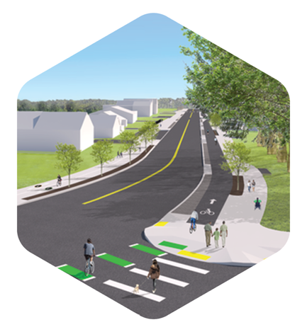
Projects on the way
We will break ground on 21 projects, including the Capitol Highway project.
We will match $3.3 million dollars worth of Fixing our Streets funds with $19 million dollars of additional funding to deliver new pavement, sidewalks and bike lanes.
Notes:
MYCHAL: We will break ground on 21 projects, including the Capitol Highway project. The community has been asking for a safer, well-maintained Capitol Highway for decades. Fixing our Streets is making it possible. We will match $3.3 million dollars worth of Fixing our Streets funds with $19 million dollars of additional funding to deliver new pavement, new sidewalks and new bike lanes.
MYCHAL: We will also begin the Martin Luther King Boulevard Pedestrian project and make four major crossing easier and safer to navigate for residents and visitors along this busy street.

Slide 9
Where We Are
Notes:
MYCHAL: Next, I would like to share more context about where we are as it relates to program implementation

Slide 10
End of 2019 forecast
Total planned investment of over $124 million dollars’ worth of capital projects.
Will complete or break ground on 41 major capital projects.
Safe Routes to Schools projects will add to these totals.
Notes:
MYCHAL: At the end of 2019, we forecast a total planned investment of over $124 million dollars’ worth of capital projects drawing from a multitude of funding sources and will complete or break ground on 41 major capital projects.
This doesn’t include dozens of Safe Routes to Schools projects. These projects range from installing crosswalks and signs to building median islands and installing rapid flashing beacons. In each case, we make it easier and safer for families and their kids to get to school.

Slide 11
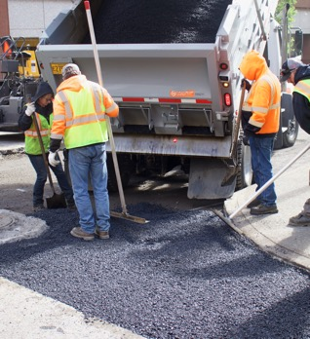
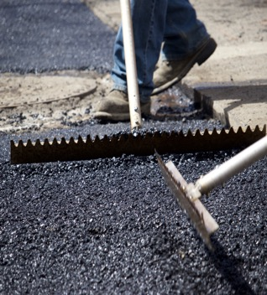
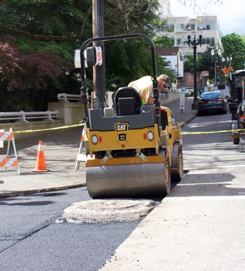
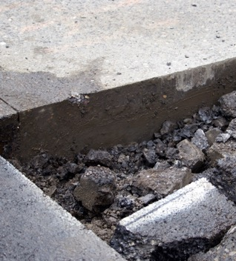
Base repairs
We have completed 253 base repair projects all over the city.
These repairs save a street.
This saves us money over the long-term.
Notes:
MYCHAL: Thanks to fixing our streets, we have also completed 253 base repair projects all over the city since 2016. These are the small, but mighty repairs that save a street. We fully reconstruct those sections of the street where it has failed. These focused interventions keep the rest of the street from failing, saving us money over the long-term.

Slide 12
By the End of 2019 we will have Delivered
48 blocks of sidewalks
375 base repair projects
30 ADA curb ramps requested by neighbors
12 miles of bike facilities
Made it easier and safer to get around on some of our most important streets
48
375
30
12
Easier/ safer
Notes:
MYCHAL: By the end of 2019, we will have installed 48 blocks of sidewalks; delivered 375 pavement reconstruction projects; provided of 30 curb ramps in partnership with our resident ramp request program; added 12 lane miles of biking facilities and made it easier and safer to get around on some of our most important streets including 82nd and 122nd Avenues, Outer Division, Halsey, Weidler, Alberta, Columbia, Denver and Beaverton Hillsdale Highway.

Slide 13
Multiplying Our Dollars
Notes:
MYCHAL: Much of this work is possible because PBOT staff have worked tirelessly to multiply tax payer dollars wherever possible by leveraging funding from other sources

Slide 14
Reaching milestones
We have made our Fixing Our Streets money go even further; we have used our local dollars to leverage $63.7 million in additional funding.
SOURCE | MILLION
Federal | $8.8
State | $1.9
TSDCs | $21
Prosper Portland | $3.6
LIDs | $8.2
General Fund | $2.9
Other Bureaus | $11.7
GTR/BH 2017 | $5.6
Notes:
MYCHAL: These funds help us deliver more projects, and ensure that we meet federal, state and local polices designed to protect the most vulnerable roadway users.

Slide 15
A Catalyst for Opportunity
Notes:
MYCHAL: The Fixing Our Streets program is about more than just projects

Slide 16
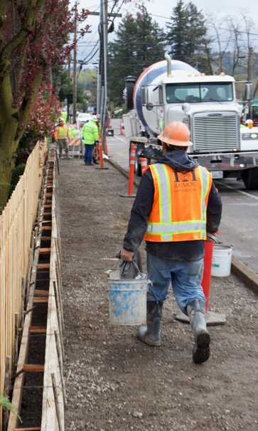
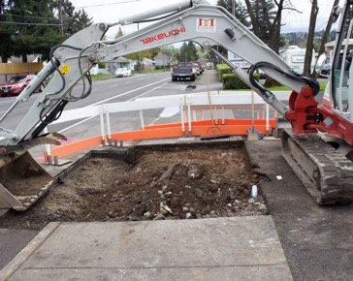
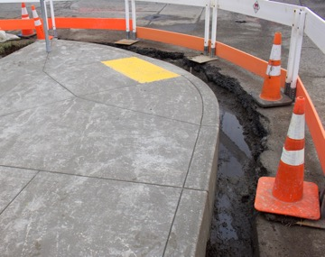
Equity
We pledged to make sure that 30% of contracts were awarded to DMWESB firms.
To date, more than two-thirds, 68% of our low–bid contracts, have gone to DMWESB firms.
Notes:
MYCHAL: I am especially proud of the early progress we have made in supporting more widely shared economic prosperity.
Over the last five years, PBOT – like the rest of our city government – has made a clear commitment to equity.
As part of this commitment, we pledged to make sure that 30% of contracts were awarded to DMWESB firms.
I’m happy to report that we have met this goal. In fact, we haven’t just met it; we’ve exceeded it. By a wide margin. To date, more than two-thirds – 68% -- of our low-bid contracts – have gone to DMWESB firms. In partnership with our colleagues in the Prime Contractor Development Program we’ve raised the bar and have shown what we can be achieved when we fully commit ourselves to increasingly equitable capital program outcomes.

Slide 17
A Catalyst for Improvement
Notes:
MYCHAL: Beyond the outcomes in our community PBOT staff have been hard at work accelerating improvements in our capacity to deliver our capital programs

Slide 18
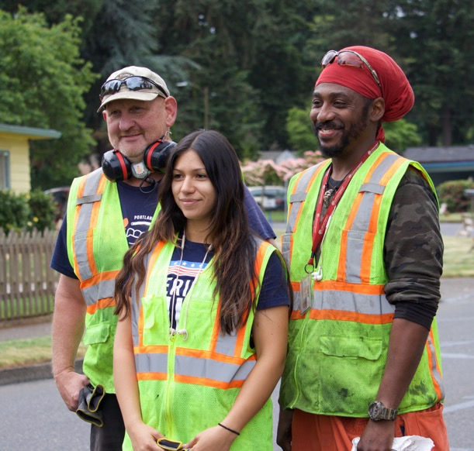
Key changes
New project oversight tools
Quicker implementation of process improvements
New project management process
Improved project delivery
Notes:
MYCHAL: The Fixing Our Streets program inaugurated a new era at PBOT. We have used the program to drive key changes at the bureau. The changes have not only improved how we have delivered Fixing Our Streets programs, they have also helped us improve our project delivery and financial forecasting for all of our capital and maintenance projects.
These key changes include:
- Capital project controls program that analyzes capital project delivery and supports resolution on key capacity challenges
- Project value stream analysis which informs key process improvement priorities
- Implementation of our stage-gate methodology to ensure all projects are delivered consistently
- The establishment of a dedicated team focused on the delivery of quick-build projects implemented through on-call contracts or directly through our Maintenance Operations crews

Slide 19
Listening to Portlanders
Notes:
MYCHAL: I'd like to turn it over to one of our Oversight Committee members Jennifer Rollins to share some of the ways that we're engaging our neighbors as we deliver this program
JENNIFER: Thank you Mychal

Slide 20
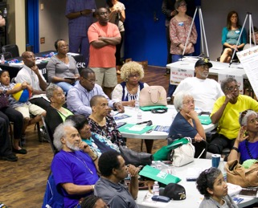
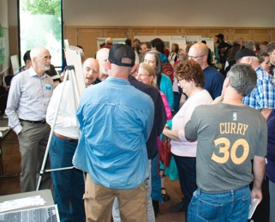
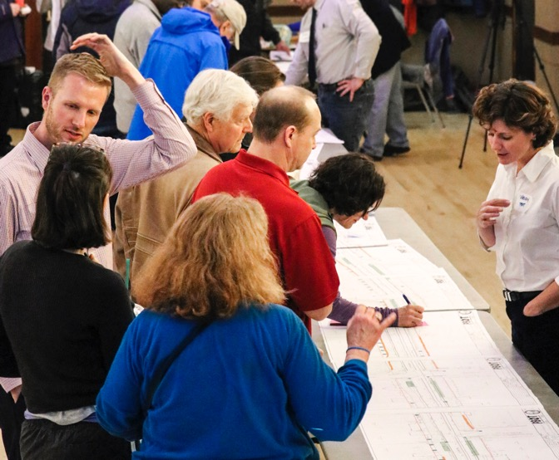
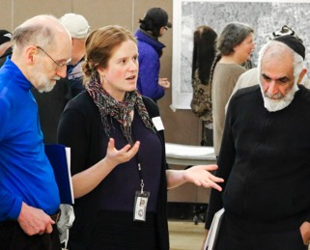
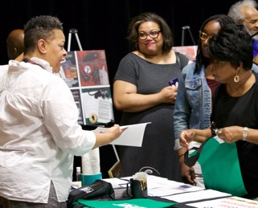
Engagement
Notes:
JENNIFER: We have been determined to keep the trust of Portlanders. For this reason, we have continued to seek their input on projects and keep them informed about our activities.
We have engaged thousands of Portlanders in person and have hosted open houses and information sessions in 35 neighborhoods throughout the city.
We translated our most recent progress report into 5 safe harbor languages and made it available on-line.

Slide 21
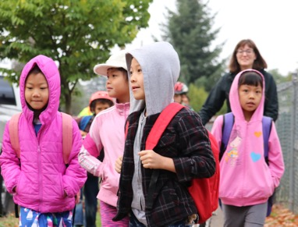
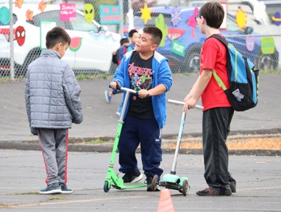
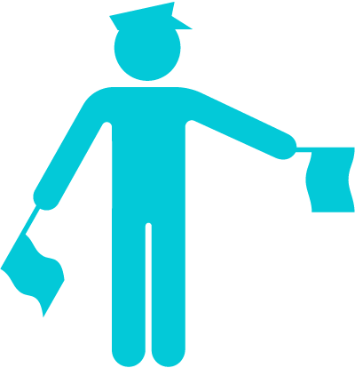
Safe Routes to Schools
We met with families in all of Portland’s 5 of school districts.
They told us where they needed safer crossings, sidewalks and other infrastructure.
As a result, we now have a comprehensive list of projects to improve walking and biking for students in each of the city’s 12 high school clusters.
Notes:
JENNIFER: With support of the program, we completed a historic outreach effort for Safe Routes to Schools. We met with families in all of Portland’s 5 of school districts. They told us where they needed safer crossings, sidewalks and other infrastructure. As a result, we now have a comprehensive list of projects to improve walking and biking for students in each of the city’s 12 high school clusters.

Slide 22
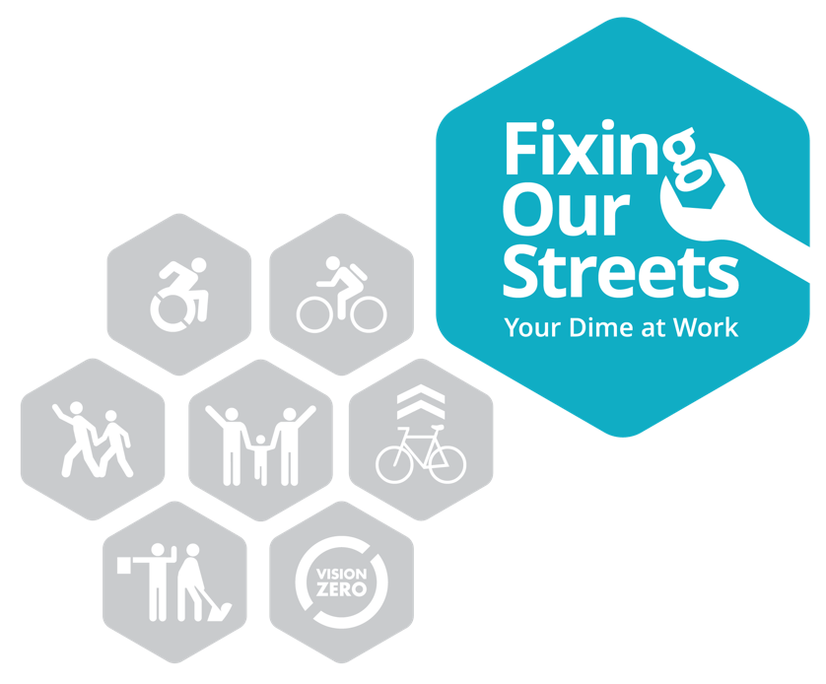
Supporting Community Priorities
We have also allocated Fixing Our Streets funds to support community driven initiatives like East Portland in Motion; Southwest in Motion and Northwest in Motion
Notes:
JENNIFER: We have also invested Fixing Our Streets funds to support community driven initiatives like East Portland in Motion; Southwest in Motion and Northwest in Motion.
Our Oversight Committee will continue to engage our neighbors to ensure that the remaining Fixing Our Streets projects reflect community needs.

Slide 23
Looking Ahead
Notes:
CHRIS: Thank you Jennifer

Slide 24
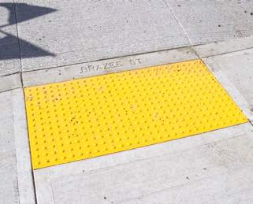
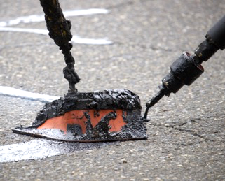
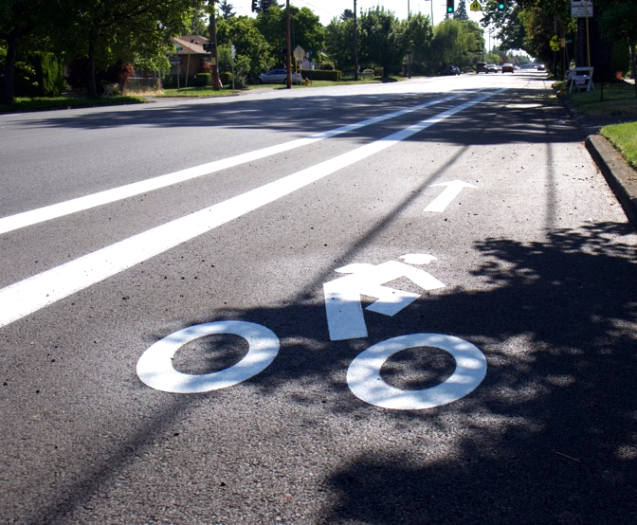
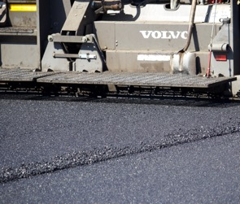
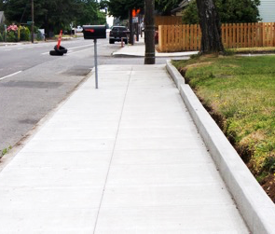
What's next
Notes:
CHRIS: In approving Measure 26-173 and the Heavy Vehicle Use Tax, voters and the City Council voted for a transparent, accountable and efficient program. Thank you for the opportunity to update you on our progress with the Fixing our Streets program.
I look forward to returning again this fall to show you how we are investing Fixing our Streets dollars to improve our roads and make it safer for Portlanders to get from place to place.

Slide 25
THANK YOU
Notes:
CHRIS: Now we would like to invite testimony from some of our neighbors who want to share their experience and expectations of the Fixing Our Streets Program
TERRANCE: Kenton Neighbor – public engagement and needed crossing improvements
BRETT: Lewis Elementary (Cleveland HS) - SRTS project priorities for implementation during spring break to avoid disruption for school commutes
KEITH: SW Vermont improvement and a pitch for SWIM investments now that the plan is complete

