Slide 1
Title 4 Original Art Murals
Amendments
March 21, 2019
Notes:
Design Commission role in these murals.
not land use regulations
No recommendation to council, comments and suggestions
Introduce Phil Nameny and Peggy Kendellen

Slide 2
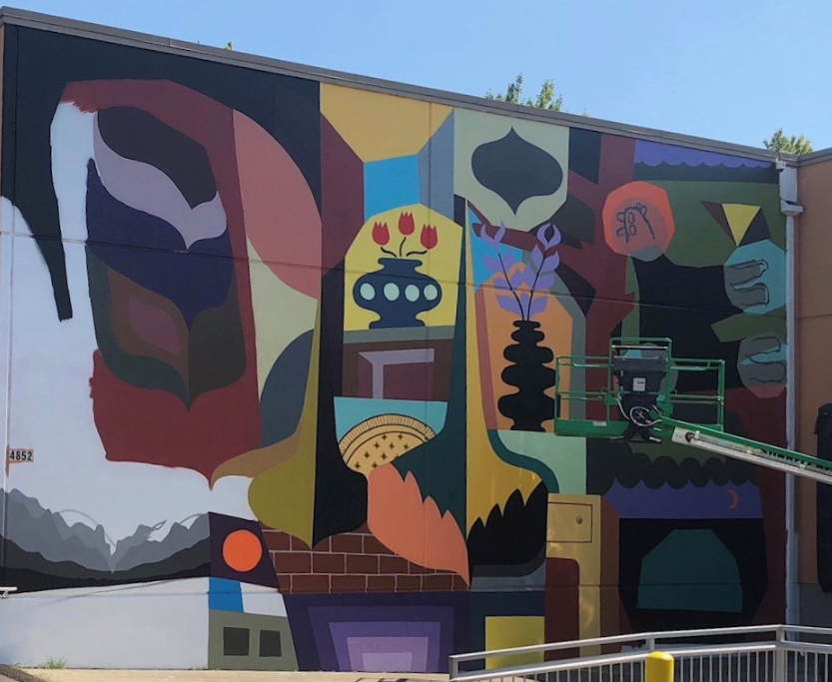
Code History
Purpose
Implementation
Amendments
Agenda
Notes:
4852 NE ML King Blvd

Slide 3
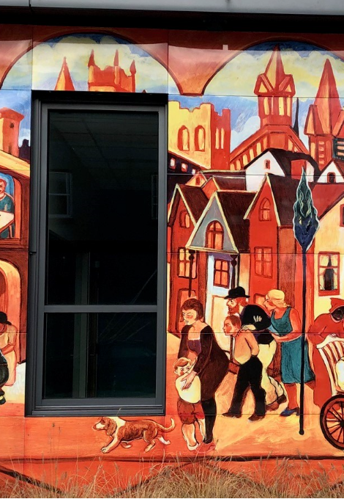
History
1998
Considered signs
2005
Considered public art
2009
Mural Code adopted
1986
Exempt in the Sign Code
Notes:
The history of mural regulation within the city of Portland stretches back more than 20 years and is closely tied to the City’s sign regulations and our constitutional right to freedom of speech.
The courts have determined that that the city cannot regulate commercial speech differently from non-commercial speech.
The city can not regulate murals or artwork distinct from signs if that distinction requires viewing the content of the piece to make a regulatory determination.
Starting in 1998 the city regulated all murals the same as signs under T32
In 2005 the Regional Arts and Culture Council adopted the new Public Art Murals program on behalf of the City of Portland under the terms of its existing IGA with the City. The new public art murals program allowed the city to expand its public art program to include murals.
Public art murals can be placed on public wall space and paid for with public funds administered by RACC. The city acts to select murals to its public art collection and does not act as regulator.
- RACC approved murals were added to the public art collection.
T32 amendment* to exempt public art, only.
3. In 2009 the City Council adopted a new Title 4, Original Art Murals which created a new mural regulatory code and permitting process. It contained a minimum criteria for reviewing and approving murals based upon application and not based on content. Criteria included limits on where the mural could go, mural size and the duration that murals needed to stay in. It also included a public notice requirement and an Administrative Rule that addressed application requirements and design standards

Slide 4
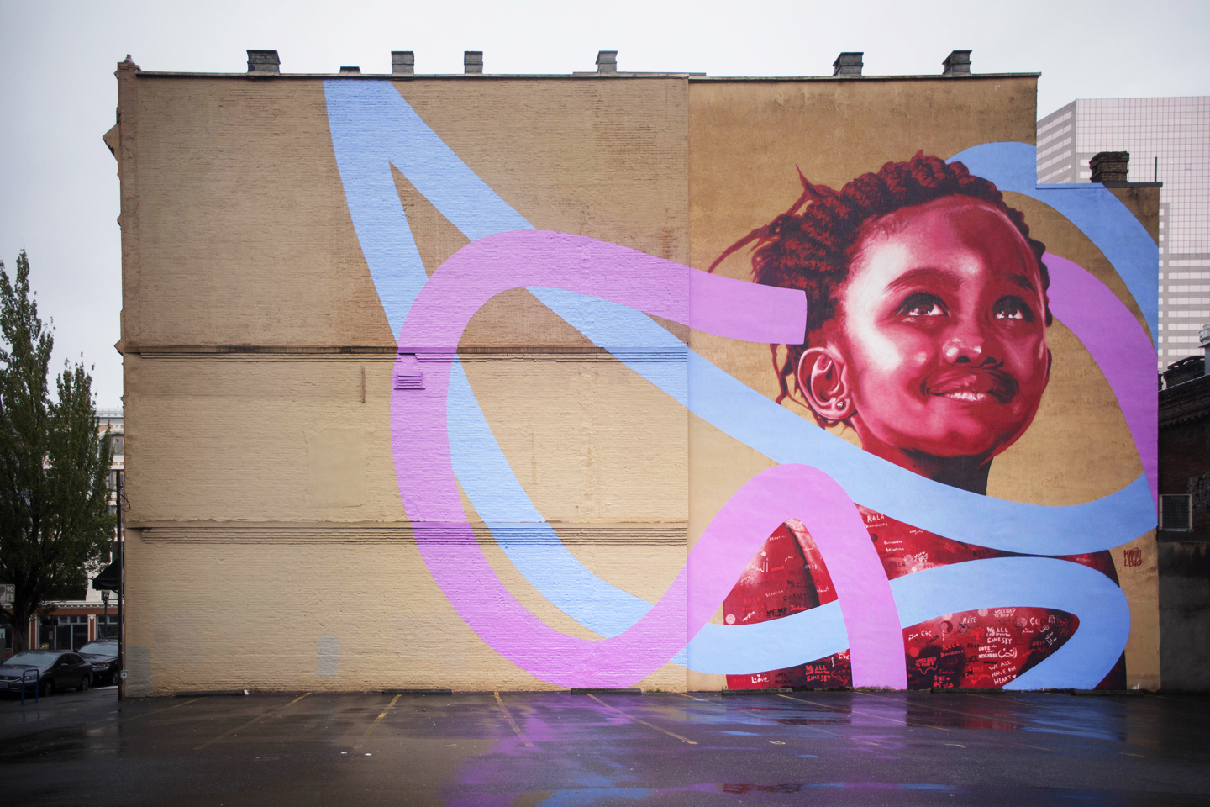
Al-Amir Restaurant, Kevin Ledo + students of David Douglas High School, 2016
Sponsored by aptArt, Awareness and Prevention through Art.

Slide 5

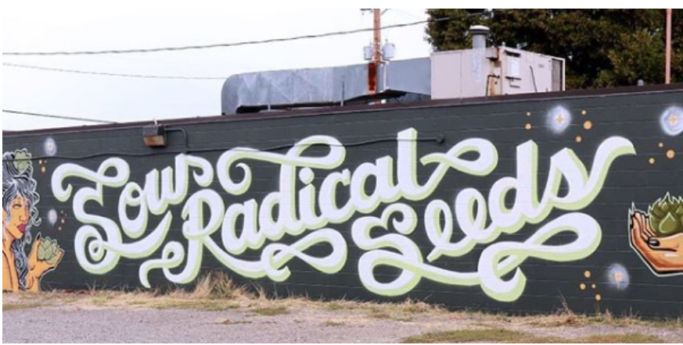
Purpose
Allows murals to be permitted separately from sign regulations
Provides an option for privately funded murals not intended for the city’s art collection
Notes:
7714 SE Stark Street

Slide 6
Purpose
Minimum Criteria
  Maximum height of 30 feet
  Remain in place for five years
  Affixed to a building wall
  Special standards in design overlay zones
  Neighborhood posting notification
  Administrative Rules
*Prohibited on buildings containing fewer than 5 dwelling units
Notes:
These criteria do not provide an opportunity for the city to regulate the content of the mural. The mural can be approved by meeting size and location criteria, rather than reviewing content.
This process can be used both for non-commercial community murals and for displays of commercial speech by businesses.

Slide 7
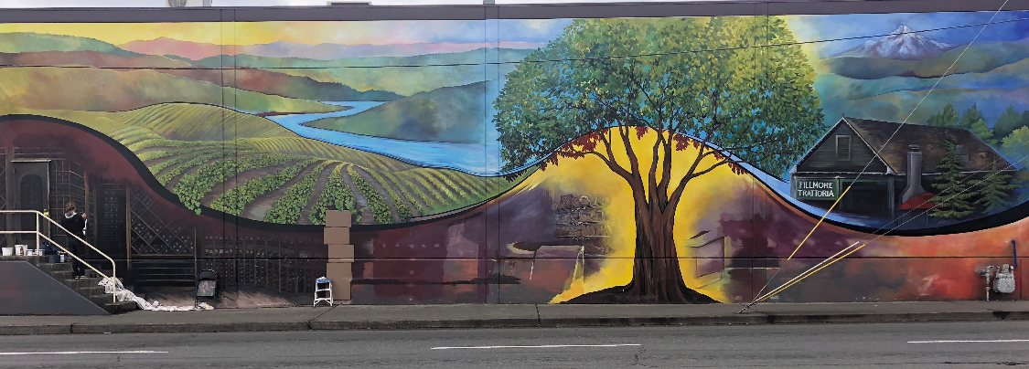
Success
49 permits (2016-2018)
Simple, clear requirements
Easy administration
Implementation
Notes:
1930 NW 23rd Place

Slide 8
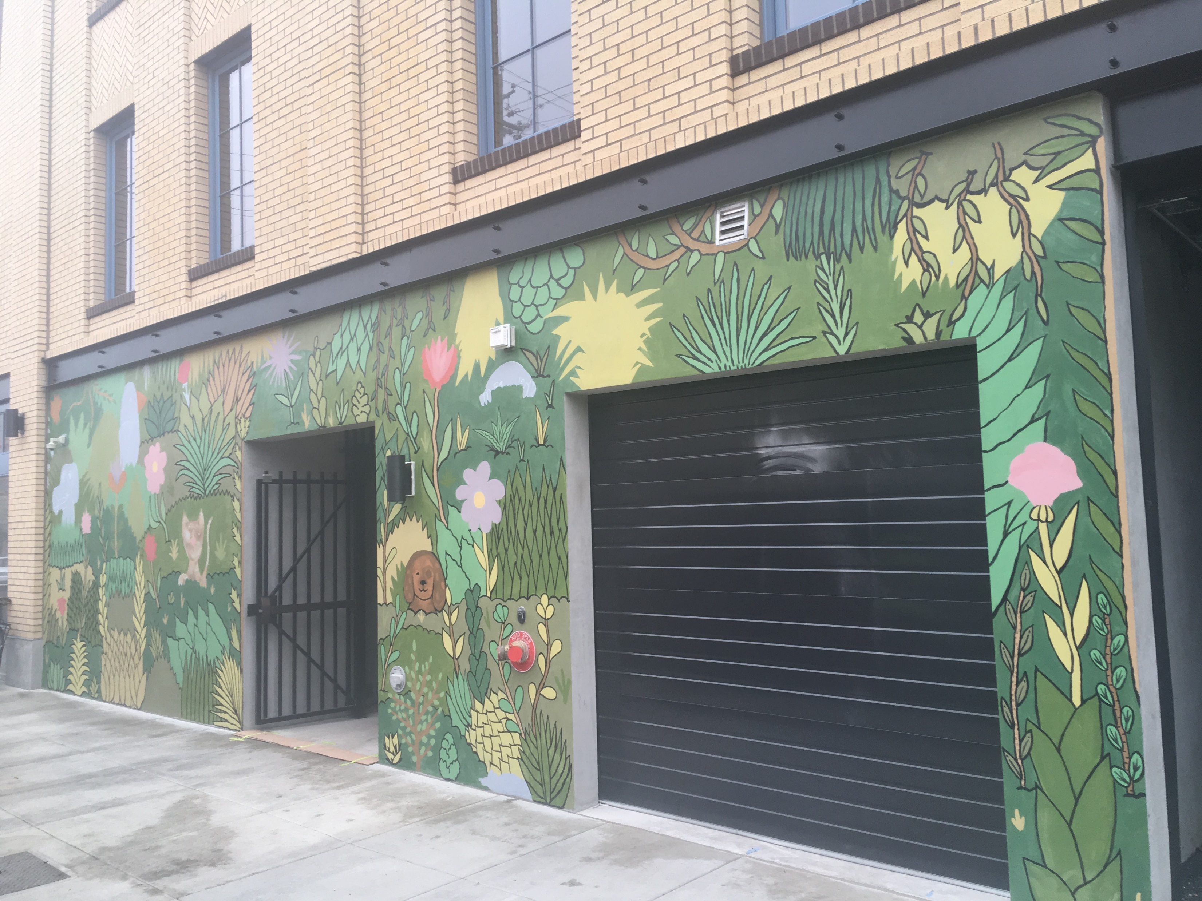
1904 NE Alberta LLC
Notes:
Council suggested that staff from BPS and BDS work together to monitor the program including the volume and variety of mural permits received.

Slide 9
Amendments
Commissioners Eudaly, Fish & RACC
Expand locations where murals can be installed
Change “building owners” to “property owners”
Allow murals on more street facing walls (Central City)
Reduce the length of time murals must remain in place
Create a consistent height measurement
Notes:
With support from Commissioner’s Fish and Eudaley the RACC asked that BPS and BDS take a look at ways to improve the code.
BDS assembled a group of stakeholders to determine if there were any negative impacts to their proposal, county, BES, PBOT office of civic and community life.

Slide 10
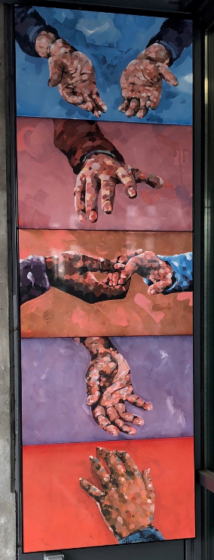
Amendments
#1. Expand locations where murals can be installed
“A hand-produced work of visual art which is tiled or painted by hand directly upon, or affixed directly to an exterior wall of a building or structure.”
#2. Change “building” owners to “property” owners
Notes:
3036 NE MLK Junior Blvd. Painted by hand and then transferred to Porcelain Enamel panels. 11’ tall
Issue #1: Murals are defined with a limitation that they are applied to the exterior walls of buildings. There have been requests to paint murals on other structures visible from the ROW, such as retaining walls, stairwells, pedestrian bridges, bridge support structures/columns, etc.
Issue #2: Related to Issue #1, the code and rules refer to buildings and building owners. Property owner may be a better term if the allowable surfaces for art murals is expanded.

Slide 11
Amendments
#3. Allow murals on more street facing walls (Central City)
Remove:
Central City. Within the Central City Plan District, murals are permitted only on non street-facing walls and street-facing walls that are more than 20 feet from a street lot line.
#4. Reduce the length of time murals must remain in place
The mural, as approved by permit, shall be maintained without alteration for a minimum of five two years. The approved mural permit does not expire so long as there is not a modification to the approved mural size, location, and image.
Notes:
Both of these are located in the Administrative Rule
Issue #4: The administrative rules do not allow any murals on street facing walls in the Central City that are closer than 20-feet from a street lot line.
Issue #5: The code requires that a mural remain unchanged for 5-years. This length of time can discourage prospective property owners from committing to a mural. There is interest in the broader community to feature walls that can accommodate multiple murals changing within a set timeframe

Slide 12
Amendments
#5. Create a consistent height measurement
Remove:
1. The top of the mural may be no higher than the floor level of the third floor for projects on buildings greater than two stories.
2. Minimum size for a mural area is 32 square feet.
Maintain: No part of the mural shall exceed 30-feet in height.
Notes:
Issue #5: There is a confusing distinction between the maximum mural height (30-ft) in Title 4 and the maximum height allowed in design overlay zones through administrative rules (up to the floor level of the 3rd floor).

Slide 13
Amendments
Other
1. Prohibited Murals
  No murals on stormwater facilities
  Clean up
    Updated the definition of “grade” to match the OSSC
    Updated the permit inspection process to reflect current practices
    Added a definition for “structure”

Slide 14
Amendments
Commissioner Eudaley & Regional Arts and Culture Council
1. Expand the locations where murals can be installed
2. Allow murals on more street facing walls in the Central City
3. Reduce the length of time murals must remain in place
4. Change reference from building owners to property owners
5. Create a consistent height measurement
Solutions
1. Allow murals on structures
2. Remove restriction in the Central City
3. Reduce minimum length of time from 5 to 2 years
4. Change reference from building owner to property owner
5. Apply height definition in Title 4 to all murals
6. Code clean-up
Notes:
Define structures

Slide 15
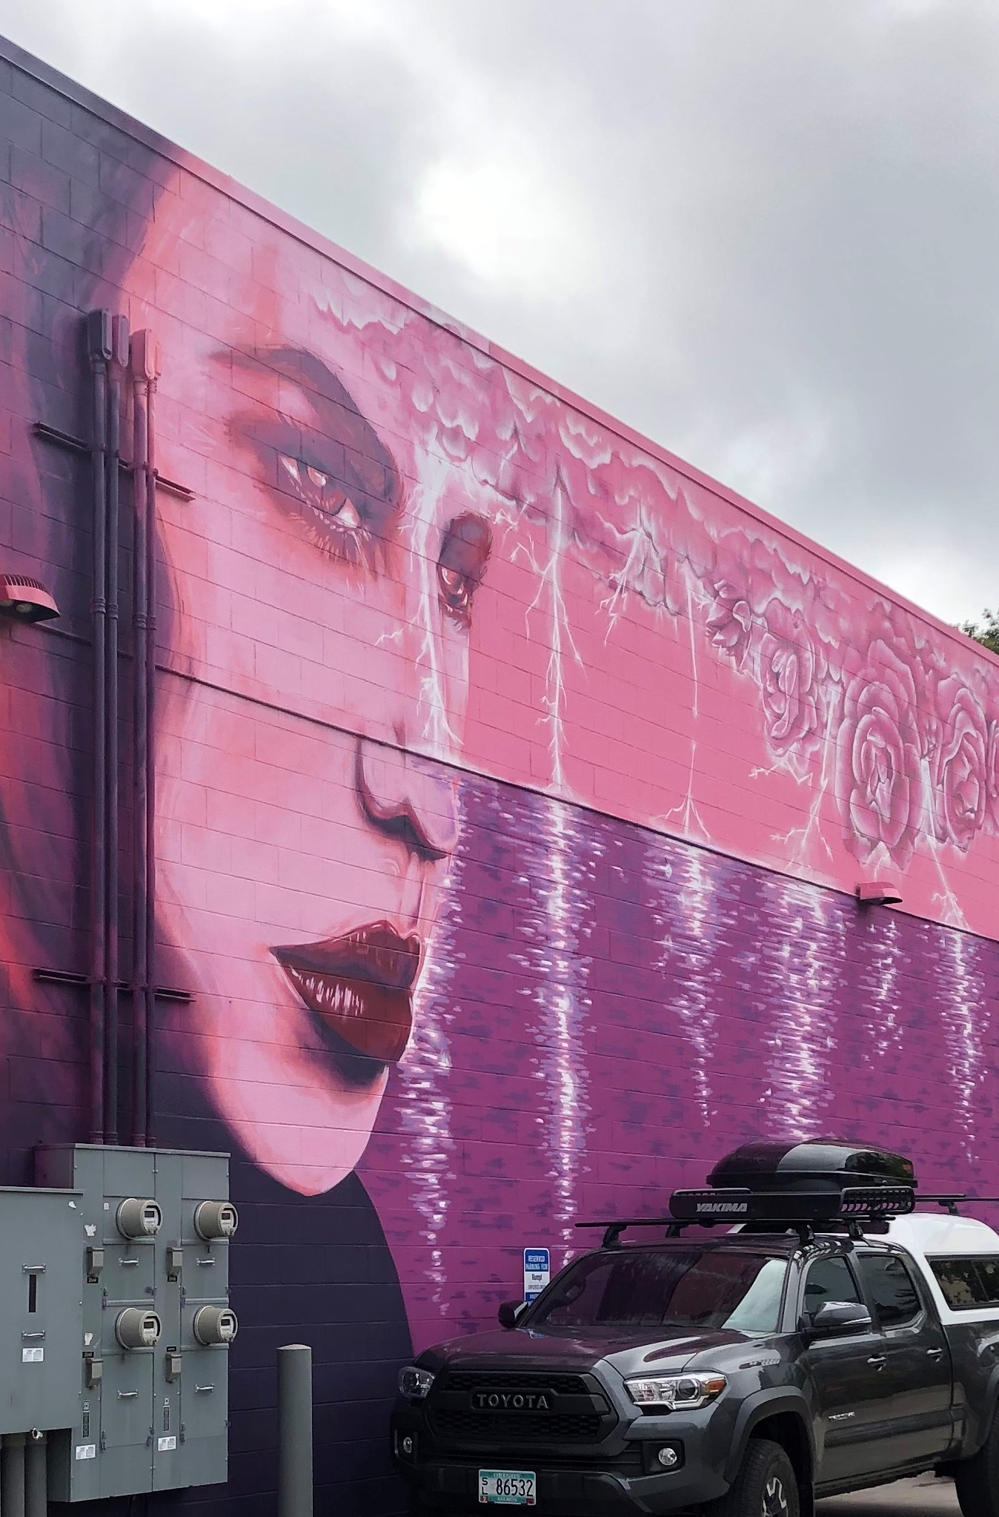
Questions
Notes:
2580 NW Upshur Street

